Slide 1
Understanding future ENSO risks
presented by
Andrew Wittenberg

Slide 2
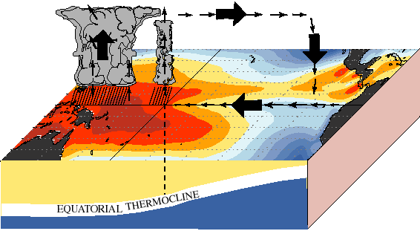
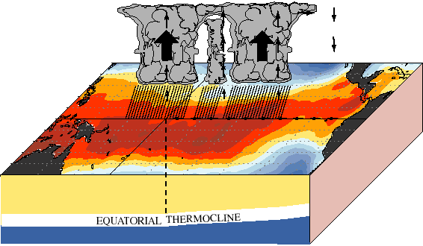
ENSO: Earth’s dominant year-to-year climate signal
2-7 years
warm
pool
cold
tongue
Normal
El Niño
Global impacts:
weather & climate, extremes, natural disasters
ecosystems, fisheries, agriculture, forests
economies: commerce, transportation, energy, water, food, health
How vulnerable are we to ENSO?
sources & limits of seasonal-to-decadal predictability
natural vs. anthropogenic risks
changes in dynamics vs. impacts
short, gappy, nonstationary observing system → models crucial
coupling & scale interactions → key test for models
Notes:
ENSO is Earth's dominant year-to-year climate signal. Every 2-7yr, the west Pacific warm pool expands eastward, carrying with it the deep convection and rainfall, and altering global climate. These changes affect weather, ecosystems, and economies worldwide, and link to all of NOAA's strategic goals.
So how vulnerable *are* we to ENSO? Models are crucial to answer this, since obs records are short. ENSO's also a key *test* for models, since it depends on the full range of scales they simulate & parameterize. So a good ENSO simulation can build confidence in our ability to simulate other things, like climate change.

Slide 3
GFDL: Strongly positioned in the ENSO community
ENSO simulations among the best in the world
realistic ENSO behavior: patterns, spectra, mechanisms, teleconnections
stable multi-millennial control runs, large ensembles
diverse model tools, complementary assimilation & forecast systems
Wittenberg et al. (JC 2014; JAMES 2018); Vecchi et al. (JC 2014); Wittenberg (CV 2015); Choi et al. (JC 2015); Delworth et al. (JC 2015);
Krishnamurthy et al. (JC 2015, 2016; CD 2019); Griffies et al. (JC 2015); Jia et al. (JC 2015); Yang et al. (JC 2015; CD 2018);
Ward et al. (ERL 2016); Zhang et al. (JC 2016); Ray et al. (JC 2018ab); Zhao et al. (JAMES 2018a); He et al. (JC 2018);
Park et al. (GRL 2018); Held et al. (JAMES 2020); Johnson et al. (JC 2020); Delworth et al. (JAMES subm); Dunne et al. (in prep)
Groundbreaking ENSO research & collaborations
Diversity, sensitivities & trends, mechanisms
Predictability, forecasts, observing system design
Impacts on hydroclimate, storms, extremes, ecosystems
Community metrics, emergent constraints, model hierarchy
60+ peer-reviewed papers related to ENSO during 2014-19, with 2300+ citations (Google Scholar, Sept. 2019)
NOAA & U.S. collaborations: ESRL, AOML, PMEL, NCEP, NDBC, CPO; U.S. CLIVAR Working Group on ENSO Diversity.
International: CLIVAR (Research Focus on ENSO; Working Group on ENSO Metrics; Pacific Region Panel); CMIP; IPCC; NMME; TPOS2020.
Collaborative studies: Lee et al. (GRL 2014, 2018; ERL 2016); Capotondi et al. (BAMS 2015; CV 2015); Erb et al. (JC 2015); Cravatte et al. (TPOS 2016); Guilyardi et al. (BAMS 2016); Zhang et al. (GRL 2016) Atwood et al. (CD 2017); Chen et al. (JC 2017); Graham et al. (CD 2014, 2017; JC 2015); L’Heureux et al. (BAMS 2017; WF 2019); Naiman et al. (JC 2017); Stuecker et al. (GRL 2017); Predybaylo et al. (JGRA 2017); Newman et al. (BAMS 2018); Ding et al. (JC 2018; GRL 2019); Timmermann et al. (Nature 2018); Chiodi et al. (GBC 2019); Kessler et al. (TPOS 2019); Vecchi et al. (CD 2019); Capotondi et al. (AGU 2020); Fedorov et al. (AGU 2020); Guilyardi et al. (AGU 2020); Predybaylo et al. (SA subm); Santidrian et al. (CC subm);
Lee et al. (in prep); McGregor et al. (in prep); Power et al. (in prep); Stevenson et al. (in prep)
Notes:
GFDL's strongly positioned in the ENSO community. Our models support realistic ENSO behavior, and this has driven a torrent of new research, including collaborations with colleagues all over the world. I'll highlight just a few of these: the diversity & sensitivities of ENSO, predictability & impacts, and advances in *understanding* simulations & projections.

Slide 4
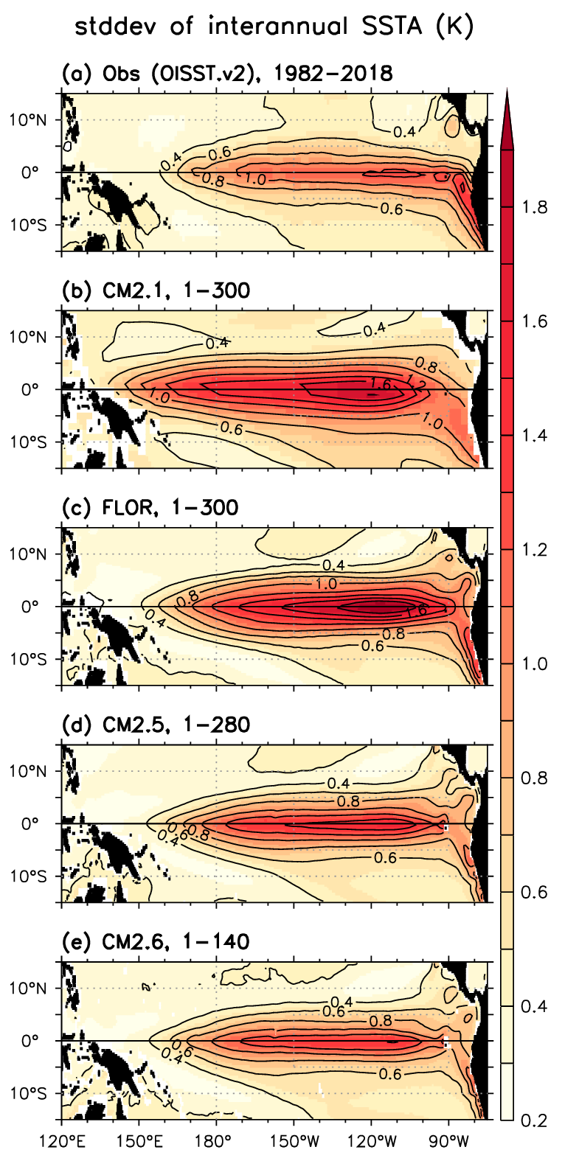
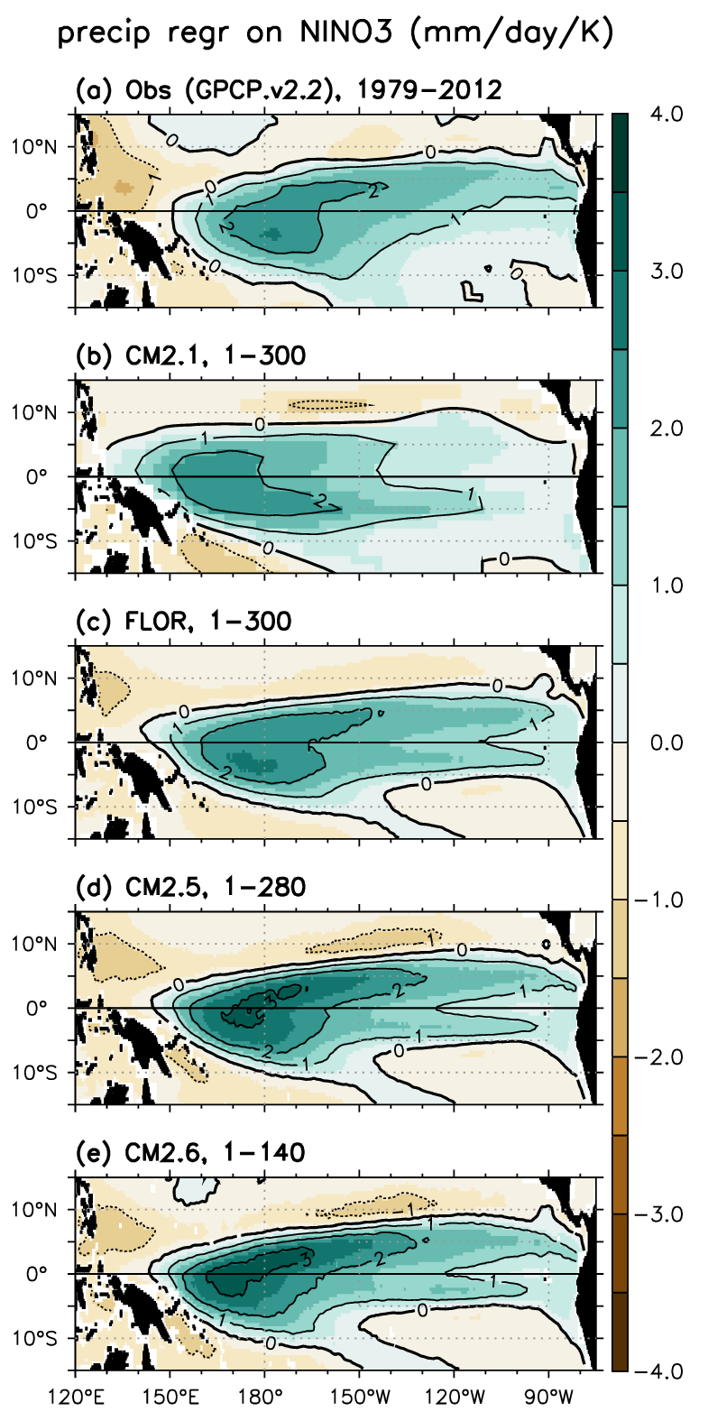
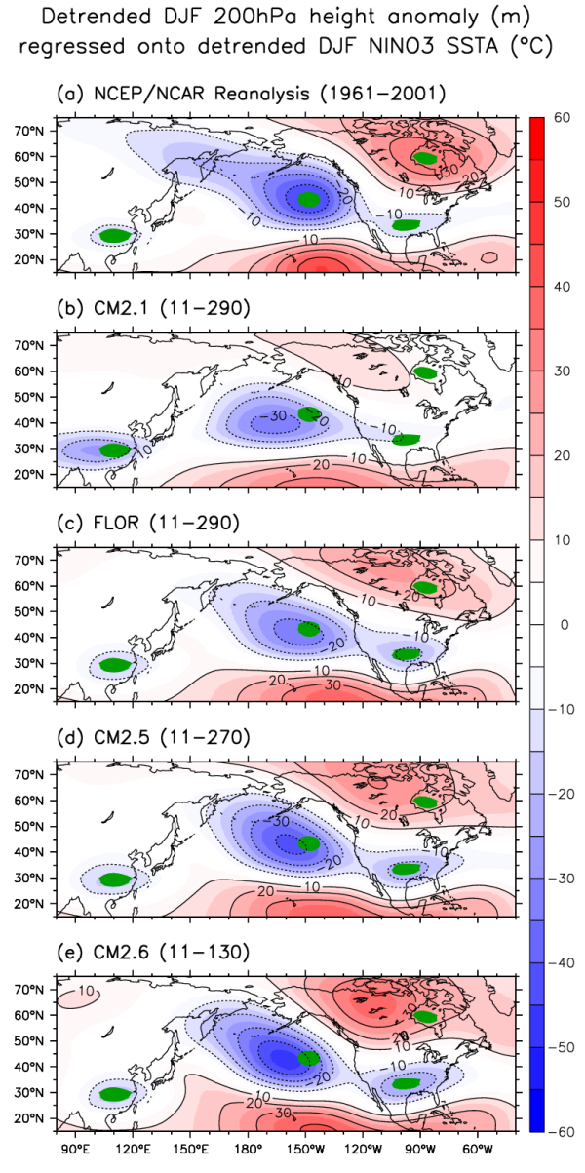
ENSO improvements with increasing resolution
OBS
NINO3
“FLOR”
forecast
model
4x atm
Aim: efficiently study
extremes, regional
impacts over land
4x ocn
2.5x ocn
Vecchi et al. (JC 2014; CD 2019); Jia et al. (JC 2015); Yang et al. (JC 2015); Wittenberg et al. (JAMES 2018); Ray et al. (JC 2018ab)
Notes:
Our simulations have improved with increasing *resolution*. Here's the *observed* strength of ENSO SST anomalies over the tropical Pacific -- we see the peak in the equatorial cold tongue *NINO3* region. Here's our old CM2.1 model -- too strong and too far west. Refining our model grids, and better representing ocean eddies, improved the SST pattern.
For *rainfall*, the obs show an eastward and equatorward shift during El Nino, and this response also improved, shifting east with increasing resolution. And this improved ENSO's remote *teleconnections* to the geopotential height anomalies that steer storms into North America.
Now, the *atmospheric* refinement provided many of these benefits, and also helped us efficiently study extremes & regional impacts over land -- so we moved forward with FLOR, which was a big win for forecasts as you'll hear tomorrow.

Slide 5
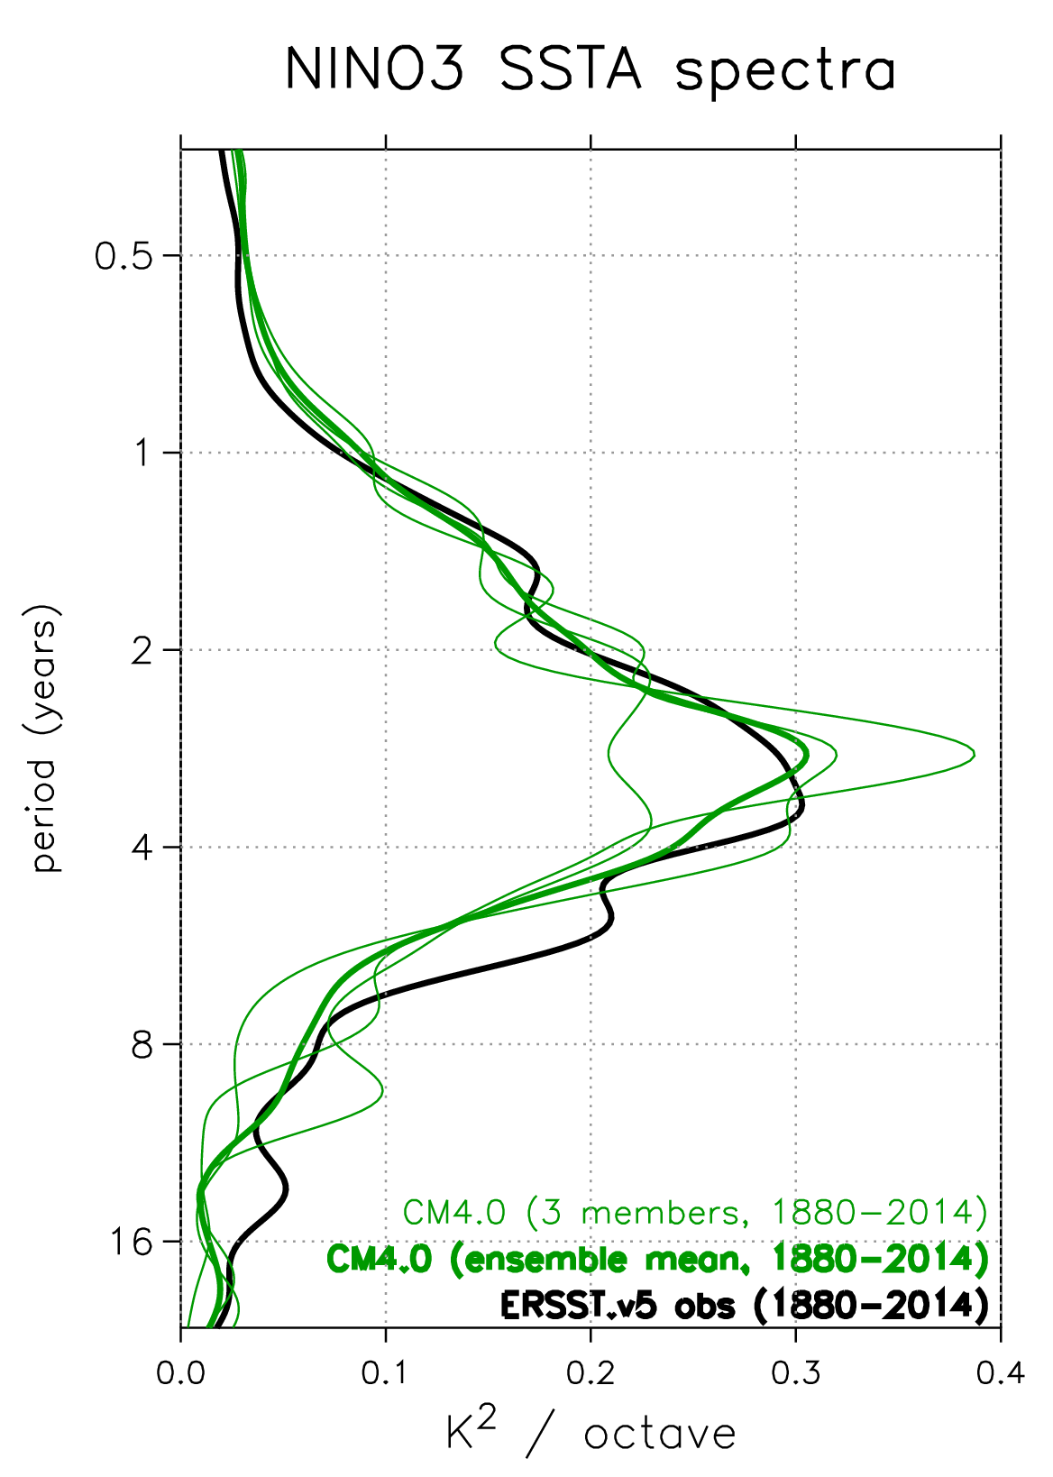
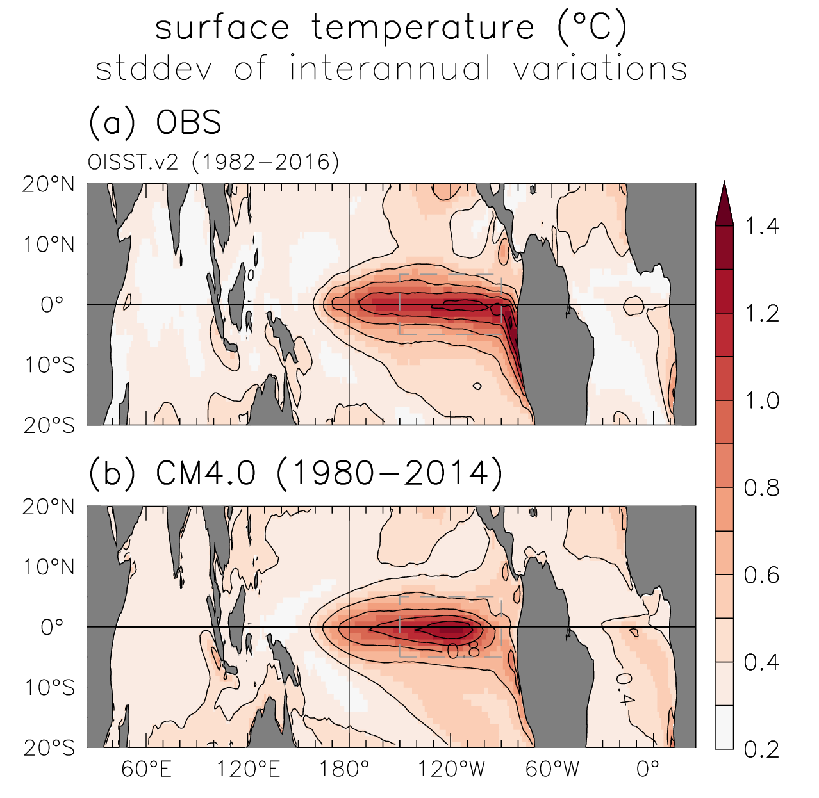
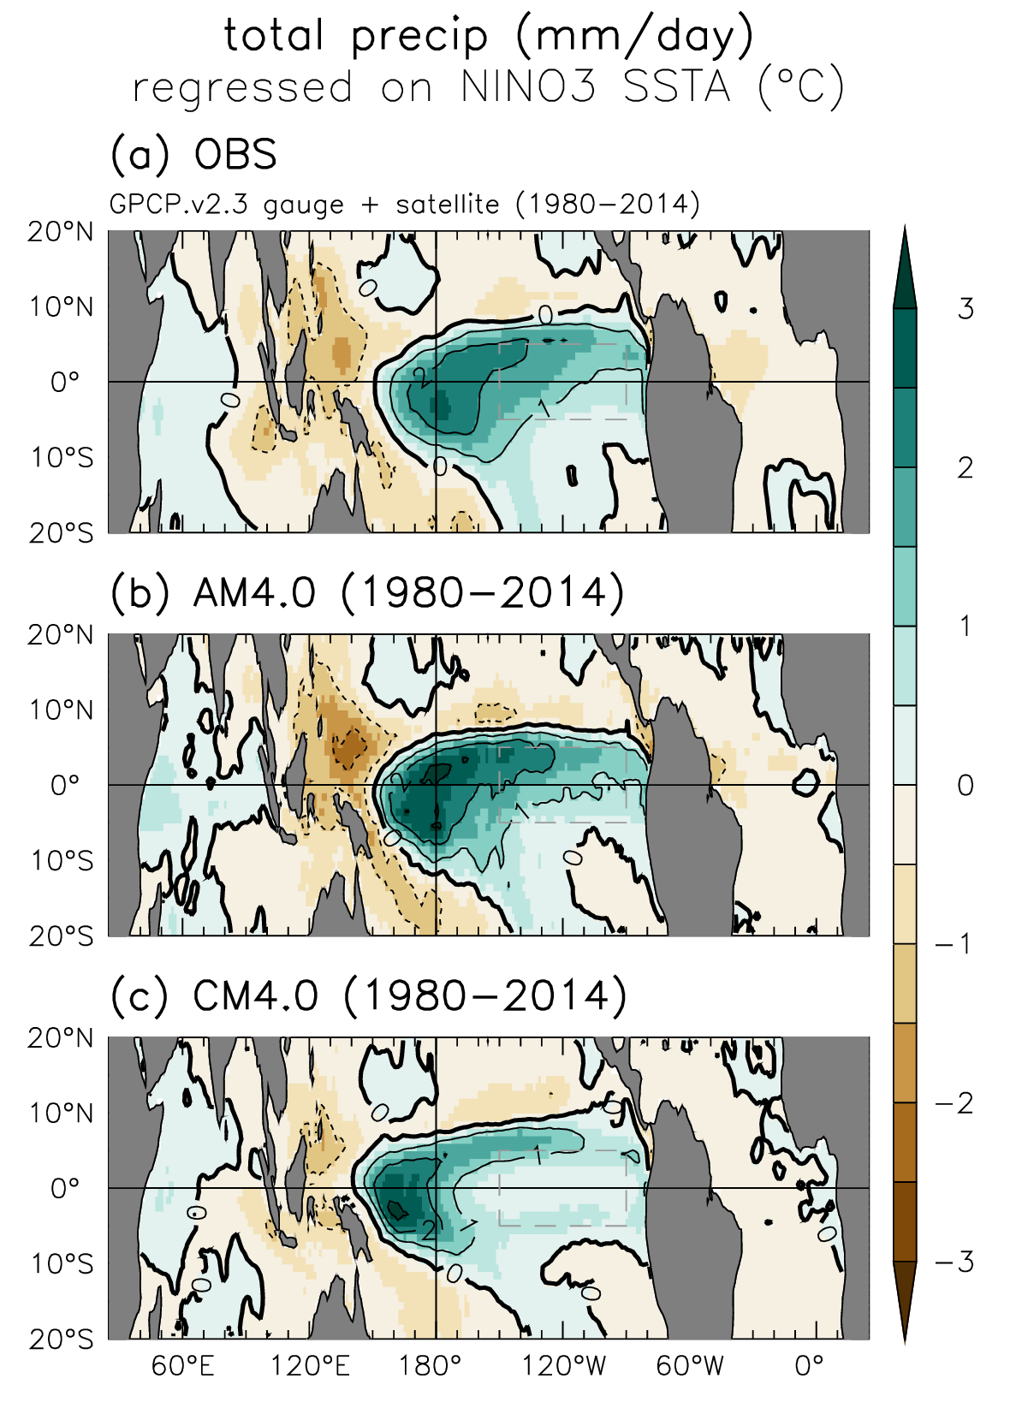
Improved ENSO patterns & spectra in CM4
Better resolution
& comprehensiveness
→ New avenues for
research & applications
Zhao et al. (JAMES 2018a)
Held et al. (JAMES, in press)
Notes:
Our latest models show further improvements. In particular, CM4's ENSO SST & rainfall patterns, and ENSO spectra, are some of the best I've seen from any coupled GCM. And their better resolution & comprehensiveness open new avenues for research & applications.

Slide 6
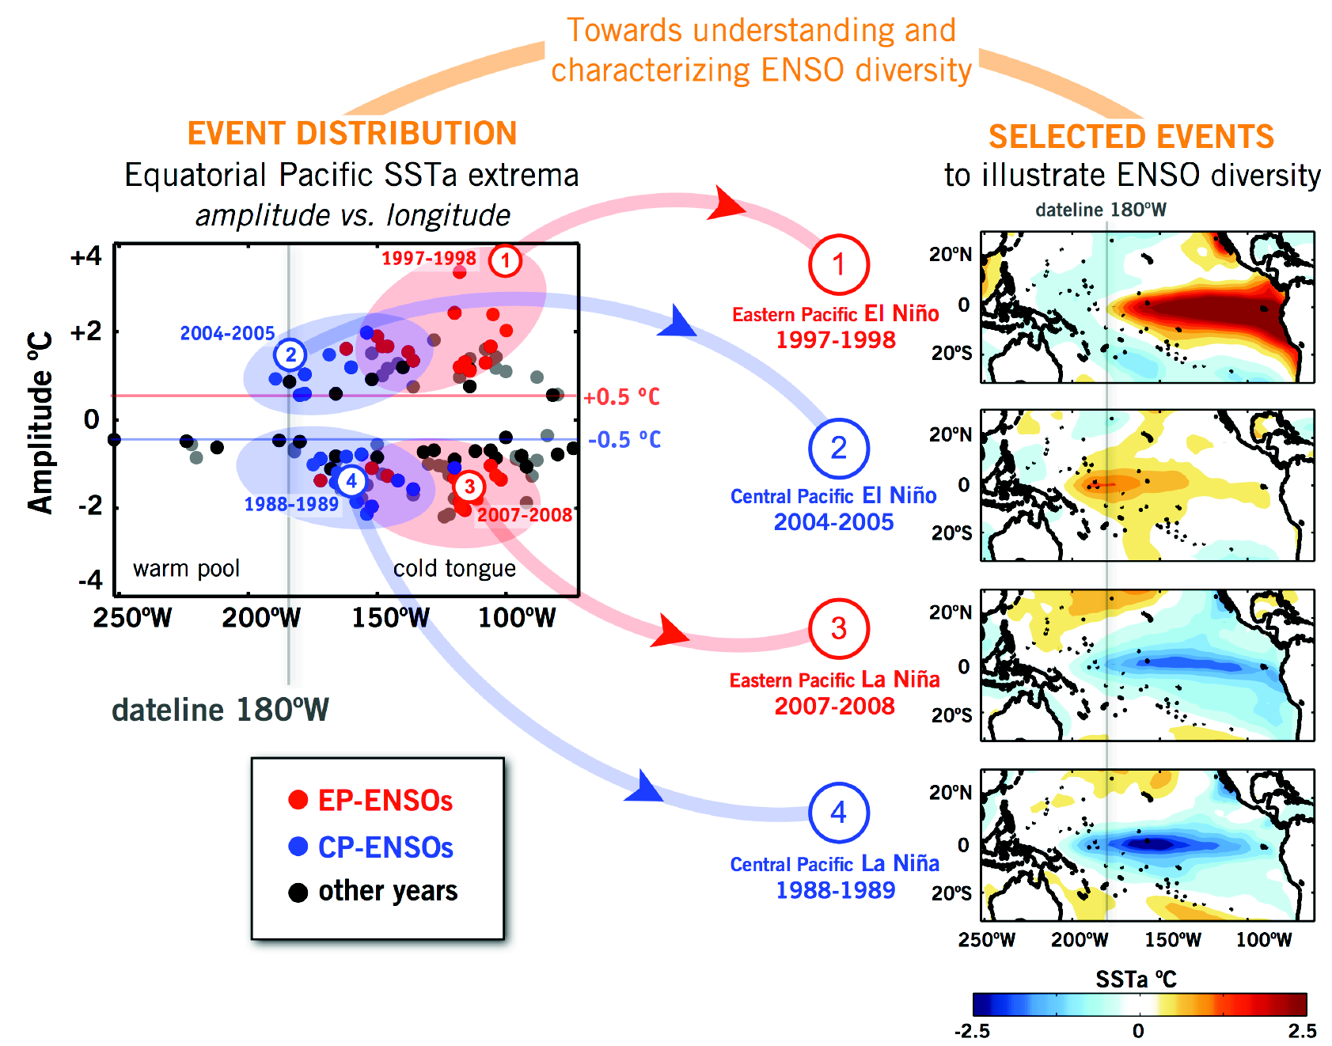
ENSO diversity in observations
ENSO flavors have different dynamics & impacts
NOAA ERSST.v3b
U.S. CLIVAR Working Group on ENSO Diversity: Capotondi, Wittenberg, et al. (BAMS 2015; AGU 2020)
Notes:
Now the past few years we've focused a lot on the *diversity* of ENSO events. Our work with the U.S. CLIVAR "Working Group on ENSO Diversity" showed these differences matter -- they have different dynamics, and impacts. Here's an example from our review paper, showing that in both obs…

Slide 7
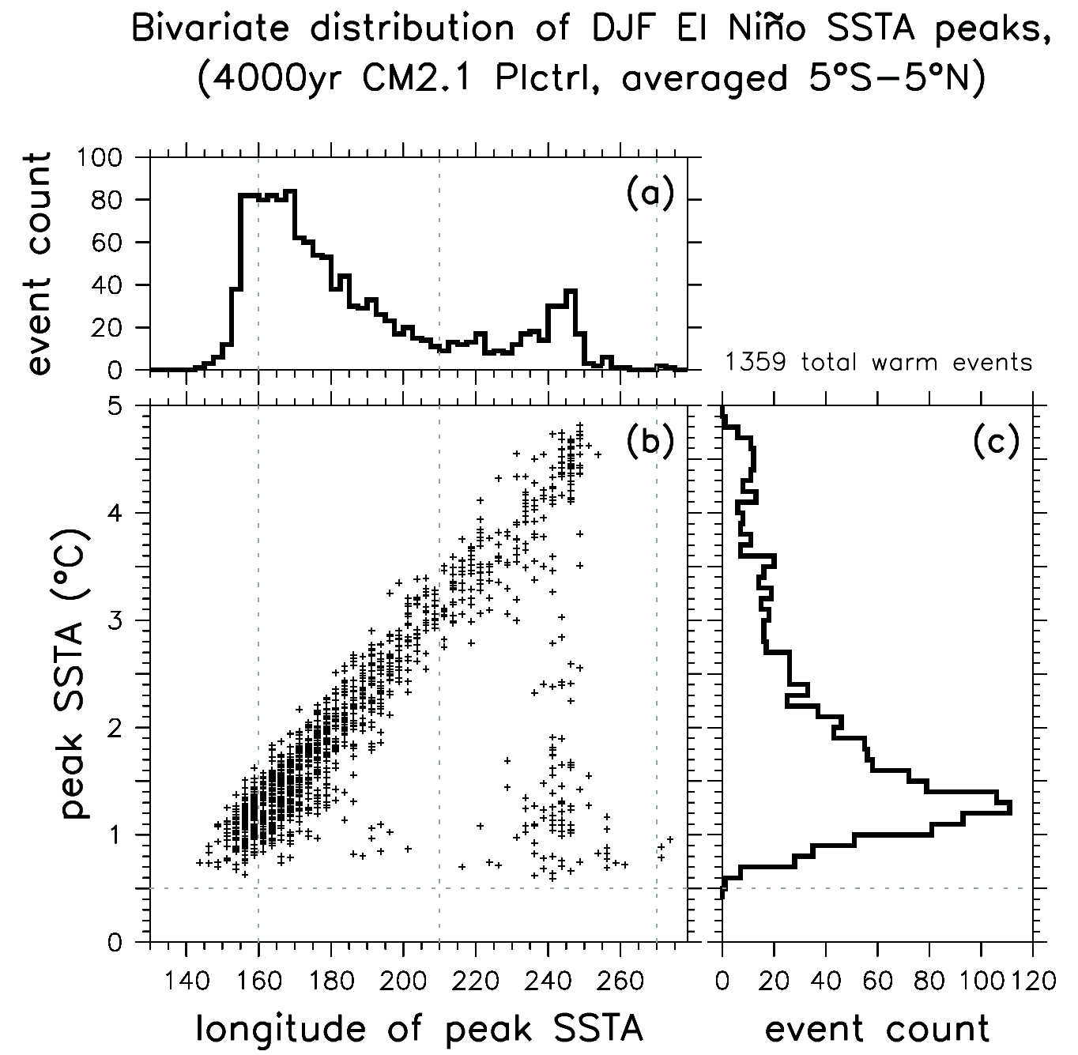
ENSO diversity in observations & models
ENSO flavors have different dynamics & impacts
GFDL CM2.1 simulation
NDJ
continuum
continuum
1900-1945 1945-2013
CM2.1 captured this diversity well
NOAA ERSST.v3b
U.S. CLIVAR Working Group on ENSO Diversity: Capotondi, Wittenberg, et al. (BAMS 2015; AGU 2020)
Sources, impacts, predictability: Wittenberg et al. (JC 2014); Graham et al. (CD 2017); Chen et al. (JC 2017); Atwood et al. (CD 2017);
L’Heureux et al. (BAMS 2017); Yang et al. (CD 2018); Timmermann et al. (Nature 2018); Johnson et al. (GRL 2019); Santidrian et al. (CC subm)
Notes:
…and models, there's a *continuum* of ENSO flavors, ranging from eastern to western Pacific types and everything in between. Our CM2.1 model captured this diversity well, and helped us explore the sources, impacts, and predictability of ENSO diversity.

Slide 8
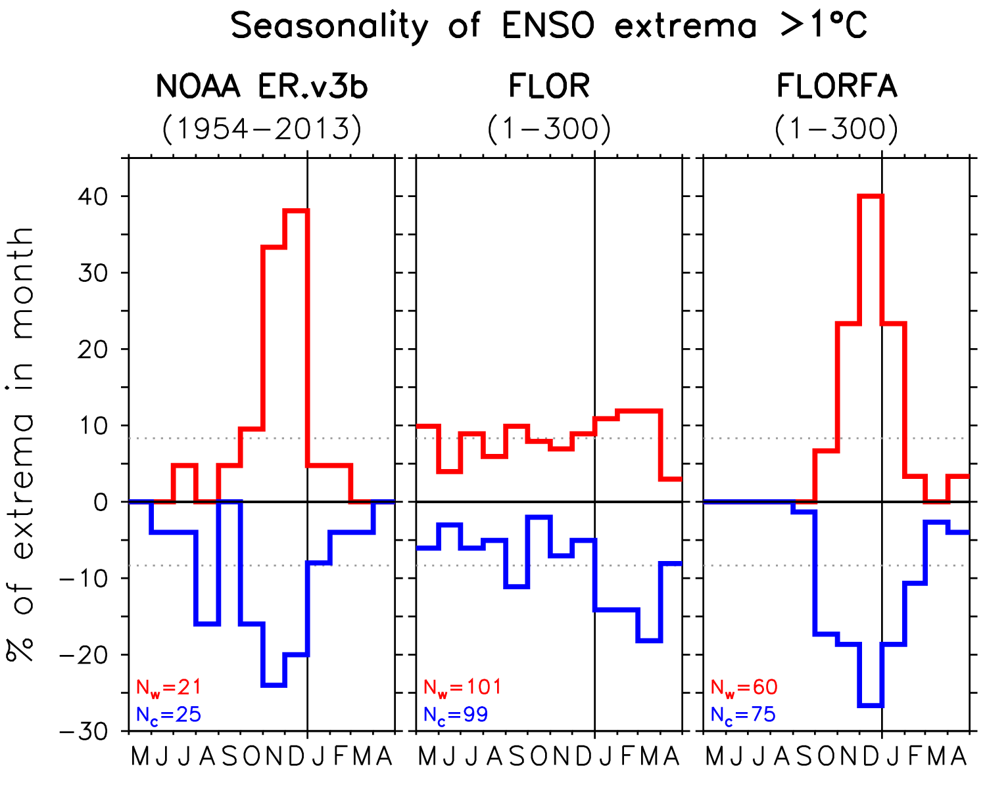
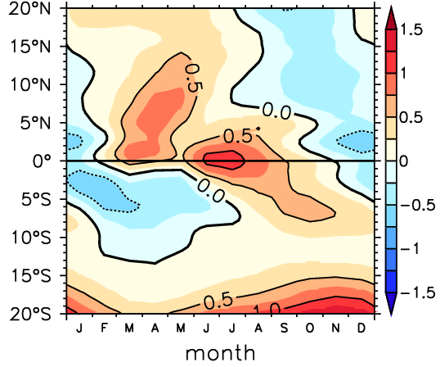
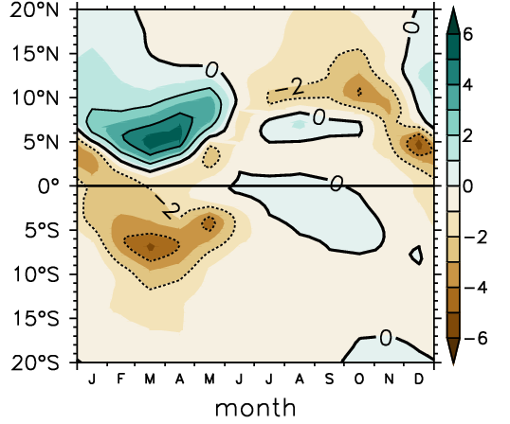
Improved seasonal synchronization of ENSO
NINO3
SSTA
distribution
Observed events (especially strong ones) tend to peak during Oct-Dec.
!
?
GFDL-FLOR (like many models) didn’t capture this.
Correct climatological SST & wind stress using flux adjustments (FA)
→ ENSO synchronizes to
end of calendar year.
calendar month
Change in SST climatology
Change in precip climatology
FA corrects east Pacific seasonality of dT/dy and ITCZ latitude.
Boosts SST→wind coupling
during the key Jun-Nov
season of ENSO growth.
weaker
coupling
stronger
coupling
averaged 150W-110W
averaged 150W-110W
calendar month
calendar month
Wittenberg et al. (in prep)‏
Notes:
The seasonal *timing* of ENSO also matters. Observed events tend to peak near the end of the calendar year. Our FLOR forecast model, like many models, didn't capture this. But we found that if we corrected its climatological SST & winds using flux adjustments, its ENSO beautifully synchronized to the end of the calendar year. This was because the adjustments corrected the east Pacific seasonality of meridional SST gradients and ITCZ latitude, boosting the SST->wind coupling during the key Jul-Nov season of ENSO growth.

Slide 9
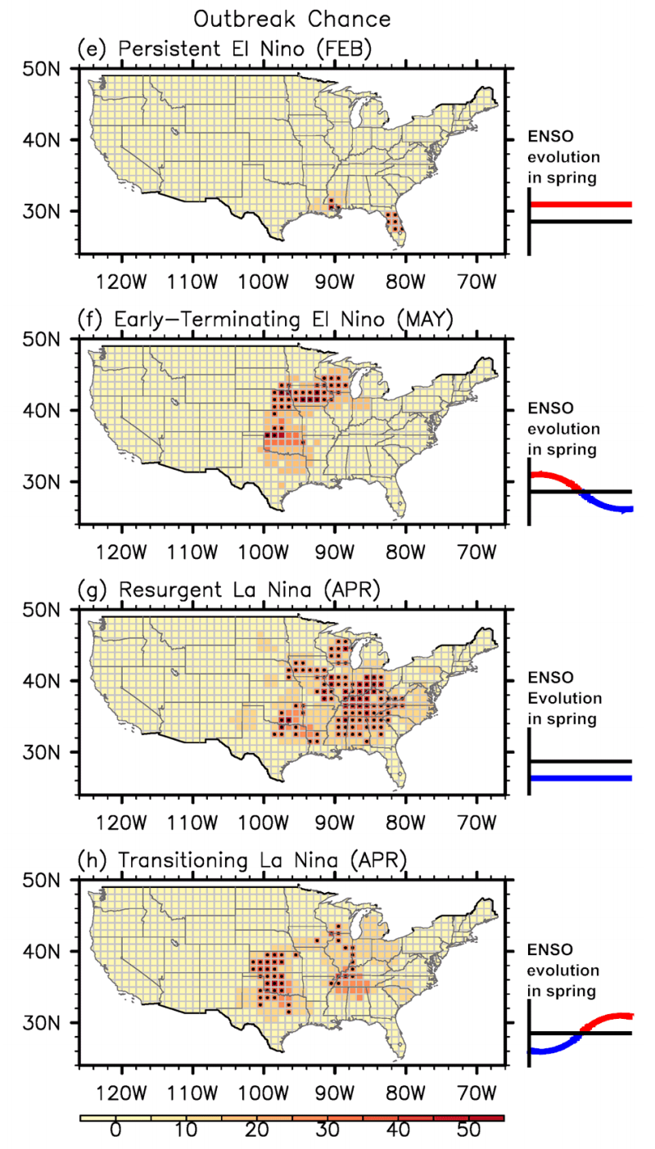
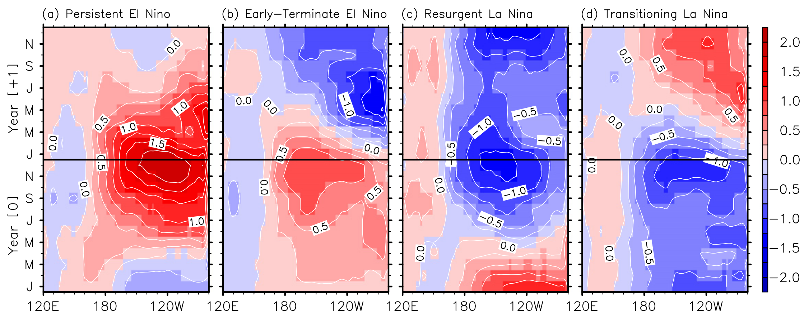
ENSO diversity & seasonality affect remote impacts
Key flavors of observed ENSO evolution
moisture
ENSO events show diverse
temporal behavior in boreal spring: persisting, terminating early,
resurging, or transitioning.
large-scale seasonal
wind shear,
moisture advection
(GPLLJ)
This significantly affects ENSO impacts,
e.g. on U.S. tornado outbreak frequency
& California rainfall.
Lee et al. (GRL 2014, 2018; ERL 2016)‏
Krishnamurthy et al. (JC 2015)
Notes:
And this *seasonality* of ENSO is *critical* for its impacts. With colleagues at AOML, we grouped historical ENSO events into their four key spatio-temporal flavors, and found these flavors were strongly linked to the patterns of *tornado* outbreaks over the U.S. -- due to how ENSO affects the large-scale seasonal wind shear and moisture advection that are conducive to outbreaks. We also found links to California *rainfall*. So the diversity and seasonal *timing* of ENSO are really critical.

Slide 10
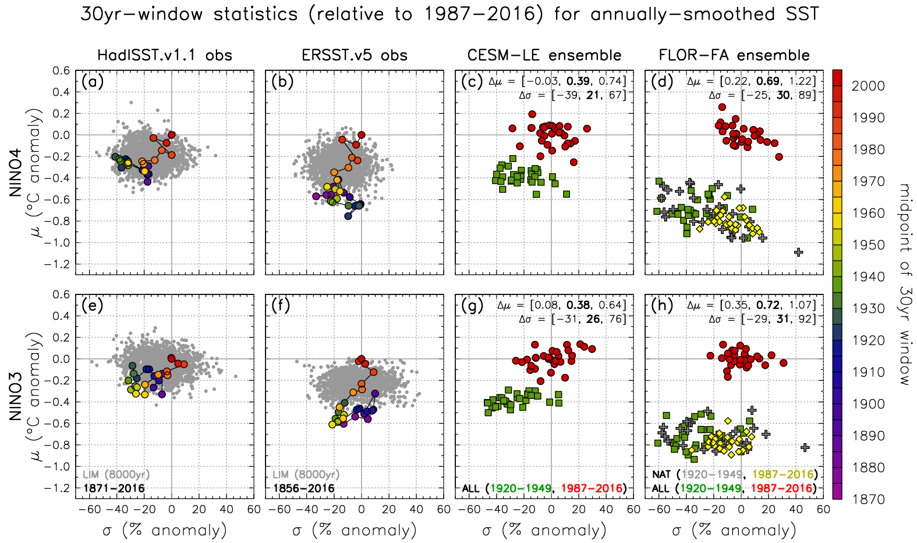
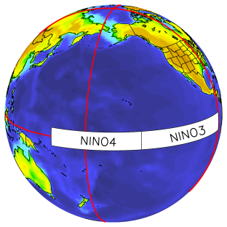
Historical changes in ENSO & mean eq. Pacific SST
2001
warmer
climate
1935
1885
stronger
ENSO
Newman, Wittenberg, et al. (BAMS 2017)‏
Notes:
Now is ENSO changing? With colleagues at ESRL, we examined *historical* changes in ENSO & mean equatorial Pacific SST. Here's NINO3 SST: vertical's the time-mean SST, horizontal's the ENSO strength. Each colored dot is a 30yr chunk from the HadISST obs reconstruction. The more recent, red dots show warming and a stronger ENSO, but still within the envelope we'd expect from a stationary system, the gray dots. Farther west in NINO4, the red dots do start to push the envelope, with warmer SSTs and stronger ENSO. The *ERSST* reconstruction shows an even stronger warming.
We repeated this for the historical *ensemble* simulations from CESM and FLOR...

Slide 11
Historical changes in ENSO & mean eq. Pacific SST
2001
1935
2001
warmer
climate
1935
1885
stronger
ENSO
Mean SST change marginally detectable. ENSO change, less so.
Newman, Wittenberg, et al. (BAMS 2017)‏
Notes:
Green is the 1920s-40s, red the most recent 30yrs. Both models show warming (easily detectable), and stronger ENSOs (less detectable with more ensemble overlap) -- though the models' *sensitivities* differed.

Slide 12
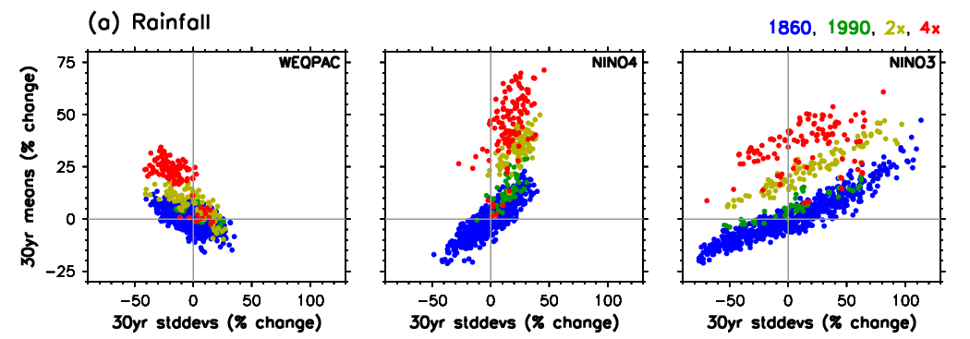
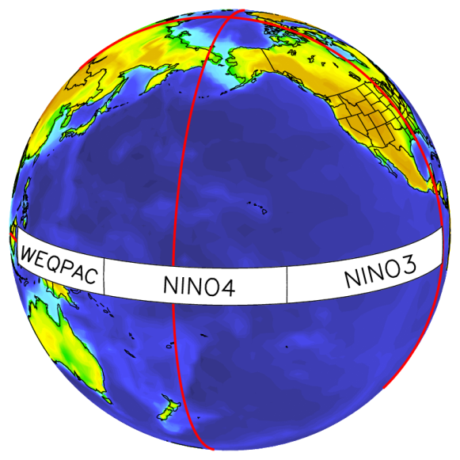
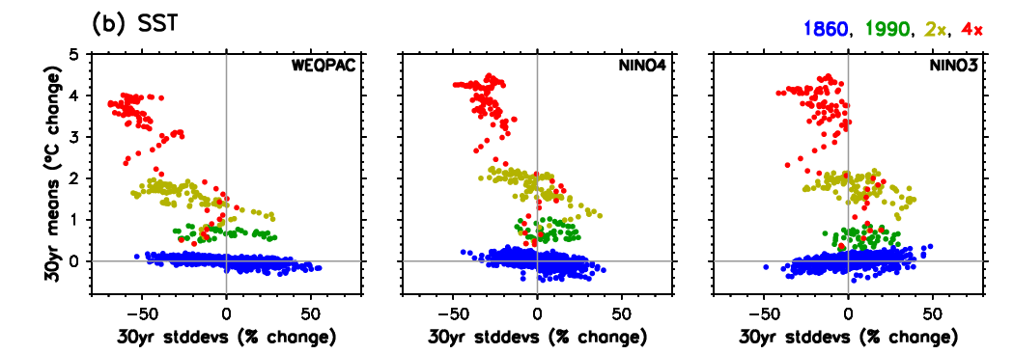
ENSO responses to increasing CO₂
Wittenberg
(U.S. CLIVAR Variations, 2015)
CM2.1 simulations show interplay of intrinsic ENSO modulation,
multidecadal climate, nonlinear sensitivity,
and regional responses to increasing CO₂.
wetter
climate
CO2-induced shift of rainfall variability
stronger-ENSO decades
➔ wetter local climate
4x
30yr
chunks
then
weaker.
Further work:
Knutson et al. (BAMS 2014)
Cai et al. (NCC 2014)
Delworth et al. (JC 2015)
Choi et al. (JC 2015)
Kam et al. (BAMS 2016)
Chen et al. (JC 2017)
Graham et al. (CD 2017)
Atwood et al. (CD 2017)
Timmermann et al. (Nature 2018)
Fedorov et al. (AGU 2020)
Stevenson et al. (in prep)
warmer
climate
2x
Stronger
ENSO...
1990
1860
stronger
ENSO
Notes:
So that's the past -- what about the future? Let's focus on these three equatorial zones, and look at how ENSO changes in the CM2.1 model, as CO2 increases.
Looking first in the west: each blue dot is a 30yr chunk from our long pre-industrial control run. Again, vertical's the 30yr mean SST relative to pre-industrial, horizontal's the strength of ENSO in that 30yr chunk. ENSO amplitude varies a *lot* from epoch to epoch, with only *slight* variations in mean SST. Now as CO2 increases to 1990, then 2 & 4 times pre-industrial, this region warms a lot -- but ENSO weakens, and is less decadally modulated.
Different story in the east, where ENSO at first strengthens near present-day CO2, then weakens at higher CO2. (Ditto in the central Pacific.) So there may be an "optimal climate" for ENSO SSTAs, perhaps around now. If so, then future ENSO risks would depend not only on region, but also on how *close* we are to this ENSO optimum, and which side of it we're on.
Same plots, but now for rainfall. In the east, strong-ENSO epochs go with wetter mean conditions -- and this continues into the future, though at a much warmer & wetter level. Farther west, as CO2 increases we get more mean rainfall, and ENSO's rain *variability* shifts eastward. We delve further into these changes in these studies here in gray.

Slide 13
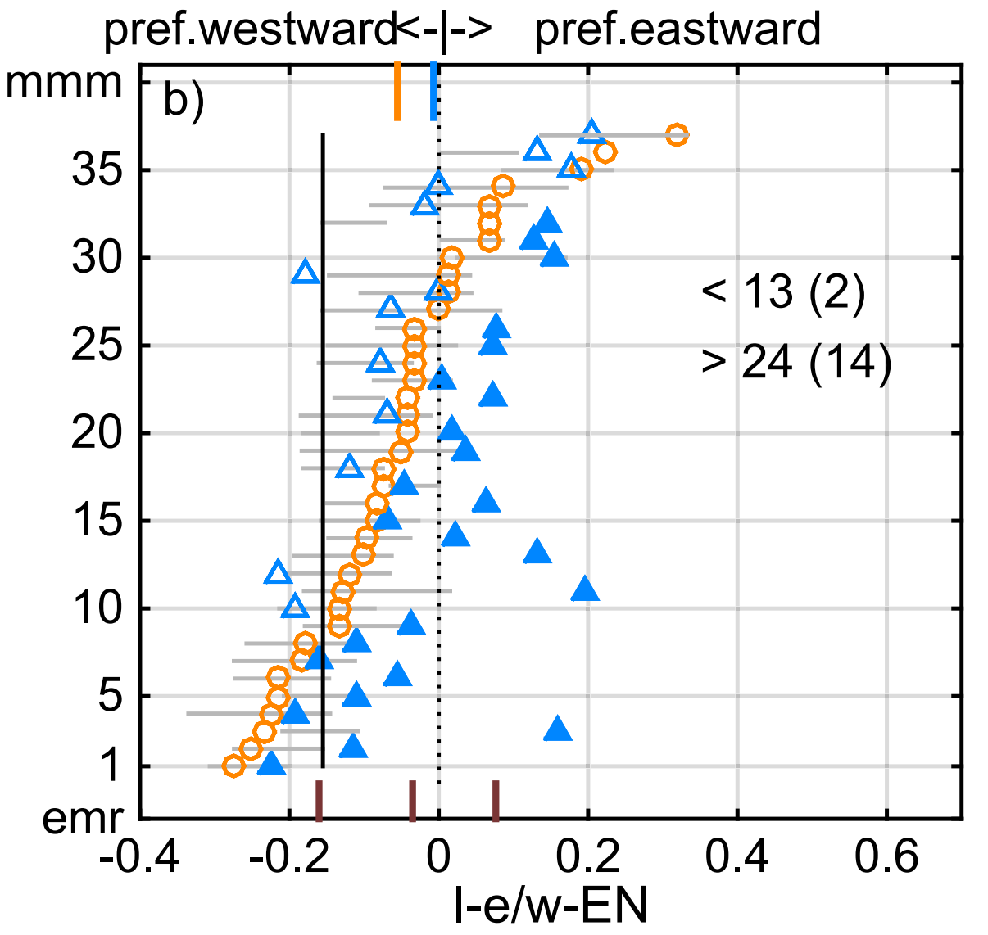
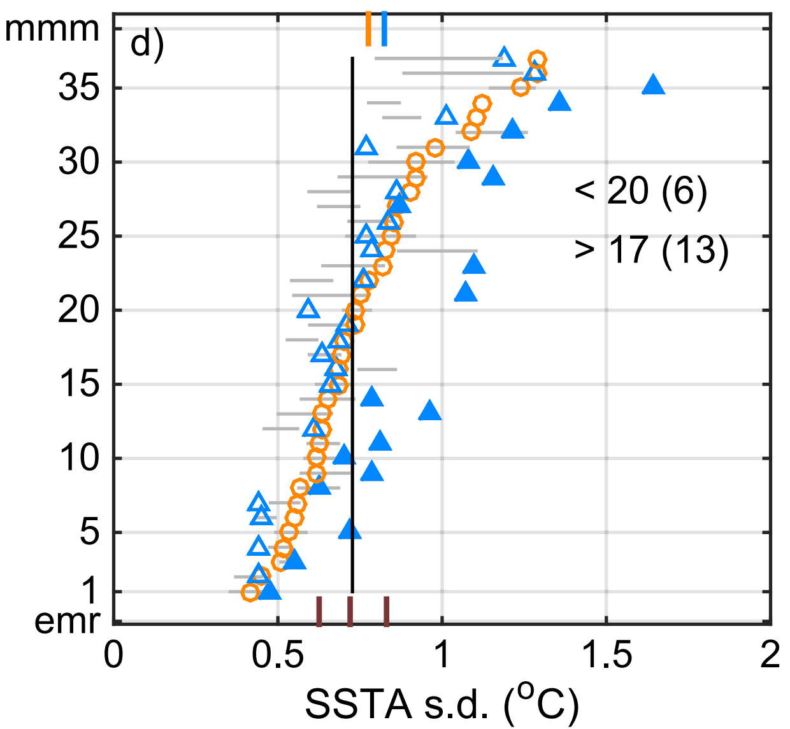
CMIP5 projections (PI, 1900-99, 2000-99)
ENSO amplitude
Zonal propagation of SSTAs
obs
obs
ENSO strengthens
in some models,
weakens in others.
Models that
strengthen tend
to do so more
significantly.
Most models show
more eastward
propagation
in the future.
Model
weak
strong
more westward
more eastward
NINO3.4 SSTA stddev (K)
Prob_{CPEN→EPEN} – Prob_{EPEN→CPEN}
No CMIP5-model consensus on future ENSO SSTA amplitude.
But they do suggest changes in ENSO’s dynamics & evolution.
Chen et al. (JC 2017)‏
Notes:
We also looked at the *CMIP5* projections of ENSO's future.
Looking first at central equatorial Pacific SSTs: ENSO strength on the horizontal. Orange dots are the CMIP5 historicals -- the models have a *range* of past amplitudes, some stronger, some weaker than obs. And going forward to the 21st century in blue, ENSO strengthens in some models, weakens in others.
But looking at the zonal *propagation* of ENSO SSTAs, we see a more *robust* change, toward more *eastward* propagation in the future.
So there's no CMIP5 consensus on future ENSO SSTA *amplitude*. But they do suggest changes in ENSO's *evolution* & dynamics.

Slide 14
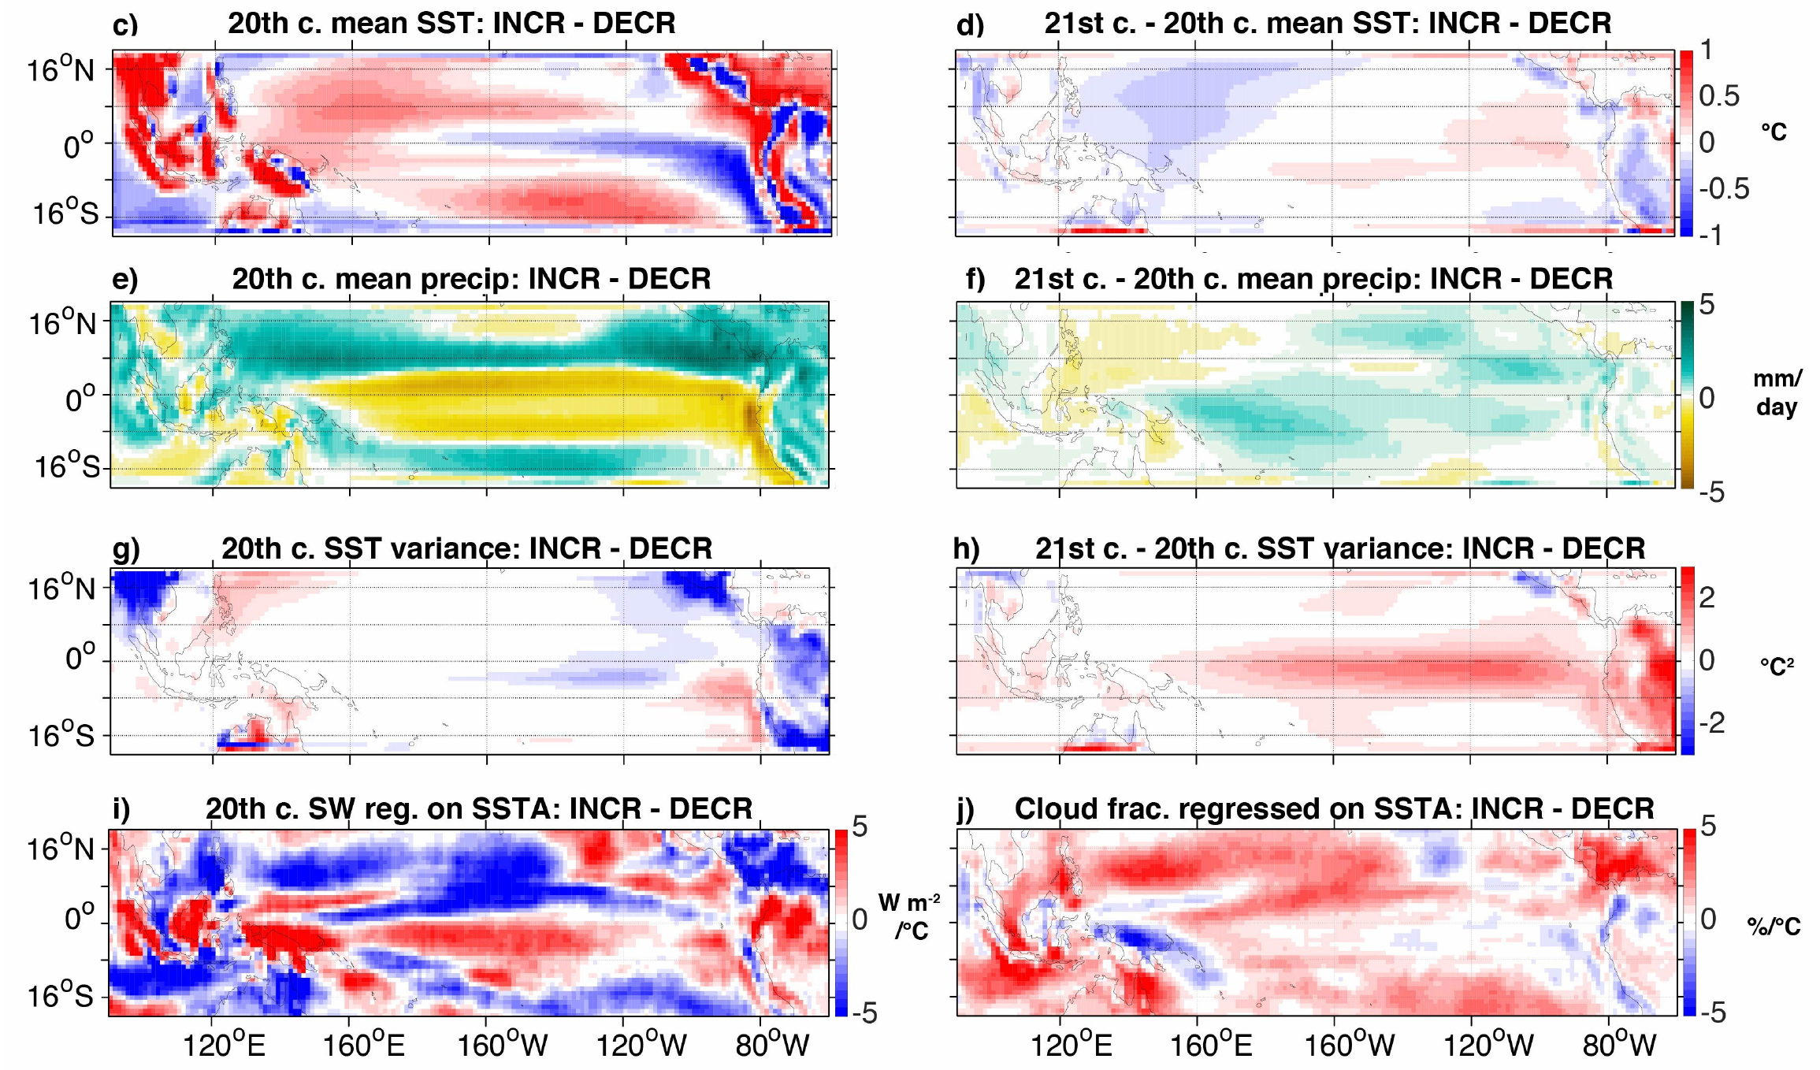
Emergent constraints for future ENSO extremes
Change in likelihood of extreme wet El Niño in NINO3 (CMIP5, 2006-2100 minus 1950-2005)
Models project a wide range of changes in El Niño rainfall extremes: some strongly increase, others decrease.
“Increasers” start with common biases: cooler & drier cold tongue, weaker ENSO, and weaker heat flux damping of SST changes.
→ More room to amplify
ENSO extremes.
Different model biases…
…yield different future changes.
cooler
more warming
drier
more wetting
Increasers also project more future warming, wetting, and ENSO SSTA amplification in the cold tongue.
weaker
SSTAs
more SSTA
amplification
Can use these emergent constraints to leverage
model diversity and inform future projections.
less SSTA damping
from cloud shading
Stevenson et al. (in prep)
Notes:
So that's SST -- what about changes in ENSO rainfall? In the NINO3 region, the CMIP5 models project a *wide range* of changes: some say El Nino rainfall will strongly increase, others decrease.
Why such diversity? Well, we found that *increasers* tend to have stronger present-day *biases* toward cool & dry conditions over the cold tongue, and also weaker ENSOs -- giving them more room to *boost* their ENSO extremes in the future. The increasers also had less convective *cloud* over the cold tongue -- leading to less radiative damping of SST changes, stronger future warming & wetting, and amplified ENSO SSTAs.
So many models may be *overestimating* future El Nino rainfall, with implications for teleconnections. So we need to reduce model biases.

Slide 15
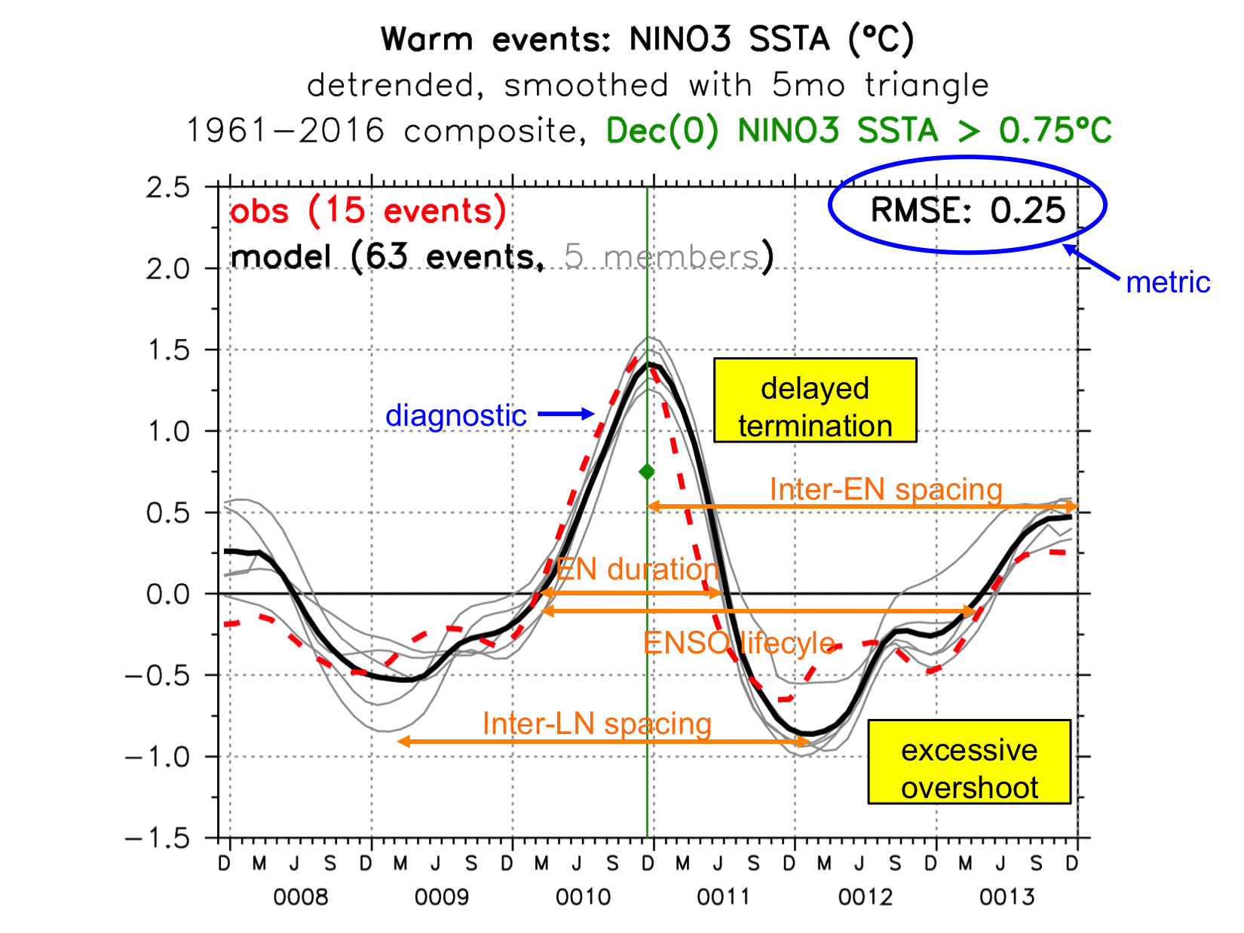
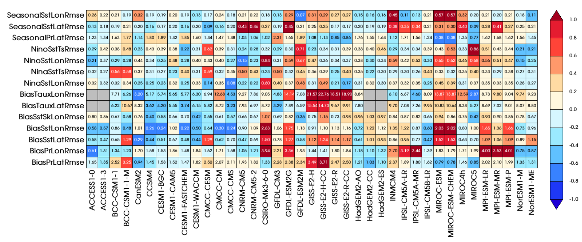
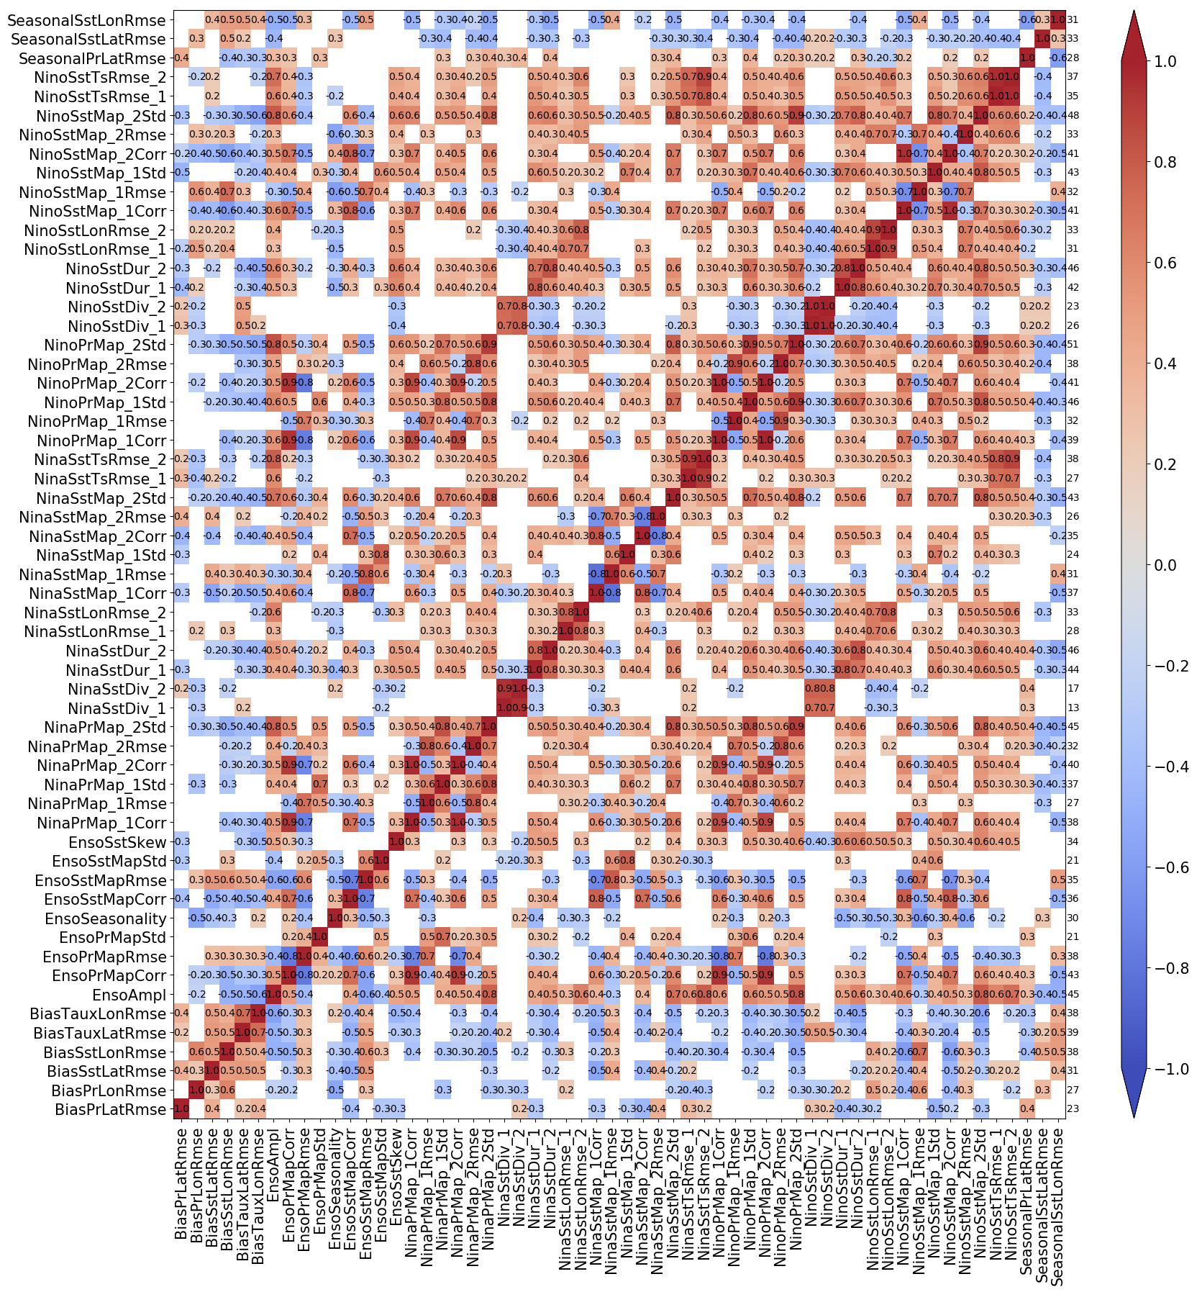
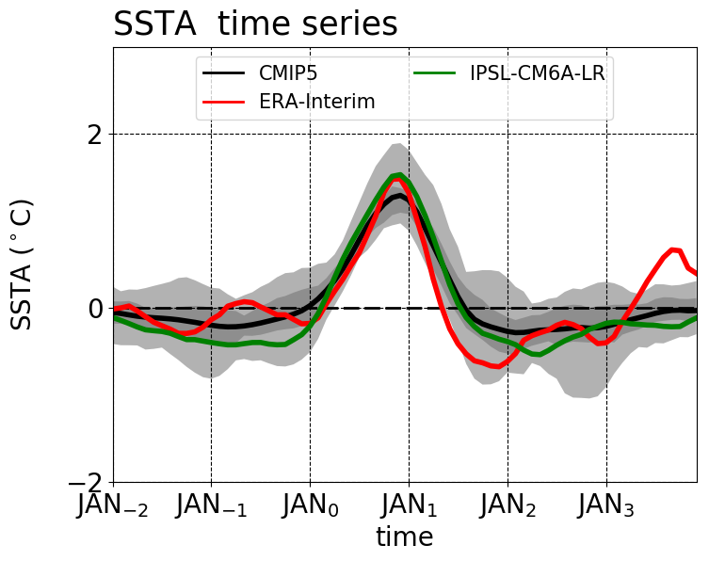
Community metrics for ENSO simulations
CLIVAR Research Focus on ENSO – Guilyardi et al. (AGU 2020); Planton et al. (in prep)‏
Example:
El Niño
life cycle
Compare to
other models
& metrics
Discover connections
among metrics, find
emergent constraints
Provide
multi-model
context
Inter-model
correlations
among metrics
Notes:
To that end, we've led CLIVAR's Research Focus on ENSO -- and produced a new Python package to diagnose ENSO in models. Here's an example, the composite *evolution* of an El Nino event. Obs in red, model in black. And some key *metrics* for that evolution -- RMS error, event duration and spacing, and so on.
We can then *compare* such metrics to other models and other metrics, as in this plot for CMIP5. CMIP provides *context* for our model diagnostics. And we can discover *connections* among metrics, and *constraints* for future changes, by computing inter-model *correlations* among metrics. We're using this to analyze the CMIP6 models, and plan to contribute it to community efforts, like ESMValTool and the PCMDI metrics package.

Slide 16
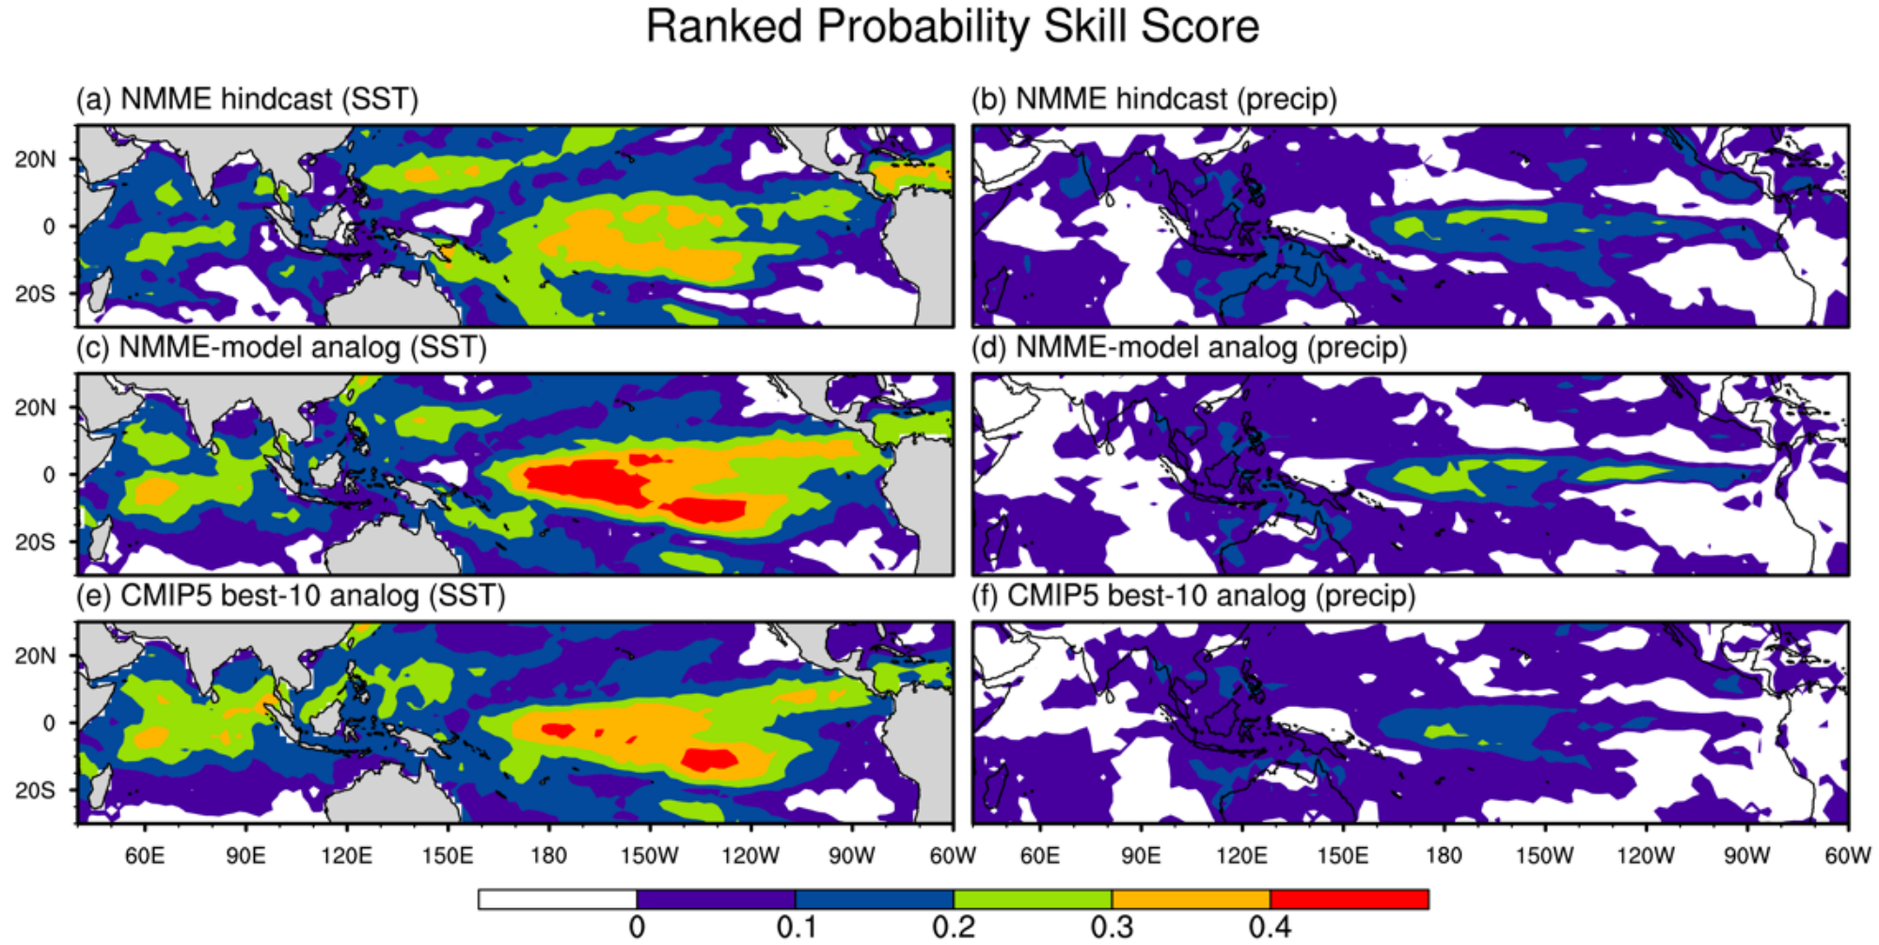
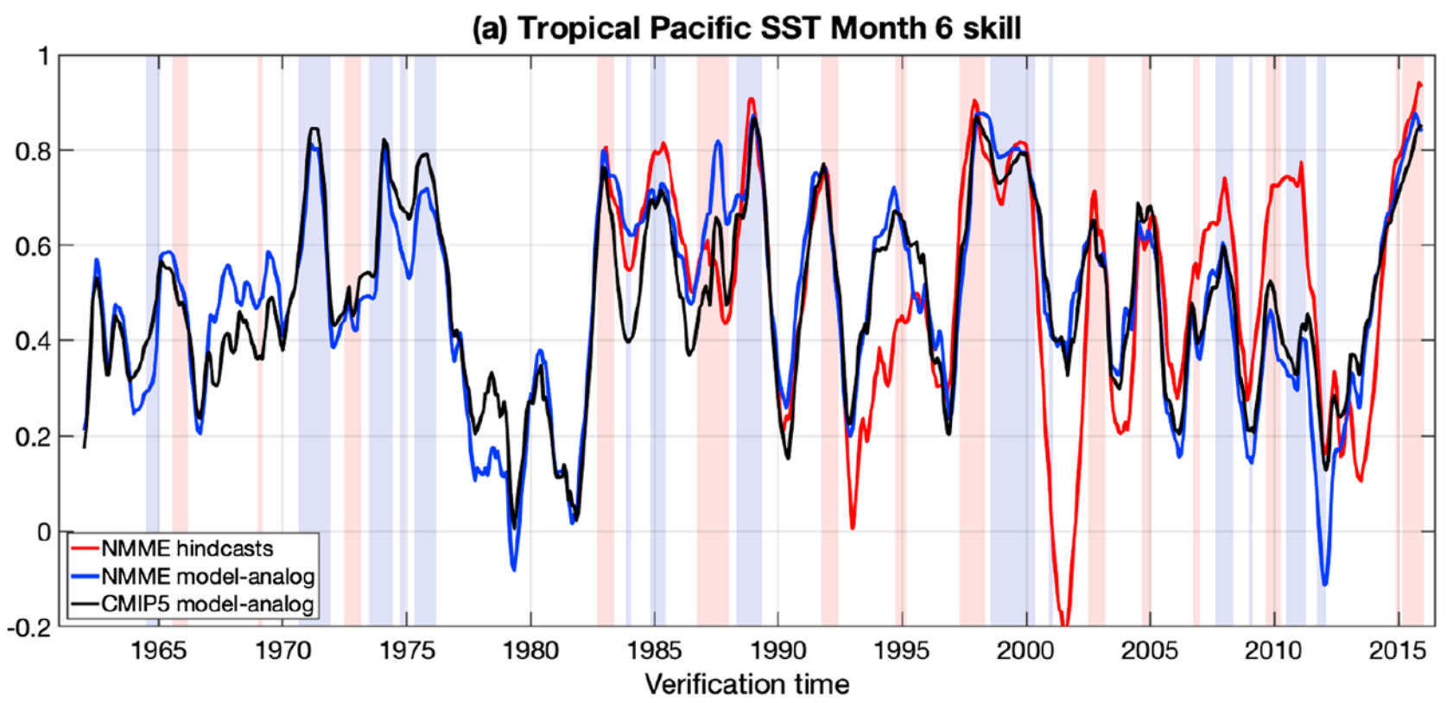
ENSO forecasts using model-analogs
Existing long model control runs are like “libraries” of ENSO behavior.
Find analogs of obs SST & SSH → trace how those states evolved in control runs.
→ Like a forecast with
no initialization shock.
(bias-corrected,1982-2009)
At 6-month leads in the tropics, analogs from
the NMME control runs beat the same models’ initialized forecasts!
Suggests that even models without assimilation (e.g. CMIP5) could offer useful forecast guidance.
Also permits rapid assessment of secular variations in predictability.
Roughly tracks NMME skill
(highest when ENSO is strong)
Ding et al. (JC 2018; GRL 2019)
Notes:
Finally, we're working to assess ENSO predictability and improve forecasts. With colleagues at ESRL, we searched *existing* long model control runs for analogs of *observed* states over the past 50 years, then simply traced how those states evolved in the control runs. So, model forecasts without initialization shock.
This simple method is amazingly skillful -- it actually beats the state-of-the-art NMME forecasts, for both SST & rainfall. This is a powerful result, suggesting that even the CMIP5 models, *without* assimilation systems, could offer forecast guidance.
We also used this method to assess secular variations in ENSO *predictability* over the past 50 years -- and found that it tracked the NMME skill, which is highest when ENSO is strong. We're hoping to work with NCEP to further develop this for use in operations.

Slide 17
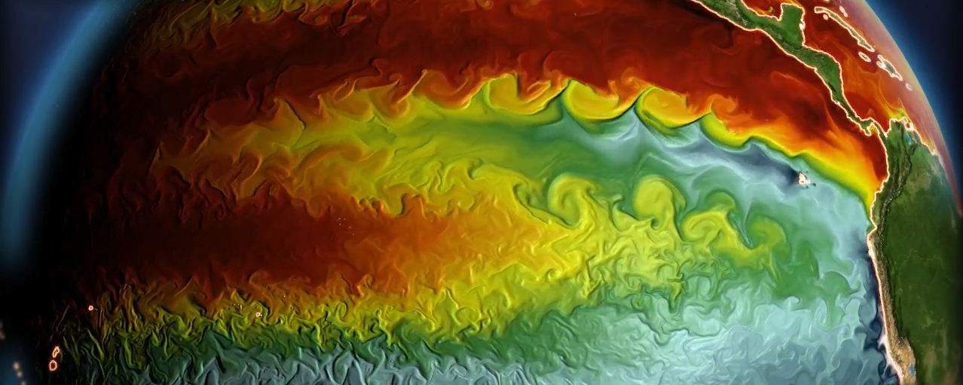
Future plans and challenges
1. Better understand ENSO & improve models a. Background climate is key (flux adjustments, heat/momentum budgets) b. Community metrics & obs constraints (TPOS2020, LES, reanalyses, paleo) c. Enhance model resolution & physics - clouds & convection, surface winds & fluxes, ocean mixing (TIWs), diurnal cycle
2. Improve predictions & projections a. Clarify ENSO connections to extremes & regional impacts b. Understand sources & limits of predictability (model analogs) c. Emergent constraints to improve future projections
GFDL-CM2.6 simulation
Notes:
Moving forward, we'll continue pushing to understand ENSO and improve models. The background climate is key, and we have great tools to explore its links to ENSO. We're improving constraints for models, and *enhancing* our models to better capture ENSO processes.
We'll also work to improve predictions & projections -- clarifying ENSO's extremes and regional impacts, understanding predictability, and discovering constraints for future changes.

Slide 18
Summary
ENSO understanding & predictions are critical to NOAA’s mission.
2. GFDL’s ENSO simulations, forecasts, and projections are among the world’s best. They are widely used, and improving.
3. GFDL is rapidly advancing community understanding of ENSO’s diversity, dynamics, sensitivities, impacts, and predictability.
Notes:
So to sum up, ENSO's critical to NOAA's mission, and GFDL brings a lot to the table. Our newest models add realism and new capabilities, and we're advancing understanding -- to inform society about the *future* of ENSO. Thanks very much.

Slide 19
2014-2019 ENSO Publications (1 of 2)
Atwood, A. R., et al., 2017: Characterizing unforced multi-decadal variability of ENSO: A case study with the GFDL CM2.1 coupled GCM. Climate Dyn., 49, 2845-2862. doi: 10.1007/s00382-016-3477-9
Capotondi, A., et al., 2015a: Climate model biases and El Niño Southern Oscillation (ENSO) simulation. U.S. CLIVAR Variations, 13, 21-25.
Capotondi, A., A. T. Wittenberg, et al., 2015b: Understanding ENSO diversity. Bull. Amer. Meteor. Soc., 96, 921-938. doi: 10.1175/BAMS-D-13-00117.1
Capotondi, A., A. T. Wittenberg, et al., 2020: ENSO diversity. Ch. 5 of: ENSO in a Changing Climate, an AGU monograph.
Chen, C., et al., 2017: ENSO in the CMIP5 simulations: Life cycles, diversity, and responses to climate change. J. Climate, 30, 775-801. doi: 10.1175/JCLI-D-15-0901.1
Chiodi, A. M., J. P Dunne, et al., 2019: Estimating Air-Sea Carbon Flux Uncertainty over the Tropical Pacific: Importance of Winds and Wind Analysis Uncertainty. Global Biogeochemical Cycles, 33, doi:10.1029/2018GB006047
Choi, K.-Y., et al., 2015: Nonlinear zonal wind response to ENSO in the CMIP5 models: Roles of the zonal and meridional shift of the ITCZ/SPCZ and the simulated climatological precipitation. J. Climate, 28, 8556-8573. doi: 10.1175/JCLI-D-15-0211.1
Christensen, J. H., et al., 2014: Climate phenomena and their relevance for future regional climate change. Chapter 14 of: Climate Change 2013: The Physical Science Basis. Contribution of Working Group I to the Fifth Assessment Report of the Intergovernmental Panel on Climate Change. Cambridge University Press, Cambridge, United Kingdom, pp. 1217-1308. doi: 10.1017/CBO9781107415324.028
Cravatte, S., et al., 2016: First Report of TPOS 2020. GOOS-215, 200 pp. http://tpos2020.org/first-report
Delworth, T. L., et al., 2015: A link between the hiatus in global warming and North American drought. J. Climate, 28, 3834-3845. doi: 10.1175/JCLI-D-14-00616.1
Delworth, T. L., et al.: SPEAR — The next generation GFDL modeling system for seasonal to multidecadal prediction and projection. Subm. to J. Adv. Model. Earth Syst.
Ding, H., et al., 2018: Skillful climate forecasts of the tropical Indo-Pacific Ocean using model-analogs. J. Climate, 31, 5437-5459. doi:10.1175/JCLI-D-17-0661.1
Ding, H., et al., 2019: Diagnosing secular variations in retrospective ENSO seasonal forecast skill using CMIP5 model-analogs. Geophys. Res. Lett., 46, 1721-1730. doi:10.1029/2018GL080598
Dunne, J. P., et al.: The GFDL Earth System Model version 4.1 (GFDL-ESM4.1): Model description and simulation characteristics. In prep for J. Adv. Model. Earth Syst.
Erb, M. P., et al., 2015: Response of the equatorial Pacific seasonal cycle to orbital forcing. J. Climate, 28, 9258-9276. doi: 10.1175/JCLI-D-15-0242.1
Fedorov, A., et al., 2020: ENSO low-frequency modulations and mean state interactions. Ch. 8 of: ENSO in a Changing Climate, an AGU monograph.
Graham, F. S., et al., 2014: Effectiveness of the Bjerknes stability index in representing ocean dynamics. Climate Dyn., 43, 2399-2414. doi: 10.1007/s00382-014-2062-3
Graham, F. S., et al., 2015: Reassessing conceptual models of ENSO. J. Climate, 28, 9121-9142. doi: 10.1175/JCLI-D-14-00812.1
Graham, F. S., A. T. Wittenberg, et al., 2017: Understanding the double peaked El Niño in coupled GCMs. Climate Dyn., 48, 2045-2063. doi: 10.1007/s00382-016-3189-1
Griffies, S. M., et al., 2015: Impacts on ocean heat from transient mesoscale eddies in a hierarchy of climate models. J. Climate, 28, 952-977. doi: 10.1175/JCLI-D-14-00353.1
Guilyardi, E., A. Wittenberg, et al., 2016: Fourth CLIVAR Workshop on the Evaluation of ENSO Processes in Climate Models: ENSO in a Changing Climate. Bull. Amer. Meteor. Soc., 97, 817-820. doi: 10.1175/BAMS-D-15-00287.1
Guilyardi, E., et al., 2020: ENSO modeling: History, progress, and challenges. Ch. 9 of: ENSO in a Changing Climate, an AGU monograph.
He, J., et al., 2018: Precipitation sensitivity to local variations in tropical sea surface temperature. J. Climate, 31, 9225-9238. doi:10.1175/JCLI-D-18-0262.1
Held, I., et al., 2020: Structure and performance of GFDL's CM4.0 climate model. J. Adv. Model. Earth Syst., in press.
Jia, L., et al., et al., 2015: Improved seasonal prediction of temperature and precipitation over land in a high-resolution GFDL climate model. J. Climate, 28, 2044-2062. doi: 10.1175/JCLI-D-14-00112.1
Johnson, N. C., et al., 2019: On the delayed coupling between ocean and atmosphere in recent weak El Niño episodes. Geophys. Res. Lett., in press.
Johnson, N. C., et al., 2020: The impact of sea surface temperature biases on North American precipitation in a high-resolution climate model. J. Climate, in press.
Kam, J., et al., 2016: Multimodel assessment of anthropogenic influence on record global and regional warmth during 2015. Section 2 of: "Explaining extreme events of 2015 from a climate perspective." Bull. Amer. Meteor. Soc., 97, S4-S8. doi: 10.1175/BAMS-D-16-0138.1
Karamperidou, C., M. A. Cane, U. Lall, and A. T. Wittenberg, 2014: Intrinsic modulation of ENSO predictability viewed through a local Lyapunov lens. Climate Dyn., 42, 253-270. doi: 10.1007/s00382-013-1759-z.
Kessler, W., et al., 2019: Second Report of TPOS 2020. GOOS-234, 265 pp. http://tpos2020.org/project-reports/second-report
Knutson, T. R., et al., 2014: Multimodel assessment of extreme annual-mean warm anomalies during 2013 over regions of Australia and the western tropical Pacific. Section 8 of: "Explaining extreme events of 2013 from a climate perspective." Bull. Amer. Meteor. Soc., 95, S26-S30. doi: 10.1175/1520-0477-95.9.S1.1
Knutson, T. R., et al., 2018: CMIP5 model-based assessment of anthropogenic influence on record global warmth during 2016. Section 3 of: "Explaining extreme events of 2016 from a climate perspective." Bull. Amer. Meteor. Soc., 99, S11-S15. doi: 10.1175/BAMS-D-17-0104.1
Krishnamurthy, L., et al., 2015: The seasonality of the Great Plains Low-Level Jet and ENSO relationship. J. Climate, 28, 4525-4544. doi: 10.1175/JCLI-D-14-00590.1
Krishnamurthy, L., et al., 2016: Impact of strong ENSO on regional tropical cyclone activity in a high-resolution climate model in the North Pacific and North Atlantic. J. Climate, 29, 2375-2394. doi: 10.1175/JCLI-D-0468.1

Slide 20
2014-2019 ENSO Publications (2 of 2)
Krishnamurthy, L., et al., 2019: Assessment of summer rainfall forecast skill in the Intra-Americas in GFDL high and low-resolution models. Climate Dyn., 52, 1965-1982. doi:10.1007/s00382-018-4234-z
Lee, S.-K., et al., 2014: Spring persistence, transition and resurgence of El Niño. Geophys. Res. Lett., 41, 8578-8585. doi: 10.1002/2014GL062484
Lee, S.-K., A. T. Wittenberg, et al., 2016: U.S. regional tornado outbreaks and their links to spring ENSO phases and North Atlantic SST variability. Environ. Res. Lett., 11, 044008. doi: 10.1088/1748-9326/11/4/044008
Lee, S.-K., et al., 2018: On the fragile relationship between El Niño and California rainfall. Geophys. Res. Lett., 45, 907-915. doi:10.1002/2017GL076197
Lee, S.-K., et al.: A seasonal outlook for U.S. tornado activity based on the leading patterns of large-scale atmospheric anomalies. In prep for Mon. Wea. Rev.
L'Heureux, M. L., et al., 2017: Observing and predicting the 2015/16 El Niño. Bull. Amer. Meteor. Soc., 98, 1363-1382. doi: 10.1175/BAMS-D-16-0009.1
L’Heureux, M. L., et al., 2019: Strength outlooks for the El Niño–Southern Oscillation. Wea. Forecasting, 34, 165–175. doi:10.1175/WAF-D-18-0126.1
McGregor, H., et al.: Orbital forcing of increasing ENSO variability over the past 6,000 years. In prep.
Murakami, H., et al., 2015: Simulation and prediction of category 4 and 5 hurricanes in the high-resolution GFDL HiFLOR coupled climate model. J. Climate, 28, 9058-9079. doi: 10.1175/JCLI-D-15-0216.1
Murakami, H., et al., 2017: Dominant role of subtropical Pacific warming in extreme eastern Pacific hurricane seasons: 2015 and the future. J. Climate, 30, 243-264. doi: 10.1175/JCLI-D-16-0424.1
Naiman, Z., et al., 2017: Impact of mountains on tropical circulation in two Earth System Models. J. Climate, 30, 4149-4163. doi: 10.1175/JCLI-D-16-0512.1
Newman, M., A. T. Wittenberg, et al., 2018: The extreme 2015/16 El Niño, in the context of historical climate variability and change. Section 4 of: "Explaining extreme events of 2016 from a climate perspective." Bull. Amer. Meteor. Soc., 99, S16-S20. doi: 10.1175/BAMS-D-17-0116.1
Park, J.-Y., et al., 2018: Ocean chlorophyll as a precursor of ENSO: An earth system modeling study. Geophys. Res. Lett., 45, doi:10.1002/2017GL076077
Power, S., et al.: Tropical Pacific decadal variability. In prep for Nature Geoscience.
Predybaylo, E., et al., 2017: Impacts of a Pinatubo-scale volcanic eruption on ENSO. J. Geophys. Res. Atmos., 122, 925-947. doi: 10.1002/2016JD025796
Predybaylo, E., et al.: Grand ensemble test of ENSO response to explosive equatorial volcanic eruptions Subm. to Science Advances.
Ray, S., et al., 2018a: Understanding the equatorial Pacific cold tongue time-mean heat budget, Part I: Diagnostic framework. J. Climate, 31, 9965-9985. doi:10.1175/JCLI-D-18-0152.1
Ray, S. et al., 2018b: Understanding the equatorial Pacific cold tongue time-mean heat budget, Part II: Evaluation of the GFDL-FLOR coupled GCM. J. Climate, 31, 9987-10011. doi:10.1175/JCLI-D-18-0153.1
Santidrian Tomillo, P., et al.: On the effect of extreme El Niño events on long-lived sea turtles. Subm to Climatic Change.
Sentman, L. T., et al.: The mechanistic role of the Central American Seaway in the GFDL Earth System Model. Part II: Global mean climate and ENSO variability response. In prep.
Stevenson, S., A. T. Wittenberg, et al.: Do climate models overestimate future extreme El Niño frequency? In prep. for J. Climate.
Stuecker, M. F., et al., 2017: Revisiting ENSO/Indian Ocean Dipole phase relationships. Geophys. Res. Lett., 44, 2481-2492. doi:10.1002/2016GL072308
Timmermann, A., et al., 2018: El Niño-Southern Oscillation complexity. Nature, 559, 535-545. doi:10.1038/s41586-018-0252-6
Vecchi, G. A., et al., 2014: On the seasonal forecasting of regional tropical cyclone activity. J. Climate, 27, 7994-8016. doi: 10.1175/JCLI-D-14-00158.1
Vecchi, G., et al., 2019: Tropical cyclone sensitivities to CO2 doubling: Roles of atmospheric resolution, synoptic variability and background climate changes. Climate Dyn., doi:10.1007/s00382-019-04913-y
Ward, D. S., E. Shevliakova, S. Malyshev, J.-F. Lamarque, and A. T. Wittenberg, 2016: Variability of fire emissions on interannual to multi-decadal timescales in two Earth System models. Environ. Res. Lett., 11, 125008. doi:10.1088/1748-9326/11/12/125008
Wittenberg, A. T., 2015: Low-frequency variations of ENSO. U.S. CLIVAR Variations, 13, 26-31.
Wittenberg, A. T., et al., 2014: ENSO modulation: Is it decadally predictable? J. Climate, 27, 2667-2681. doi: 10.1175/JCLI-D-13-00577.1
Wittenberg, A. T., et al., 2018: Improved simulations of tropical Pacific annual-mean climate in the GFDL FLOR and HiFLOR coupled GCMs. J. Adv. Model. Earth Syst., 10, 3176-3220. doi:10.1029/2018MS001372
Wittenberg, A. T., et al.: Understanding tropical Pacific annual-mean climate via flux adjustments. In prep. for J. Climate.
Yang, X., et al., 2015: Seasonal predictability of extratropical storm tracks in GFDL's high-resolution climate prediction model. J. Climate, 28, 3592-3611. doi: 10.1175/JCLI-D-14-00517.1
Yang, X., et al., 2018: On the seasonal prediction of the western United States El Niño precipitation during the 2015/16 winter. Climate Dyn., 51, 3765-3783. doi:10.1007/s00382-018-4109-3
Zhang, W., et al., 2016: Improved simulation of tropical cyclone responses to ENSO in the western north Pacific in the high-resolution GFDL HiFLOR coupled climate model. J. Climate, 29, 1391-1415. doi: 10.1175/JCLI-D-15-0475.1
Zhang, W., et al., 2016: Unraveling El Niño's impact on the East Asian monsoon and Yangtze River summer flooding. Geophys. Res. Lett., 43, 11375-11382. doi: 10.1002/2016GL071190
Zhao, M., et al., 2018a: The GFDL global atmosphere and land model AM4.0/LM4.0: 1. Simulation characteristics with prescribed SSTs. J. Adv. Model. Earth Syst., 10, 691-734. doi:10.1002/2017MS001208

