Slide 1
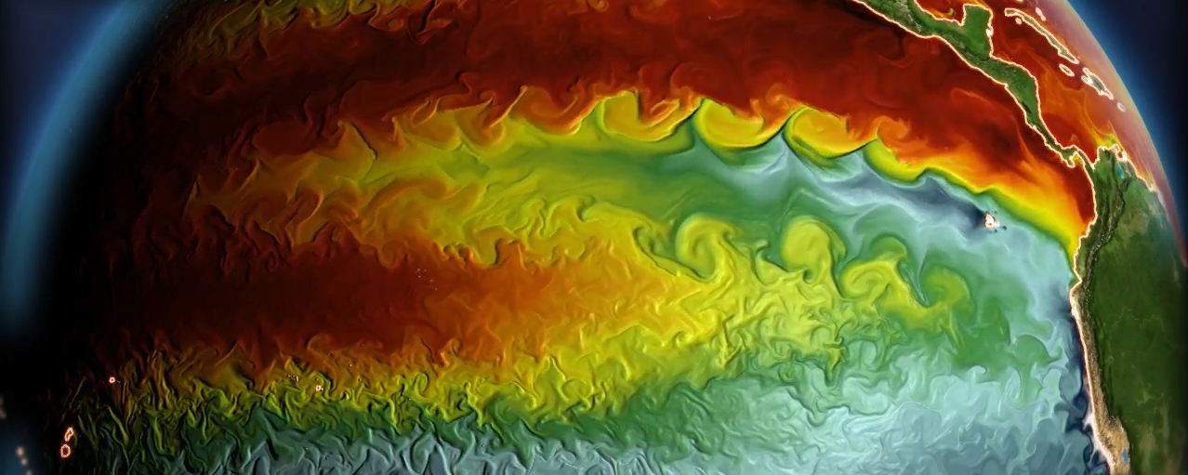
Leveraging observations to improve
ENSO simulations & outlooks
GFDL CM2.6 simulation
Andrew T. Wittenberg
NOAA GFDL, Princeton, NJ, USA

Slide 2
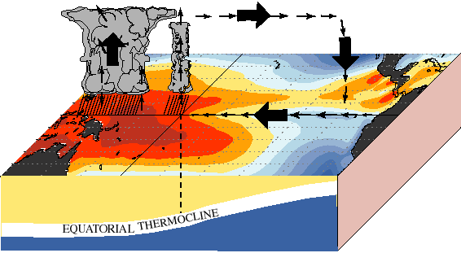
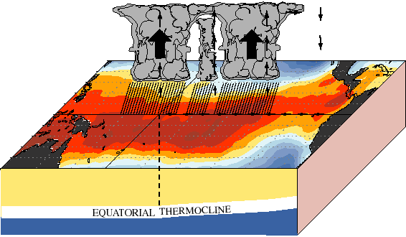
ENSO: Earth’s dominant year-to-year climate signal
2-7 years
warm
pool
cold
tongue
Normal
El Niño
Global impacts:
Weather & climate, extremes, natural disasters
Ecosystems, fisheries, agriculture, forests
Economies: commerce, transportation, energy, water, food, health
Reliable predictions & future projections are crucial
Understand sources & limits of seasonal-to-decadal predictability
Assess future ENSO risks: natural vs. anthropogenic influences
Predict changes in ENSO’s dynamics & impacts
Short, gappy, nonstationary observing system → models essential
Coupled, multiscale, diverse, intermittent → tough test for models
Notes:
ENSO is Earth's dominant year-to-year climate signal. Every 2-7yr, the west Pacific warm pool expands eastward, carrying with it the deep convection and rainfall, and altering global climate. These changes affect weather, ecosystems, and economies worldwide, and link to all of NOAA's strategic goals.
So how vulnerable *are* we to ENSO? Models are crucial to answer this, since obs records are short. ENSO's also a key *test* for models, since it depends on the full range of scales they simulate & parameterize. So a good ENSO simulation can build confidence in our ability to simulate other things, like climate change.

Slide 3
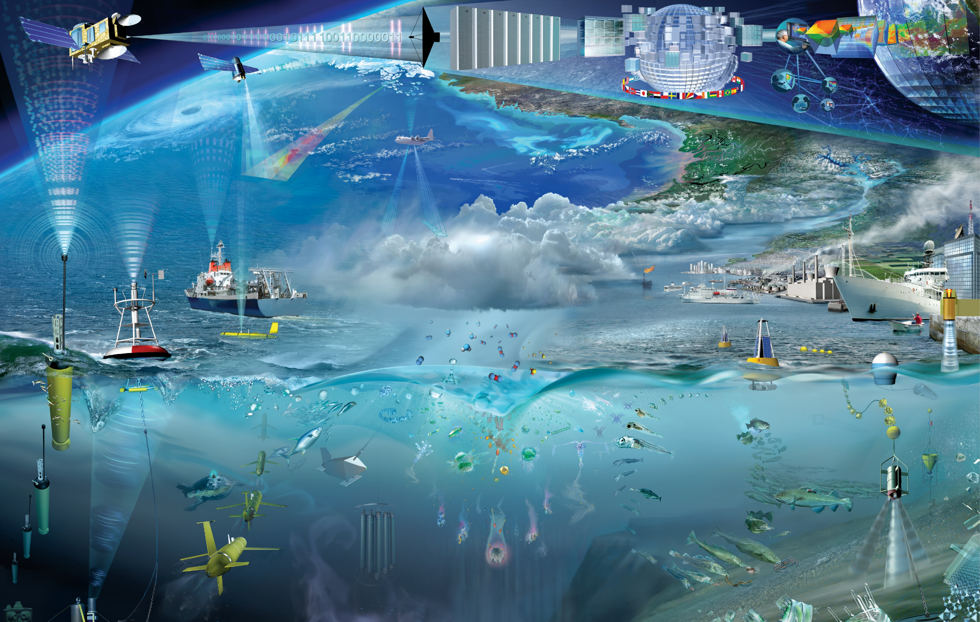
Tropical Pacific Observing System (TPOS)
Satellites (SST, SSH, winds) & In Situ (robots, moorings, ships, drifters). “Backbone” + field campaigns.
GOOS 2008
Glynn Gorick

Slide 4
Ocean/Atmosphere Reanalyses
Assimilate observations into dynamical or statistical models.
These provide full context: Global, gridded, holistic, with co-located variables
- Aggregate & harmonize diverse and disparate observations
- Preferred by GCM developers — easy to compare directly with models
But they have issues:
- Short duration Limited number of events for evaluating models & forecasts
- Spurious trends, jumps, spikes, & missing events Due to model biases, sparse & changing observing systems, incomplete covariances
- Some key variables are undiagnosed (or not readily available) E.g. budgets, assimilation increments, upwelling, high space/time resolution
- Incomplete accounting for uncertainties PDFs (error bars) may be unavailable, or implausible (overconfident) Incomplete accounting for obs uncertainties + model/forcing biases
Reanalyses & reconstructions often disagree with each other & with independent obs
→ Can be fuzzy targets & biased forcings for model development.

Slide 5
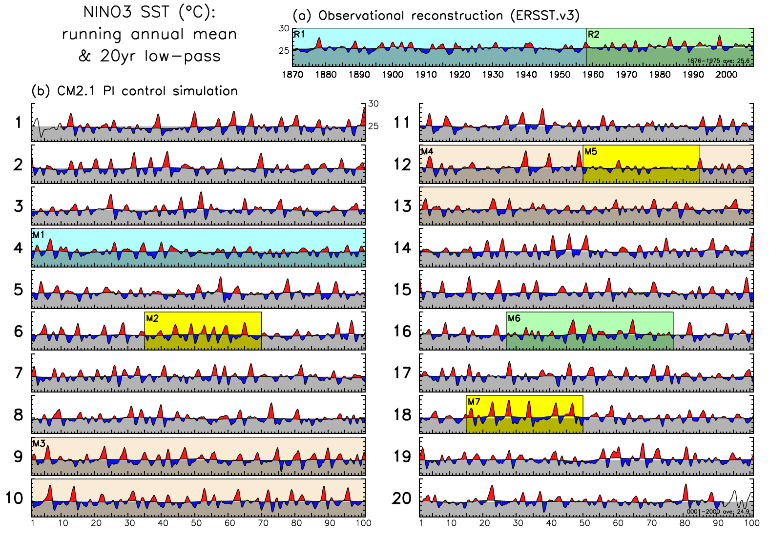
ENSO modulation
Wittenberg (GRL 2009)
https://doi.org/10.1029/2009GL038710

Slide 6
Key ENSO feedbacks
noise
heat
fluxes
warm pool extent
(evaporation,
cloud shading)
wind stress
“coupling”
“damping”
TIW stirring
u, w,
mixing
SST
warm
pool
cold
tongue
“zonal-advective
& Ekman
feedbacks”
Indonesia
South America
(fast / slow)
h
“thermocline feedback”
“Bjerknes feedback loops”

Slide 7
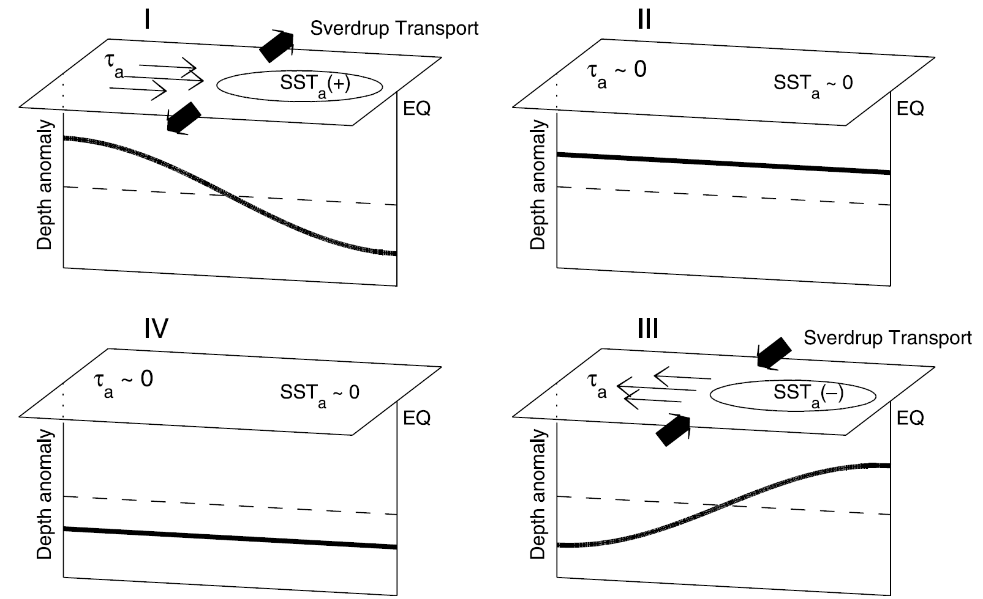
Feedbacks can be nonlocal in space & time Recharge Oscillator (Jin 1997)
figure from
Meinen &
McPhaden
(1997)
Modulated by the seasonal cycle:
equatorial wind anomalies shift south in boreal winter/spring
→ reduces their projection on oceanic Kelvin waveguide
→ aids seasonal synchronization of ENSO

Slide 8
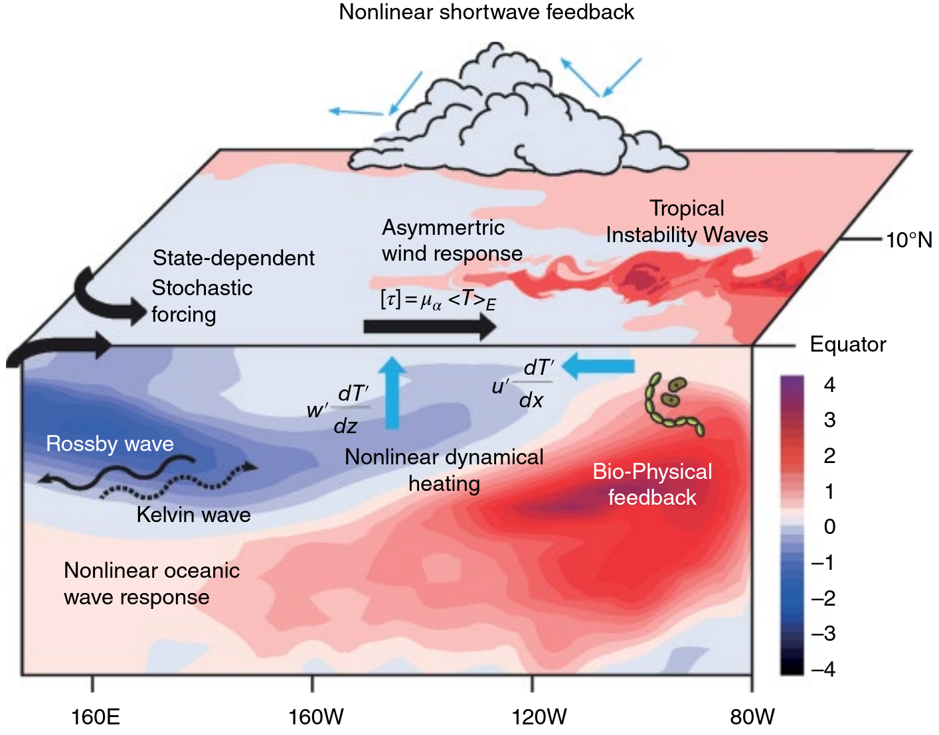
Many feedbacks are nonlocal or nonlinear
… affect ENSO asymmetry & irregularity, seasonal timing, predictability, extremes & impacts, interactions across time scales and with background climate (biases & change).
Process studies require dense sampling + large-scale context! (E.g. basin-wide winds.)
Some nonlocal effects:
1) EN-like SST anomalies → narrow eq westerly 𝝉_{x}’ → deepens EEqPac thermocline → but off-eq cyclonic stress → Sverdrup discharge → shoals eq thermocline
2) Off-eq precip bias → cyclonic wind stress → Ekman suction → Sverdrup discharge → shoals eq thermocline
3) Off-eq solar absorption & too little vertical mixing → off-eq deep cooling → shoals eq thermocline
Also: Bjerknes feedbacks, Peru upwelling, ENSO/PMM interaction, interbasin coupling, TIWs, WWEs, transient climate change.
An et al. (AGU 2020): https://doi.org/10.1002/9781119548164.ch7

Slide 9
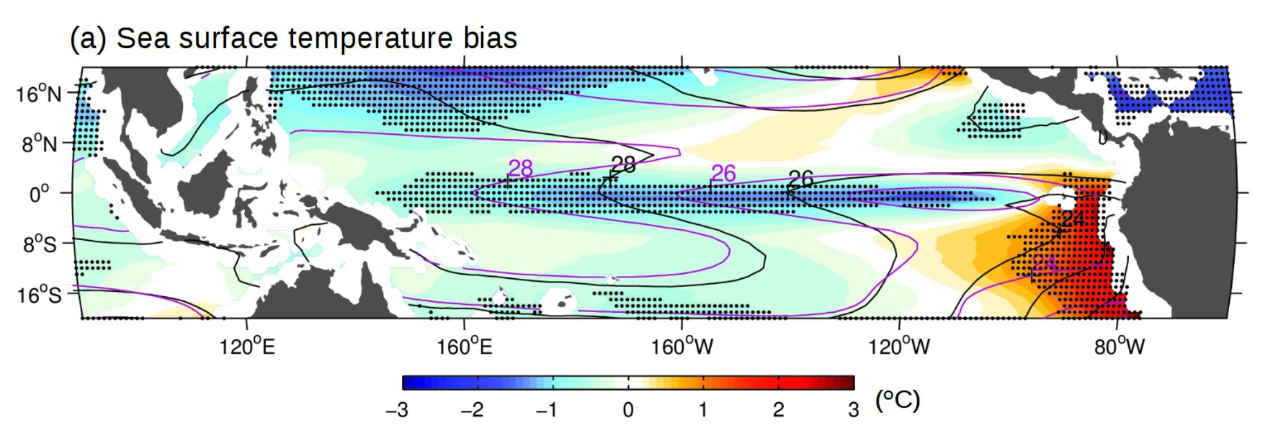
Common tropical Pacific biases in CGCMs
Santoso et al.
(BAMS 2019)
20-model mean for CMIP5 historical runs, relative to ERSST.v5. SST contours are for obs (black) and models (purple). Stippling: at least 90% of models have bias of same sign.
Stem from errors in parameterizations → amplify due to ocean/atm feedbacks
Equatorial cold SST bias, eastern warm bias, strong trades, double ITCZ, weak TIWs.
→ Weak ENSO coupling, damping, diversity, asymmetry; shifted teleconnections.
Notes:
‹#›

Slide 10
Improving models is a key motivation for the new TPOS backbone & process studies.
Three major TPOS reports:
Rep 1 (Cravatte et al. 2016): “An urgent need to improve the skill, effectiveness & efficacy of modeling systems that are critical to realizing the impact of an improved TPOS… and to advance understanding & modeling through observing system infrastructure for process studies.”
Rep 2 (Kessler et al. 2019): “Promote observing approaches that jointly measure the ocean & marine boundary layers and air-sea fluxes, principally to support model development…, improve representation of key processes, constrain the coupled system, address biases in observations & models, and improve coupled data assimilation.”
Rep 3 (Kessler et al. 2021): “Encourage process studies leading to improved process parameterizations, towards reducing model biases that degrade the efficacy of observational initializations… Accelerate advances in understanding & predicting tropical Pacific variability… models and their assimilation products are an essential element.”
⇒ Called for better sampling of key climate regimes, particularly those linked to CGCM biases, forecast errors, and ENSO.
E.g. equator, coupled boundary layers, air-sea fluxes, convection & clouds, upwelling/mixing.

Slide 11
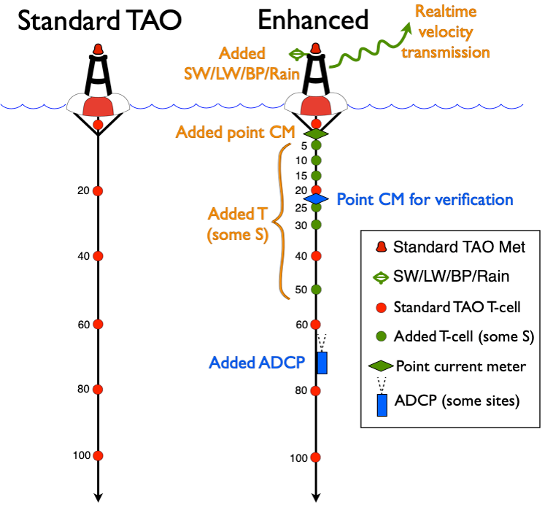
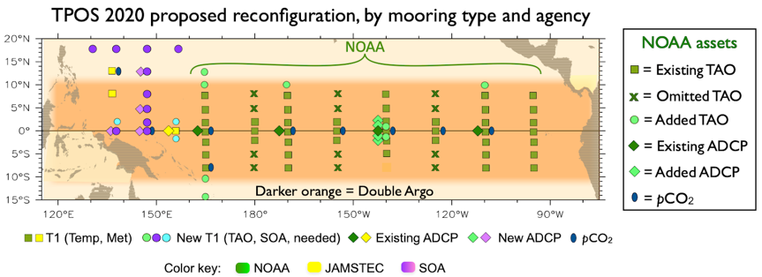
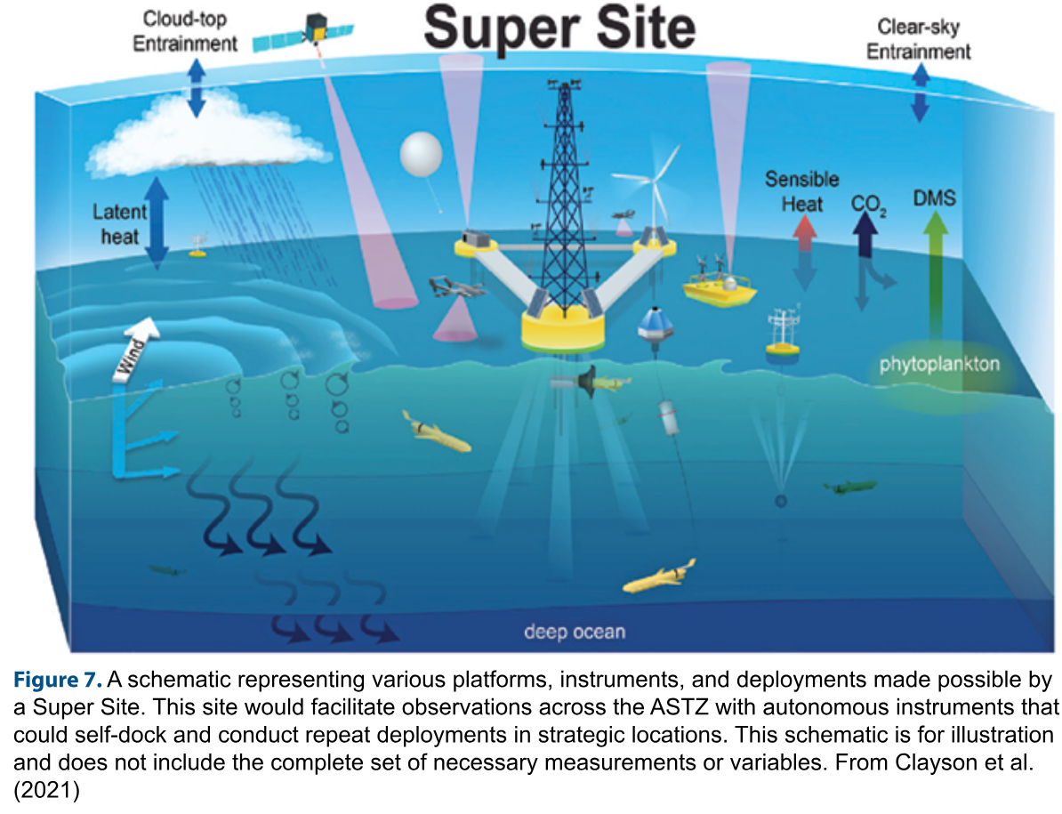
- Denser obs (y & z) in cold tongue
- More surface fluxes, currents, salinity
- Extensions into ITCZ/SPCZ
- Rely more on 2xArgo + satellites for mapping
- Refocus moorings on key physical regimes
- Augment backbone with field campaigns
NOAA/GOMO

Slide 12
Complementary approaches to model development
Indirect:
- Tweak parameters → evaluate emergent simulated climate & variability
- Rapid cycle, but challenging to attribute model biases to specific pathways
- Solutions confounded by nonlocal coupled feedbacks, error compensation
Direct:
- Evaluate detailed process representation against co-located observations
- Test cases must be well constrained & sufficiently representative
- Slower, but more likely to work across diverse climates & events (past, future)
- Improved processes may unmask other biases → iteration may be needed
Two proposed TPOS process studies aim to support more “direct” approaches to process evaluation in models.

Slide 13
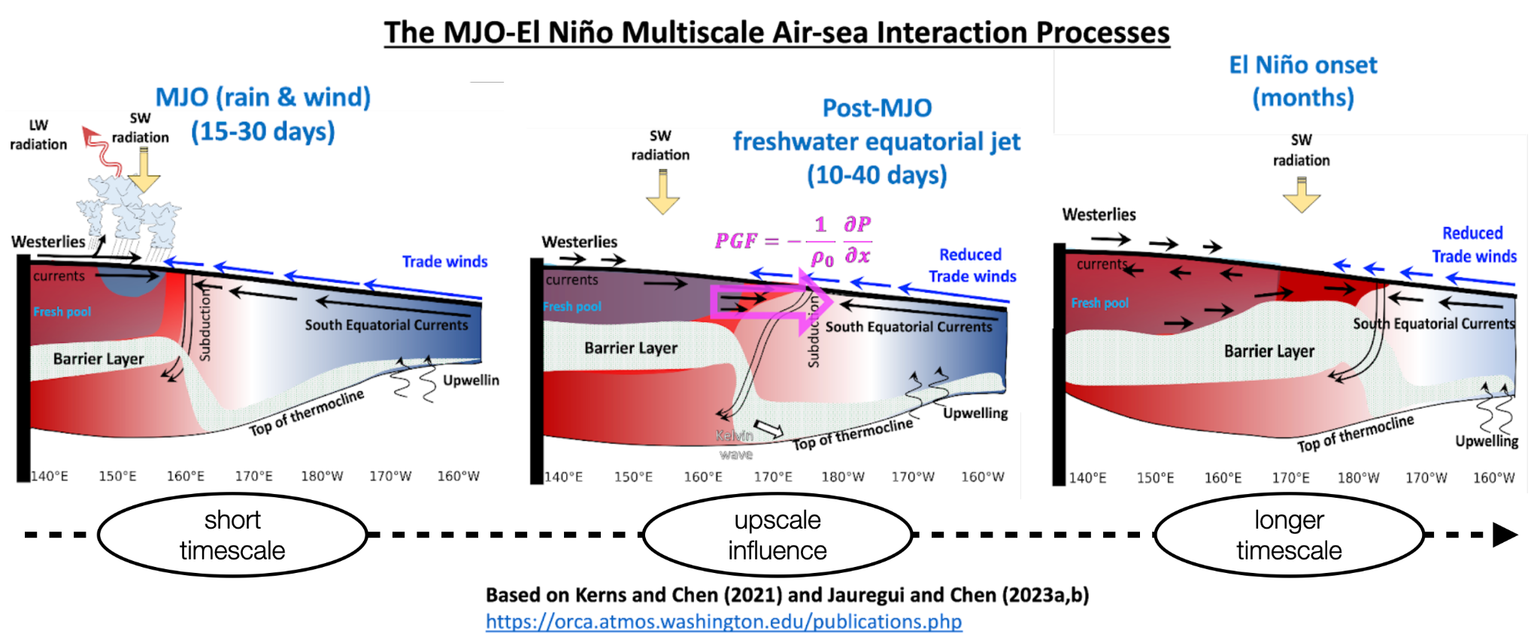
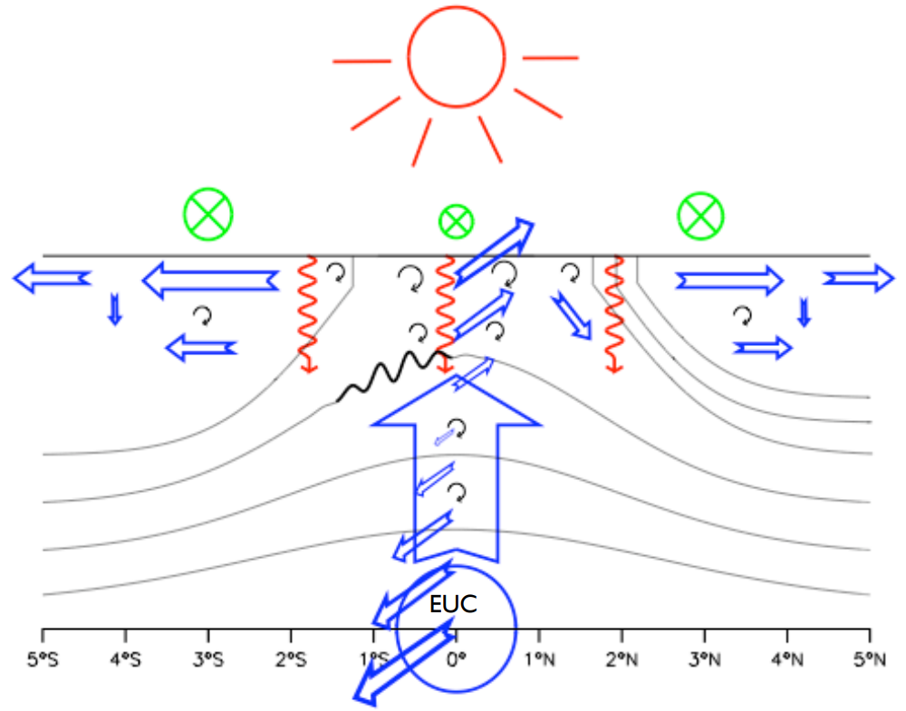
Proposed TPOS Process Studies
Pacific Upwelling & Mixing Act to Couple Atmosphere & Thermocline (PUMACAT)
Air-sea Interaction at the Eastern Edge of the Warm Pool (EEWP)
(expanded from PUMP)
X-Z: atmos convection & rain, MABL, wind stress, salinity, 𝜕SST/𝜕x, 𝜕ρ/𝜕z, SEC
Billy Kessler, PUMP (CLIVAR SSC, Jan 2005)
These regions strongly interact through winds, currents, SST, thermocline → process studies are complementary.
Y-Z: wind stress, upwelling, SEC/EUC shear, 𝜕T/𝜕z, 𝜕T/𝜕y, TIWs, diurnal cycle, mixing, MABL

Slide 14
NOAA Climate Program Office (CPO)
Climate Variability & Predictability (CVP) Program
Observation & Modeling in support of
Tropical Pacific Process Studies, Pre-Field-II
Air-sea Interaction at the Eastern Edge of the Warm Pool (EEWP) Pacific Upwelling & Mixing Act to Couple Atmosphere & Thermocline (PUMACAT)
Key focus: What should TPOS measure to improve
understanding, models, and predictions?
8 new projects funded for 2023-2025
(building on 8 prior projects funded by Pre-Field-I, 2019-2021)
Ocean data assimilation & USV/UAV OSSEs (Mazloff et al.; Serra et al.; Zhang et al.)
Coupled boundary layers, fluxes, waves (Seo et al.; Subramanian et al.; Clayson et al.)
Improving mixing in OGCMs (Deppenmeier et al.)
Improving CGCMs for forecasts & projections (Wittenberg et al., GFDL/Princeton)

Slide 15
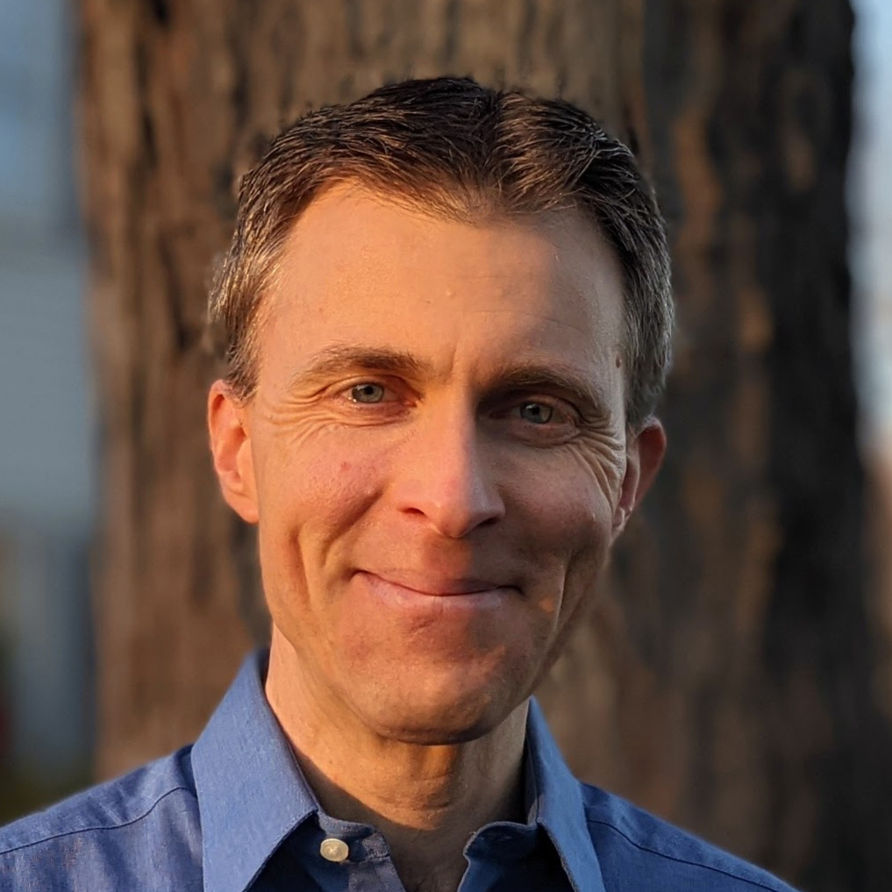
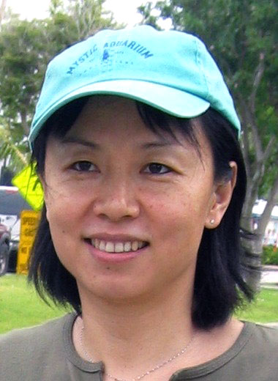
GFDL project: Understanding EqPac climate processes via hierarchical coupled modeling
Project funded by: NOAA/CPO CVP
Objectives:
1. Improve the diagnostic hierarchy for eqPac biases in CGCMs
2. Advance understanding of eqPac’s role in climate & ENSO, and of coupled nonlocal feedbacks across scales
3. Attribute & reduce biases in GFDL’s CGCMs & products
4. Inform the TPOS strategy
Andrew Wittenberg
NOAA GFDL
Xian Wu
Princeton Univ.
Brandon Reichl
NOAA GFDL
Fanrong Zeng
NOAA GFDL
Feiyu Lu
Princeton Univ.
Alistair Adcroft
Princeton Univ.

Slide 16
GFDL project: Understanding EqPac climate processes via hierarchical coupled modeling
Recent Progress
- SPEAR ensembles: free, nudged, FA (1851-2100, 30 members each)
- Atm/ocn resolution affects clouds, convection, rain, TIWs, mixing → ENSO
- Bias corrections (FA/OTA) improve troPac climate & ENSO - Improve ENSO patterns & forecasts; amplify projected future ENSO rain extremes
- Highlight intrinsic biases in components: AGCM: Too much convective precip → excessive equatorial easterlies OGCM: Too viscous near equator → less transient shear & mixing → strong ∂T/∂z (especially for the “cold state” in boreal autumn & La Niña → TIWs?)
- Model-analog forecasts of ENSO: Match skill of NMME forecasts!
- MOM6 OMIP2 tests (1d, regional, global) vs. Argo & LES - Stratified shear-driven mixing (Jackson et al. 2008) - ePBL ocean boundary layer mixing + convection + Langmuir (Reichl & Li 2019)
- More vertical layers (Δz*) → smoothes mixing variations in warm pool, deepens h
- Near equator: weaken bkgd z-viscosity, ePBL mixing, submeso MLE restratification → Much better diurnal cycle & near-surface ∂T/∂z
- Strengthen equatorial bkgd z-diffusivity → deeper thermocline
- MOM6-1d with GOTM GLS mixing reproduces LES → valuable reference model
- Global OGCM & CGCM simulations completed → no red flags
- Finalizing & analyzing SPEAR_HI_25 (0.25°A, 0.25°O)

Slide 17
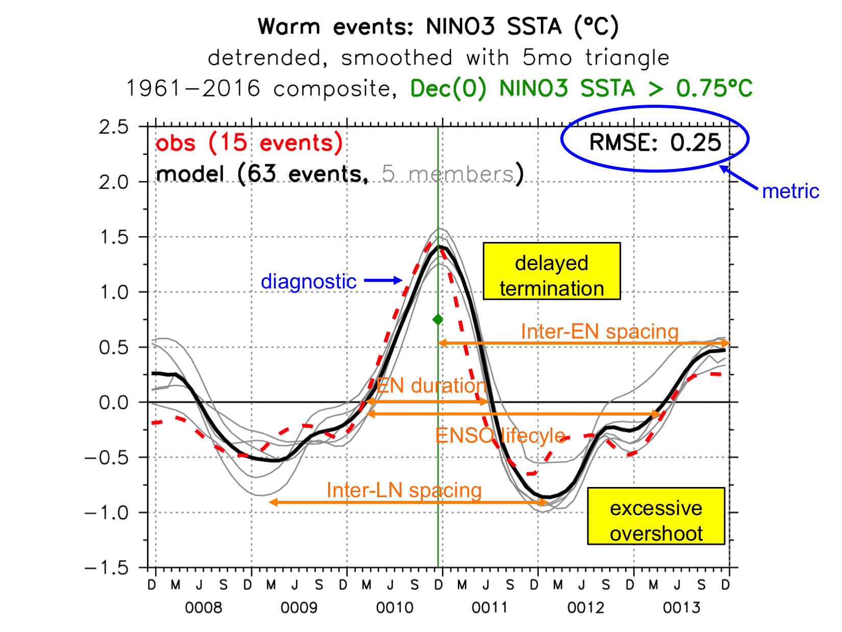
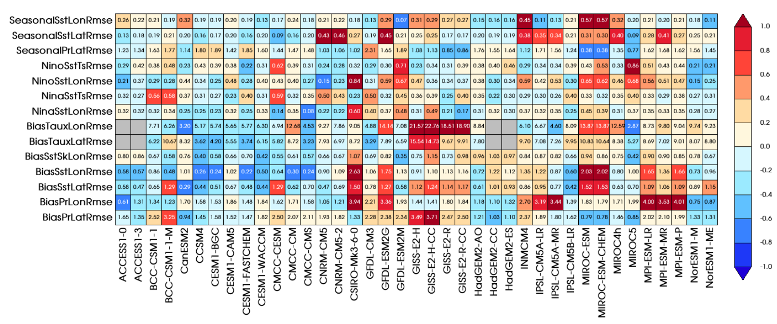
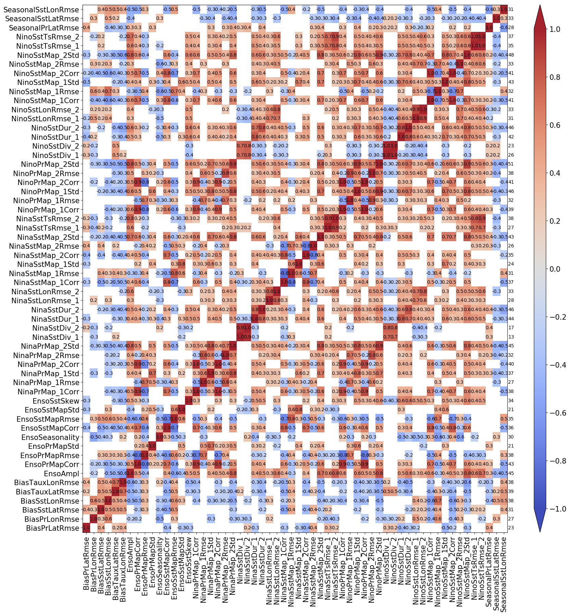
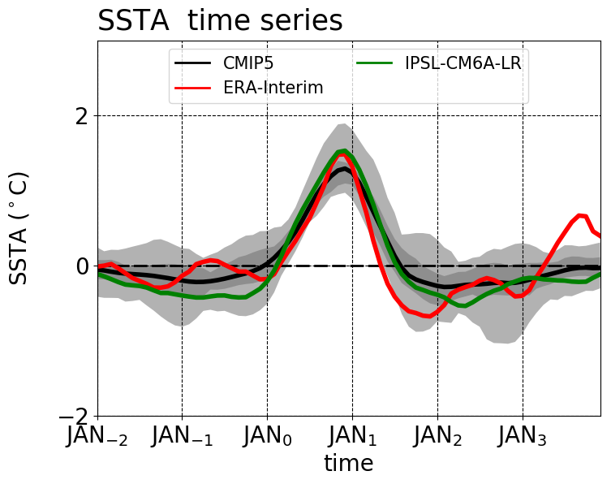
Community metrics for ENSO simulations
CLIVAR Pacific Region Panel – Planton et al. (BAMS 2021)‏
Example:
El Niño
life cycle
Compare to
other models
& metrics
Discover connections
among metrics, find
emergent constraints
Provide
multi-model
context
Inter-model
correlations
among metrics
Notes:
To that end, we've led CLIVAR's Research Focus on ENSO -- and produced a new Python package to diagnose ENSO in models. Here's an example, the composite *evolution* of an El Nino event. Obs in red, model in black. And some key *metrics* for that evolution -- RMS error, event duration and spacing, and so on.
We can then *compare* such metrics to other models and other metrics, as in this plot for CMIP5. CMIP provides *context* for our model diagnostics. And we can discover *connections* among metrics, and *constraints* for future changes, by computing inter-model *correlations* among metrics. We're using this to analyze the CMIP6 models, and plan to contribute it to community efforts, like ESMValTool and the PCMDI metrics package.

Slide 18
Ideas for the PSMI panel (1)
1. Engage with & advocate for TPOS
- Help develop process studies for model improvement (e.g. EEWP, PUMACAT) Input is highly desired! Especially on atmospheric aspects.
- Aid in broader coordination CLIVAR: US (POS, PPAI) and International (PRP, OMDP, GSOP) Resources: funders, postdocs, OSSEs, ship time, island sites, MIPs
2. CLIVAR ENSO metrics: Use, advertise, contribute, recruit!
- Process metrics: CLIVAR PRP Working Group on Conceptual Models of ENSO
- Model-analogs & AI as evolution/prediction metrics, and shorter path to forecasts
- Emergent constraints to improve models & inform IPCC; links among metrics
- Reference observations: products, uncertainties, epochs
- Resources: postdocs, web/data techs, funding opportunities
3. Propose frameworks & benchmarks for GCMs
- Model hierarchies Model resolution & complexity: AI/ML benchmarks, turbulence closure scheme, 1d, 3d Intermediaries between obs & GCMs obs → LES → high-res regional OGCM → coarse-res global OGCM → CGCM Partial coupling & obs constraints: AMIP/OMIP, nudged, flux-adjusted, data assimilation, regional coupling
- Comprehensive model test cases, with reliable observational targets Provide inputs + desired outputs (e.g. for MIPs) Both detailed processes + broad-scale context Diverse regimes, to constrain PDFs Transient & nonlinear: Shears, gusts, fronts, extremes Day/night; clear/cloudy; calm/windy; stable/convecting; dry/rainy; phases of TIWs, MJO, ENSO, …

Slide 19
Ideas for the PSMI panel (2)
4. Rally reanalyses & reconstructions
- Aggregate useful gridded obs & process datasets for modelers E.g. Obs4MIPs, Ana4MIPs, Reanalyses.org, IRI Climate Data Library Integrate community guidance (e.g. NCAR Climate Data Guide)
- Survey, intercompare, reconcile existing products How fuzzy are the targets? Assess spread & outliers; document strengths & weaknesses
- Better constraints for processes Save ocean/atmos budgets for heat, momentum, TKE, salt, moisture; including analysis increments Save upwelling & mixing, convection & clouds, flux components, solar penetration, wave state Characterize PDFs: High frequency (daily, hourly) and resolution (including vertical)
- Reanalyze better, longer, & more often Latest models; Realistic uncertainty estimates (including systematic bias) Data recovery (e.g. oldweather.org) Proxies (corals etc.) to help constrain long-term PDFs of ENSO
5. Help coordinate resources
- Climate Process Teams (CPTs) Atmos convection & clouds; ocean mixing & upwelling; surface fluxes, TIWs, diurnal cycle
- Advanced computing Resolution × complexity × ensemble × duration × inits × experiments
- Recruitment & training Need diverse brains for parameterization, bias correction, AI/ML Workshops, summer schools, internships, …

Slide 20
Thank you!

Slide 21
Reserve Slides

Slide 22
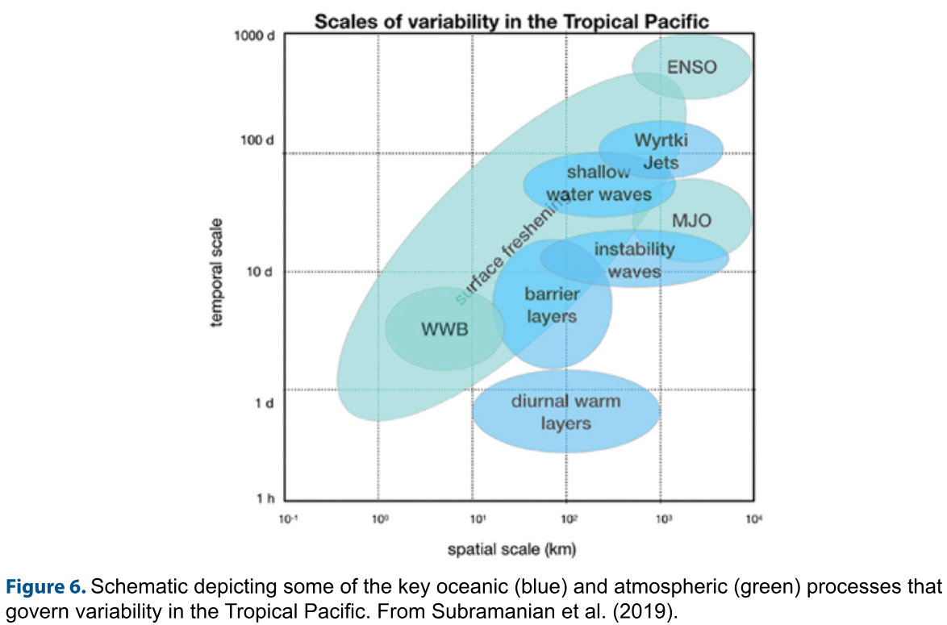
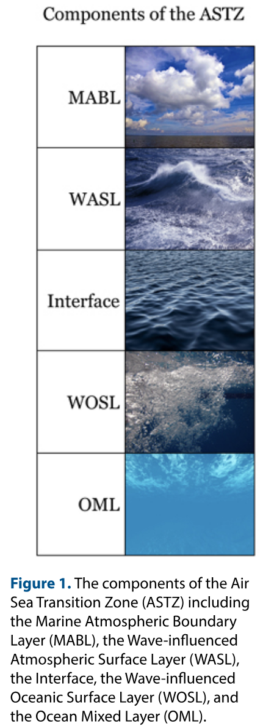
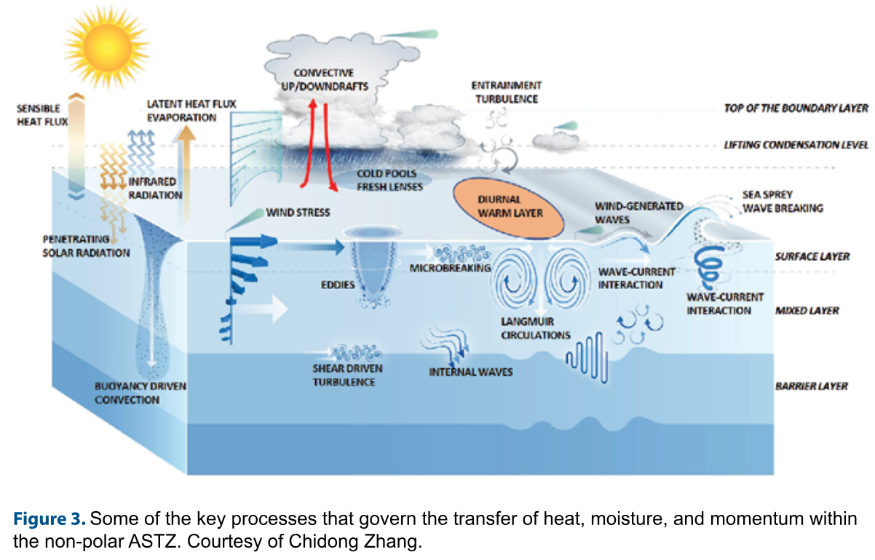
Multi-scale interactions in the tropical Pacific
Air-Sea Transition Zone (ASTZ) Report US CLIVAR, Aug 2023 https://usclivar.org/us-clivar-reports

Slide 23
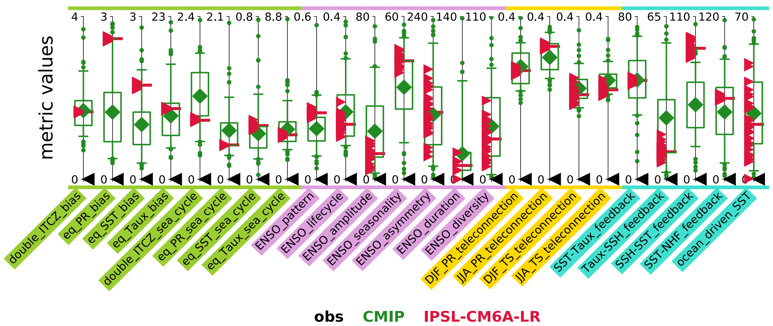
Implications for evaluating models
Some metrics (mean biases, teleconnections) are
well constrained by available obs.
CLIVAR
ENSO
Metrics
Package
For others (e.g. ENSO asymmetry), the ensemble spread from ENSO modulation is comparable to the CMIP inter-model spread, making it hard to evaluate models based on limited obs.
Planton et al. (BAMS 2021): https://doi.org/10.1175/BAMS-D-19-0337.1 Lee et al. (GRL 2021): https://doi.org/10.1029/2021GL095041
Notes:
‹#›

Slide 24
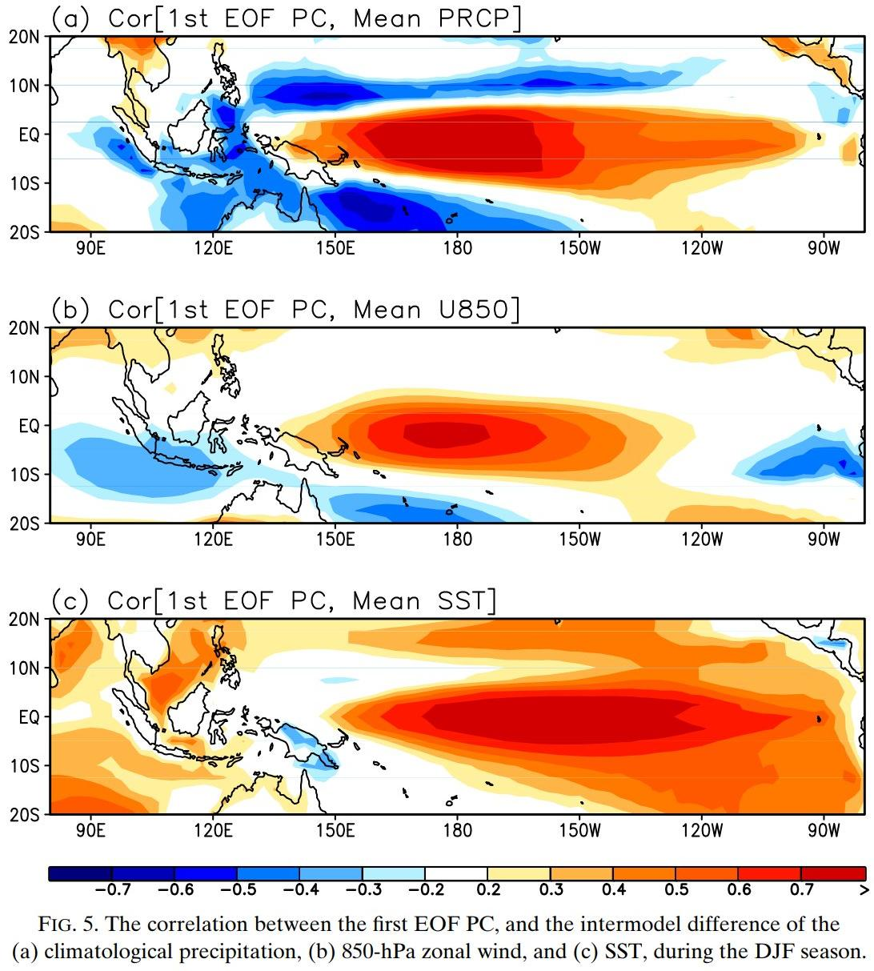
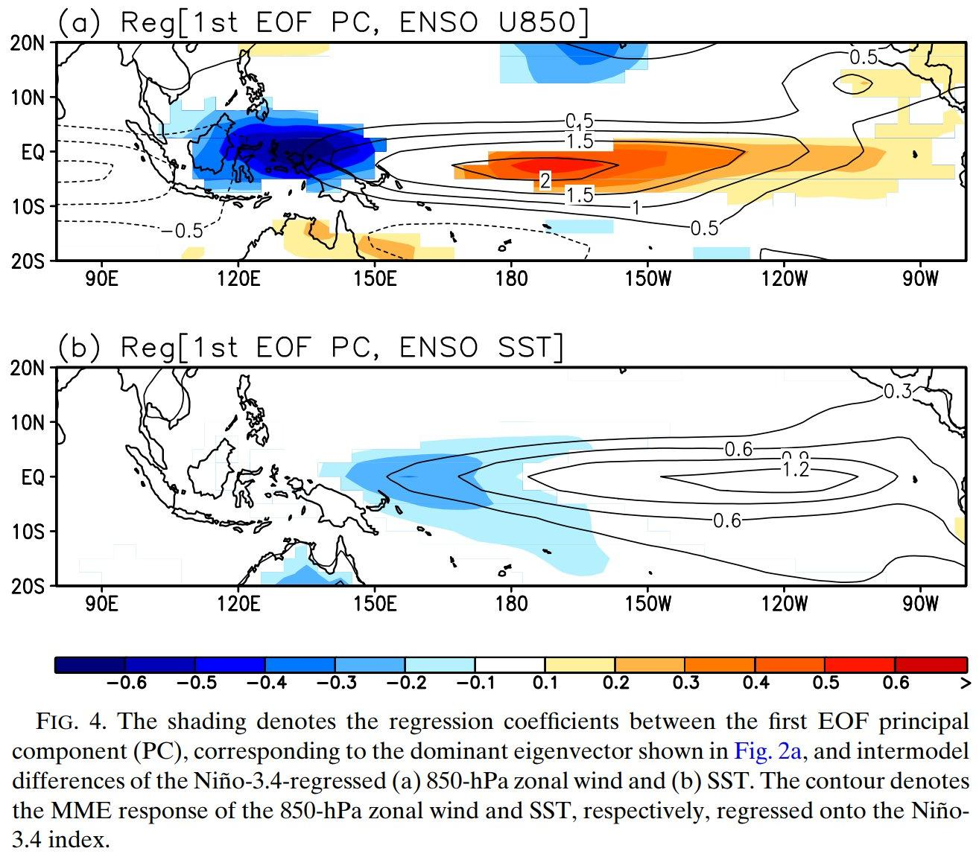
Background climate biases affect ENSO
Improved El Niño
anomaly response...
…goes with weaker/better background cold tongue.
Leading mode of CMIP5 inter-model variation in rain response.
rainfall
wetter equator
Eastward
& equatorward shift of El Niño rain/wind/SST anomalies...
u₈₅₀
weaker trades
...linked to
warmer equatorial cold tongue (ECT).
SST
warmer ECT
Ham & Kug
(JC 2015)
Notes:
‹#›

Slide 25
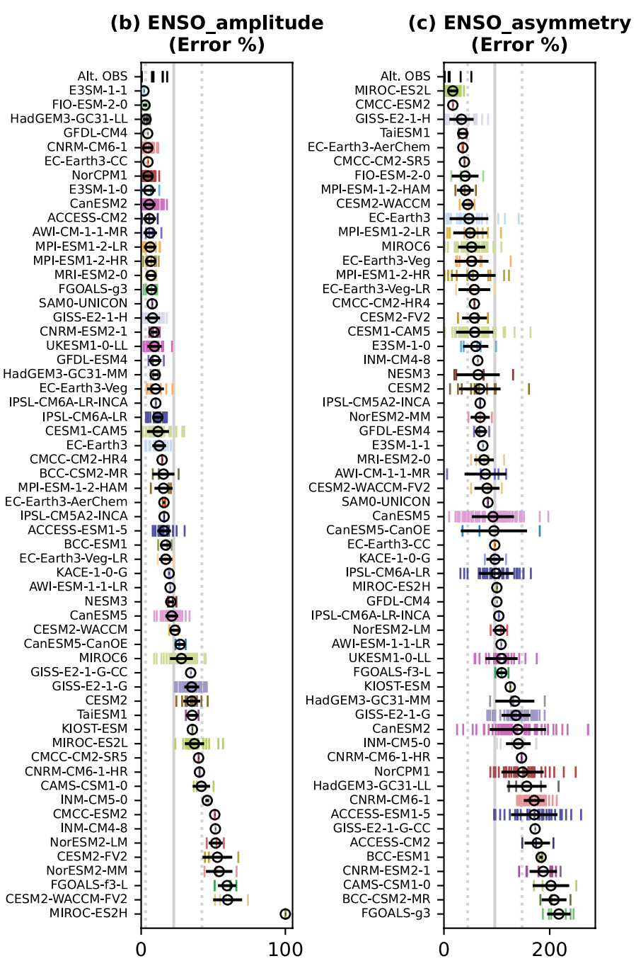
CMIP6 (1850-2014)
biases in ENSO
amplitude & asymmetry
best models
best
models
Many CGCMs now get a reasonable amplitude (stddev of NINO3.4 SSTA),
within the obs range.
But they struggle with ENSO diversity,
asymmetry & nonlinearity (skewness of NINO3.4 SSTA). Implications for extremes, impacts, predictions.
Note that amplitude, and
especially asymmetry, are strongly
modulated — with large ensemble
spread even on centennial scales. Might not be well sampled by obs; must look to dynamics & feedbacks.
worst
models
worst
models
Lee et al. (GRL 2021)
https://doi.org/10.1029/2021GL095041
←better worse→
←better worse→
Notes:
‹#›

Slide 26
Recent studies using the ENSO Metrics Package
Lee et al. (GRL 2021): “Robust evaluation of ENSO in climate models: How many ensemble members are needed?” - For CMIP5/6 & LEs, need N ≥ 50 to constrain ENSO baseline & process metrics - Less for climatology (N ≥ 6) & ENSO teleconnections (N ≥ 12) for 95% of N-ensemble means (of 1979-2018 metrics) to fall within 10% of actual mean metric
Xu et al. (JC 2022): “The Andes affect ENSO statistics” - Elevate the Andes to more realistic levels in CESM_1.2.2 → better (more LN-like) troPac climate → weaker ENSO; more asymmetric, irregular, evaporatively-damped
Planton et al. (in prep for JAMES): “Detecting ENSO variance changes in a warmer world.” - CMIP6 historical runs: Sample size to detect past & future ENSO amplitude changes? Need 5 – 9 members, for ensemble-mean 30yr variance to fall within 15% of actual long-term variance - If ENSO strengthens → more decadal modulation → later detection - Quiet/hyperactive ENSO decades can aid earlier detection
Lee et al. (in prep for GMD): “Diversifying objective summaries of Earth system model performance: An overview of the PCMDI Metrics Package (PMP).” - A section is devoted to the ENSO metrics

Slide 27
Community Connections
CLIVAR/ICTP ENSO Summer School Yann Planton developed & ran student tutorials, applying package to CMIP6 → supported the WCRP Academy Lighthouse Activity (LHA)
Jiwoo Lee joined the CMIP7 Climate Model Benchmarking Task Team → Actively promoting the CLIVAR ENSO Metrics via the PMP framework
Connections with other community efforts PMP, ESMValTool, CliMAF, MDTF ES-Doc & Comparator: model resolution, lineage, parameterization schemes
Tropical Pacific Observing System (TPOS) Obs targeting + new reference data

Slide 28
Next Steps for ENSO Metrics
Leverage recent enhancements - Added more obs datasets to test robustness (Planton et al., in prep) - Index statistics: mean, stddev, skewness, d.o.f. → significance - Wait times between ENSO events: mean, stddev, skewness, PDFs, transition probabilities
New metrics in development - ENSO regional teleconnections: regressions, composites (per McGregor et al. 2022) - New ENSO process metrics (per Chen et al. JC 2021) BWJ indices, ML heat budget, nonlinear dynamical heating (NDH) - Model-analogs as metrics of ENSO evolution, predictability, forecast skill Applied to NMME & CMIP5 historical: Ding et al. (JC 2018; GRL 2020) Applied to CMIP6 & LE, historical & future: Lou et al. (subm. & in prep.) + ongoing work at NOAA PSL & GFDL - CLIVAR PRP Working Group on Conceptual Models of ENSO
New projects: - Impact of climate change on ENSO (Planton, Lee, et al., in prep) - EqPac upwelling & mixing in CGCMs (Wittenberg et al., NOAA CVP), funded 2023-25 - Dynamical ENSO metrics & emergent constraints (Jin et al., NOAA MAPP), funded 2024-26

Slide 29
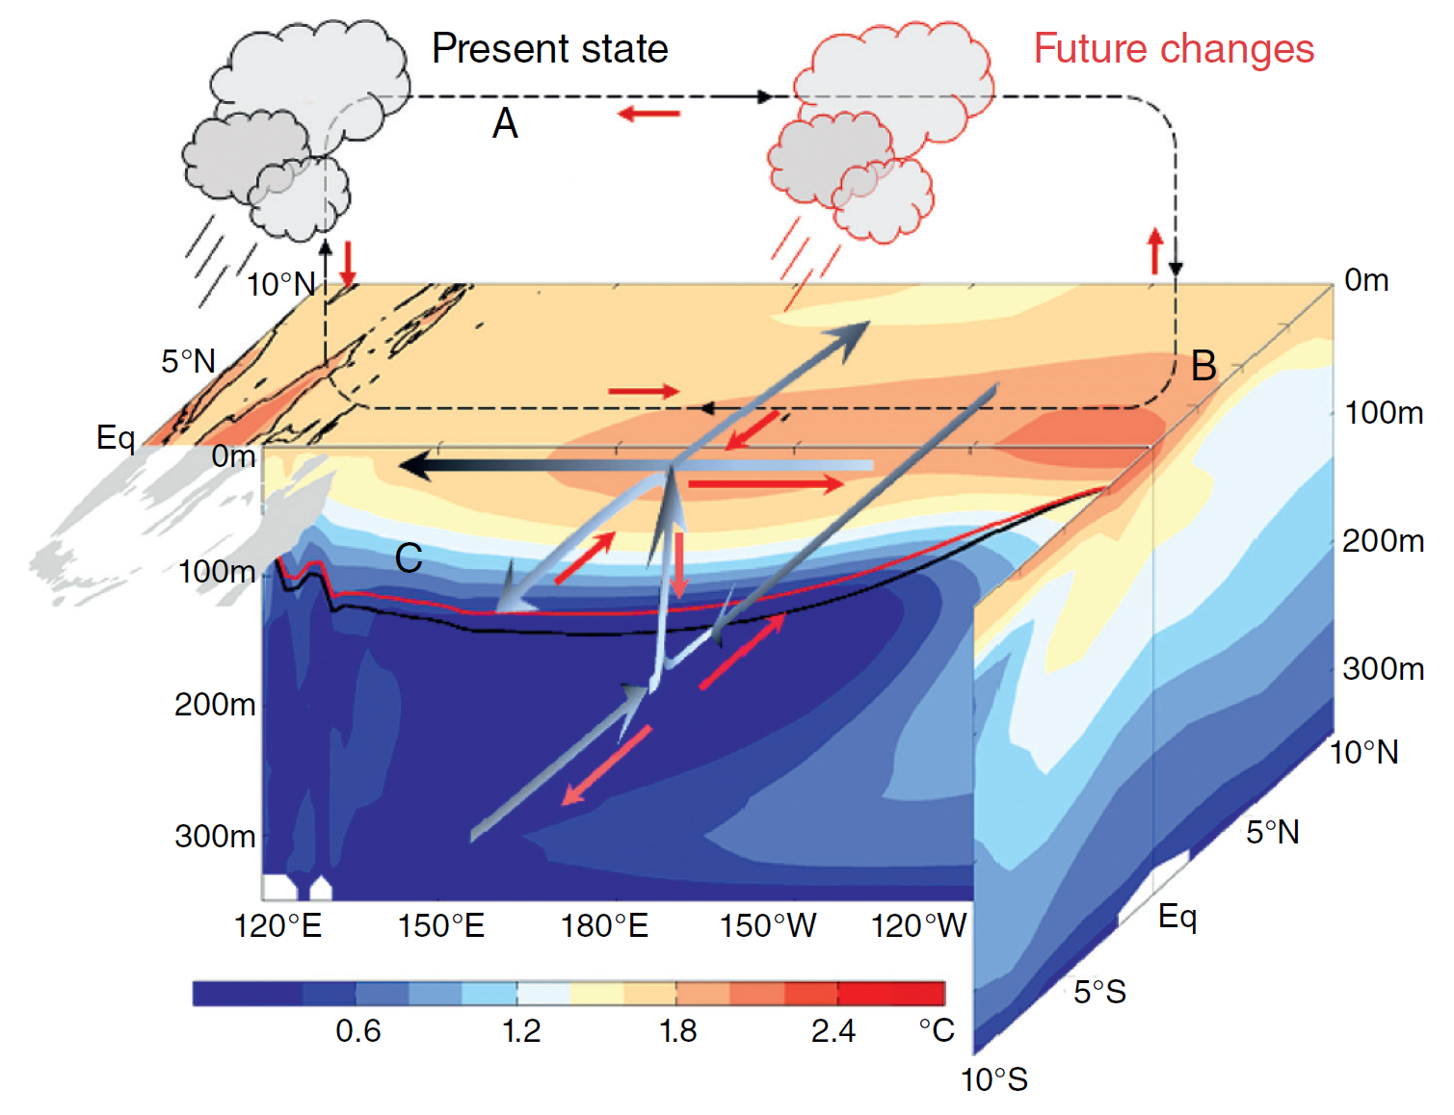
“Average” CMIP5-projected changes in tropical Pacific climate
Cai et al. (NCC 2015b, AGU 2020)
Sen Gupta et al. (GRL 2012)
Weaker cold tongue SST contrast, weaker Walker circulation, rainier central Pacific.
Thermocline intensifies & shoals (warming proceeds from the top down)
Weaker subsurface meridional overturning, stronger EUC → affects ENSO! (rain extremes, faster onset, slower decay, …)
Notes:
‹#›

Slide 30
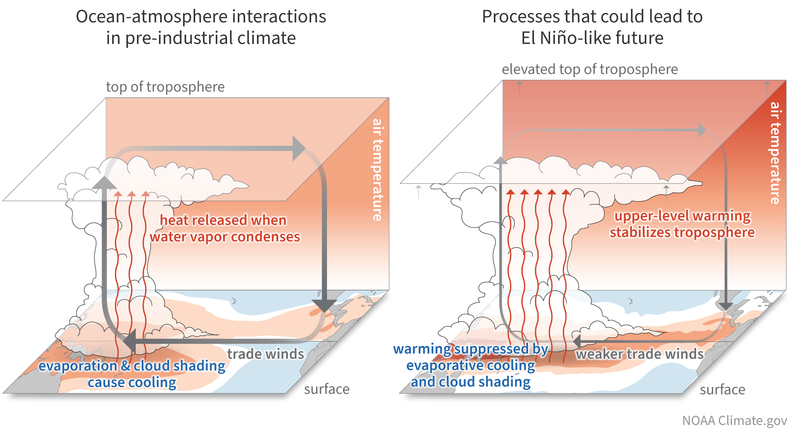
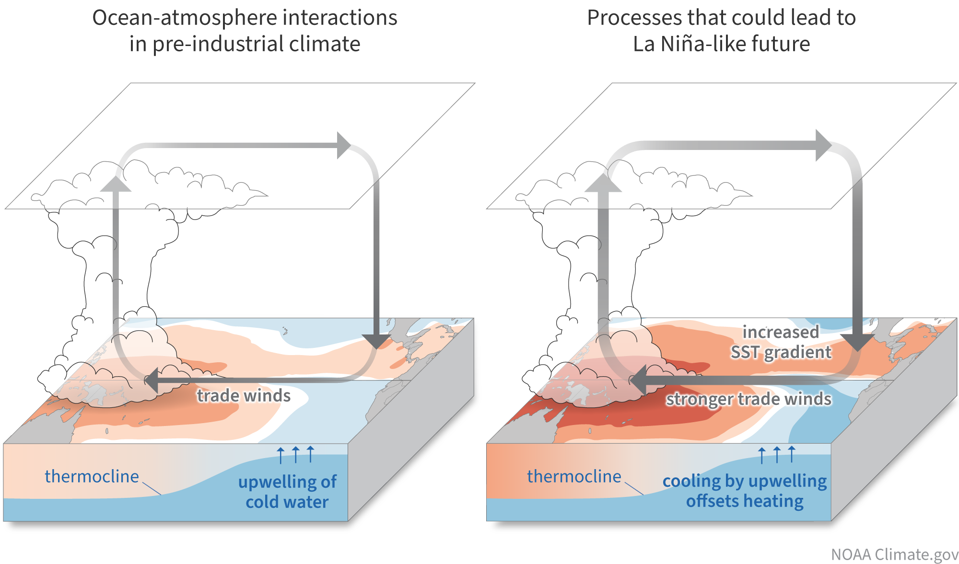
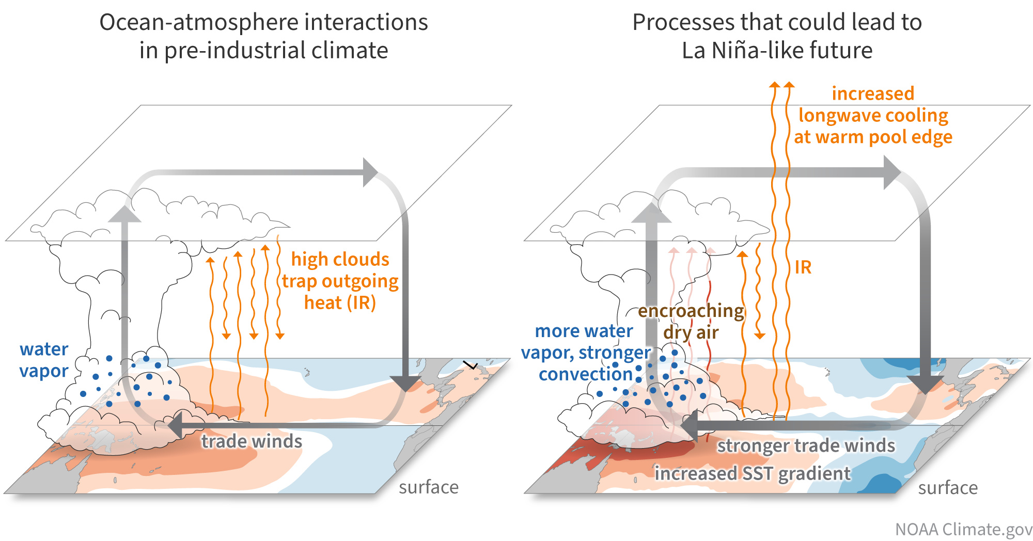
Understanding & addressing equatorial Pacific biases
Mechanisms of EqPac climate change
Lee et al. (npjCAS 2022) &
NOAA Climate.gov
Future of ENSO & its impacts depend on changes in background ocean thermal gradients.
E.g. warm pool / cold tongue SST contrast: EN-like or LN-like? More stratified troposphere; ocean dynamical thermostat; cirrus contraction.
Unresolved physics in CMIP-class models: Clouds & convection, air-sea fluxes, shears & mixing, barrier layers, diurnal cycle, TIWs, … → Atm/ocean errors + coupled feedbacks → Emergent biases in CGCMs → Degrade ENSO forecasts, projections
Need a hierarchical coupled model framework to:
- Attribute emergent coupled biases
- Guide TPOS obs to improve CGCMs
- Test new physics in coupled/global context
- Identify where bias corrections could help
→ NOAA CVP/TPOS-funded project at GFDL
A. Wittenberg, X. Wu, B. Reichl, F. Zeng, F. Lu, A. Adcroft

Slide 31
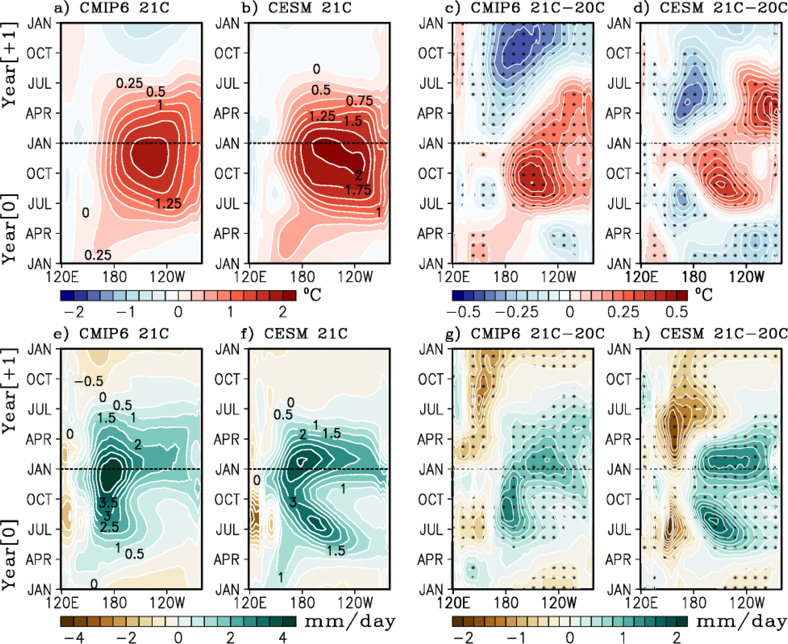
Projected changes in El Niño evolution (CMIP6 & CESM-LENS)
slower
decay
Faster onset
for future El Niños
→ reduced forecast
lead time?
faster
onset
Slower decay
of east Pacific SSTA,
stronger rain response
→ Stronger remote impacts over continents.
more
rain
“Average” picture…
wide range
among models!
Lopez et al. (Nature Communications 2022)
https://doi.org/10.1038/s41467-022-29519-7
Notes:
‹#›

Slide 32
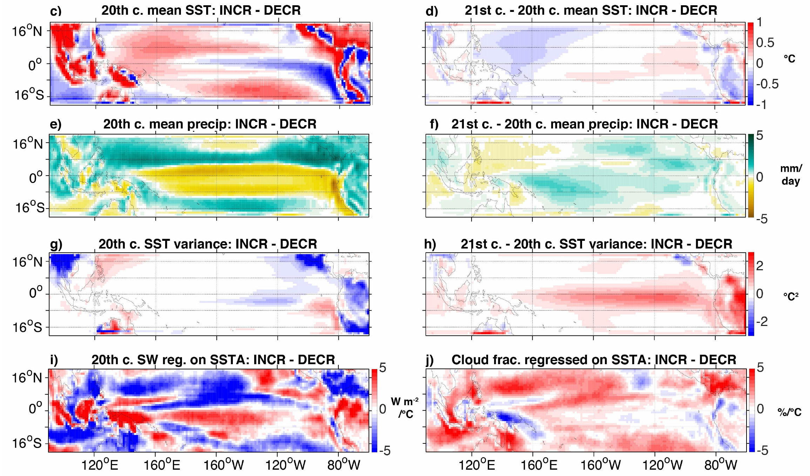
Emergent constraints for future ENSO extremes (CMIP5)
Stevenson et al. (J. Climate, 2021): https://doi.org/10.1175/JCLI-D-19-0969.1
Change in likelihood of extreme wet El Niño in NINO3 (CMIP5, 2006-2100 minus 1950-2005)
Models project a wide range of changes in El Niño rainfall extremes: some strongly increase, others decrease.
“Increasers” start with common biases: cooler & drier cold tongue, weaker ENSO, and weaker heat flux damping of SST changes.
→ More room to amplify
ENSO extremes.
Different model biases…
…yield different future changes.
cooler
more warming
drier
more wetting
Increasers also project more future warming, wetting, and ENSO SSTA amplification in the cold tongue.
weaker
SSTAs
more SSTA
amplification
Can use these emergent constraints to leverage
model diversity and inform future projections.
less SSTA damping
from cloud shading
Notes:
So that's SST -- what about changes in ENSO rainfall? In the NINO3 region, the CMIP5 models project a *wide range* of changes: some say El Nino rainfall will strongly increase, others decrease.
Why such diversity? Well, we found that *increasers* tend to have stronger present-day *biases* toward cool & dry conditions over the cold tongue, and also weaker ENSOs -- giving them more room to *boost* their ENSO extremes in the future. The increasers also had less convective *cloud* over the cold tongue -- leading to less radiative damping of SST changes, stronger future warming & wetting, and amplified ENSO SSTAs.
So many models may be *overestimating* future El Nino rainfall, with implications for teleconnections. So we need to reduce model biases.
‹#›

Slide 33
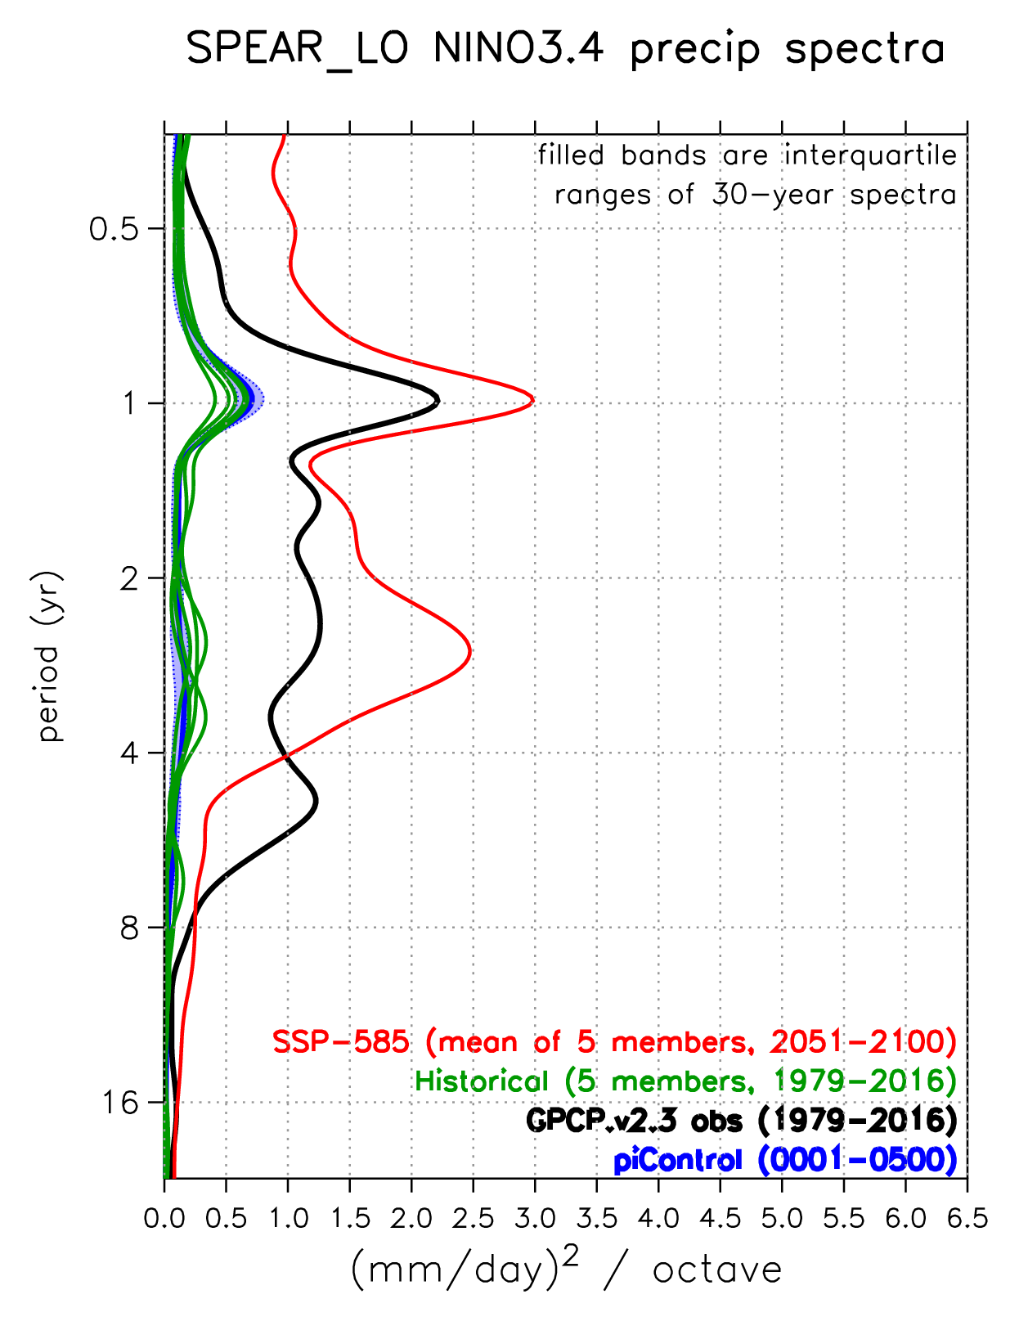
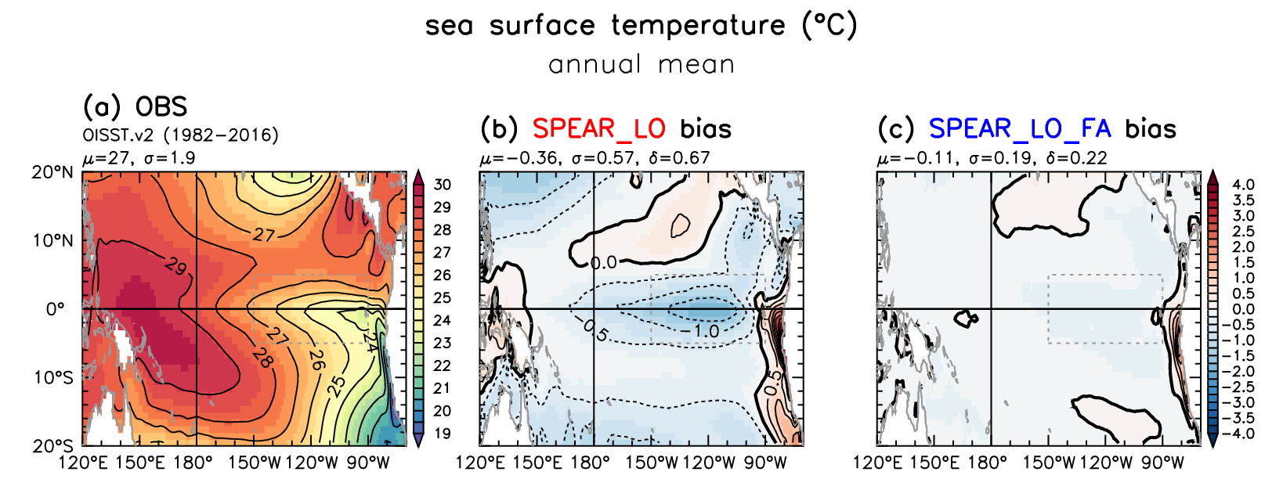
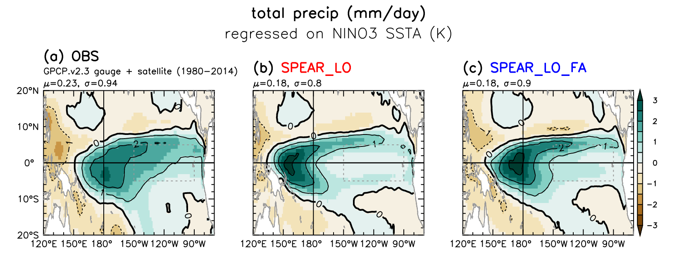
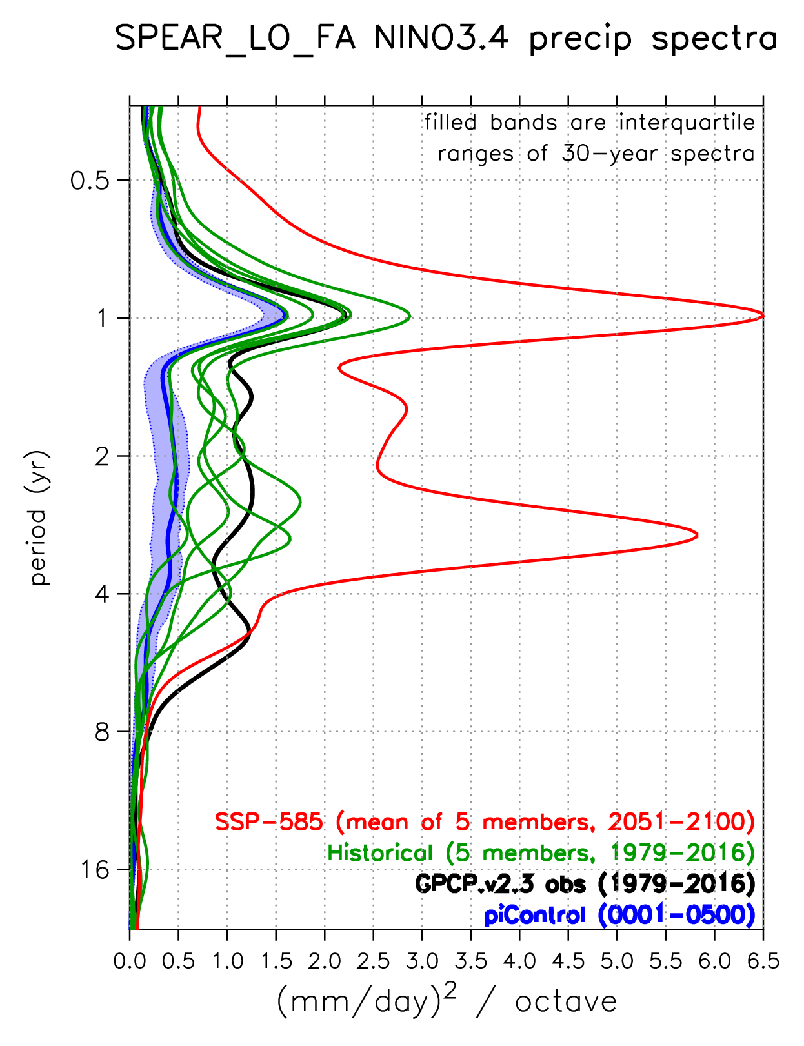
How do tropical SST biases affect future projections?
Wittenberg et al. (in prep.)
SPEAR: NINO3.4 rainfall spectra
Experiment: Correct GFDL-SPEAR CGCM’s
tropical climatological SST & wind stress,
using surface flux adjustments (FA).
Now
Observed
SPEAR
SPEAR_FA
Future
Mean
SST
Original
Model
El Niño
precip
anomaly
FA improves ENSO’s anomaly patterns,
amplitude, and spectra.
Also amplifies projected future rainfall extremes
in the central equatorial Pacific.
Bias
Corrected
Notes:
‹#›

Slide 34
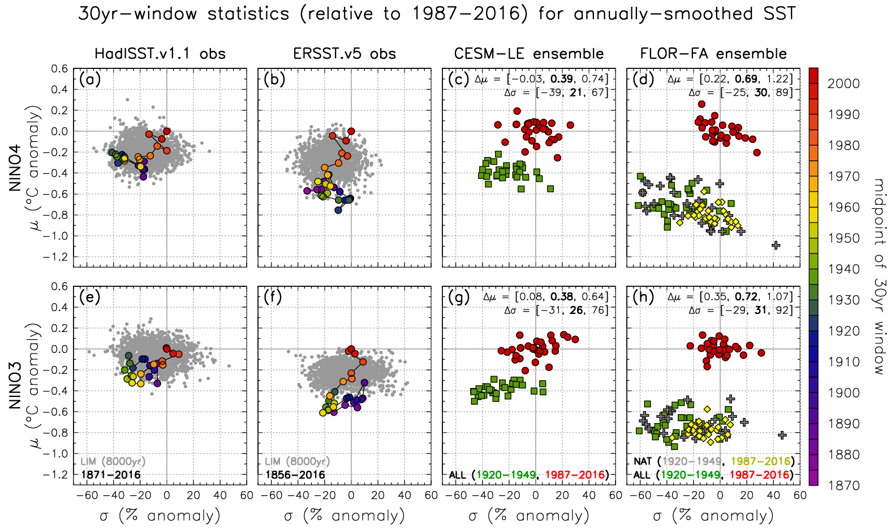
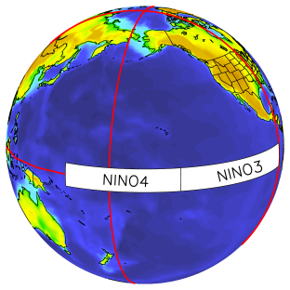
Historical changes in ENSO & mean eq. Pacific SST
2001
warmer
climate
1935
1885
stronger
ENSO
Newman, Wittenberg, et al. (BAMS 2017)‏
Notes:
Now is ENSO changing? With colleagues at ESRL, we examined *historical* changes in ENSO & mean equatorial Pacific SST. Here's NINO3 SST: vertical's the time-mean SST, horizontal's the ENSO strength. Each colored dot is a 30yr chunk from the HadISST obs reconstruction. The more recent, red dots show warming and a stronger ENSO, but still within the envelope we'd expect from a stationary system, the gray dots. Farther west in NINO4, the red dots do start to push the envelope, with warmer SSTs and stronger ENSO. The *ERSST* reconstruction shows an even stronger warming.
We repeated this for the historical *ensemble* simulations from CESM and FLOR...

Slide 35
Historical changes in ENSO & mean eq. Pacific SST
2001
1935
2001
warmer
climate
1935
1885
stronger
ENSO
Mean SST change marginally detectable. ENSO change, less so.
Newman, Wittenberg, et al. (BAMS 2017)‏
Notes:
Green is the 1920s-40s, red the most recent 30yrs. Both models show warming (easily detectable), and stronger ENSOs (less detectable with more ensemble overlap) -- though the models' *sensitivities* differed.

Slide 36
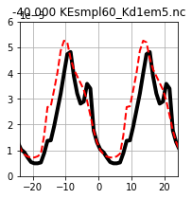
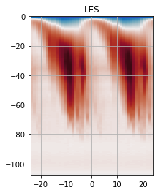
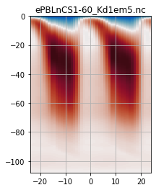
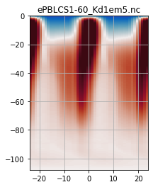
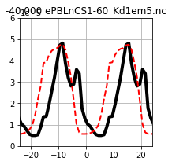
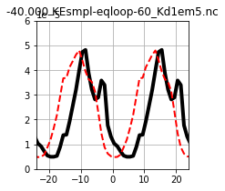
ePBL changes → Better eqPac upper-ocean diurnal cycle
from Brandon Reichl (AMS, Jan 2023)
LES & MOM6-1d simulations on equator at 140°W, forced by 8xdaily JRA55-do & ROMS, ~30 days
Diurnal composite of downward heat flux (red=down) over full simulation
Scheme w/ d(TKE)/dt
MOM6-1d OM4
OM4-revised
@40 m
Whitt et
al. (2022)
LES
The phase-shift is linked to using a steady-state equation for TKE!
5E-5
10⁻⁵[℃ m/s]
@40 m
Depth [m]
Depth [m]
Depth [m]
Temperature Flux [℃ m/s]
0
Scheme w/o d(TKE)/dt
10⁻⁵[℃ m/s]
@40 m
10⁻⁵[℃ m/s]
-5E-5
LES
Hours from Solar Noon
Hours from Solar Noon
Hours from Solar Noon
Hours from Solar Noon
Hours from Solar Noon
- OM4-revised corrects the problematic ePBL mixing → more realistic diurnal cycle
- Phase-shift in downward propagation of turbulent fluxes remains → ongoing work

Slide 37
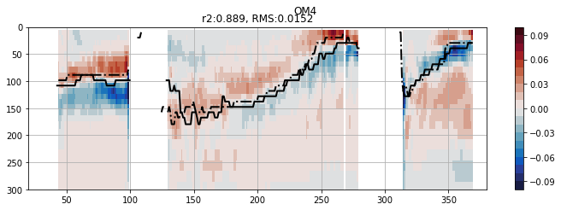
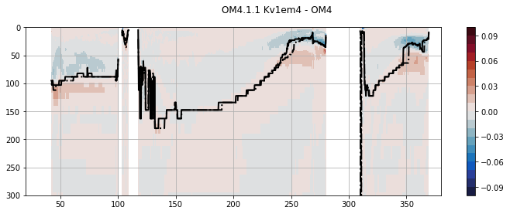
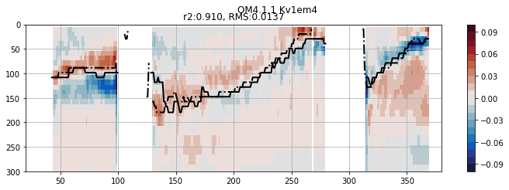
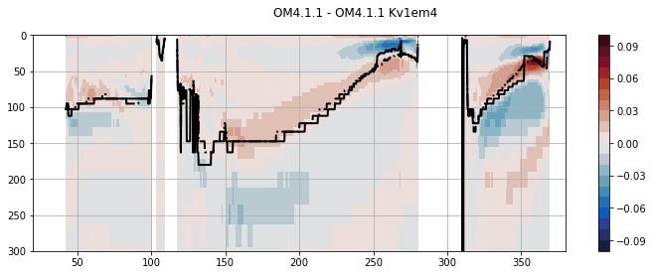
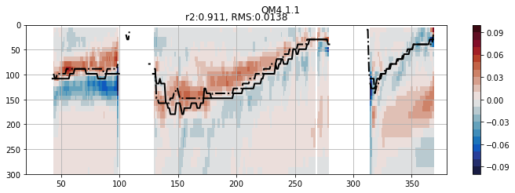
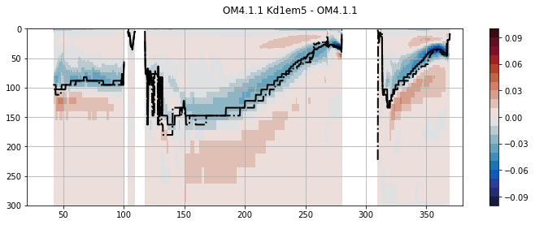
Mixing changes → Better eqPac dT/dz
from Brandon Reichl (AMS, Jan 2023)
0.25° MOM6 global OGCM
(forced by 8xdaily JRA55-do, 1999-2008)
Equatorial slice for upper 300m of ocean
Shallow &
“steppy”
thermocline
Simulated dT/dz bias [°C/m]
relative to Argo (1999-2008)
Original
OM4
Impact of parameterization change
Better ePBL mixing (better diurnal cycle)
10x less background
vertical viscosity
(stronger shears)
2x more background
vertical diffusivity
Reduced
equatorial
biases

Slide 38
ENSO forecasts using model-analogs
Existing long model control runs are like “libraries” of ENSO behavior.
Find analogs of obs SST & SSH → trace how those states evolved in control runs.
→ Like a forecast with
no initialization shock.
(bias-corrected,1982-2009)
At 6-month leads in the tropics, analogs from
the NMME control runs beat the same models’ initialized forecasts!
Suggests that even models without assimilation (e.g. CMIP6) could offer useful forecast guidance.
Rapid forecasts; assess variations in predictability, and sensitivity of skill to model changes.
Roughly tracks NMME skill
(highest when ENSO is strong)
Ding et al. (JC 2018;
GRL 2019, 2020)
Notes:
Finally, we're working to assess ENSO predictability and improve forecasts. With colleagues at ESRL, we searched *existing* long model control runs for analogs of *observed* states over the past 50 years, then simply traced how those states evolved in the control runs. So, model forecasts without initialization shock.
This simple method is amazingly skillful -- it actually beats the state-of-the-art NMME forecasts, for both SST & rainfall. This is a powerful result, suggesting that even the CMIP5 models, *without* assimilation systems, could offer forecast guidance.
We also used this method to assess secular variations in ENSO *predictability* over the past 50 years -- and found that it tracked the NMME skill, which is highest when ENSO is strong. We're hoping to work with NCEP to further develop this for use in operations.

Slide 39
Mixed-layer temperature anomaly equation
weaker in future?
dominant
terms near
equator
stronger in future
stronger in future?
Model biases & climate change affect ENSO, via subtle balance of subsurface feedbacks & atmospheric response patterns.
Need realistic ENSO for right reasons, or we may get bad predictions & projections.

Slide 40
Observed Tropical Pacific Decadal Variability (TPDV)
Power et al. (Science 2021): https://doi.org/10.1126/science.aay9165
Decades with more ENs than LNs → warm decadal pattern resembling ENSO.
EN/LN asymmetry & diversity also contribute to decadal residual.
Null hypothesis: TPDV is a residual of random ENSO events.
Similar patterns
Similar evolution
ENSO precursor & aftermath
add meridional broadening
Notes:
‹#›

Slide 41
Pacific decadal interactions with ENSO
Di Lorenzo et al. (Oceanogr. 2013); also Meehl et al. (CD 2021)
KOE =
Kuroshio-
Oyashio
Extension
Random ENSO modulation + ML/RW reddening at higher latitudes.
PDO & NPGO might interact with ENSO flavors.
Are these open or closed loops? Do these links imply predictability?
Notes:
‹#›

Slide 42
NOAA/GOMO
NOAA/GOMO

