Slide 1

Global dimensions to U.S. ozone pollution: Implications for air quality policy
Presentation to Environmental Defense Fund, April 25, 2017
Meiyun Lin
(Princeton University & NOAA GFDL)
Notes:
1

Slide 2

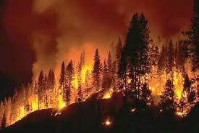

Global dimensions to U.S. O₃ air quality
Natural events e.g., stratospheric [Langford et al, 2009; Lin et al., 2012; 2015a]; fires [Jaffe & Wigder, 2012]
Warming climate
+ in polluted regions
[Jacob & Winner, 2009 review]
+ natural sources
[Fiore et al., 2015 review; Lin et al., 2017]
? Transport pathways
[Lin et al., 2014]
stratosphere
lightning
CH₄
Rising Asian emissions
[e.g., Jacob et al., 1999;
Hilboll et al., 2013;
Lin et al., 2015b; 2017]
“Background Ozone”
Wildfire, biogenic
X
Pacific
Asia
North America
→ Need process-level understanding on daily to MULTI-decadal time scaleS
2

Slide 3
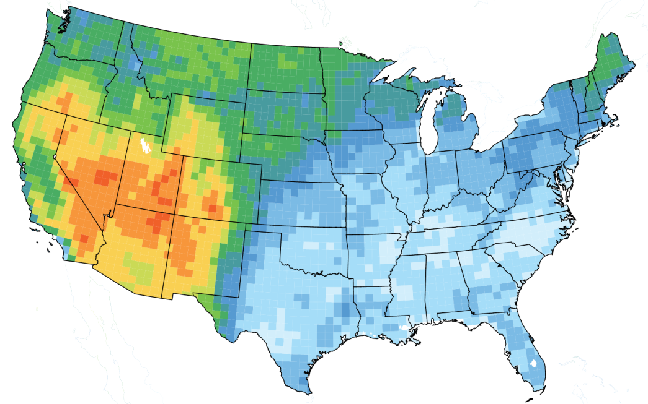
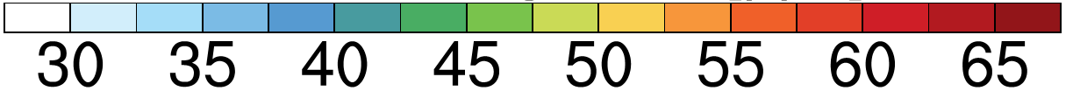
Challenges of a lowered U.S. O₃ air quality standard
Mean Background in GFDL-AM3
(Lin et al., 2012ab; April-June 2010)
Los Angeles
NAAQS
Background
Obs. annual 4th highest MDA8 O₃
70
(ppb)
Denver
2015 O₃ NAAQS
Fig. 17 from Lin et al. (ACP, 2017), data c/o R. Payton (EPA)
3

Slide 4

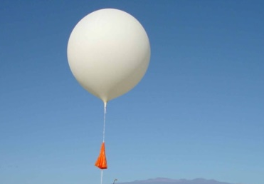
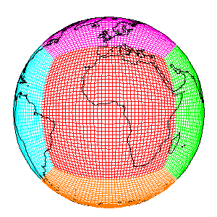
Today’s presentation
Late spring deep stratospheric intrusions over WUS and their links to climate variability
How does WUS surface O₃ in spring and summer respond to rising Asian anthropogenic emissions and domestic NO_{x} controls over the past two decades?
To what extent wildfire emissions contribute to WUS summertime O₃ variability?
Eastern U.S. summertime O₃ pollution: changing heat waves, droughts, and regional precursor emissions
Satellites
In situ
Surface networks
GFDL-AM3
4
Notes:
Examples of how satellite, in situ measurements and models can be combined to detect and attribute non-controllable sources

Slide 5
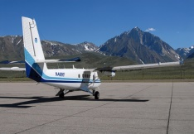
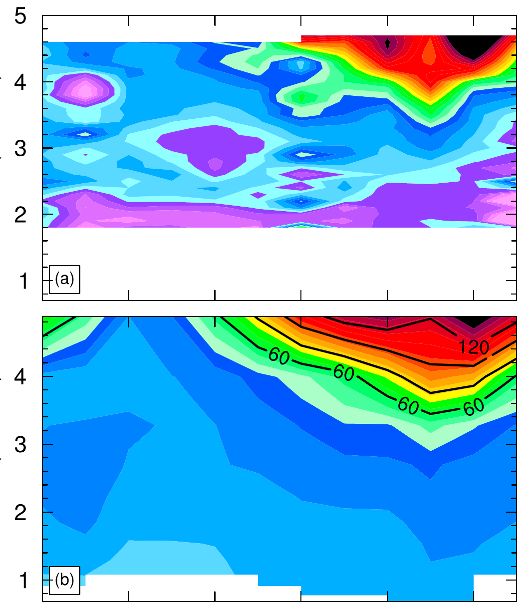
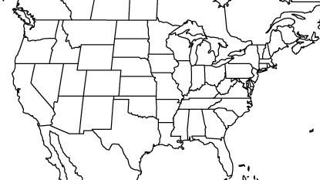
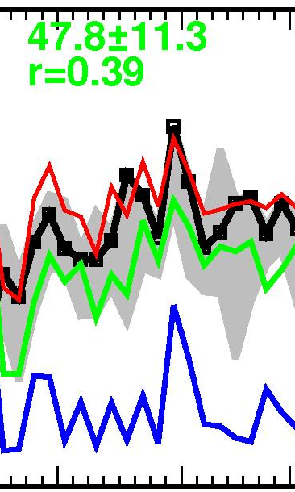
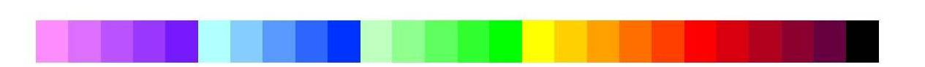
Deep stratospheric intrusions can push surface O₃ to exceed the NAAQS level
CalNex2010
S. California (May 23, 2010)
100
May 24
Altitude (km)
Lidar (Langford)
75
New standard
OBS, AM3
Surface O₃ (ppb) , MDA8
Background
(zero out US anthrop. emissions)
50
O₃Strat
25
O₃Strat
GFDL-AM3
5
Flight track
May/13/2010
Jun/1/2010
[ppb]
30
60
90
120
150
Lin M.Y. et al (JGR, 2012b), Springtime high surface ozone events over the WUS: Quantifying the role of stratospheric intrusions
5
Notes:
Remember to introduce the O3Strat tracer
One day after, this intrusion pushed surface O₃ to exceed 75 ppbv at Colorado Spring (2 km altitude)
BGO3: estimated by zeroing out N. American anthropogenic emissions in the model
Gray shading represents the range of ozone observations at sites within ~200 km diameter

Slide 6
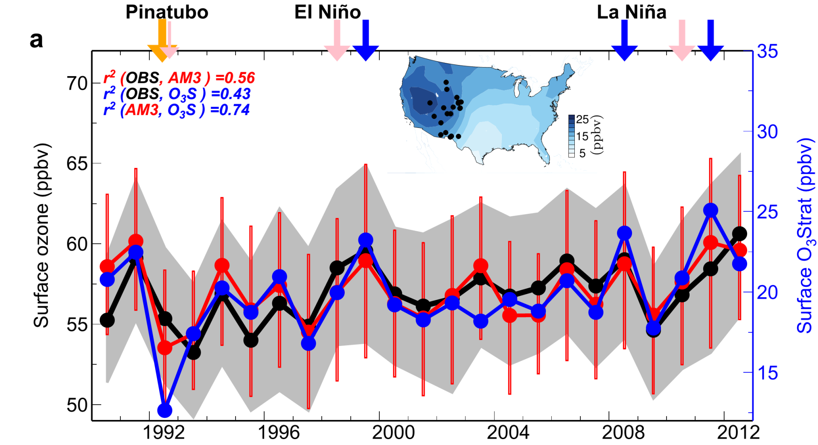
Climate variability can modulate frequency of deep stratospheric intrusions
75th
50th
O₃Strat
25th
Emissions held constant
Nudged to “real” winds
22 sites
(>1.5 km)
Stratospheric Contribution (ppb)
April-May
1990
2012
Strong stratospheric influence on year-to-year variability on WUS surface ozone during spring
Lin M. et al. (Nature Communications, 2015)
6
Notes:
Jet variability (internal or ENSO-forced)

Slide 7
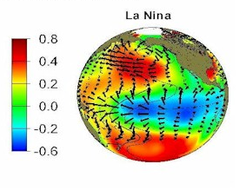
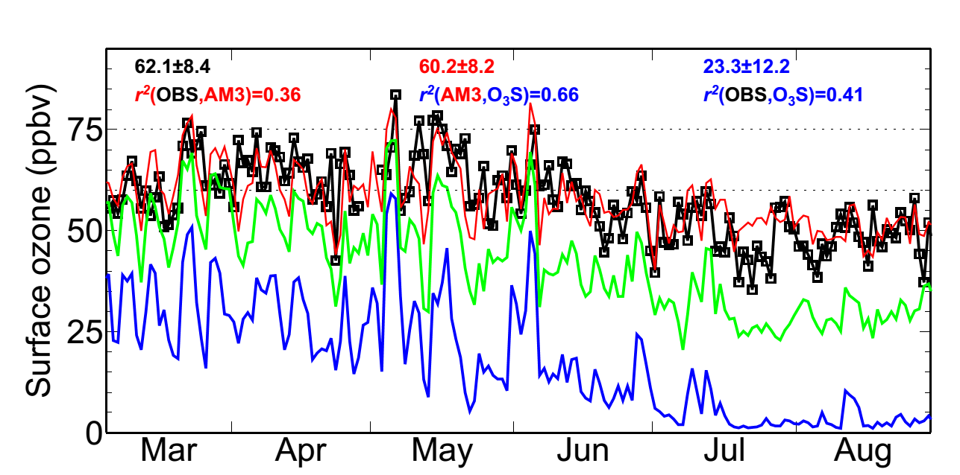
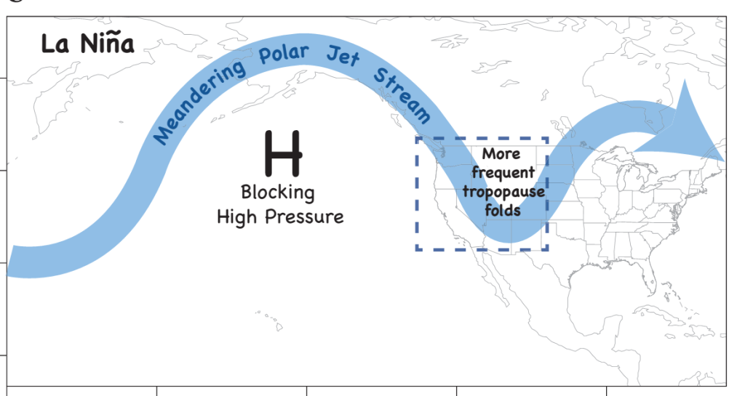
Developing ozone seasonal forecasts to aid western U.S. air quality planning
Tropical SST cooling during La Niña peaks in winter
More frequent intrusions expected in the following spring over WUS?
v
v
v
OBS
AM3
SST (C)
MDA8 O₃ (ppb)
BGO₃
O₃Strat
Gothic Colorado Year 1999 (2.9 km asl)
Regional preparations for an active stratospheric intrusion season
Deploy targeted measurements aimed at identifying “exceptional events”
Conduct daily forecast for public health alerts
Lin M. et al (Nature Communications, 2015)
7

Slide 8
Role of rising Asian anthropogenic emissions
Notes:
AM3 O3Strat captures the episodic ozone enhancements although the mean baseline level of O3Strat may represent an upper limit

Slide 9
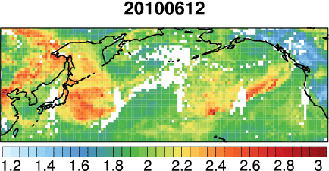
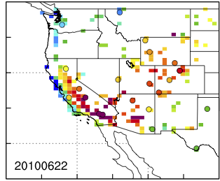
Asian pollution contribution to WUS high-O₃ events
NASA AIRS CO
[10¹⁸ molecules cm⁻²]
22-June-2010
OBS
Model
Asian
Surface MDA8 O₃
NAAQS
[ppb]
[ppb]
Asian pollution can contribute ~20% on days when OBS > 60 ppb
Lin M. et al [JGR, 2012a]: Transport of Asian O₃ pollution into surface air over the WUS in spring
9
Notes:
Asian emissions contribute 8-12 ppb on days when OBS O₃ ≥ 65 ppb (future NAAQS)
Consistent with elevated free trop O₃ levels observed by in ozonesondes during CalNex

Slide 10
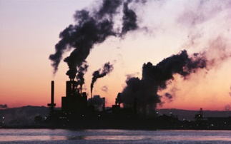
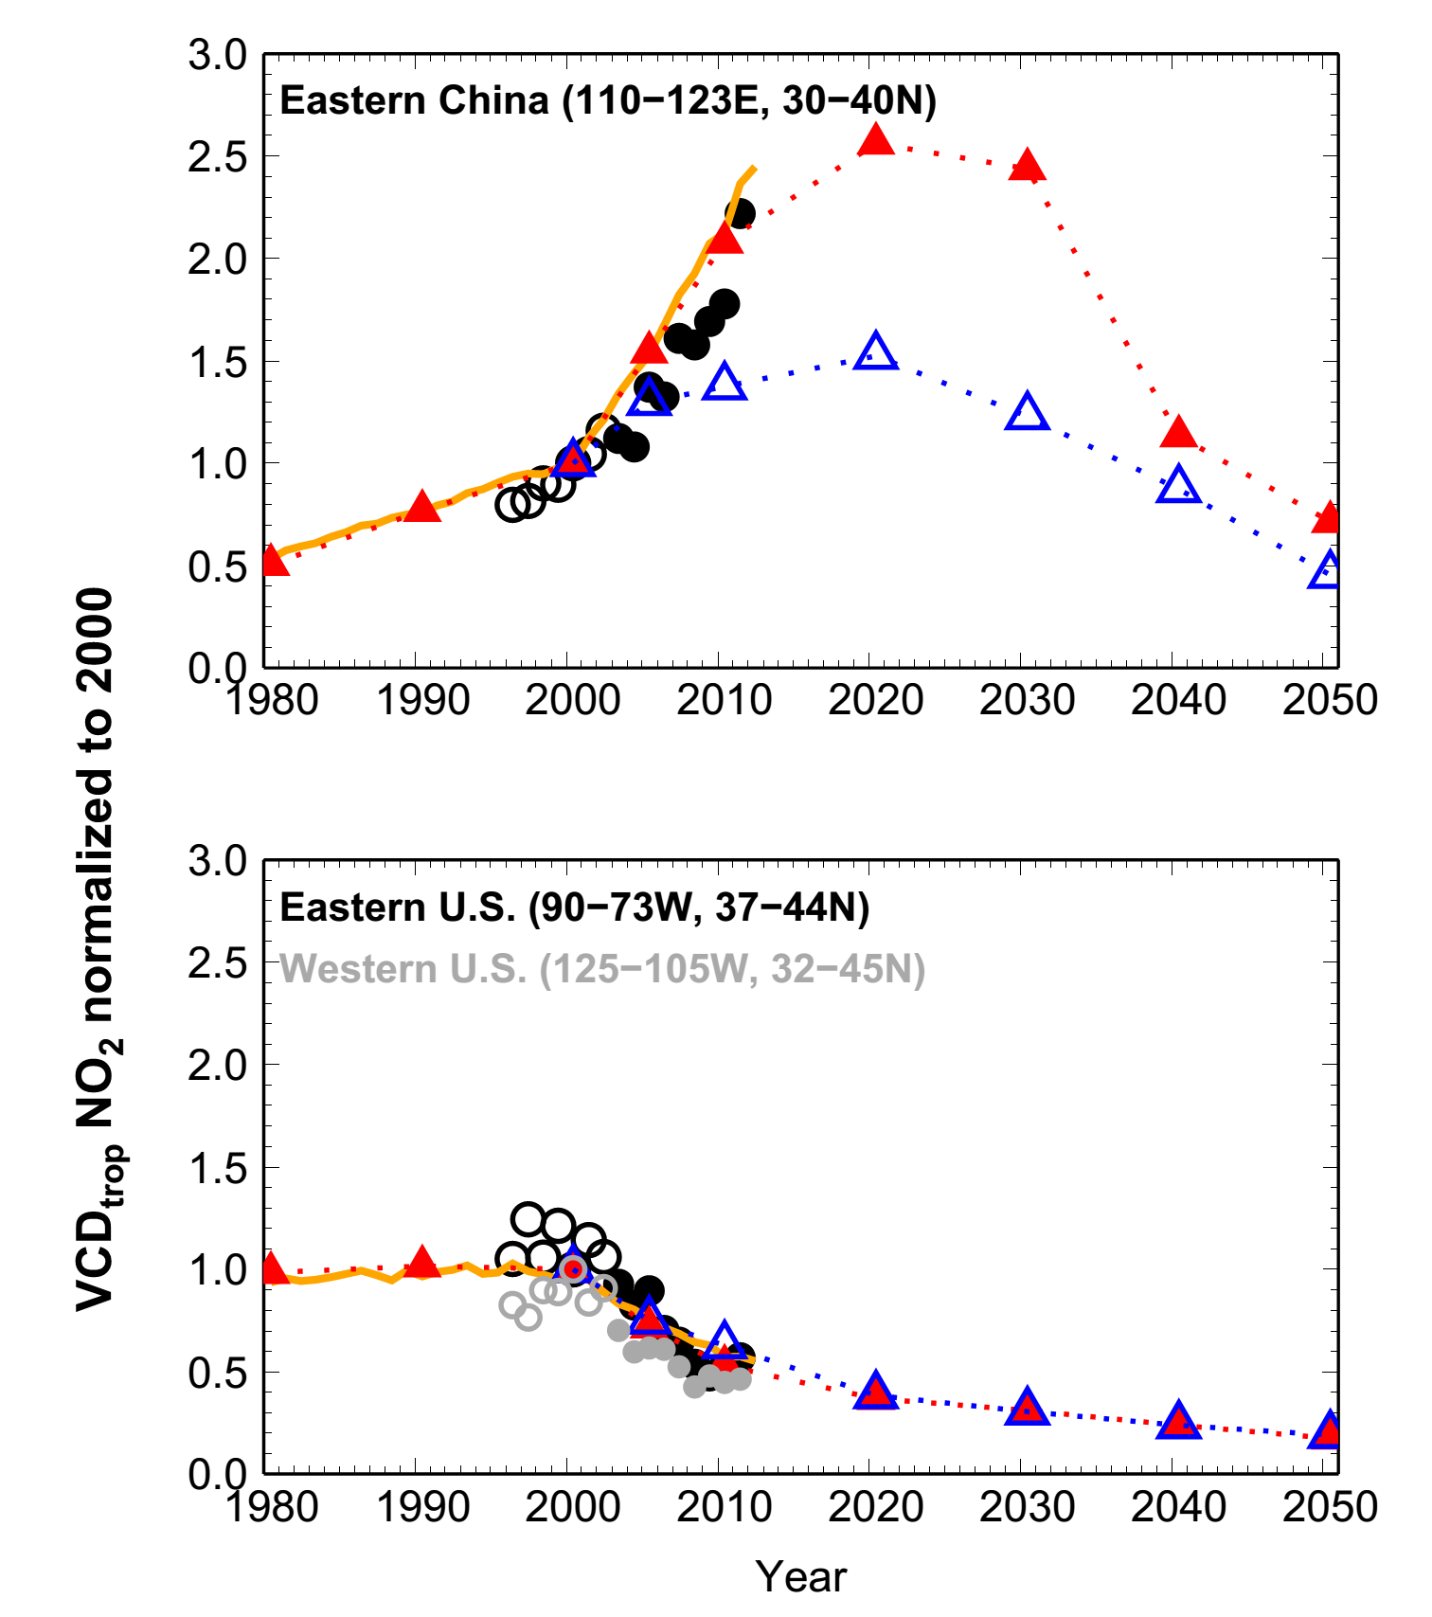
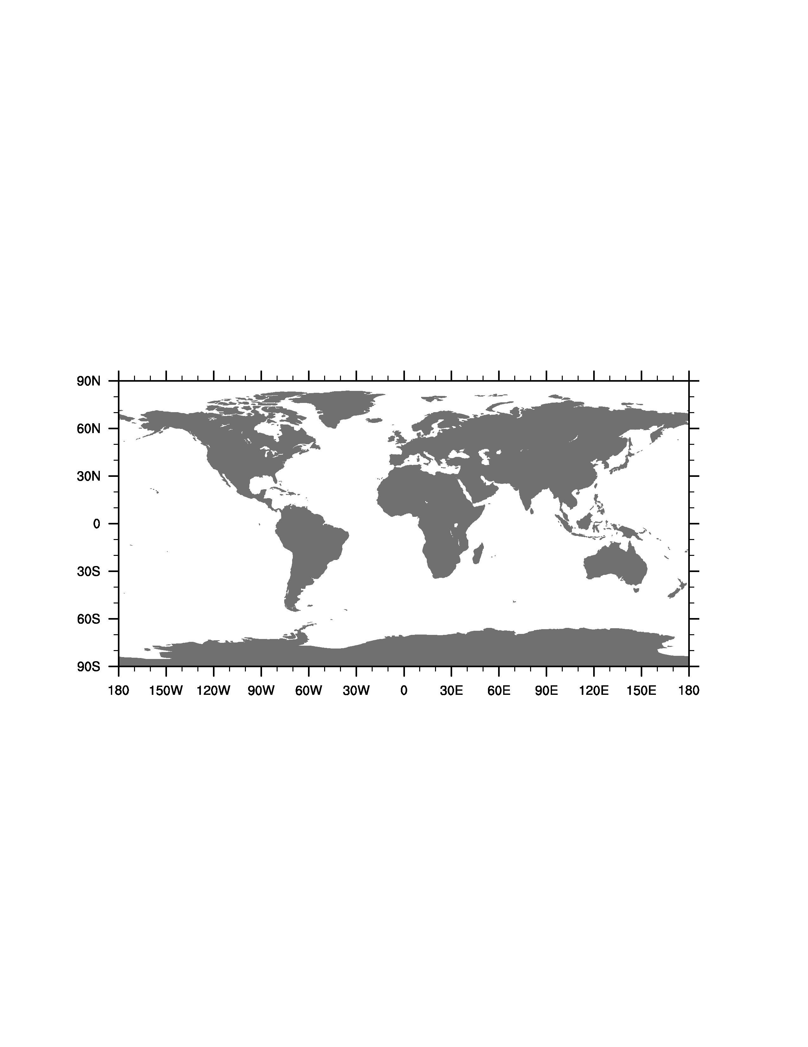
Changes in anthropogenic emissions of NO_{x}
RCP8.5
(AM3 BASE)
RCP8.5 (AM3 BASE):
Almost tripled over 1980-2010
Largest increases in the 2000s
Peak in 2020-2030
Satellites
RCP4.5
50% reductions over 2000-2010 from the U.S. NOx SIP call
Normalized to Y2000
Figure 1 of Lin et al. (ACP, 2017): Emission data from Lamarque et al. (2010, 2012);
Satellite (GOME/SCIAMACHY) NO2 data from KNMI (www.temis.nl)
10

Slide 11
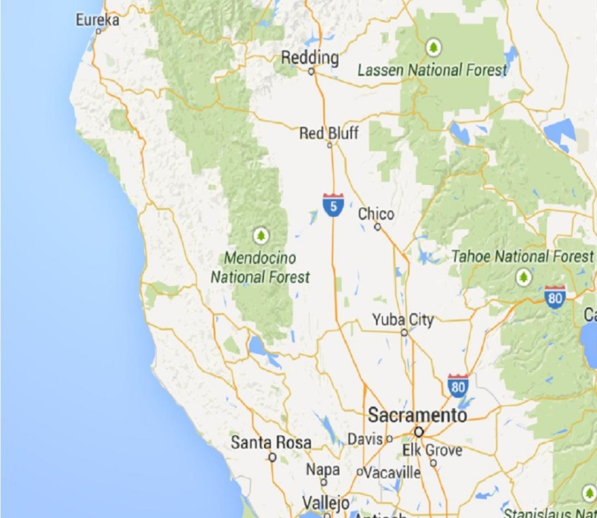
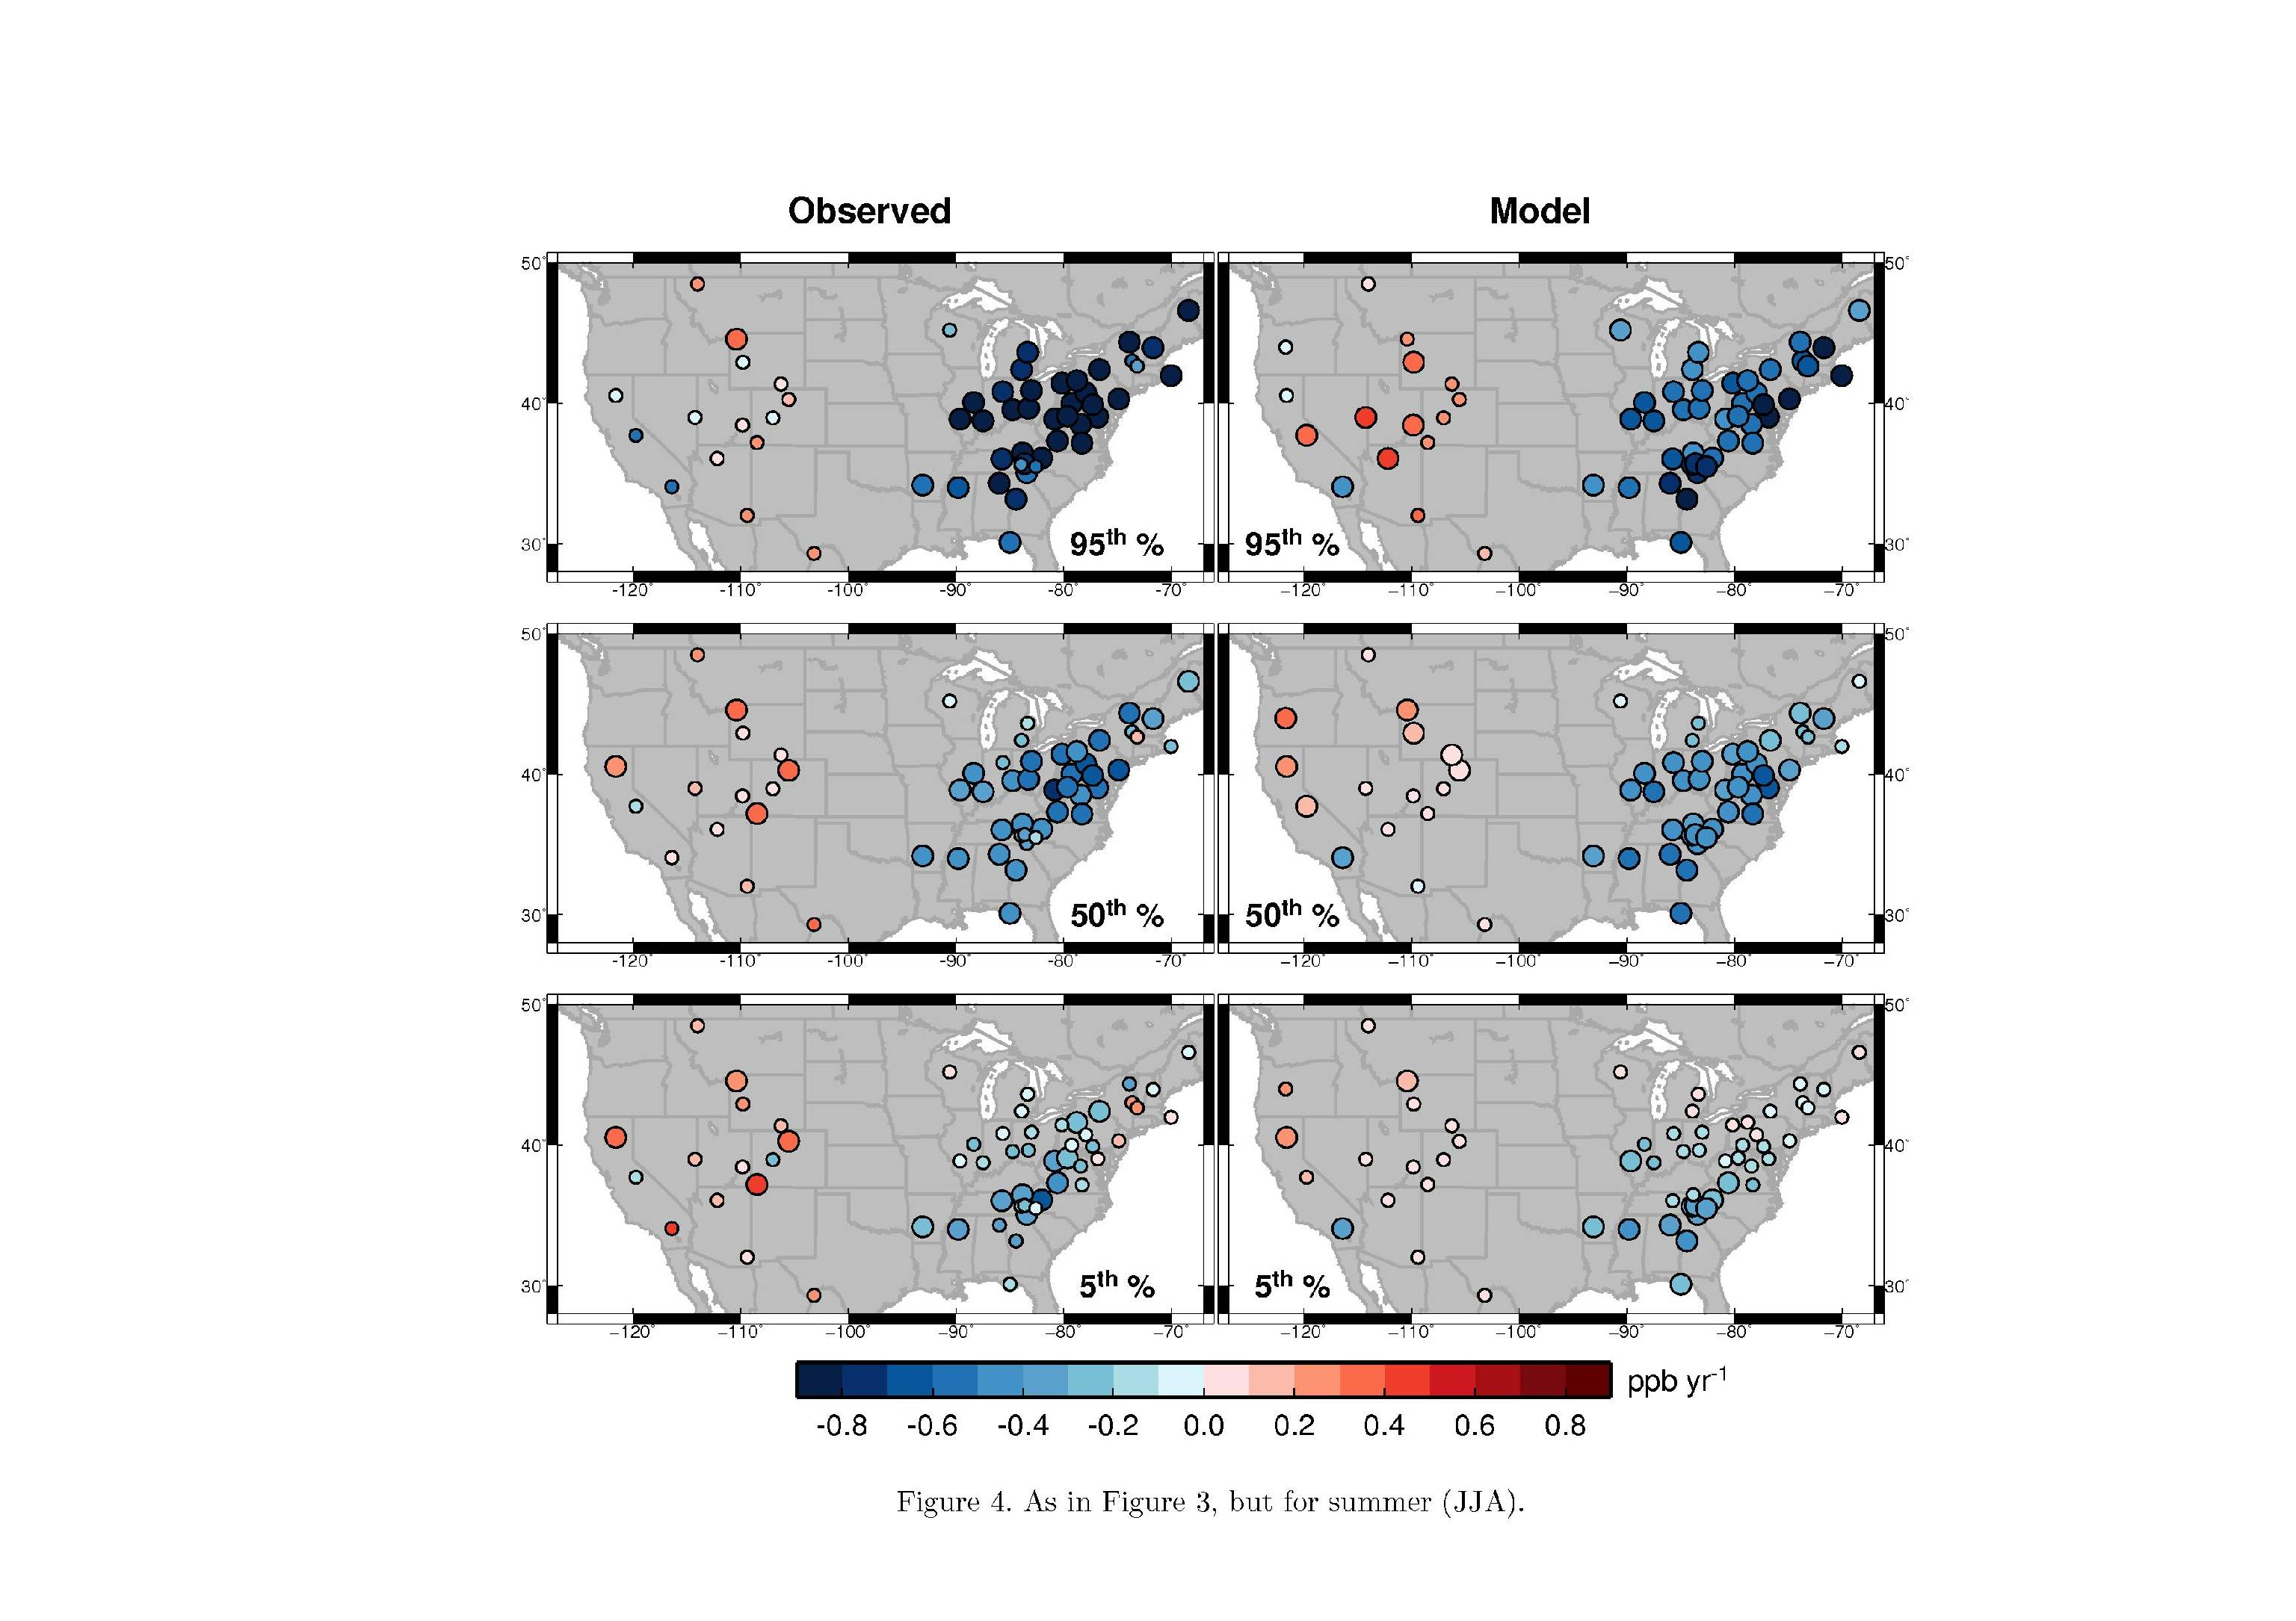
Model baseline sampling approach for evaluating O₃ trends at WUS sites
Observed spring MDA8 O₃ trend 1988-2014
Baseline
(Lassen)
Larger circles indicate significant trends (p<0.05)
Within a ~200x200 km² model grid cell
Pollution
0.8
0.4
AM3_BASE surface
AM3_BASE 700 hPa, filtered
0.0
-0.4
-0.8
ppb yr⁻¹
11
Lin, M., Horowitz L.W., Payton, R., Fiore, A.M., Tonnesen, T. [ACP, 2017]

Slide 12
SPRING US surface MDA8 O₃ trends over 1988-2014
OBS
AM3_BASE
(Baseline filtering for WUS)
0.8
0.4
95%
0.0
-0.4
-0.8
50%
ppb yr⁻¹
(MAM, 1988-2014)
Larger circles indicate significant trends (p<0.05)
5%
Figure 7 from Lin et al. [ACP, 2017]
12

Slide 13
SUMMER US surface MDA8 O₃ trends over 1988-2014
OBS
AM3_BASE
(Baseline filtering for WUS)
0.8
0.4
95%
0.0
-0.4
-0.8
50%
ppb yr⁻¹
Larger circles indicate significant trends (p<0.05)
5%
Figure 8 from Lin M., et al. [ACP, 2017]
13

Slide 14
Median springtime MDA8 O₃ trends at Great Basin NP
Most of the observed variability reflect changes in the background
The effects of US NO_{x} controls (BASE minus NAB) are < 0.1 ppb yr⁻¹
See Figure 13 of Lin et al. (ACP, 2017) for additional analysis for other sites
14

Slide 15
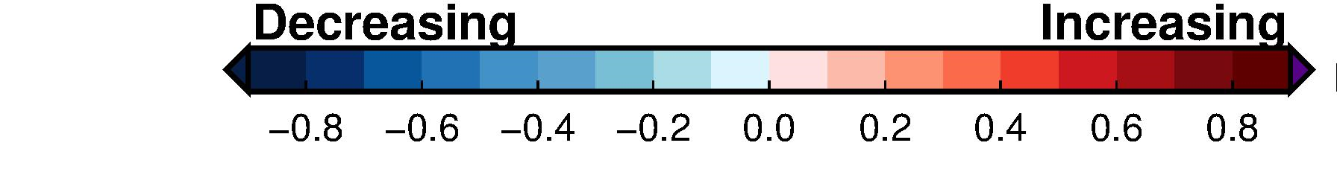
Observed vs modelled background O₃ trends for SPRING
OBS
Background
95th
50th
ppb yr⁻¹
Large circles indicate significant trends (p<0.05)
Figure 10 from Lin et al. [ACP, 2017]
15

Slide 16
Observed vs modelled background O₃ trends for SUMMER
OBS
Background
95th
50th
ppb yr⁻¹
Larger circles indicate significant trends (p<0.05)
Figure 11 from Lin et al. [ACP, 2017]
16
Notes:
More emphasis on model evaluation of delta ozone changes

Slide 17
Summarizing drivers of decadal mean O₃ changes
from 1981-1990 to 2003-2012 over WUS
2003-2012 minus 1981-1990
BASE
Background
Meteorology
Delta O₃ [ppb]
Asian (~50%)
CH₄ (~15%)
Wildfires
(6% in spring; 12% in summer)
MAM
JJA
Figure 20 from Lin et al. [ACP, 2017]
17

Slide 18
Summertime ozone variability and trends
Notes:
AM3 O3Strat captures the episodic ozone enhancements although the mean baseline level of O3Strat may represent an upper limit

Slide 19
Wildfires: NOT the primary driver of summer O₃ IAV over WUS?
Yellowstone NP (AUG)
IAVFIRE – FIXEMIS (Aug2012)
High fire years
-6
-0
6 ppb
Interannual correlations of YEL O₃ w/ T_{max}
Hot and dry summers:
deeper PBLH allowing more O₃ to mix down to the surface (see also Zhang et al., 2014)
enhance regional O₃ production and orographic lifting of urban pollution to mountaintop sites (e.g., Denver → Rocky Mountain NP)
Figs 15 and 16 from Lin et al. [ACP, 2017]

Slide 20
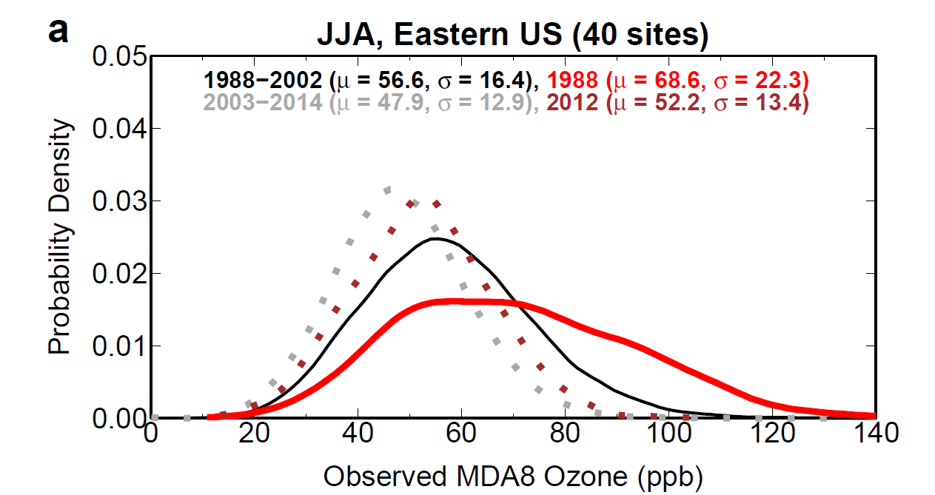
Observed declines in EUS summertime surface O₃
following regional NO_{x} reductions
Post-NOx SIP Call
(2012 Heat Wave)
Pre-NOx SIP Call
(1988 Heat Wave)
Regional NO_{x} reductions alleviated the O₃ buildup during the recent 2012 heat wave relative to earlier heat waves (e.g., 1988)
Meiyun Lin et al. [ACP, 2017]
20

Slide 21
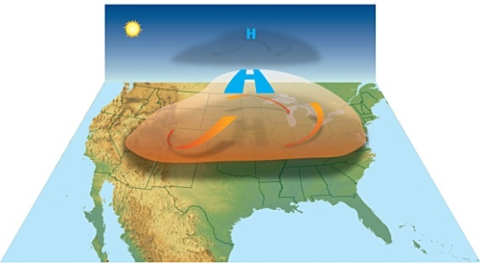
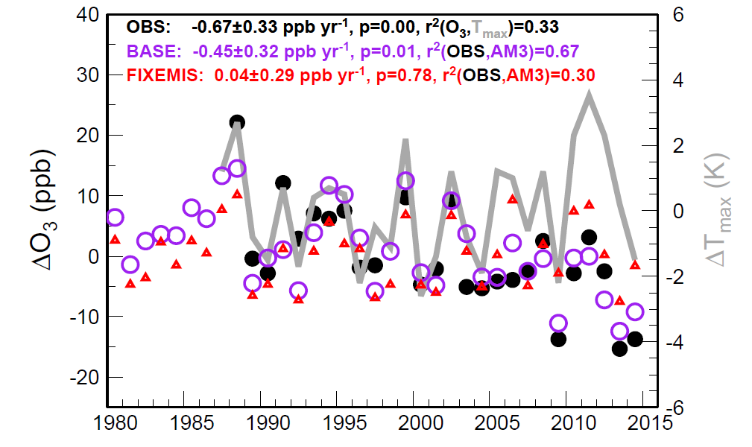
GFDL-AM3 captures interannual variability of O₃ anomalies associated with high temperatures
Penn State University CASTNet site
R² (OBS, AM3_BASE) = 0.67
R² (OBS, AM3_FIXEMIS) = 0.30
DEP*0.65
July
1980
2015
O₃ deposition sink to vegetation must be reduced by 35% in the model to match the observed anomaly during the severe drought of 1988
Meiyun Lin et al. [ACP, 2017]
21

Slide 22
Influence of droughts on ozone removal
OBS
AM3 BASE
DEP*0.65
Penn State Univ.
Reduced stomatal uptake under drought stress
Influence the highest ozone events above 100 ppb
Model challenges in simulating such land-biosphere couplings
Meiyun Lin et al. [ACP, 2017]
22

Slide 23
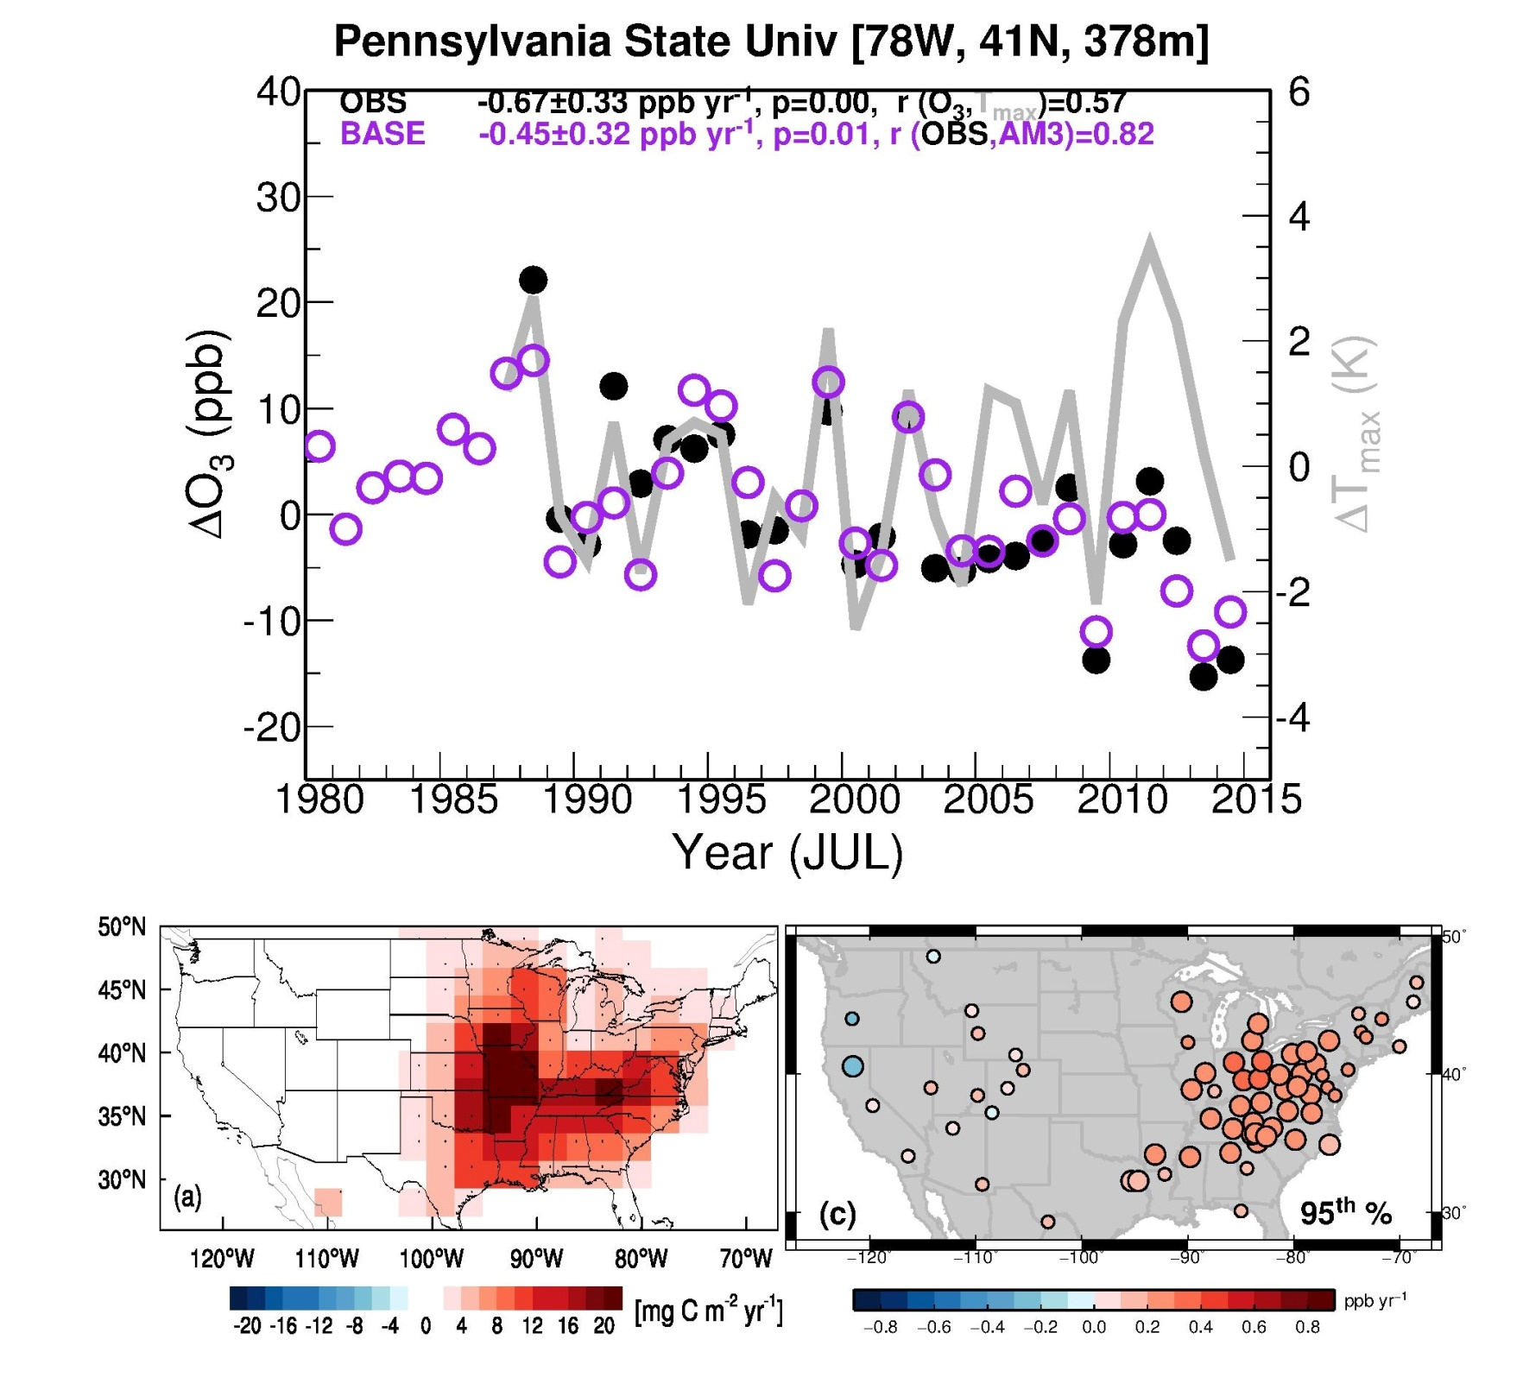

If NO_{x} emissions had not declined, more frequent hot extremes since 1990 would have worsened the highest O₃ events over EUS
1990-2012 trend in the frequency of warm days (above the 90th percentile for 1961-1990 base)
1990-2012 trend in biogenic isoprene emissions
JJA
JJA
95th percentile MDA8 O₃ trend in AM3_FIXEMIS
Larger circles indicate significant trends (p<0.05)
JJA
Meiyun Lin et al. [ACP, 2017]

Slide 24
Some final policy-relevant messages
Late spring stratospheric intrusions
The key driver of observed year-to-year variability in springtime high-O₃ events >70 ppb at WUS rural sites
Need to develop forecast capabilities
Asian pollution
drives much of multi-decadal WUS background O₃ increases (50-65%; 0.2 ppb/yr), with lesser contribution from rising methane (~15%)
Wildfires
can enhance monthly mean MDA8 O₃ at individual sites by 2-8 ppb in some summers
but not the primary driver of observed O₃ year-to-year variability
U.S. NO_{x} emission controls
Lead to decreases in the highest pollution events in low-elevation US regions and during summer
guard against rising pollution levels triggered either by climate change or by global emission growth.
Need internationally collaborative efforts to mitigate global air pollution
Enormous progress made in the U.S. (e.g., Los Angeles) provides a template for Asian mega-cities (e.g. , Beijing)
Notes:
Missing meteorology?

Slide 25
Additional Slides for Q & A Discussions
Notes:
AM3 O3Strat captures the episodic ozone enhancements although the mean baseline level of O3Strat may represent an upper limit

Slide 26




For more information, please see the papers
Lin, M. et al (2012a): Transport of Asian ozone pollution into surface air over the western United States in spring (PDF)
Lin M. et al (2012b): Springtime high surface ozone events over the western United States: Quantifying the role of stratospheric intrusions (Full Text)
Lin, M. et al. (2014): Tropospheric ozone trends at Manna Loa Observatory tied to decadal climate variability (PDF)
Lin, M. et al. (2015a): Climate variability modulates western U.S. ozone air quality in spring via deep stratospheric intrusions (PDF)
Lin, M. et al. (2015b): Revisiting the evidence of increasing springtime ozone mixing ratios in the free troposphere over western North America, Geophysical Research Letter (PDF)
Lin, M. et al. (2017): U.S. surface ozone trends and extremes from 1980 to 2014: Quantifying the roles of rising Asian emissions, domestic controls, wildfires, and climate (PDF)
26

Slide 27
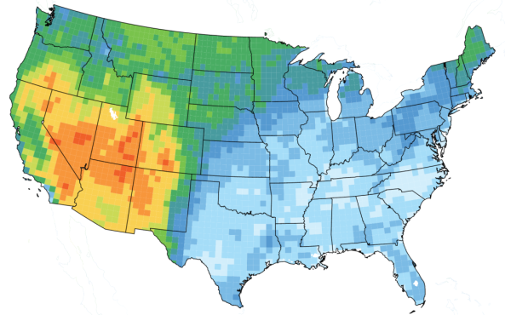
Lin et al. (JGR2012a, 2012b)
Stratospheric and Asian influences
on springtime high-O₃ events at WUS rural sites
CASTNET (>1.5 km; Apr-Jun 2010)
100
1:1 line
80
NAAQS
60
Background
(Bias-corrected)
Hi-Res GFDL-AM3
40
max
O₃Strat
(Bias-corrected)
75th
25th
20
Asian
min
Notes:
Up to here: 5-min

Slide 28
Springtime ozone observed in Denver has increased at a rate similar to remote rural sites
Figure 17 from Lin et al. [ACP, 2017]

Slide 29
Summertime O₃ in Denver correlates with temperature
Fig. 17c from Lin et al. [ACP, 2017]
Observed MDA8 O₃
(Jul-Aug 95th )
Role of VOCs from fires + urban NO_{x} (Jaffe & Wigder,2012; Baker et al., 2016)?
Increased VOC emissions from oil and gas operations? But total VOC emissions may not be increasing over time due to the marked reductions in VOC emissions from vehicles [Bishop and Stedman, 2008, 2015]
Increased frequency of heat waves and air stagnation events (Horton et al., 2015)

Slide 30
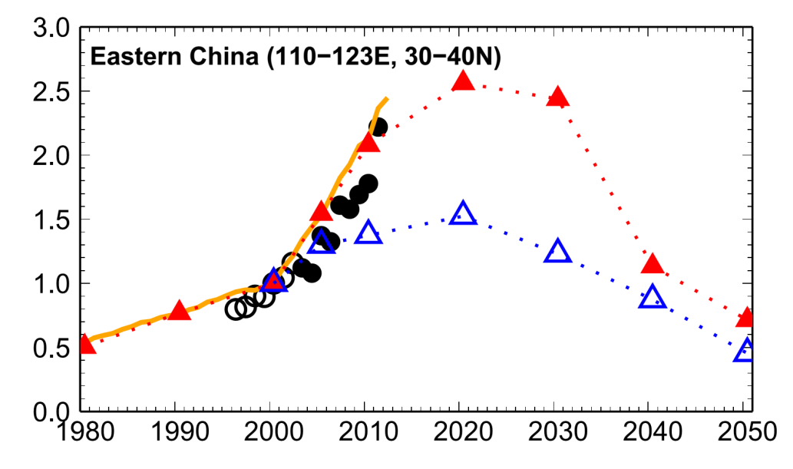
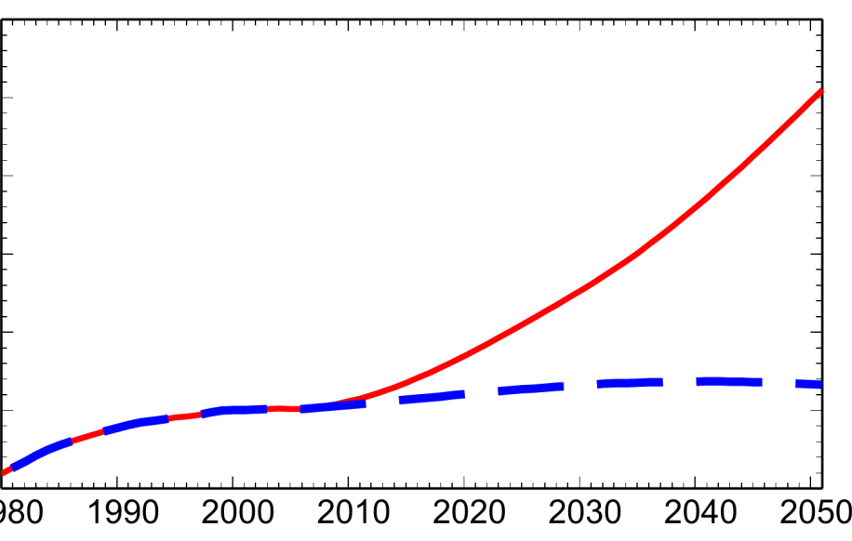
Projections of near-term changes in WUS lower trop. ozone in spring (March-April-May)
OBS (GRB, LAV, ROM)
AM3 BASE, nudged
E. China NO_{x} emissions
3000
Global CH₄ (ppb)
RCP8.5
2500
RCP8.5
Normalized to 2000
2000
RCP4.5
Satellites
RCP4.5
1500
30
1980
Figure 14 from Lin et al. [ACP, 2017]
30

Slide 31
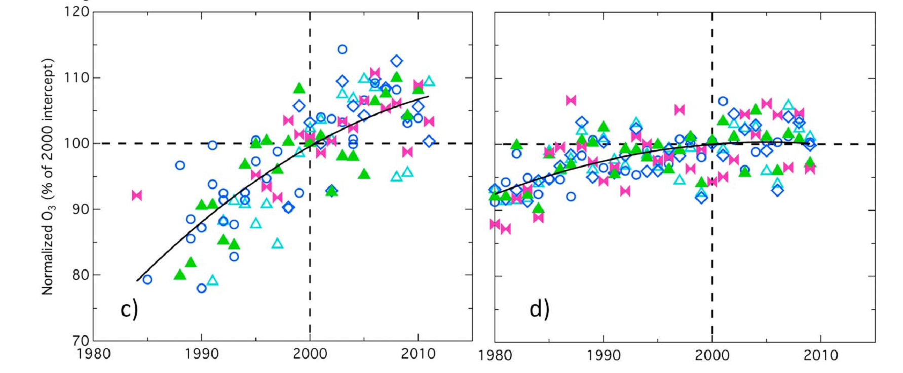
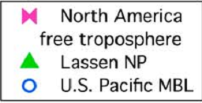
Baseline O₃ trends derived from observations and free-running chemistry-climate models differ by a factor of 2 (Parrish et al., 2014)
OBS (Spring)
Free-running CMIP5 models
Mt. Happo
Japanese MBL
U.S. Pacific MBL
N. American FT
Lassen NP
Need model hindcasts driven by observed meteorology (next slide)
These discrepancies reflect a combination of factors:
(1) Internal climate variability (Lin et al., 2014; 2015a; Barnes et al., 2016)
(2) Measurement sampling biases (Lin et al., 2015b)
(3) Model difficulty resolving observed remote baseline conditions (Lin et al., 2017)
Notes:
Remember to define baseline
Concerns …

Slide 32
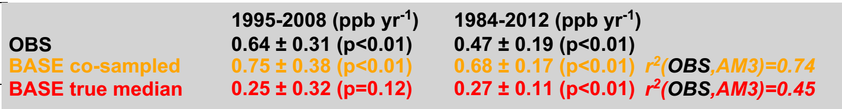
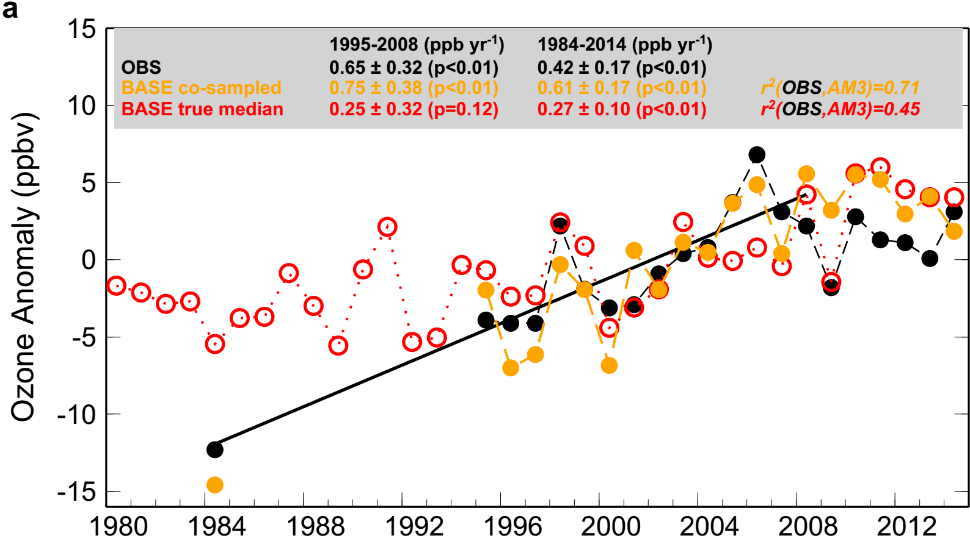
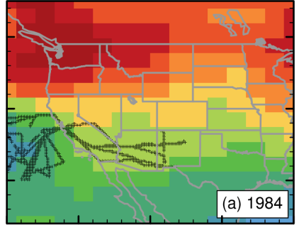
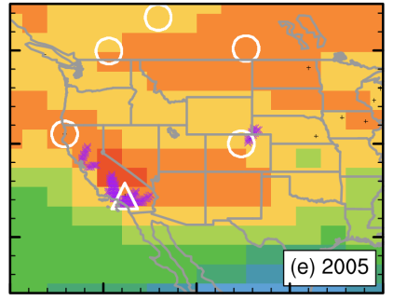
Influence of measurement sampling biases
Western N. American FT (3-8 km altitude)
[Cooper2010, Nature]
Sampling biases
[Cooper et al.]
BASE true average
Nudged to “real” winds
Ozone Anomaly (ppb)
1984
2005
40
60
80
Year (April-May)
FIXEMIS 500hPa O₃
Year (April-May)
15-year trends driven by internal climate variability can be as large as emission-driven trends.
Even with co-sampling, free-running CCMs are not expected to reproduce the trends.
Lin, M.; Horowitz, LW; Cooper, OR et al. [GRL, 2015]
32
Notes:
26 min up to here

Slide 33
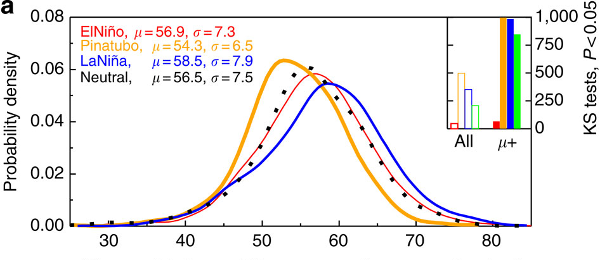
Observed changes in surface O₃ distribution,
particularly in the upper tail
Neutral: µ = 56.5,σ = 7.5
El Niño (1998, 2010): µ = 56.9,σ = 7.3
La Niña (1999, 2008, 2011): µ = 58.5,σ = 7.9
Pinatubo (1992, 1993): µ = 54.3,σ = 6.5
Statistical testing
Probability Density
Observed daily max 8-h average O₃ [ppbv], Apr-May
Little change in WUS surface air during El Niño despite increased UTLS O₃ burdens reported previously [e.g. Langford1998; Bronnimann2004; Neu2014].
Lin M. et al (Nature Communications, 2015)
33
Notes:
Tied to Neu paper …

Slide 34
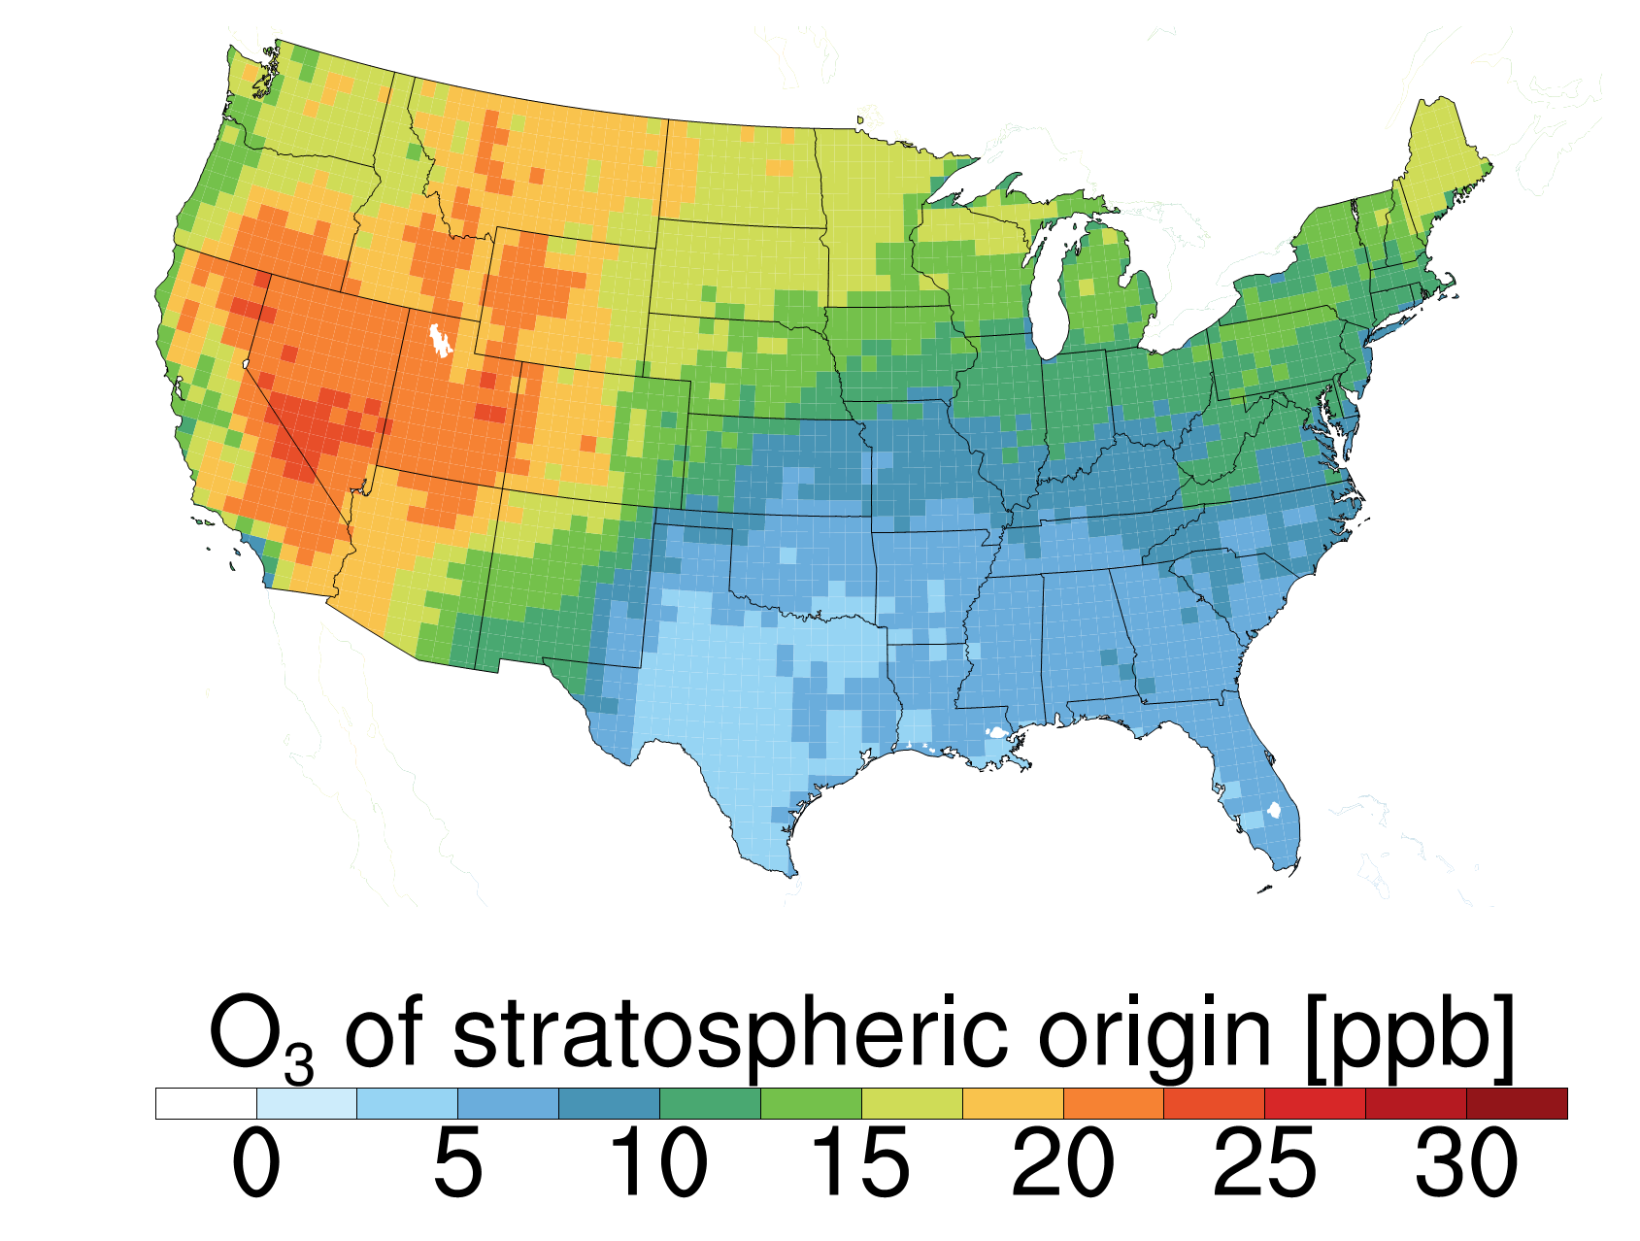
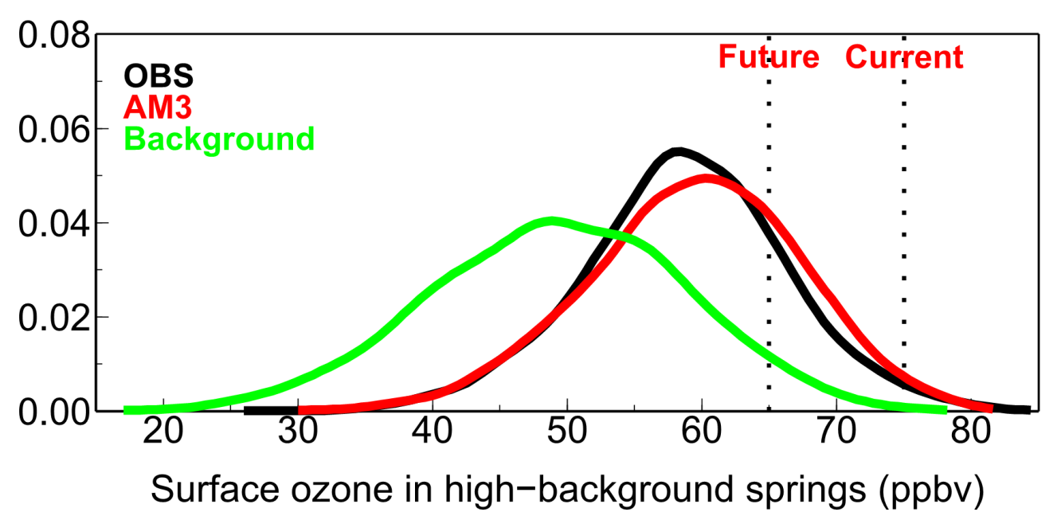
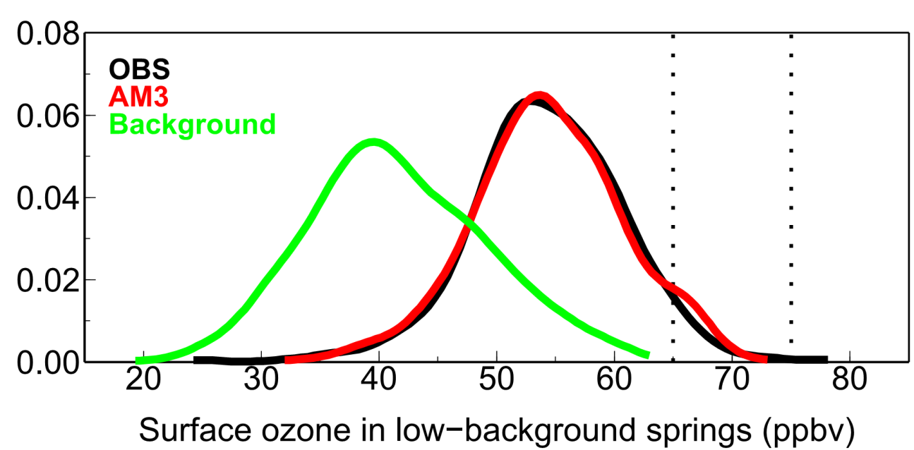
Surface O₃ distribution in high vs low background springs
NAAQS
(N. American anthrop. emissions set to zero)
1991
1999
2008
2011
2012
Probability Density
1992
1993
Meiyun Lin et al. (Nature Communications, 2015)
34
Notes:
As our national ozone standard becomes more stringent, the relative importance of these stratospheric intrusions grows, leaving less room for U.S. anthropogenic emissions to contribute to ozone pollution prior to exceeding the level set by the U.S. EPA.

