Slide 1
Development of time-differencing and grid-nesting schemes in the GFDL hurricane model
Gregory J Tripoli
Department of Atmospheric and Oceanic Sciences
Univeristy of Wisconsin - Madison

Slide 2
Timeline of Tripoli at GFDL
September, 1974: Arrival at GFDL from Krishnamurti group, Florida State University
Initial Assignment: Cover a critical need and work with Bram Oort to build ocean analysis system until some could be hired.
December, 1974: Ocean analysis system completed and running
December, 1974? Syd Levitus comes on board, Tripoli sent to Kurihara group (Bob and Kuri)

Slide 3
Timeline of Tripoli at GFDL
January, 1975-June, 1976: Work on the development of a new time integration system for a future hurricane model to be written explicitly for the new vector processor technology. Besides lack of vectorizability, a problem is that the current code, based on the GFDL general circulation model, running at high resolution to resolve hurricanes, is limited in timestep by fast gravity waves. New ideas of semi-implicit systems to increase efficiency should be studied
Step 1: Build code for shallow water equations system to efficiently consider a system of slow and fast manifold disturbances
Step 2: Consider the semi-impicit but it was not highly vectorizable
Step 3: Multiple bsrainstorming sessionsand testing with the shallow water model resulted in the development of an engineering solutions that combined the advantages Matsuno damping on some terms with the neutrality of a leapfrog scheme on others.

Slide 4
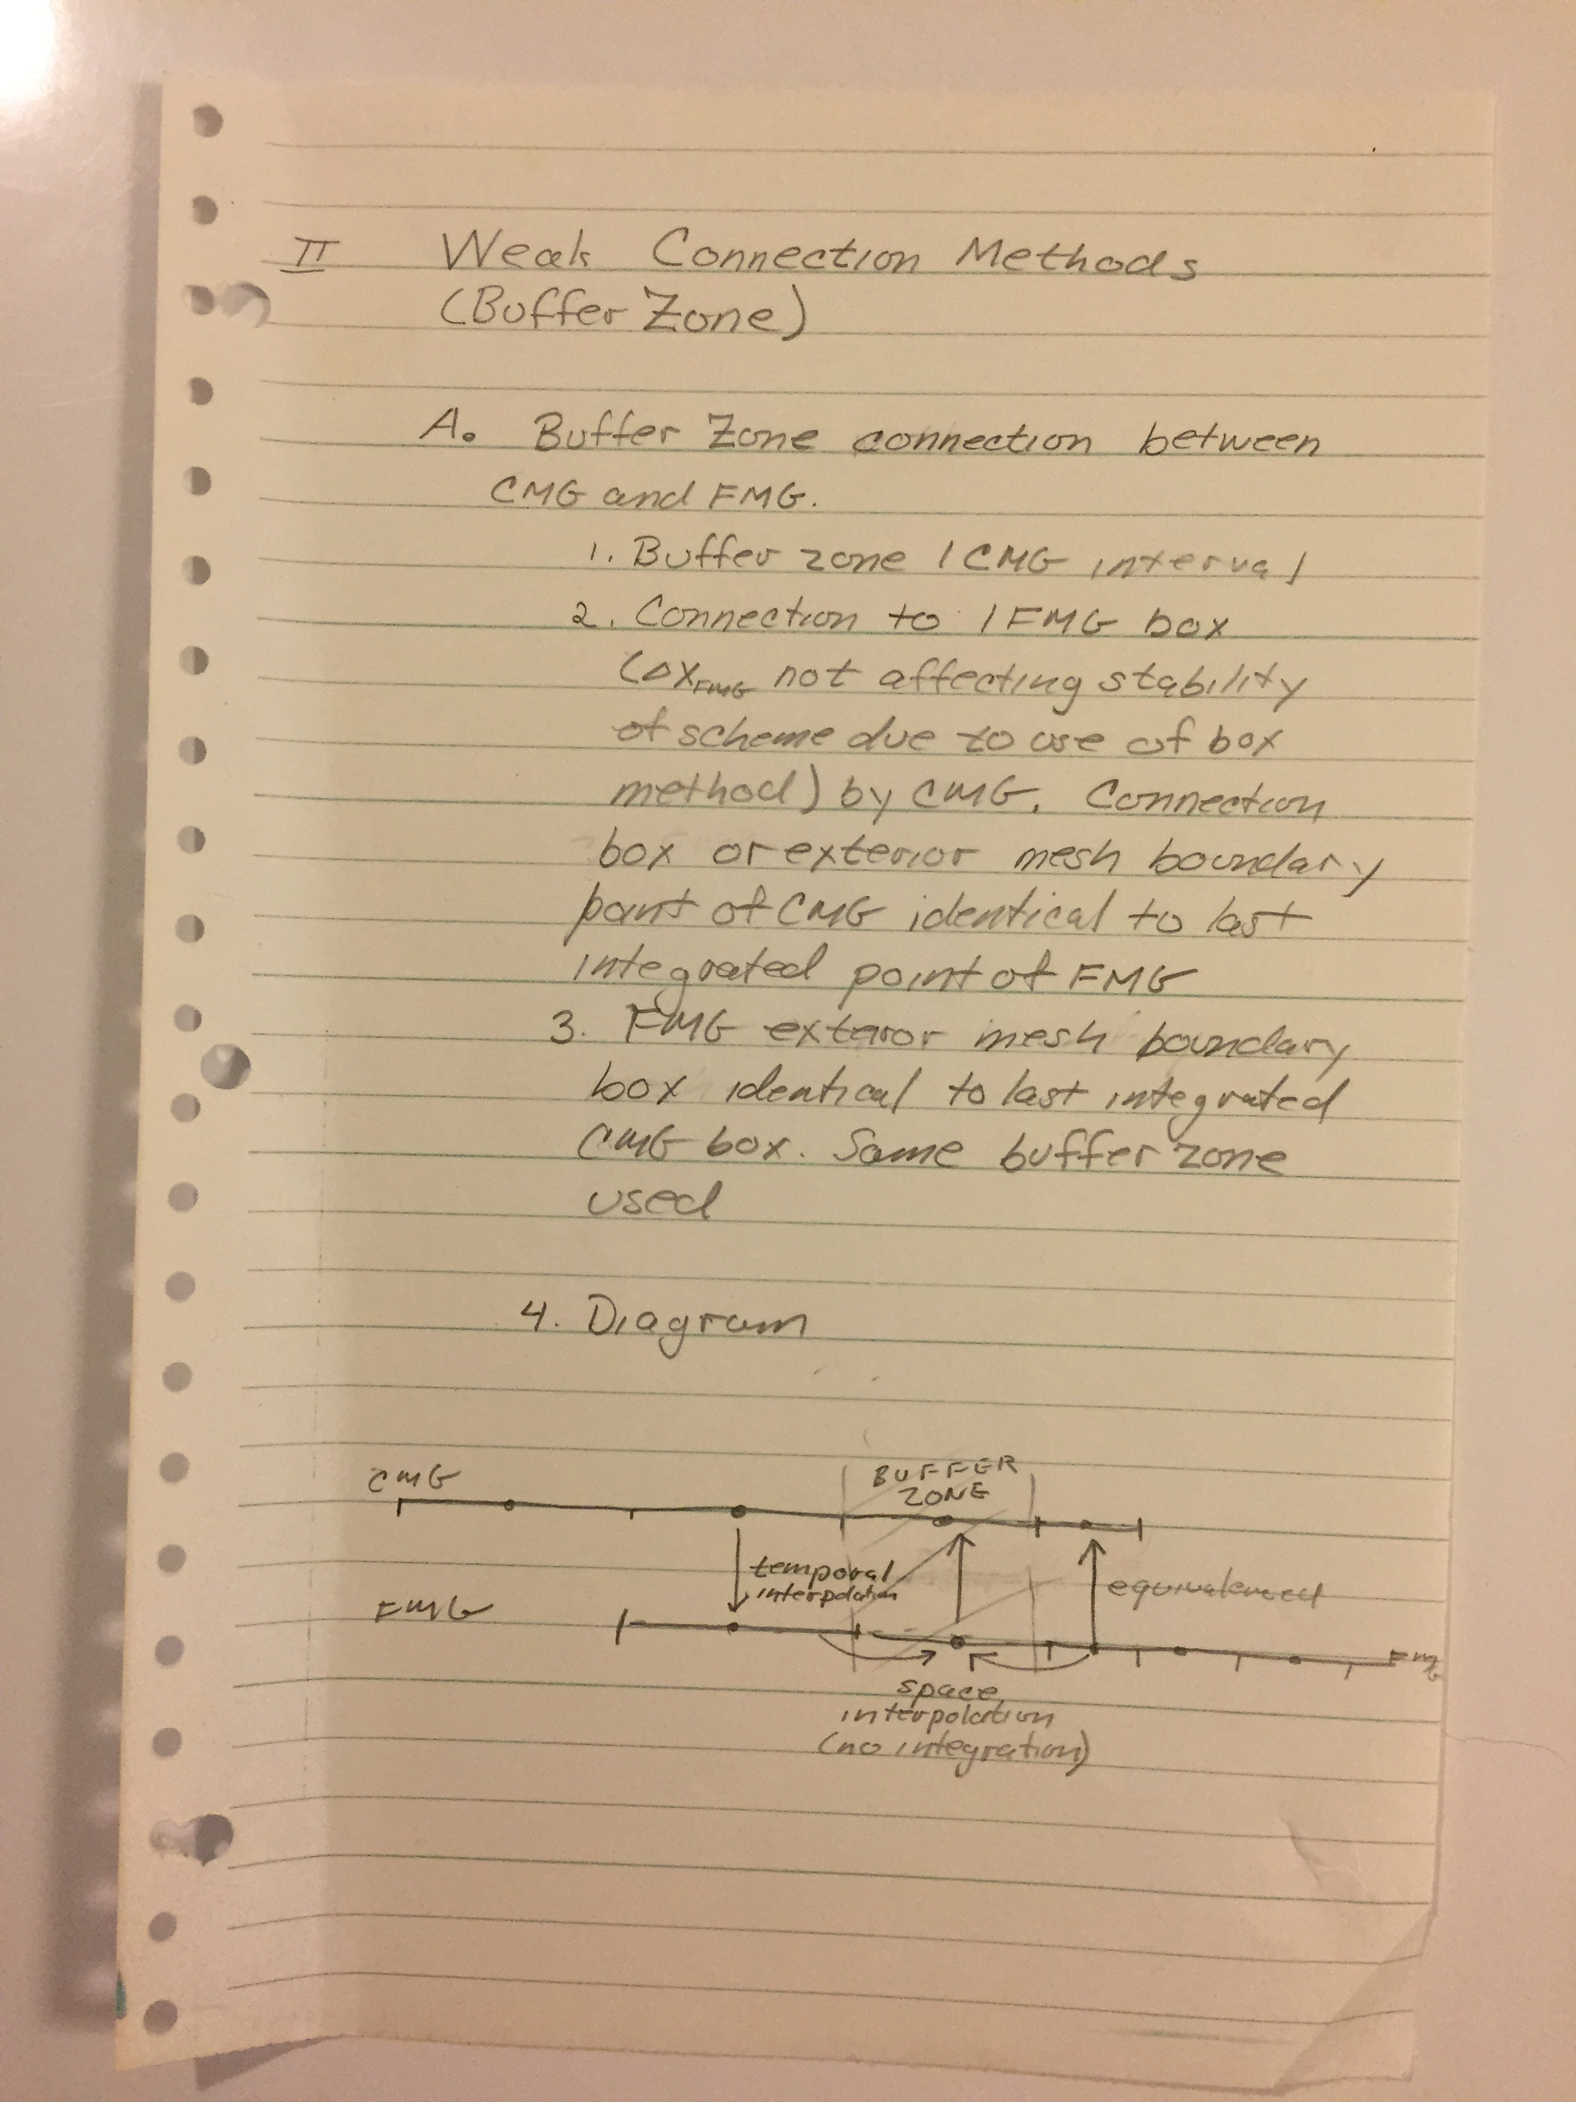
Development of Grid nesting

Slide 5
Finding “alpha”

Slide 6
Timeline of Tripoli at GFDL
June 1976- November, 1976: Work on the development of a new 2-way grid nesting system for a future hurricane model.
Other 1-way and 2-way nesting systems were reported in the literature, but the perception is that they were “ad hoc”, not rooted in sound dynamical and numerical proof
Kuri and Tripoli saw an opportunity to apply the shallow water technology to see how grid nesting affected the solution
To do this,Tripoli had to extend the shallow water model to 2D but initial testing would begin in 1D
Step 1: 1D tests were very useful, showing it difficult to tune the grid nesting conditions to dispersive disturbances because of the tendency of numerical resolution to slow or reflect some waves more than others.
Step 2: Finding a solution: Initially we tried to strongly enforce both mass and energy conservation across the interface, but serious reflection problems persisted
Step 3: Solution was to conserve mass fluxes only and to use an overlapping “picture frame” boundary condition to ease transition.
Step 4: Try this in a 2D shallow water system: not easy but ultimately we worked out the kinks

Slide 7
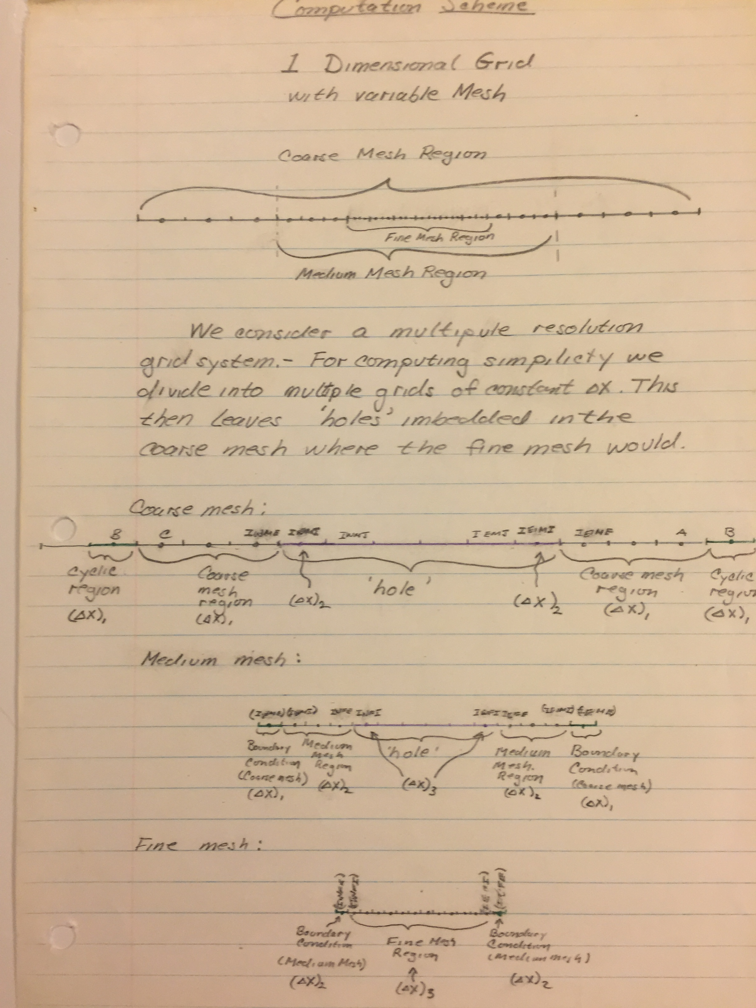
Mesh design

Slide 8
Timeline of Tripoli at GFDL
November, 1976- April, 1977: Write a new 3D code, based on multiple grid nesting, with arbitrary domain sizes and fully vectorized for TI ASC computer
Step 1: Learn about machine
Step 2: Design a model infrastructure around the grid nesting and paging memory row by row for each grid (similar to other hurricane model), but with arbitrary domain (and so grid nest0 size

Slide 9
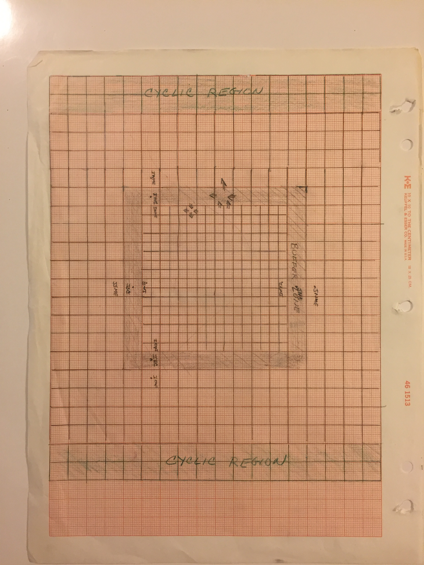
Grid Nesting

Slide 10
Timeline of Tripoli at GFDL
April, 1977: Tripoli moves on to CSU to build a new cloud resolving model, but the GFDL hurricane model lives on:
April, 1977: the new GFDL model could run, but there were bugs tht needed to be fixed before it could be useful
Bender arrives and debugs the code that Tripoli was working on

Slide 11
Epilogue
GFDL hurricane model evolves and lives on for 40 years!
Tripoli goes on to write CSU mesoscale model that becomes RAMS
Principles of the GFDL grid nesting scheme are the basis of Clark and Farley nesting that becomes the basis of MM5 and WRF grid nesting
Tripoli eventually resets at UW-Madison and develops an entirely new kind of model (UW-NMS) based on conservation solutions to many of the frustrations learned while collaborating with Kuri during that very productive 1.3 years.

