Slide 1
Evolution of Hurricane Track and Intensity Guidance at the National Hurricane Center
Mark DeMaria
National Hurricane Center, Miami, FL
GFDL Hurricane Science Symposium
May 2, 2017

Slide 2
Outline
1954-1975 – Barotropic and statistical track
forecast model era
1976-1994 – Emergence of dynamical track forecast models
1995-present – Dynamical models for intensity
and storm structure
– Statistical intensity models
Future outlook

Slide 3
National Hurricane Center Forecast History
1954: First quantitative forecasts of 24 hr lat/lon began at the Miami Hurricane Forecast Center
The Hurricane Forecast Center officially became NHC in 1956
1961 - Forecasts extended to 48 hr
1964 - Forecasts extended to 72 hr
2003 - Forecasts extended to 120 hr
Introduction of quantitative forecasts motivated development of statistical and barotropic track guidance models

Slide 4
Statistical Track Forecast Models
Statistical Models
HURRAN (1970-86), CLIPER (1970-present)
Statistical-Synoptic Models
Miller-Moore (1959-64), T59/60 (1959-64), NHC64/67/72 (1964-1972)
Statistical-Dynamical Models
NHC73/83/90/98 (1973-2006)

Slide 5
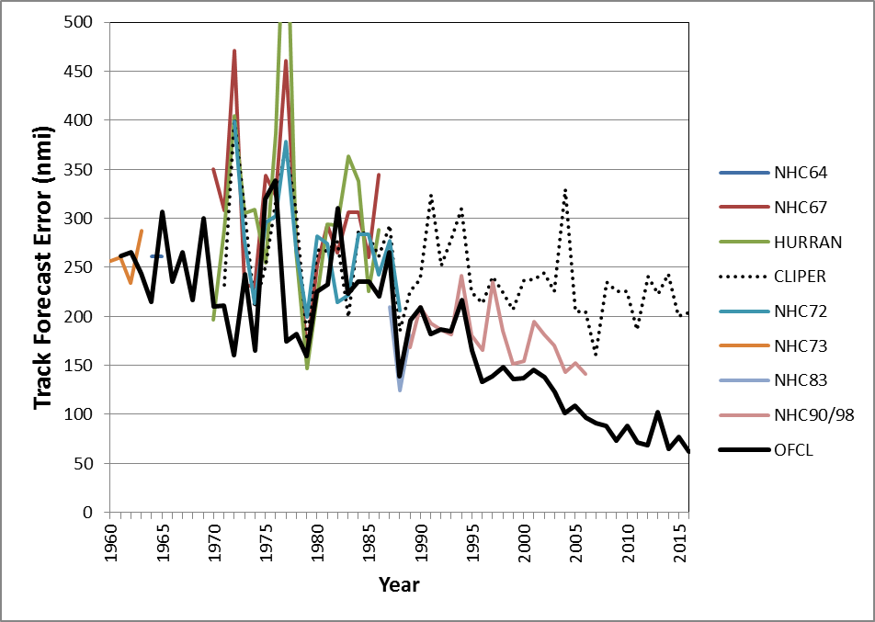
48 hr Statistical Track Model Errors

Slide 6
NHC Barotropic Track Models
NMC barotropic model 1959-196?
SANBAR 1971-1989
SANders BARotropic
VicBAR 1989-2002
Demo of Vic Ooyama nested spline method
LBAR 1996-2016
Limited Area Sine Transform BARotropic Model
LASTBAR

Slide 7
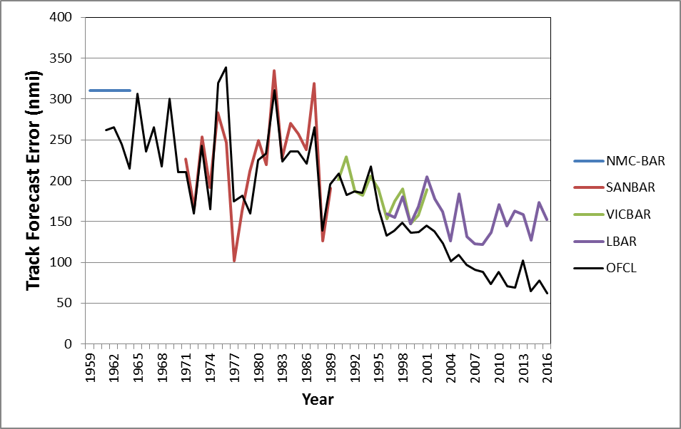
Barotropic Model 48 h Track Errors

Slide 8
Dynamical Track Models
Regional Models
Moveable Fine Mesh (MFM) (1976-1988)
Quasi-Lagrangian Model (QLM) (1988-1994)
GFDL (1995-2016, experimental runs 92-94)
HWRF (2007-present)
HMON (beginning in 2017)
Global Models
AVN/GFS (1992-present), UKMet (1995-present), NOGAPS/NAVGEM (1995-present), ECMWF (2006-present)

Slide 9
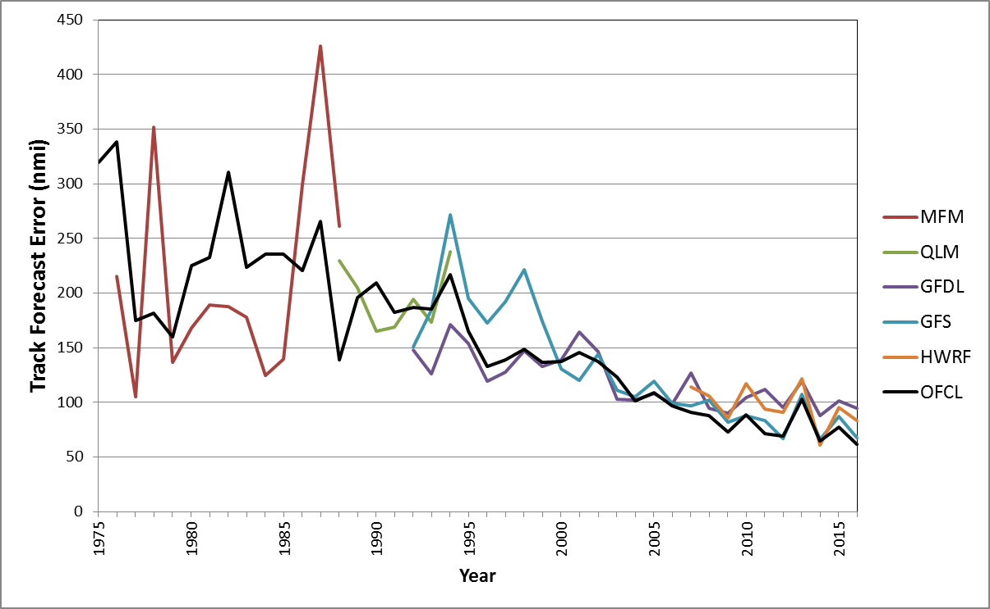
Dynamical Model 48 h Track Errors

Slide 10
GFDL Model Innovations
Provided intensity forecasts
Demonstrated utility of output besides ATCF
Special initialization around TC center and near environment
Emphasized need for improved physics
Ocean coupling
Ensemble forecasts
Paved the way for HWRF

Slide 11
Wind Swath Plot for Hurricane Hernan (1996)

Slide 12
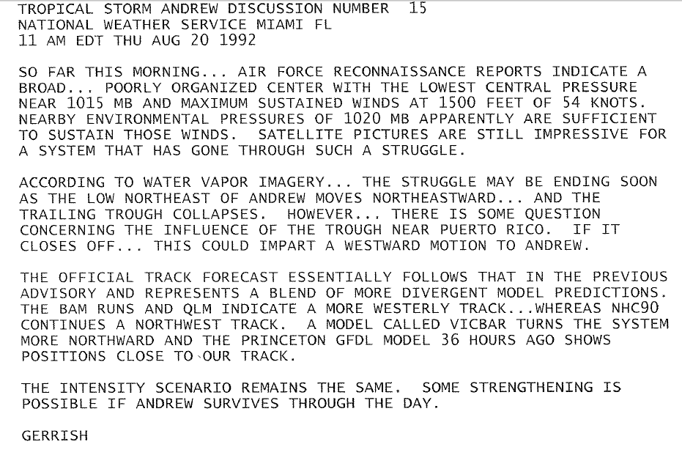
Andrew 1992 Forecast Discussion
Note: Three days later Andrew was a category 5 hurricane headed for Miami

Slide 13
Intensity Forecast Models
Statistical Models
SHIFOR/OCD5 (1988-present), T-CLIPER (2012-present)
Statistical-Dynamical Models
SHIPS (1991-present), LGEM (2006-present)
Dynamical Models
GFDL (1995-2016, experimental in 1992), HWRF (2007-present), AVN/GFS (1992-present)

Slide 14
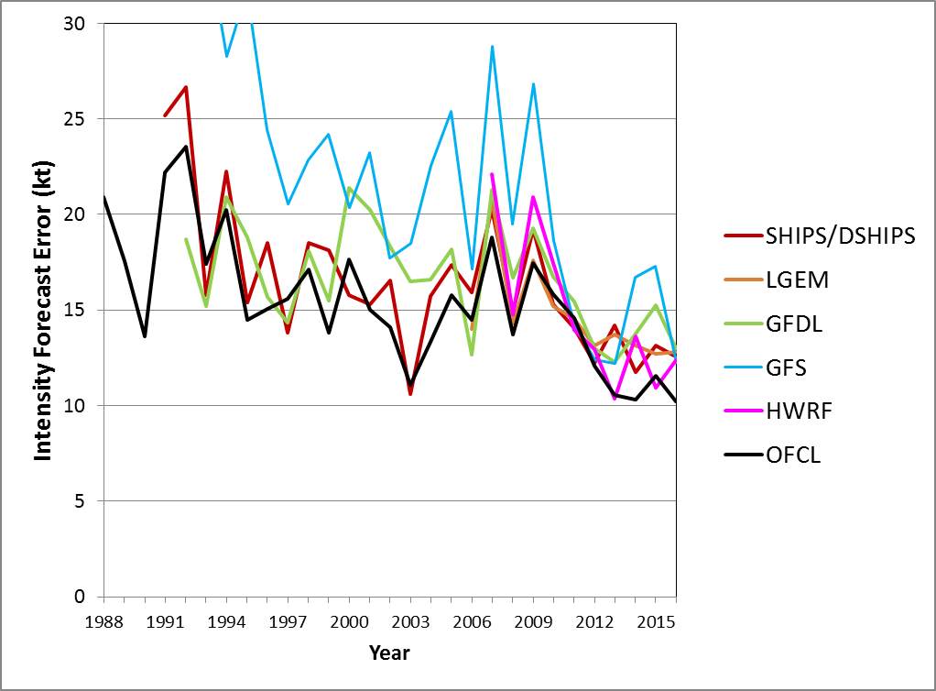
48 h Intensity Model Errors

Slide 15
Current Forecast Challenges
Intensity prediction, especially for rapid intensity changes
Tropical cyclone formation
Greater need to support NHC’s new pre-genesis watch/warning capabilities
Track forecasting
Joaquin 2015 forecasts
Wind structure and precipitation
Improved ensemble forecast systems
Coupling with wave/storm surge forecasting systems

Slide 16
Future Directions
Unified modeling system
FV3 with embedded high resolution nests
Advanced diagnostics and statistical post-processing
Hurricane track, intensity, structure, wave, storm surge forecast system
Deterministic and probabilistic
Dynamically driven NHC probabilistic products

Slide 17
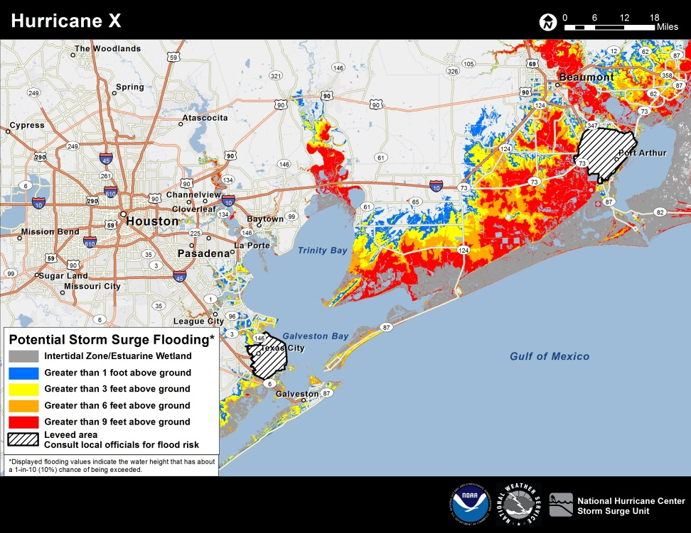
NHC Probabilistic Products
Operational Wind Speed Probability
Product and Prototype Time of Arrival
of 34 kt winds.
Example Potential Storm Surge Flooding
Graphic

