Slide 1
Vijay Tallapragada Chief, Modeling and Data Assimilation Branch & HFIP Development Co-Manager Environmental Modeling Center NOAA/NWS/NCEP GFDL Hurricane Symposium, May 2, 2017
Impact of GFDL hurricane model on NCEP Operations and TC community modeling efforts

Slide 2
Hurricane Modeling:
State-of-the-art in 2006
Naomi Surgi, NPSR December 2006
2

Slide 3
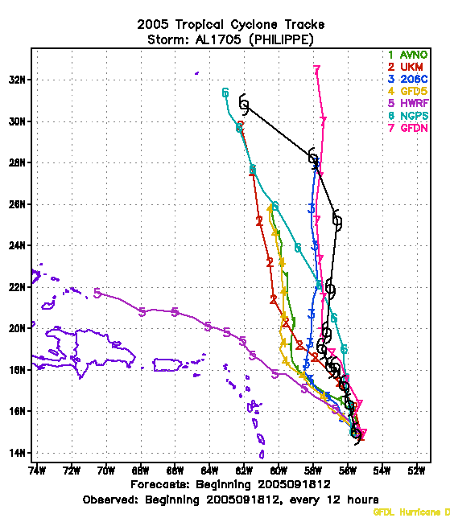
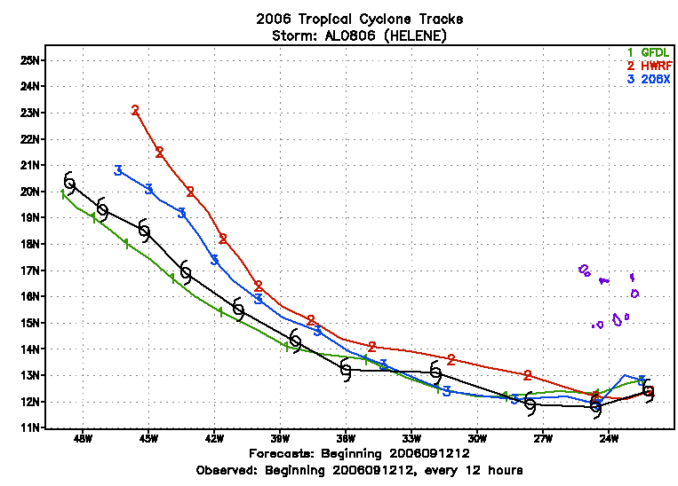
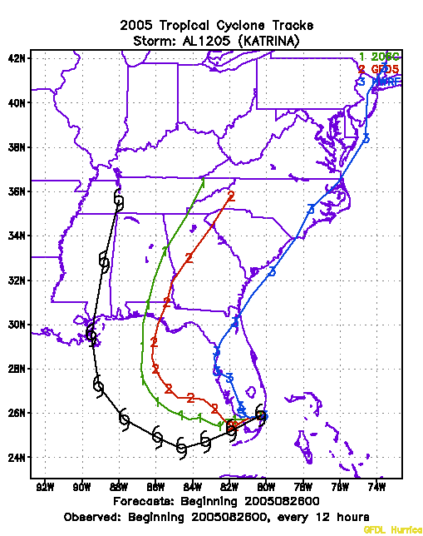
A great beginning of my interaction with Morris Bender
Vijay and Gopal: Here is a forecast from the September 12th, for the operational GFDL (Mom Mix. 1.0). The GFDL run with (Mom Mix= .5) 206X and Vijay's latest result, of HWRF with Mom mix=.5 --- That is why I introduced the scheme of ONLY reducing the momentum mixing in the storm core, but making it unity elsewhere.
Morris Bender, --- 9/26/2006
9/2
Personal Communication, Morris Bender, 8/10/2006

Slide 4
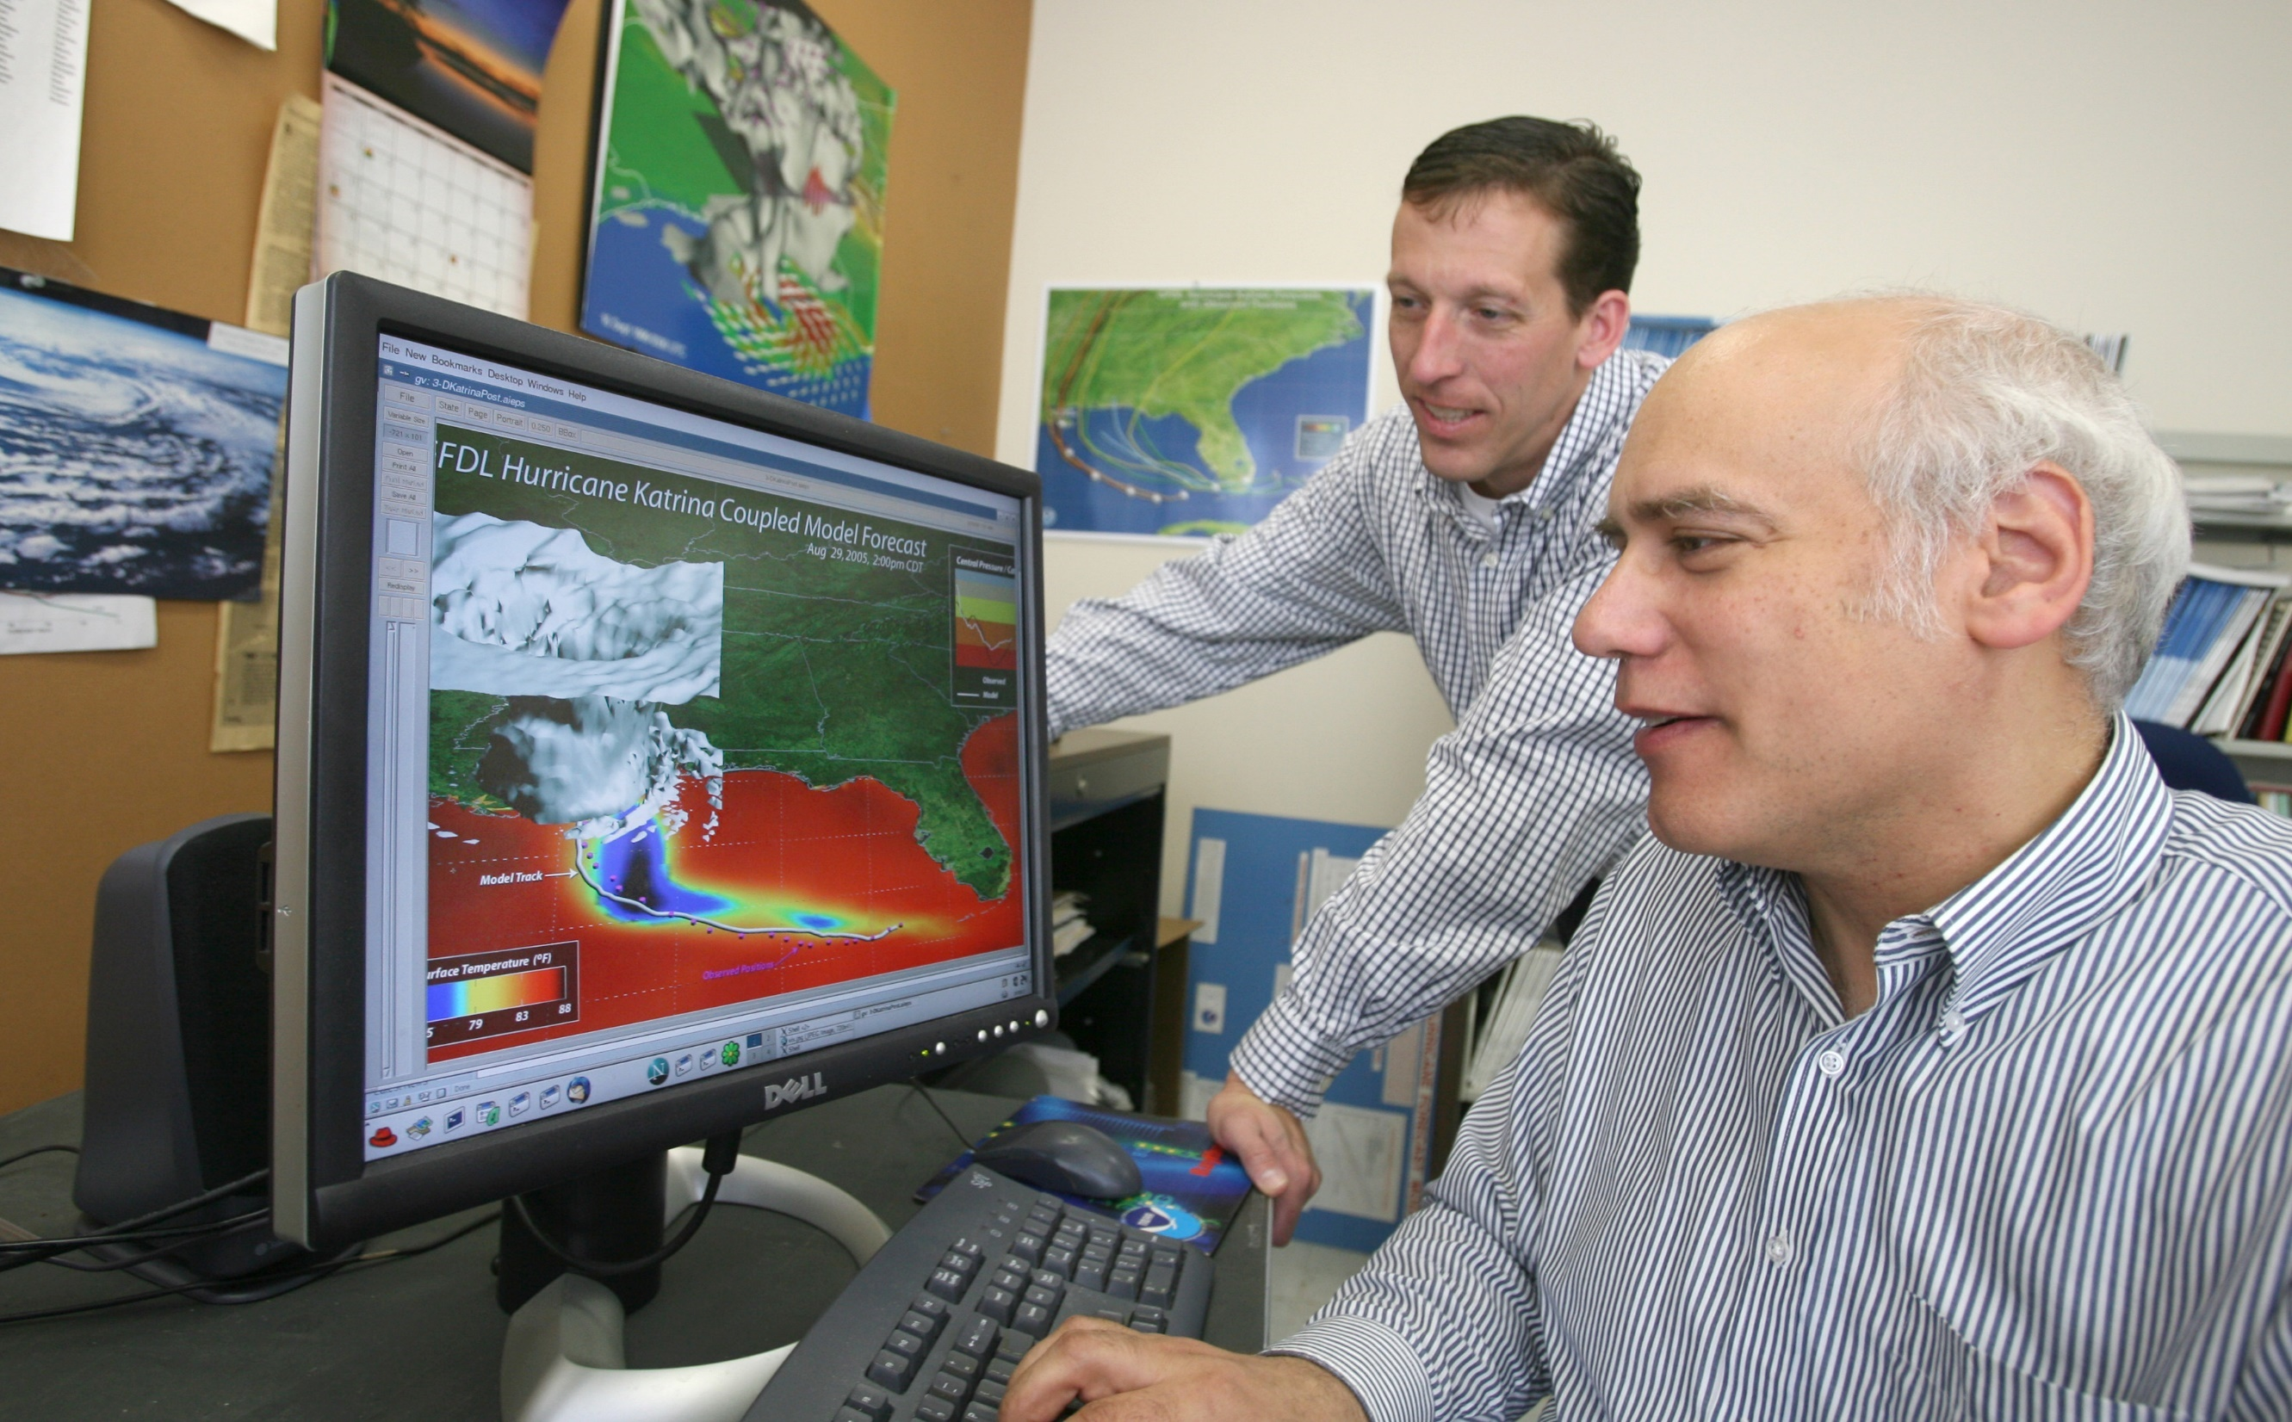
Morris Bender, Timothy Marchok, Naomi Surgi & David Michaud (2006) – “For development of critical improvements to the Geophysical Fluid Dynamics Laboratory Hurricane Predictions System, and its implementation into operational hurricane forecasts”

Slide 5
Influence of GFDL on Operational and Community TC Modeling
Fundamental and Advanced Research transitioned from GFDL to HWRF
Idealized capability for advanced research
Vortex relocation and initialization
Sophisticated nesting techniques, storm tracking and advanced physics
Coupling to ocean and waves
Knowledge transfer and shared testing and evaluation strategies for over a decade
Advanced model diagnostics (and tools) to aid forecasters and researchers alike
GFDL Contributions to operations, JHT and HFIP (and NGGPS)
Continuous upgrades to GFDL hurricane model for more than a decade past it’s life time – almost done single handedly by Morris
High-resolution multi-model regional ensembles with GFDL, HWRF and COAMPS-TC
Expansion of GFDL forecasts to Navy for all NH basins (in addition to GFDN)
Great R2O contributions in collaboration with URI and EMC
Transition of hurricane modeling techniques to FV3 for future advancements in TC forecasts

Slide 6
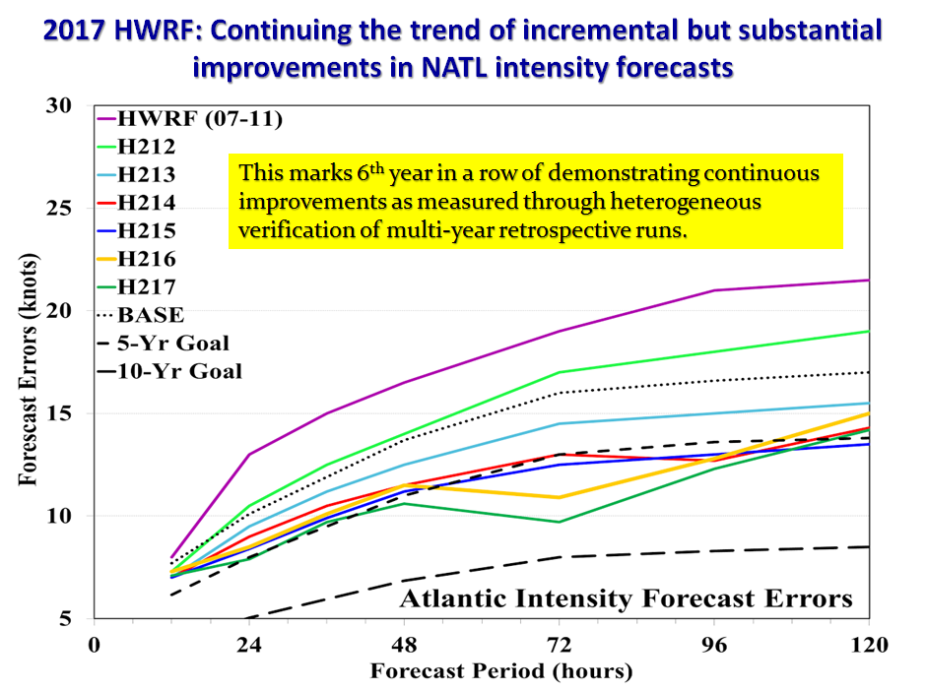
Hurricane Modeling:
State-of-the-art in 2017
After 22 years of glorious service, GFDL Hurricane model is being retired in 2017!
Notes:
You can verbalize this slide

Slide 7
2017 HMON V1.0.0 (A new Operational Hurricane Model at NCEP replacing GFDL Hurricane Model)
HISTORY REPEATS ……
Notes:
7
7

Slide 8
HWRF vs GFDL vs HMON
 | HWRF | GFDL | HMON
Dycore | Non-hydrostatic, NMM-E | Hydrostatic | Non-hydrostatic, NMM-B
Nesting | 18/6/2 kms; 75°/25°/8.3°, Full two-way moving | ½.°,1/6°,1/18°; 75°/11°/5°, Two-way moving with bc | 18/6/2 kms; 75°/12°/8°, Full two-way moving
Data Assimilation and Initialization | Self-cycled two-way HWRF EnKF-GSI with inner core DA (TDR); Vortex relocation & adjustment | Spin-up using idealized axisymmetric vortex | NDAS, NLDAS with partial cycling; Vortex relocation & adjustment
Physics | Updated surface (GFDL),GFS-EDMF PBL, Scale-aware SAS, NOAH LSM, RRTM, Ferrier | Surface (GFDL), GFS PBL(2014), SAS, GFDL LSM, RRTM, Ferrier | Surface (GFDL), GFS PBL (2015), SAS, NOAH LSM, RRTM, Ferrier
Coupling | MPIPOM, RTOFS/GDEM Wavewatch-III | MPIPOM, RTOFS/GDEM, No waves | HYCOM, RTOFS/NCODA, No waves
Post-processing | NHC interpolation method, GFDL tracker | NHC interpolation Method, In-line tracker | NHC interpolation method, GFDL tracker
NEMS/NUOPC | No | No | Yes with moving nests

Slide 9
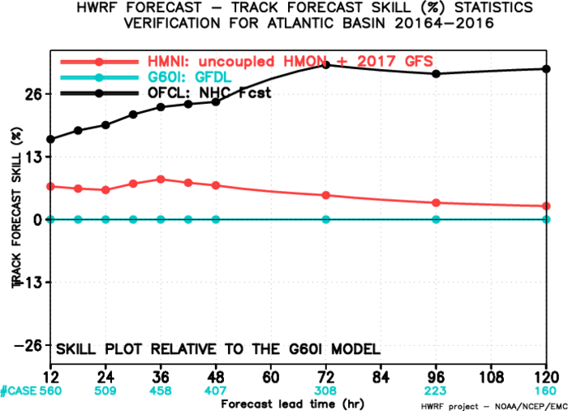
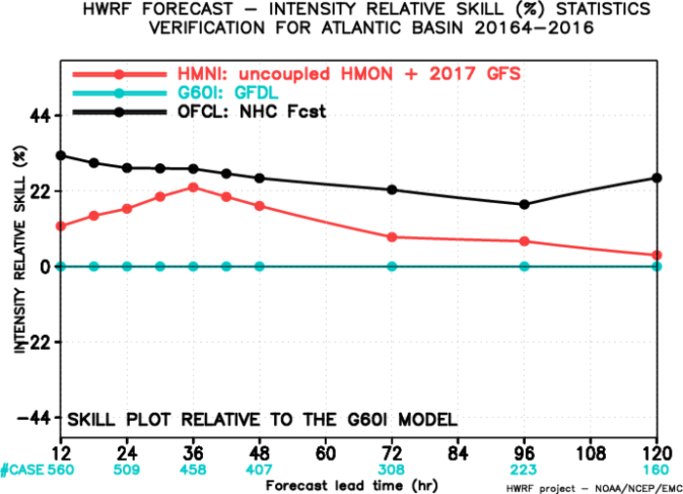
2014-16 Atlantic Basin: Relative to GFDL
(Interpolated)
HMON has improved track skills as compared to GFDL at all lead times with an average improvement of more than 5%. It also has improved intensity skills with a mean improvement of >10%. Both tracks and intensity need to close gap with the official skill.
33

Slide 10
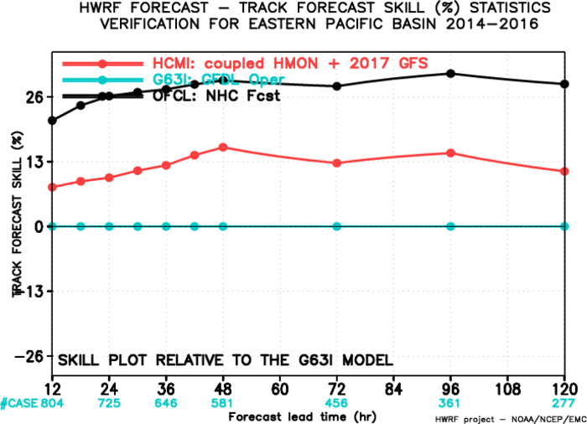
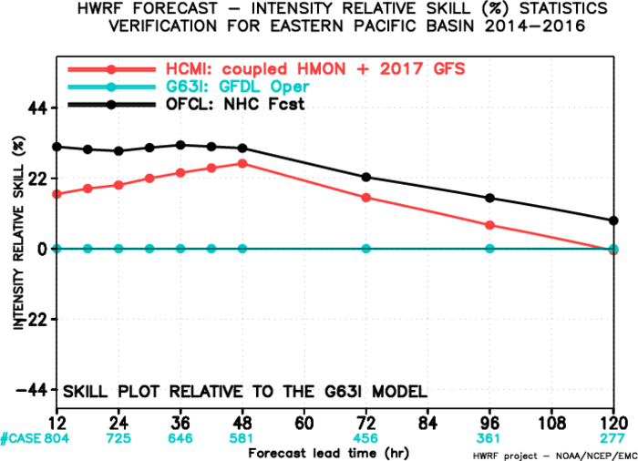
2014-16 East Pacific Basin: Relative to GFDL
(Interpolated)
HMON has improved track and intensity skills as compared to GFDL but still needs to close gap with official skill especially for longer lead times for intensity.
36

Slide 11
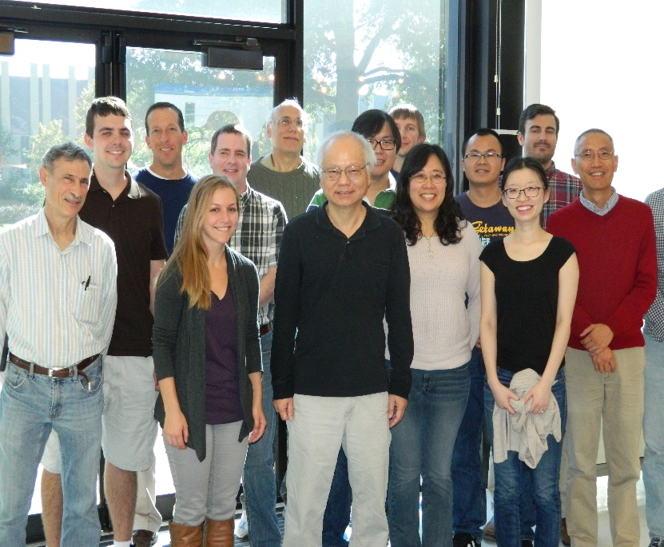
Evaluation of Tropical Cyclone Forecasts
with the GFDL FV3 Dynamical Core
Morris Bender, Jan-Huey Chen, Matthew Morin and Shian-Jiann Lin
The Journey Continues…….

Slide 12
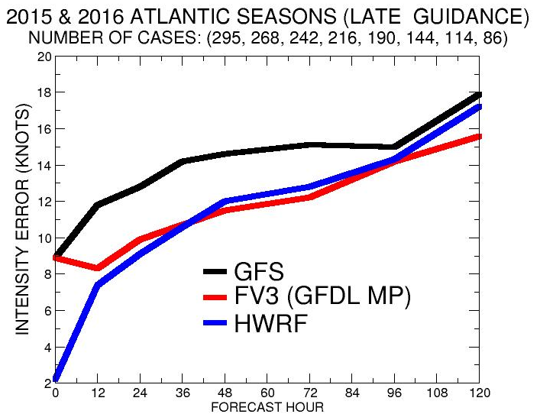
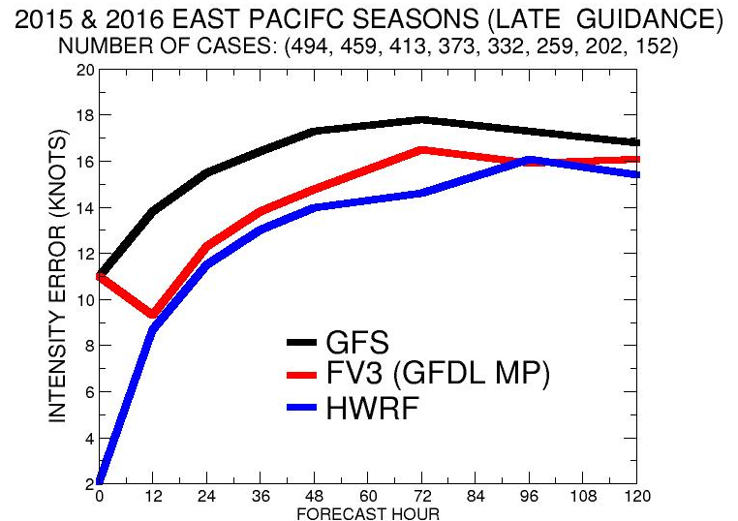
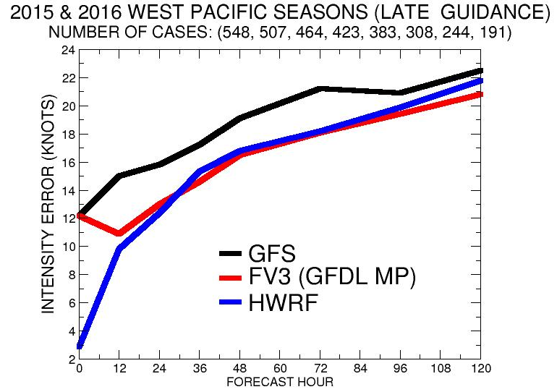
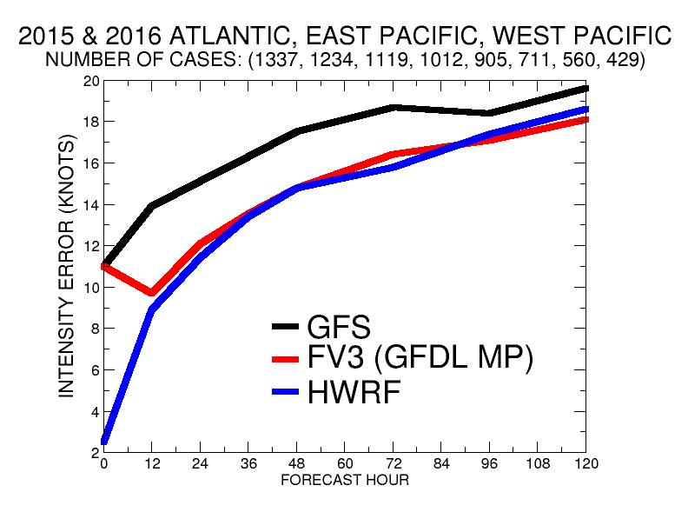
Late Model Intensity Guidance

Slide 13
On a personal note…
THANK YOU MORRIS FOR YOUR KINDNESS, SUPPORT, AND GUIDANCE FOR ALL THESE YEARS!
YOUR COMMITMENT FOR ADVANCING OPERTIONAL HURRICANE FORECASTS AND SERVICE TO THE NATION IS UNPARALLEL!!
LOOKING FORWARD TO HAVING CONTINUED INTERACTIONS WITH YOU IN YOUR NEW ROLE!!!

