Slide 1
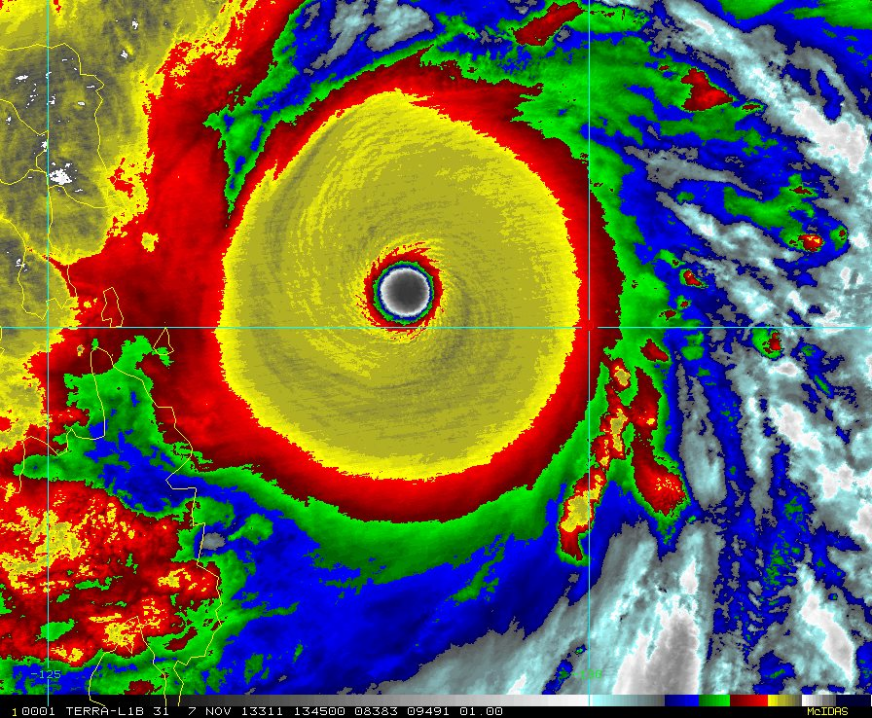
Using the GFDL Hurricane Model to Explore Tropical Cyclones and Climate Change
Tom Knutson
NOAA/GFDL
Climate Impacts and Extremes Group
GFDL/NOAA, Princeton, New Jersey
May 2017
Collaborators :
Bob Tuleya
Joe Sirutis
Morris Bender
Isaac Ginis
Weixing Shen
and many others…
Super Typhoon Haiyan, 2013

Slide 2
Publications (partial list)
Knutson, Thomas R., Robert E Tuleya, and Yoshio Kurihara, 1998: Simulated increase of hurricane intensities in a CO2-warmed climate. Science, 279(5353), 1018-1020.
Knutson, Thomas R., and Robert E Tuleya, 1999: Increased hurricane intensities with CO₂ -induced global warming as simulated using the GFDL hurricane prediction system. Climate Dynamics, 15, 503-519.
Shen, W, Robert E Tuleya, and I Ginis, 2000: A sensitivity study of the thermodynamic environment on GFDL model hurricane intensity: Implications for global warming. Journal of Climate, 13(1), 109-121.
Knutson, Thomas R., Robert E Tuleya, W Shen, and I Ginis, 2001: Impact of CO₂-induced warming on hurricane intensities simulated in a hurricane model with ocean coupling. Journal of Climate, 14(11), 2458-2468.
Knutson, Thomas R., and Robert E Tuleya, 2004: Impact of CO2-induced warming on simulated hurricane intensity and precipitation: Sensitivity to the choice of climate model and convective parameterization. Journal of Climate, 17(18), 3477-3495.
Bender, Morris A., Thomas R Knutson, Robert E Tuleya, Joseph J Sirutis, Gabriel A Vecchi, Stephen T Garner, and Isaac M Held, 2010: Modeled impact of anthropogenic warming on the frequency of intense Atlantic hurricanes. Science, 327(5964).
Knutson, Thomas R., Joseph J Sirutis, Gabriel A Vecchi, Stephen T Garner, Ming Zhao, Hyeong-Seog Kim, Morris A Bender, Robert E Tuleya, Isaac M Held, and G Villarini, 2013: Dynamical downscaling projections of 21st century Atlantic hurricane activity: CMIP3 and CMIP5 model-based scenario. Journal of Climate, 26(17) .
Knutson, Thomas R., Joseph J Sirutis, Ming Zhao, Robert E Tuleya, Morris A Bender, Gabriel A Vecchi, G Villarini, and D Chavas, 2015: Global Projections of Intense Tropical Cyclone Activity for the Late Twenty-First Century from Dynamical Downscaling of CMIP5/RCP4.5 Scenarios. Journal of Climate, 28(18) .
Tuleya, Robert E., Morris A Bender, Thomas R Knutson, Joseph J Sirutis, B Thomas, and I Ginis, 2016: Impact of upper tropospheric temperature anomalies and vertical wind shear on tropical cyclone evolution using an idealized version of the operational GFDL hurricane model. Journal of the Atmospheric Sciences, 73(10).

Slide 3
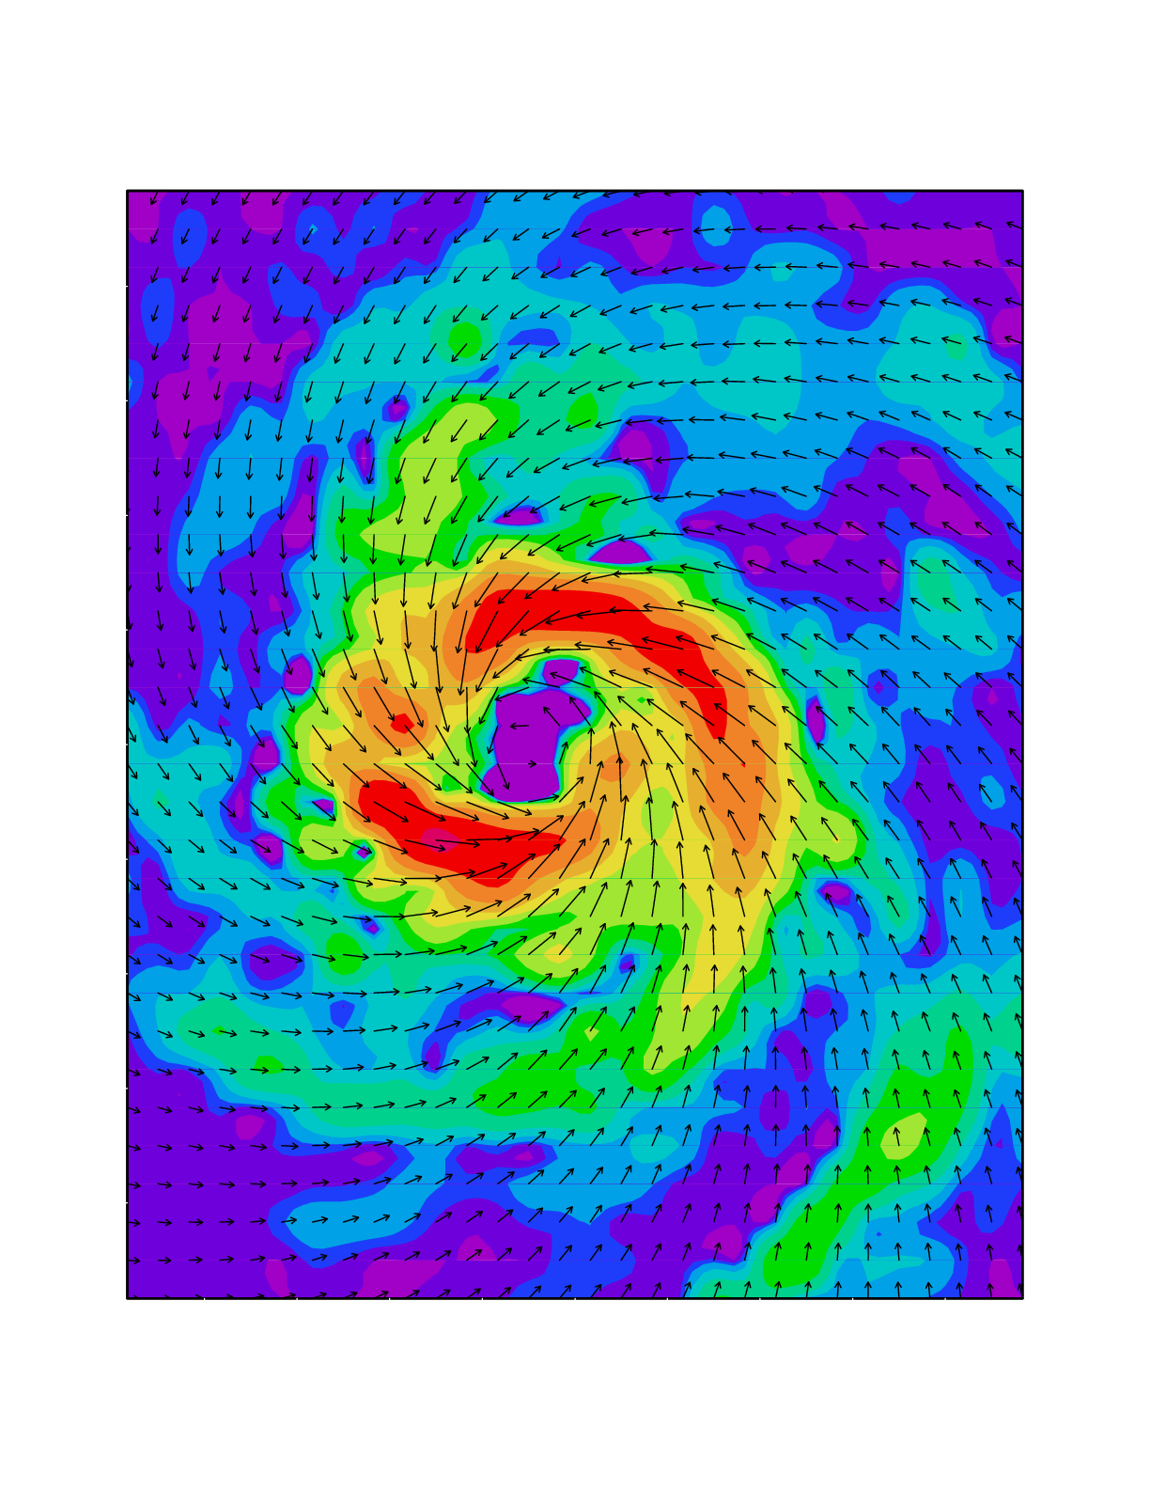
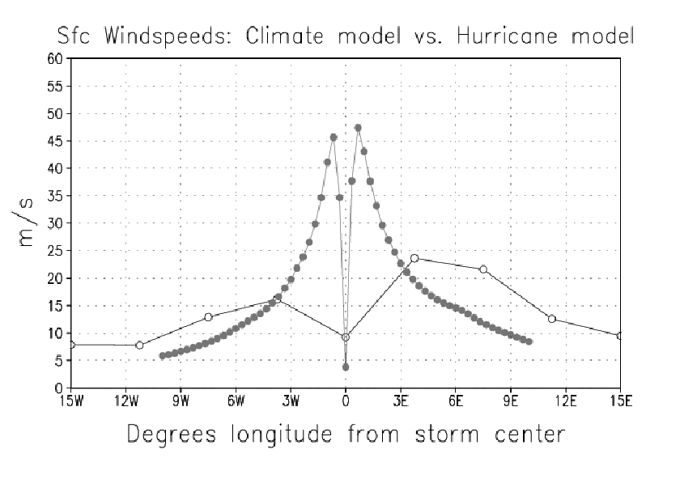
Hurricanes simulated in high resolution (1/6º) nested models have more realistic intensity and structure than global model tropical storms…
Simulated precipitation and surface winds

Slide 4
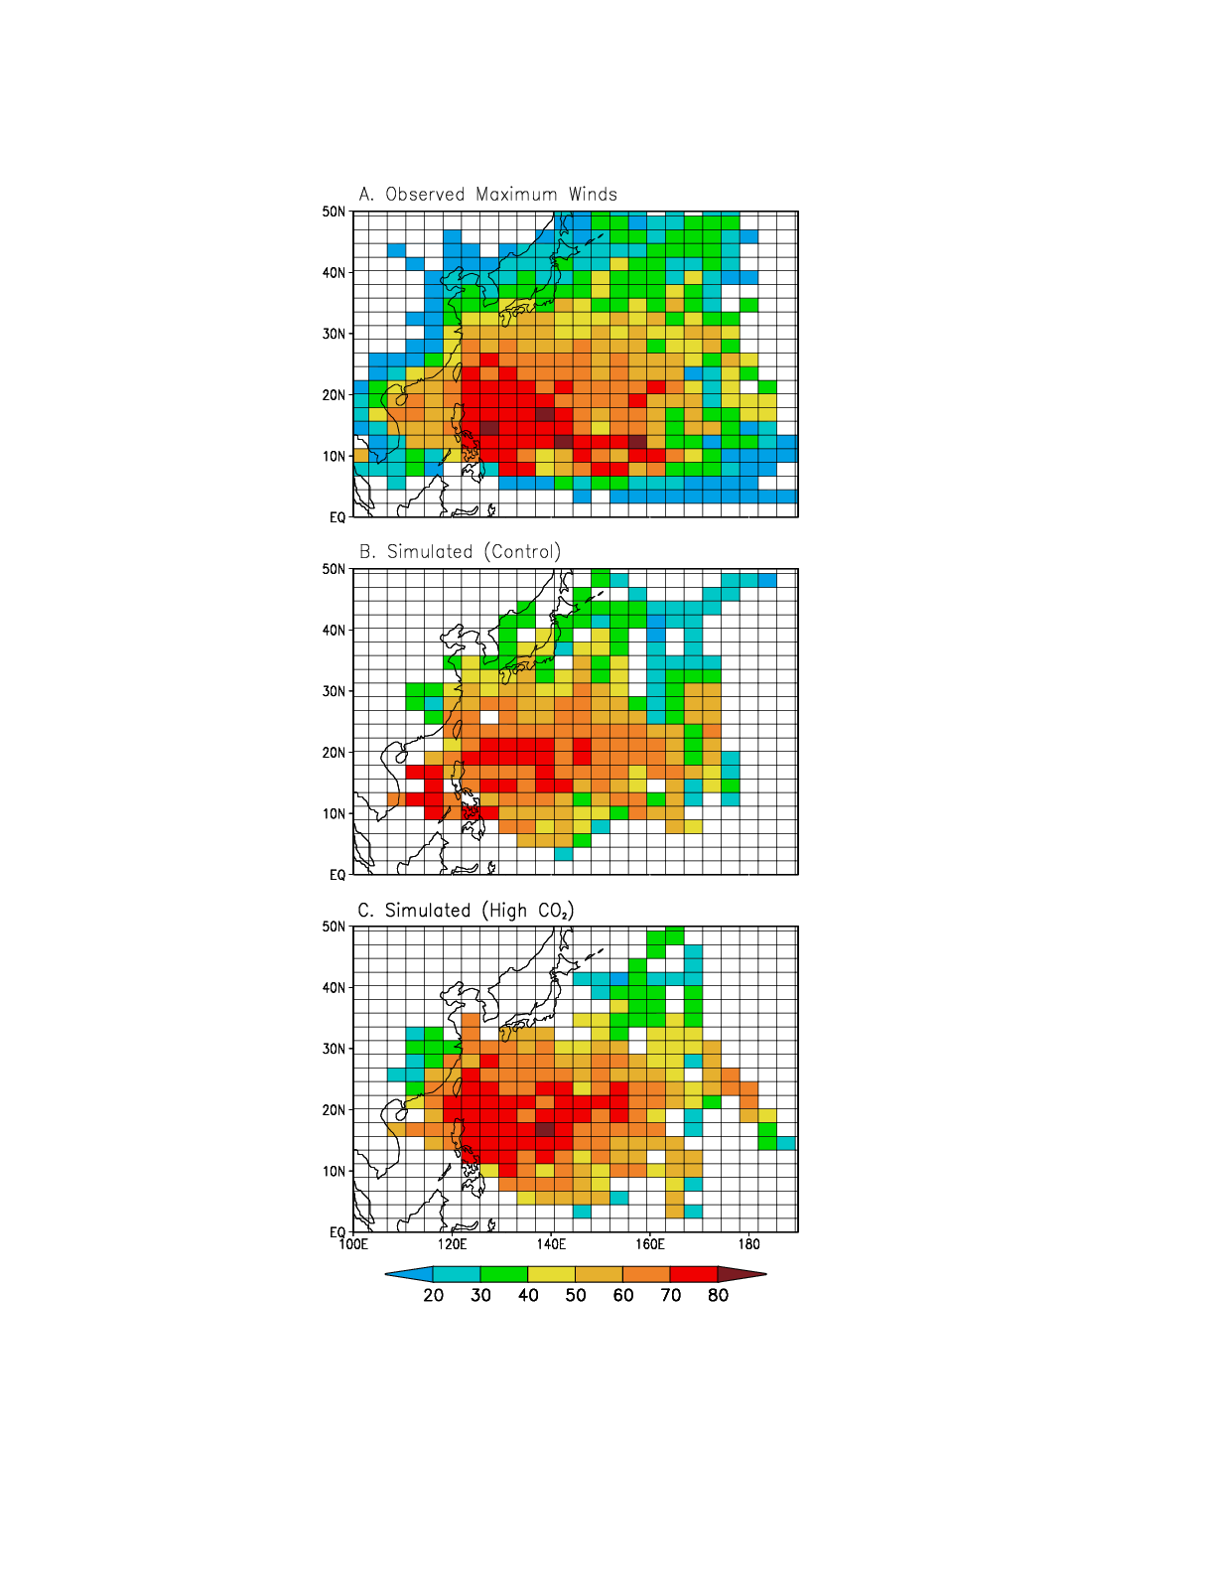
Observed (1971-92)
Simulated maximum surface wind speeds –- NW Pacific:
Control (51 cases)
High CO₂ (51 cases)
Source: Knutson, Tuleya, and Kurihara, Science, 1998.
m/s
Source: Knutson, Tuleya, and Kurihara, Science, v. 279, 1998.

Slide 5
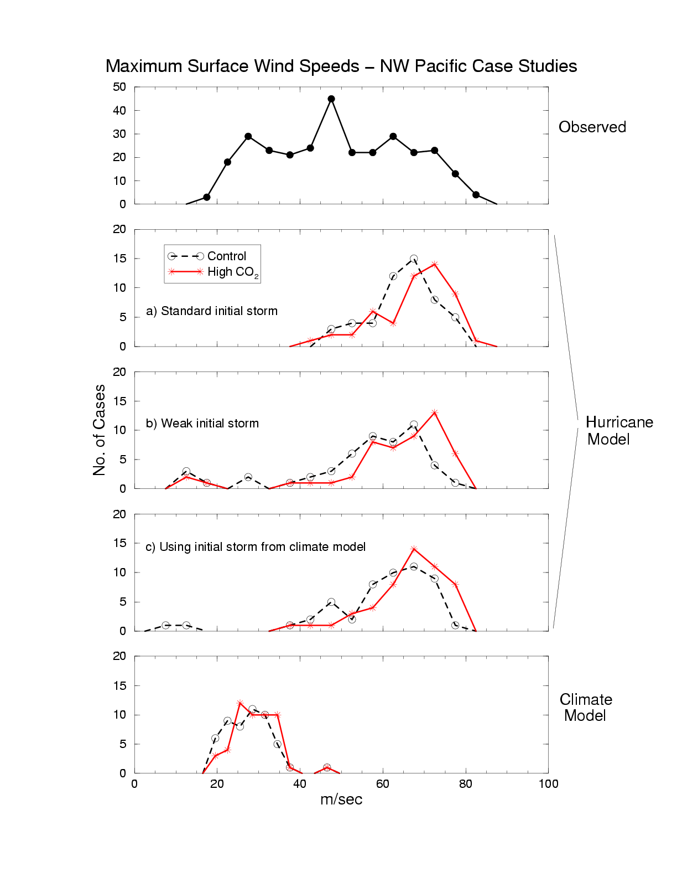
A Hurricane (typhoon) model simulates higher intensities (5-11%) in a CO₂-warmed climate…

Slide 6
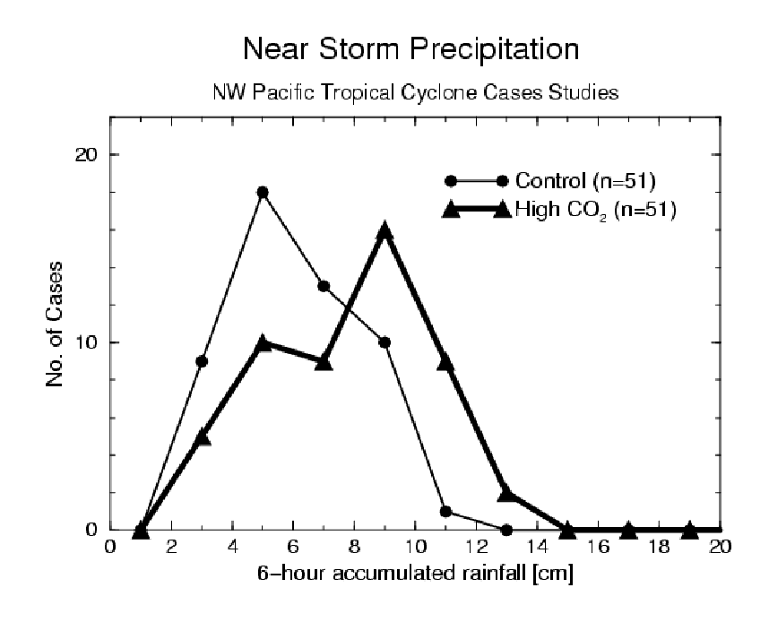
Near-Storm Precipitation increased by 28% in the high CO₂ case studies
Source: Knutson and Tuleya, Climate Dynamics., 1999

Slide 7
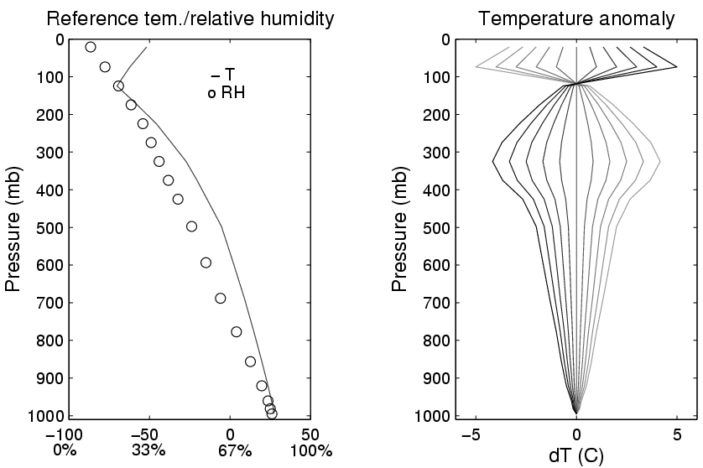
Environmental Conditions for Idealized Hurricane Model Simulations
Source: Shen et al., Journal of Climate, 2000.

Slide 8
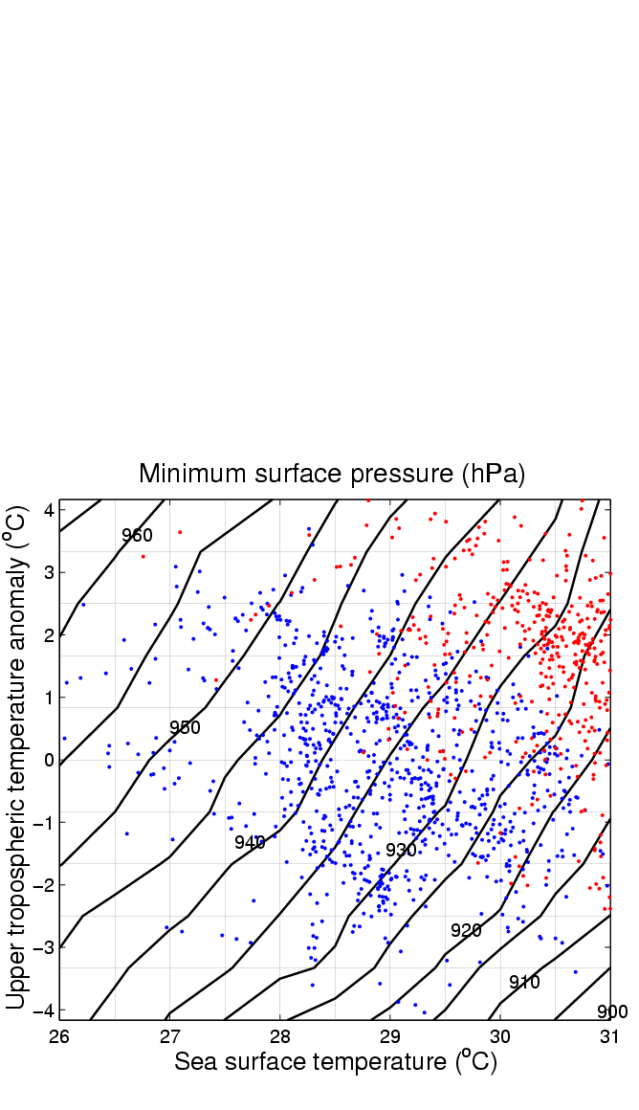
Source: Shen et al., Journal of Climate, 2000.

Slide 9
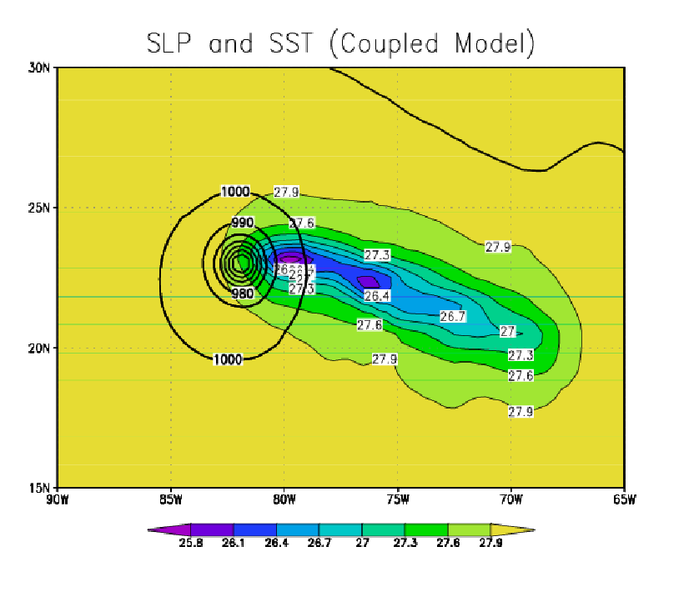
Hurricane-generated sea surface cooling
Cool wake
Hurricane
SST (deg C)
Model: GFDL Coupled Hurricane-Ocean model; Reference: Knutson et al., J. Climate, 2001.

Slide 10
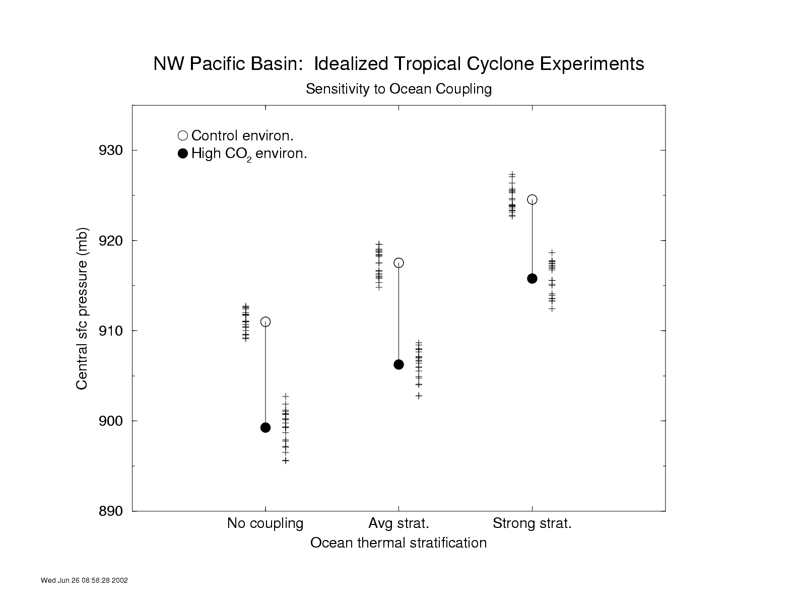
Source: Knutson et al., Journal of Climate (2001)

Slide 11
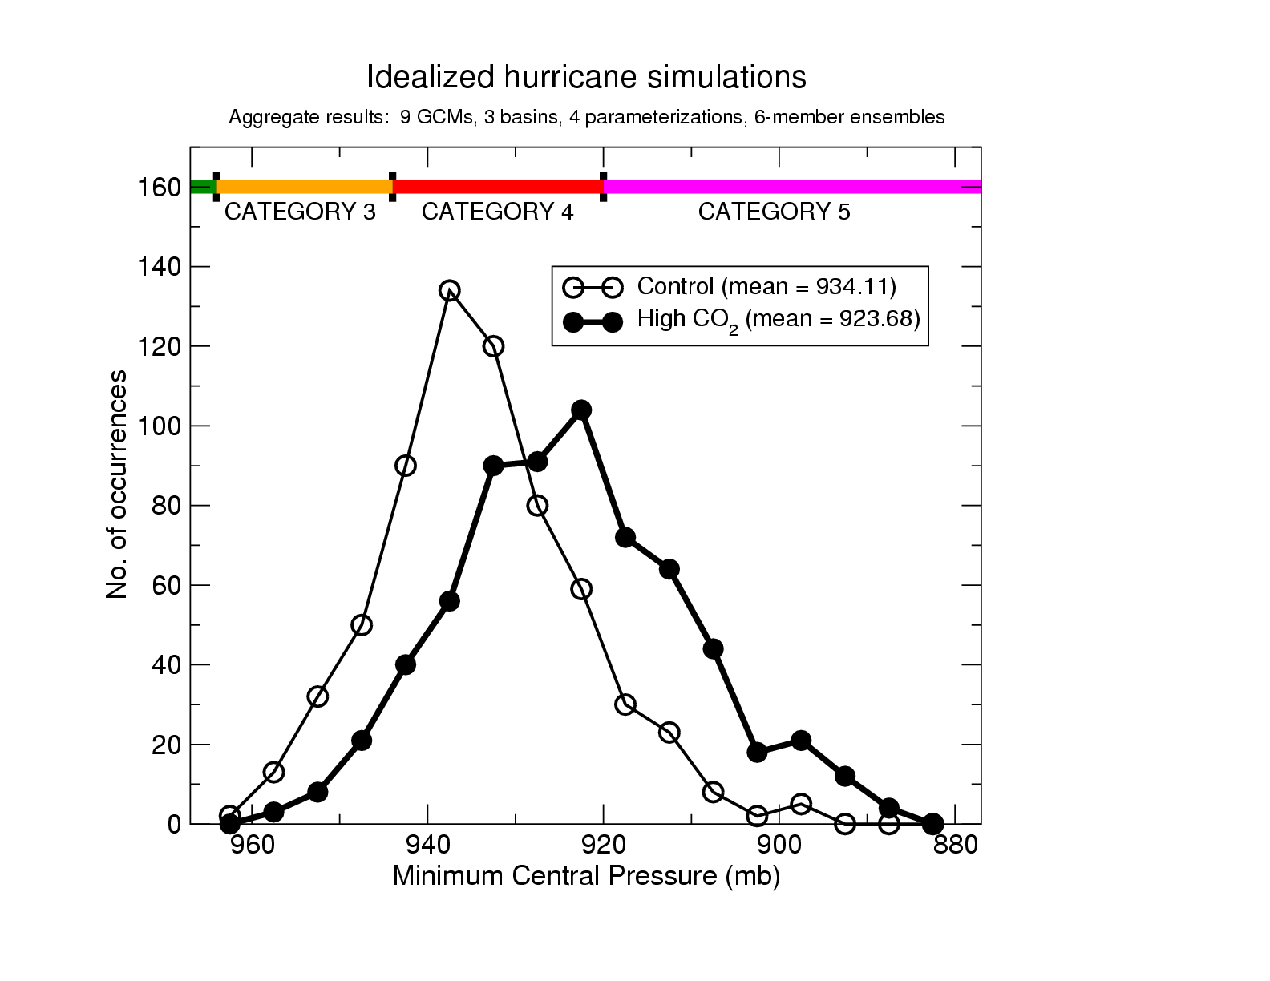
11
Projected increasing hurricane intensities with climate warming… robust to choice of different “parent” climate models and of convective parameterization.
Hurricane Intensity
Current climate
~Late 21st century
Sensitivity: ~4% increase in wind speed per ºC SST increase
Source: Knutson and Tuleya, J. Climate, 2004
Notes:
11

Slide 12
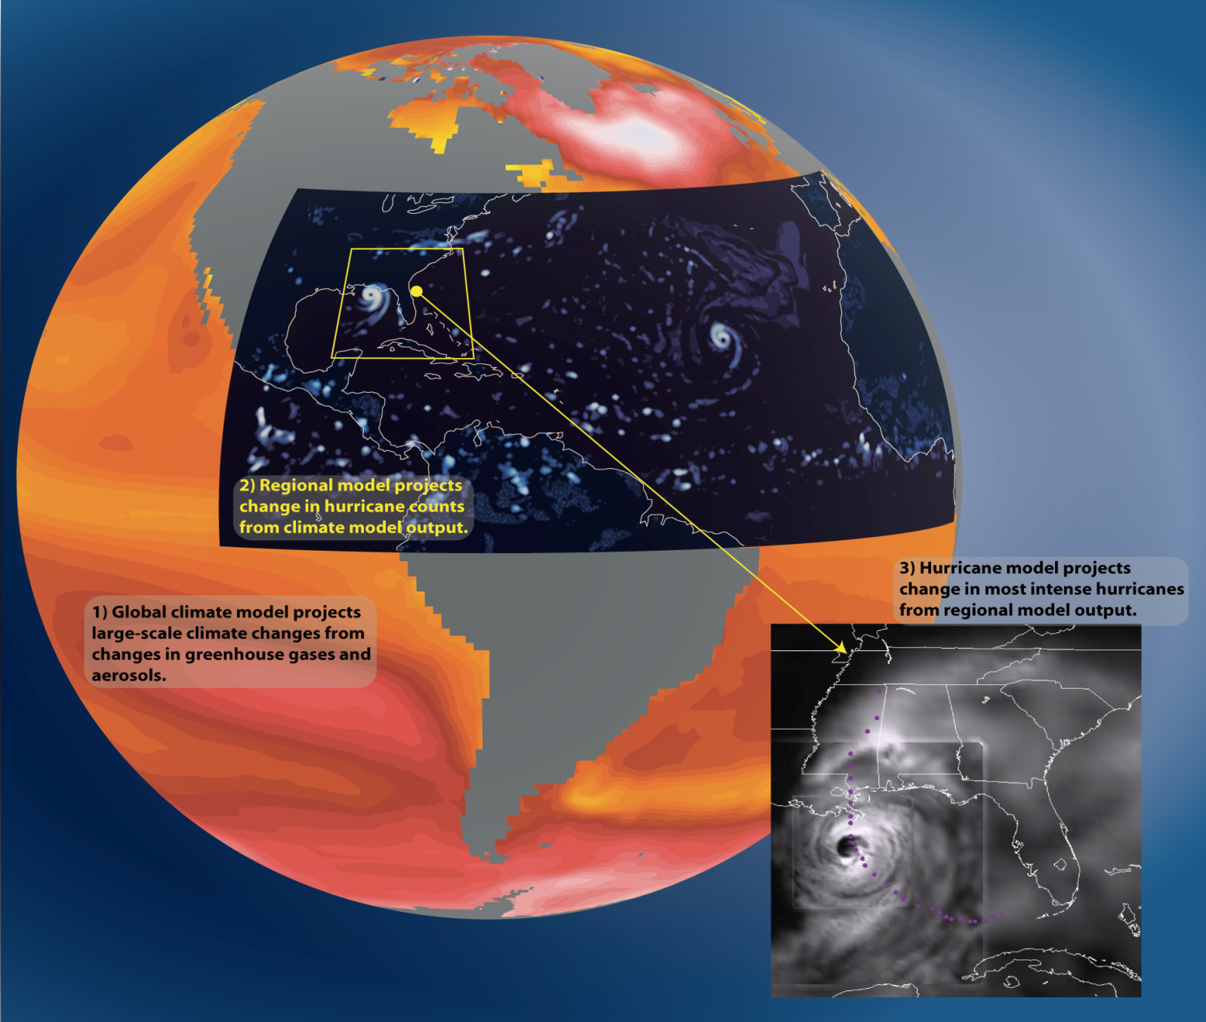
Modeling approach: Downscale tropical cyclones from lower resolution models into the GFDL hurricane model for improved storm intensity and structure

Slide 13
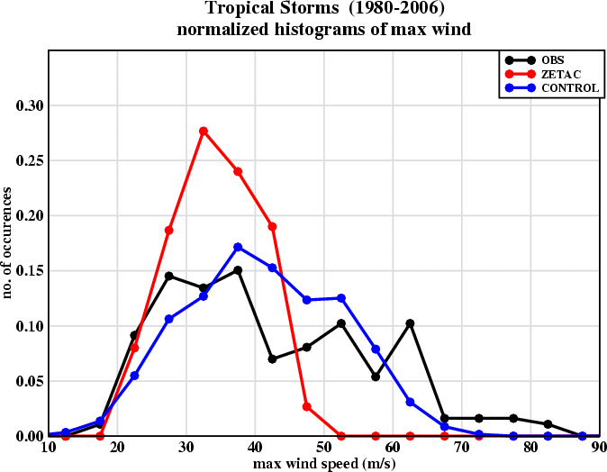
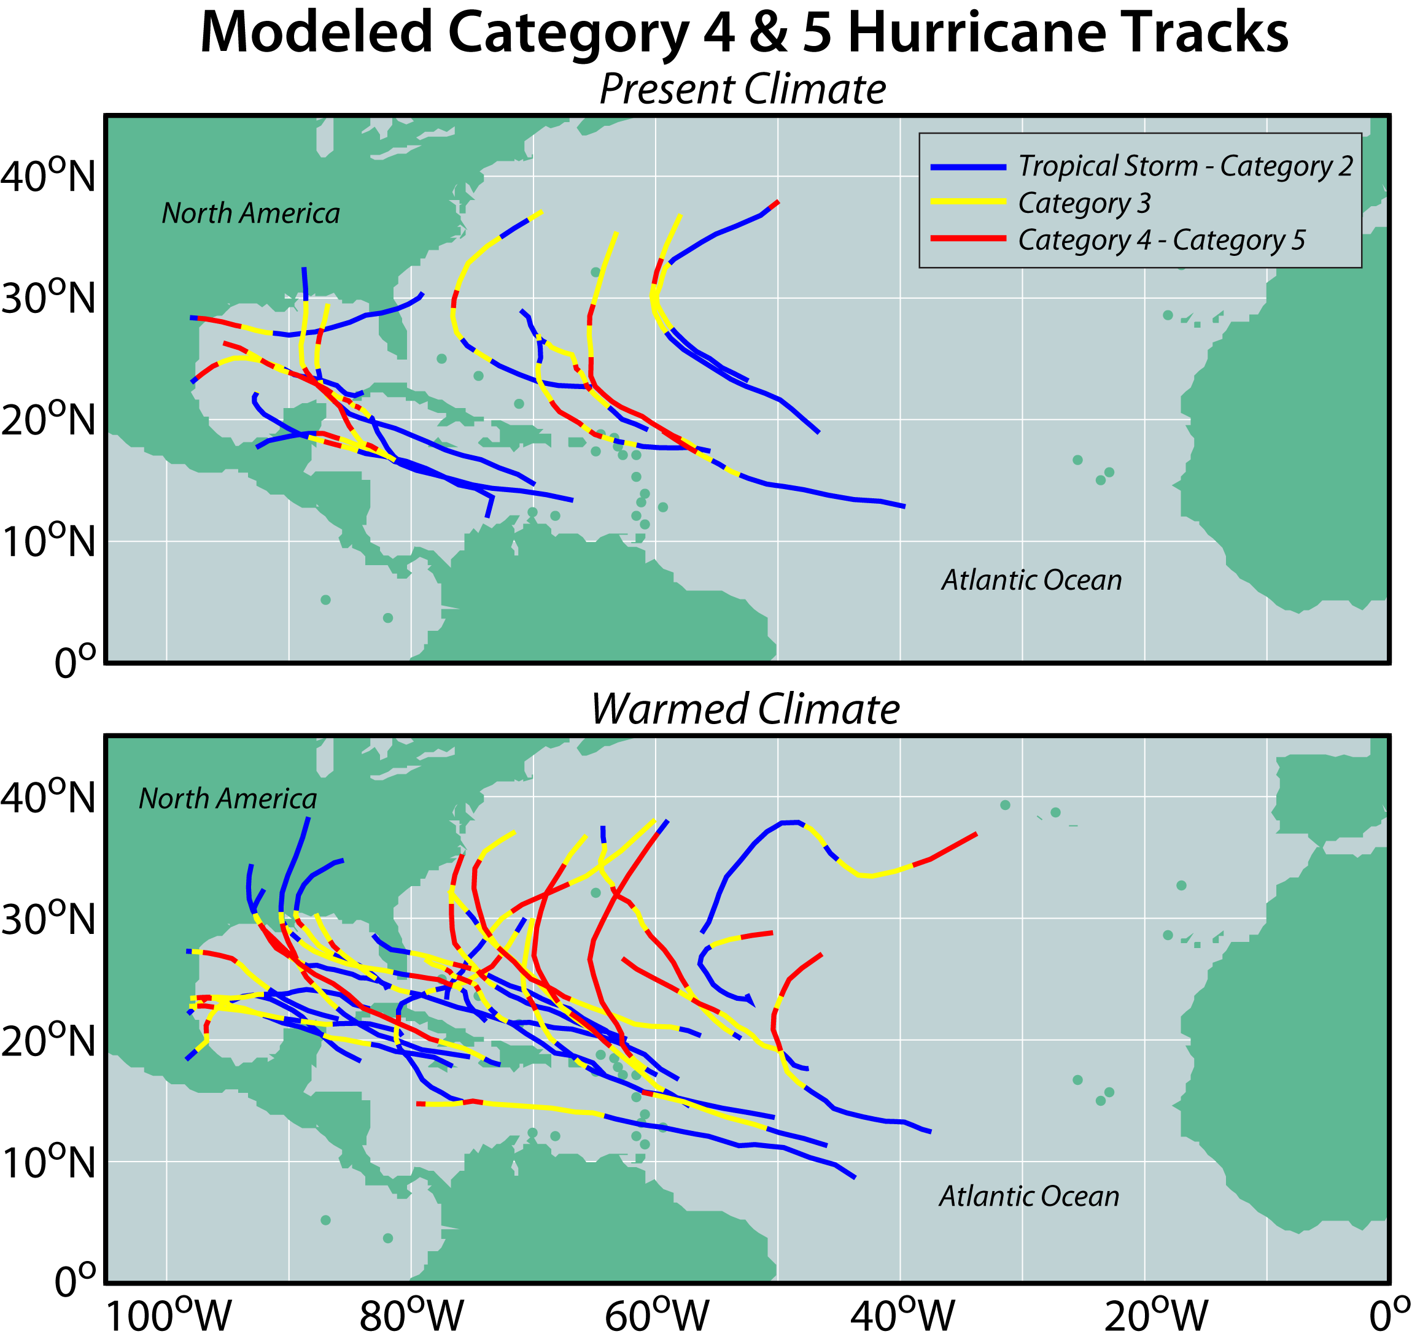
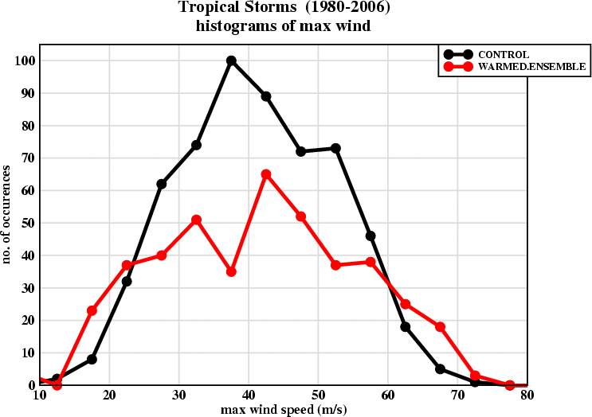
Late 21st Century Climate Warming Projection-- Average of 18 CMIP3 Models
Simulated distributions of present-day intensitiess, downscaling from NCEP Reanalysis
18km grid Zetac model
9 km GFDL hurricane model (2nd downscaling step)
observed
More Very Intense Storms in Warm Climate (Red)
(27 Simulated Hurricane Seasons) Source: Bender et al., Science, 2010

Slide 14
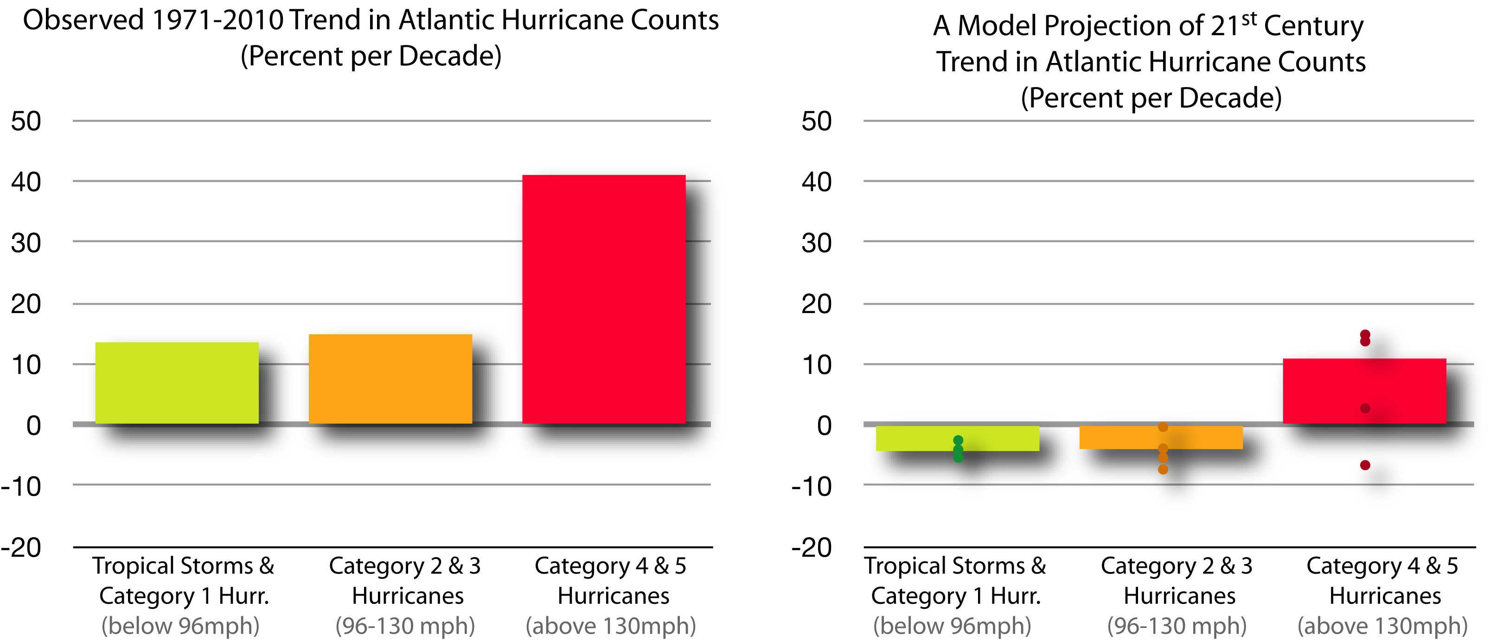
Comparison of Recent Atlantic Hurricane Trends vs 21st Century Projected Trend Rates (in percent per decade)
Figure courtesy Gabe Vecchi, GFDL./NOAA

Slide 15
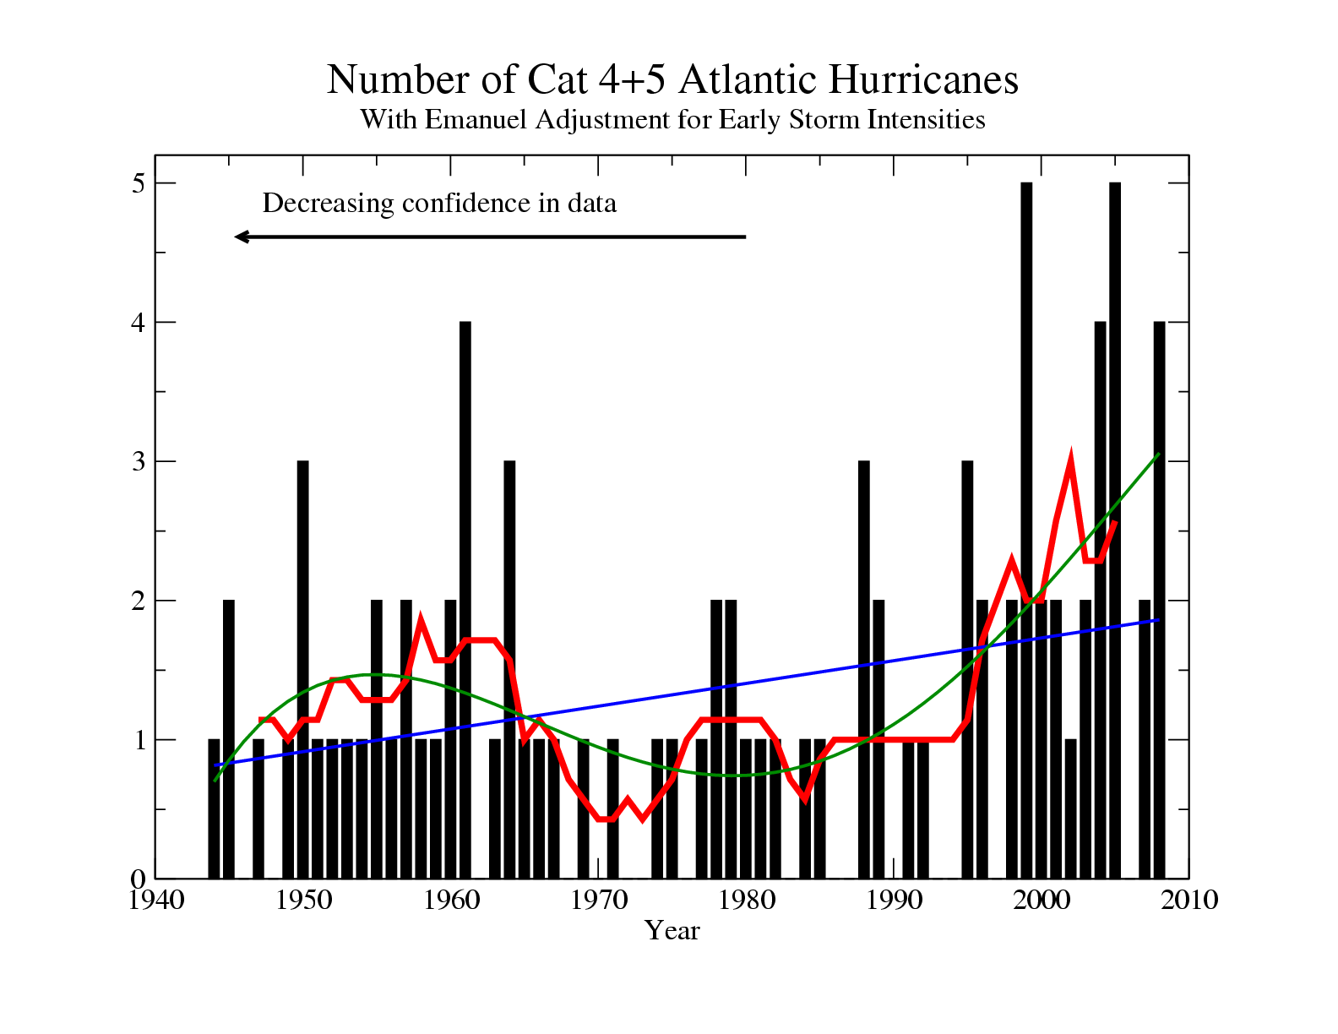
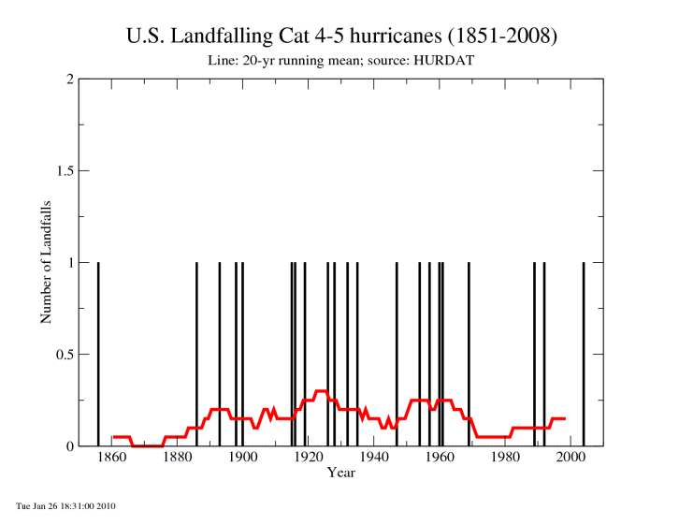
Emergence Time Scale: Assume the observed Cat 4+5 data since 1944 represents the noise (e.g. through bootstrap resampling). Add a 10% per decade trend to samples of this noise and determine the timescale at which 95% of the resulting series have a positive trend. Estimate: ~60 yr
Sensitivity tests:
i) assume residuals from a 4th order polynomial: 55 yr;
ii) resample chunks of length 3-7 yr: 65-70 yr
Source: Bender et al., Science, 2010.

Slide 16
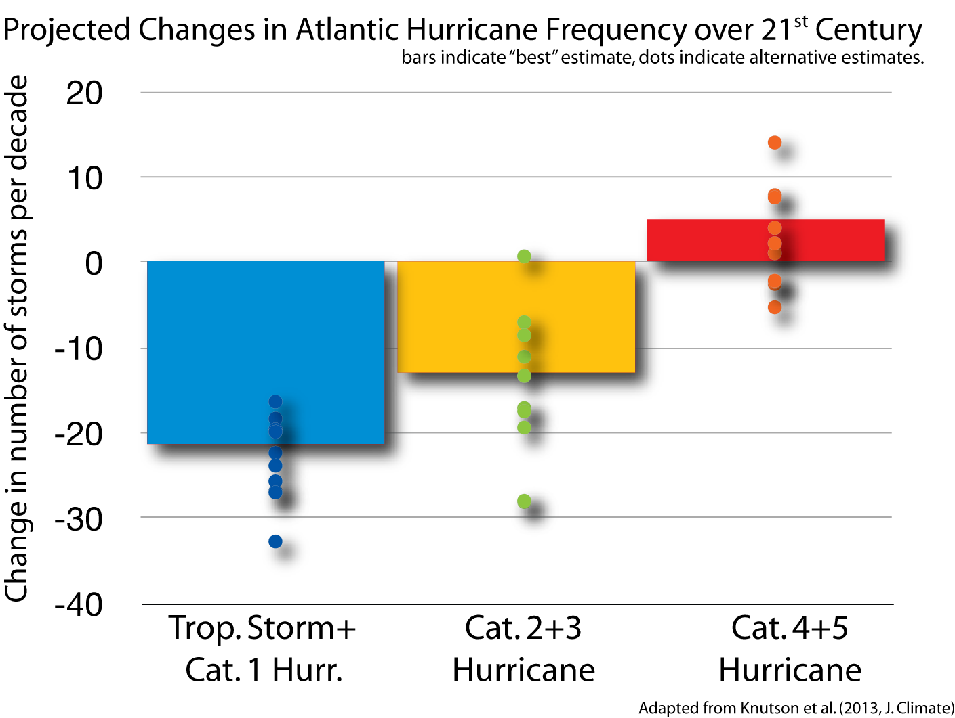
Summary of Atlantic Tropical Cyclone Projections over the 21st Century
Adapted from Knutson et al. (2013, J. Clim.). See also: Knutson et al. (2009), Zhao et al. (2009), Bender et al. (2010), Villarini et al. (2011), Villarini and Vecchi (2012, 2013)

Slide 17
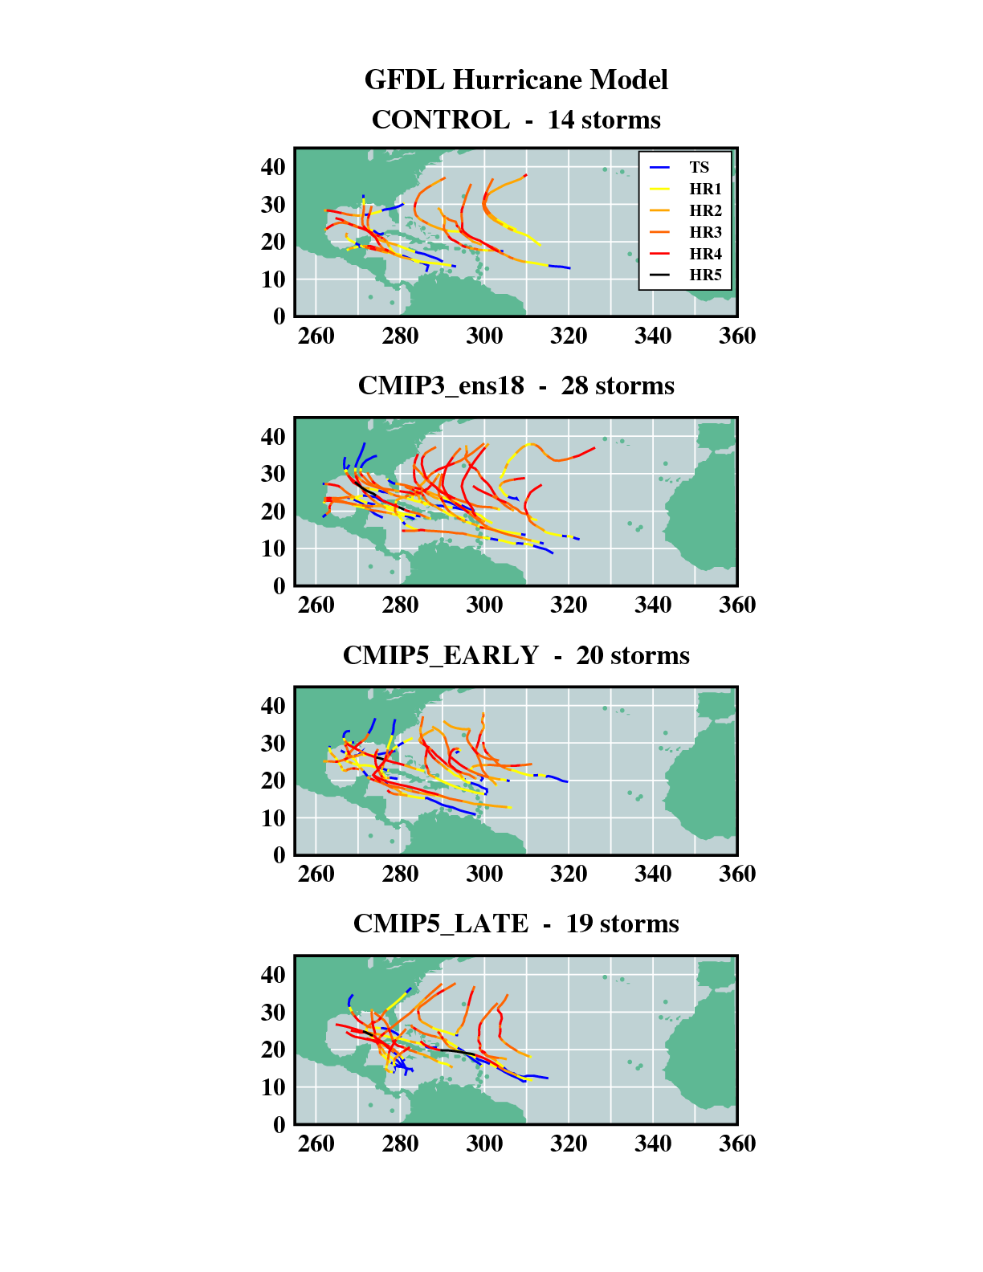
GFDL Hurricane Model: Category 4 & 5 Hurricane Tracks (27 years)
Source: Knutson et al. (J. Climate, 2013).

Slide 18
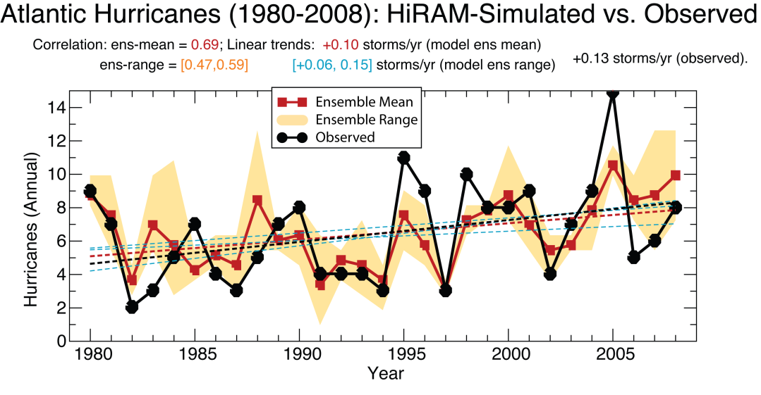
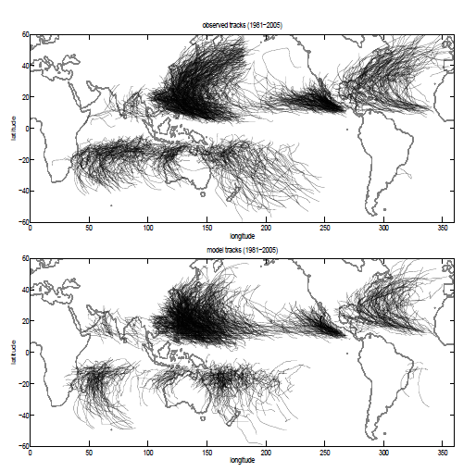
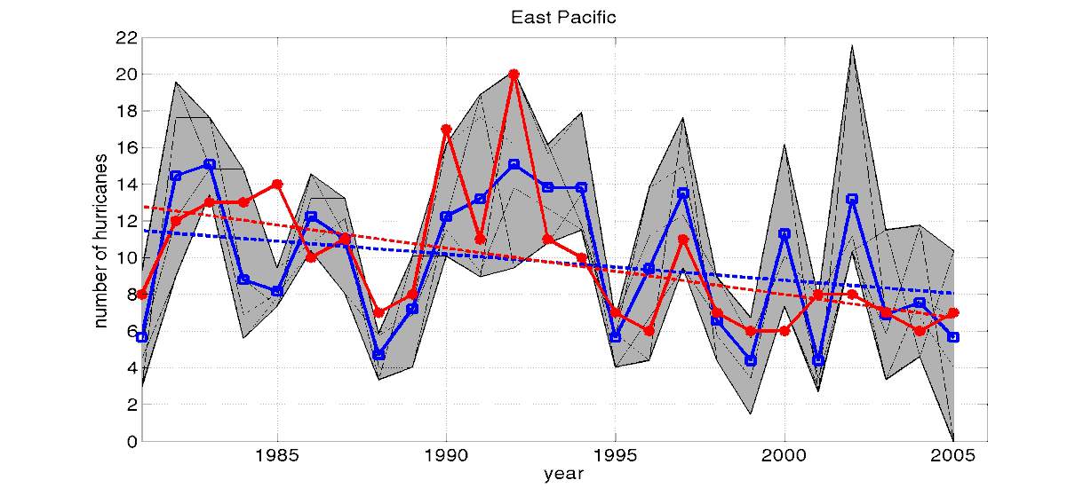
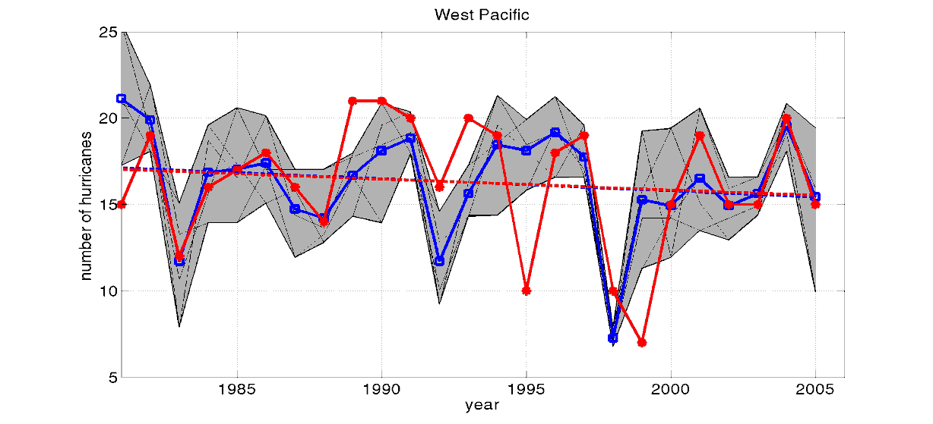
Simulating global tropical cyclone activity at higher resolution
18
GFDL HIRAM 50km grid global model:
Simulated vs Observed Tropical Storm Tracks (1981-2005)
corr = 0.69
East Pacific
corr=0.62
West Pacific
corr=0.52
Sources: Adapted from Zhao et al. J. Climate, 2009.

Slide 19
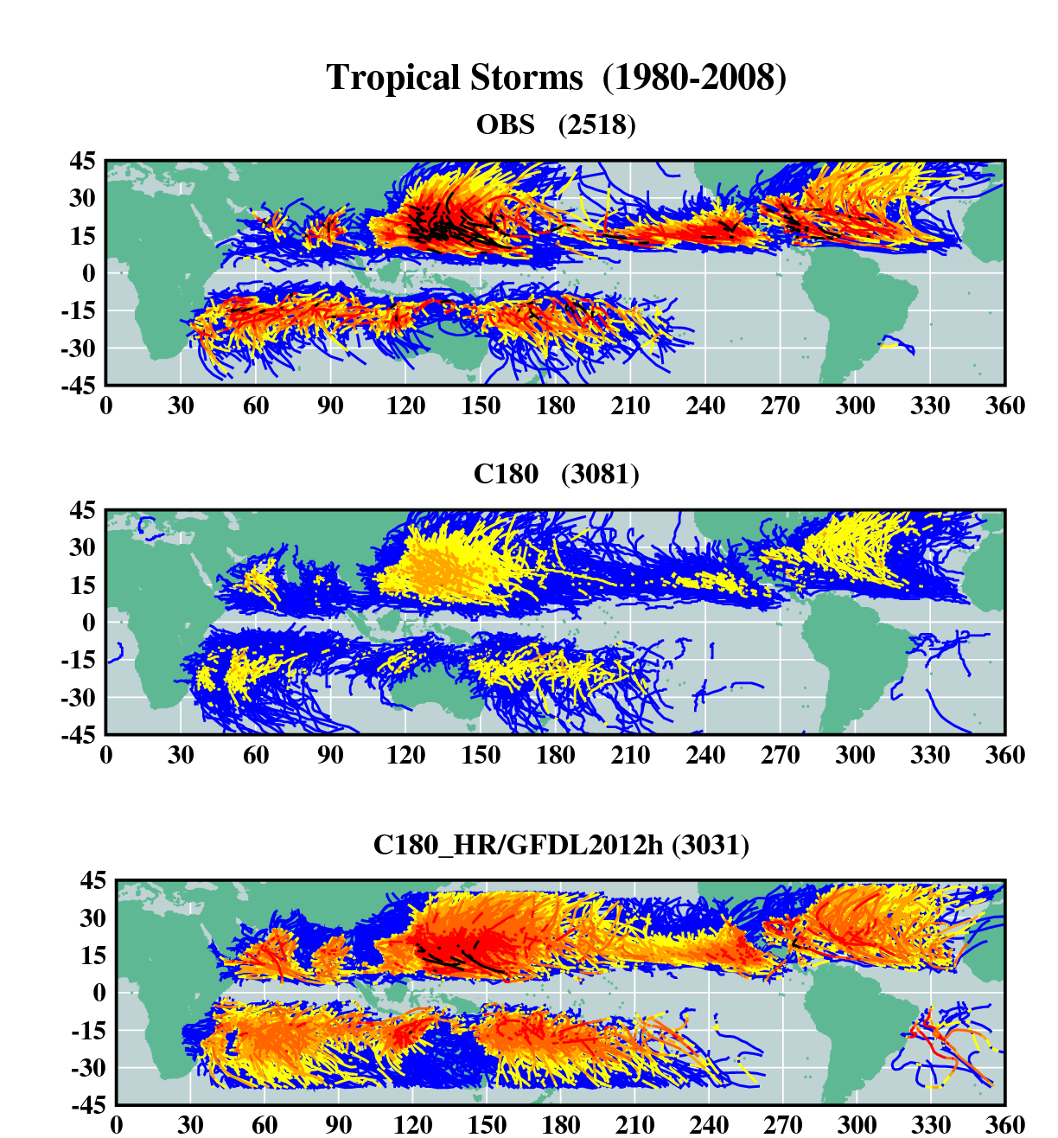
Present-Day Climate
Observed
50-km grid global model
6-km grid dynamical downscale
Storm
Category:
Source: Knutson et al., J. of Climate, 2015.

Slide 20
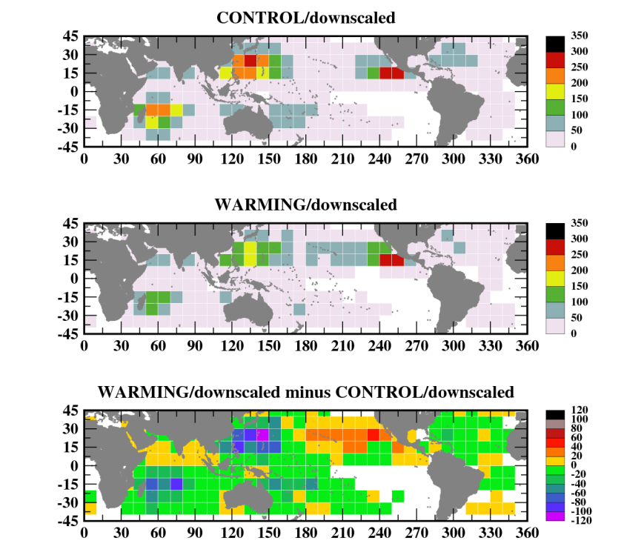
Tropical Storm Occurrence Simulations (Category 0-5)
Present-day simulation
Unit: Number of storm days per 20 years
RCP4.5 Ensemble: Late 21st Century Projection
Late 21st century minus present-day
16% reduction by late 21st century
Source: Knutson et al., J. of Climate, 2015.

Slide 21
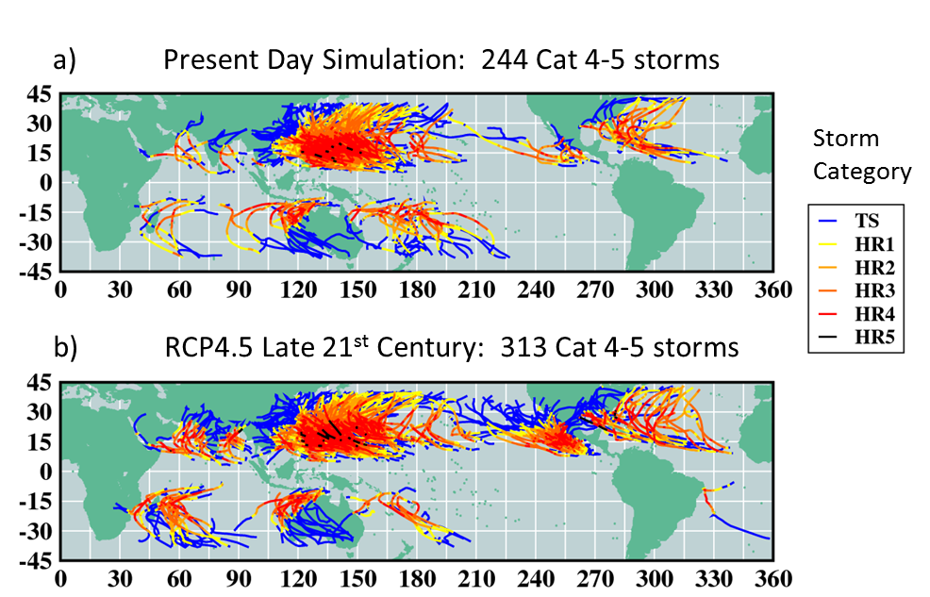
Category 4-5 Tropical Cyclone Occurrence
34% increase projected globally in
Cat 4-5 days
Source: Knutson et al., J. of Climate, 2015.

Slide 22
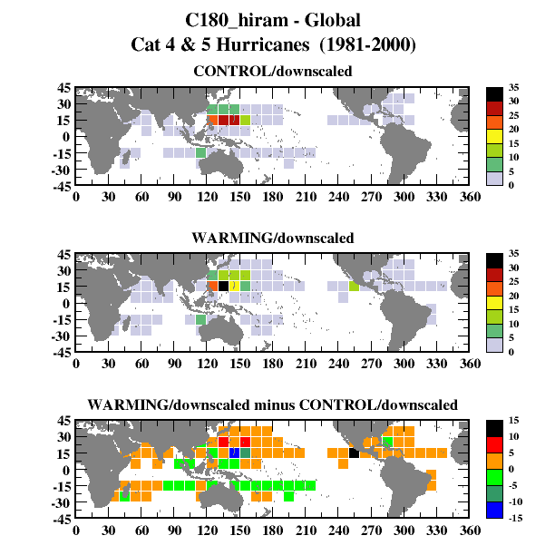
Present-day simulation
Category 4-5 Tropical Cyclone Occurrence
Unit: Number of storm days per 20 years
RCP4.5 Ensemble: Late 21st Century Projection
Late 21st century minus present-day
34% increase projected globally in
Cat 4-5 days
Source: Knutson et al., J. of Climate, 2015.

Slide 23
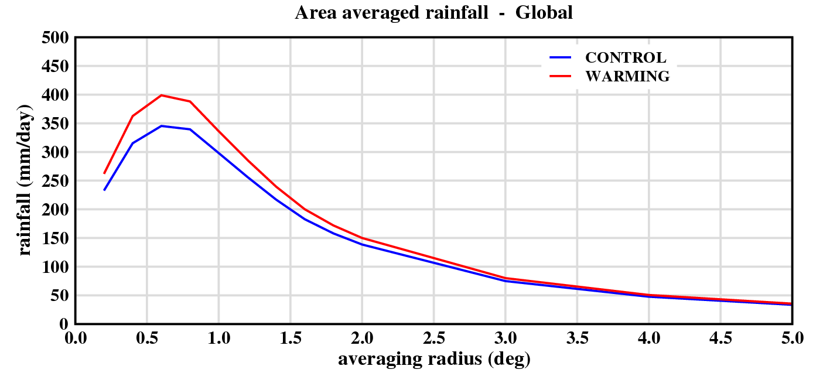
Tropical Cyclone-related Rainfall Rates
Note: TC rainfall rates (averaged over the storm lifetime) are based on the 10% rainiest tropical cyclones, restricting analysis to 30N-30S.
Source: Knutson et al., J. of Climate, 2015.

Slide 24
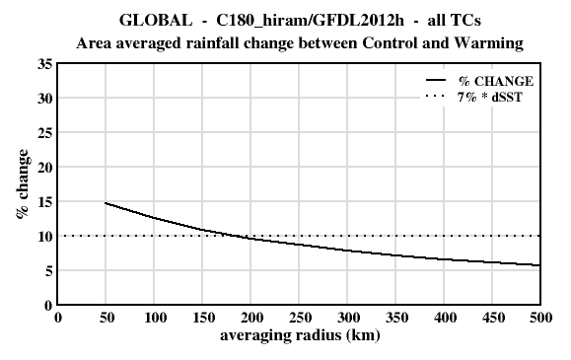
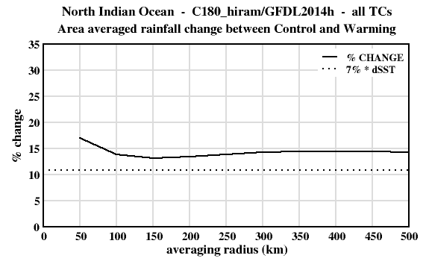
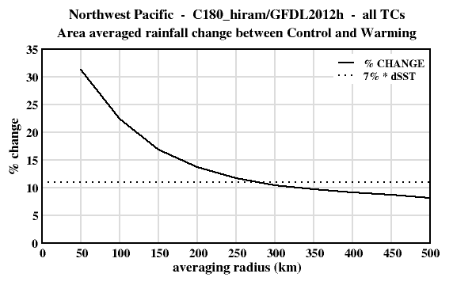
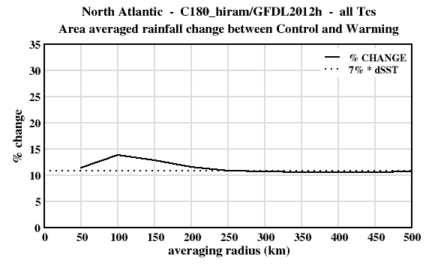

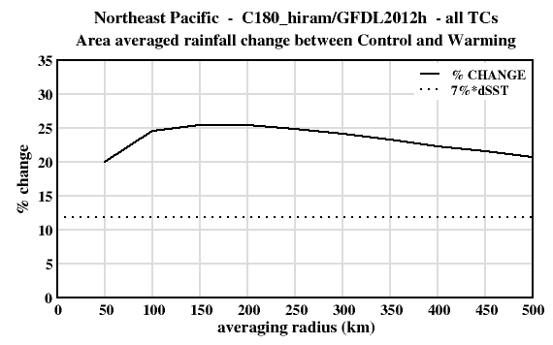
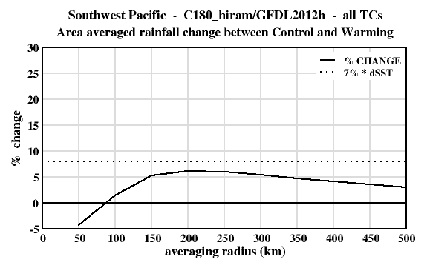
Tropical Cyclone Precipitation Changes (%) by Basin
a)
e)
d)
b)
f)
c)
g)
Source: Knutson et al., J. of Climate, 2015.

Slide 25
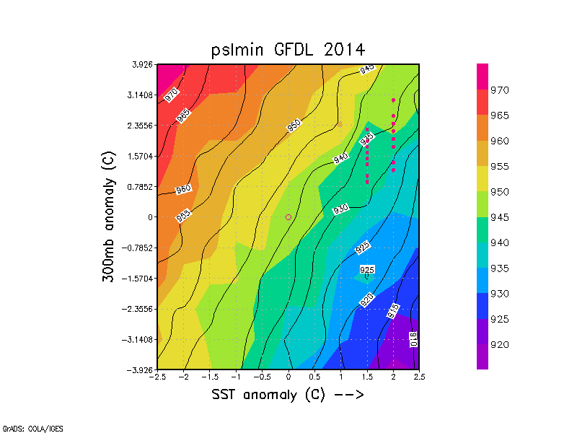
Impact for range of SSTs and upper level thermal anomalies
Weak storms
Source: Tuleya et al., JAS, 2016
Intense storms

Slide 26
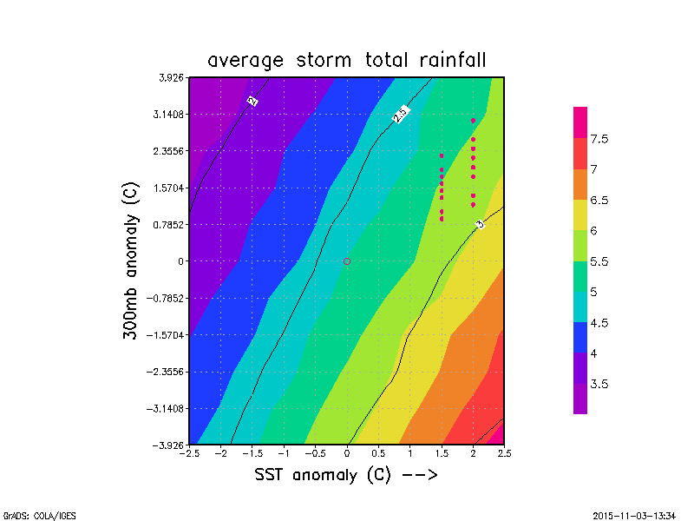
Impact on rainfall for range of SSTs and upper thermal anomalies
Source: Tuleya et al., JAS, 2016

Slide 27
Summary
1) GFDL Hurricane Model has proven to be useful for “early looks” at hurricane intensity, size, structure, and precipitation behavior under global warming scenarios, by simulating hurricanes at higher spatial resolution than possible within typical global climate models and with available computing resources.
2) The model simulates more intense hurricanes and higher tropical cyclone rainfall rates with global warming. The intensification due of increased sea surface temperatures outpaces the decreasing intensity tendency from enhanced upper tropospheric warming (stability).
3) The negative feedback from ocean coupling (cold wakes) does not prevent the storm intensification from occurring under CMIP global warming scenarios according to the coupled Hurricane Model simulations.
4) The Hurricane Model in idealized mode suggests how windshear can also modulate intensities, subject to other factors such as initial storm intensity and the favorability of the thermodynamic environment for storm intensification.

