Slide 1
US Center Side Event
Prediction of Weather and Climate Extremes
COP-21, PARIS [FRANCE]
December 1, 2015
V. Ramaswamy,
Whit Anderson, Young Cho, Paul Ginoux, Gabe Vecchi

Slide 2
Many thanks to
Isabel Gates, Georgia Mu [State Department]
Amanda McCarty [NOAA]
Leann Estrada, Eric Sokolowsky [NASA]

Slide 3
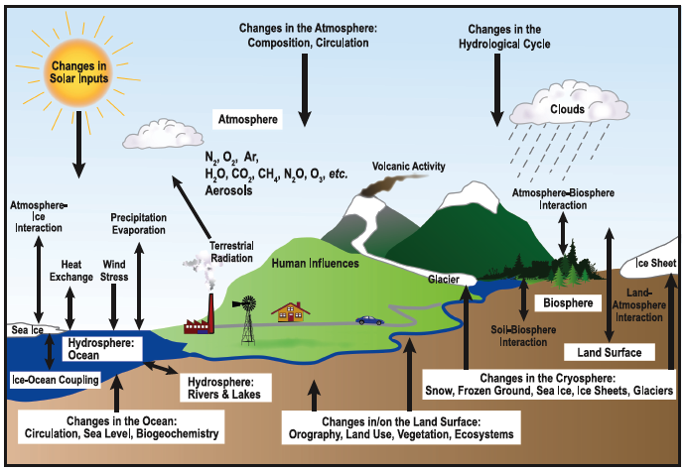
Changes in the Earth System
[Atmosphere, Oceans, Land, Ice]

Slide 4
Observed

Slide 5
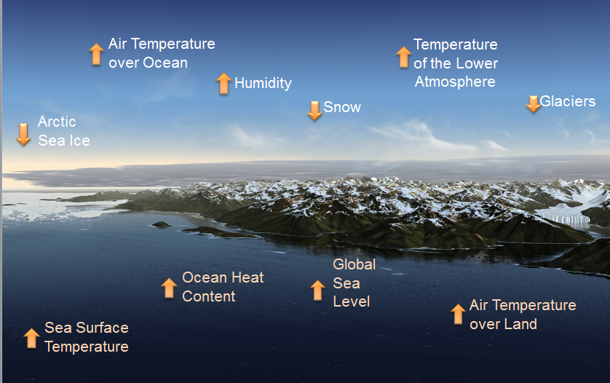
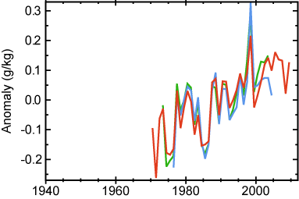
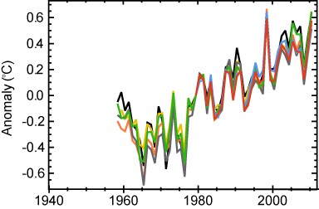
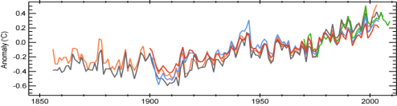
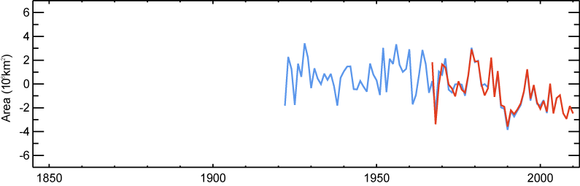
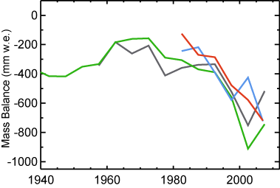
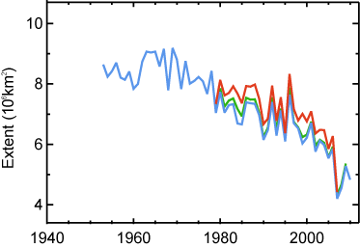
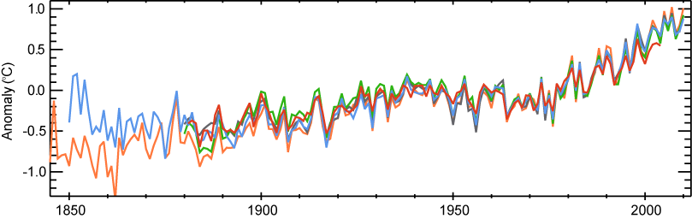
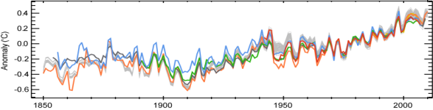
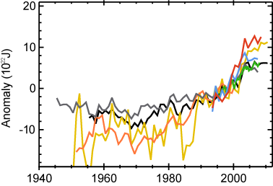
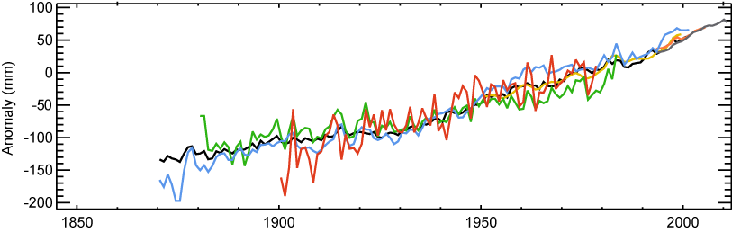
Indicators of Changing Conditions
Changing Conditions
Adapted from
IPCC AR5 (2013)
Multiple Lines of Evidence for a
Warming World
Source: National Climatic Data Center
Source: National Climatic Data Center
Notes:
Here are 10 indicators measured globally over many decades that show that the Earth’s climate is warming.
Each shows independently analyzed data from platforms that include weather stations, satellites, weather balloons, ships and buoys.
Upward arrows indicate increasing trends; downward arrows indicate decreasing trends.
All the indicators are consistent with a warming world.

Slide 6
Regional sea level changes
Source: FAQ 13.1, Figure 1 from IPCC AR5

Slide 7
Future
How will it change?

Slide 8
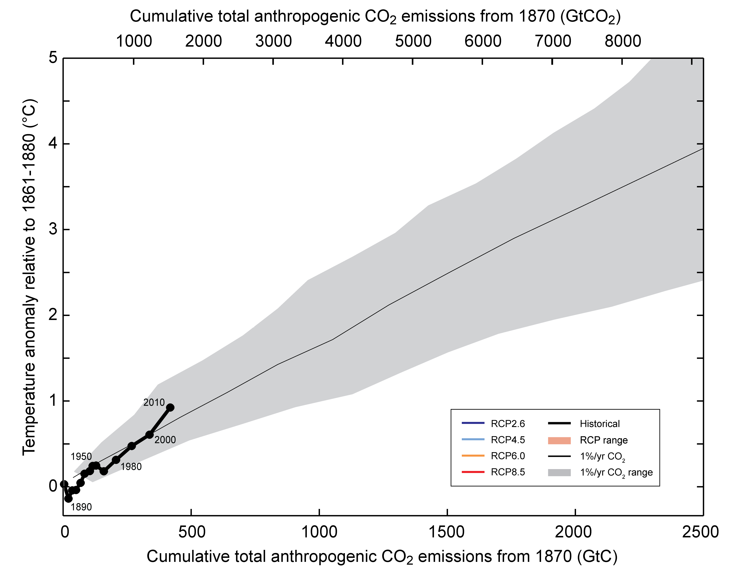
Warming caused by cumulative carbon emissions to 2010
Cumulative emissions of CO₂ largely determine global mean surface warming by the late 21st century and beyond.

Slide 9
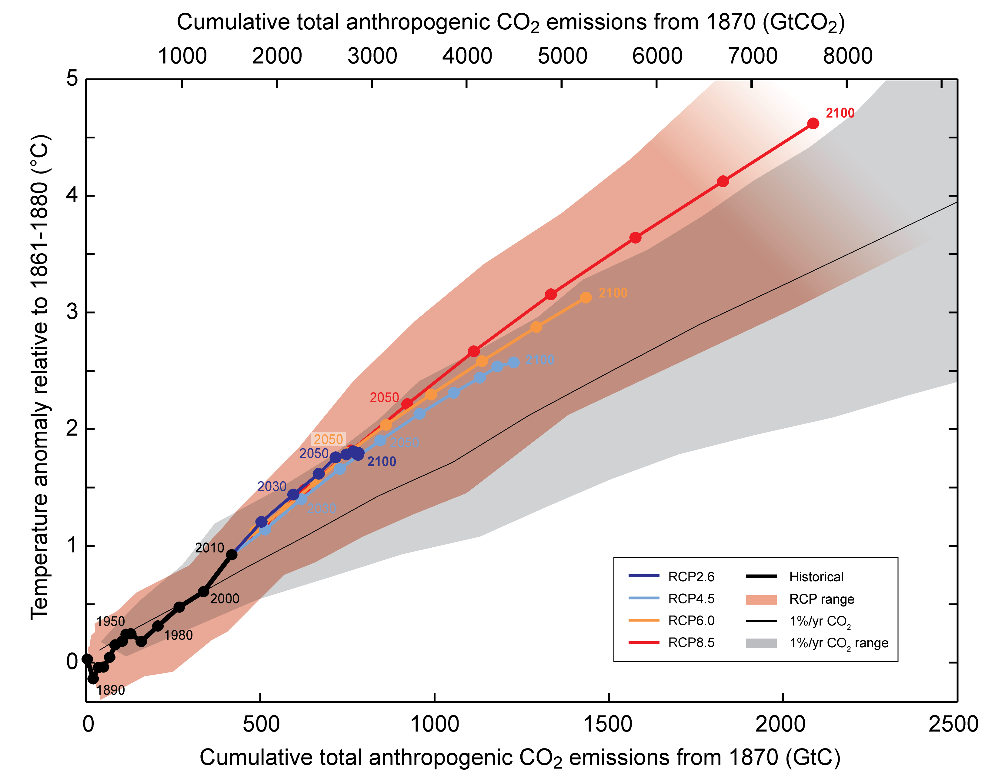
Warming caused by cumulative carbon emissions to 2100

Slide 10
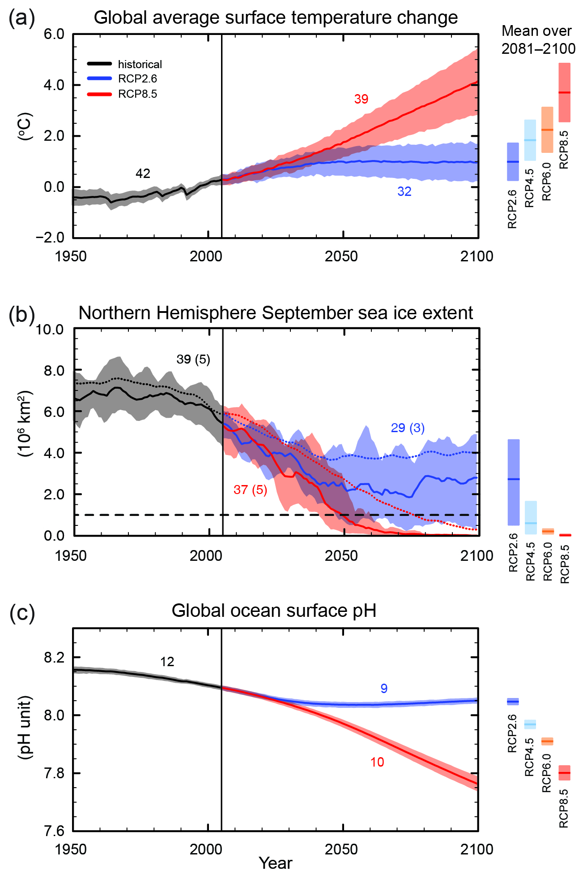
Projections
Continued emissions of GHGs will cause further warming and long-lasting changes of the climate system.
Continued warming of the planet
Melting of Arctic sea-ice
IPCC (AR5 (2013)
Increased acidification of oceans
Fig. SPM.7
Notes:
Similar range of warming on the high end, lower at the bottom.
More and newer models but similar uncertainties

Slide 11
Changing Conditions
Addressing Climate Phenomena in the 21st Century
Weather in the Climate Change context
Tornadoes
Snowstorms
Hurricanes Typhoons
Heat Waves
Storm Track Variations
Madden-Julian Oscillation
El Niño-Southern Oscillation
Precipitation extremes
Seasonal-Interannual
Decadal to multi-decadal Variability
Solar Variability
Ocean Circulation
Greenhouse Gases and Aerosols
1
DAY
30
DAYS
1
SEASON
3
YEARS
10
YEARS
30
YEARS
100
YEARS
SHORT-TERM
INTERANNUAL
DECADE-TO-
CENTURY
And Weather to Climate is a Continuum…..

Slide 12
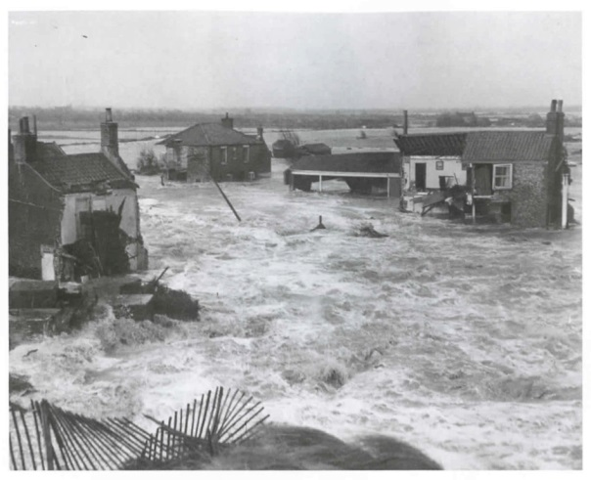
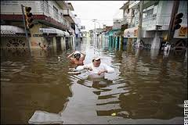
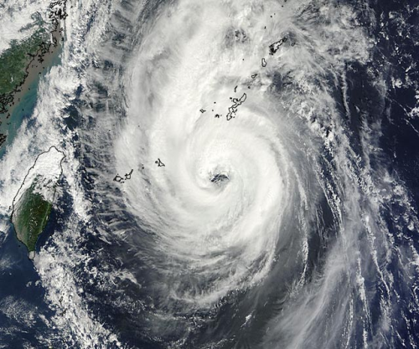
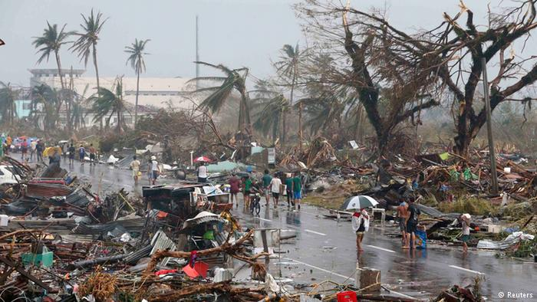
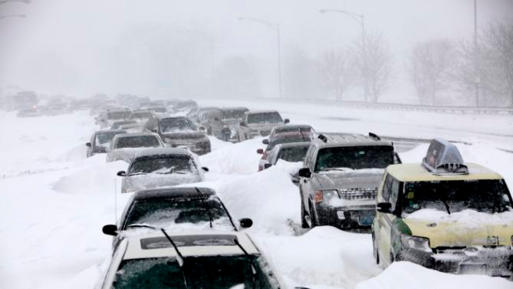
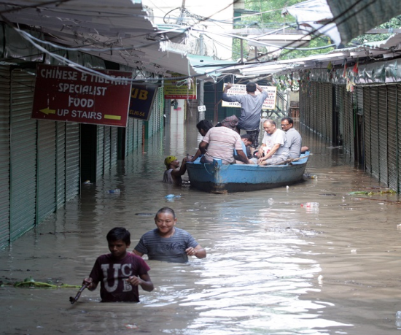
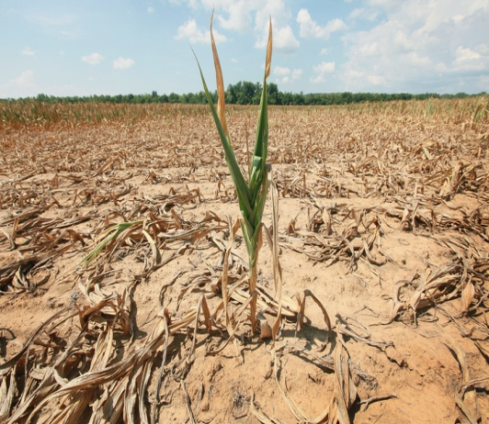
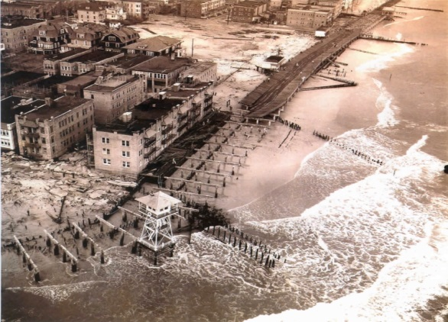
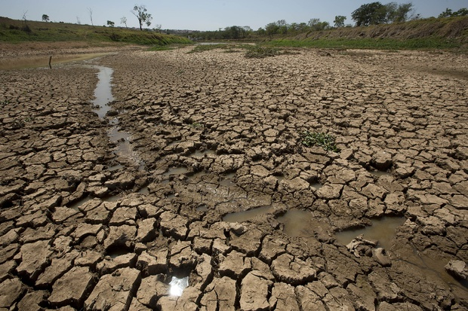
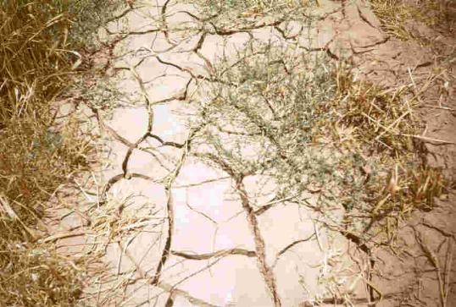
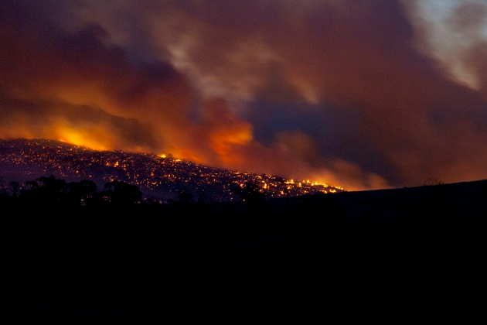
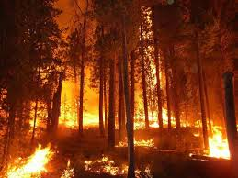
Weather/ Climate events have caused widespread disruptions and losses

Slide 13
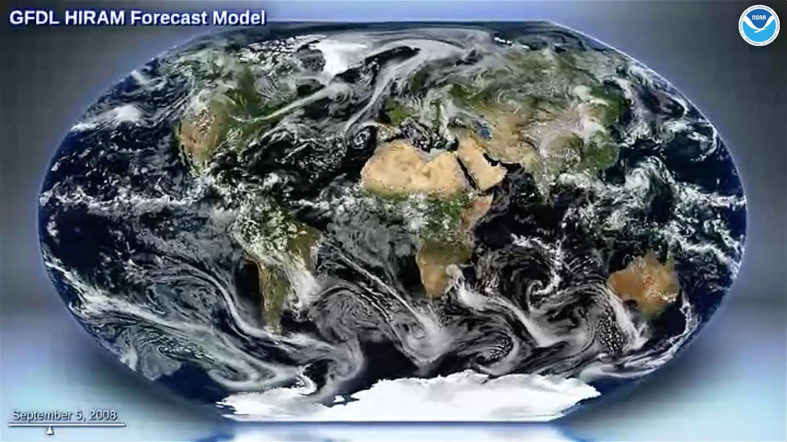
Weather-climate “seamless” model for regional information
[capturing the complexity, at high-spatial-resolutions]
Global,
12.5 km resolution
www.gfdl.noaa.gov

Slide 14


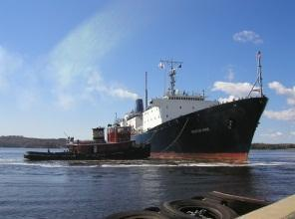
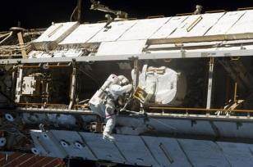
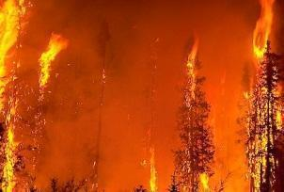
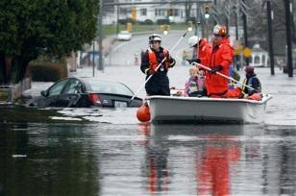

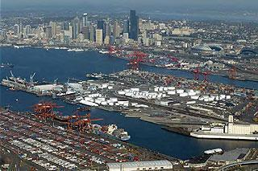
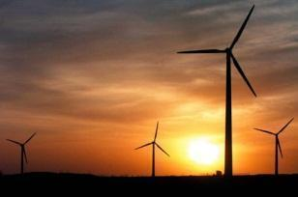
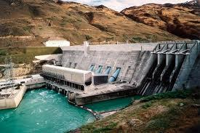
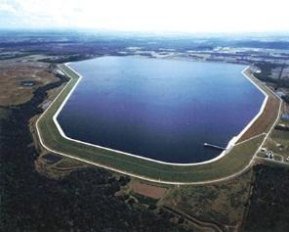
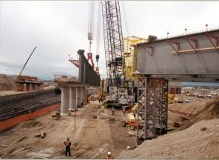
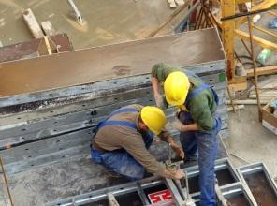



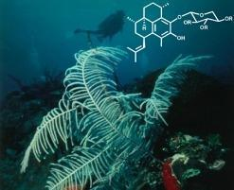

Changing Conditions
Changing Conditions
Regional-scale Predictions/ Projections:
Information for Diverse Sectors
Life and Property
Aviation
Maritime
Space Operations
Forests
Emergency Management
Commerce
Ports
Energy
Hydropower
Reservoir Control
Infrastructure
Construction
Agriculture
Recreation
Ecosystems
Health
Environment
Careful preparations are required to seize opportunities, and minimize risks and vulnerabilities
Notes:
Clearly, human lives, livelihoods and the ecosystems that support us are at stake. And this extends across all sectors of society. Thoughtful, well-informed plans and preparations are required to seize opportunities, and minimize risks and vulnerabilities.

Slide 15
Climate Research and Modeling ➔ ➔
Information on the Regional scale for Adaptation and Mitigation
NOAA state-of-the-art modeling for
Weather-Climate (“Seamless”)
Pollution and Climate: Continental- and Intercontinental-scale distribution of Aerosols (Short-lived Climate Forcers).
Climate Change: Global Surface Temperature Projections out to 2100 under the RCP 8.5 emissions scenario.
Weather in the Climate context: Tropical Cyclones in a Global Climate Model.
www.gfdl.noaa.gov

