Slide 1



Key drivers of Western U.S. surface O₃ variability over recent decades: Stratospheric intrusions, Asian pollution, and climate
Meiyun Lin
Acknowledgements:
NOAA: L.W. Horowitz, O.R. Cooper, A.O. Langford, S. J. Oltmans, CalNex Science Team
Others: A.M. Fiore and H. Rieder (Columbia), D. Tarasick (Environment Canada)
Zheng Li (Nevada Clark County DAQ)
Presented at Air Quality Research Subcommittee Meeting, Feb-19-2015
Notes:
1

Slide 2
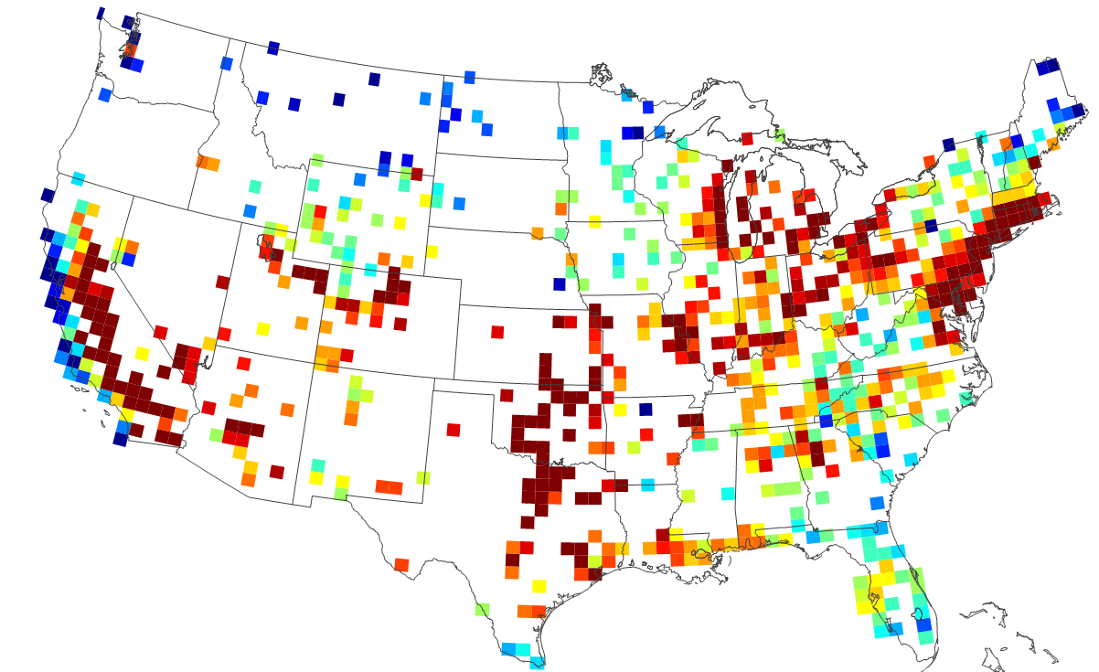
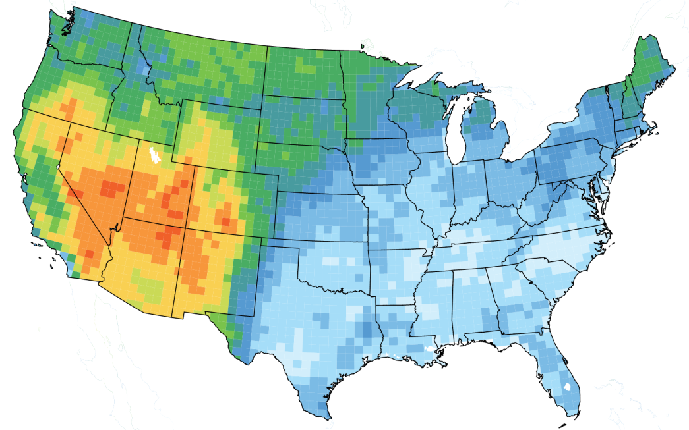
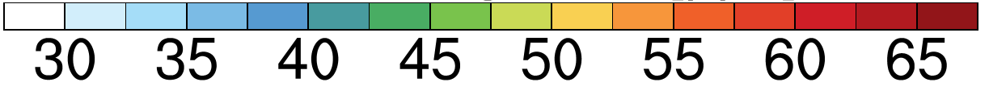
Major challenges for Western U.S. air quality managements
Annual 4th Hi MDA8 O₃ (2011-2013 AQS)
Current NAAQS
Mean background, Apr-Jun
NA anthrop emis off in GFDL AM3 (~0.5ᵒx0.5ᵒ)
ppb
ppb
Future NAAQS?
MAJOR CHALLENGES:
-Rising Asian emissions and global CH₄ [e.g. Jacob et al. 1999; Cooper et al. 2010; Clifton et al. 2014]
-More frequent wildfires in summer [e.g. Westerling et al. 2006; Pfister et al. 2008; Jaffe 2011]
-Frequency of stratospheric intrusions in spring [e.g. Langford et al., 2009; Lin et al., 2012b]
Need process-level understanding on daily to MULTI-decadal time scaleS
2
2
Notes:
Model indicates S. Nevada particularly susceptible; observations lacking

Slide 3

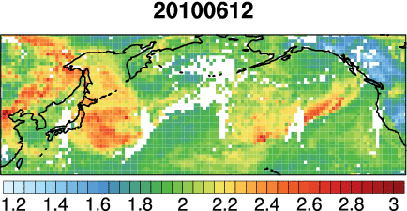
Trans-Pacific Asian pollution plumes:
The view from satellites
Animation of daily AIRS CO columns [10¹⁸ molecules cm⁻²]
→ How important is Asian influence in surface air?
Lin MY et al. (JGR, 2012a): AGU Editors’ Highlight, Featured in Science, Nature News, NY Times Greenblog)
3

Slide 4
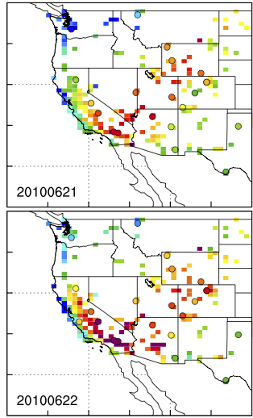
Asian pollution contribution to WUS high-O₃ events
Observed
AM3 Model total
Model Asian
June 21
2010
June 22
2010
Surface MDA8 O₃
[ppb]
[ppb]
Asian emissions contribute 8-12 ppb on days when OBS O₃ ≥ 65 ppb (future NAAQS)
→ Role of tripling NO_{x} emissions from E. China over recent decades?
4

Slide 5
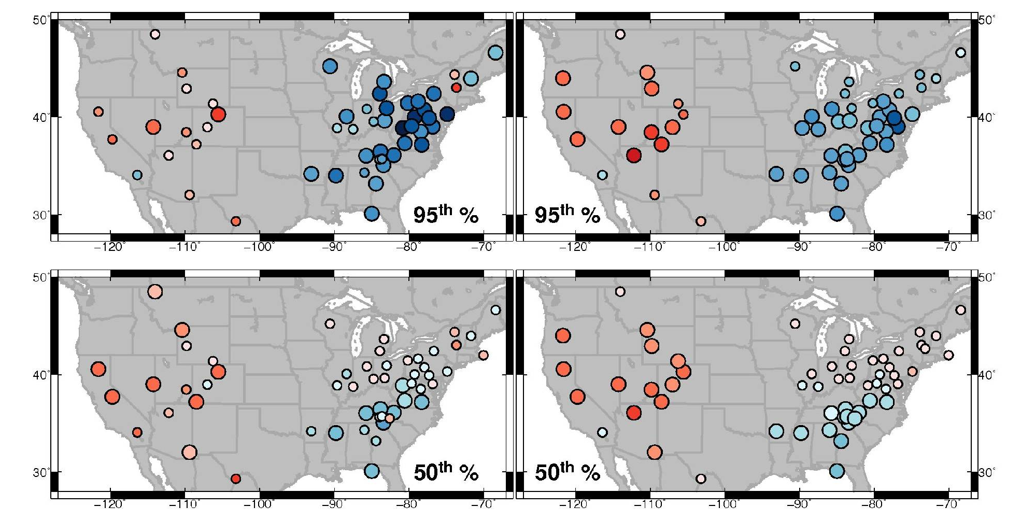
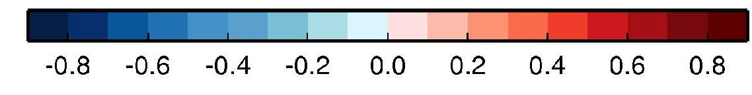
Long-term U.S. surface ozone trends:
Did regional NO_{x} reductions work?
Observed
GFDL-AM3 BASE
(with both emis & met varying over time)
95th
MAM 1988-2012
50th
MDA8 O₃ trends (ppb yr⁻¹)
Larger circles indicate statistically significant trends
WUS: High background, thus little response to local NO_{x} reductions
AM3 BASE captures key features of observed surface O₃ trends
NASA Project PIs (M.Y. Lin and O.R. Cooper)
5
Notes:
- Ozone increases over WUS despite reductions in local emissions
- AM3 captures key features of observed surface O₃ trends (increases in WUS; larger decreases in 95% vs. 50% and north-south gradient over EUS)
- The model is nudged to “real” winds, sampled at site elevation and filtered to remove local influence -- more representative of observed conditions at remote WUS sites

Slide 6
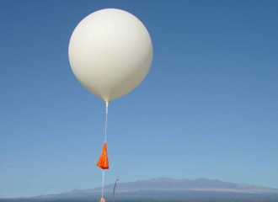
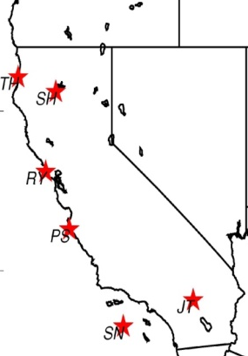
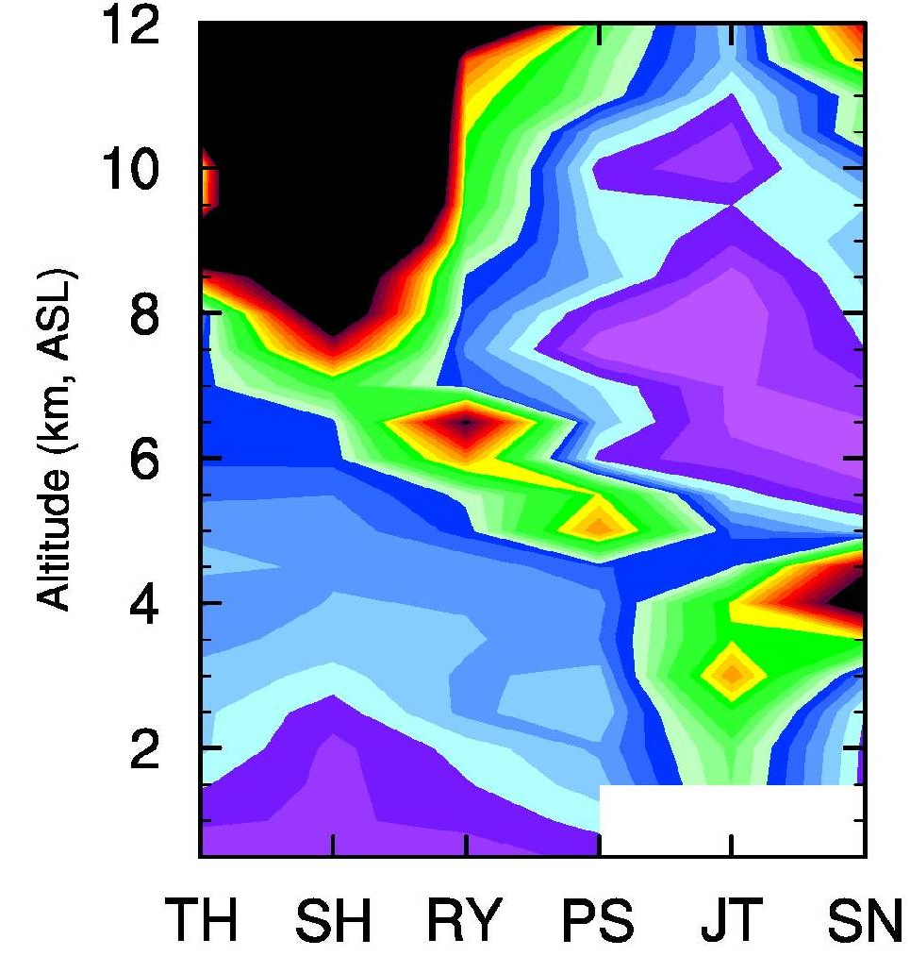
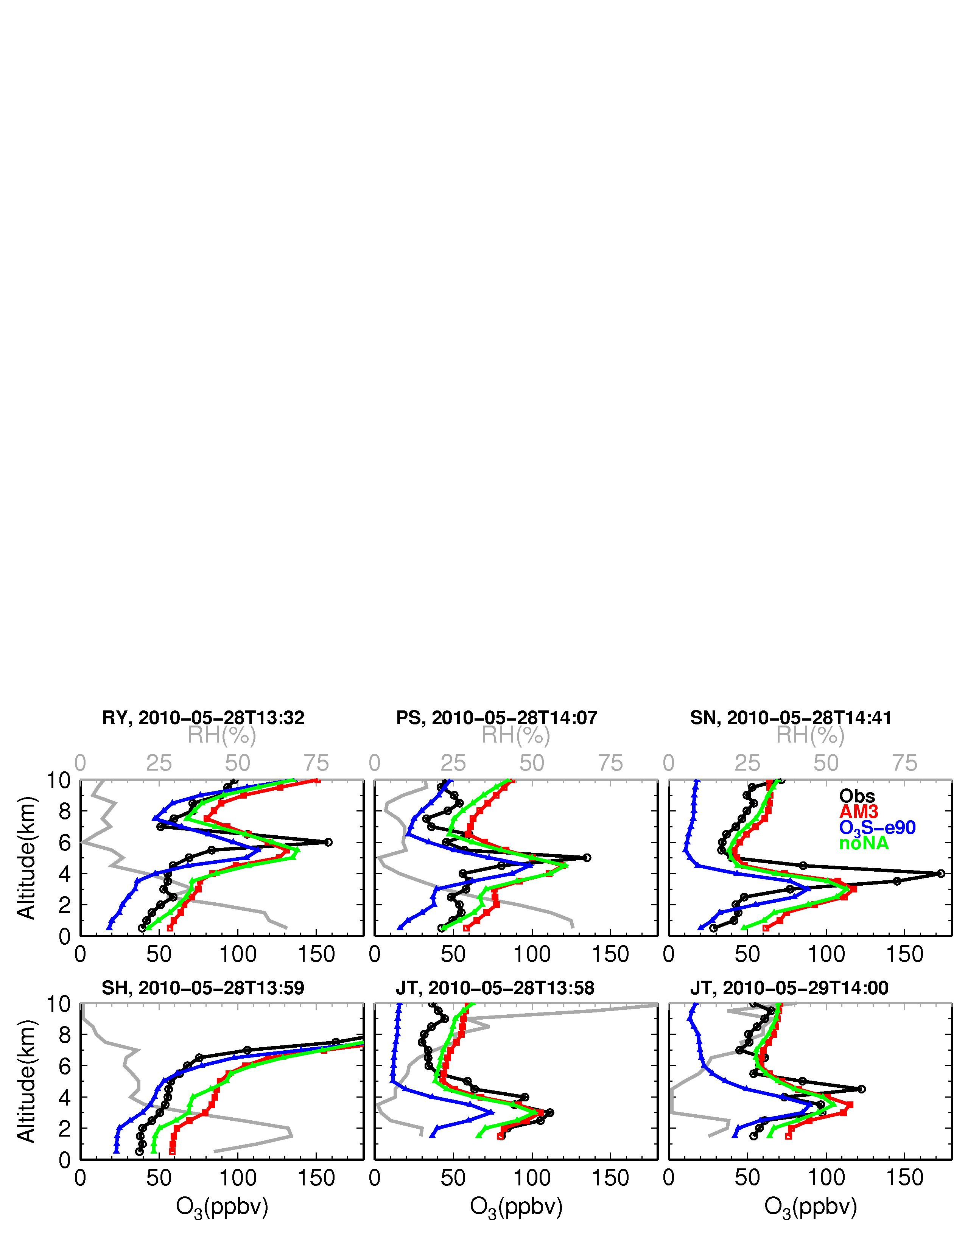
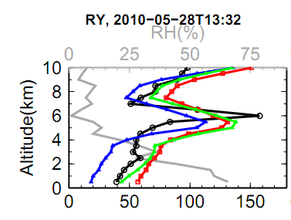
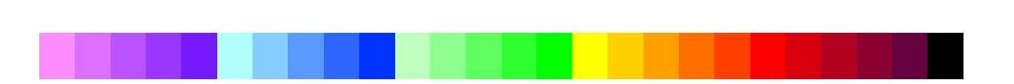
Subsidence of stratospheric O₃ to the lower trop of S. California (May 28, 2010)
Sondes over California
Observed RH (%)
OBS O₃
AM3 total
Altitude (km)
zeroNA
O₃Strat
O₃ [ppb] at Joshua Tree (JT)
North → South
Simulated enhancements of O₃Strat consistent with observed low RH
Reaching surface air on the following day
30
50
70
90
110
130
150
[ppb]
See more process-oriented analysis in Lin MY et al (JGR, 2012b)
6
Notes:
O₃Strat contributes ~75% to enhanced O₃ >100 ppbv at 2-5 km a.s.l.
Consistent with observed low humidity; NA emissions contribute little

Slide 7
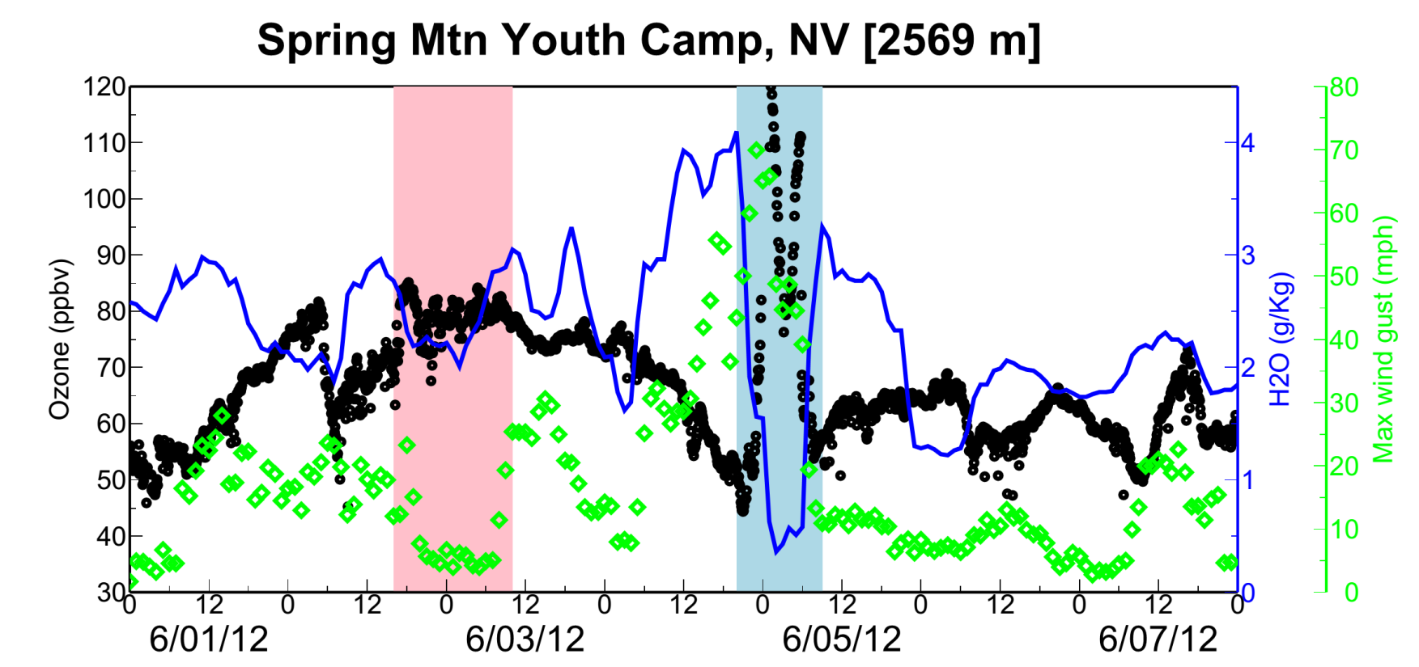
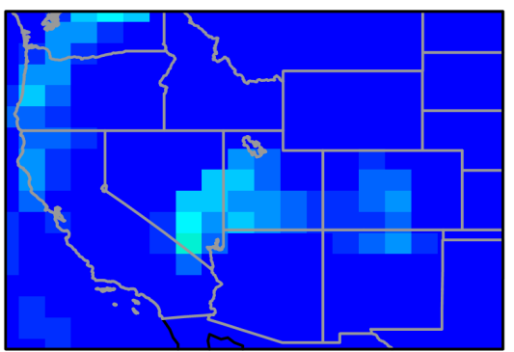
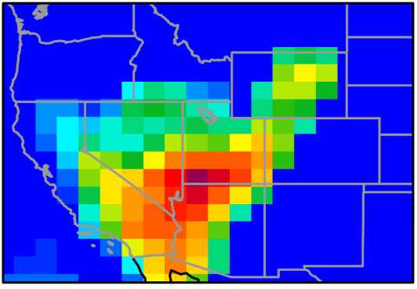
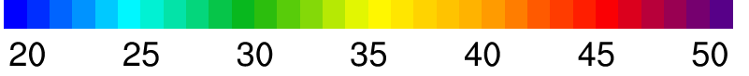
Stratospheric influence on the highest observed surface ozone events in S. Nevada (e.g. June 5, 2012)
, Observed
Pollution
Ozone (ppb, 5-min)
Wind gust (mph, hourly)
June 3
June 5
Data c/o Zheng Li (Nevada DAQ)
Lin MY et al (in prep, 2015)
Model O₃Strat (ppb, 8-h average)
Baseline level (~20 ppb) likely represents an upper limit.
What controls year-to-year variability of such events?
7
Notes:
AM3 O3Strat captures the episodic ozone enhancements although the mean baseline level of O3Strat may represent an upper limit

Slide 8
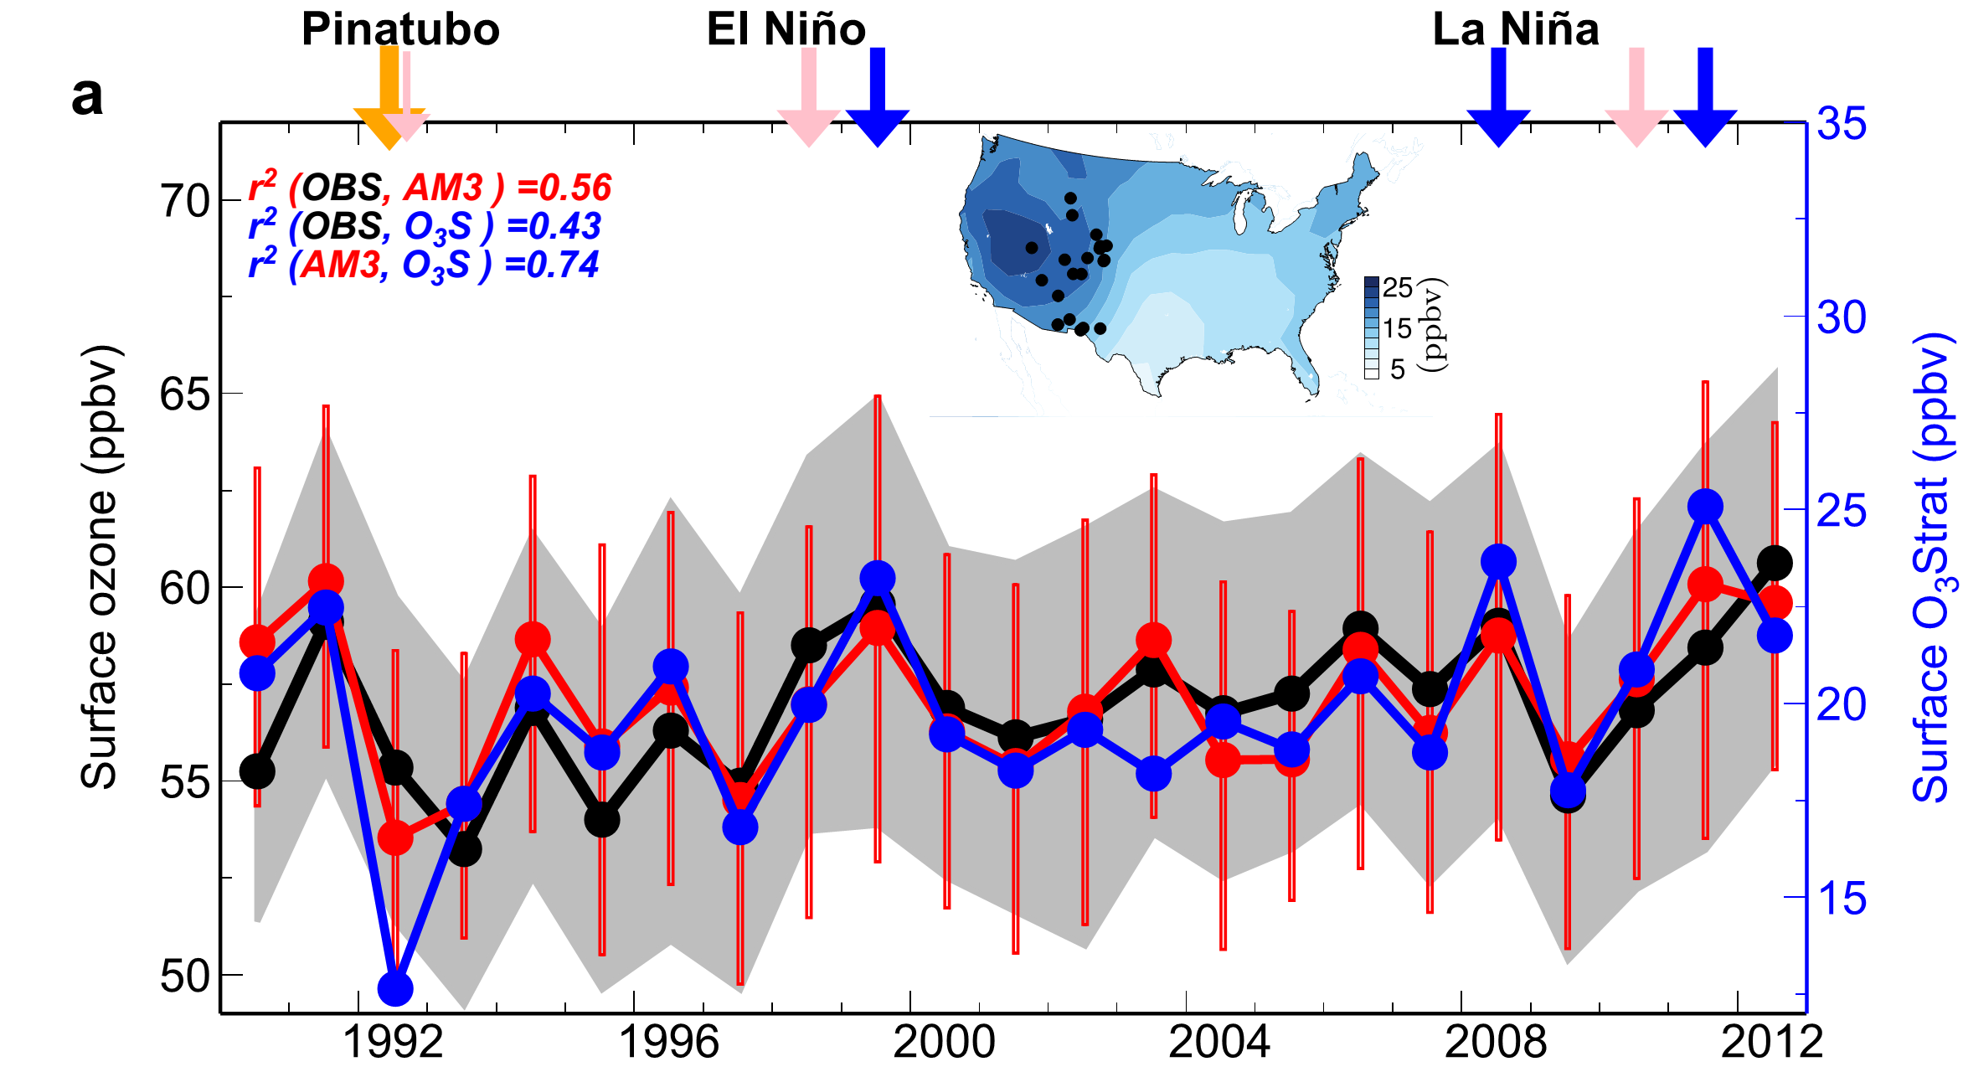
Strong stratospheric influence on year-to-year variability of high-elevation Western U.S. surface O₃ during April-May
75th
50th
O₃Strat
25th
Emissions held constant
Nudged to “real” winds
Stratospheric Contribution (ppb)
1990
Large IAV may complicate the attribution of observed O₃ trends in short records
Lin MY et al (in review, 2015)
8

Slide 9
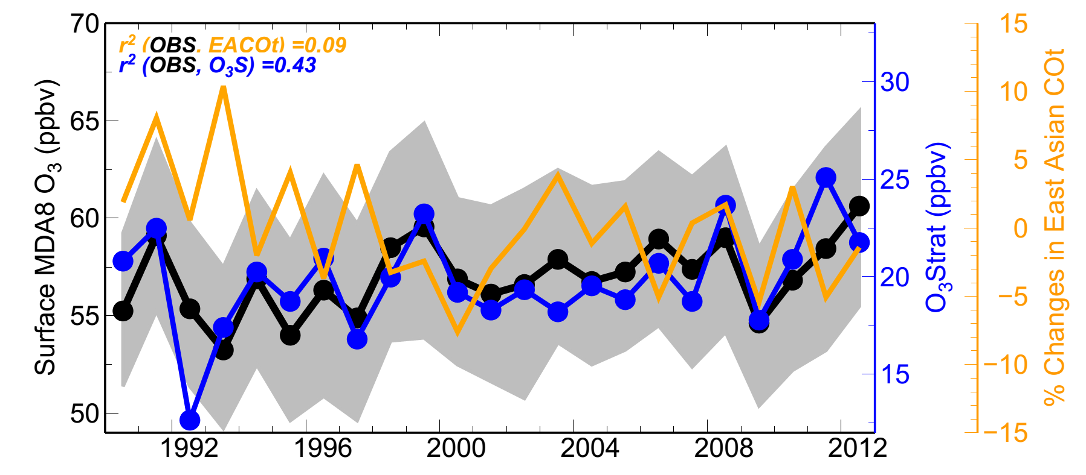

Asian pollution contributes less to WUS surface ozone
inter-annual variability than the stratospheric influence
r² (OBS, EACOt ) = 0.09
r² (OBS, O₃Strat) = 0.43
Apr-May
Stratospheric Contribution (ppb)
1990
Airflow from Eurasia towards the WUS in spring has weakened in the 2000s
Consistent with declines in Radon-222 and O₃ observed at Mauna Loa, Hawaii (3.4 km altitude) during spring
Too small to be discernable from surface O₃ observations over WUS
Lin MY et al (2014)
9

Slide 10
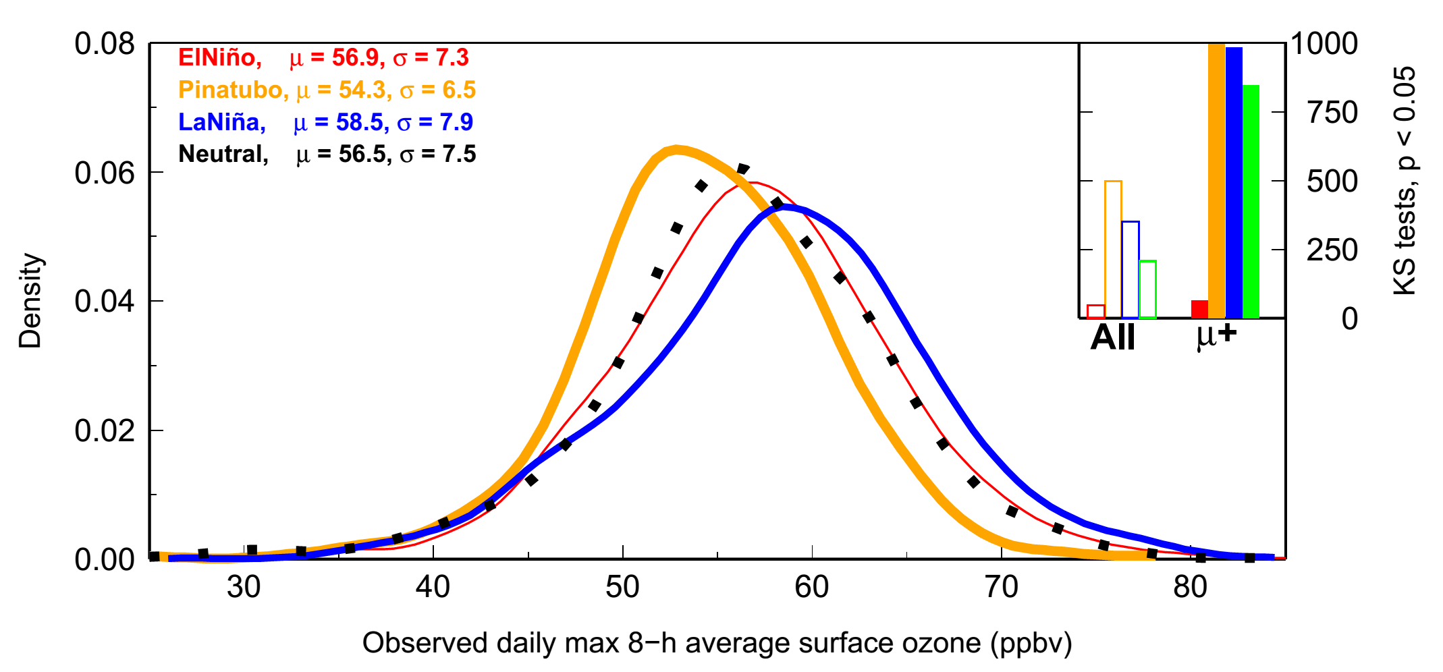
The high tail of the observed daily surface O₃ distribution over Western U.S. increases during La Niña springs
Neutral: µ = 56.5,σ = 7.5
El Niño (1998, 2010): µ = 56.9,σ = 7.3
La Niña (1999, 2008, 2011): µ = 58.5,σ = 7.9
Pinatubo (1992, 1993): µ = 54.3,σ = 6.5
Changes in the high tail are statistically significant
Probability Density
Observed daily max 8-h average (MDA8) ozone [ppb]
Lin MY et al (in review, 2015)
10

Slide 11
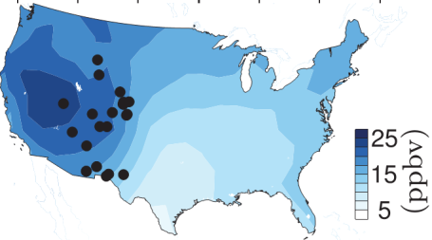
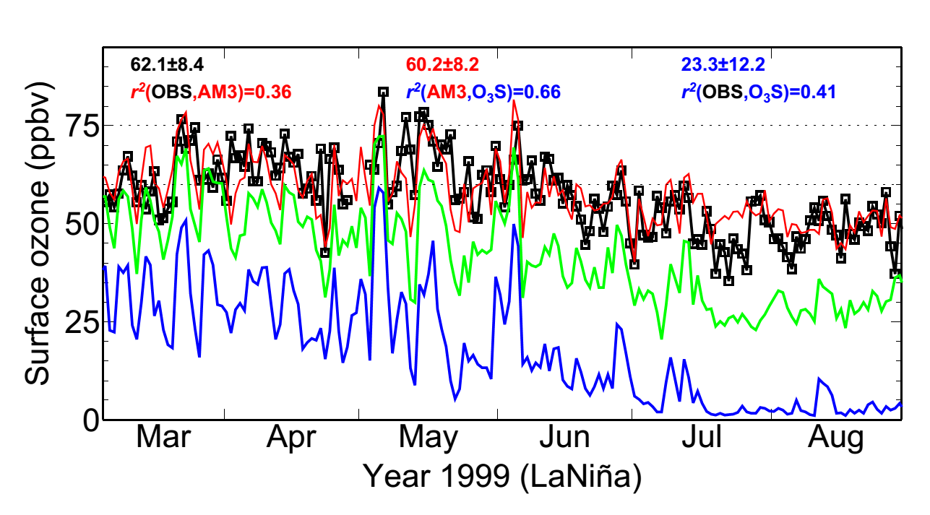
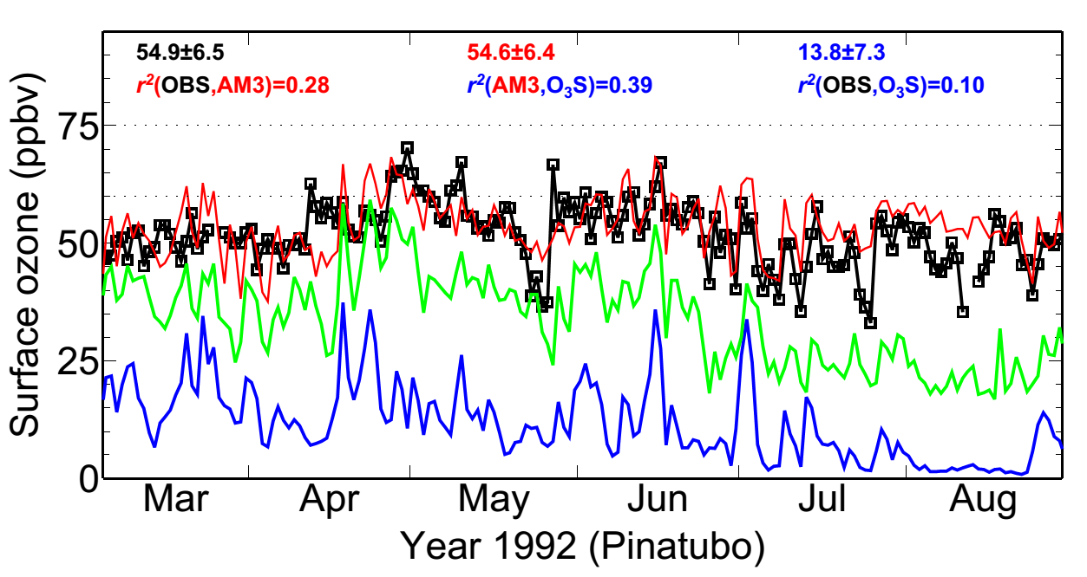
Following strong La Niña conditions, deep STT may occur with sufficient frequency as to confound NAAQS attainment
Gothic in the Colorado Rocky Mtn (2.9 km altitude)
NAAQS
1999 (La Niña)
MDA8 O₃ (ppb)
Total
Frequent deep stratospheric intrusion events
BGO₃
O₃Strat
1992 (Pinatubo)
MDA8 O₃ (ppb)
Weaker events, lower mean values
11
11

Slide 12
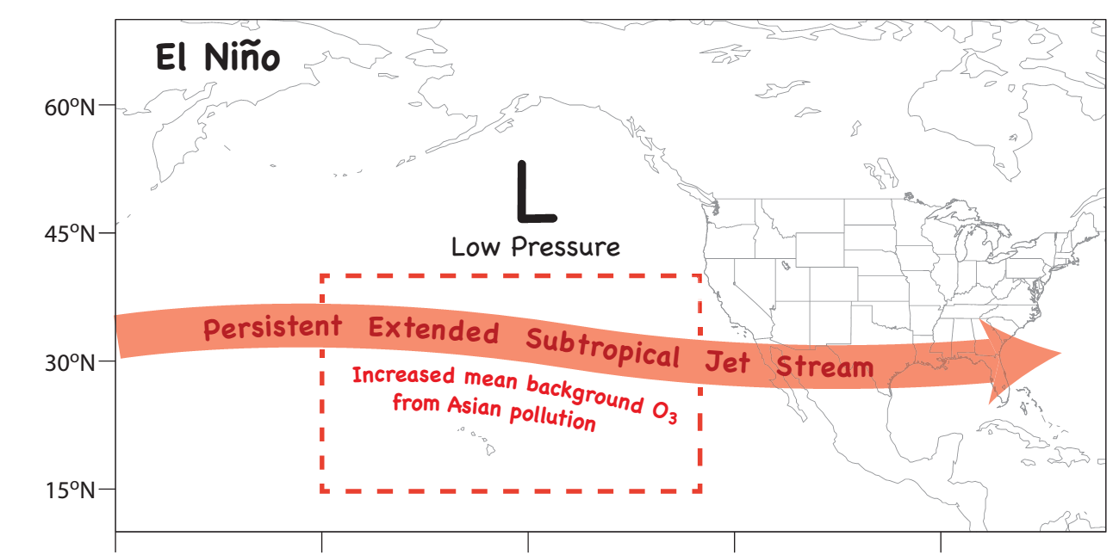
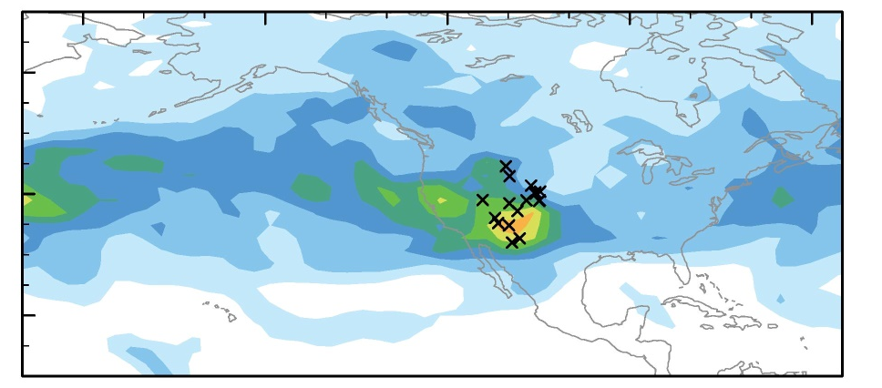
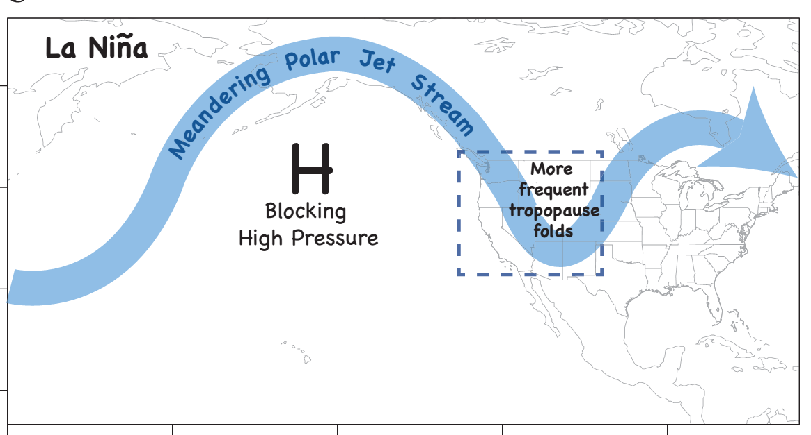
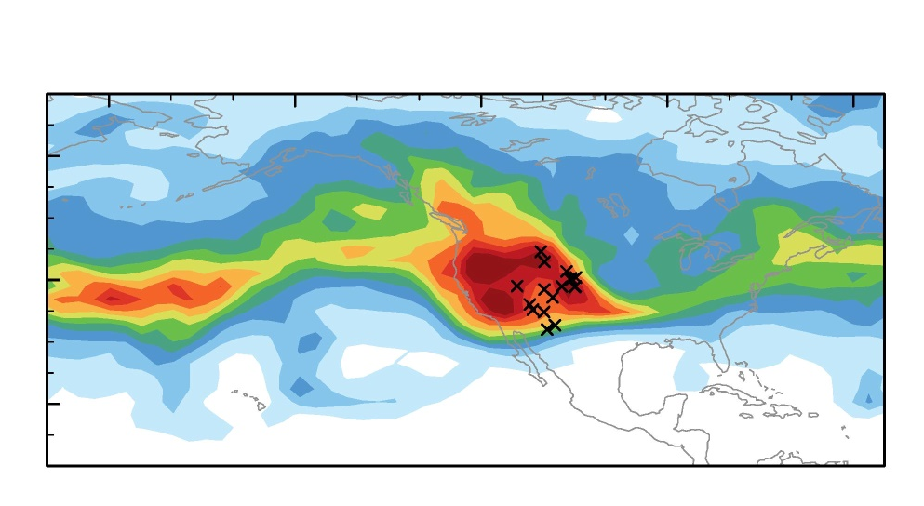
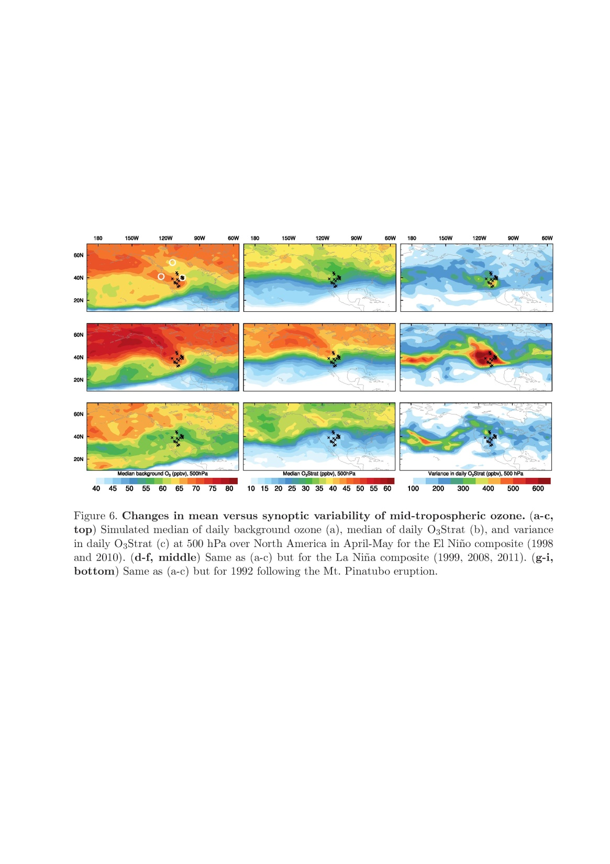
ENSO-related jet characteristics and their impacts on lower trop. ozone variability over western NA
Variance in daily O₃Strat at 500hPa
(April-May)
El Niño
El Niño
La Niña
La Niña
(ppb²)
Lin MY et al (Nature GeoSci., 2014);
Lin MY et al (in review, 2015)
12
Notes:
AM3 O3Strat captures the episodic ozone enhancements although the mean baseline level of O3Strat may represent an upper limit

Slide 13
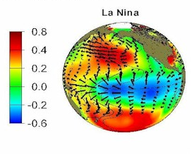
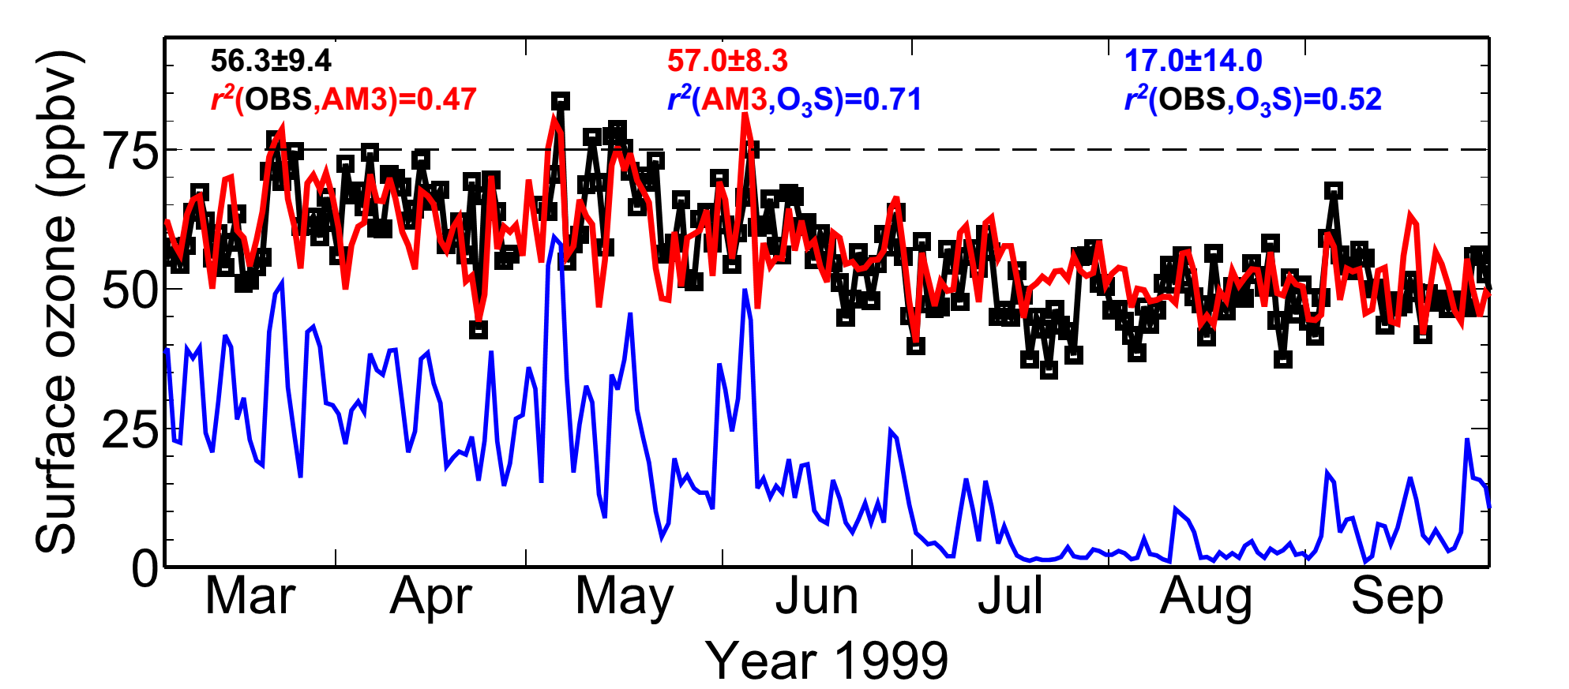
Developing seasonal predictions with a few months of lead time to aid Western U.S. AQ planning?
Tropical SST cooling typically peaks in winter
More frequent stratospheric intrusions expected in the following spring over WUS?
Gothic, Colorado
SST (C)
MDA8 O₃ (ppb)
The time lag could allow regional preparations, e.g.
Conducting daily forecasts for public health alerts
Deploying targeted measurements aimed at identifying “exceptional events”
Lin MY et al (in review, 2015)
13
Notes:
Mention Pat Reddy
Mention O3/CO/H2O in Andy Langford and Mick Newchurch

Slide 14

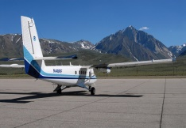
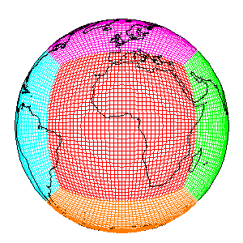
Some Final Thoughts For Moving Forward
Exploiting the linkage between La Niña and WUS stratospheric intrusion frequency to aid regional preparations for a high-ozone season?
→ Conducting daily forecast and targeted measurements
Need multi-model assessment of stratospheric influence
→ Process-oriented evaluation to establish model credibility
→ Focusing on the known deep SI events as a first step
→ Leveraging CalNex (2010) and LVOS (2013) measurements
The available weekly ozonesonde measurements are too infrequent to capture the actual variability of mean O₃
→ Need more frequent, continuous sonde measurements for spring?
Meiyun.Lin@noaa.gov
GFDL AM3
14
Notes:
Maps + PDF

Slide 15
Additional Slides for Discussions
Notes:
AM3 O3Strat captures the episodic ozone enhancements although the mean baseline level of O3Strat may represent an upper limit

Slide 16
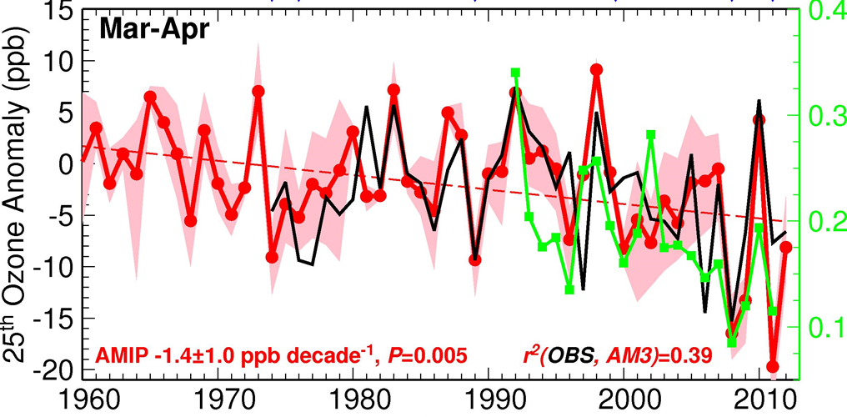
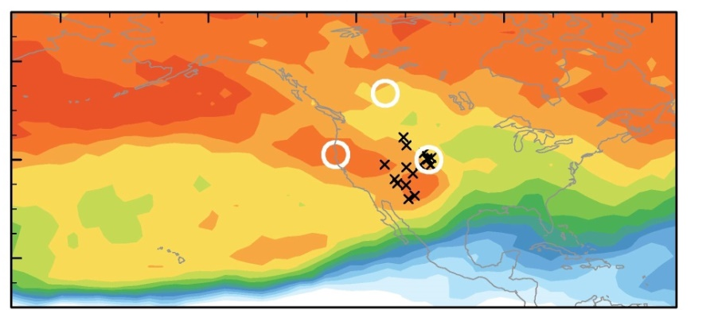
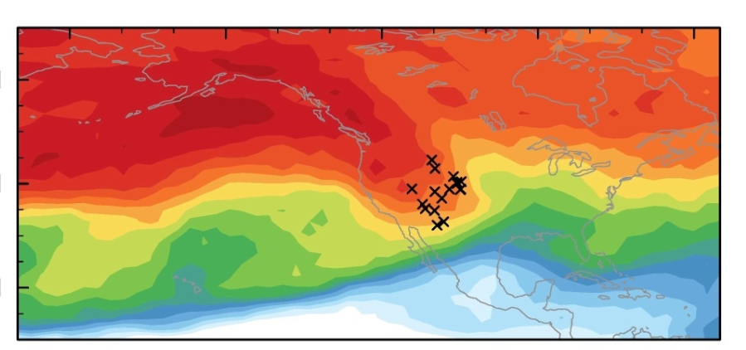
Decreasing ozone at Mauna Loa in SPRING tied to recent
La-Niña-like decadal cooling + weakening airflow from Asia
LaNiña-like decadal cooling
[Chavez2003; Meehl2013; Kosaka2013]
ElNiño
Ozone Anomaly , ppb
(25th percentile)
Decreasing Rn (Bq/m³)
Weakening airflow
from Eurasia
AMIP (fixed emissions)
P<0.01
(ppb)
80
60N
70
Mean background
500 hPa, Apr-May
40N
Even higher
60
20N
50
El Niño
La Niña
40
Lin MY et al (Nature GeoSci., 2014)
16

Slide 17
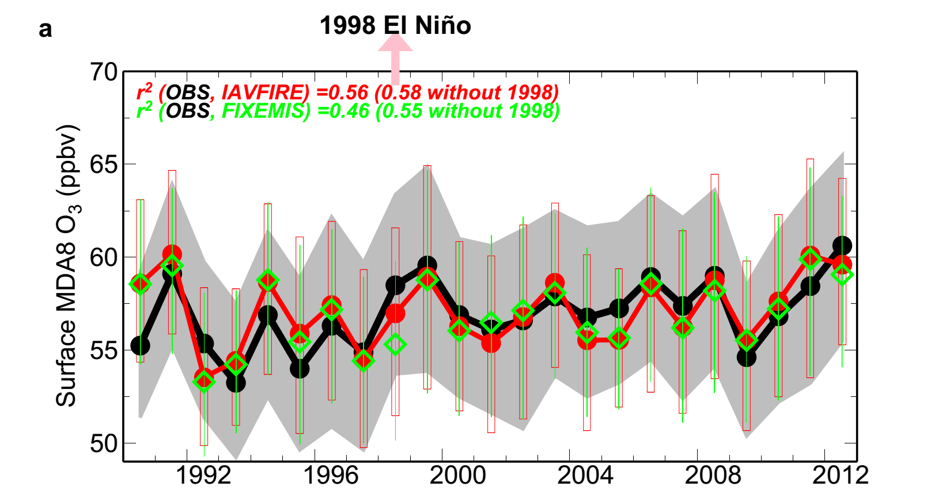
Minor influence from wildfire emissions on inter-annual variability of springtime surface ozone over WUS
17
Notes:
Maps + PDF

Slide 18
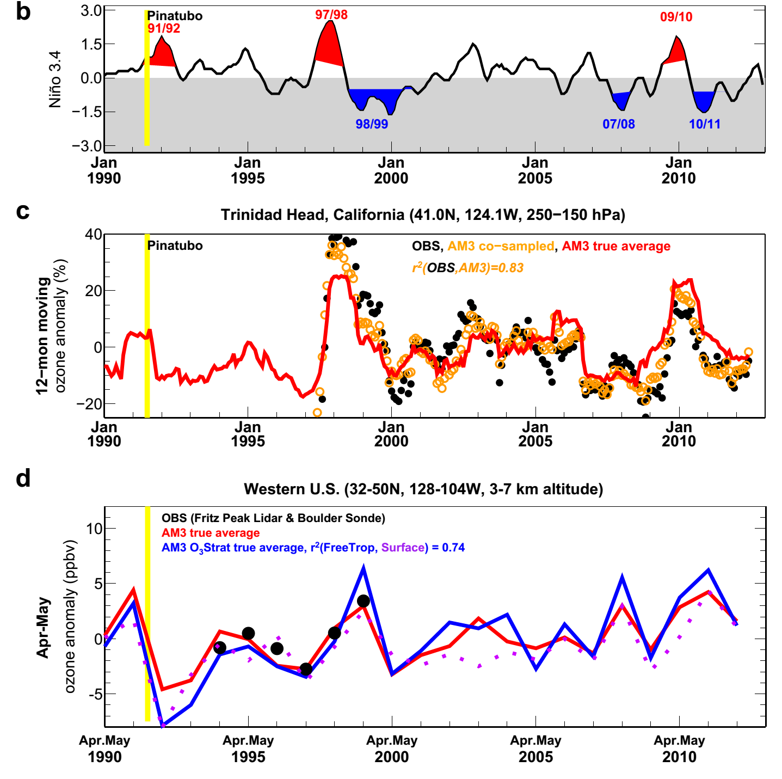
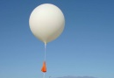
Western US surface O₃ variability correlates poorly with O₃ burdens in the UTLS but strongly with that in the Free Trop
3.0
Niño 3.4 Index
1.5
0
-1.5
-3.0
40
12-mon running mean UTLS O₃ anomaly (%)
r²(UTLS, Surface) = 0.07
20
0
Trinidad
-20
10
Apr-May mean FreeTrop & Surface O₃ anomaly (ppb)
r²(FreeTrop, Surface) =0.74
98/99
07/08
10/11
5
0
-5
1990
1995
2000
2005
2010
Langford1999 noted positive correlations btw FreeTrop and UTLS O₃ observed at Fritz Peak during 1994-1998 (without La Niña years): AM3 captures the observed relationship (r²=0.69) for this short record but indicates little correlation (r²=0.18) for the entire 1990-2012 period.
18

Slide 19
List of papers featured in the talk
Lin, M., A.M. Fiore, L. W. Horowitz, O. R. Cooper, V. Naik, J. Holloway, B. J. Johnson, A. M. Middlebrook, S. J. Oltmans, I. B. Pollack, T. B. Ryerson, J. X. Warner, C. Wiedinmyer, J. Wilson, B. Wyman: Transport of Asian ozone pollution into surface air over the western United States in spring, Journal of Geophysical Research,117, D00V07, 2012, doi:10.1029/2011JD016961 (PDF)
Lin M., A. M. Fiore , O. R. Cooper , L. W. Horowitz , A. O. Langford , Hiram Levy II , B. J. Johnson , V. Naik , S. J. Oltmans , C. Senff (2012): Springtime high surface ozone events over the western United States: Quantifying the role of stratospheric intrusions, Journal of Geophysical Research, 117, D00V22, doi:10.1029/2012JD018151 (Full Text)
Lin, M., L.W. Horowitz, S. J. Oltmans, A. M. Fiore, Songmiao Fan (2014): Tropospheric ozone trends at Manna Loa Observatory tied to decadal climate variability, Nature Geoscience, 7, 136-143, doi:10.1038/NGEO2066 (PDF)
Lin, M., A. M. Fiore, L.W. Horowitz, A. O. Langford, S. J. Oltmans, D. Tarasick, H. E. Rieder (2015): Climate variability modulates western U.S. ozone air quality in spring via deep stratospheric intrusions, in review, 2015.
19
Notes:
Maps + PDF

