Slide 1



Challenges in quantifying sources and variability of lower tropospheric ozone over western N. America: Perspectives from satellites and models
Invited talk at AIRS Spring Science Team Meeting (21-April-2015)
Meiyun Lin
(Princeton Univ & NOAA GFDL)
Acknowledgements: L.W. Horowitz (NOAA GFDL), A.M. Fiore (Columbia/LDEO), O.R. Cooper (NOAA ESRL), A.O. Langford (NOAA ESRL), S. J. Oltmans (NOAA ESRL), Harald Rieder (Univ of Graz-Austria), AIRS Science Team: Juying Warner (Univ of Maryland), Laura Pan (NCAR) …
Notes:
1

Slide 2
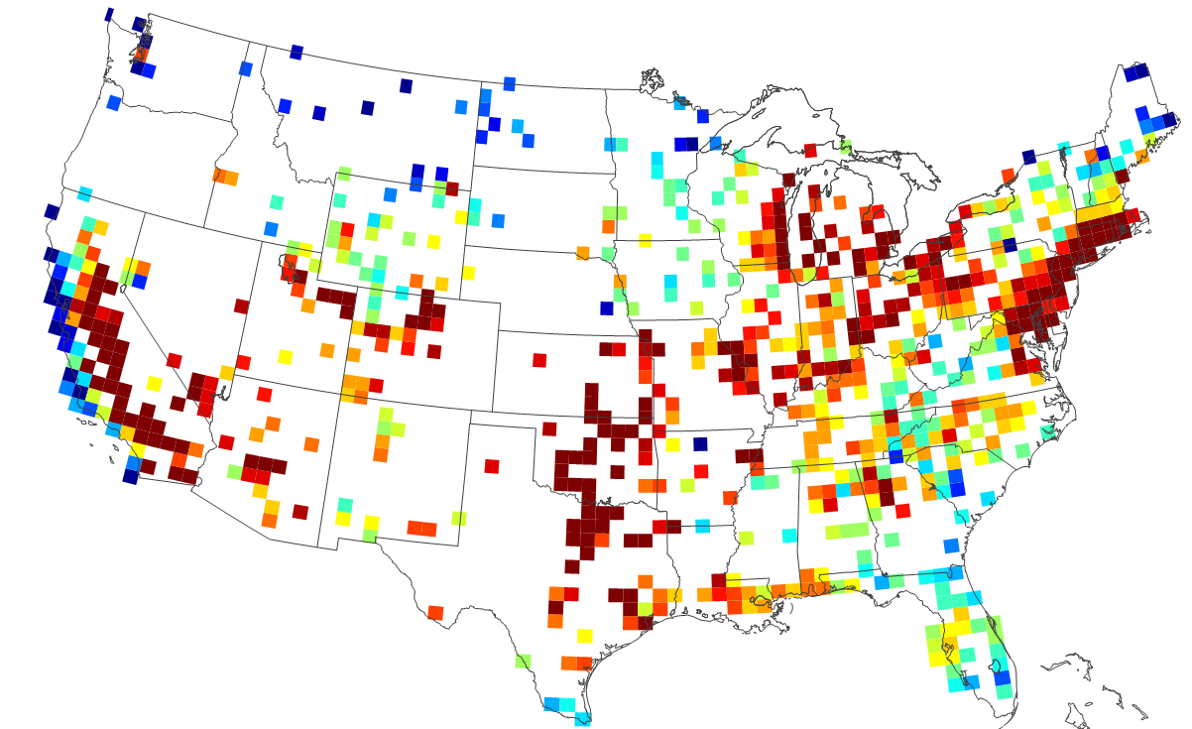
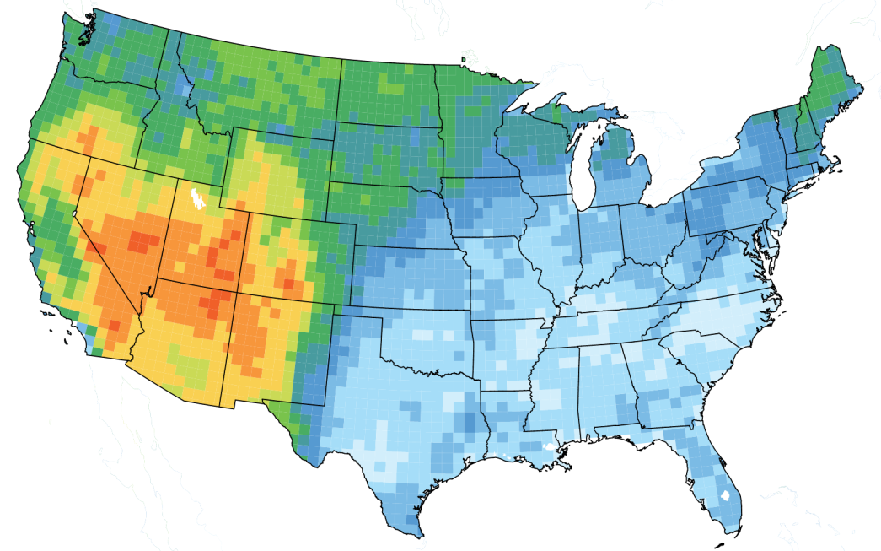
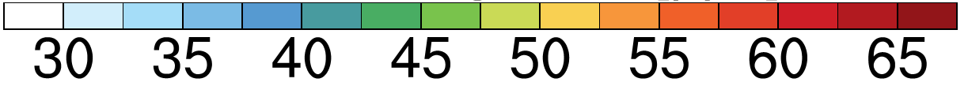
Major challenges for Western U.S. air quality management
Annual 4th Hi MDA8 O₃ (2011-2013 AQS)
Current NAAQS
Mean background, Apr-Jun
NA anthrop emis off in GFDL AM3 (~0.5ᵒx0.5ᵒ)
ppb
ppb
Future NAAQS?
MAJOR CHALLENGES:
-Rising Asian emissions and global CH₄
-More frequent wildfires in summer
-Frequency of stratospheric intrusions (STT) in spring
uncontrollable “exceptional events”
Need process-level understanding on daily to MULTI-decadal time scaleS
2
2

Slide 3

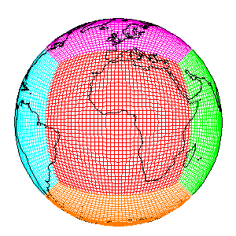
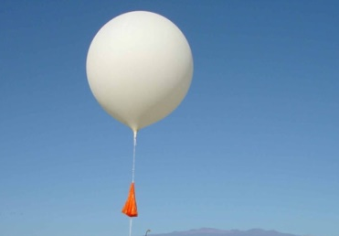
Addressing the challenges:
How can NASA satellites help?
Capture variability in chemical composition associated with synoptic-scale weather patterns
Vast spatial coverage at near-daily intervals (e.g. AIRS, OMI, IASI)
BUT very little vertical information (CO & O₃); Lack of sensitivity in the lower troposphere
Satellites
GFDL AM3
Today’s talk
In situ
?
Upper-level info from space
Downwind surface influence
Surface networks
Daily
Inter-annual
3

Slide 4
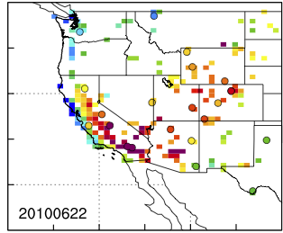
Asian pollution contribution to WUS high-O₃ events
Observed
Model total
Model Asian
22-June-2010
Future NAAQS?
Surface MDA8 O₃
[ppb]
[ppb]
Asian pollution can contribute ~20% on days when OBS > 65 ppb
→ How can AQ managers identify such events?
Meiyun Lin et al [JGR, 2012a]: Transport of Asian ozone pollution into surface air over the WUS in spring
4
Notes:
Asian emissions contribute 8-12 ppb on days when OBS O₃ ≥ 65 ppb (future NAAQS)
Consistent with elevated free trop O₃ levels observed by in ozonesondes during CalNex

Slide 5
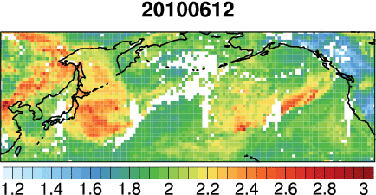
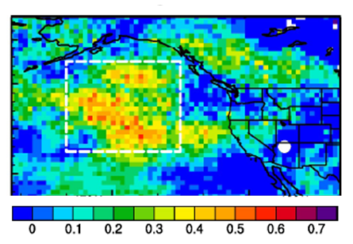
Asian pollution “forecasting” with daily AIRS CO data
May-June 2010
sonde
Animation of daily AIRS CO columns
[10¹⁸ molecules cm⁻²]
Correlation coefficient (r)
model Asian O₃ at Grand Canyon
AIRS CO columns 2 days prior
Why CO?
→ Indicate potential downwind influence
Data assimilation to improve forecasts
Daily exceedance attributions (qualitatively)
Quantitative estimates require models
Meiyun Lin et al. [JGR, 2012a]: Transport of Asian O₃ pollution into surface air over the WUS in spring
Publicity: AGU Editors’ Highlight, Nature News, ScienceShot)
5
Notes:
Why CO?
Ideal tracer for pollution transport
-Lifetime of weeks to months
-transported globally, but not evenly mixed in contrast to the other tracers like CO2 and N2O.
-Easy to measure elevated CO above background levels
Animation: Remember to mention pollution reaching Mauna Loa, Hawaii

Slide 6
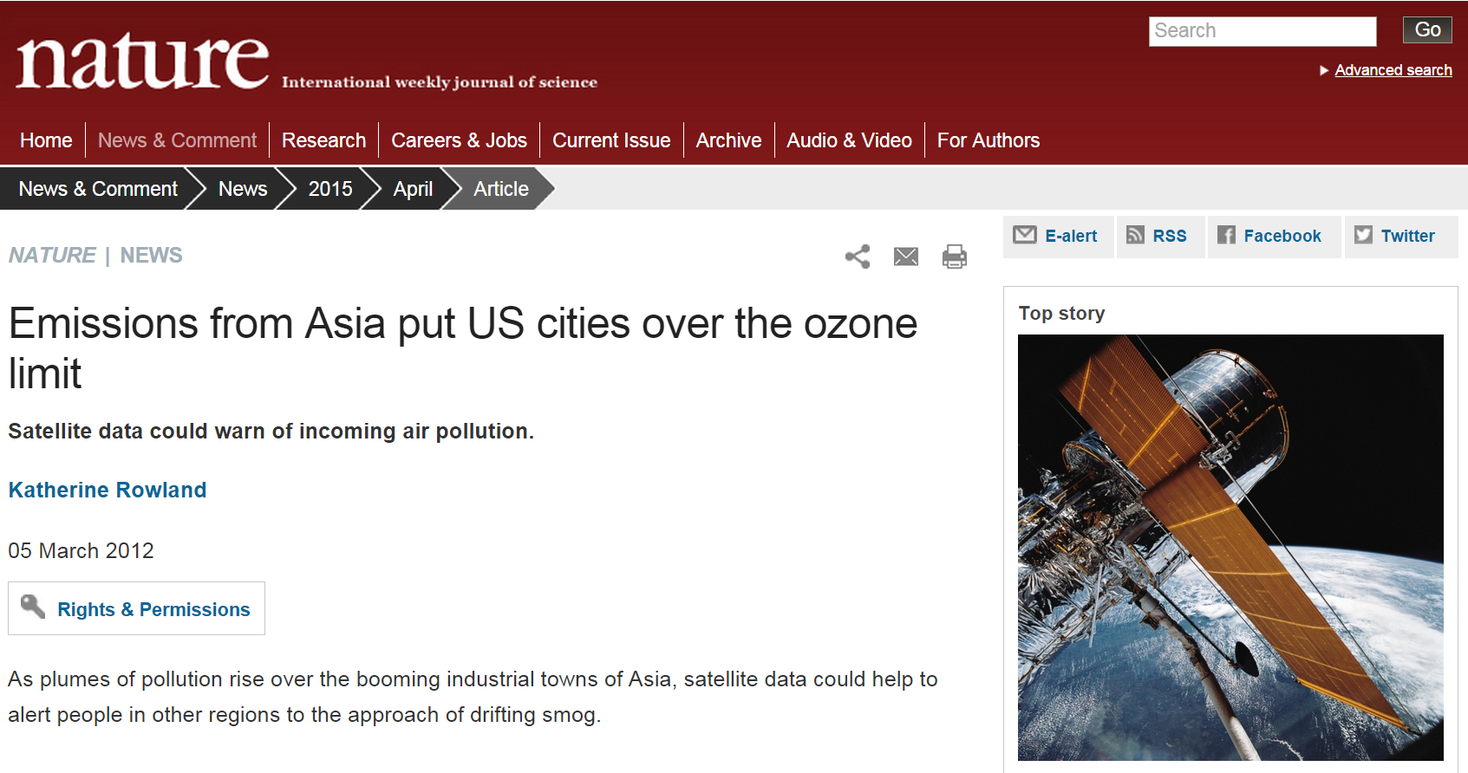
6
Notes:
Nature News

Slide 7

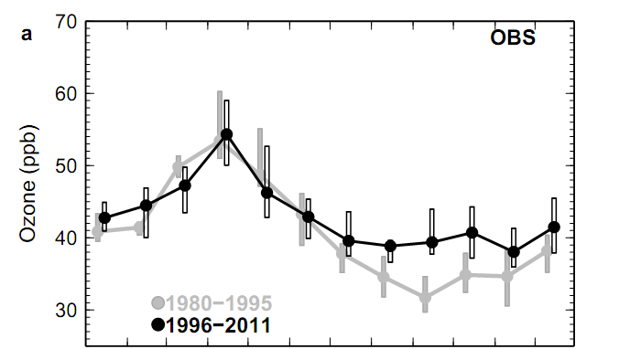
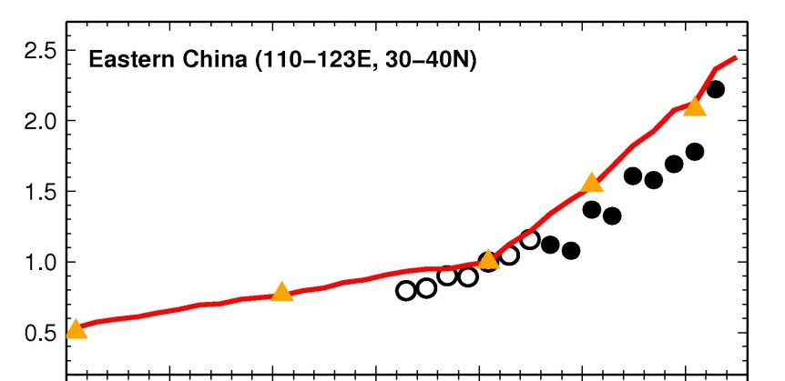
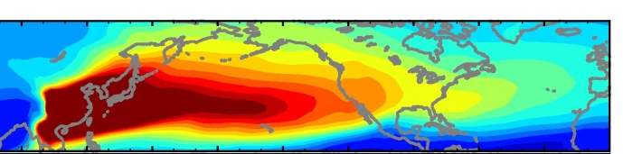

Tropospheric ozone trends at Mauna Loa Observatory
tied to decadal climate variability
Meiyun Lin et al (2014)
Mauna Loa Observatory (3.4 km altitude)
The puzzle:
No trend in spring
(decrease in 25th)
Increase in fall
75th
50th
25th
Jan Feb Mar Apr May Jun Jul Aug Sep Oct Nov Dec
E. China NO_{x} Emissions
Tracer of East Asian CO Pollution
Spring
Normalized to Y2000
Model
Satellites
(GOME/SCIAMACHY)
Fall
1980 1990 2000 2010
7

Slide 8
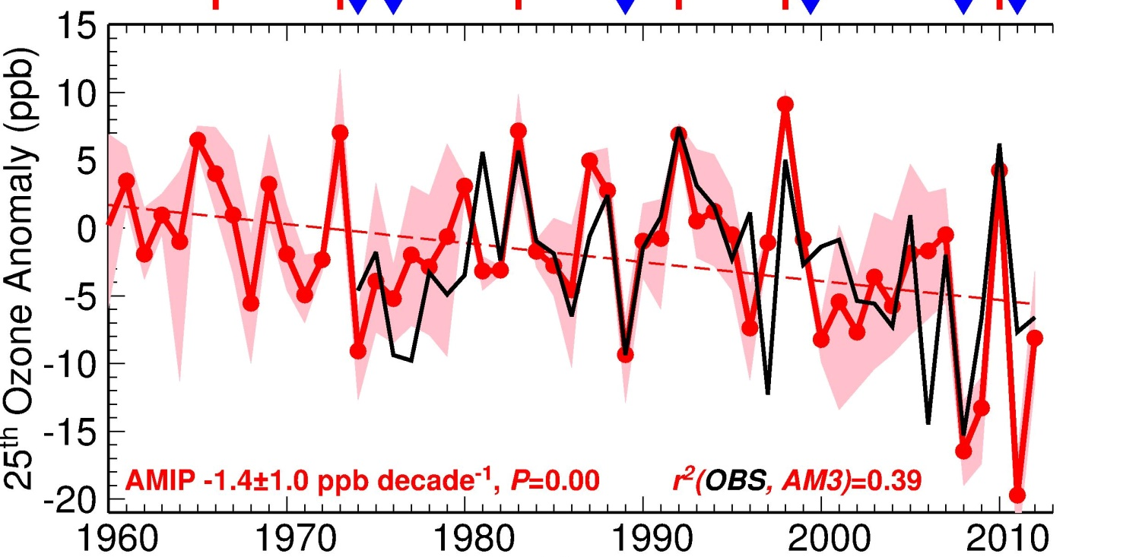
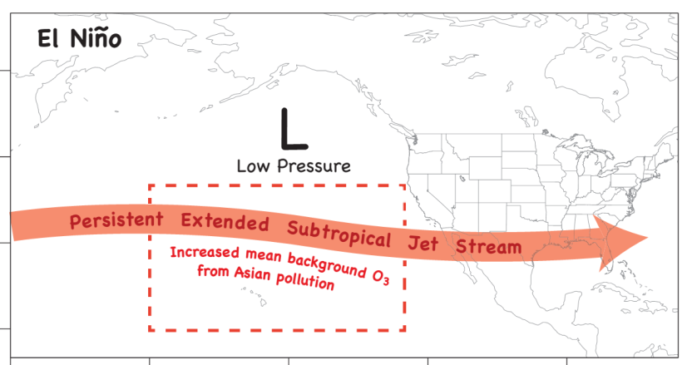
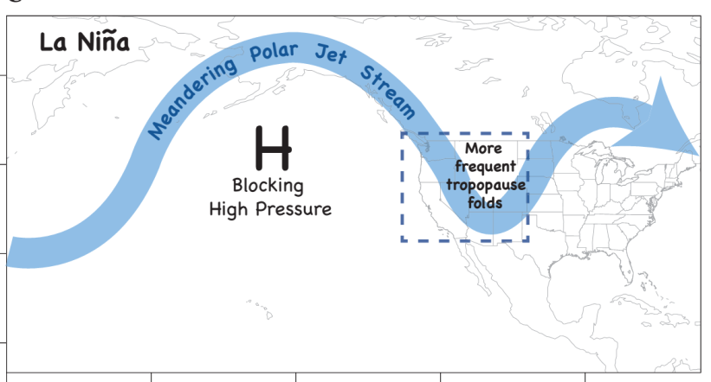
Springtime airflow from Eurasia towards the NE Pacific weakens in 2000s, offsetting rising O₃ from Asian emissions
LaNiña-like decadal cooling
[Chavez2003; Meehl2013; Kosaka2013]
ElNiño
LaNiña
Key role of circulation shifts
Minor influence from fires
Ozone Anomaly , ppb
(25th percentile)
r²(OBS, AMIP) = 0.39; Fixed anthrop & fire emissions
P<0.01
ElNiño
LaNiña
Meiyun Lin et al (Nature GeoSci., 2014)
8

Slide 9
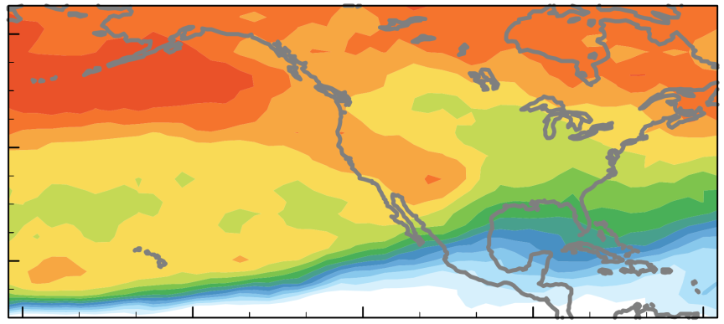
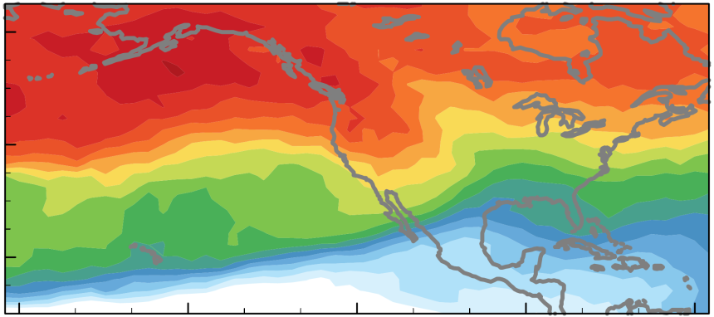
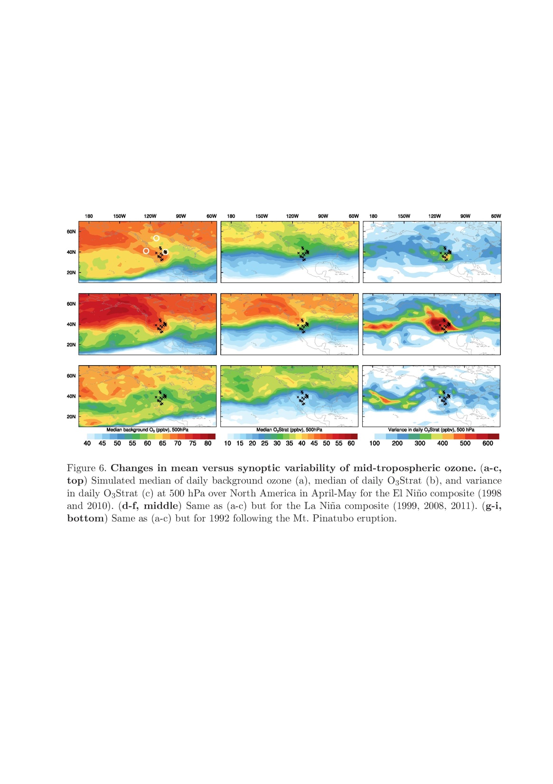
Springtime airflow from Eurasia towards the NE Pacific weakens in 2000s, offsetting rising O₃ from Asian emissions
LaNiña-like decadal cooling
[Chavez2003; Meehl2013; Kosaka2013]
ElNiño
LaNiña
Signal in AIRS CO?
Ozone Anomaly , ppb
(25th percentile)
r²(OBS, AMIP) = 0.39; Fixed anthrop & fire emissions
P<0.01
(ppb)
60N
Model BGO₃ (500 hPa)
80
70
40N
60
20N
50
El Niño
La Niña
40
Meiyun Lin et al (Nature GeoSci., 2014)
9

Slide 10
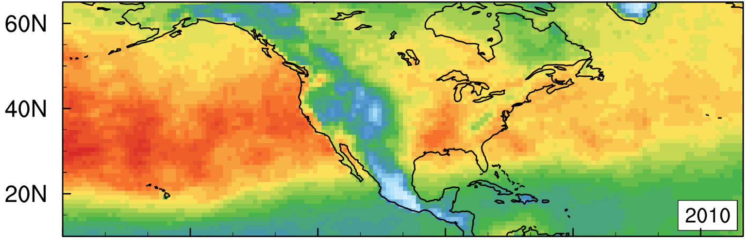
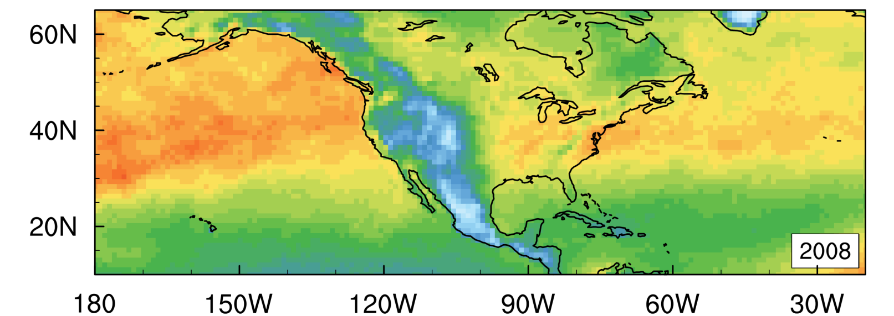
ENSO-driven changes in the Asian pollution signal
measured by AIRS CO
Rise in O₃ + CO
→
The subtropical jet shift modulates hemispheric pollution transport, rather than STT
El Niño (Mar2010)
La Niña (Mar2008)
AIRS CO columns [10¹⁸ molecules cm⁻²] [Data: V6; AIRS Science Team/Joao Texeira 2013]
10
Notes:
Shifts in the subtropical jet position during El Nino primarily modulate hemispheric pollution transport, rather than the stratosphere-to-troposphere ozone transport.
Ask Juying Warner: Why we are not seeing any CO over the WUS?
Artifact of elevation? Better in 500 hPa data?

Slide 11
Stratospheric O₃ intrusions
(STT)
Notes:
That has implications for surface air quality and human health.

Slide 12
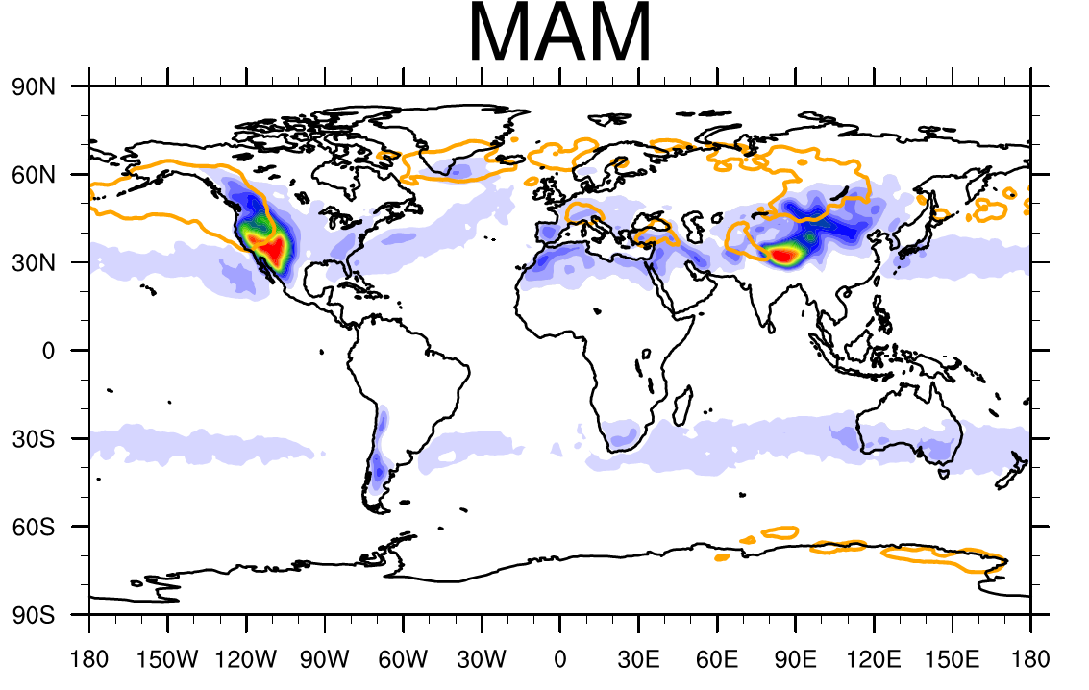
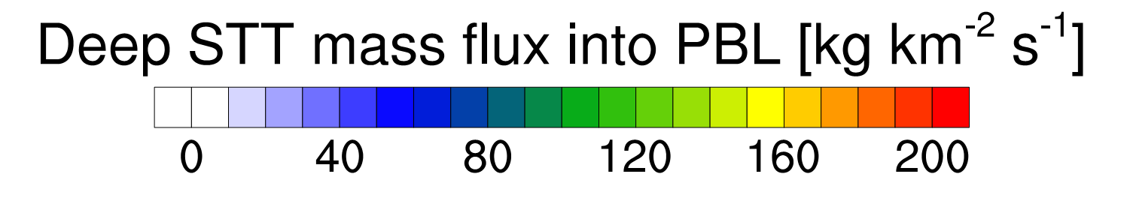
Southwest US is global hotspot for deep STT
(Proximity to N. Pacific storm track exit and high-elevation)
Jet streak
| Spring (ERA-Interim, 1979-2011)
B. Škerlak, M. Sprenger, and H. Wernli , ACP, 14, 913–937, 2014
AIRS/IASI/OMI O₃ retrievals can capture upper-level dynamics conducive to stratospheric intrusions [Pan et al. 2007; Pittman et al., 2009; Wei et al., 2010]
Link to potential influence in the lower troposphere?
12
Notes:
That has implications for surface air quality and human health.

Slide 13
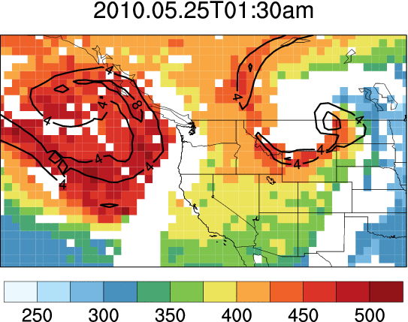
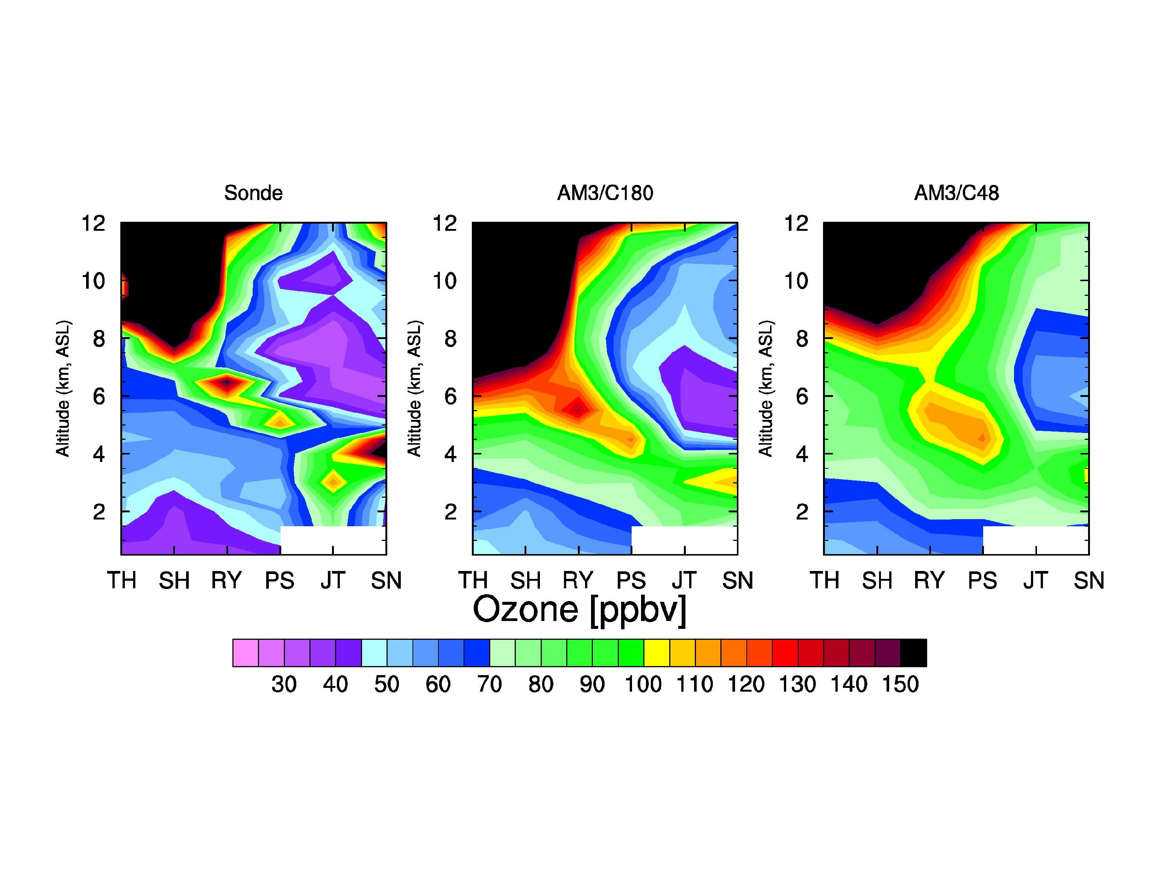
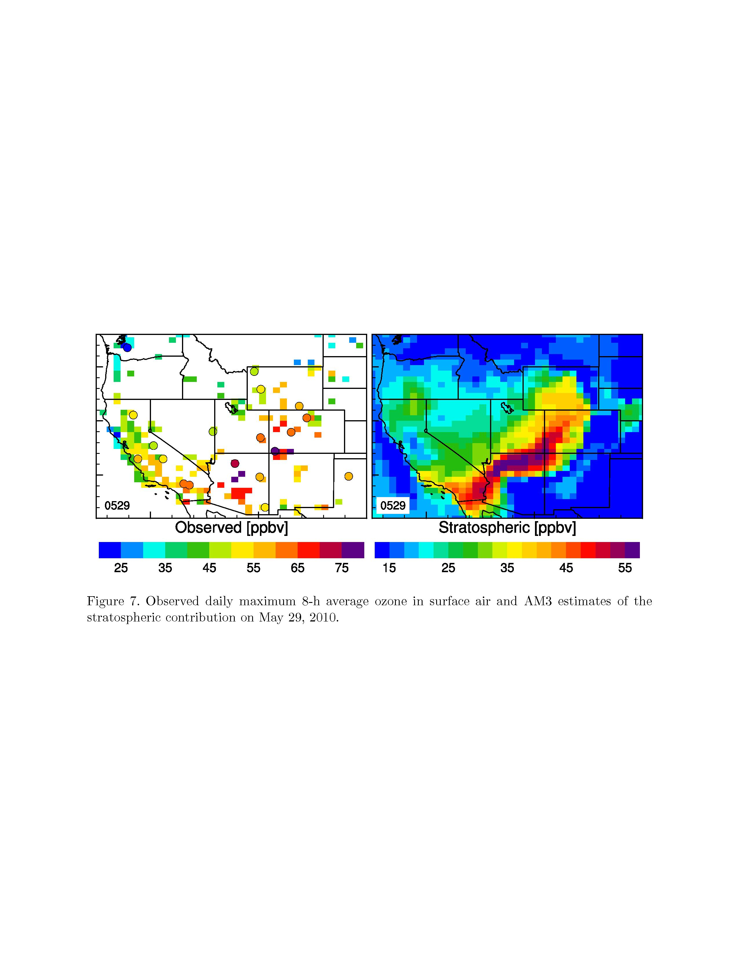

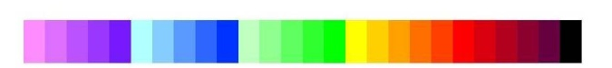
AIRS column O₃ enhancements can indicate potential downwind surface influence
AIRS, May 25-29
Sonde O₃, May 28
Surface O₃, May 29
300 hPa PV
Altitude (km a.s.l.)
TH
SH
Total column O₃ [DU]
RY
PS
SN
JT
North → South
[ppb]
30
60
90
120
150
Daily max 8-hr O₃ [ppb]
Meiyun Lin et al (JGR, 2012b): Springtime high surface ozone events over the western United States: Quantifying the role of stratospheric intrusions
13
Notes:
AIRS column O₃ enhancements can indicate potential downwind surface influence
AIRS O₃ retrievals capture upper dynamics conducive to deep stratospheric intrusions over the western U.S.

Slide 14
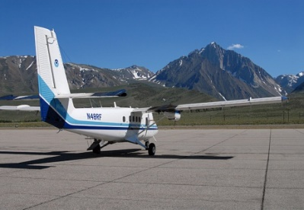
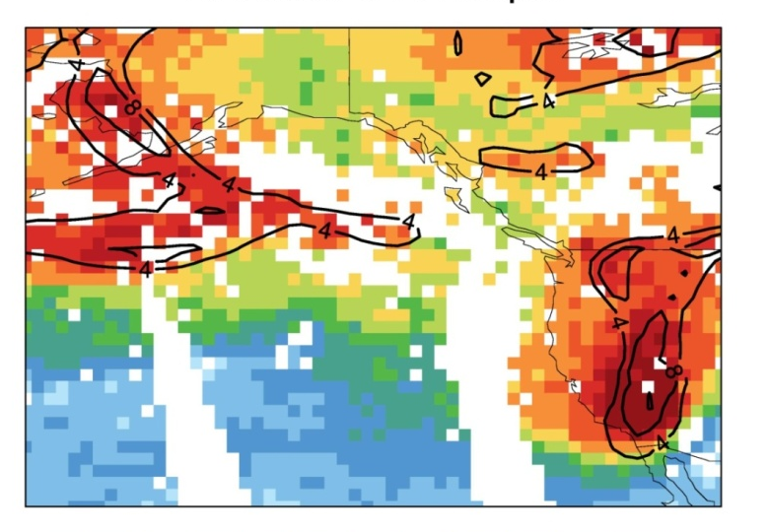
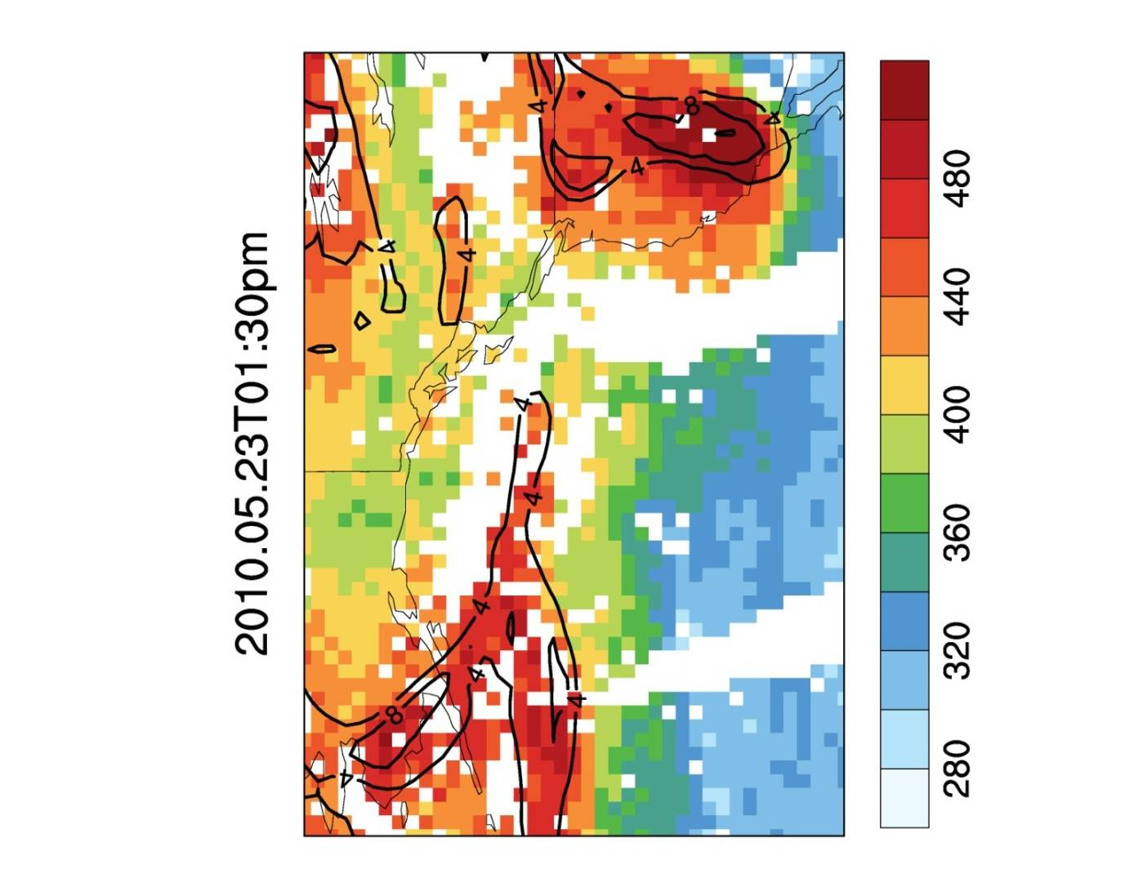

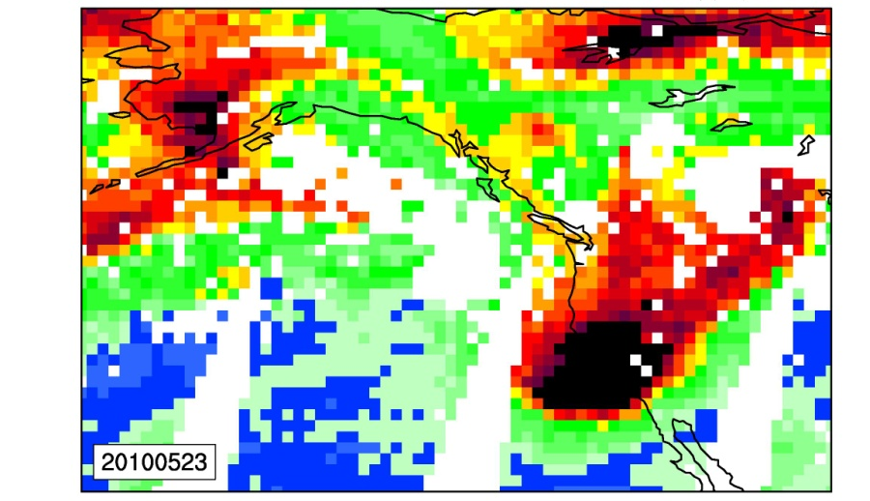

An unusually large tropopause fold over Southern California (May 23, 2010)
Aqua AIRS Ascending
DU
480
440
400
300 hPa PV
360
320
Lidar
Total column O₃
Altitude (km a.s.l.)
280
V5 products
O₃Strat
GFDL AM3
400 hPa O₃
Flight track, S. CA
O₃ [ppb]
30
60
90
120
150
Led to surface ozone exceedances in Colorado on the following day
Lin MY et al (JGR, 2012b): Springtime high surface ozone events over the western United States: Quantifying the role of stratospheric intrusions
14
Notes:
Need to Explain why column ozone see the variability: southward intrusion of ozone-rich polar stratospheric air …
Excellent ability in capturing synoptic-scale ozone gradients associated with strong potential vorticity gradients.
AIRS O₃ retrievals capture consistent dynamic features with PV, model and lidar measurements [see also Pan et al., 2007; Pittman et al., 2009; Wei et al., 2010]

Slide 15
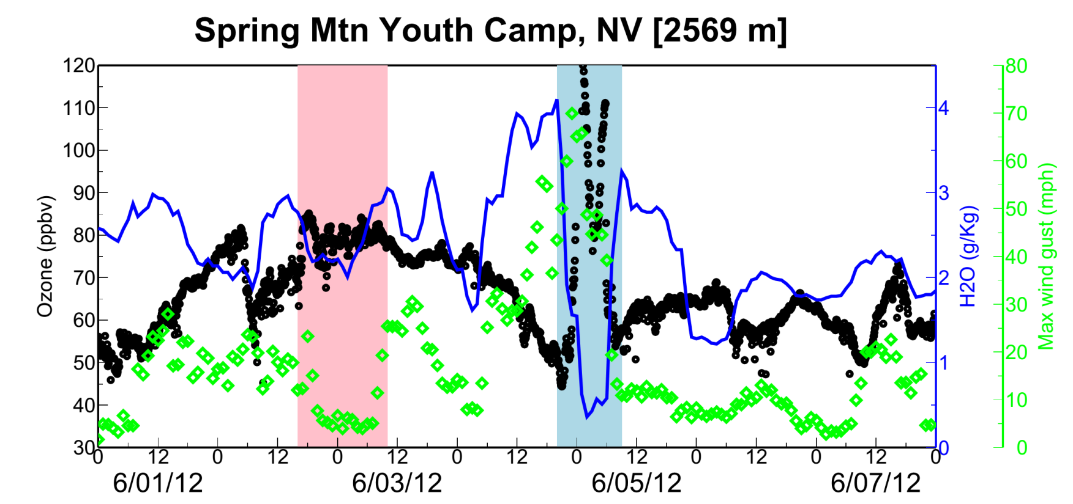
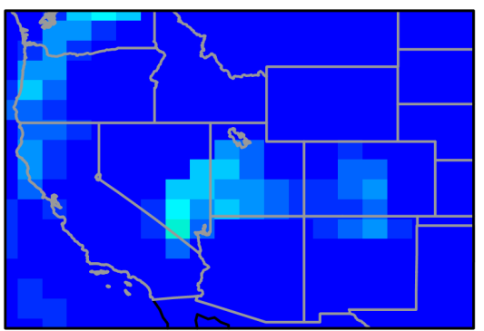
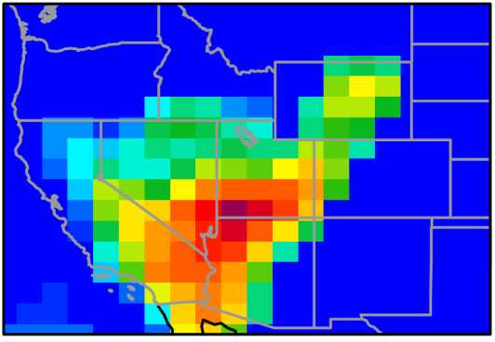
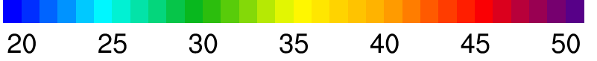
Observed evidence of stratospheric O₃ impact on surface air quality
Pollution
O₃
Ozone (ppb, 5-min)
Wind gust (mph, hourly)
NAAQS
H₂O
June 3
June 5
Data c/o Zheng Li (Nevada DAQ)
Lin MY et al (in prep, 2015)
Model O₃Strat (ppb, 8-h average)
Baseline level (~20 ppb) likely represents an upper limit.
How do such intrusion events vary from year to year?
15
Notes:
AM3 O3Strat captures the episodic ozone enhancements although the mean baseline level of O3Strat may represent an upper limit
Define O3S

Slide 16

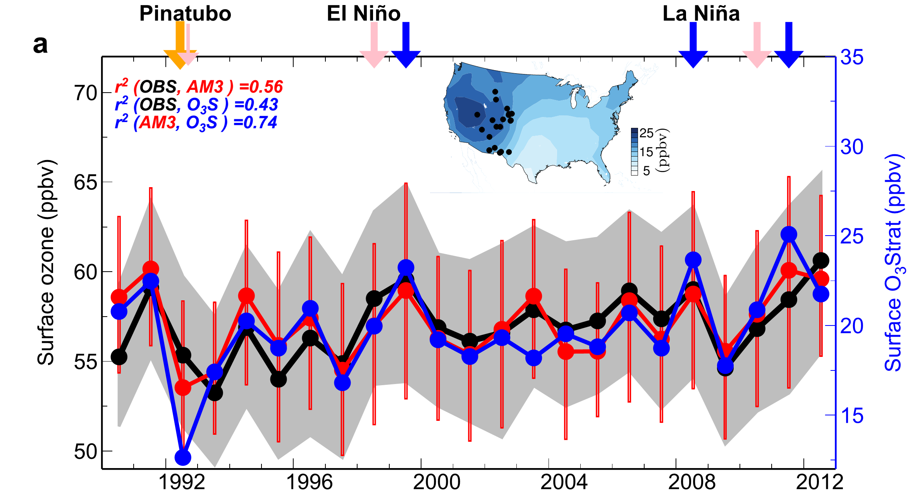
Climate variability modulates western U.S. ozone air quality via deep stratospheric intrusions
75th
50th
O₃Strat
25th
Emissions held constant
Nudged to “real” winds
Stratospheric Contribution (ppb)
1990
April-May
Meiyun Lin, Fiore AM, Horowitz LW, Langford AO, Oltmans SJ, Tarasick D, Rieder H (in press, 2015)
16

Slide 17
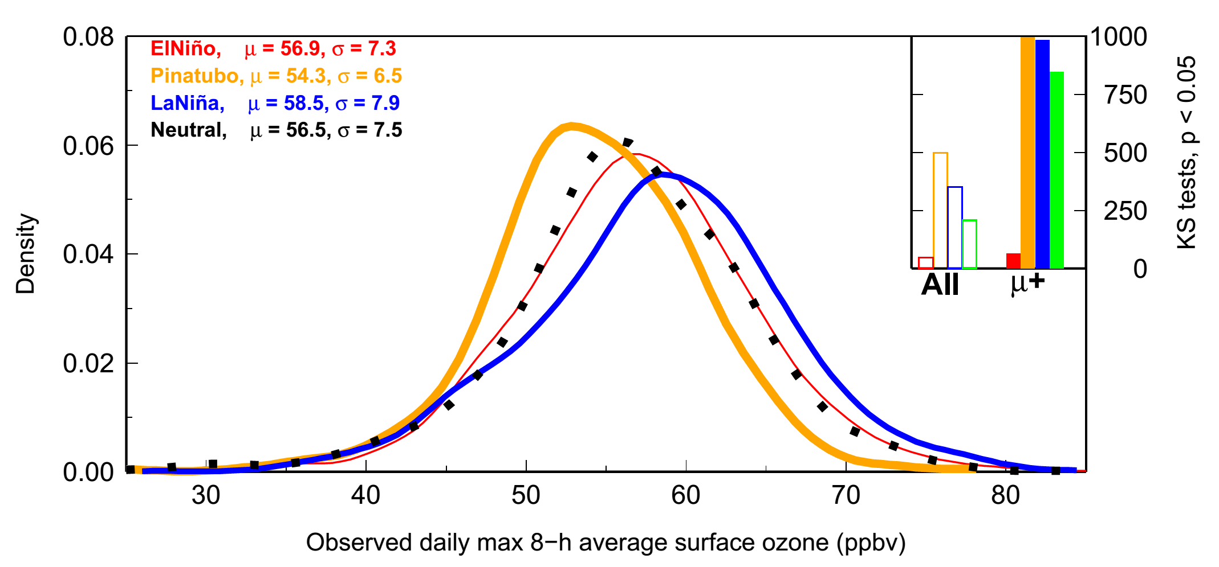
The high tail of the observed daily surface O₃ distribution over Western U.S. increases during La Niña springs
Neutral: µ = 56.5,σ = 7.5
El Niño (1998, 2010): µ = 56.9,σ = 7.3
La Niña (1999, 2008, 2011): µ = 58.5,σ = 7.9
Pinatubo (1992, 1993): µ = 54.3,σ = 6.5
Changes in the high tail are statistically significant
Probability Density
Observed daily max 8-h average (MDA8) ozone [ppb]
El Niño → Little change in WUS surface O₃ despite higher UTLS O₃ levels
Lin MY et al (Nature Communications, in press, 2015)
17
Notes:
In the next few slides, I will reconcile these findings by contrasting inter-annual variability in mean
ozone aloft versus in the frequency of stratospheric intrusions that enhance WUS surface ozone.
TES?

Slide 18
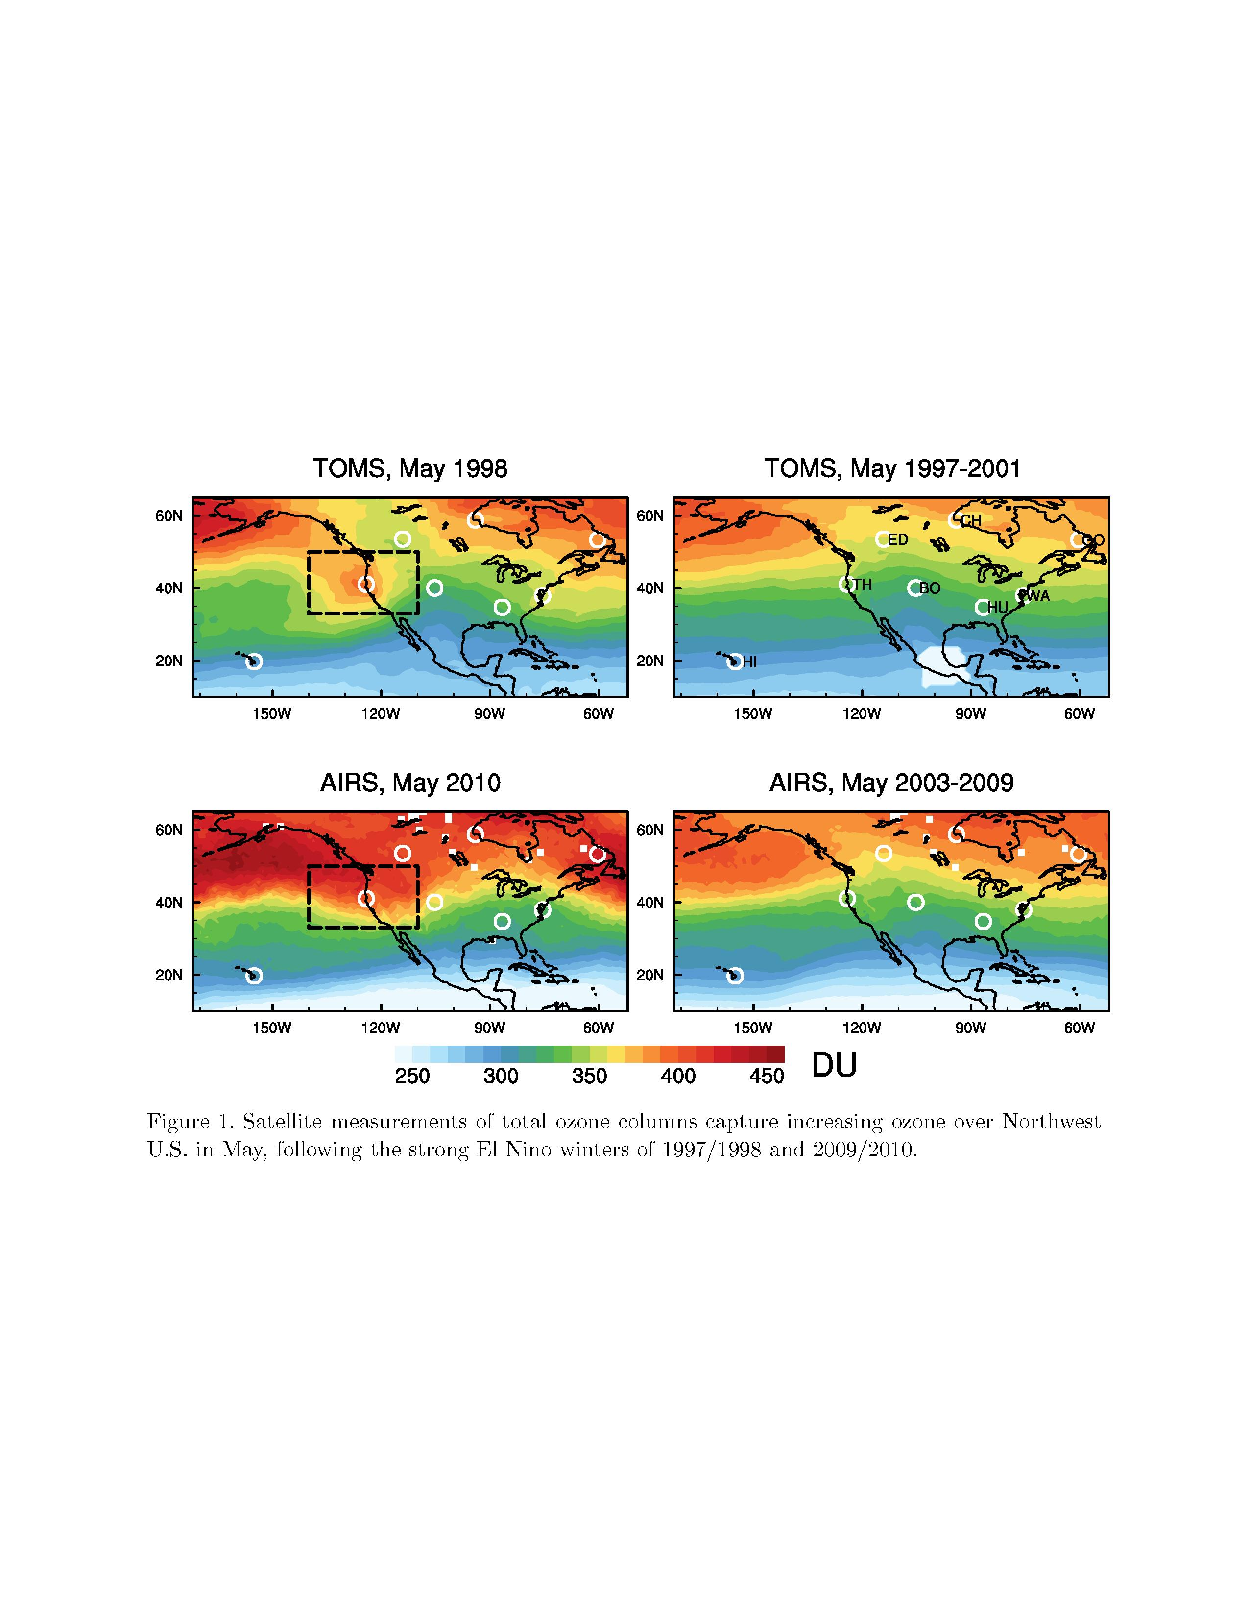
Following an El Niño, enhanced total ozone columns over the Northwest U.S. in the late spring
TOMS
(1997/1998 El Niño)
AIRS
(2009/2010 El Niño)
Changes in stratospheric overturning circulation that increases extratropical UTLS O₃ burdens (Bronnimann2004; Randel2009; Calvo2010; Neu2014), but …(next slide)
Lin MY et al (Nature Communications, in press, 2015), Supplemental Info
18
Notes:
Consistent with Trinidad Head sonde, we find that this El Nino-related ozone variability is also represented in the satellite observations of total column ozone. Your see here greater total ozone over the NW US (within the black box) in May 1998 compared with 5-year mean from TOMS. Lower panel from AIRS …There is no clear sign for La Nina years in satellite observations of total column. Enhanced UT/LS ozone during El Nino years provide additional source available to be transported into the troposphere.

Slide 19
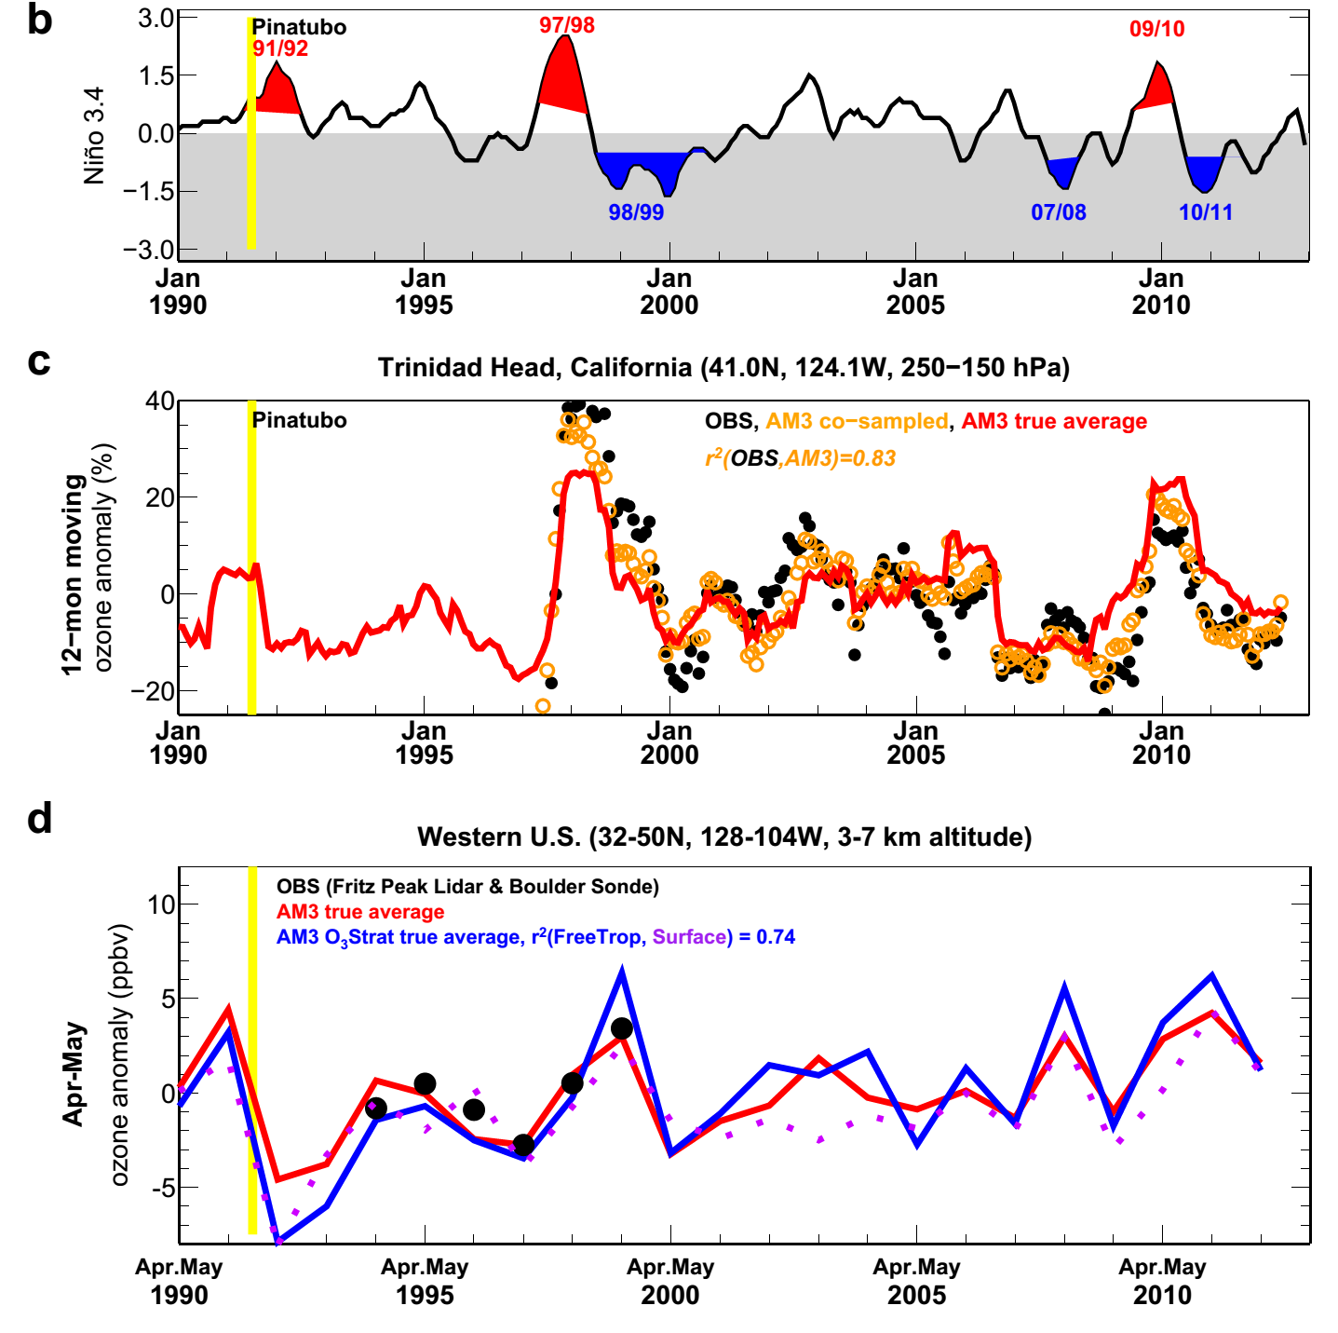
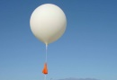
Western US surface O₃ variability correlates poorly with O₃ burdens in the UTLS but strongly with that in the Free Trop
3.0
Niño 3.4 Index
1.5
0
-1.5
-3.0
40
12-mon running mean 250-150hPa O₃ anomaly (%)
r²(UTLS, Surface) = 0.07
20
0
Trinidad
-20
10
Apr-May mean FreeTrop & Surface O₃ anomaly (ppb)
r²(FreeTrop, Surface) =0.74
98/99
07/08
10/11
5
0
-5
1990
1995
2000
2005
2010
Langford1999 noted positive correlations btw FreeTrop and UTLS O₃ observed at Fritz Peak during 1994-1998 (without La Niña years): AM3 captures the observed relationship (r²=0.69) for this short record but indicates little correlation (r²=0.18) for the entire 1990-2012 period.
19
Notes:
TES:

Slide 20

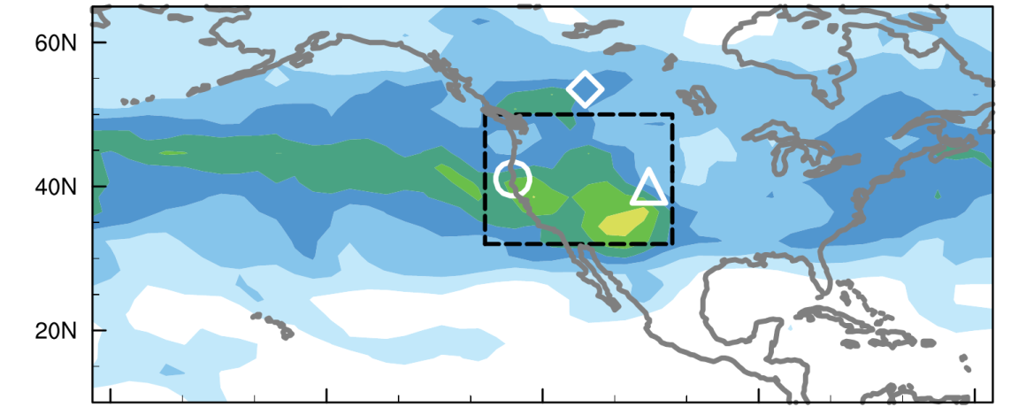

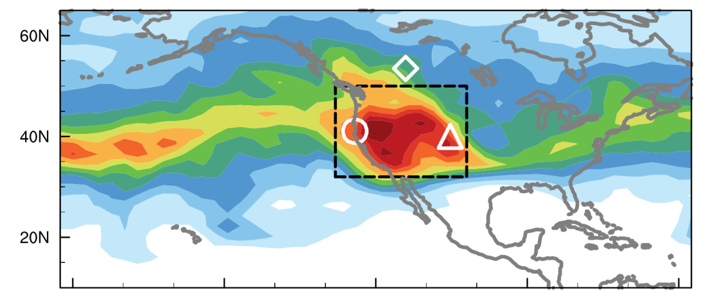
ENSO-related jet characteristics and their impacts on lower trop. ozone variability over western NA
El Niño
N=4, 1979-2012
σ² (daily O₃Strat), 500 hPa, Apr-May
ppb²
La Niña
N=4, 1979-2012
Detecting from space requires 1) strong sensitivity in mid-trop
2) vast spatial coverage at daily intervals; not in TES
Lin MY et al (Nature Communications, in press, 2015)
20

Slide 21
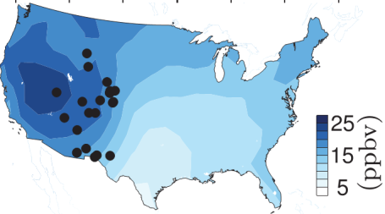
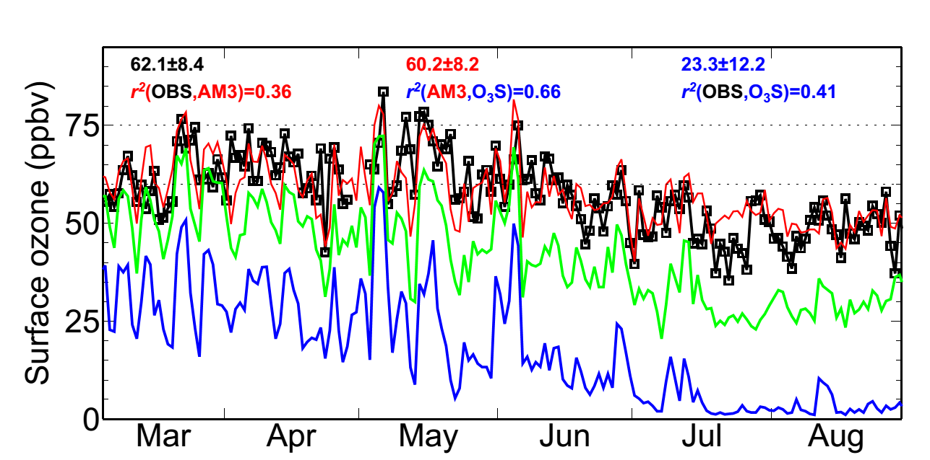
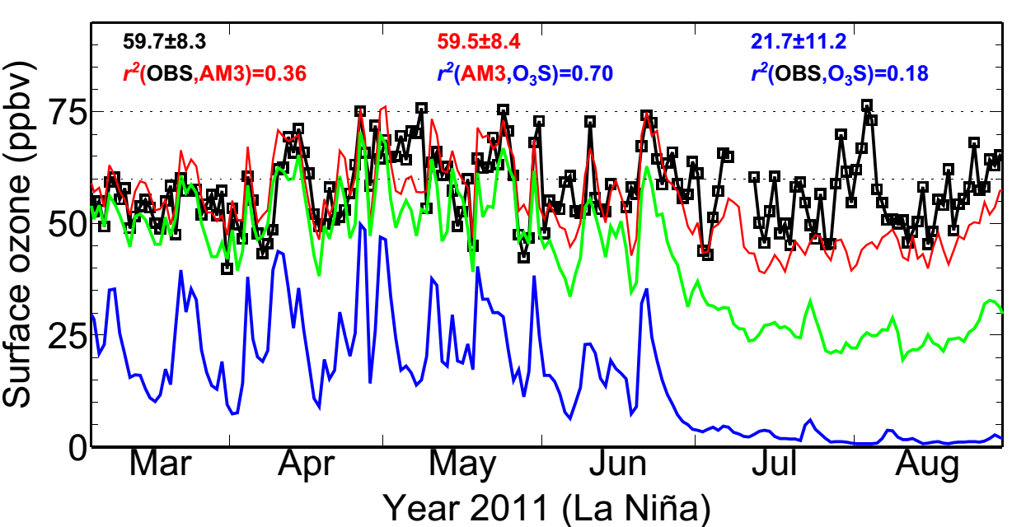
Following strong La Niña, deep STT may occur with sufficient frequency as to confound ozone attainment
Gothic, Colorado (2.9 km altitude)
70 ppb
MDA8 O₃ (ppb)
Total
1999 (La Niña)
BGO₃
O₃Strat
Chiricahua NM in Arizona (1.5 km altitude)
2011 (La Niña)
MDA8 O₃ (ppb)
21
21

Slide 22
Following strong La Niña, deep STT may occur with sufficient frequency as to confound ozone attainment
Gothic, Colorado (2.9 km altitude)
65 ppb
MDA8 O₃ (ppb)
Total
1999 (La Niña)
BGO₃
O₃Strat
Chiricahua NM in Arizona (1.5 km altitude)
2011 (La Niña)
MDA8 O₃ (ppb)
22
22

Slide 23
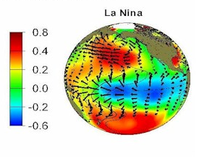
Developing seasonal predictions with a few months of lead time to aid Western U.S. AQ planning?
Tropical SST cooling typically peaks in winter
More frequent stratospheric intrusions expected in the following spring over WUS?
Chiricahua NM, Arizona (1.5 km altitude)
SST (C)
MDA8 O₃ (ppb)
23
Forecasting from space (next slide)?
The winter-spring link could allow regional preparations, e.g.
Deploying targeted measurements aimed at identifying “exceptional events”
Conducting daily forecast for public health alerts
Lin MY et al (Nature Communications, in press, 2015)
23
Notes:
Mention Pat Reddy
Mention O3/CO/H2O in Andy Langford and Mick Newchurch

Slide 24
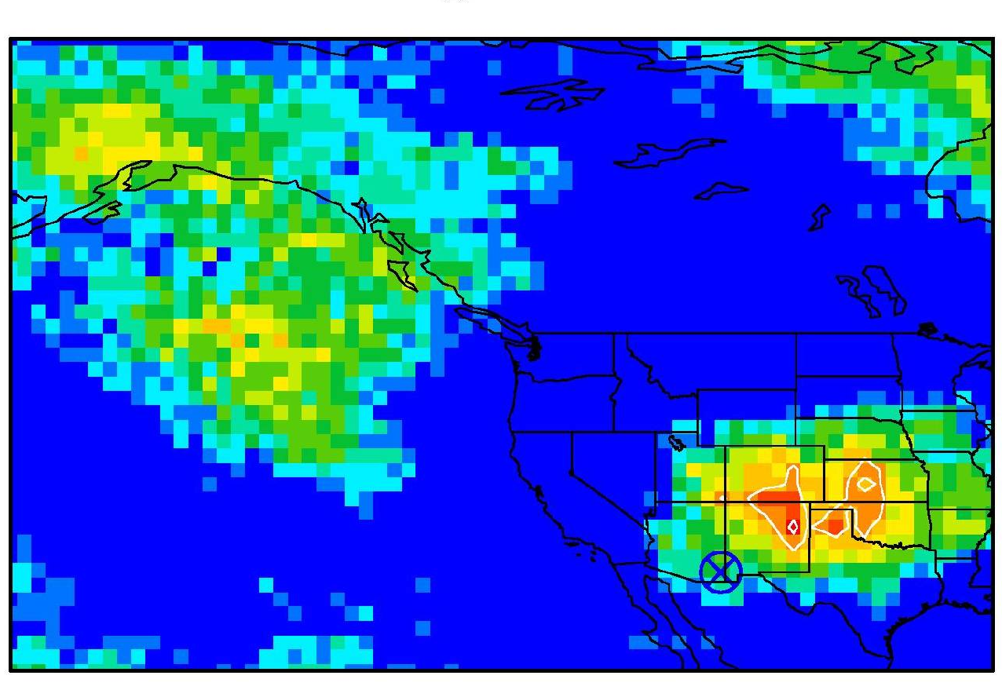
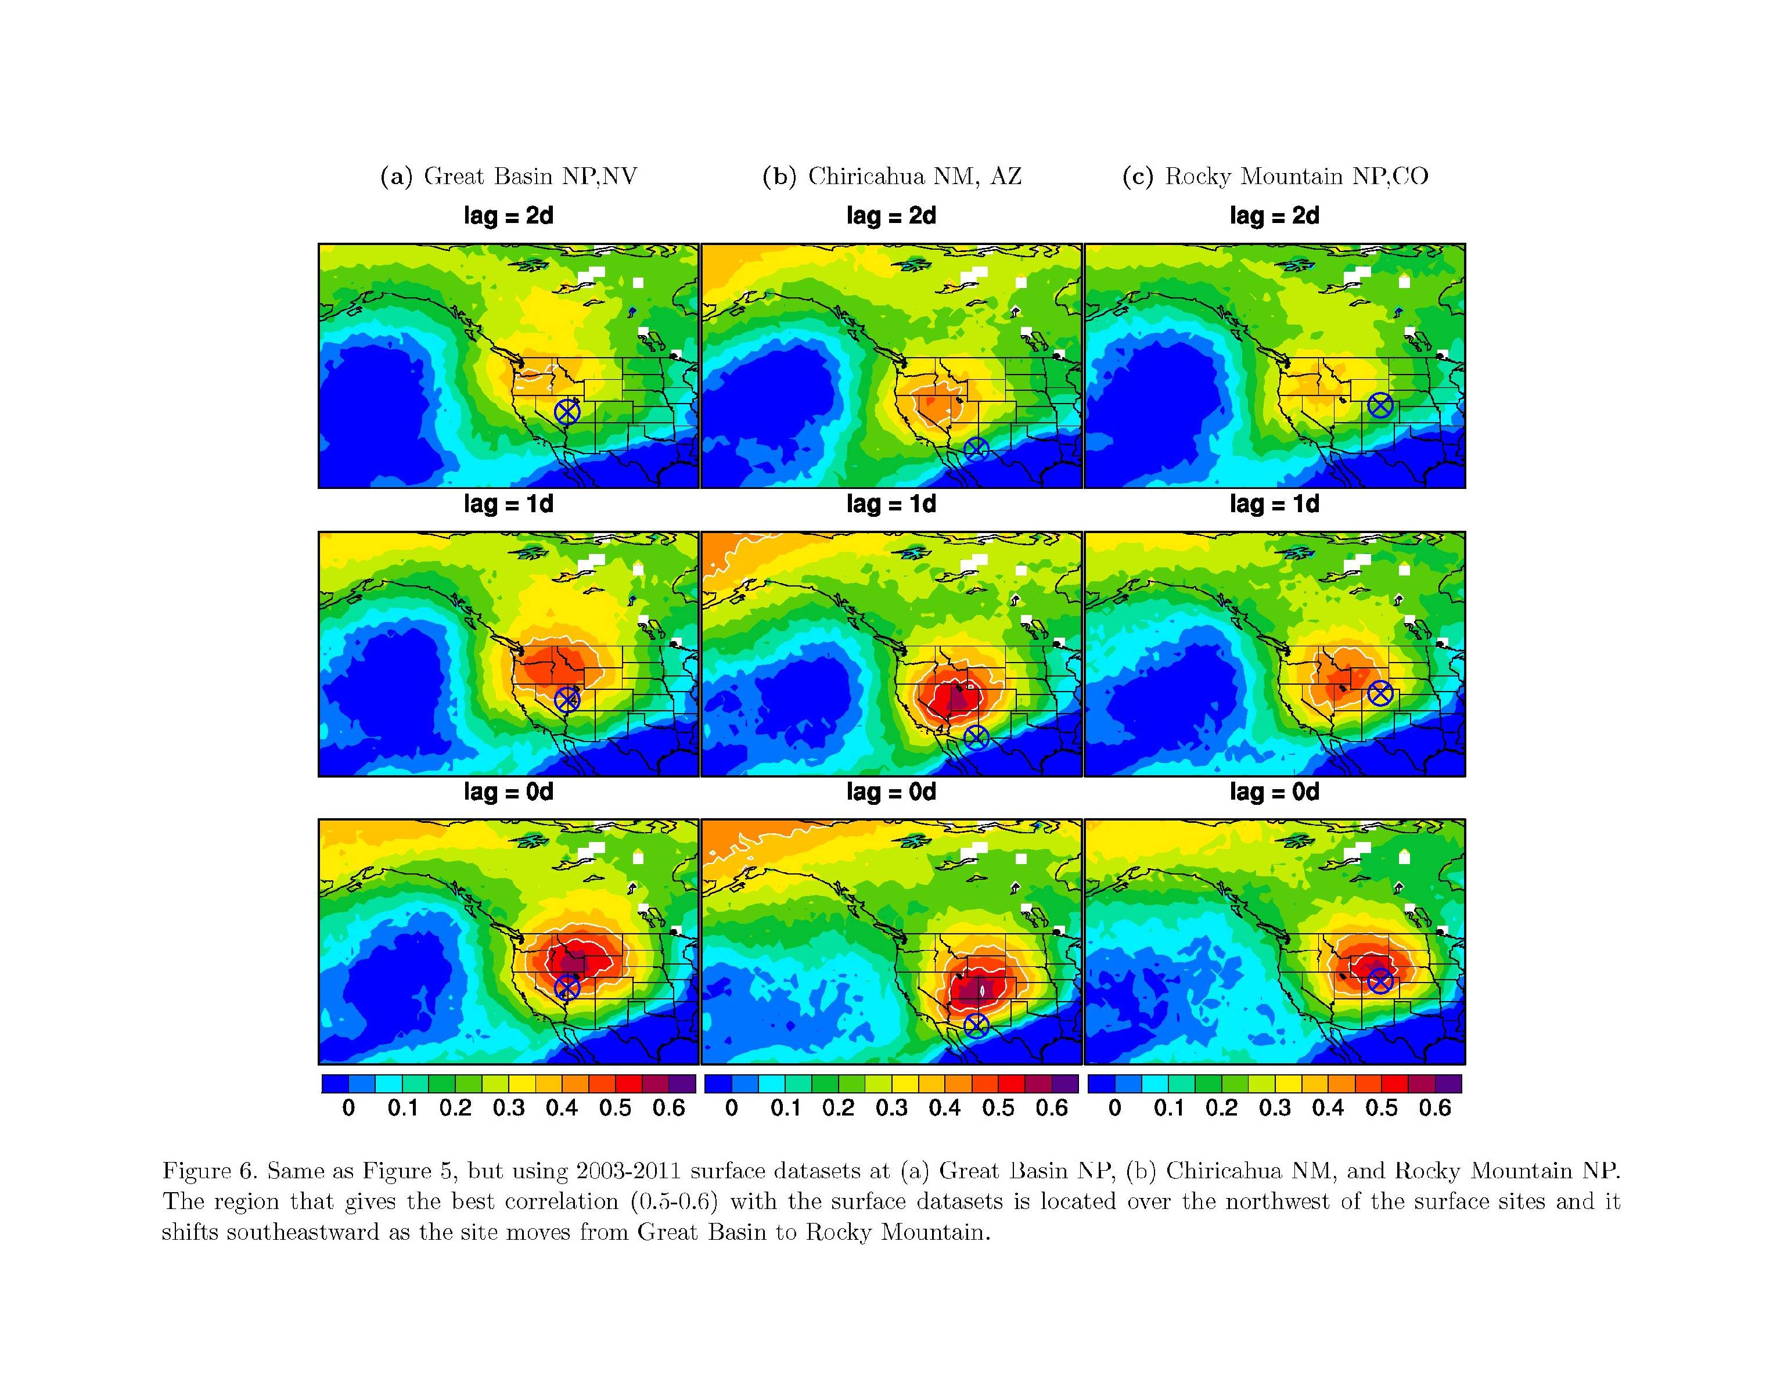
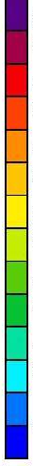
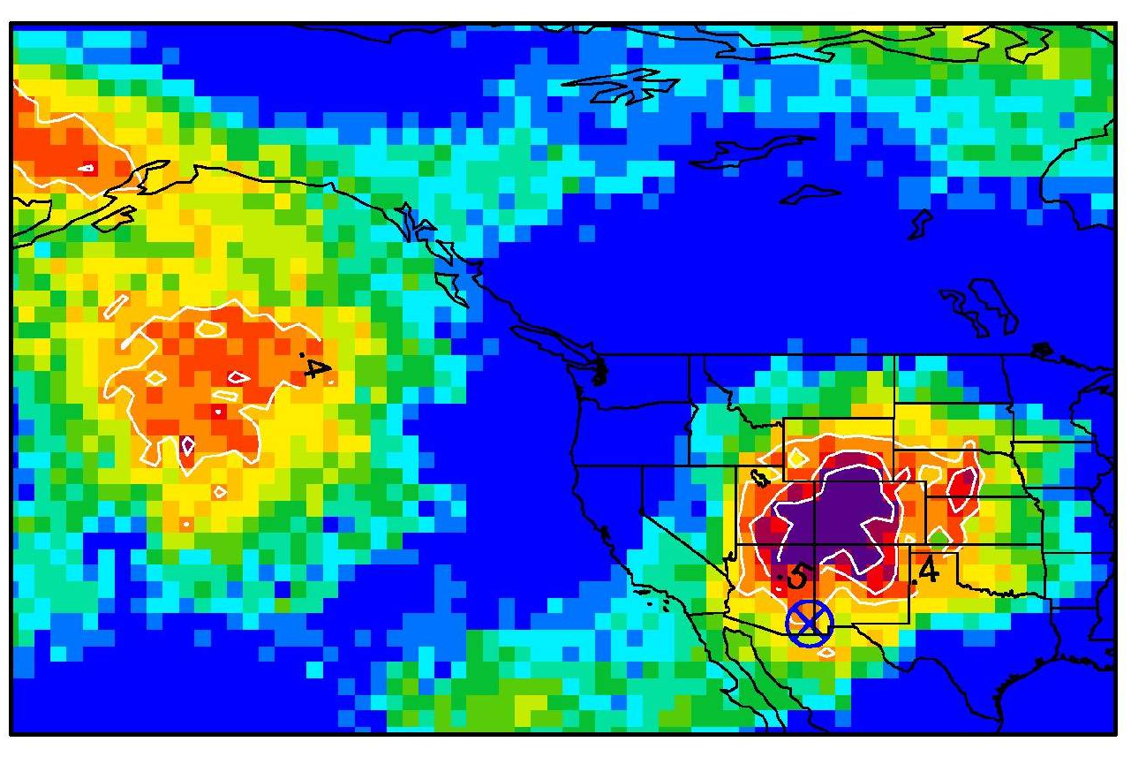
Stratospheric intrusion “forecasting” from space
(Correlations of daily AIRS UT/LS ozone and surface ozone)
r(OBS, AIRS), 0 day
r(AM3 O₃S, AIRS), 3d prior
r
0.6
0.5
0.4
0.3
r(AM3 O₃S, AIRS), 0 day
r(AM3 O₃S, AIRS), 1d prior
0.2
0.1
0
Apr-May 2011
Apr-Jun, 2003-2011
Stronger potential for accurate prediction in ~1 day
Uncertain as to where the intrusion will reach the WUS surface
Useful for exceptional event demonstrations
24
Notes:
Stronger potential for accurate prediction in ~1 day as to where the intrusion
will reach the surface
→ AIRS O₃ variability ~5ºx5º NW of a receptor site indicates incoming intrusions

Slide 25
Challenges for satellite instruments going forward:
perspectives from the air quality applied sciences
Inform transported “background”
Surface AQ
Time average; big-picture
Global-to-regional scale
Upper-level dynamics
Episodic
Regional-to-local scale
Vertically refined
Future?
Need to improve sensitivity in the mid- & lower troposphere
Vast spatial coverage at Hi-Res and at near-daily intervals; GEO-CAPE?
Ability to quantitatively relate pollutant concentrations to their sources and transport on synoptic time scales
Providing data to improve air quality forecasts
Thank you! (Meiyun.Lin@noaa.gov)
25

Slide 26
Additional Slides for Discussions
Notes:
AM3 O3Strat captures the episodic ozone enhancements although the mean baseline level of O3Strat may represent an upper limit

Slide 27

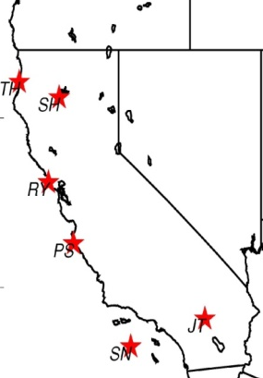


Subsidence of stratospheric O₃ to the lower trop of S. California (May 28, 2010)
Sondes over California
Observed RH (%)
OBS O₃
AM3 total
Altitude (km)
zeroNA
O₃Strat
O₃ [ppb] at Joshua Tree (JT)
North → South
Simulated enhancements of O₃Strat consistent with observed low RH
Reaching surface air on the following day
30
50
70
90
110
130
150
[ppb]
Lin MY et al (JGR, 2012b): Springtime high surface ozone events over the WUS …
27
Notes:
O₃Strat contributes ~75% to enhanced O₃ >100 ppbv at 2-5 km a.s.l.
Consistent with observed low humidity; NA emissions contribute little

Slide 28



Simulating deep stratospheric intrusions:
role of model resolution (May 28, 2010 example)
Sondes
AM3 (~0.5ºx0.5º)
AM3 (~2ºx2º)
Altitude (km)
Sonde sites, North → South
O₃ [ppbv]
0.5º model better captures vertical structure
2º model reproduces the large-scale view
→ Establishing its suitability for exploring interannual variability
28
Lin MY et al (JGR, 2012b): Springtime high surface ozone events over the WUS …

Slide 29


Inter-annual variability of
Western U.S. surface ozone in April-May
r² (OBS, EACOt ) = 0.09
r² (OBS, O₃Strat) = 0.43
O₃Strat
Stratospheric Contribution (ppb)
LaNiña
Pinatubo
1990
Strong stratospheric influence on WUS O₃ IAV: Greater following strong La Niña events; Can complicate attribution of O₃ trends in short records
In contrast, Asian influence (FixEmis) is minor; Weakened in the 2000s
Lin MY et al: Climate variability modulates Western U.S. ozone air quality via deep stratospheric intrusions, Nature Communications, in press, 2015.
29

Slide 30



Increasing ozone at Mauna Loa in FALL tied to a shift in circulation patterns since the mid-1990s
OBS: 11% decade⁻¹ (p<0.05)
FIXEMIS (Nudged): 7% decade⁻¹ (p<0.05)
BASE (Nudged): 13% decade⁻¹ (p<0.05)
Changes in NCEP 500hPa height
(1995-2011 minus 1980-1994)
[m]
Sep -Oct
→ Must consider decadal climate variability for attribution of pollutant trends
Lin M.Y. et al (Nature GeoSci., 2014)
30
Notes:
Much of the observed increase in ozone at Mauna Loa during fall is explained by circulation pattern shifts. Since the mid-1990s, the Pacific-North American (PNA) pattern has shifted to a more positive phase, causing an intensification of the southward transport of ozone-rich air from the mid-latitudes north of Hawaii to subtropical Hawaii.

Slide 31
List of relevant papers
Lin, M., A.M. Fiore, L. W. Horowitz, O. R. Cooper, V. Naik, J. Holloway, B. J. Johnson, A. M. Middlebrook, S. J. Oltmans, I. B. Pollack, T. B. Ryerson, J. X. Warner, C. Wiedinmyer, J. Wilson, B. Wyman: Transport of Asian ozone pollution into surface air over the western United States in spring, Journal of Geophysical Research,117, D00V07, 2012, doi:10.1029/2011JD016961 (PDF)
Lin M., A. M. Fiore , O. R. Cooper , L. W. Horowitz , A. O. Langford , Hiram Levy II , B. J. Johnson , V. Naik , S. J. Oltmans , C. Senff (2012): Springtime high surface ozone events over the western United States: Quantifying the role of stratospheric intrusions, Journal of Geophysical Research, 117, D00V22, doi:10.1029/2012JD018151 (Full Text)
Lin, M., L.W. Horowitz, S. J. Oltmans, A. M. Fiore, Songmiao Fan (2014): Tropospheric ozone trends at Manna Loa Observatory tied to decadal climate variability, Nature Geoscience, 7, 136-143, doi:10.1038/NGEO2066 (PDF)
Lin, M., A. M. Fiore, L.W. Horowitz, A. O. Langford, S. J. Oltmans, D. Tarasick, H. E. Rieder (2015): Climate variability modulates western U.S. ozone air quality in spring via deep stratospheric intrusions, Nature Communications, in press, 2015
31
Notes:
Maps + PDF

