Slide 1



Quantifying Asian influence on Western U.S. surface ozone exceedances and long-term trends
Transboundary ozone pollution conference California April 2015
Meiyun Lin
(Princeton & NOAA GFDL)
Acknowledgements: L.W. Horowitz (NOAA GFDL), O.R. Cooper (NOAA ESRL), A.M. Fiore (Columbia/LDEO), S. J. Oltmans (NOAA ESRL), CalNex Science Team, GFDL Atmospheric Chemistry & Climate group
Notes:
1

Slide 2
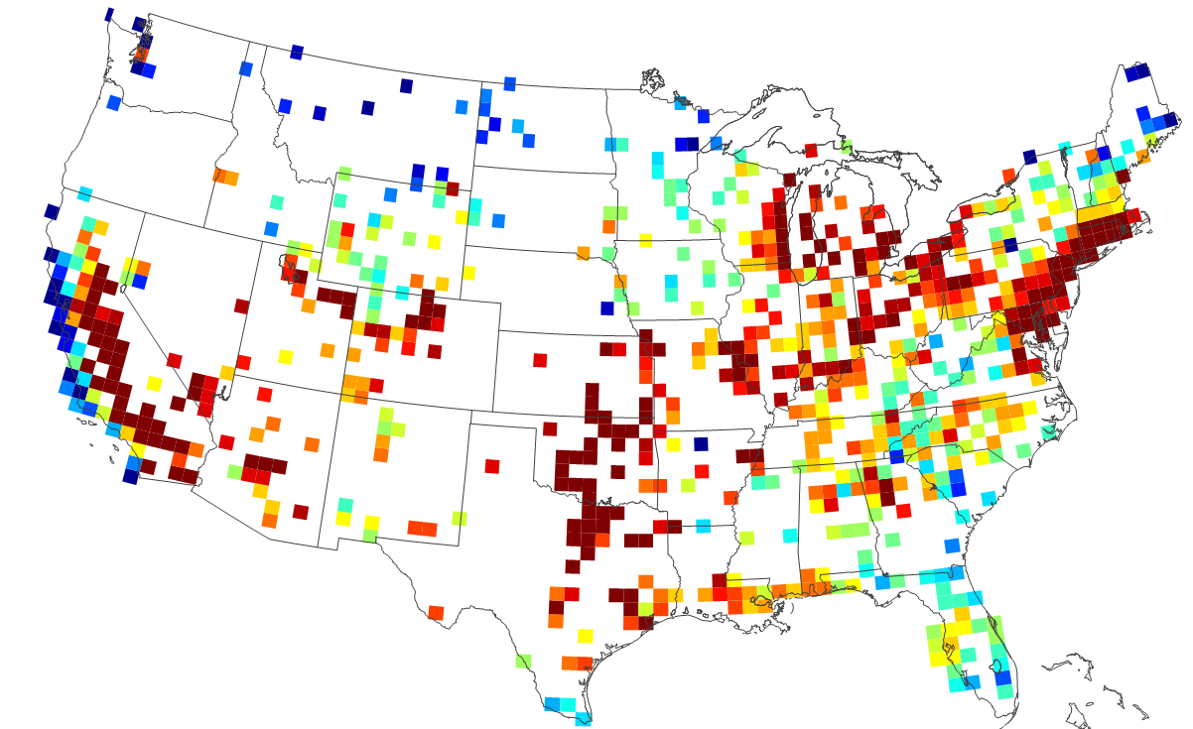
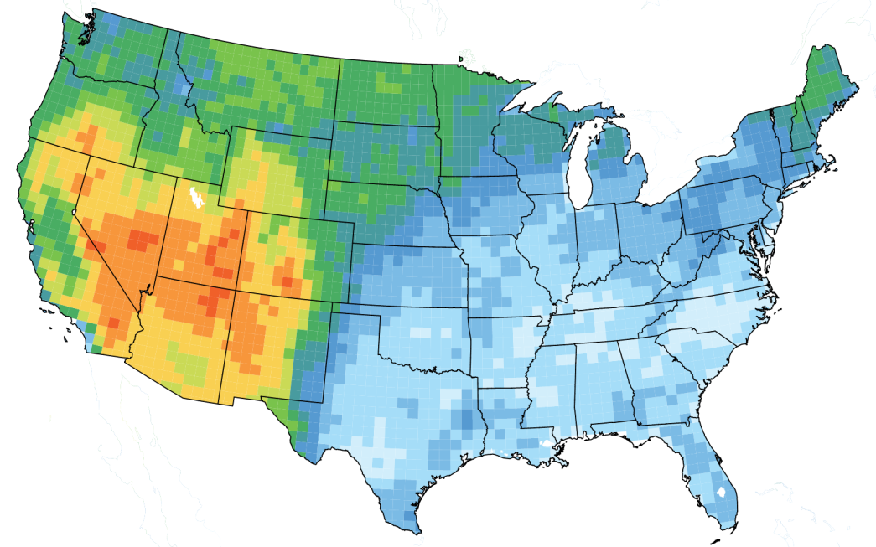
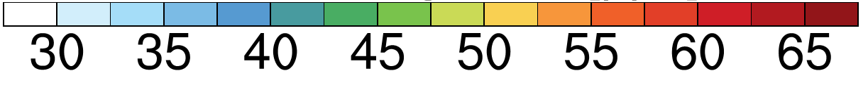
Major challenges for Western U.S. air quality management
Sparse monitoring
Annual 4th Hi MDA8 O₃ (2011-2013 AQS)
Current NAAQS
Mean background, Apr-Jun
NA anthrop emis off in GFDL AM3 (~0.5ᵒx0.5ᵒ)
ppb
ppb
Future NAAQS?
SALIENT QUESTIONS:
- Asian pollution contribution to WUS high-O₃ events?
- How can AQ managers identify such events?
- Are there changes in large-scale transport patterns?
- Role of rising Asian emissions over recent decades?
Need process-level understanding on daily to MULTI-decadal time scaleS
2
2
Notes:
Tied to these salient questions, I will discuss the relative strengths and limitations of current global-scale models for estimating the contribution of trans-boundary pollution.

Slide 3
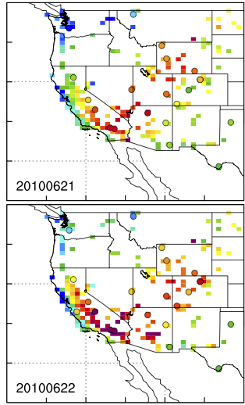
Asian pollution contribution to WUS high-O₃ events
Observed
Model total
Model Asian
June 21
2010
June 22
2010
Future NAAQS?
Surface MDA8 O₃
[ppb]
[ppb]
→ How can AQ managers identify such events?
3
Lin MY et al [JGR, 2012a]: Transport of Asian ozone pollution into surface air over the WUS in spring
Notes:
Asian emissions contribute 8-12 ppb on days when OBS O₃ ≥ 65 ppb (future NAAQS)
Consistent with elevated free trop O₃ levels observed by in ozonesondes during CalNex

Slide 4

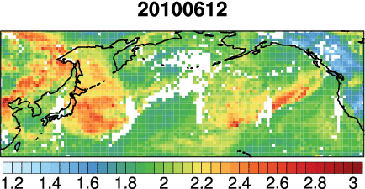
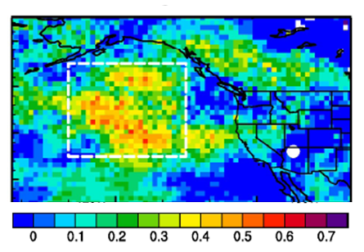
Asian pollution “forecasting” with daily NASA AIRS CO columns
May-June 2010
Animation of daily AIRS CO columns
[10¹⁸ molecules cm⁻²]
Correlation coefficient (r)
btw model Asian O₃ at Grand Canyon and AIRS CO columns 2 days prior
→ Indicate potential downwind influence
Daily exceedance attributions (qualitatively)
Quantitative estimates require models
Additional O₃/CO profile measurements can help
Lin MY et al. [JGR, 2012a]
Publicity: AGU Editors’ Highlight, Nature News, ScienceShot)
4

Slide 5
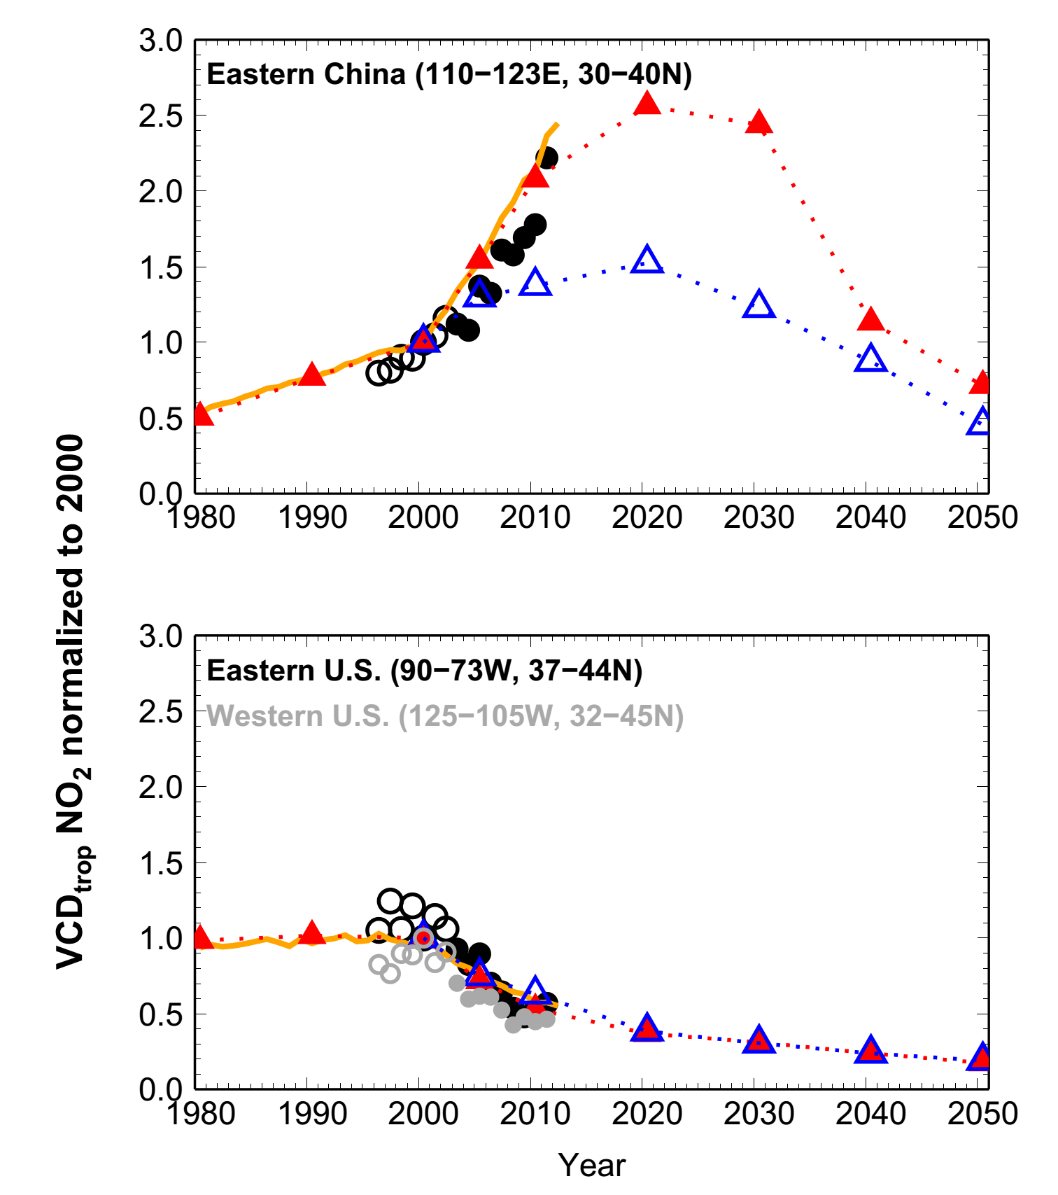
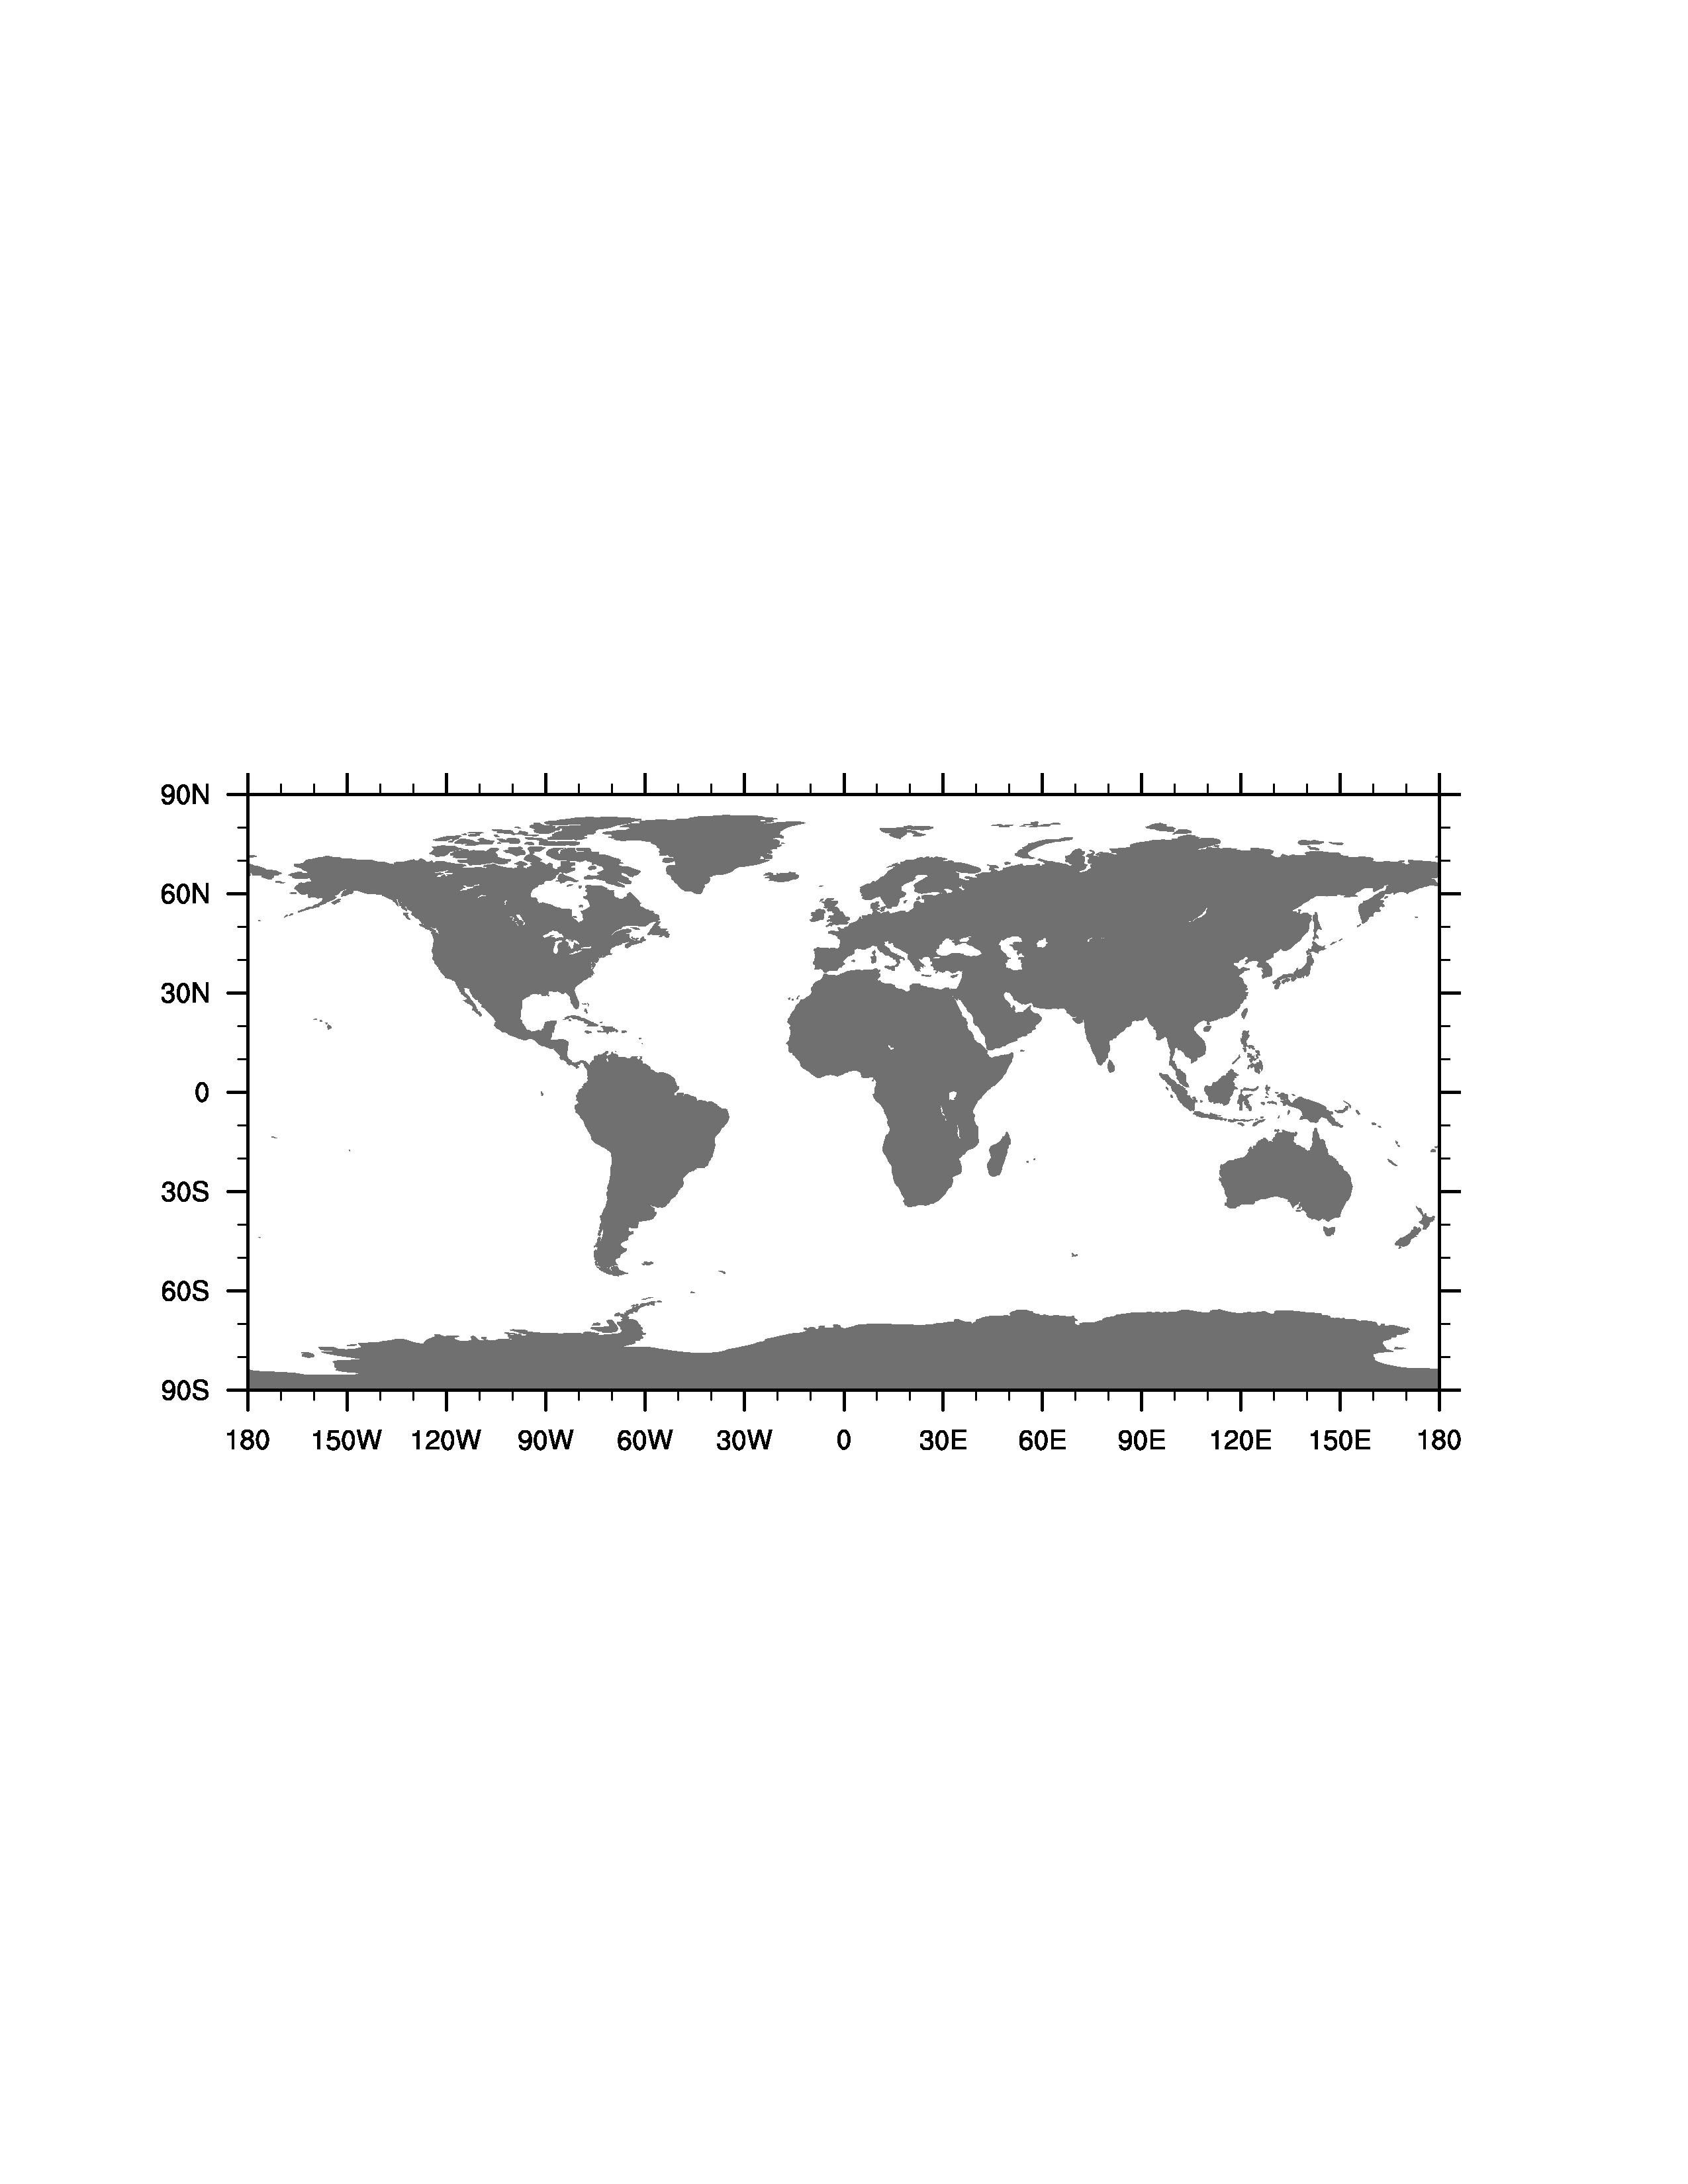
Rising Asian NO_{x} emissions
RCP8.5 (AM3 BASE):
Almost tripled over 1980-2010
Largest increases in the 2000s
Peak in 2020-2030
E. China
RCP8.5
(AM3 BASE)
EUS & WUS
GOME/SCIAMACHY
NO₂ columns
Normalized to Y2000
RCP4.5
(CCMs in Parrish et al)
Changes in NO_{x} emissions from 1980 to 2050
50% reductions over 2000-2010 from the U.S. NOx SIP call
IAV in transport patterns
Influence from circulation changes is poorly understood
5
5
Notes:
Need to motivate emissions versus circulation changes …
Lifetime of ozone …

Slide 6

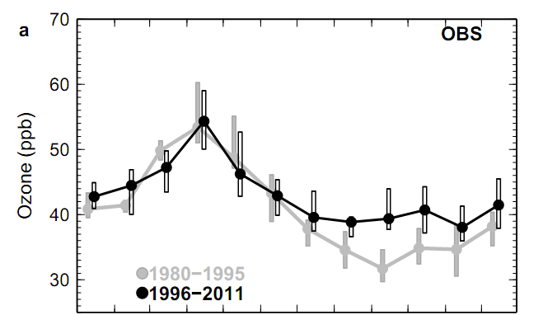
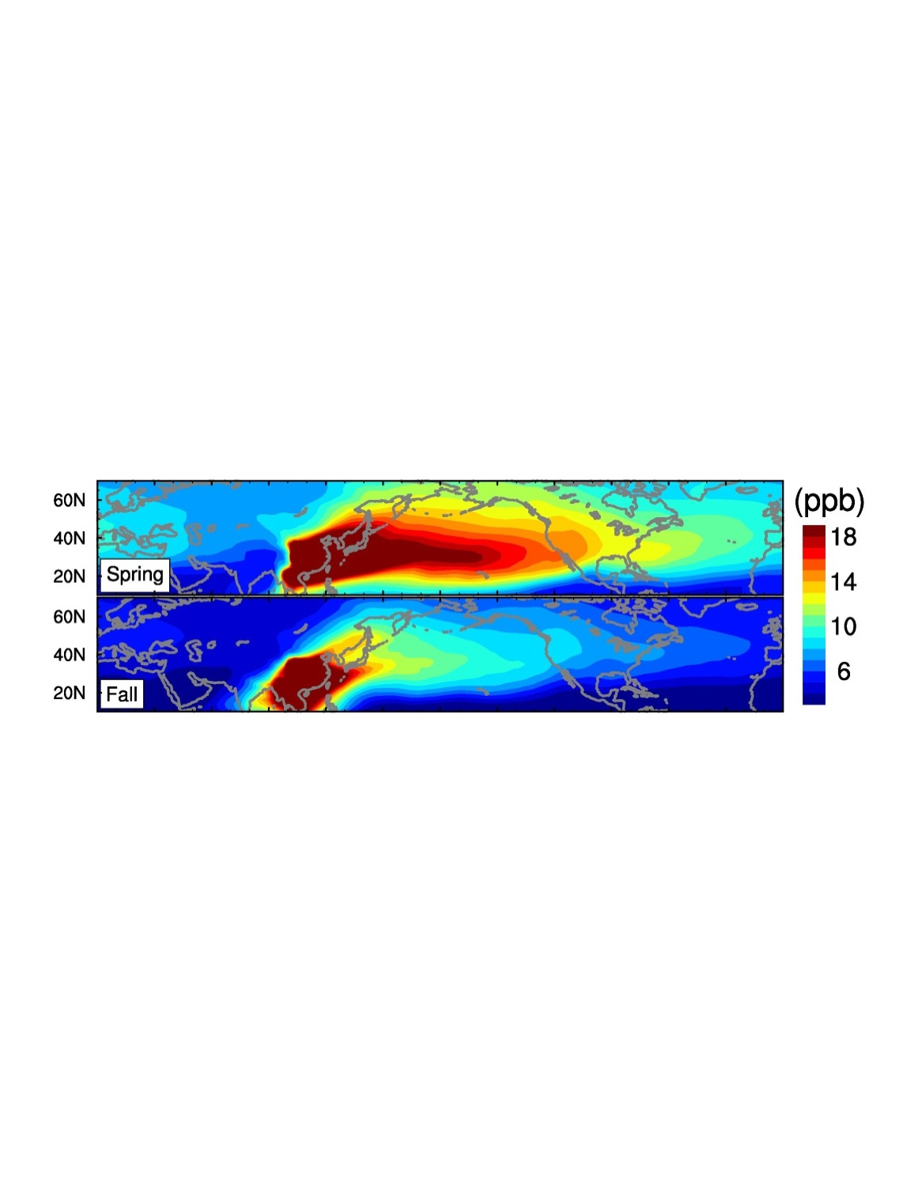

Tropospheric ozone trends at Mauna Loa Observatory
tied to decadal climate variability
Lin MY et al (2014)
Mauna Loa (3.4 km altitude), Hawaii
The puzzle:
Little change in spring
Increase in fall
75th
50th
25th
Jan Feb Mar Apr May Jun Jul Aug Sep Oct Nov Dec
Model Tracer of East Asian CO Pollution (EACOt)
Spring
Fall
6
Notes:
Airflow from Asia towards the subtropical eastern Pacific

Slide 7
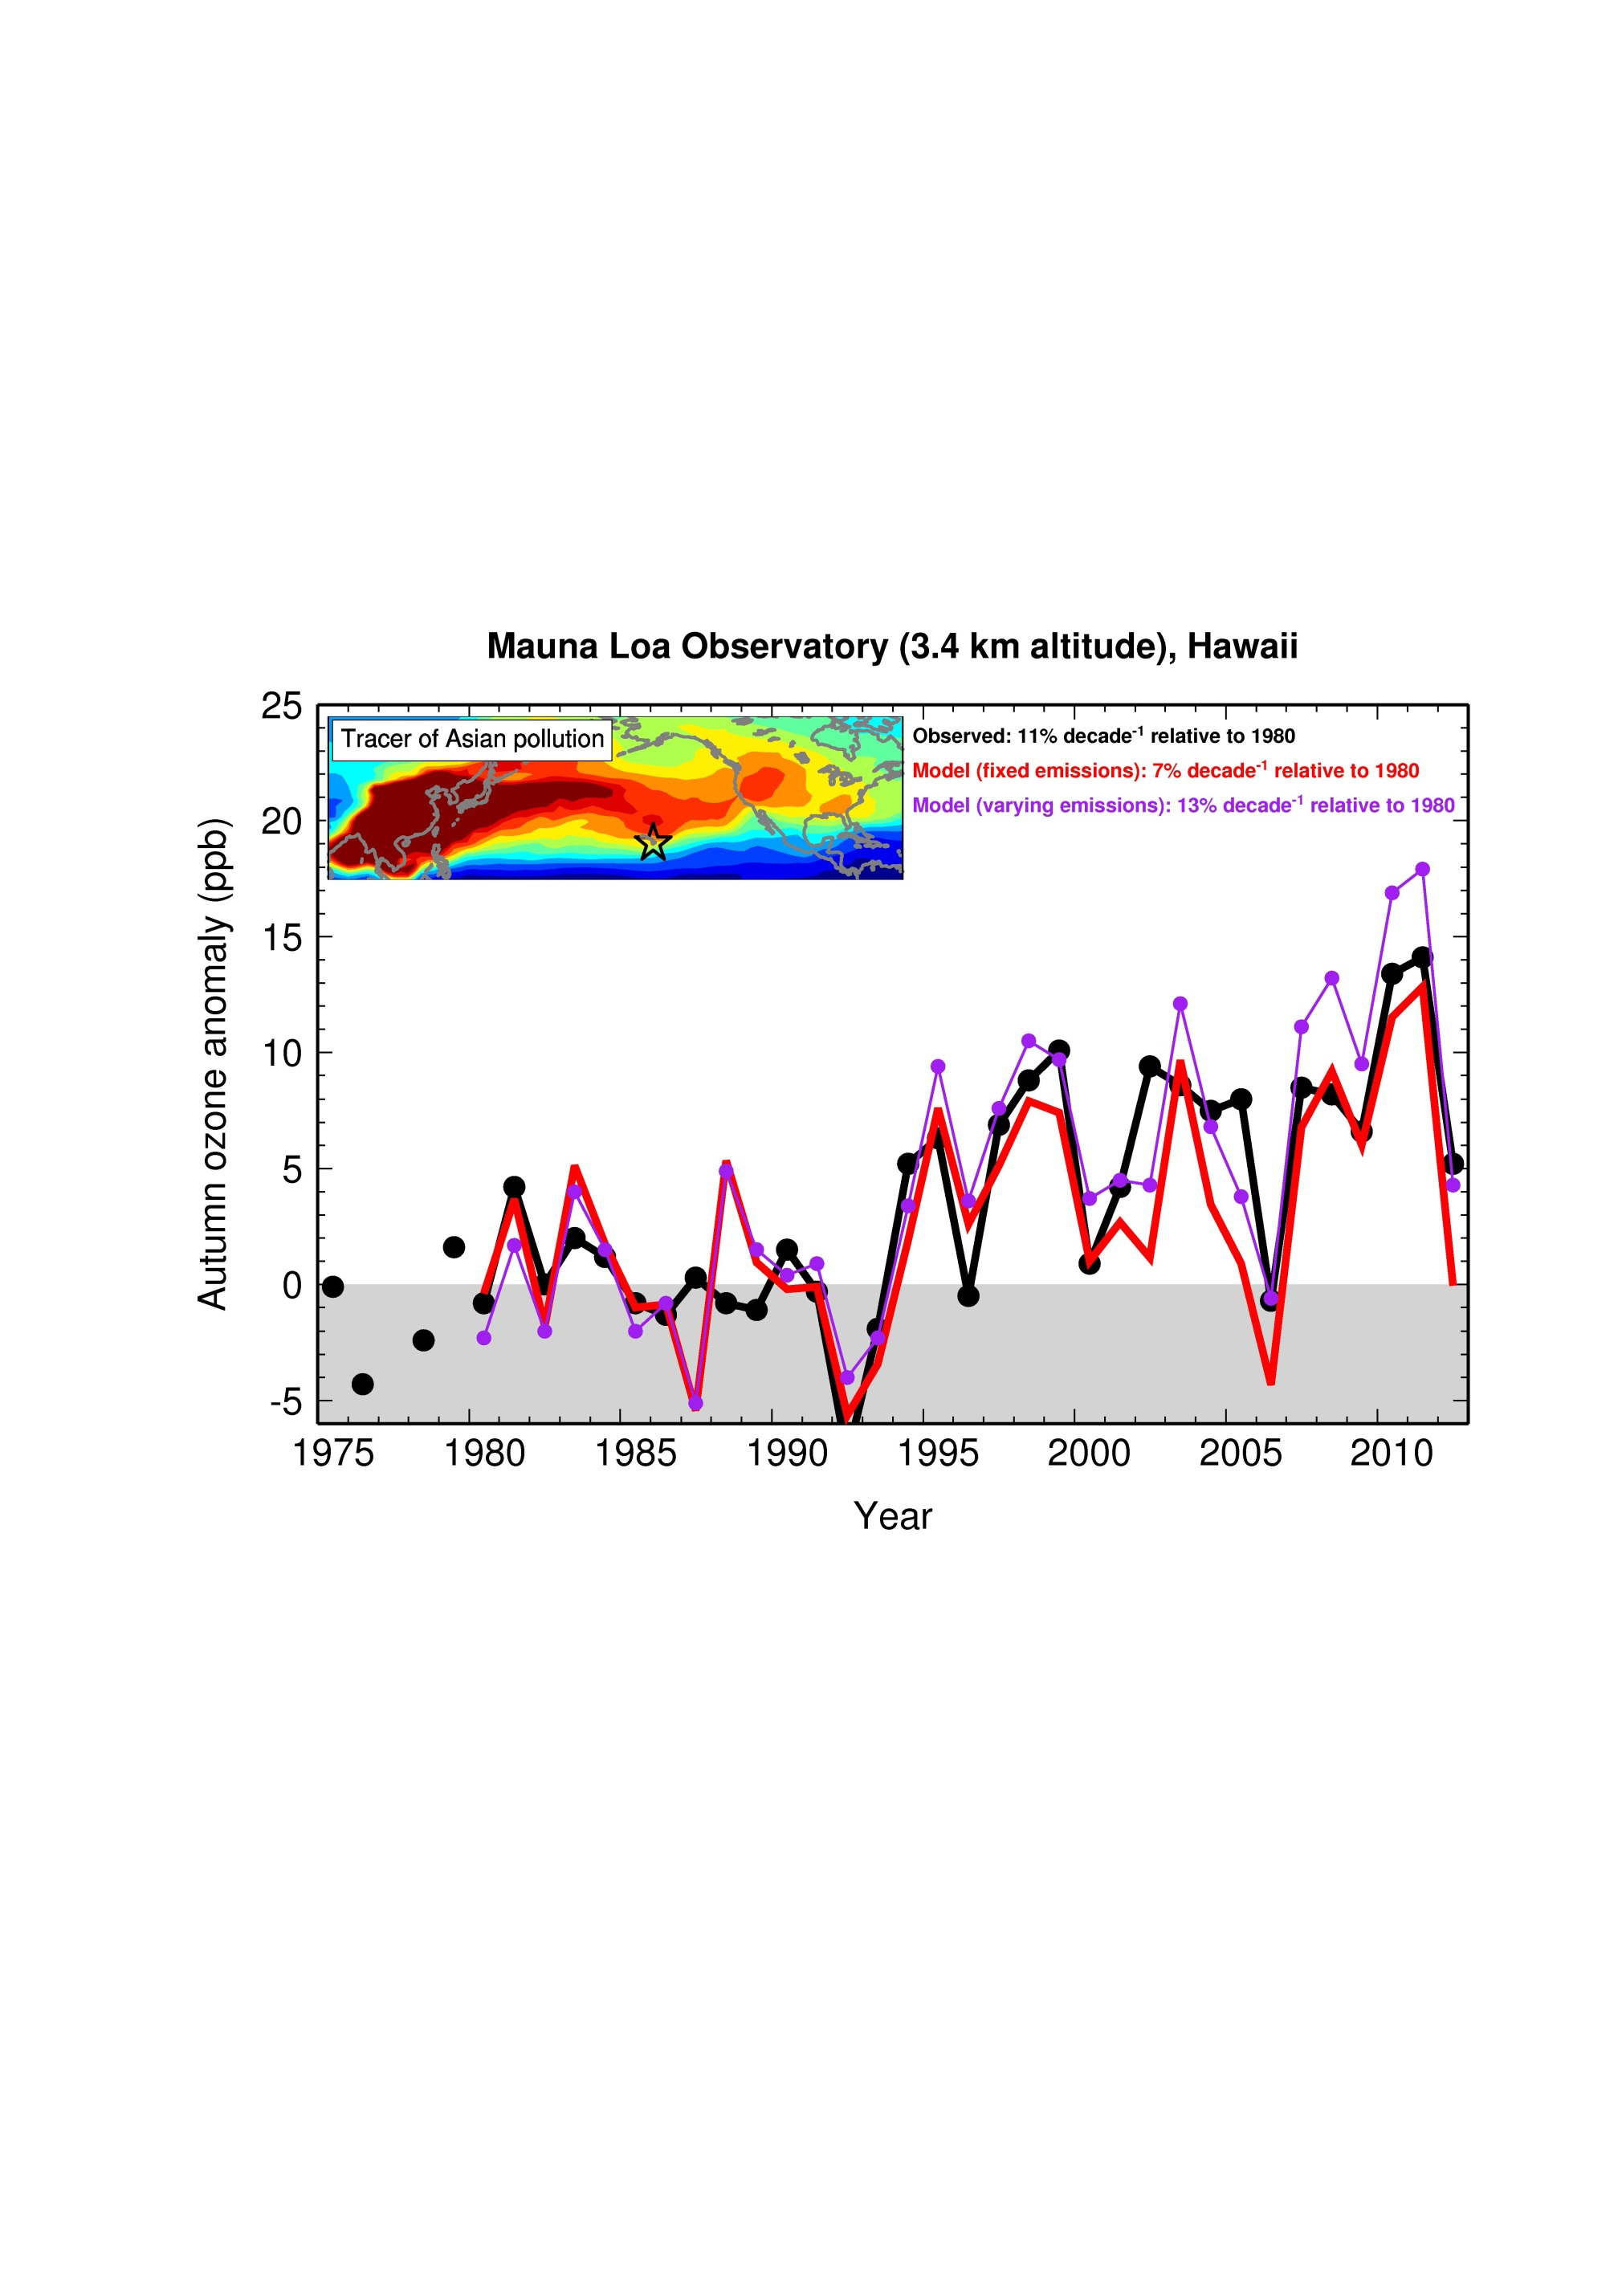
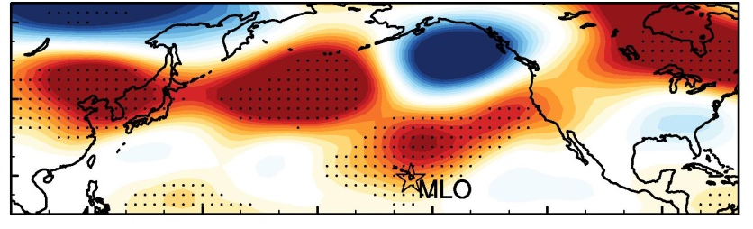

Increasing ozone at Mauna Loa in FALL tied to a shift in circulation patterns since the mid-1990s
OBS: 11% decade⁻¹ (p<0.05)
FIXEMIS (Nudged): 7% decade⁻¹ (p<0.05)
BASE (Nudged): 13% decade⁻¹ (p<0.05)
Changes in NCEP 500hPa height
(1995-2011 minus 1980-1994)
[m]
Sep -Oct
→ Must consider decadal climate variability for attribution of pollutant trends
Lin M.Y. et al (Nature GeoSci., 2014)
7
Notes:
Much of the observed increase in ozone at Mauna Loa during fall is explained by circulation pattern shifts. Since the mid-1990s, the Pacific-North American (PNA) pattern has shifted to a more positive phase, causing an intensification of the southward transport of ozone-rich air from the mid-latitudes north of Hawaii to subtropical Hawaii.

Slide 8
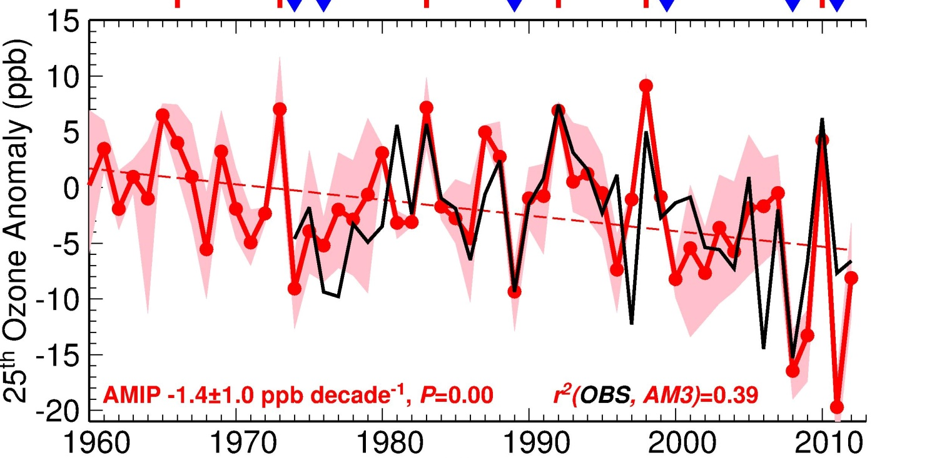
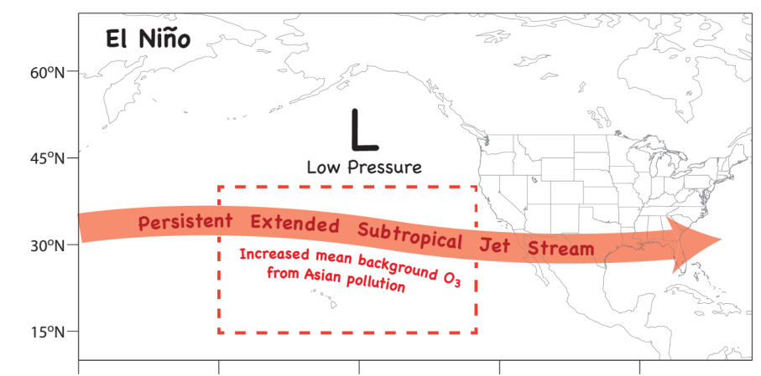
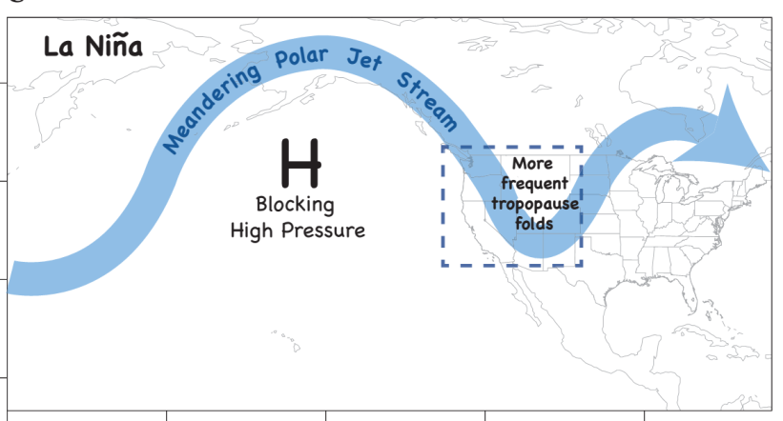
Springtime airflow from Eurasia towards the NE Pacific weakens in the 2000s due to La-Niña-like decadal cooling
LaNiña-like decadal cooling
[Chavez2003; Meehl2013; Kosaka2013]
ElNiño
Ozone Anomaly , ppb
(25th percentile)
Relevant for
Western U.S.?
r²(OBS, AMIP) = 0.39; Fixed emis: -1.4±1.0 ppb decade⁻¹
P<0.01
ElNiño
LaNiña
Weakening airflow offsets increasing O₃ from rising Asian emissions [Lin et al 2014]
Lin M.Y. et al (Nature GeoSci., 2014)
8

Slide 9
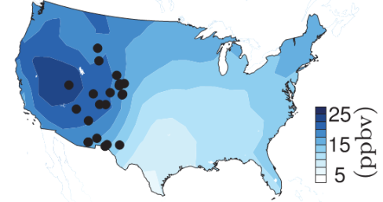
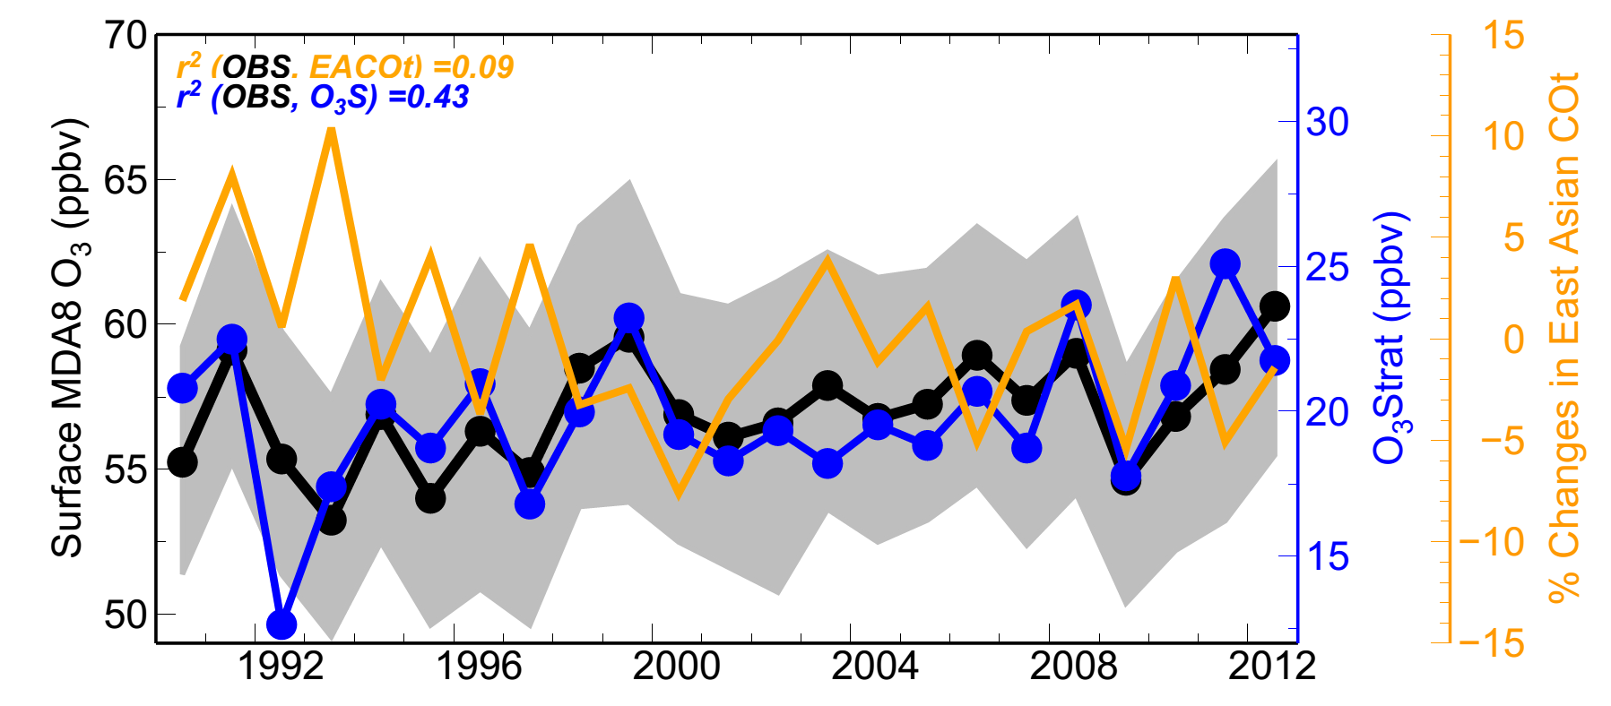
Inter-annual variability of
Western U.S. surface ozone in April-May
r² (OBS, EACOt ) = 0.09
r² (OBS, O₃Strat) = 0.43
O₃Strat
Stratospheric Contribution (ppb)
LaNiña
Pinatubo
1990
Strong stratospheric influence on WUS O₃ IAV: Greater following strong La Niña events; Can complicate attribution of O₃ trends in short records
In contrast, Asian influence (FixEmis) is minor; Weakened in the 2000s
Lin MY et al: Climate variability modulates Western U.S. ozone air quality via deep stratospheric intrusions, Nature Communications, in press, 2015.
9

Slide 10
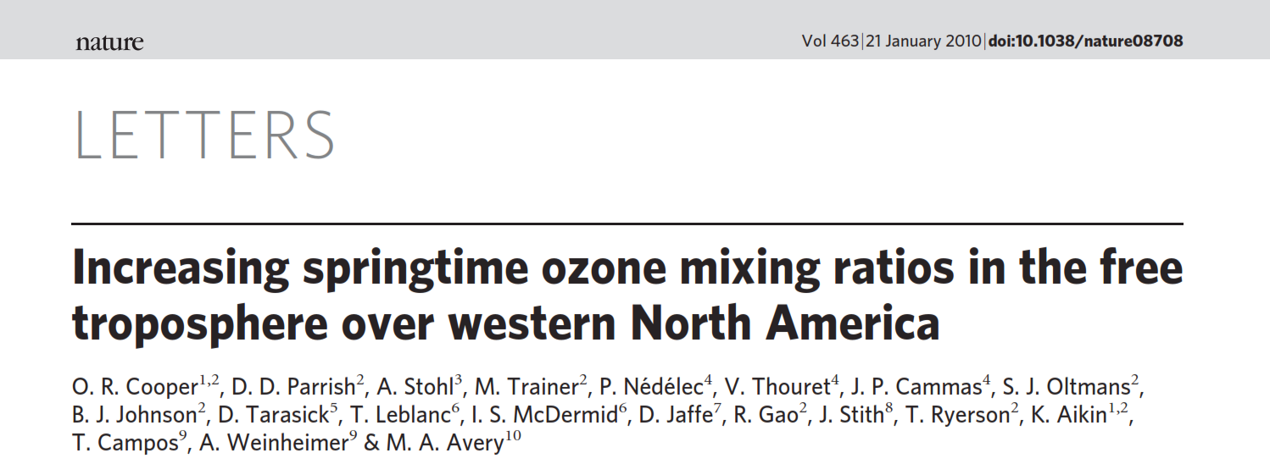
Free tropospheric ozone trend above western North America
A composite of ozone observations, 3-8 km above western North America
Observed ozone rates of increase:
0.64±0.31 ppb yr⁻¹ during 1995-2008
0.52±0.20 ppb yr⁻¹ during 1984-2011
0.41±0.26 ppb yr⁻¹ during 1995-2011
These rates are much higher than those simulated in current models [Lamarque et al., 2010; Parrish et al., 2014] and than the ozone rate of increase attributed to rising Asian emissions by models with single-year meteorology [Zhang et al., 2008; Fiore et al., 2009]
95%
67 %
50%
33%
5 %
10
Poster 3-

Slide 11
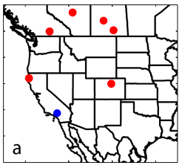
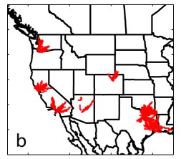
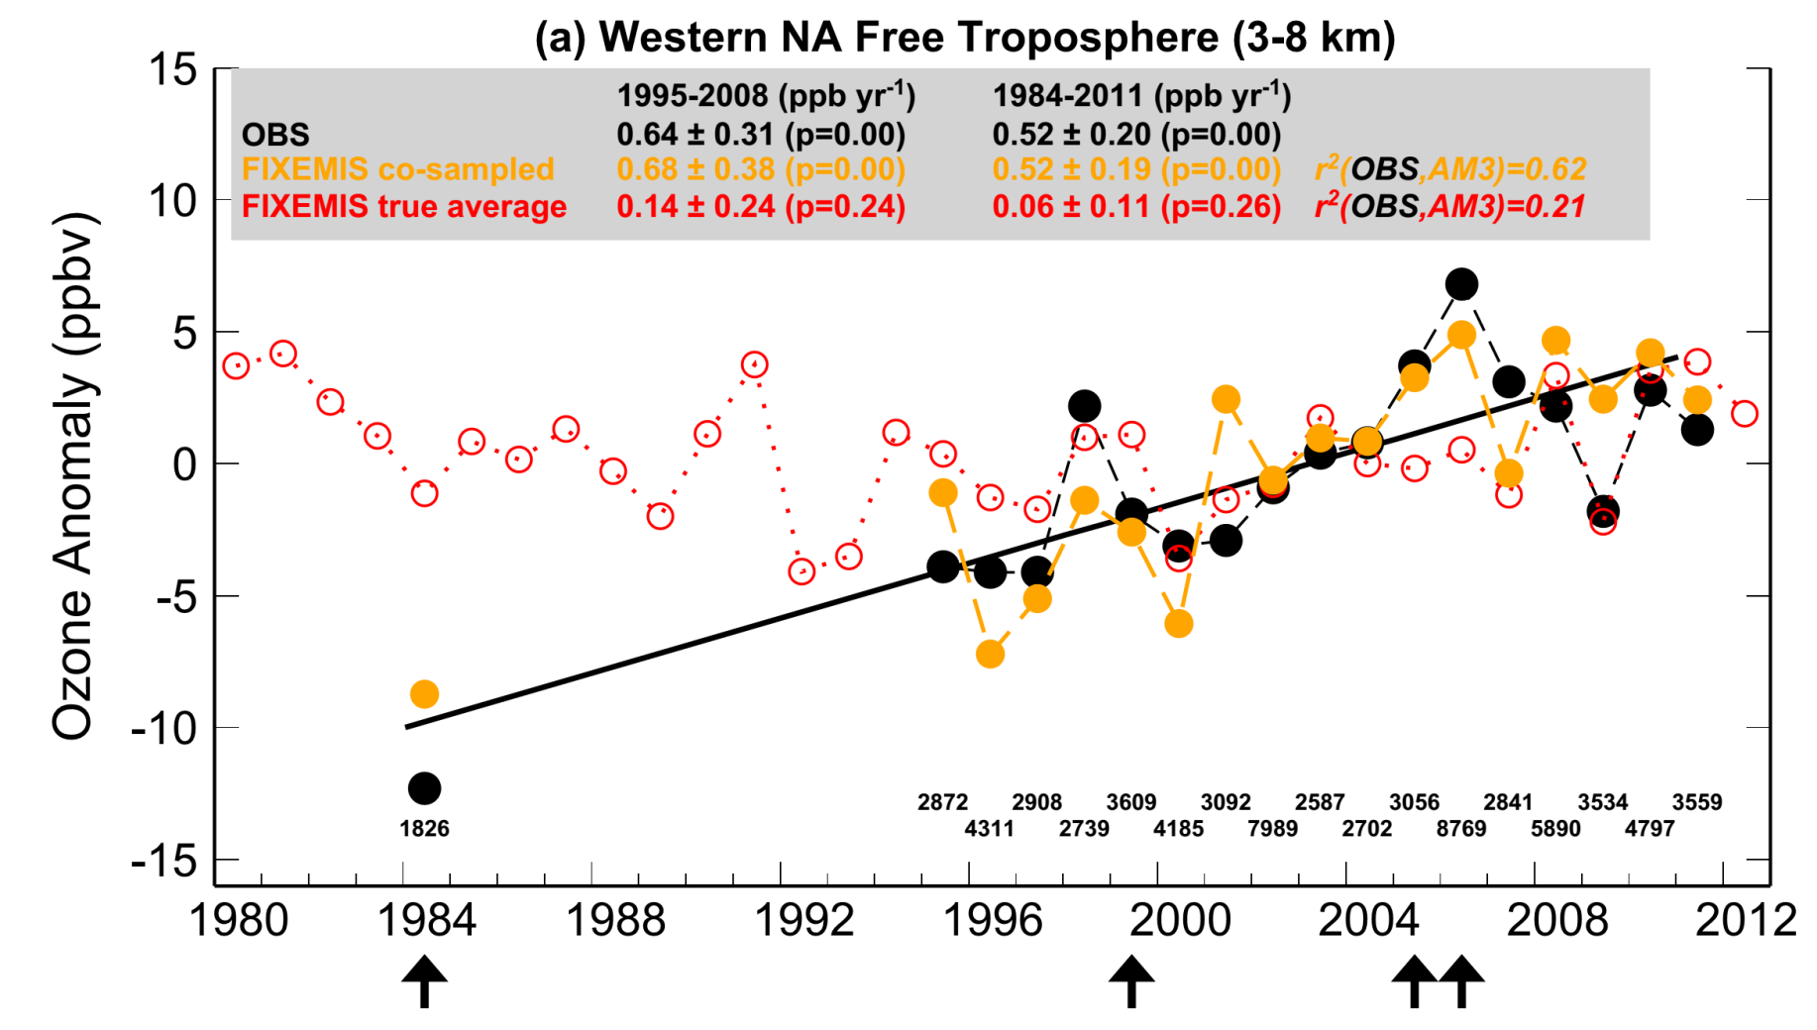
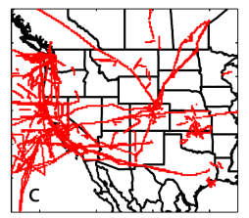
Representativeness of ozone observations constructed from various platforms?
Apr-May
OBS as in Cooper et al (2010, 2012)
FIXEMIS co-sampled with OBS in space and time r²(OBS, AM3)= 0.62
FIXEMIS ‘true average’ (i.e. continuous sampling) r² (OBS,AM3)= 0.21
Anomaly in median O₃ (ppb)
# samples
next slide
Time periods | OBS | FIXEMIS co-sampled | FIXEMIS true average | BASE (varying emissions) true average
1995-2008 (ppb yr⁻¹) | 0.64±0.31 | 0.68±0.38 | 0.14±0.24 | 0.25±0.32 (p=0.12)
1984-2011 (ppb yr⁻¹) | 0.52±0.20 | 0.52±0.19 | 0.06±0.11 | 0.25±0.12
1995-2011 (ppb yr⁻¹) | 0.41±0.26 | 0.56±0.26 | 0.19±0.20 | 0.35±0.27
Lin MY and Horowitz LW et al (To be submitted, 2015)
11
Notes:
Explain why looking at FIXEMIS

Slide 12
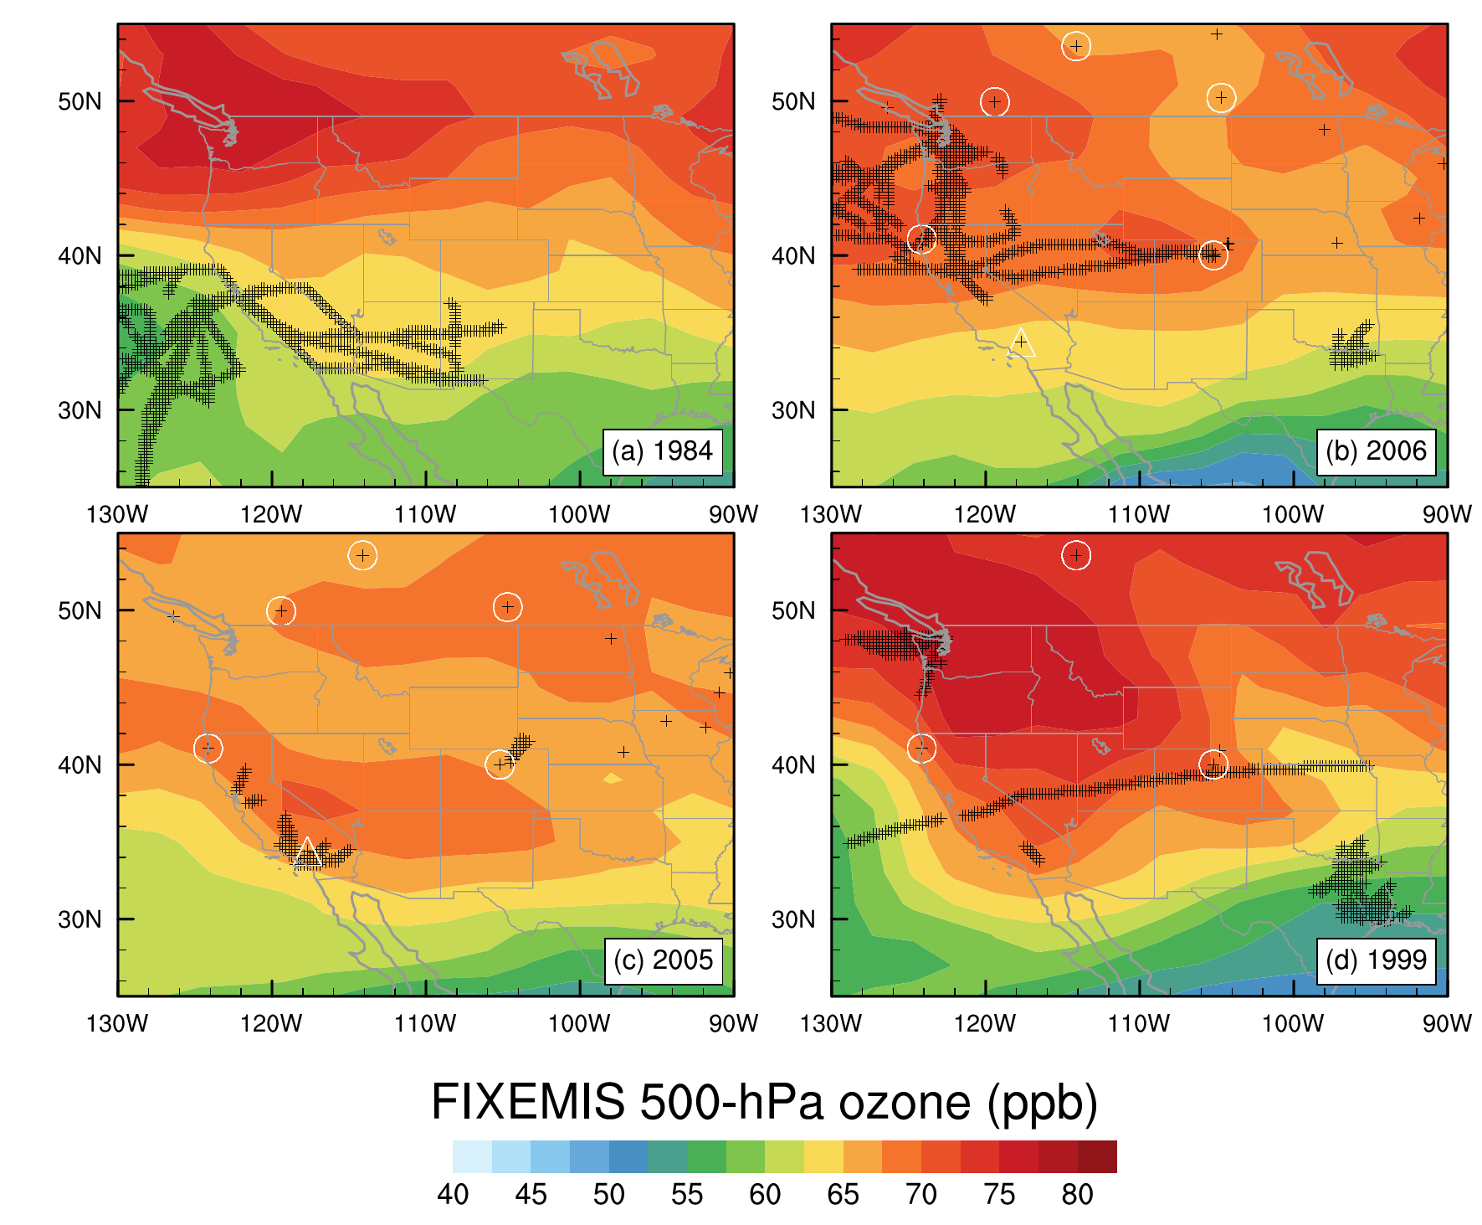
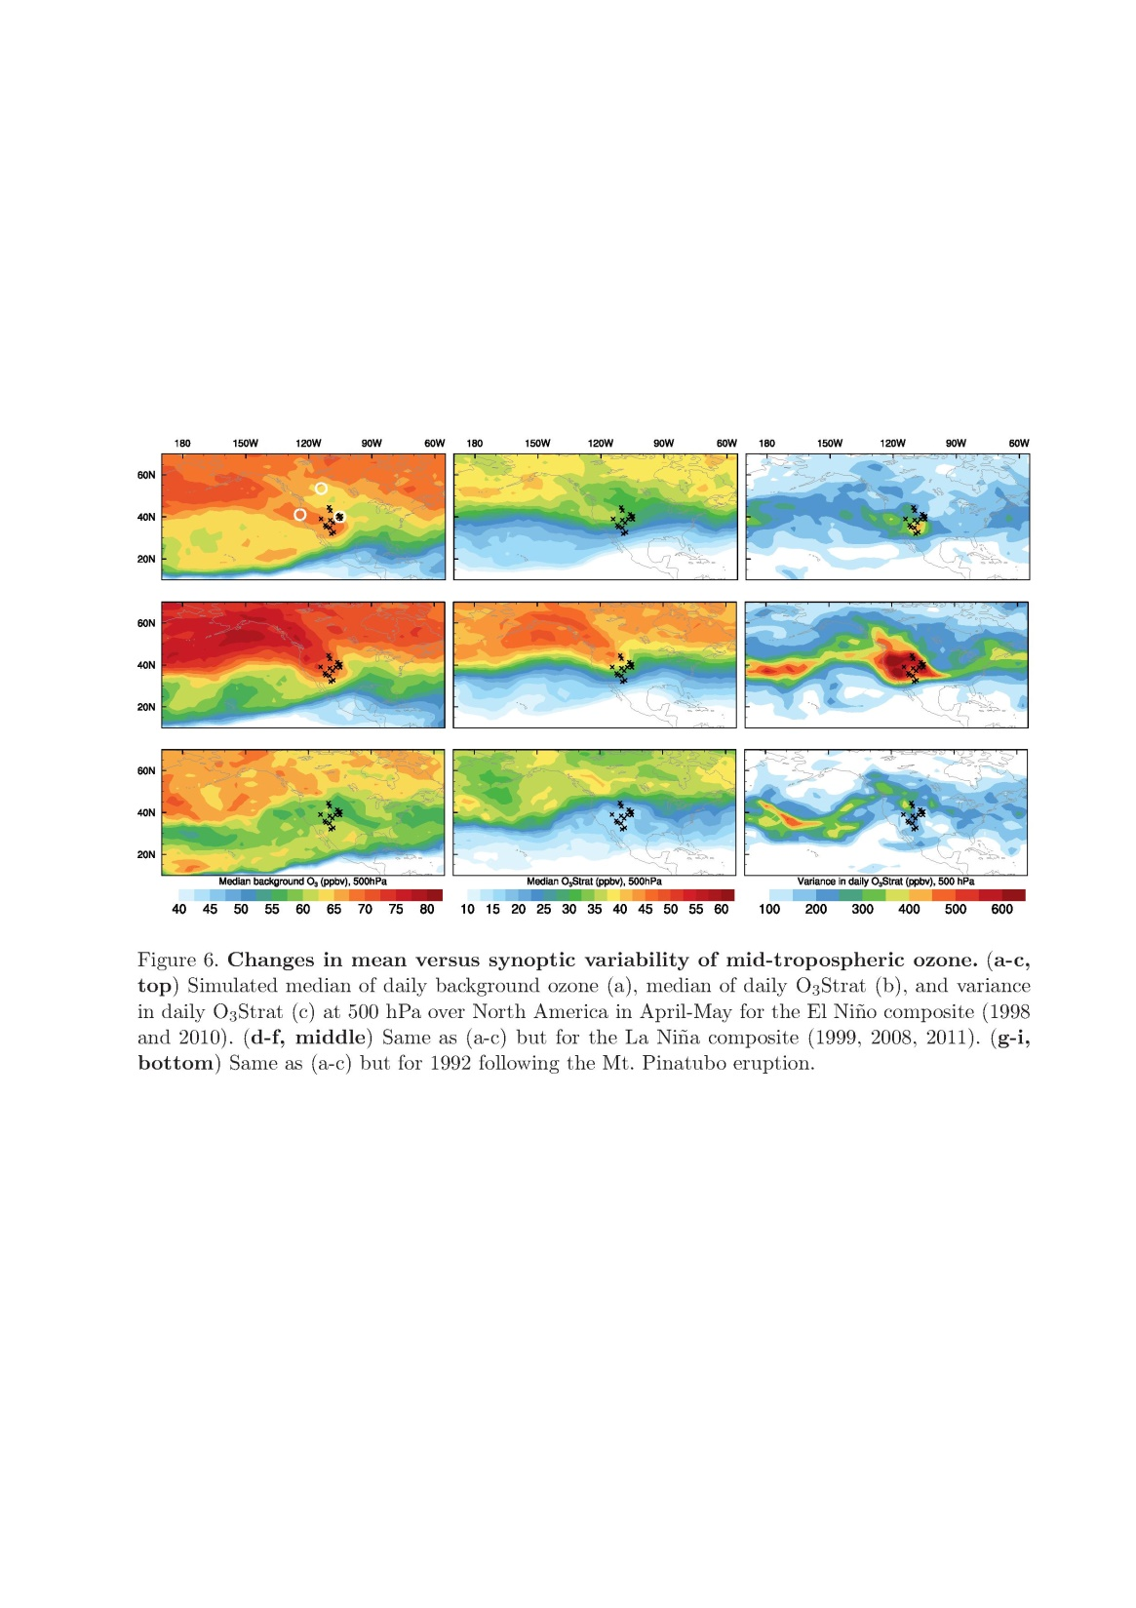
Sparse in-situ sampling and short observational records can complicate trend attribution
(ppb)
INTEX-B
80
70
CITE-1C
1984
2006
60
50
40
Aircraft, 3-8 km
Sondes, 3-8 km
MOZAIC
1999
2005
FIXEMIS 500hPa ozone, Apr-May
→ Need daily ozonesondes or continuous lidar measurements
12
Notes:
In a region with high springtime ozone variability like western US, sparse sampling and short observational records
can complicate trend attribution.
I would argue that we need daily ozonesondes or ideally continuous lidar measurements: also useful for daily exceedances attribution …

Slide 13
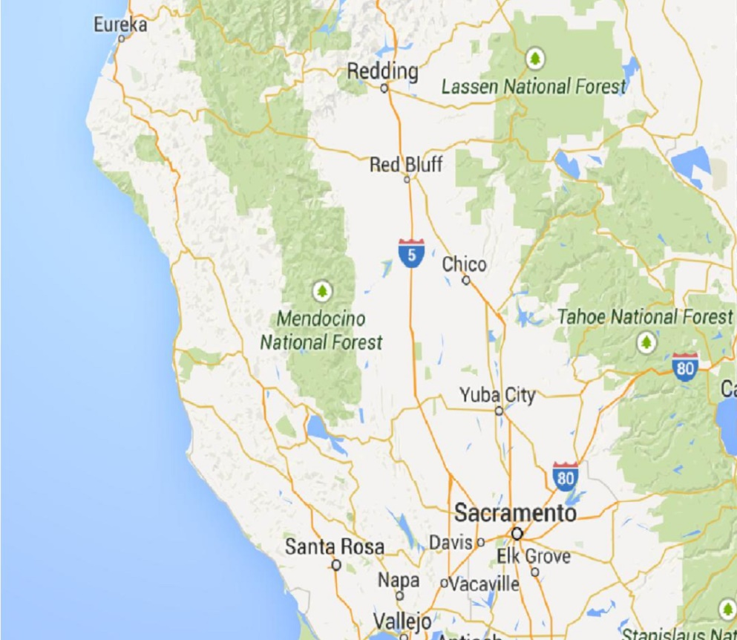
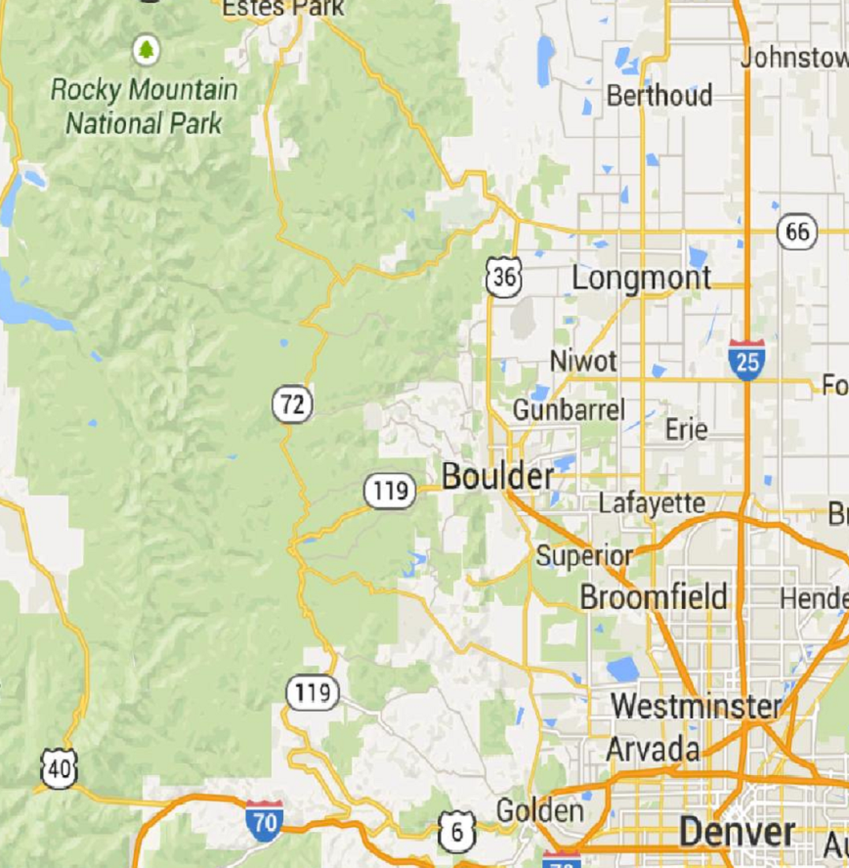
Selection of model baseline to be more representative of observed conditions at WUS mountain sites
Within a ~2ºx2º global model grid
Baseline
(Rocky Mtn)
Baseline
(Lassen)
Pollution
Pollution
Problem: -Model limitations in resolving observed baseline conditions
-Local pollution influence in the model grid perturbs the small baseline signal
Approach: -Sample the model at site elevation
-Filter the model to remove the influence from fresh local pollution
(i.e. removing data on days when N. American COt ≥ 33th percentile)
13
Notes:
limitations of global-scale models in resolving urban-to-rural gradients and sharp topography, which results in artificial contamination of locally produced O₃ in the model grid

Slide 14
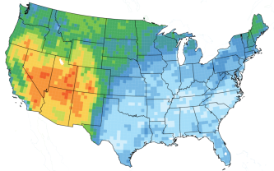
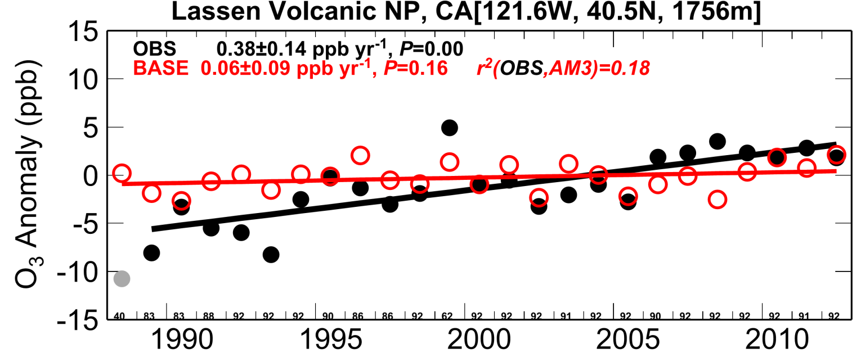
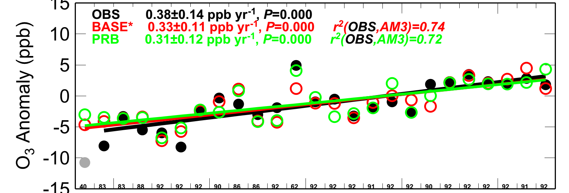
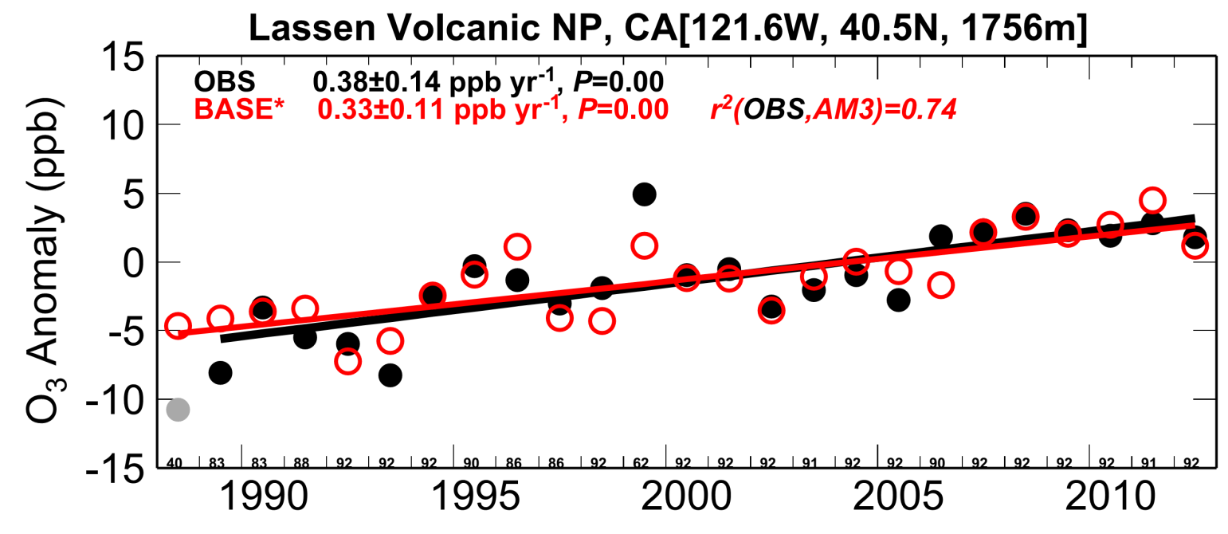
Simulated ozone trends with/without
selection of baseline conditions in the model
Lassen Volcanic NP (1.7 km, Mar-Apr-May)
Model surface
Model Baseline
BGO₃
Observed weaker variability in the 2000s attributed to BGO₃
MY Lin, LW Horowitz, OR Cooper et al (in prep, 2015)
14
Notes:
Filter vs non-filter …

Slide 15
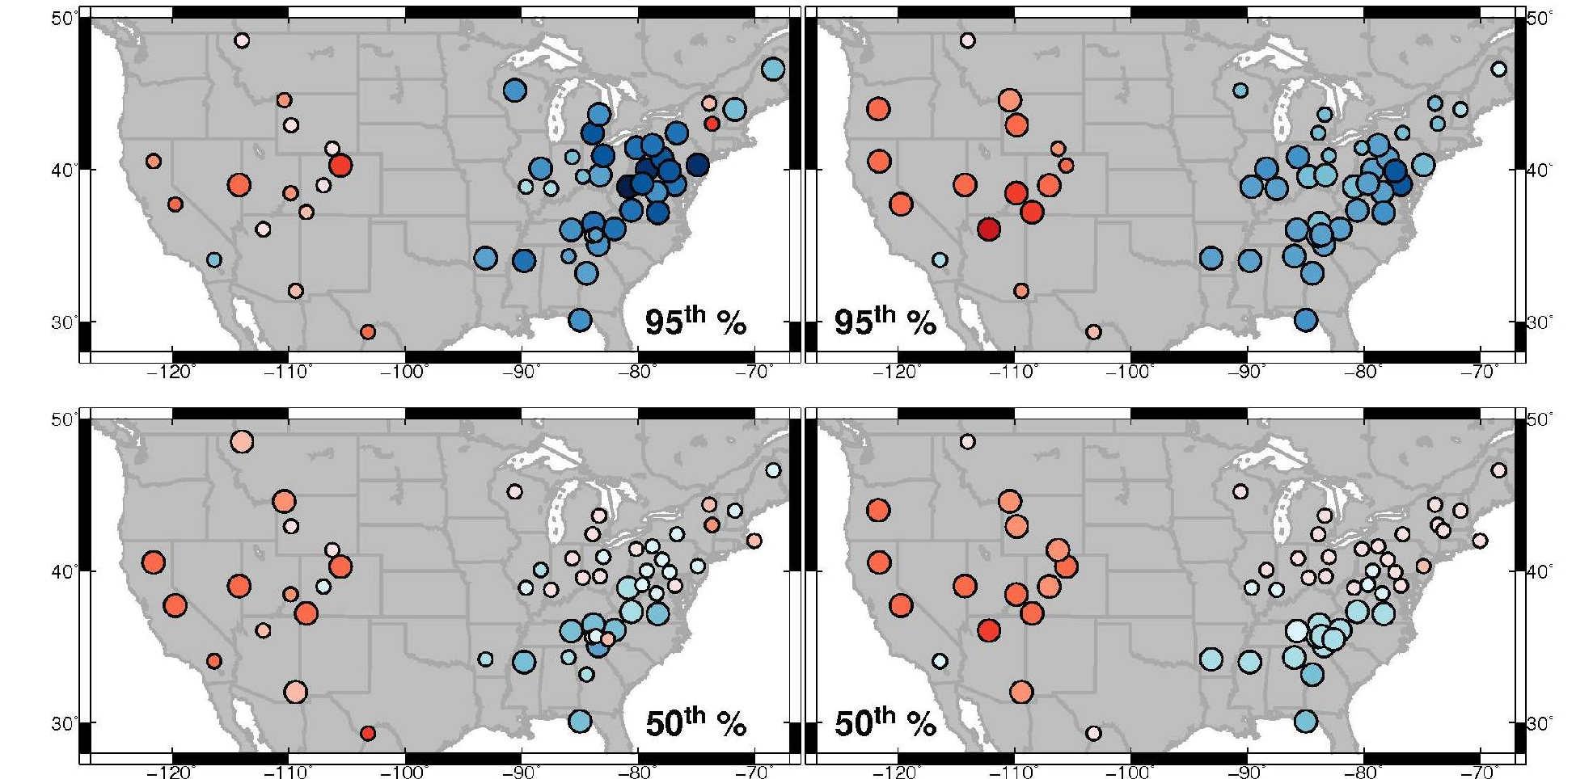
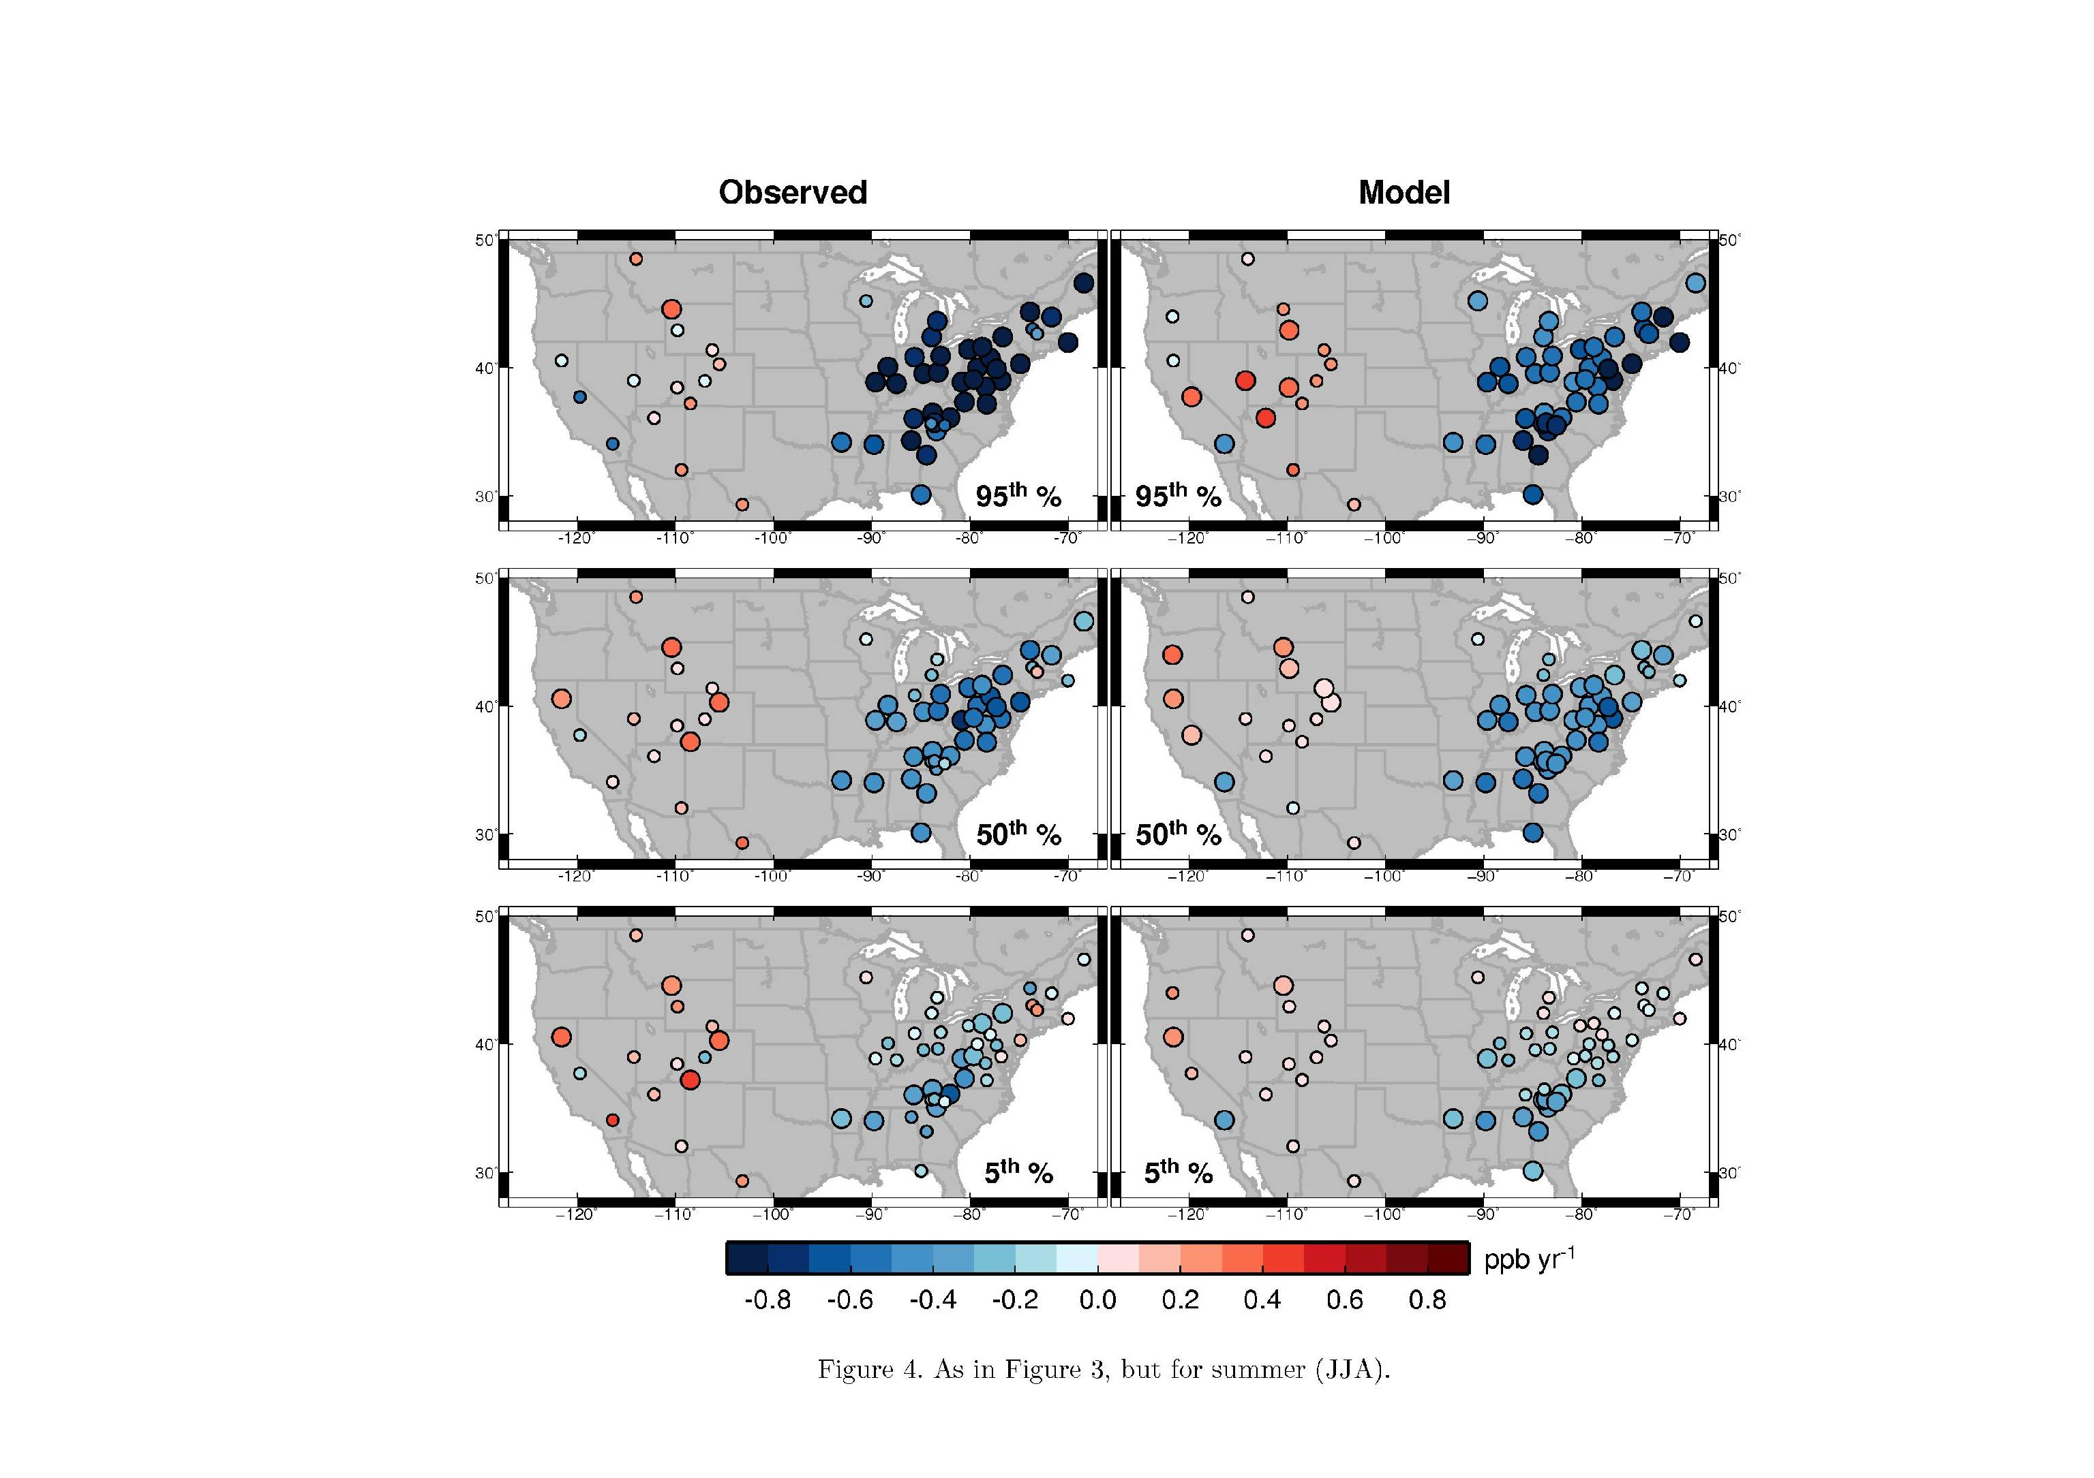
SPRING U.S. surface O₃ trends:
Do domestic NO_{x} reductions work?
Observed
AM3 BASE
95%
MAM 1988-2012
50%
MDA8 O₃ trends (ppb yr⁻¹)
Larger circles indicate statistically significant trends
Model filtered to be more representative of observed conditions
High background, thus little response to local NO_{x} reductions
WUS
MY Lin, LW Horowitz, OR Cooper et al (in prep, 2015)
15
15
Notes:
Remember to mention 95th and 50th percentiles …

Slide 16
SUMMER U.S. surface O₃ trends:
Do domestic NO_{x} reductions work?
Observed
AM3 BASE
95%
JJA 1988-2012
50%
MDA8 O₃ trends (ppb yr⁻¹)
Larger circles indicate statistically significant trends
MY Lin, LW Horowitz, OR Cooper et al (in prep, 2015)
16

Slide 17
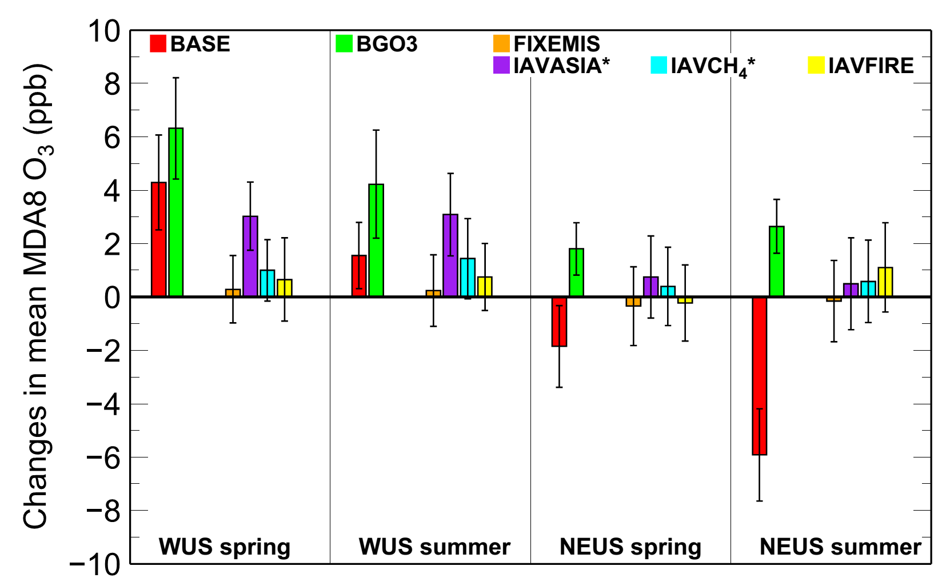
Summarizing drivers of U.S. surface ozone trends
GFDL AM3 (2003-2012 minus 1981-1990)
Background increases ~6 ppb in spring and ~4 ppb in summer
U.S. domestic emission controls offset 2-3 ppb
WUS
MY Lin, LW Horowitz, OR Cooper et al (in prep, 2015)
Lin et al [in prep; 2015]

Slide 18
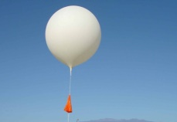

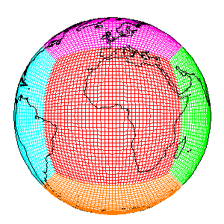
Some Final Thoughts on WUS ozone
Asian pollution can contribute to high-O₃ events above 65 ppb
→ Potential for satellites to identify such events
→ Need more rigorous model evaluation
Rising “background” (4-6 ppbv from 1980s to 2000s)
→ Counteract ozone abatements from domestic emission controls
→ Need apple-to-apple comparison btw obs and models
Strong year-to-year variability due to dynamical influences
→ Sparse sampling and short records can complicate trend attribution
→ Need additional (e.g. daily) ozonesonde or lidar measurements
→ Need to maintain multi-decadal measurements at NPS sites
Meiyun.Lin@noaa.gov
GFDL AM3
18
Notes:
Maps + PDF

Slide 19
Additional Slides for Discussions
Notes:
AM3 O3Strat captures the episodic ozone enhancements although the mean baseline level of O3Strat may represent an upper limit

Slide 20
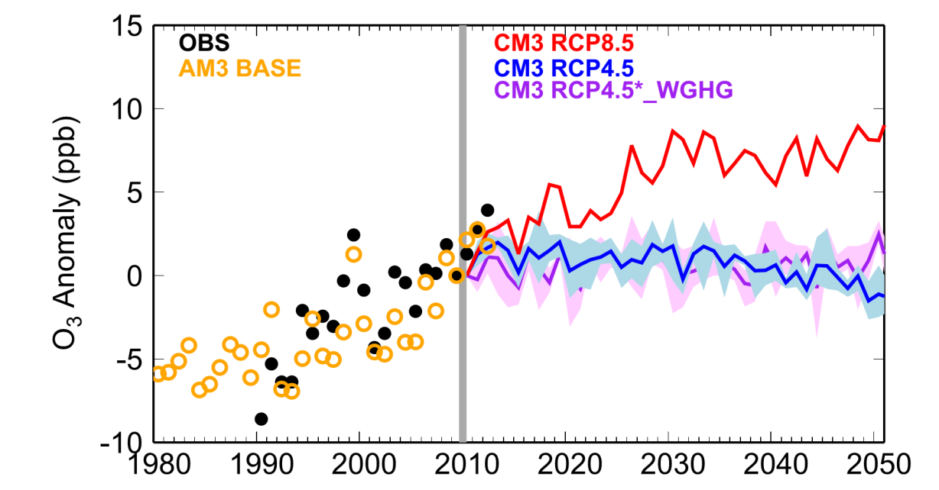
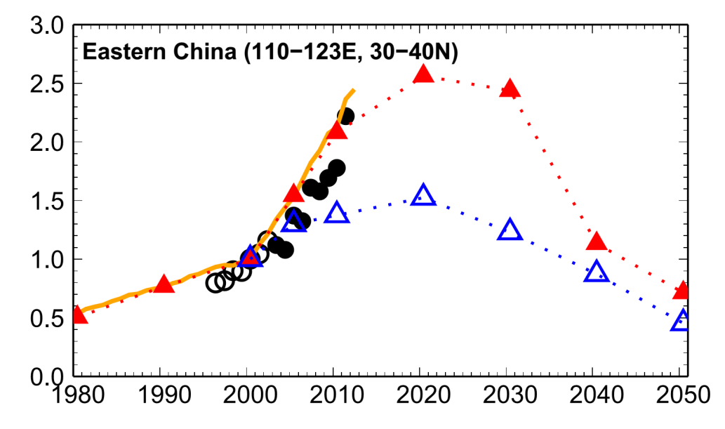
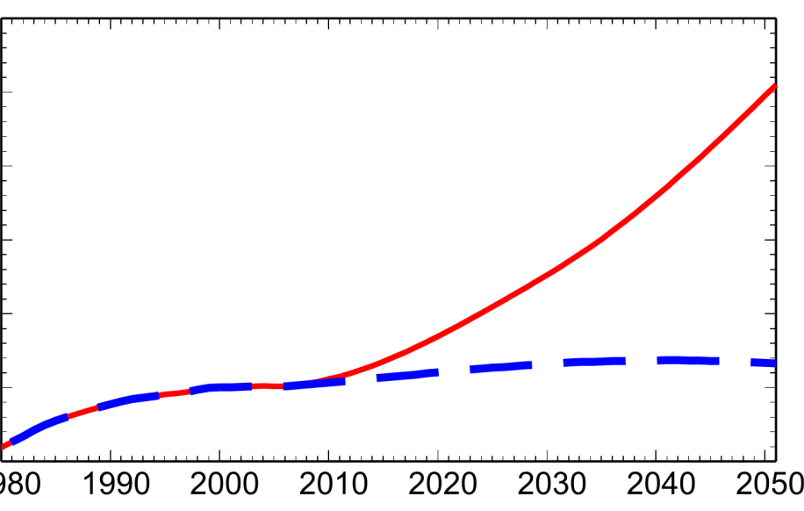
Projections of near-term changes in WUS lower trop. ozone in spring (March-April-May)
OBS (GRB, LAV, ROM)
AM3 BASE, nudged
Median O₃ anomaly in ppb relative to 2010
E. China NO_{x} emissions
3000
Global CH₄ (ppb)
RCP8.5
2500
RCP8.5
Normalized to 2000
2000
RCP4.5
Satellites
RCP4.5
1500
20
1980
20

Slide 21
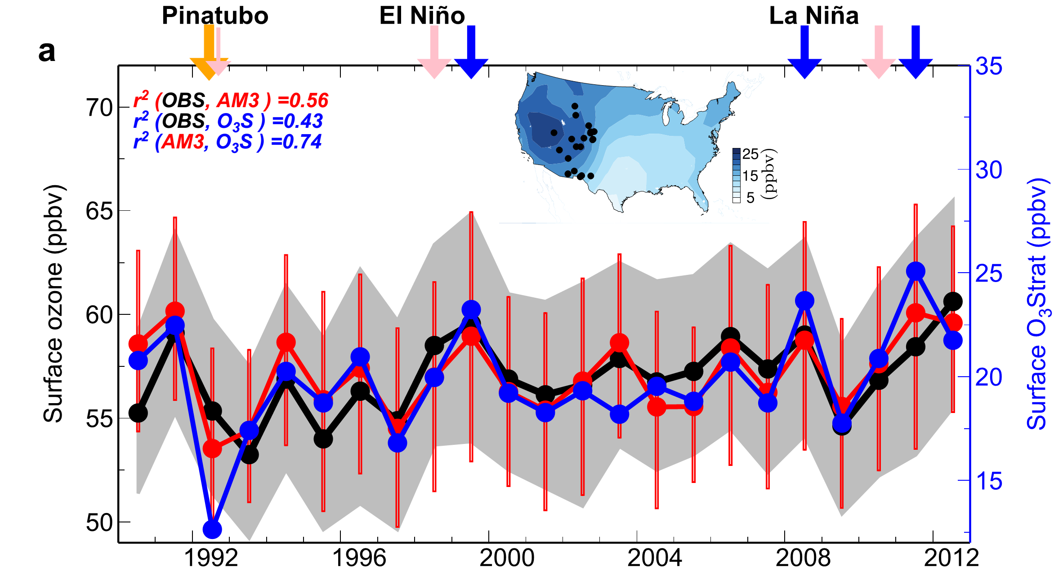
Strong stratospheric influence on year-to-year variability of high-elevation Western U.S. surface O₃ during April-May
75th
50th
O₃Strat
25th
Emissions held constant
Nudged to “real” winds
Stratospheric Contribution (ppb)
1990
Large IAV may complicate the attribution of observed O₃ trends in short records
Lin MY et al (in review, 2015)
21

Slide 22

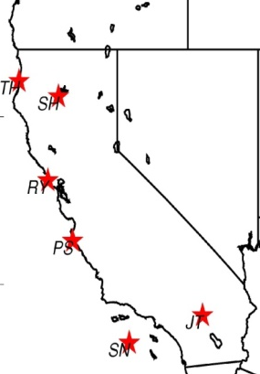
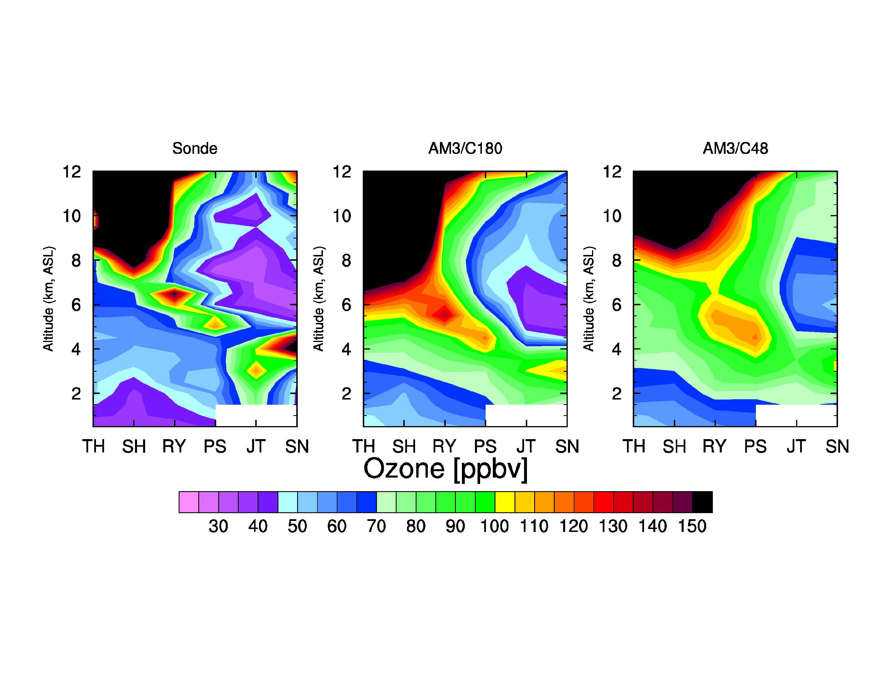
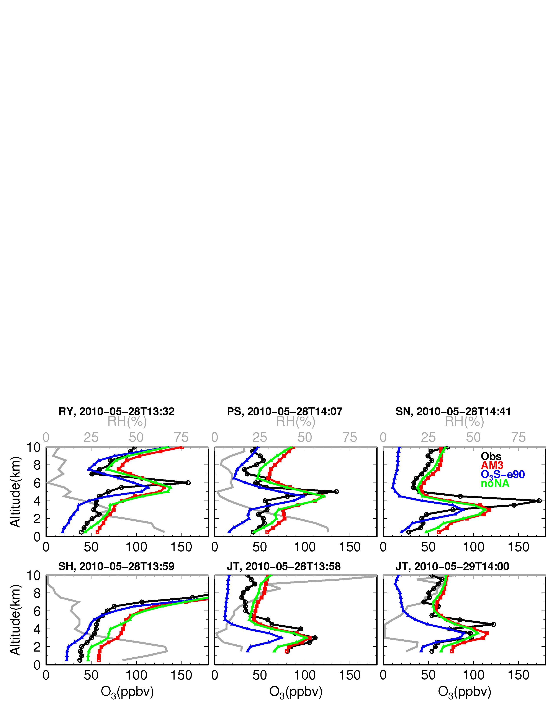
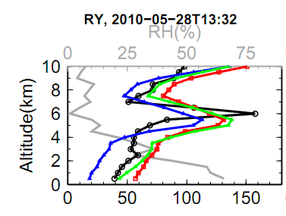
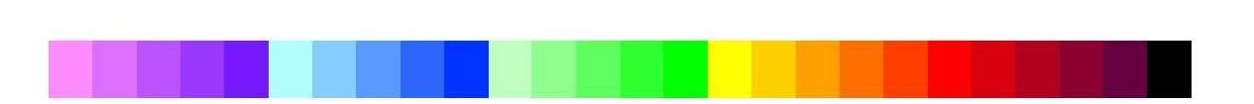
Subsidence of stratospheric O₃ to the lower trop of S. California (May 28, 2010)
Sondes over California
Observed RH (%)
OBS O₃
AM3 total
Altitude (km)
zeroNA
O₃Strat
O₃ [ppb] at Joshua Tree (JT)
North → South
Simulated enhancements of O₃Strat consistent with observed low RH
Reaching surface air on the following day
30
50
70
90
110
130
150
[ppb]
Lin MY et al (JGR, 2012b): Springtime high surface ozone events over the WUS …
22
Notes:
O₃Strat contributes ~75% to enhanced O₃ >100 ppbv at 2-5 km a.s.l.
Consistent with observed low humidity; NA emissions contribute little

Slide 23
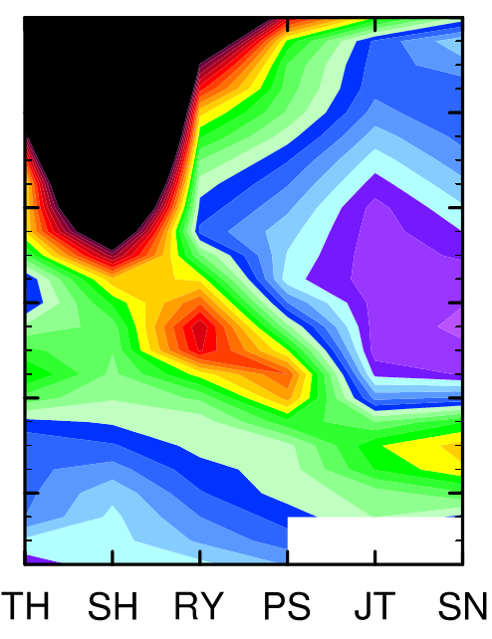

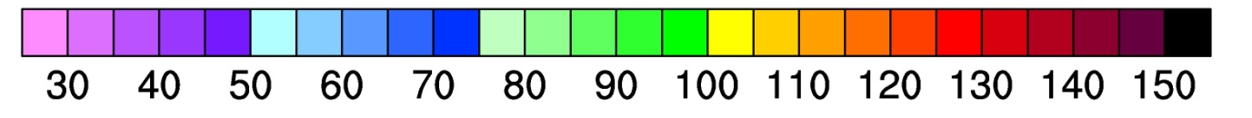
Simulating deep stratospheric intrusions:
role of model resolution (May 28, 2010 example)
Sondes
AM3 (~0.5ºx0.5º)
AM3 (~2ºx2º)
Altitude (km)
Sonde sites, North → South
O₃ [ppbv]
0.5º model better captures vertical structure
2º model reproduces the large-scale view
→ Establishing its suitability for exploring interannual variability
23
Lin MY et al (JGR, 2012b): Springtime high surface ozone events over the WUS …

Slide 24
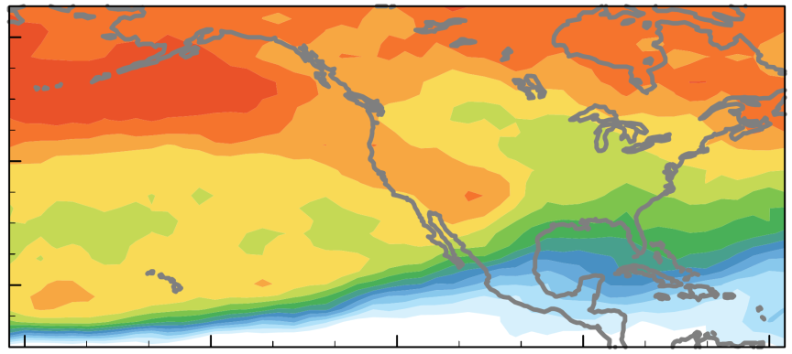
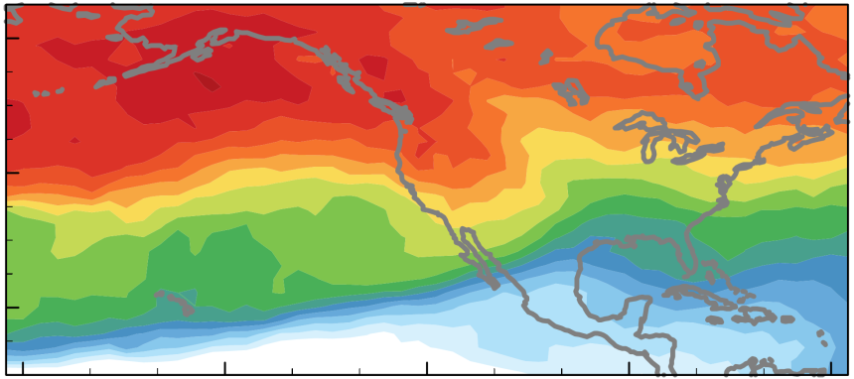
Springtime airflow from Eurasia towards the NE Pacific weakens in the 2000s due to La-Niña-like decadal cooling
LaNiña-like decadal cooling
[Chavez2003; Meehl2013; Kosaka2013]
ElNiño
Ozone Anomaly , ppb
(25th percentile)
Relevant for
Western U.S.?
r²(OBS, AMIP) = 0.39; Fixed emis: -1.4±1.0 ppb decade⁻¹
P<0.01
(ppb)
60N
NA BGO₃ (500 hPa)
80
70
40N
60
20N
50
El Niño
La Niña
40
24
Weakening airflow offsets increasing O₃ from rising Asian emissions [Lin et al 2014]
Lin M.Y. et al (Nature GeoSci., 2014)
24

Slide 25
List of relevant papers
Lin, M., A.M. Fiore, L. W. Horowitz, O. R. Cooper, V. Naik, J. Holloway, B. J. Johnson, A. M. Middlebrook, S. J. Oltmans, I. B. Pollack, T. B. Ryerson, J. X. Warner, C. Wiedinmyer, J. Wilson, B. Wyman: Transport of Asian ozone pollution into surface air over the western United States in spring, Journal of Geophysical Research,117, D00V07, 2012, doi:10.1029/2011JD016961 (PDF)
Lin M., A. M. Fiore , O. R. Cooper , L. W. Horowitz , A. O. Langford , Hiram Levy II , B. J. Johnson , V. Naik , S. J. Oltmans , C. Senff (2012): Springtime high surface ozone events over the western United States: Quantifying the role of stratospheric intrusions, Journal of Geophysical Research, 117, D00V22, doi:10.1029/2012JD018151 (Full Text)
Lin, M., L.W. Horowitz, S. J. Oltmans, A. M. Fiore, Songmiao Fan (2014): Tropospheric ozone trends at Manna Loa Observatory tied to decadal climate variability, Nature Geoscience, 7, 136-143, doi:10.1038/NGEO2066 (PDF)
Lin, M., A. M. Fiore, L.W. Horowitz, A. O. Langford, S. J. Oltmans, D. Tarasick, H. E. Rieder (2015): Climate variability modulates western U.S. ozone air quality in spring via deep stratospheric intrusions, Nature Communications, in press, 2015.
25
Notes:
Maps + PDF

