Slide 1
Year-to-year variability in Western U.S. high-O₃ events tied to climate regimes and stratospheric intrusions: Implications for regional AQ planning
Meiyun Lin
Acknowledgements:
A.M. Fiore, L.W. Horowitz, A.O. Langford, S. J. Oltmans, D. Tarasick, H. Rieder
Presented at AQAST7 Harvard, June 2014
Notes:
1

Slide 2
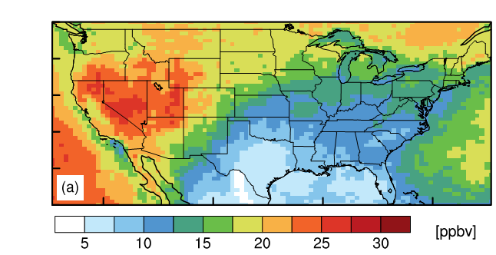
Strong stratospheric influence on
Western U.S. surface ozone during spring
Mean stratospheric ozone tracer (O₃Strat) in surface air during April-June 2010
May 28, 2010
TH
SH
RY
Altitude (km a.s.l.)
PS
SN
JT
30
60
90
120
150
O₃Strat in ppb from 50x50km² GFDL AM3
Ozone (ppb)
Model indicates S. Nevada particularly susceptible; observations lacking
Lin M.Y. et al (JGR, 2012b)
2

Slide 3
Stratospheric ozone intrusions push observed surface ozone in Las Vegas above the NAAQS threshold
New Measurements:
Nevada Rural Ozone Initiative (NVROI), July 2011-present (R. Fine & M. Gustin)
Las Vegas Ozone Study, May-June 2013 (A.O. Langford)
5
4
Altitude (km a.s.l.)
3
2
a few hours prior to enhancements at surface monitors
1
Time → (5/24 20:00 to 5/25 13:00)
ppb
ppb
Observed MDA8 O₃ on May 25, 2013
Ozone Lidar over Las Vegas
Lin M.Y. et al (in prep, 2014)
3

Slide 4
Stratospheric ozone intrusions push observed surface ozone in Las Vegas above the NAAQS threshold
New Measurements:
Nevada Rural Ozone Initiative (NVROI), July 2011-present (R. Fine & M. Gustin)
Las Vegas Ozone Study, May-June 2013 (A.O. Langford)
ppb
Observed MDA8 O₃ on May 25, 2013
25-May-2013
→ Understanding year-to-year variability of such events is crucial for
developing a predictive capability & screening of exceptional events
Lin M.Y. et al (in prep, 2014)
4

Slide 5
Strong stratospheric influence on year-to-year variability of high-altitude Western U.S. surface O₃ during spring
75th
50th
O₃Strat
25th
Fixed emissions in AM3
1990
Apr-May
Lin M.Y. et al (2014b, in revision)
5
Notes:
We want to understand whether these events occur each year, what role they might play in year to year variability in observed high-ozone events?

Slide 6
The high tail of the observed daily surface O₃ distribution over Western U.S. increases during La Niña springs
Changes in the high tail are statistically significant
Neutral, µ = 56.5,σ = 7.5
El Niño, µ = 56.9,σ = 7.3
La Niña, µ = 58.5,σ = 7.9
Pinatubo, µ = 54.3,σ = 6.5
Observed daily max 8-h average ozone
Lin M.Y. et al (2014b, in revision)
6

Slide 7
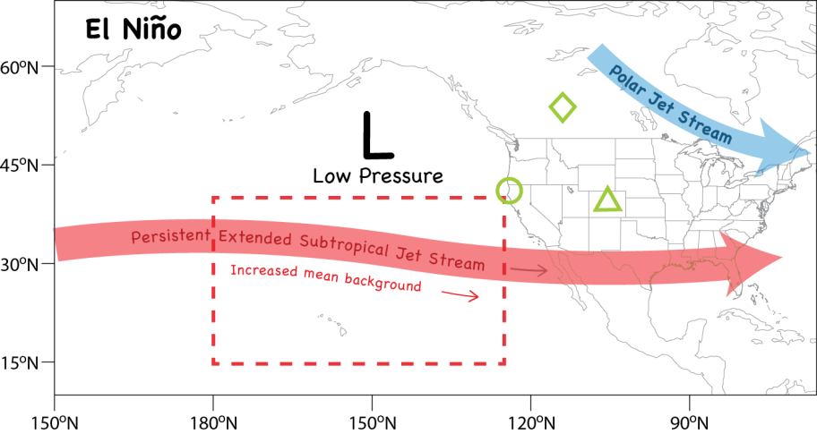
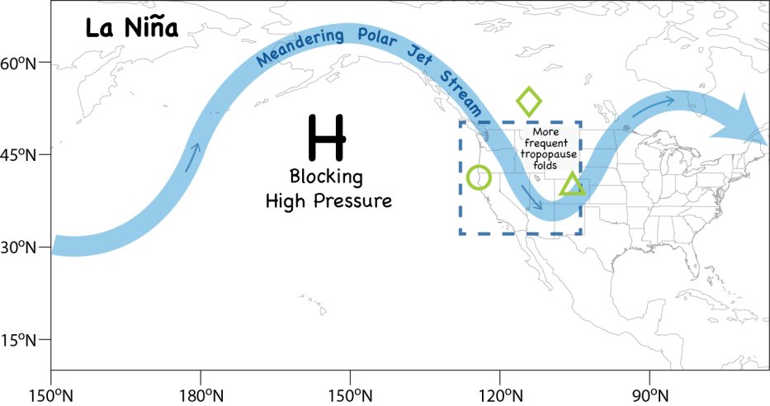
ENSO and mid-tropospheric O₃ over Pacific N.A. in Apr-May
Median AM3 background O₃ at 500hPa
El Niño
El Niño
Lin et al. 2014a (Poster)
La Niña
La Niña
(ppb)
Lin M.Y. et al (2014b, in revision)
7

Slide 8
Following La Niña conditions, more frequent tropopause folds over Western N.A. in late spring
El Niño
Variance in daily O₃Strat at 500hPa
El Niño
La Niña
La Niña
(ppb²)
Lin M.Y. et al (2014b, in revision)
8
Notes:
Maps + PDF

Slide 9
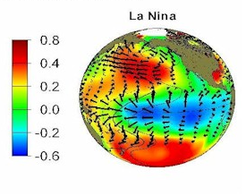
Developing seasonal predictions with a few months of lead time to aid Western U.S. AQ planning?
Tropical SST cooling typically peaks in winter
more frequent stratospheric intrusions expected in the following spring over WUS?
SST (C)
Lin M.Y. et al (2014b, in revision)
9

Slide 10
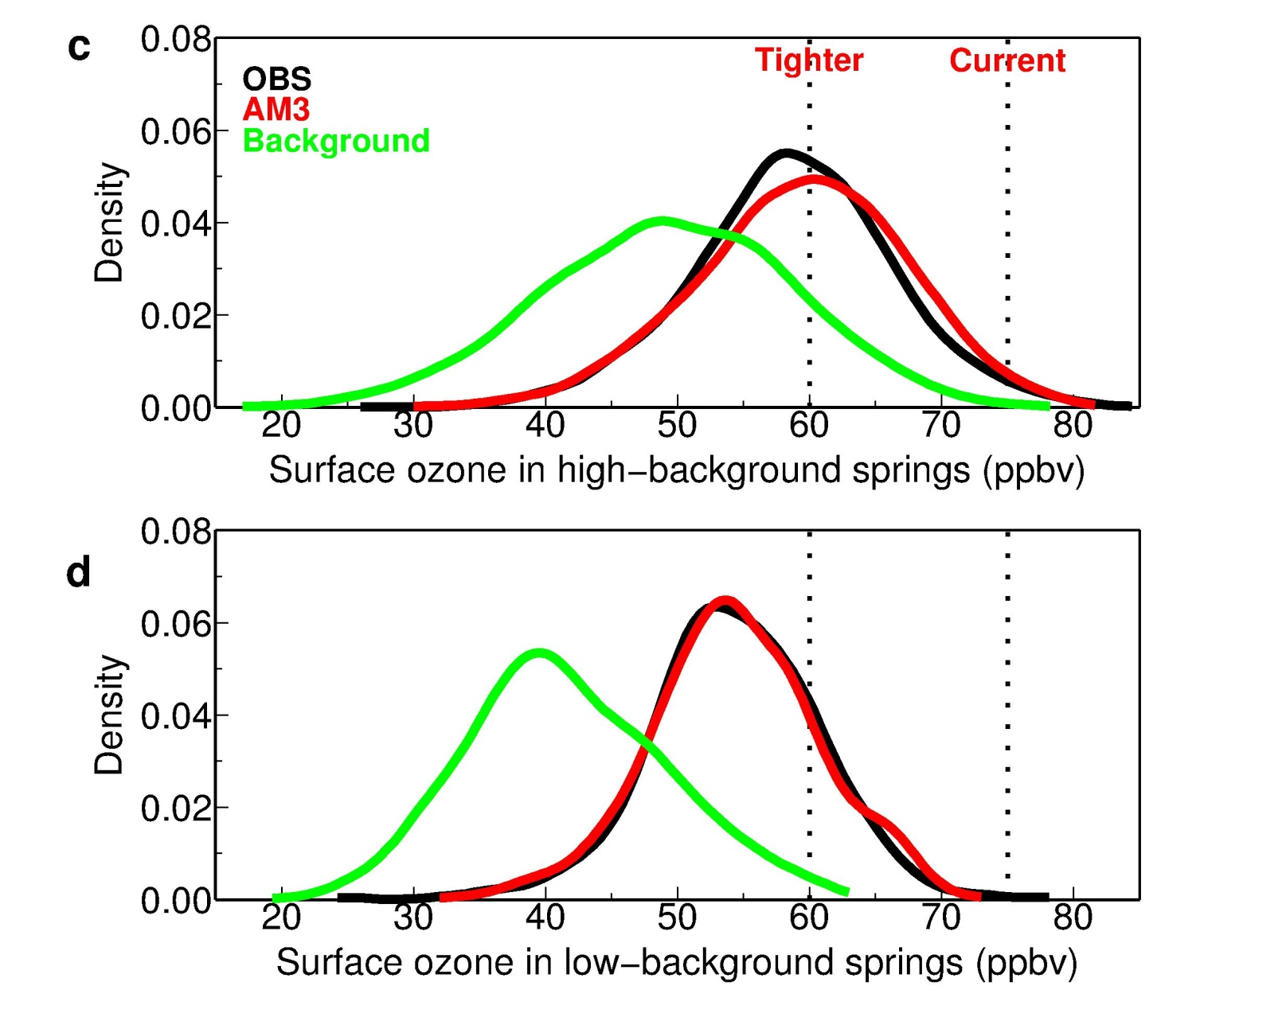
Regional preparations for a high “background” spring: Tighter controls on U.S. domestic emissions?
High-altitude sites
NAAQS
(N. American anthrop. emissions set to zero)
O₃S (ppb)
1991
1999
2008
2011
2012
1992
1993
Lin M.Y. et al (2014b, in revision)
10
Notes:
Maps + PDF

Slide 11
Regional preparations for a high “background” spring:
Developing daily forecast tools for public heath alerts
Aura OMI (May 24, 2008)
300 hPa PV
Total column O₃
[DU]
r
0
0.1
0.2
0.3
0.4
0.5
0.6
Correlating AM3 surface O₃Strat at Grand Canyon with OMI ~250-350hPa one day prior
Potential AQ Applications:
1) Indicate downwind surface influence
2) Public health alerts
3) Identify exceptional events
4) Chemical data assimilation
(April-June, 2005-2008)
Thank you! (Meiyun.Lin@noaa.gov)

Slide 12
Additional slides for Q & A
Notes:
Maps + PDF

Slide 13
Changes in lower stratospheric ozone
r² (OBS, AM3)= 0.81
r² (OBS, AM3)= 0.82
12-month
running mean
UT/LS O₃ is observed to increase following El Niño conditions
(see also Langford et al.,1998; Bronnimann et al., 2004; Manzini, 2009; Randel et al., 2009)
Little change in UT/LS O₃ during La Niña despite increased O₃S in surface air
13

Slide 14
Following El Niño conditions, stronger mean O₃-rich airflow from Asia towards Hawaii in spring
Mean O₃ Anomaly (ppb)
Year
Tropospheric ozone trends at Mauna Loa Observatory
tied to decadal climate variability (see Poster)

