Slide 1



Key drivers of western US surface O₃ variability over recent decades: Stratospheric intrusions, Asian pollution, and Climate Variability
HTAP/WRAP Workshop, 13-May-2015
Meiyun Lin
(Princeton University/GFDL)
Notes:
1

Slide 2
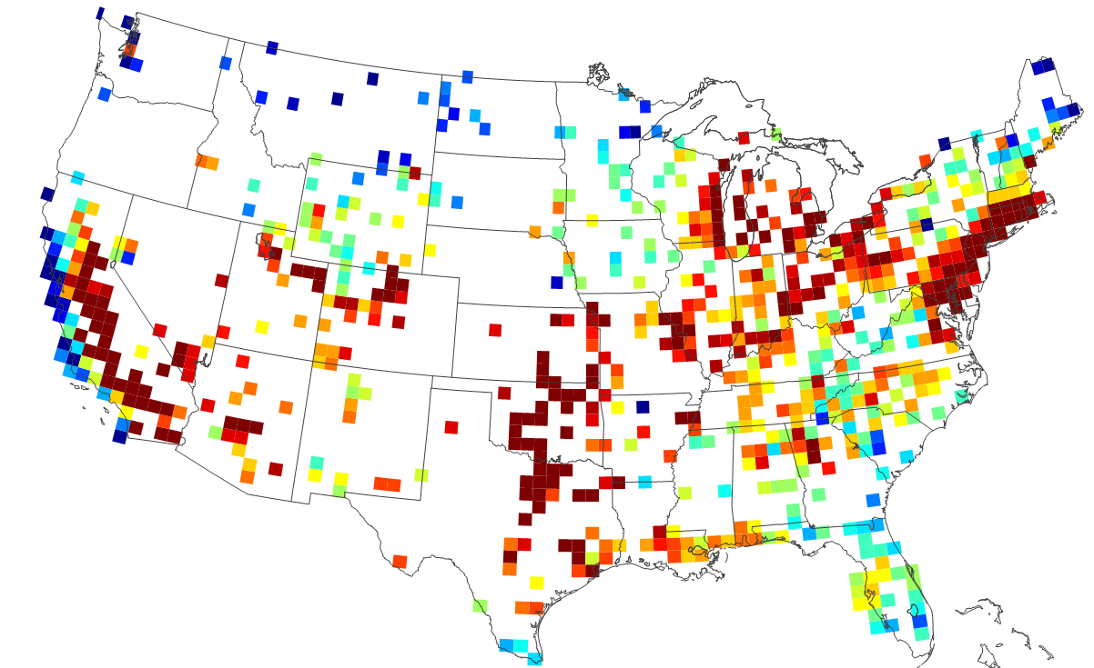
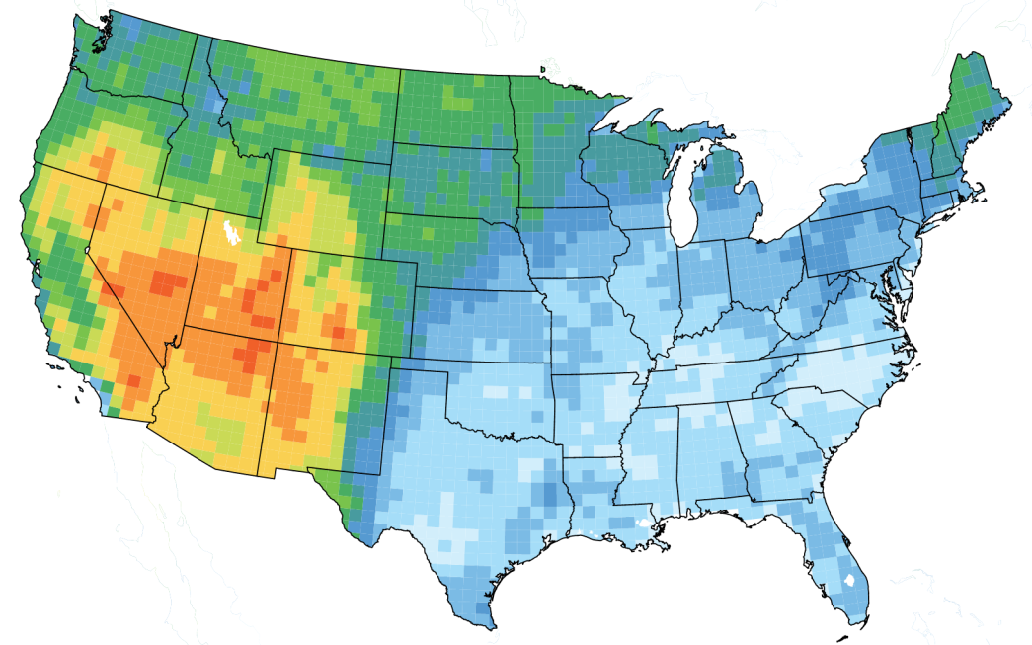
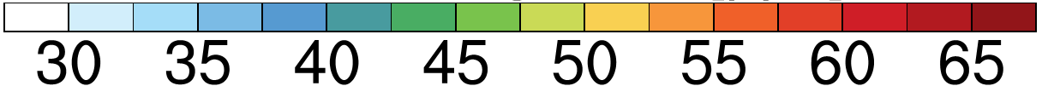
Major challenges for western US air quality management
Sparse monitoring
Annual 4th Hi MDA8 O₃ (2011-2013 AQS)
Current standard
Mean background, Apr-Jun
(N. American anthrop emis off in AM3, 0.5ᵒ)
ppb
ppb
Future standard?
MAJOR CHALLENGES:
-More frequent wildfires in summer [e.g. Westerling et al. 2006; Pfister et al. 2008; Jaffe 2011; T. Moore]
-Stratospheric intrusions (STT) in late spring [e.g. Langford et al., 2009; Lin et al., 2012]
-Rising Asian emissions and global CH₄ [e.g. Jacob et al. 1999; Cooper et al. 2010]
THIS TALK: How DO LARGE-SCALE circulation patterns MODULATE THEIR IMPACTS?
2

Slide 3
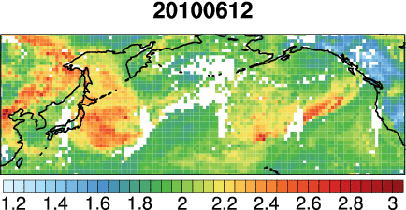

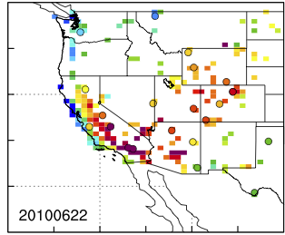
Asian pollution contribution to WUS high-O₃ events
AIRS CO
[10¹⁸ molecules cm⁻²]
MLO (Oltmans)
22-June-2010
OBS
Model
Asian
Surface MDA8 O₃
Future NAAQS?
[ppb]
[ppb]
Asian pollution can contribute ~20% on days when OBS > 65 ppb
3
Meiyun Lin et al [JGR, 2012a]: Transport of Asian O₃ pollution into surface air over the WUS in spring
Notes:
Asian emissions contribute 8-12 ppb on days when OBS O₃ ≥ 65 ppb (future NAAQS)
Consistent with elevated free trop O₃ levels observed by in ozonesondes during CalNex

Slide 4

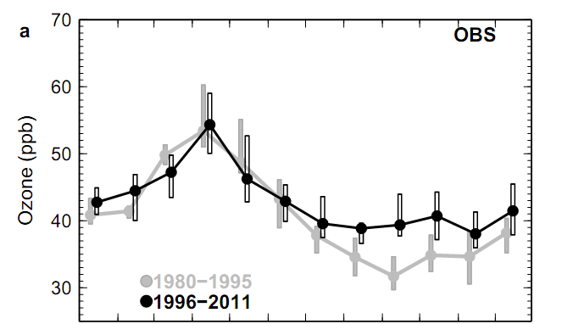
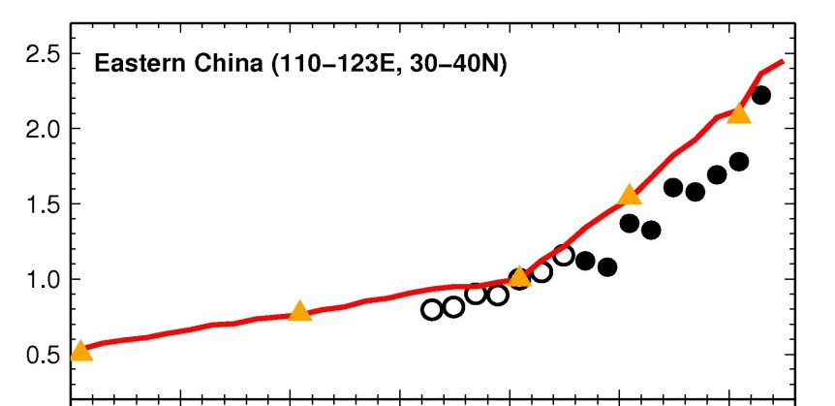
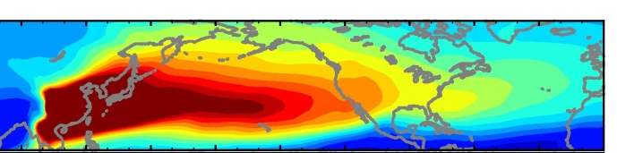

Tropospheric ozone trends at Mauna Loa Observatory
tied to decadal climate variability
Mauna Loa Observatory (3.4 km altitude)
The puzzle:
No trend in spring
(decrease in 25th)
Increase in fall
75th
50th
25th
Jan Feb Mar Apr May Jun Jul Aug Sep Oct Nov Dec
Tripling NO_{x} emissions from E. China
Tracer of East Asian CO Pollution
Spring
Normalized to Y2000
Model
Satellites
(GOME/SCIAMACHY)
Fall
1980 1990 2000 2010
4
Meiyun Lin, Larry Horowitz, Samuel Oltmans, Arlene Fiore, and Songmiao Fan (2014)

Slide 5
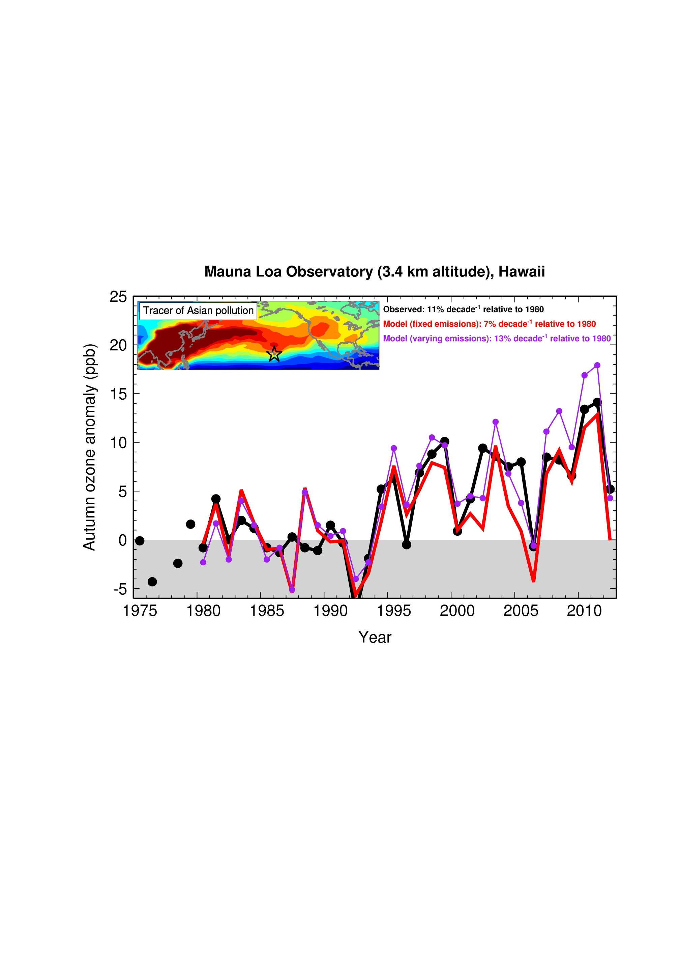
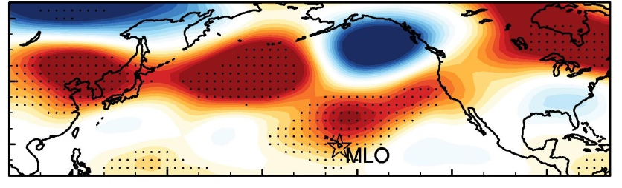

Increasing ozone at Mauna Loa in FALL tied to a shift in circulation patterns since the mid-1990s
OBS: 11% decade⁻¹ (p<0.05)
FIXEMIS (Nudged): 7% decade⁻¹ (p<0.05)
BASE (Nudged): 13% decade⁻¹ (p<0.05)
Changes in NCEP 500hPa height , PNA+
(1995-2011 minus 1980-1994)
[m]
Sep -Oct
Circulation variability can pose a substantial challenge to detecting ozone changes in short records and attributing these changes to anthropogenic emission trends.
Lin M.Y. et al (Nature GeoSci., 2014)
5
Notes:
Much of the observed increase in ozone at Mauna Loa during fall is explained by circulation pattern shifts. Since the mid-1990s, the Pacific-North American (PNA) pattern has shifted to a more positive phase, causing an intensification of the southward transport of ozone-rich air from the mid-latitudes north of Hawaii to subtropical Hawaii.

Slide 6
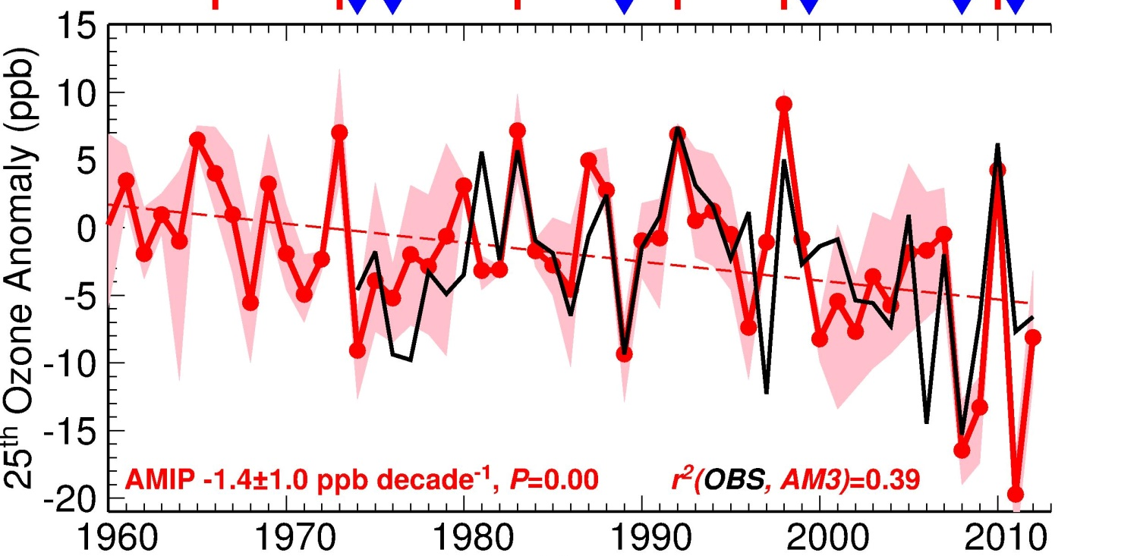
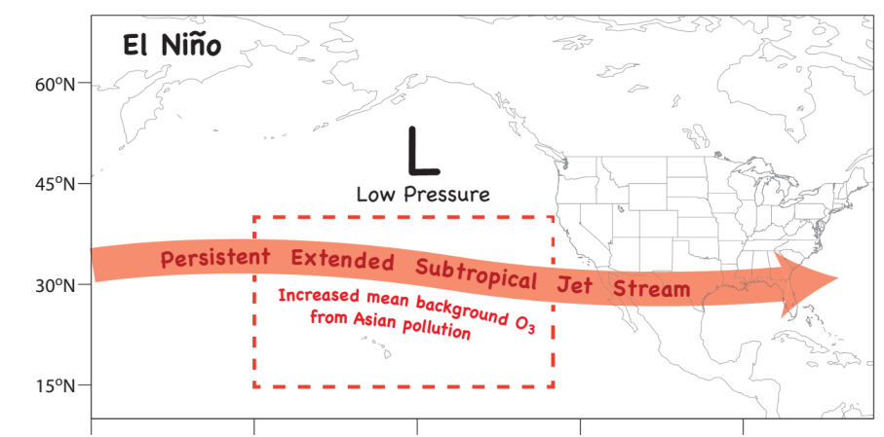
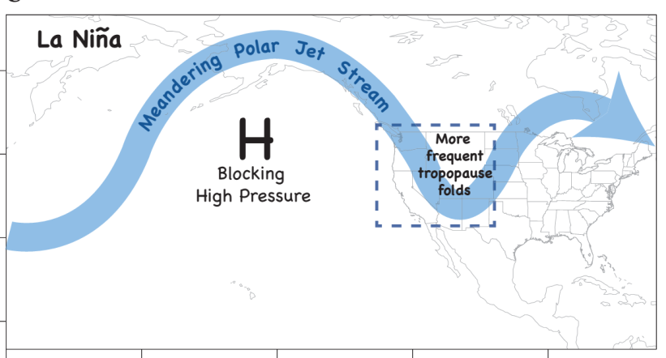
Springtime airflow from Eurasia towards the NE Pacific weakens in 2000s, offsetting rising O₃ from Asian emissions
LaNiña-like decadal cooling (PDO-)
[Chavez2003; Meehl2013; Kosaka2013]
ElNiño
Ozone Anomaly , ppb
(25th percentile)
Minor influence from fires
r²(OBS, AMIP) = 0.39; Fixed anthrop & fire emissions
P<0.01
ElNiño
LaNiña
Western US?
Lin M.Y. et al (Nature GeoSci., 2014)
6
6

Slide 7

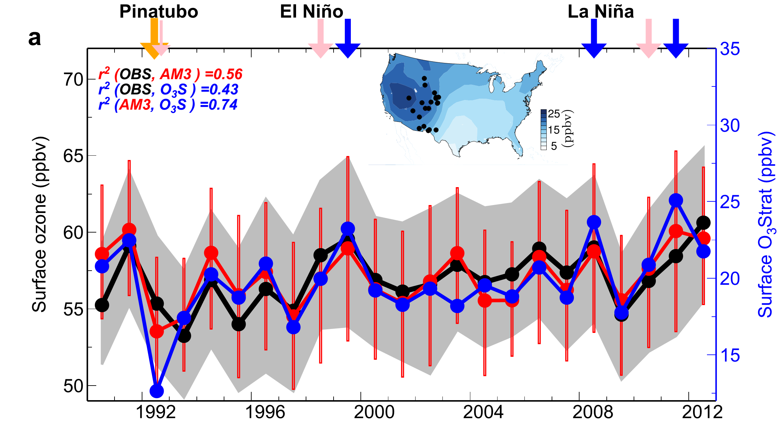
Climate variability modulates western U.S. ozone air quality via deep stratospheric intrusions
75th
50th
O₃Strat
25th
Emissions held constant
Nudged to “real” winds
Stratospheric Contribution (ppb)
1990
April-May
Meiyun Lin, Fiore AM, Horowitz LW, Langford AO, Oltmans SJ, Tarasick D, Rieder H (Published 12th-May-2015)
7
Notes:
Jet variability (internal or ENSO-forced)

Slide 8
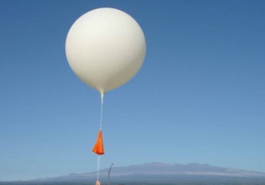
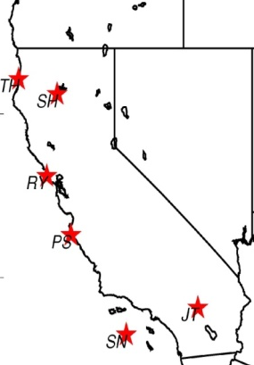
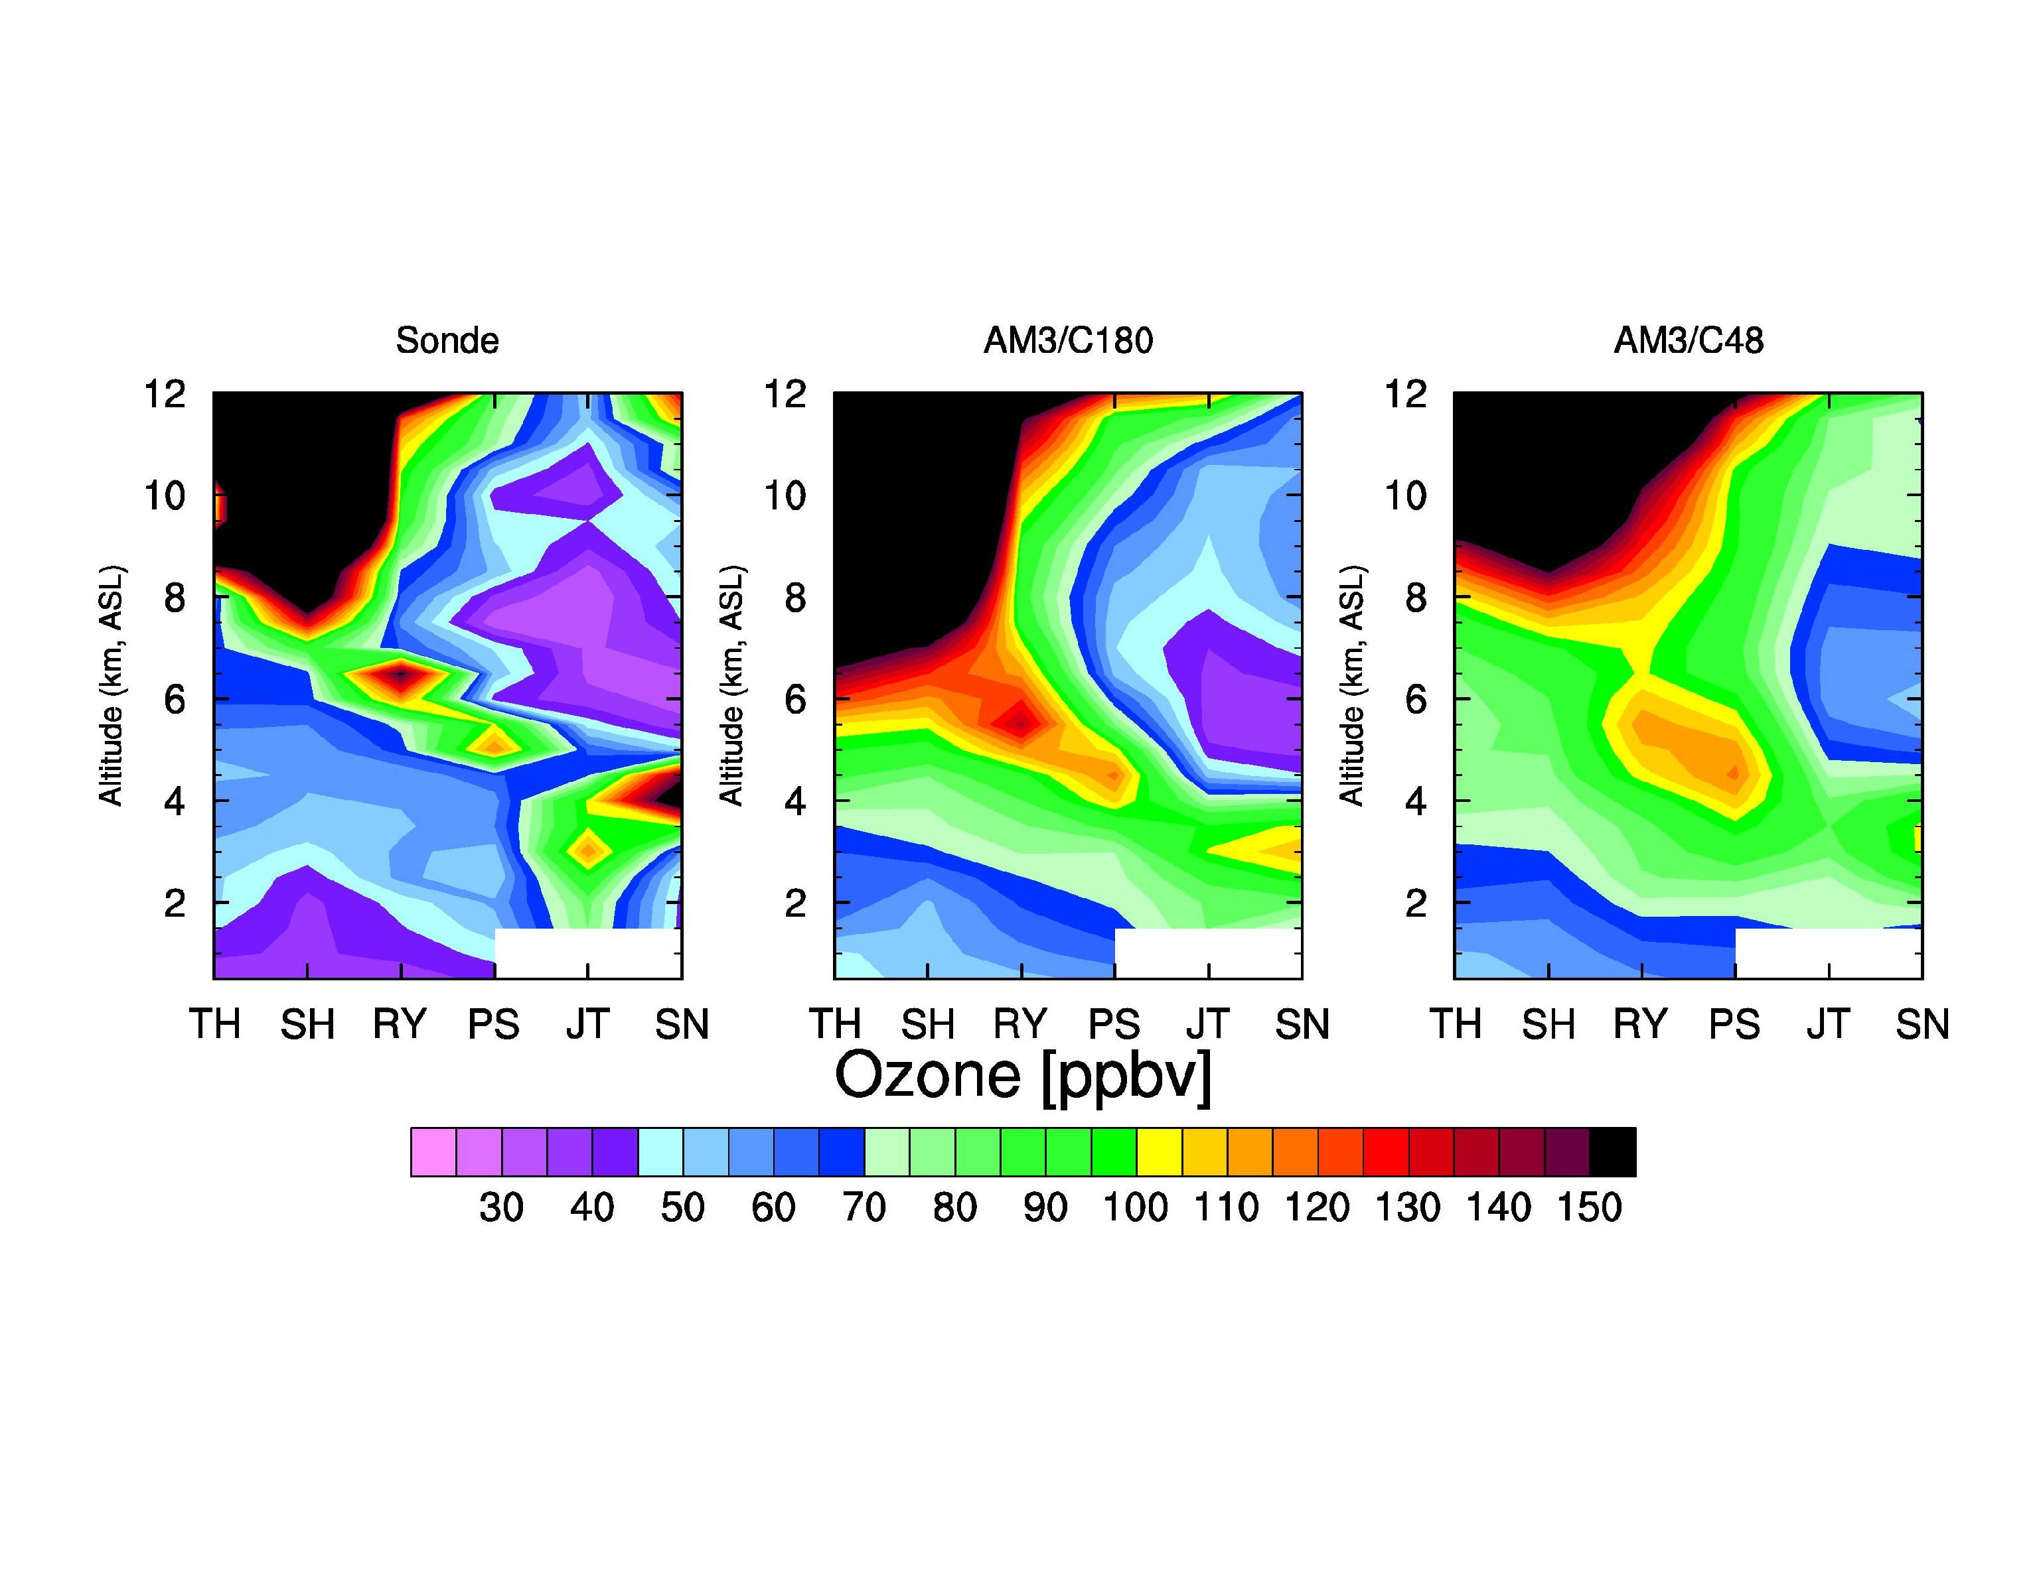
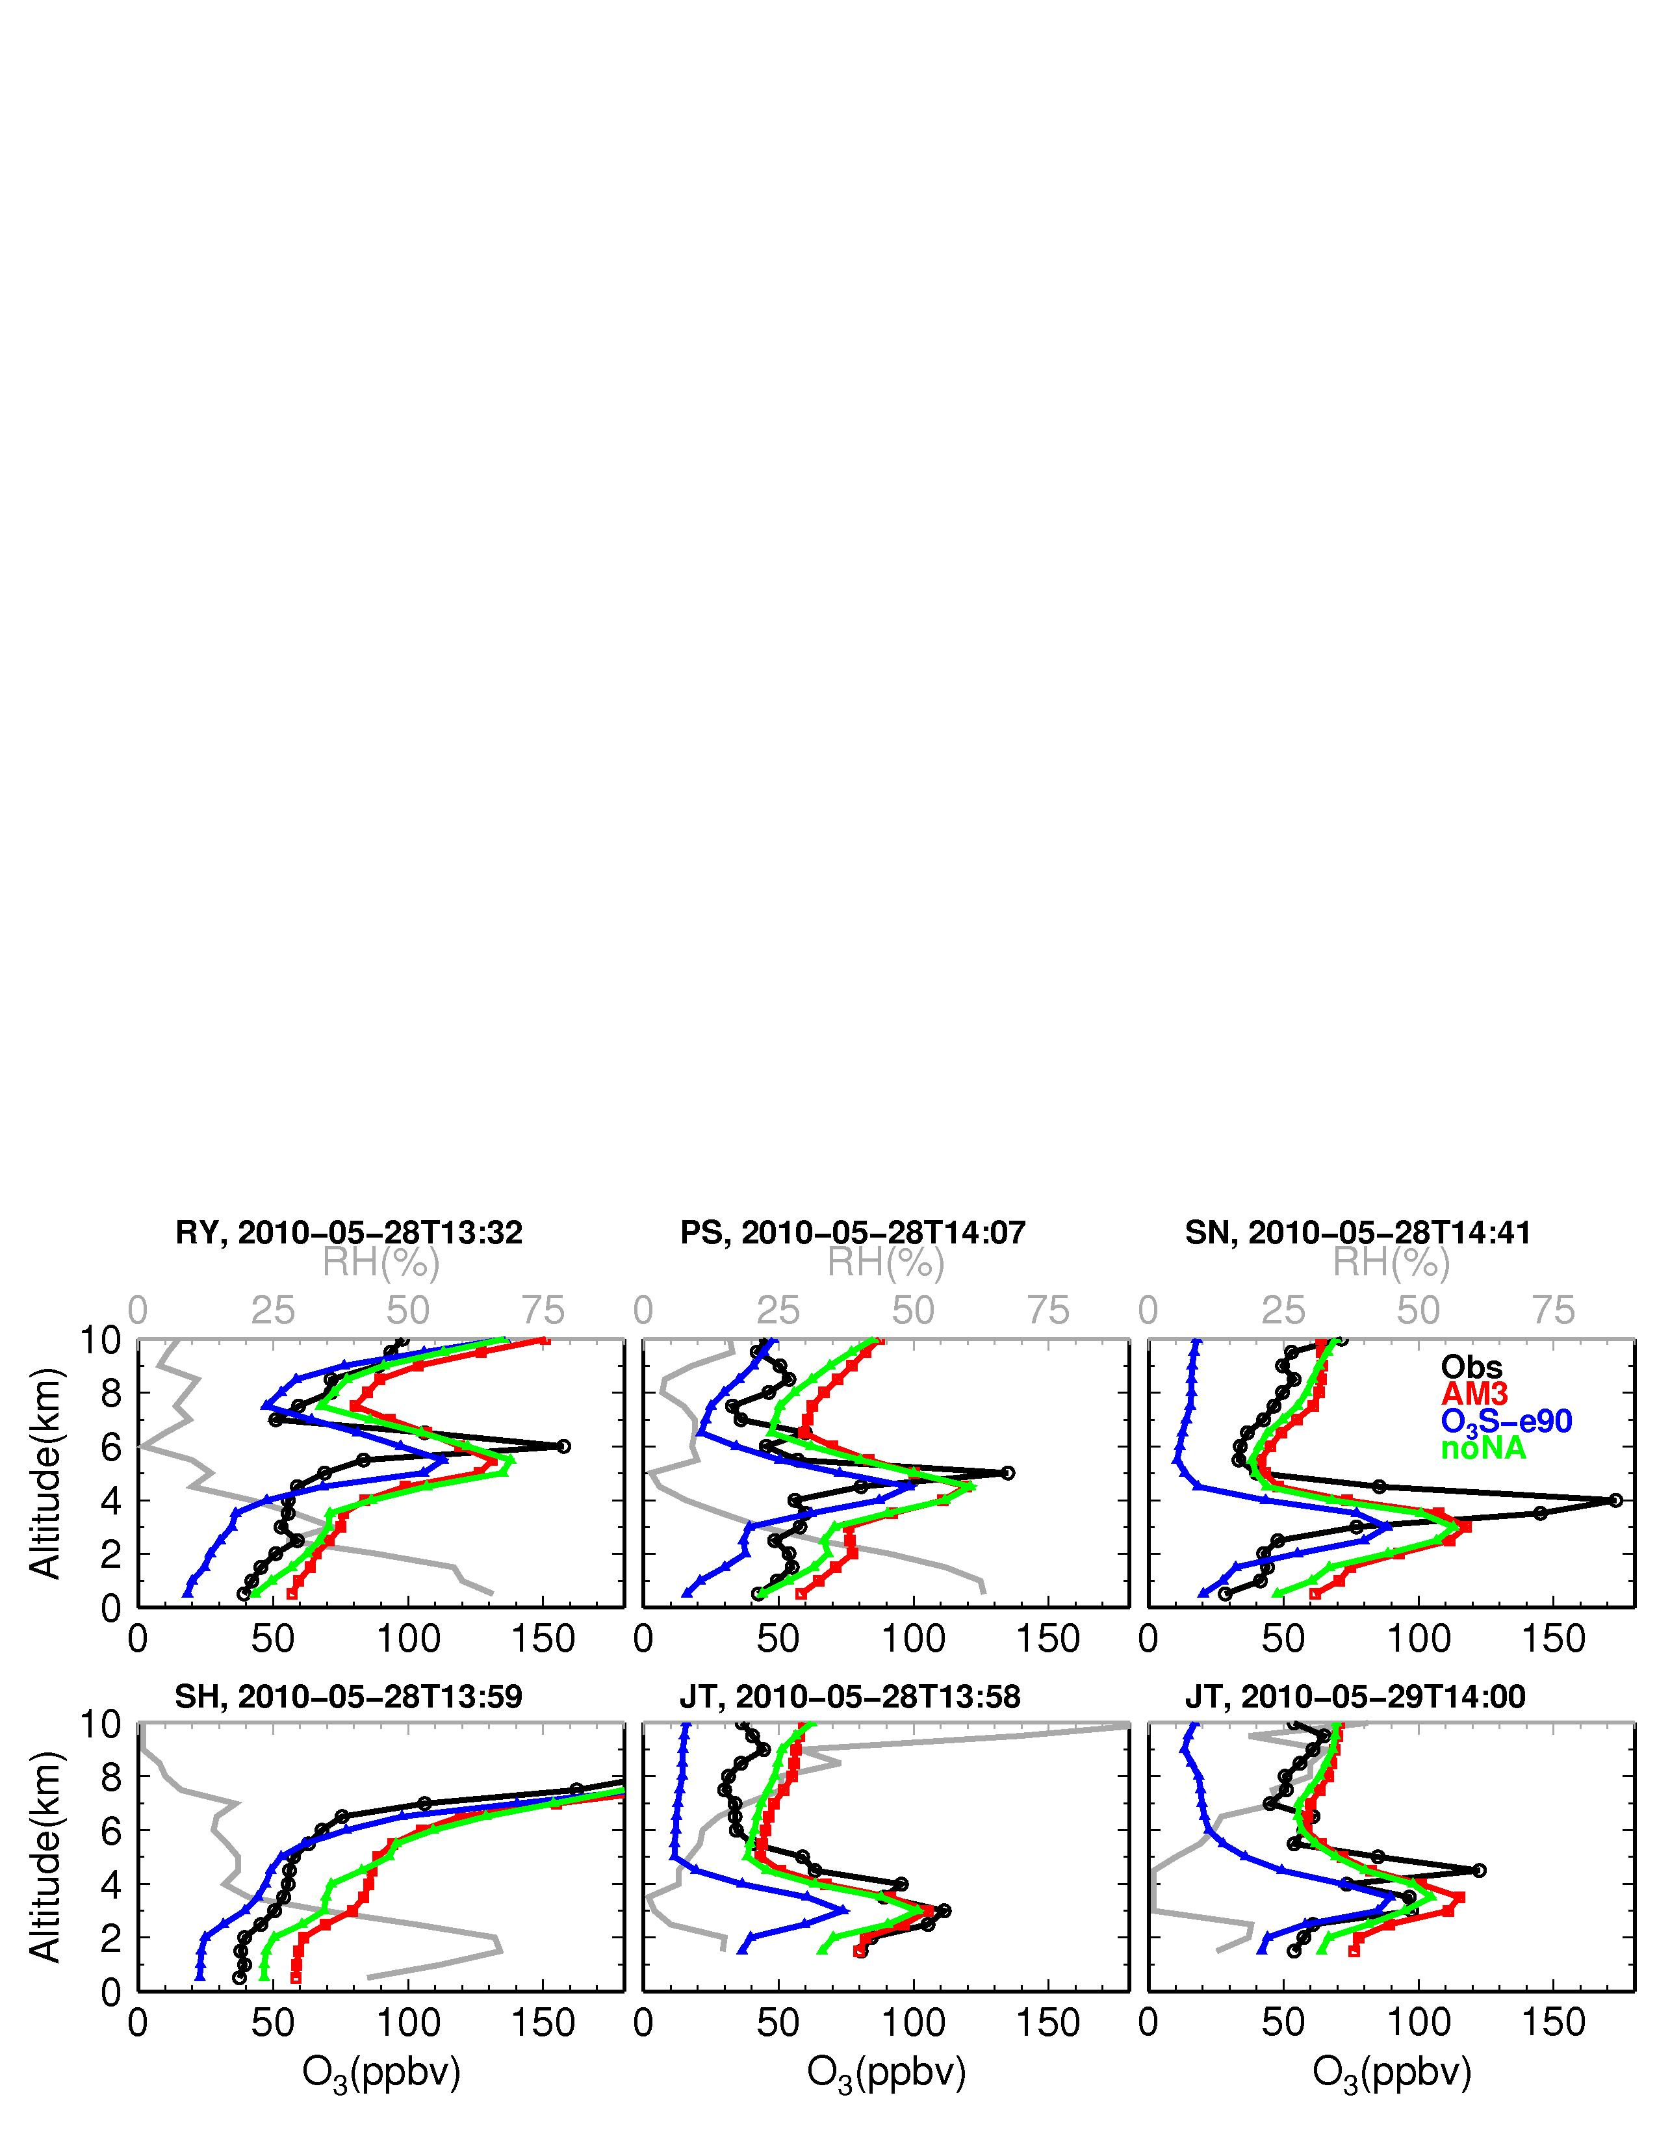
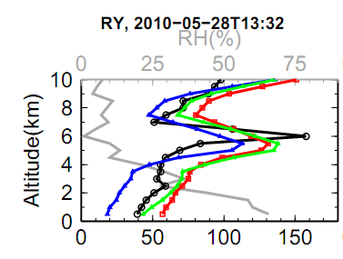
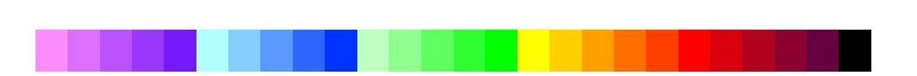
AM3 captures a deep STT event over California
Sondes over California
Observed RH (%)
(Cooper)
OBS O₃
AM3 total
Altitude (km)
BGO₃
O₃Strat
O₃ [ppb], Joshua Tree (JT)
North → South
Simulated enhancements of O₃Strat consistent with observed low RH
Reaching surface sites on May 29
30
50
70
90
110
130
150
[ppb]
Meiyun Lin et al (JGR, 2012b): Springtime high surface ozone events over the WUS
Quantifying the role of stratospheric intrusions
8
Notes:
O₃Strat contributes ~75% to enhanced O₃ >100 ppbv at 2-5 km a.s.l.
Consistent with observed low humidity; NA emissions contribute little

Slide 9
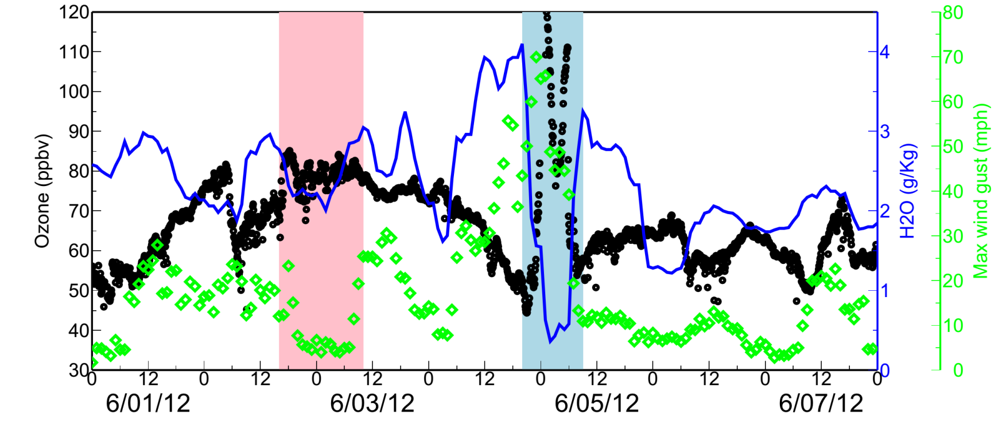
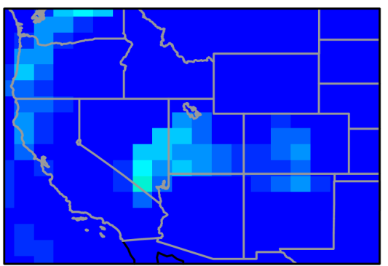
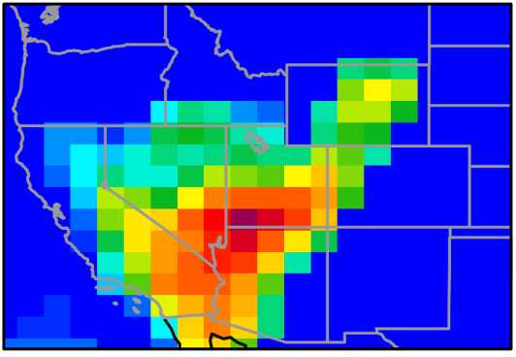
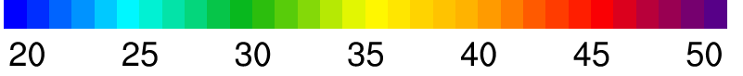
Observed evidence of high surface ozone events from regional pollution vs stratospheric intrusions
Spring Mtn Youth Camp, Nevada (2.6 km altitude)
Ozone (ppb), 5-min
Wind gust (mph)
NAAQS
June 3
June 5
O₃ data (Zheng Li, Nevada DAQ)
- Met data (NOAA DRI)
Baseline (upper limit)
AM3 O₃Strat (ppb, 8-h average)
AM3 O₃Strat: Deep STT can elevate surface MDA8 O₃ by 20-40 ppb (Robust!)
9
Notes:
AM3 O3Strat captures the episodic ozone enhancements although the mean baseline level of O3Strat may represent an upper limit
Define O3S

Slide 10
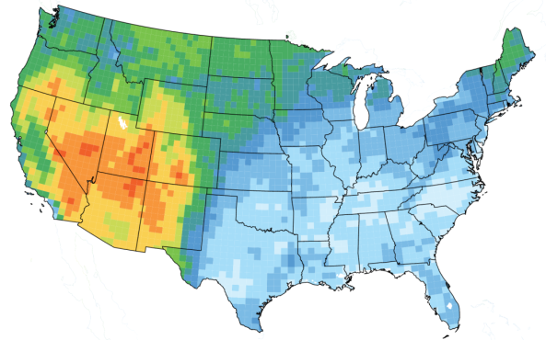
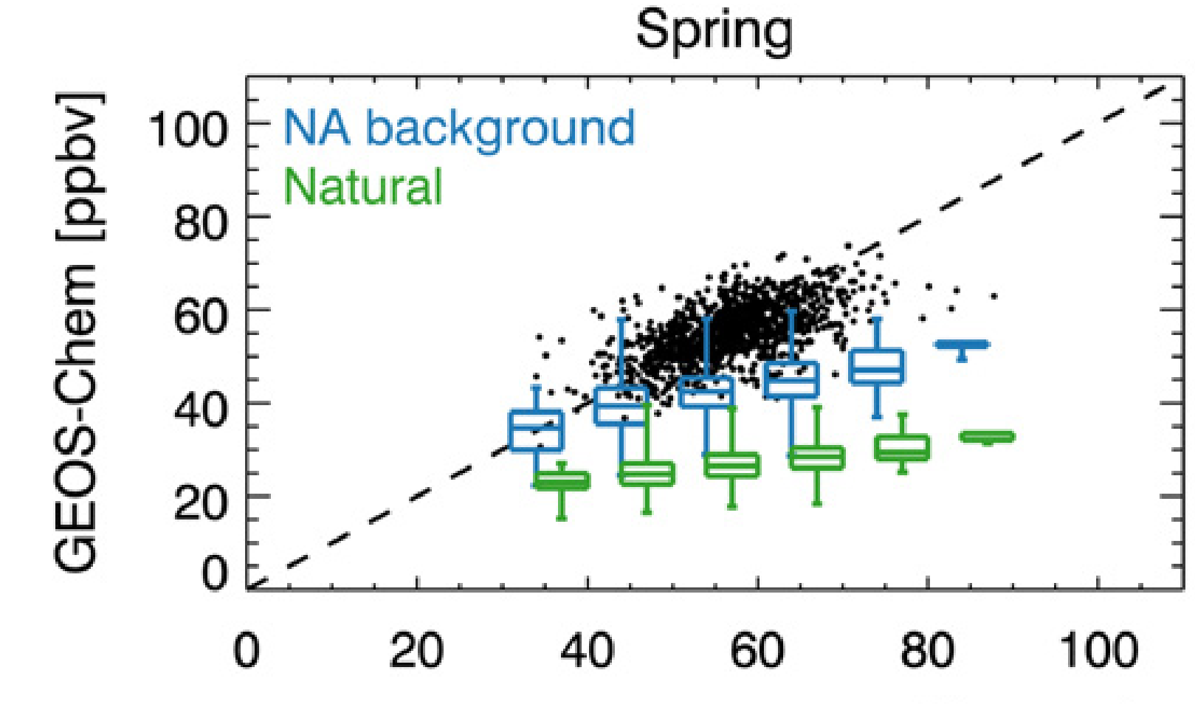
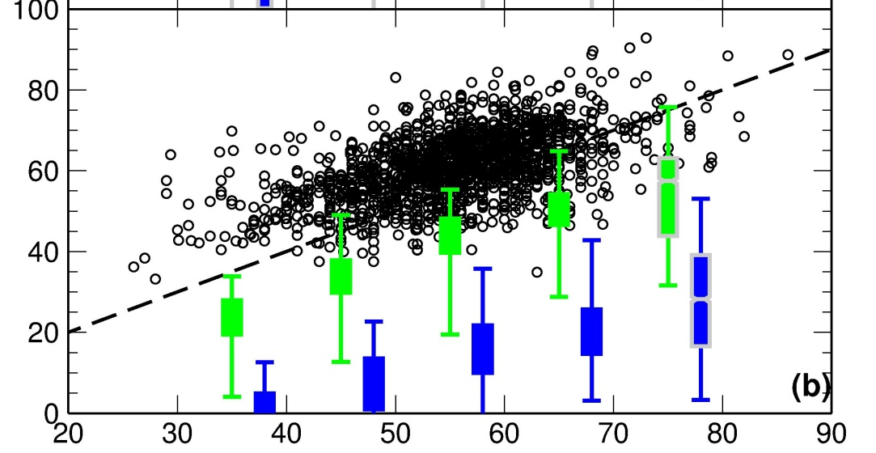
More frequent deep STT
→ Increase in the high tail of observed O₃ distribution
Background ozone variability in GEO-CHEM vs. GFDL-AM3
Zhang et al (2011, AE )
80
BGO₃
60
0.5º
Natural
CASTNET (>1.5 km; Spring)
Lin et al (2012b, JGR)
Observations (ppbv)
80
max
GFDL AM3 (ppb)
BGO₃
60
75th
The models often bracket the observed values (Fiore et al., 2014)
AM3 better captures the observed high tail, on which deep STT has the greatest impact
O₃Strat
(Bias-corrected)
median
0.5º
25th
min
Observations (ppb)
10

Slide 11
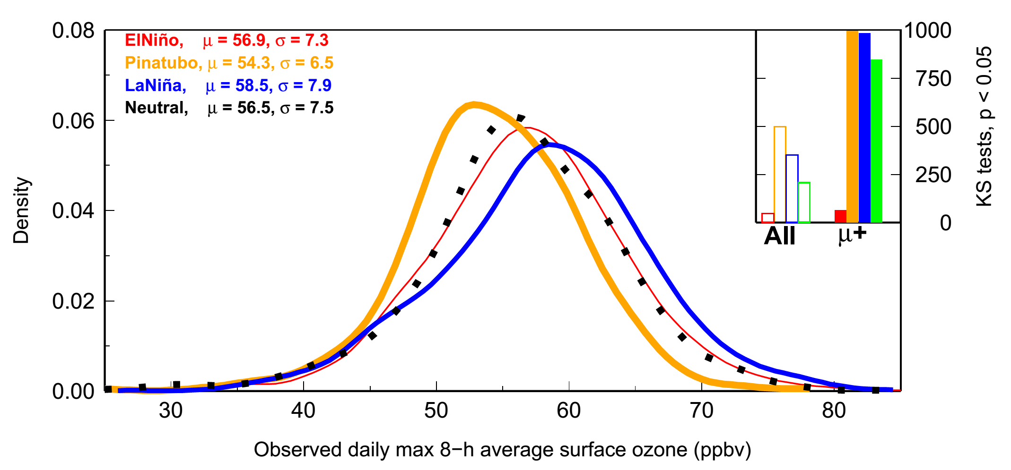
The high tail of the observed daily surface O₃ distribution over Western US increases during La Niña springs
Neutral: µ = 56.5,σ = 7.5
El Niño (1998, 2010): µ = 56.9,σ = 7.3
La Niña (1999, 2008, 2011): µ = 58.5,σ = 7.9
Pinatubo (1992, 1993): µ = 54.3,σ = 6.5
Changes in the high tail are statistically significant
Probability Density
Observed daily max 8-h average (MDA8) ozone [ppb]
El Niño → Little change in WUS surface O₃
despite higher UTLS O₃ levels [Langford1999, Neu2014]
Lin MY et al (Nature Communications, 2015)
11
Notes:
Cite Neu et al., Langford et al …
In the next few slides, I will reconcile these findings by contrasting inter-annual variability in mean
ozone aloft versus in the frequency of stratospheric intrusions that enhance WUS surface ozone.
TES?

Slide 12

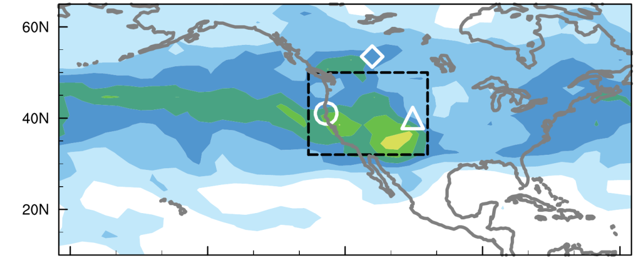
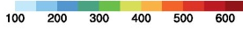

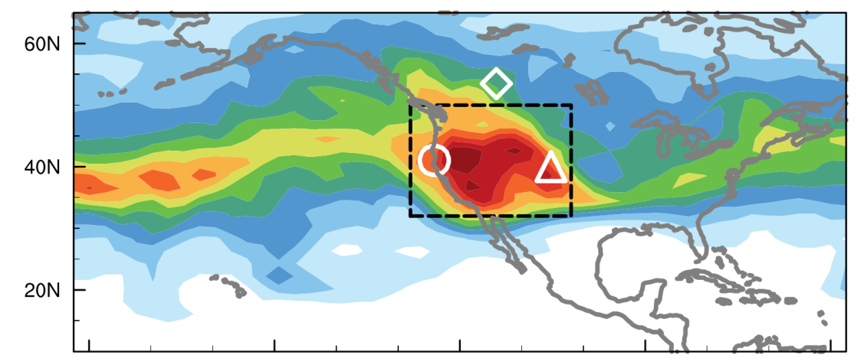
ENSO-related jet characteristics and their impacts on sources of lower trop O₃ variability over western NA
El Niño
N=4, 1979-2014
σ² (daily O₃Strat), 500 hPa, Apr-May
ppb²
La Niña
N=4, 1979-2014
Tropopause folds at the polar jet penetrate
much deeper into the lower troposphere than those at the subtropical jet
Meiyun Lin et al (Nature Communications, 2015)
12

Slide 13
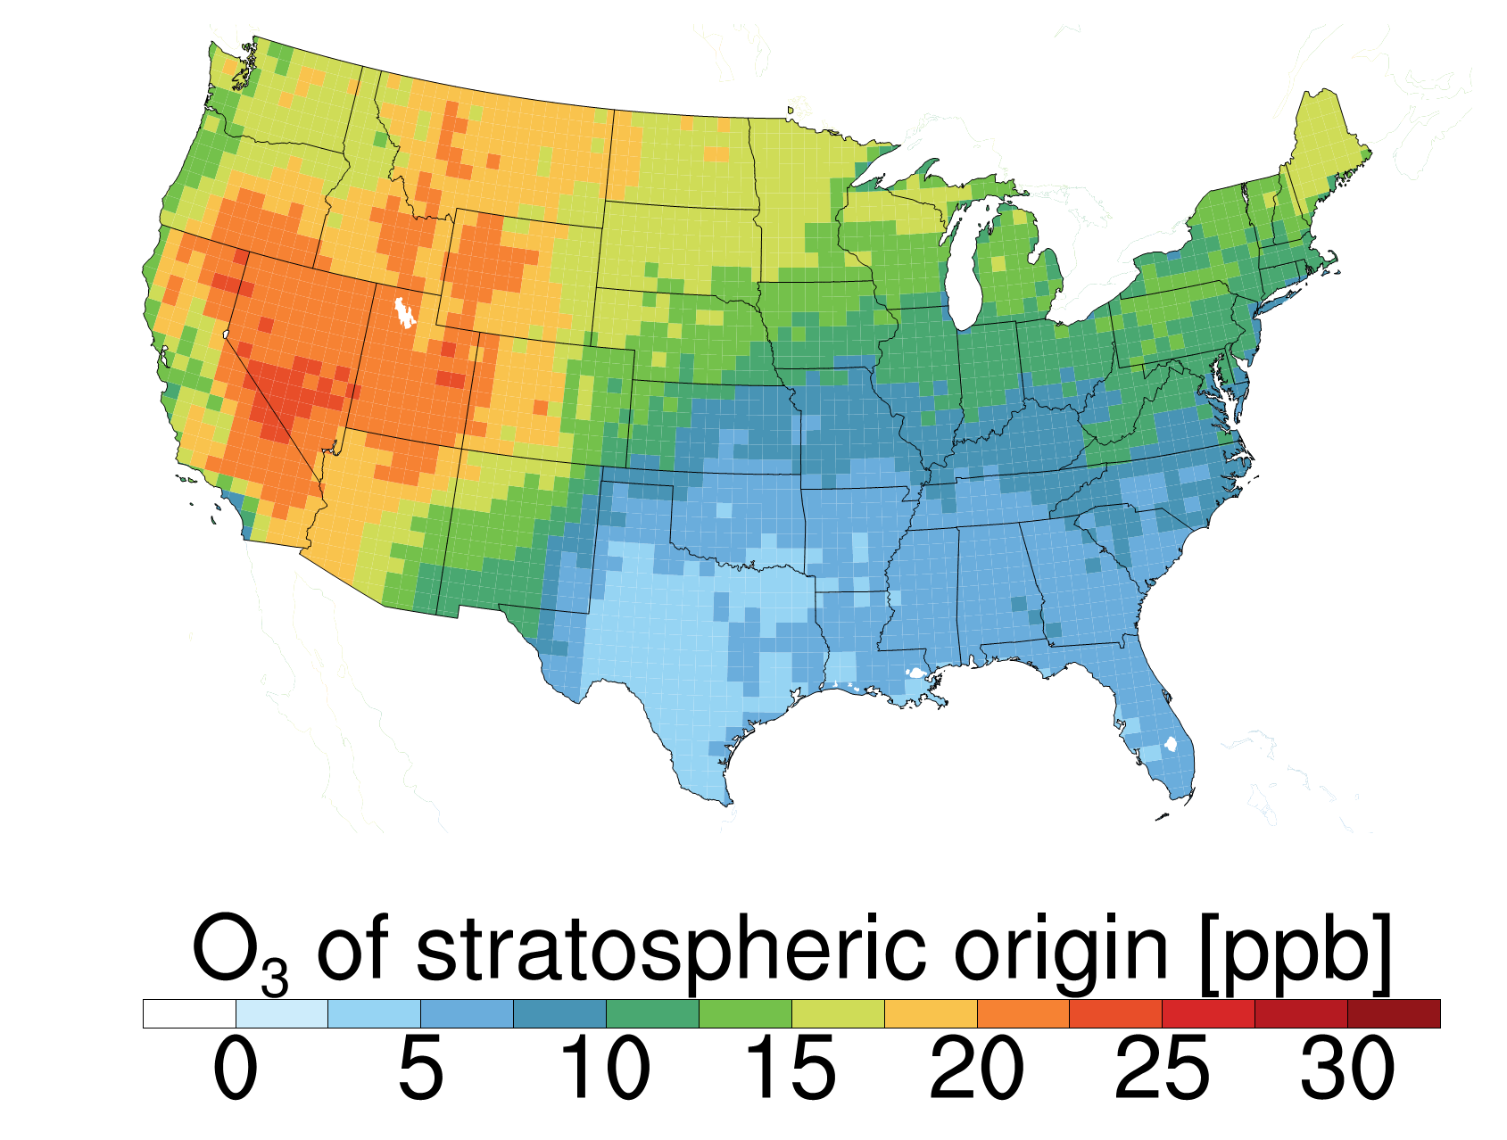
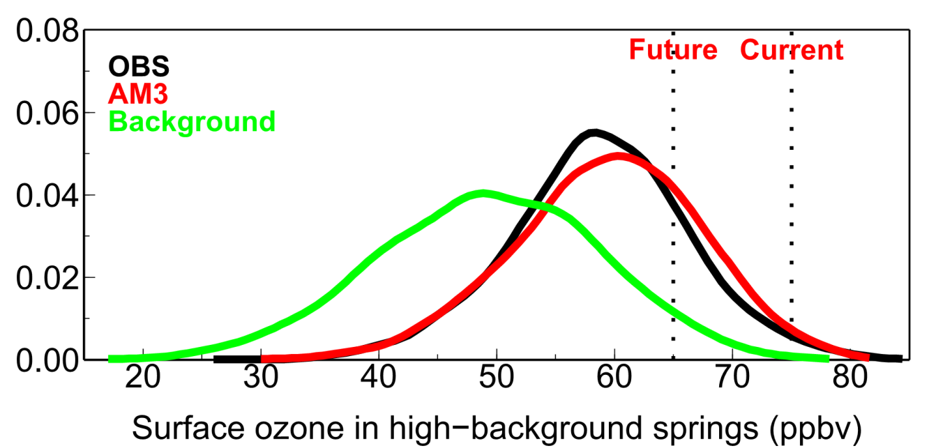
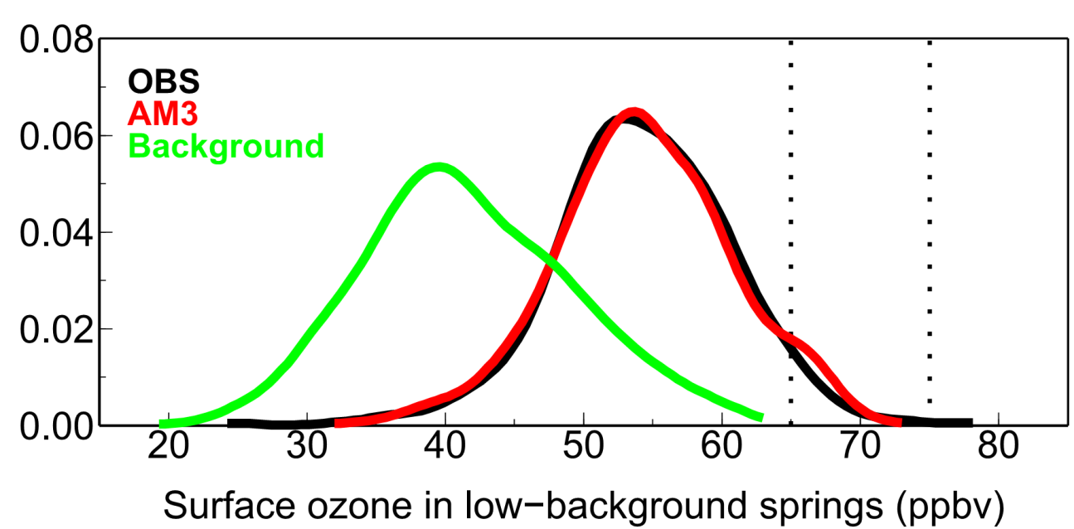
Surface O₃ distribution in high vs low background springs
NAAQS
(N. American anthrop. emissions set to zero)
1991
1999
2008
2011
2012
Probability Density
1992
1993
Meiyun Lin et al (Nature Communications, 2015)
13
Notes:
As our national ozone standard becomes more stringent, the relative importance of these stratospheric intrusions grows, leaving less room for U.S. anthropogenic emissions to contribute to ozone pollution prior to exceeding the level set by the U.S. EPA.

Slide 14
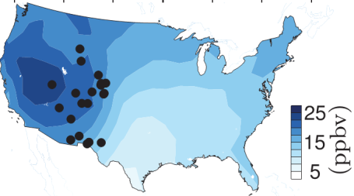
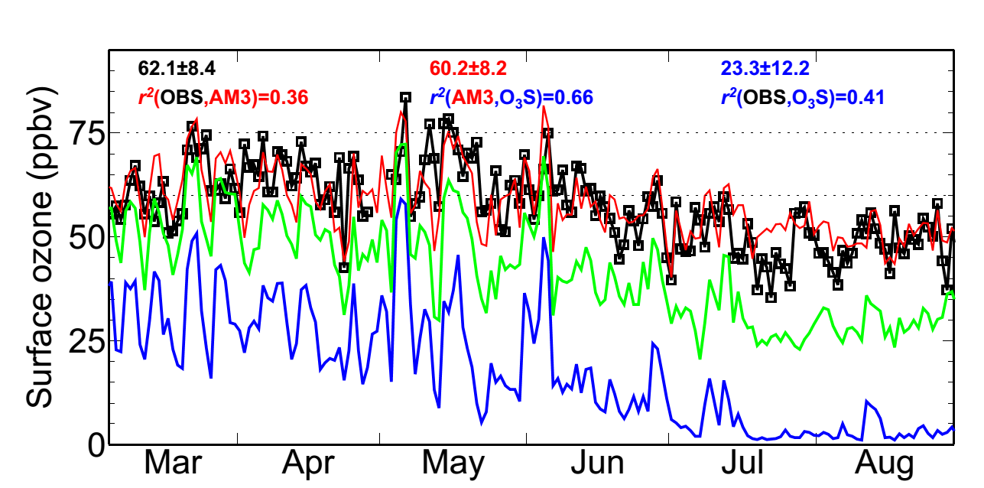
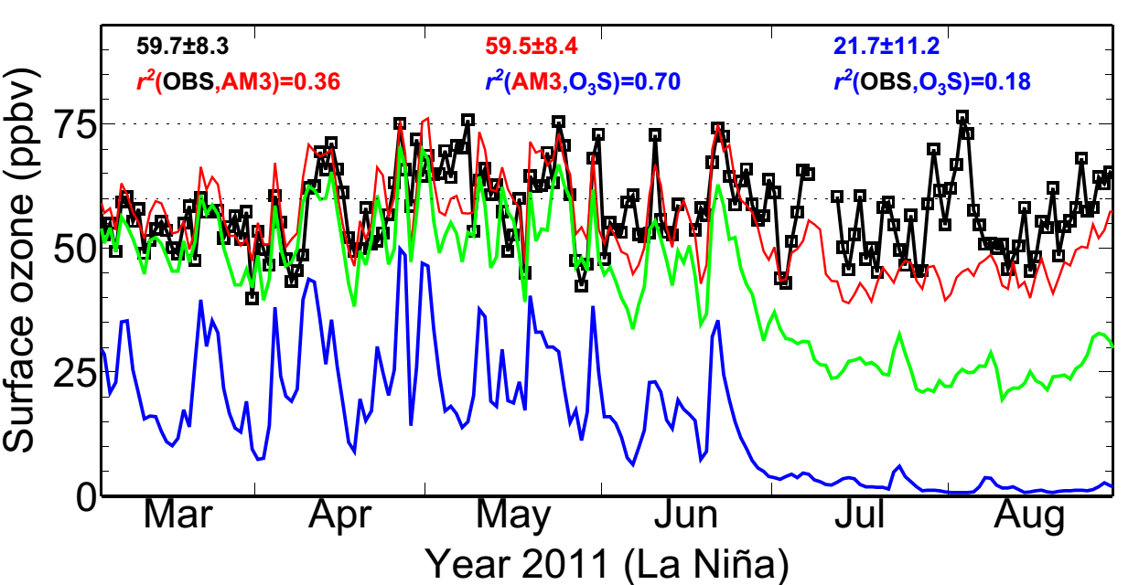
Following strong La Niña, deep STT may occur with sufficient frequency as to confound ozone attainment
Gothic, Colorado (2.9 km altitude)
70 ppb
MDA8 O₃ (ppb)
Total
1999 (La Niña)
BGO₃
O₃Strat
Chiricahua NM in Arizona (1.5 km altitude)
2011 (La Niña)
MDA8 O₃ (ppb)
Lin MY et al
(Nature Commun., 2015)
14
14

Slide 15
The importance of STT grows under a lower NAAQS level
→Leaving less room for the addition of US anthrop. emissions
Gothic, Colorado (2.9 km altitude)
65 ppb
MDA8 O₃ (ppb)
Total
1999 (La Niña)
BGO₃
O₃Strat
Not so “exceptional” events?
Chiricahua NM in Arizona (1.5 km altitude)
2011 (La Niña)
MDA8 O₃ (ppb)
Lin MY et al
(Nature Commun., 2015)
15
15

Slide 16
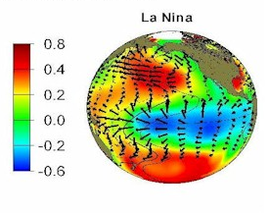
Developing ozone forecasts a few months in advance
to aid western US air quality management
Tropical SST cooling typically peaks in winter
More frequent stratospheric intrusions expected in the following spring over WUS?
SST (C)
MDA8 O₃ (ppb)
Regional preparations for an active stratospheric intrusion season
Deploy targeted measurements aimed at identifying “exceptional events”
(Daily ozonesonde/lidar measurements; collocated CO/O₃/H₂O monitors at select WUS sites)
Conduct daily forecast for public health alerts (Pat Reddy)
Meiyun Lin et al (Nature Communications, 2015)
16

Slide 17


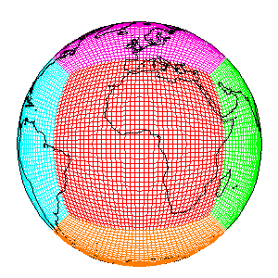
Some final thoughts on western US ozone
Strong interannual variability due to dynamical influences
→ Challenges to detecting & attributing trends in short records
Suggestions for future multi-model assessment
→ Process-oriented evaluation for episodic events
→ Focusing on the known deep SI events as a first step
→ Leveraging CalNex (2010) and LVOS (2013) measurements
The available weekly ozonesonde measurements are too infrequent to capture the actual variability
→ Need additional ozonesonde or continuous lidar measurements!
→ and ideally, maintain these measurements over multiple decades
Meiyun.Lin@noaa.gov
GFDL AM3
17
Notes:
Large year-to-year variability …

Slide 18
Additional Slides for Discussions
Notes:
AM3 O3Strat captures the episodic ozone enhancements although the mean baseline level of O3Strat may represent an upper limit

Slide 19
List of papers featured in the talk
Lin, M., A.M. Fiore, L. W. Horowitz, O. R. Cooper, V. Naik, J. Holloway, B. J. Johnson, A. M. Middlebrook, S. J. Oltmans, I. B. Pollack, T. B. Ryerson, J. X. Warner, C. Wiedinmyer, J. Wilson, B. Wyman: Transport of Asian ozone pollution into surface air over the western United States in spring, Journal of Geophysical Research,117, D00V07, 2012, doi:10.1029/2011JD016961 (PDF)
Lin M., A. M. Fiore , O. R. Cooper , L. W. Horowitz , A. O. Langford , Hiram Levy II , B. J. Johnson , V. Naik , S. J. Oltmans , C. Senff (2012): Springtime high surface ozone events over the western United States: Quantifying the role of stratospheric intrusions, Journal of Geophysical Research, 117, D00V22, doi:10.1029/2012JD018151 (Full Text)
Lin, M., L.W. Horowitz, S. J. Oltmans, A. M. Fiore, Songmiao Fan (2014): Tropospheric ozone trends at Manna Loa Observatory tied to decadal climate variability, Nature Geoscience, 7, 136-143, doi:10.1038/NGEO2066 (PDF)
Lin, M., A. M. Fiore, L.W. Horowitz, A. O. Langford, S. J. Oltmans, D. Tarasick, H. E. Rieder (2015): Climate variability modulates western U.S. ozone air quality in spring via deep stratospheric intrusions, Nature Communications, 6:7105, doi:10.1038/ncomms8105.
19
Notes:
Maps + PDF

Slide 20
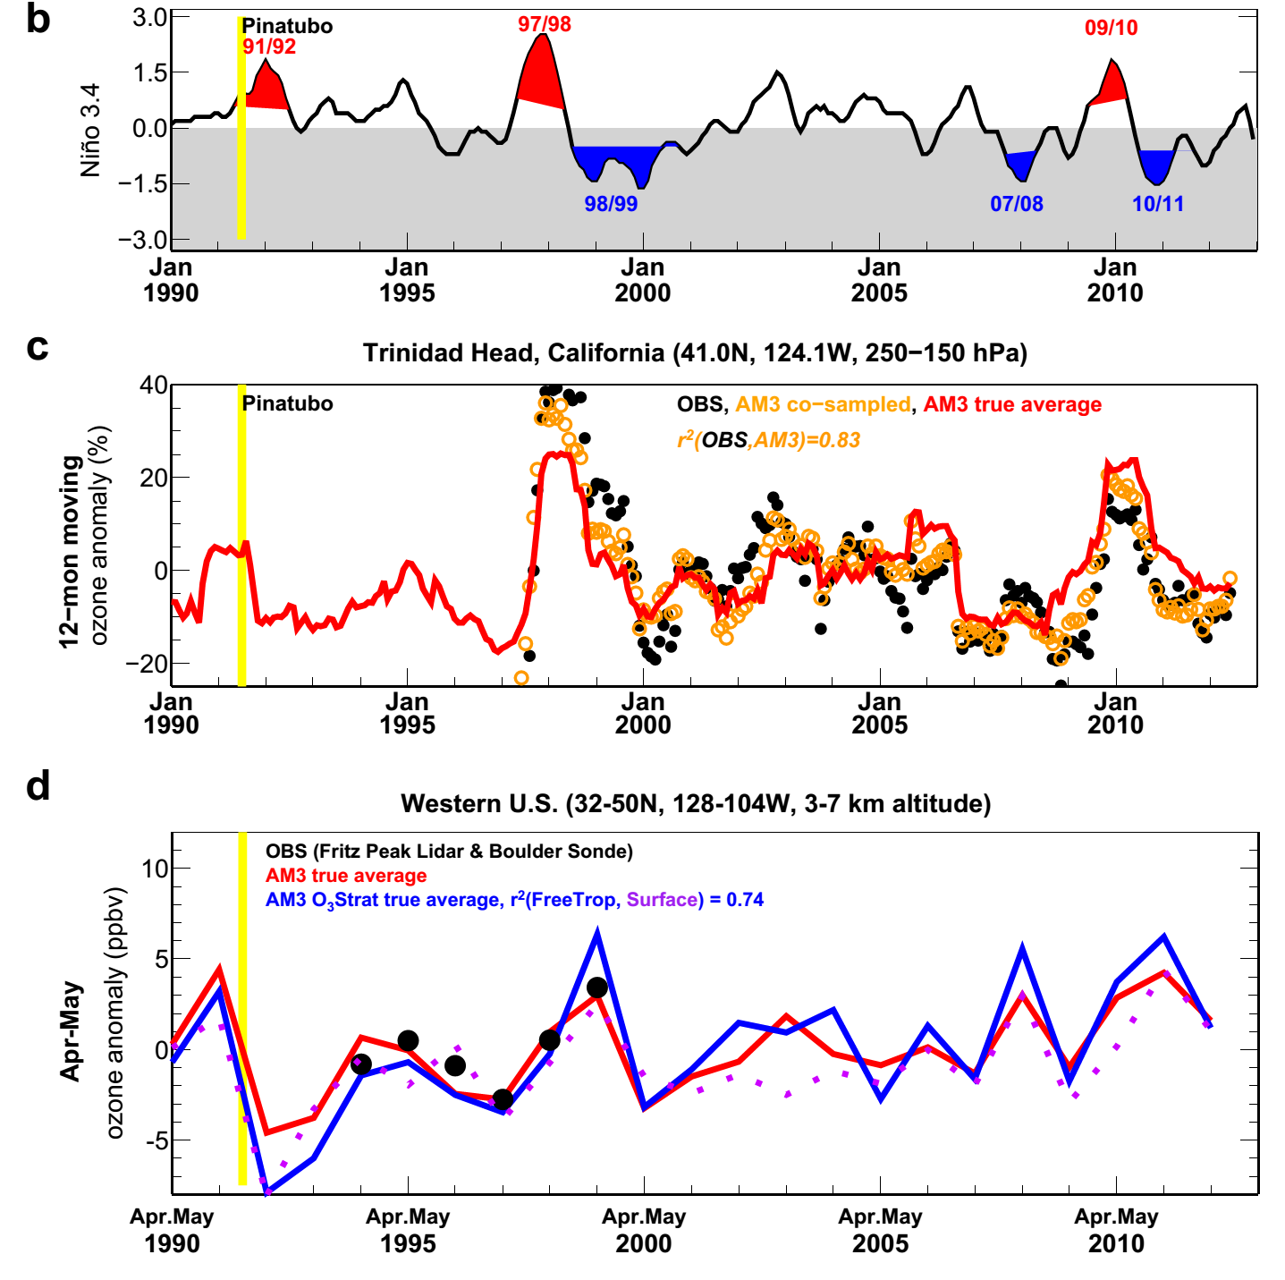
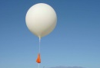
Western US surface O₃ variability correlates poorly with O₃ burdens in the UTLS but strongly with that in the Free Trop
3.0
Niño 3.4 Index
1.5
0
-1.5
-3.0
40
12-mon running mean 250-150hPa O₃ anomaly (%)
r²(UTLS, Surface) = 0.07
20
0
Trinidad
-20
10
Apr-May mean FreeTrop & Surface O₃ anomaly (ppb)
r²(FreeTrop, Surface) =0.74
98/99
07/08
10/11
5
0
-5
1990
1995
2000
2005
2010
Langford1999 noted positive correlations btw FreeTrop and UTLS O₃ observed at Fritz Peak during 1994-1998 (without La Niña years): AM3 captures the observed relationship (r²=0.69) for this short record but indicates little correlation (r²=0.18) for the entire 1990-2012 period.
20

Slide 21

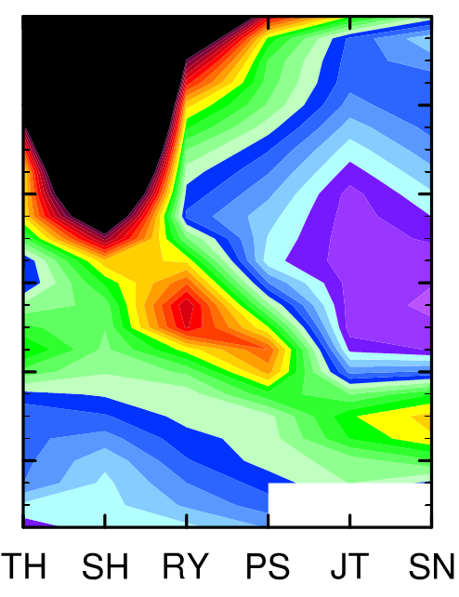

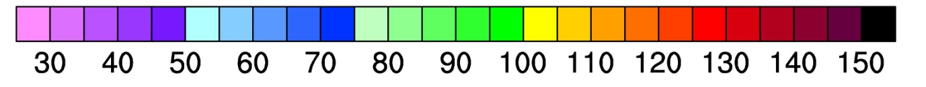
Simulating deep stratospheric intrusions:
role of model resolution (May 28, 2010 example)
Sondes
AM3 (~0.5ºx0.5º)
AM3 (~2ºx2º)
Altitude (km)
Sonde sites, North → South
O₃ [ppbv]
0.5º model better captures vertical structure
2º model reproduces the large-scale view
→ Establishing its suitability for exploring interannual variability
21
Lin MY et al (JGR, 2012b): Springtime high surface ozone events over the WUS …

Slide 22
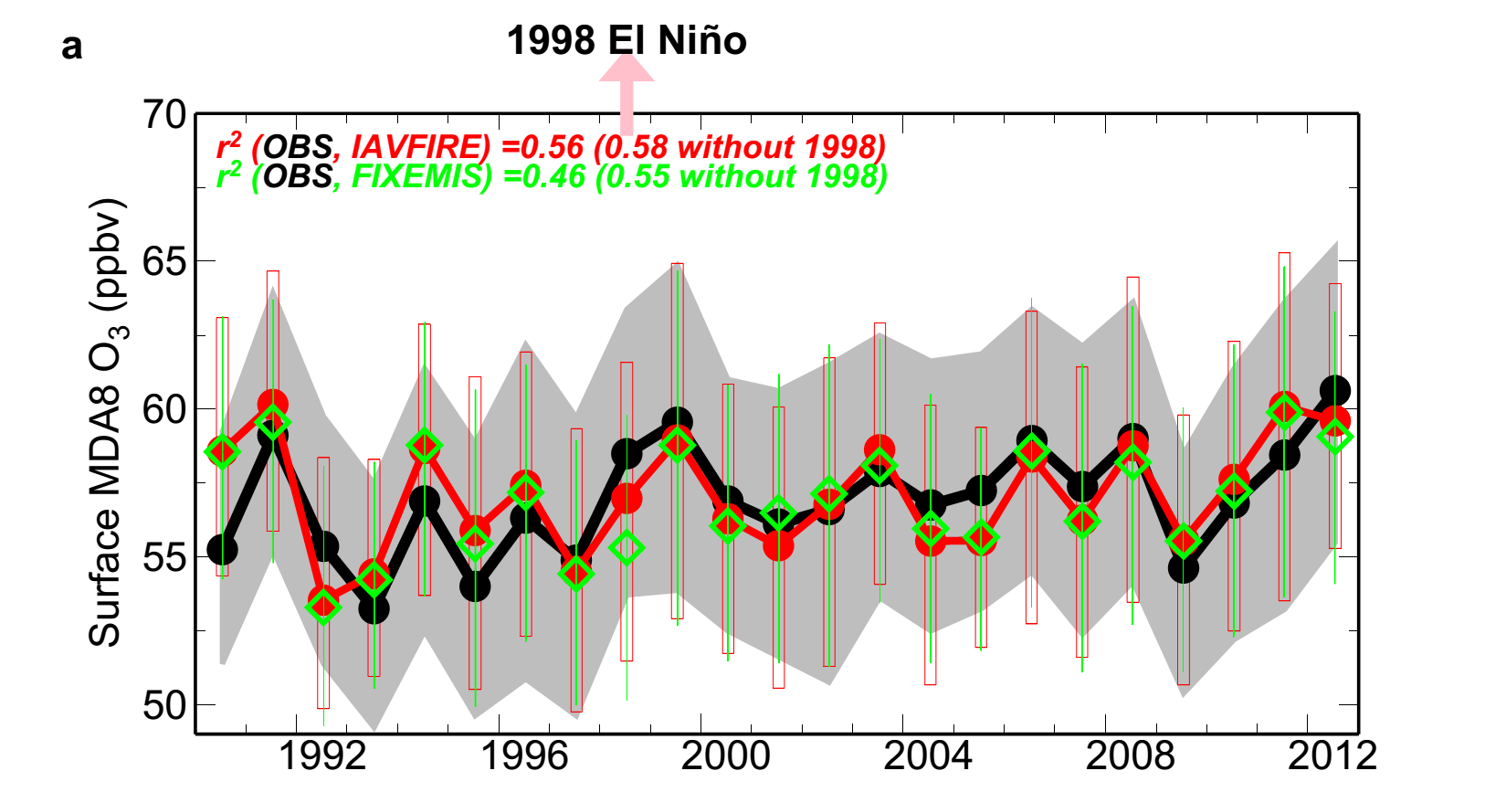
Minor influence from wildfire emissions on inter-annual variability of springtime surface ozone over WUS
Meiyun Lin et al (Nature Communications, 2015)
22
Notes:
Maps + PDF

Slide 23
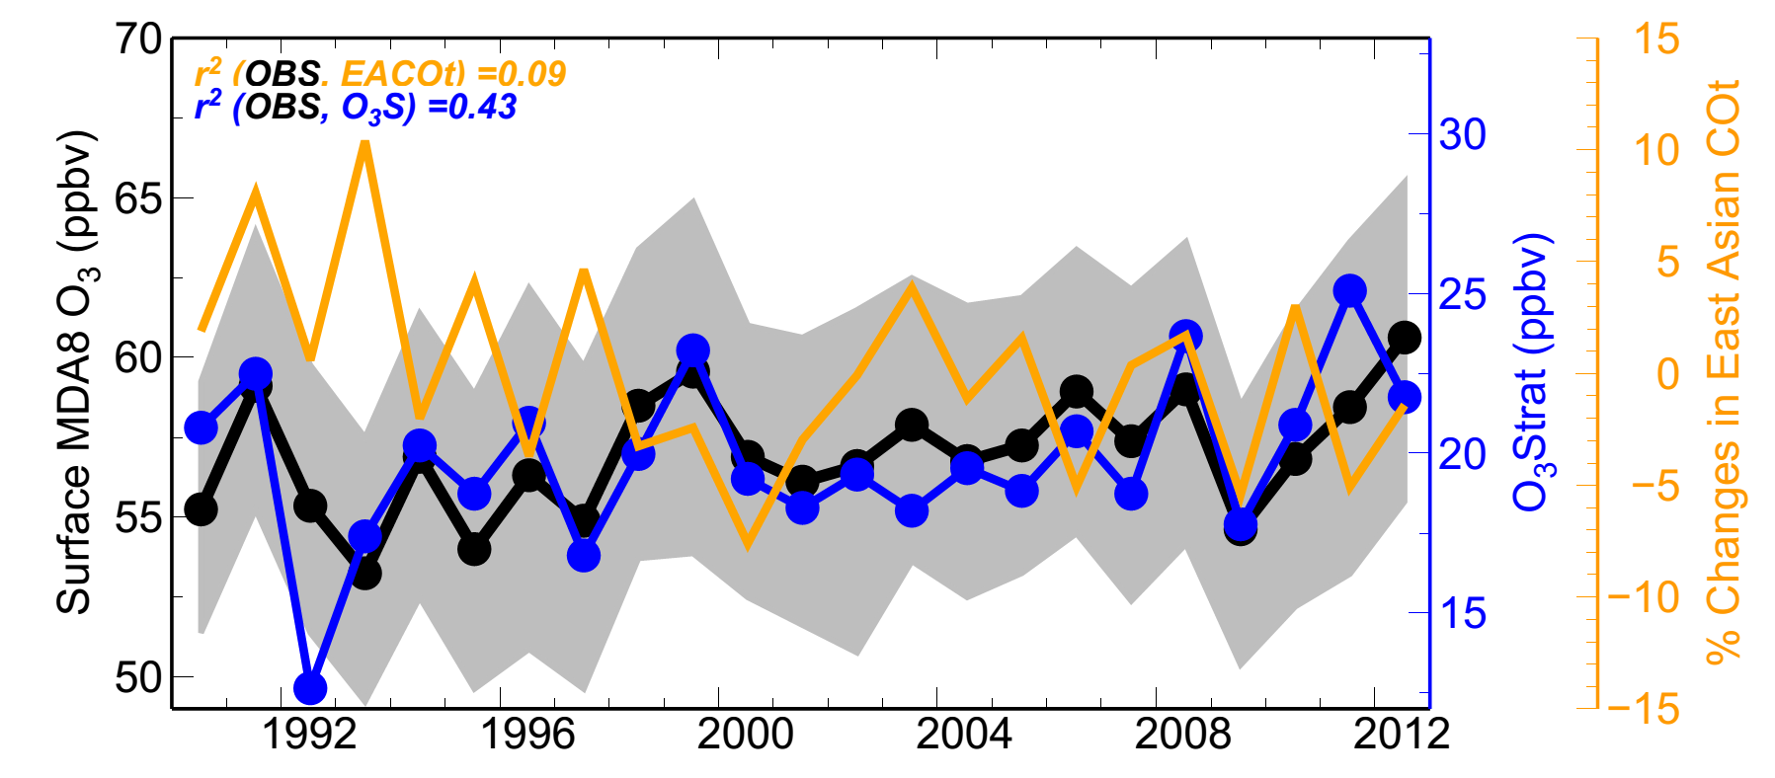
Asian pollution contributes less to WUS surface ozone
inter-annual variability than the stratospheric influence
r² (OBS, EACOt ) = 0.09
r² (OBS, O₃Strat) = 0.43
Apr-May
Stratospheric Contribution (ppb)
1990
Airflow from Eurasia towards the WUS in spring has weakened in the 2000s
Consistent with declines in Radon-222 and O₃ observed at Mauna Loa, Hawaii (3.4 km altitude) during spring
Too small to be discernable from surface O₃ observations over WUS
Lin MY et al (2014)
23

