Slide 1


Preindustrial to Present-day Changes in OH and Methane lifetime – Preliminary Results
ACCMIP 2nd Meeting, Pasadena, CA, Jan 30, 2012
Vaishali Naik
Apostolos Voulgarakis (GISS)
and the ACCMIP Modeling Team
Acknowledgments: Jasmin John, Larry Horowitz (GFDL), Arlene Fiore (LDEO/Columbia), Michael Prather (UCI)

Slide 2
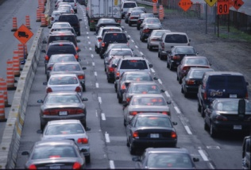
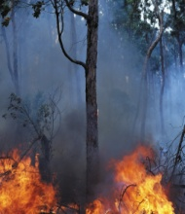
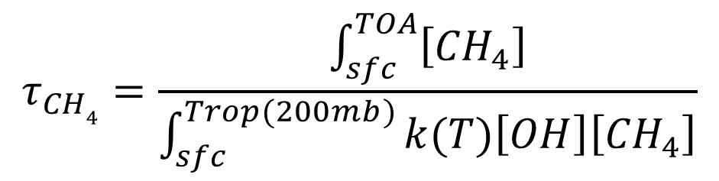
What Determines Hydroxyl radical (OH) and Methane lifetime?
Stratospheric O₃
Stratosphere
Aerosols, Clouds
T
Troposphere
O₃ + hν
O¹D + H₂O
OH
CH₄
k
CH₃+H₂O
+
$$τ_{CH4}=\frac{\int_{sfc}^{TOA}{\left[{CH}_{4}\right]}}{\int_{sfc}^{Trop(200mb)}{k(T)\left[OH\right]\left[{CH}_{4}\right]}}$$
NO_{x}
CO, NMVOCs

Slide 3
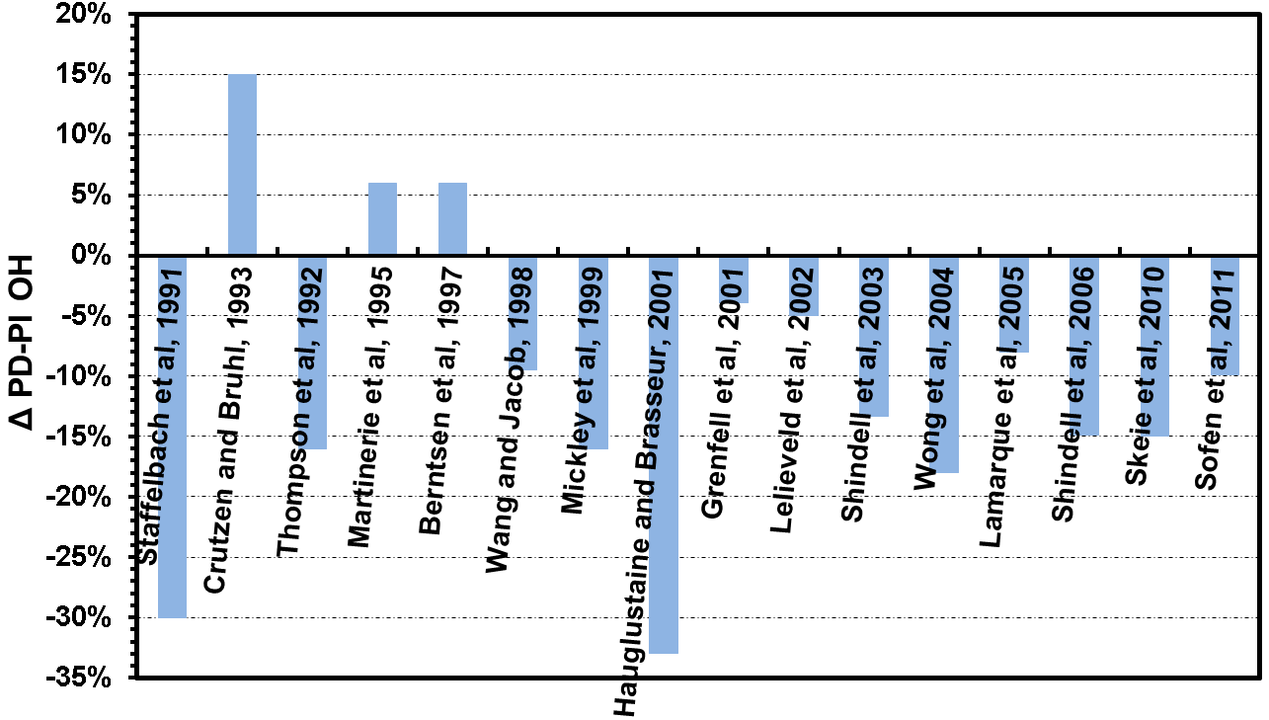
No consensus in the Preindustrial to Present day Changes in Tropospheric Mean OH in Published Literature
OH increases – NO_{x} emissions, H₂O, photolysis
OBS-based
OH decreases – CO, VOC emissions, CH₄
Notes:
Models with different chemical schemes, met fields and emissions
However, models agree that there has been a large scale redistribution of OH from preindustrial to present day.

Slide 4
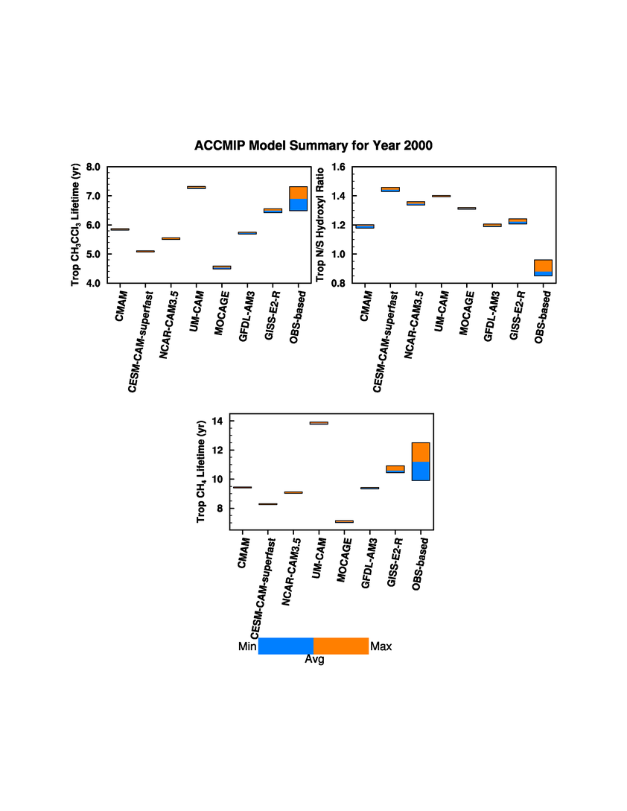
How well do ACCMIP Models Simulate Present day (2000) OH?
[CH₃CCl₃] = 50 pptv & k = 1.64e-12 exp(-1520/T)
Most models overestimate observation-based present day OH
Caveat – Obs-based lifetimes based on 2006-2010 (Prather et al., 2012)
Hemisphere divided at ITCZ
All models overestimate obs-based interhemispheric OH gradient
Notes:
IPCC 2001 tMCF = 5.7
Montzka et al 2001 = 6.3
Prather et al., 2012 = 6.9+-0.414
Remind that obs-based NH/SH coming from Montzka, Krol, Prinn work

Slide 5
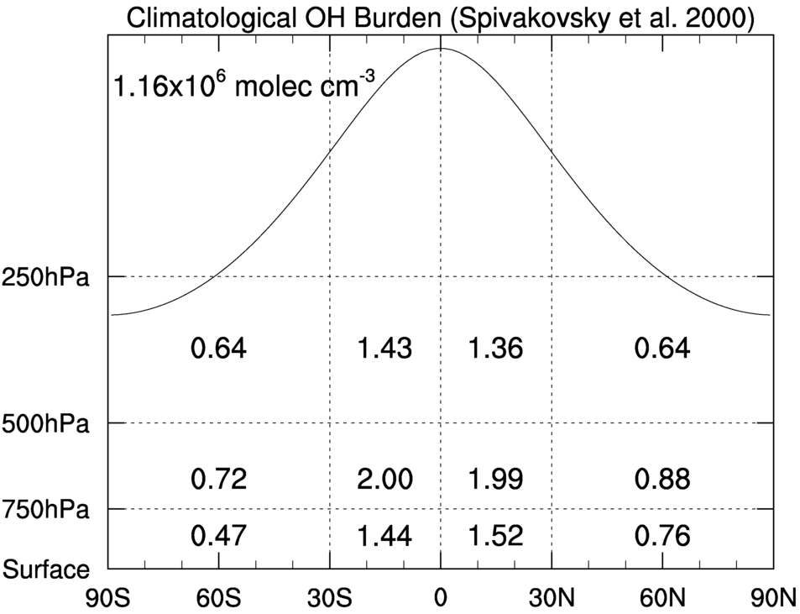
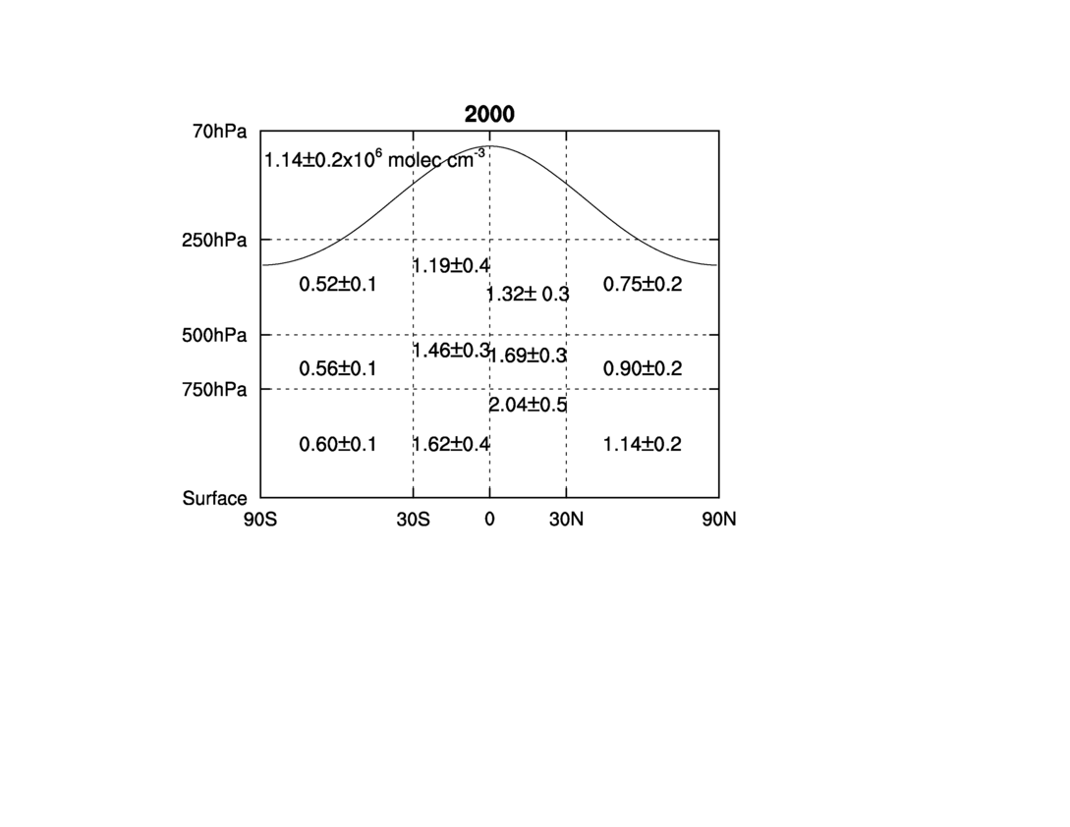
Multi-model Mean OH vs. Climatological OH
Global mean OH agrees well
ACCMIP 2000
Large differences in horizontal and vertical gradients!
Notes:
Vertical and horizontal gradients do not match
in slide 5 there's a clearly large gradient pretty much all through the tropsphere in the middle 2 boxes in ACCMIP models, but not in Spivakovsky -that actually reverses in upper trop

Slide 6
How have OH and its driving factors changed from Preindustrial to Present-day?

Slide 7
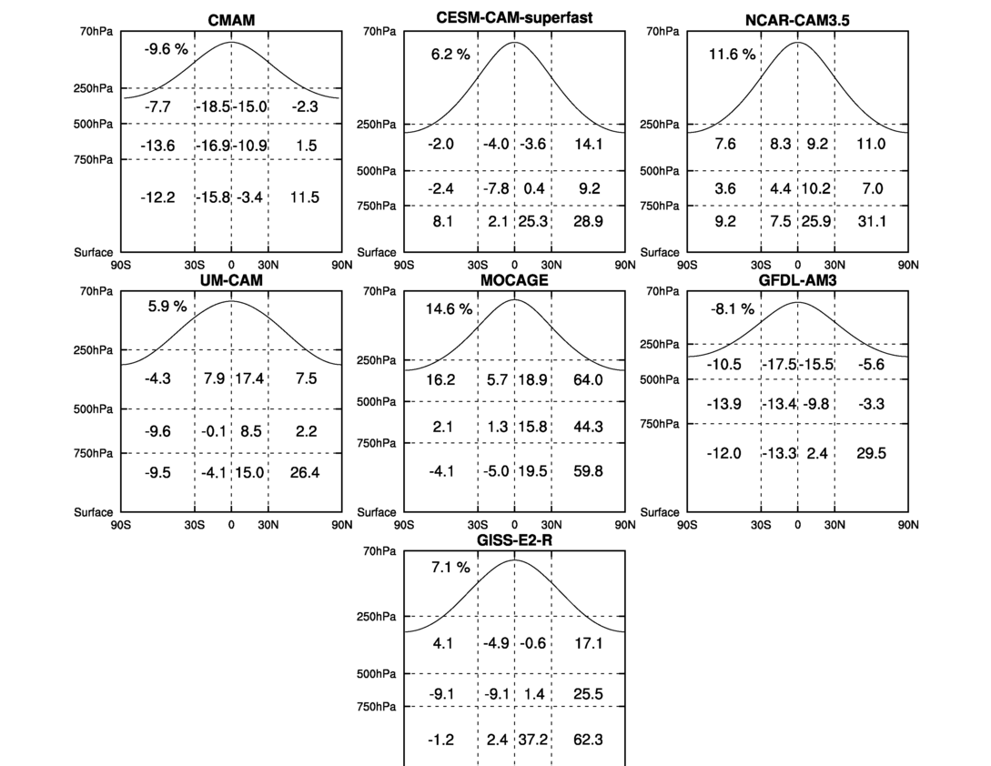
PD-PI % change in regional airmass-weighted OH
All models simulate PD-PI increases in NH lower troposphere – NO_{x} emissions outweighing CO/CH₄
Most models simulate PD-PI decreases in SH troposphere – CH₄

Slide 8
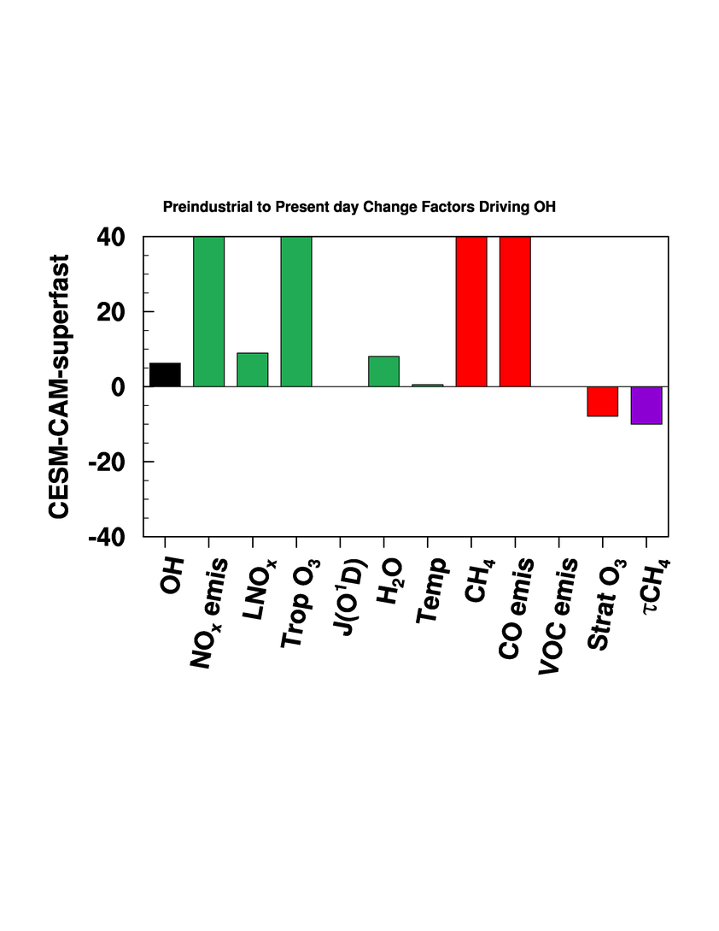
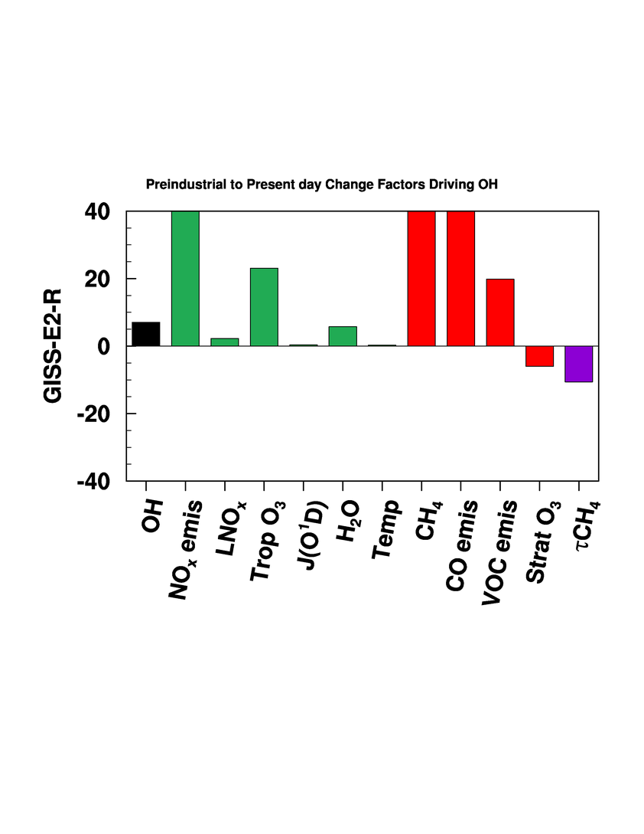
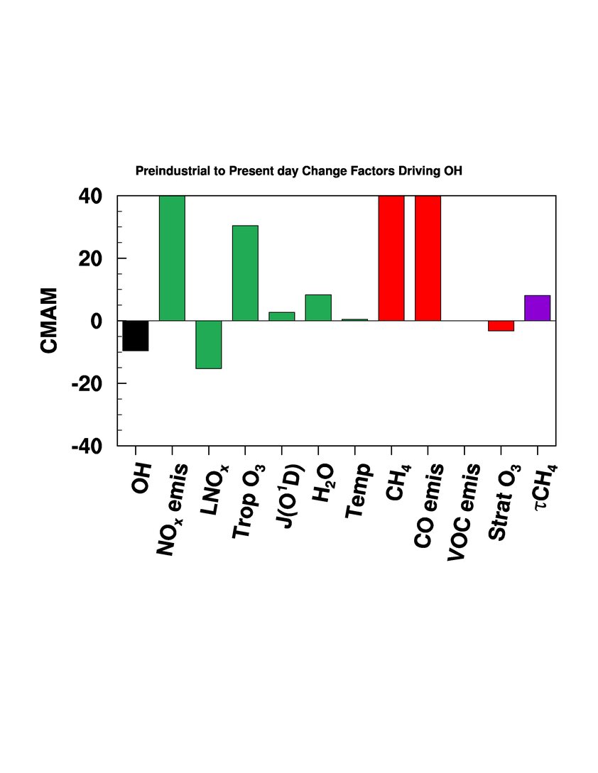
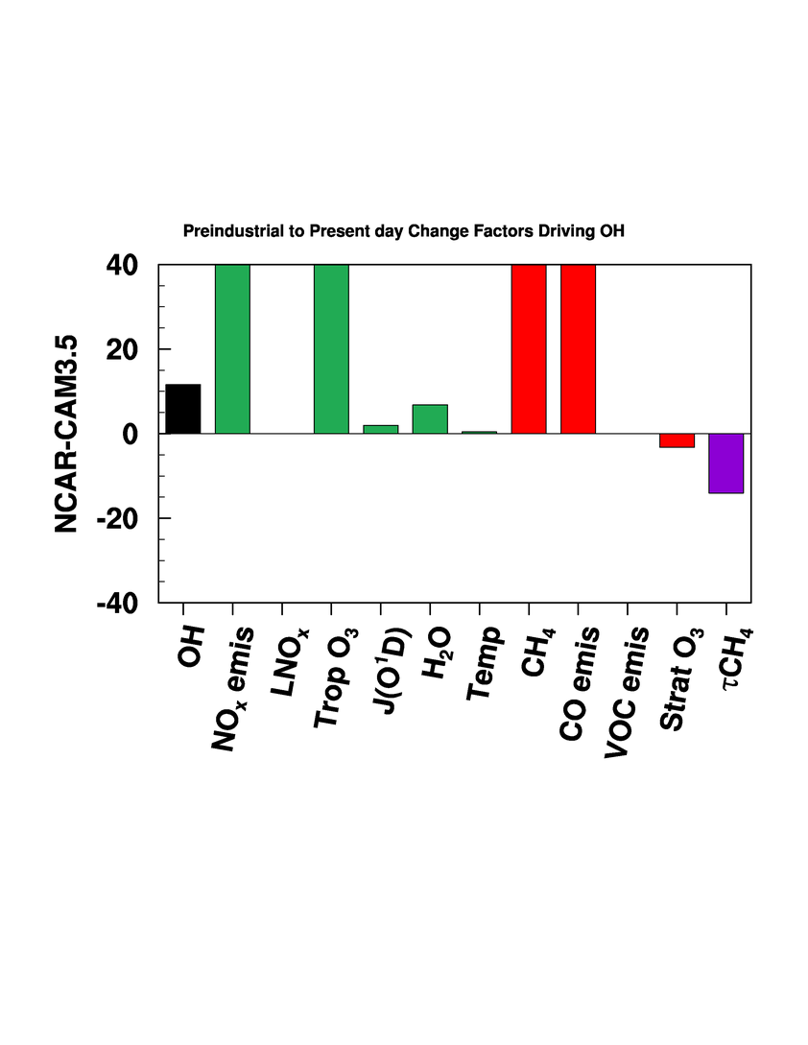
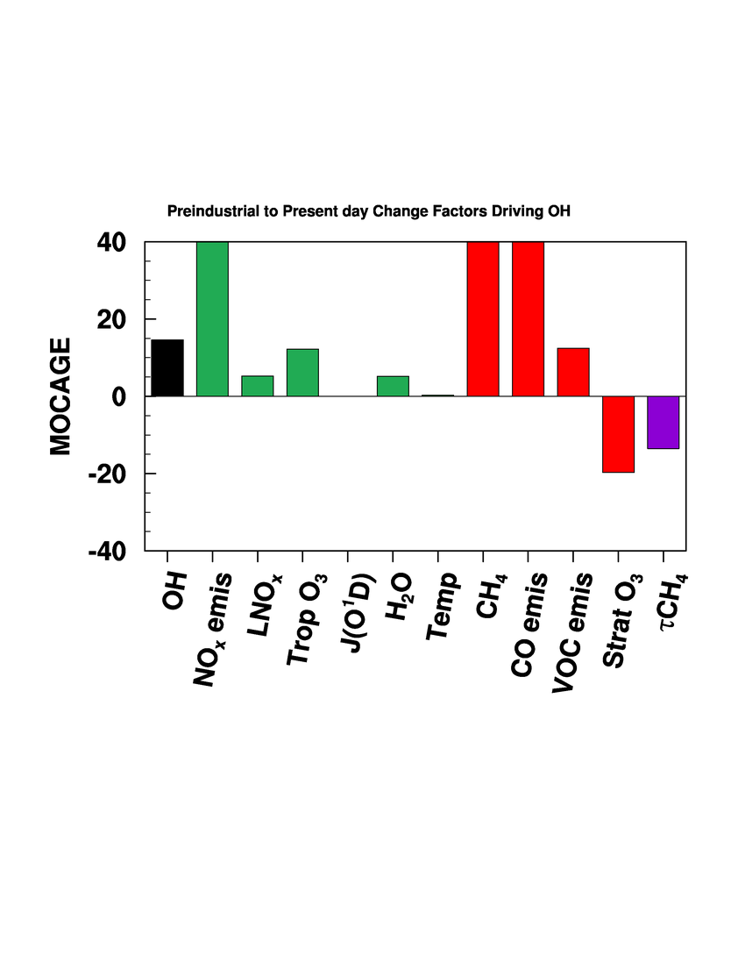
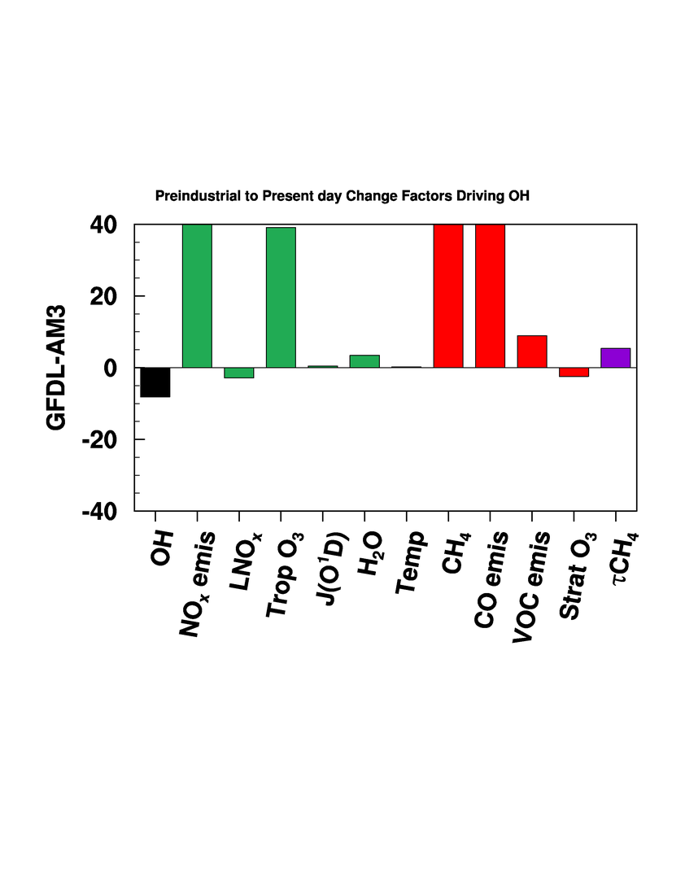
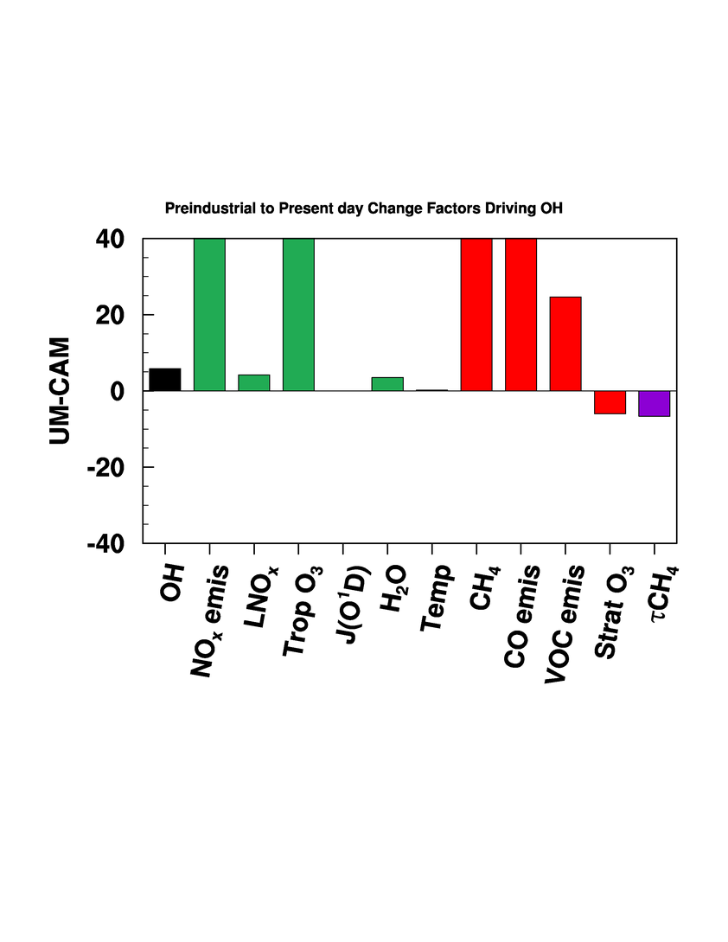
PD-PI % change in factors driving OH change – surface to 200 mb
409
124
121
206
119
177
177
122
82
CESM-CAM-superfast
GISS-E2-R
CMAM
419
122
121
222
120
140
350
117
119
NCAR-CAM3.5
MOCAGE
GFDL-AM3
183
121
139
+ ΔOH_{(PD-PI)}%: NO_{x}/H₂O/J(O¹D) increases outweigh CO/CH₄/VOC increases
UM-CAM
- ΔOH_{(PD-PI)}%: Are small reductions in LNO_{x} having a big impact?

Slide 9
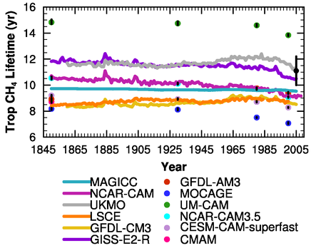
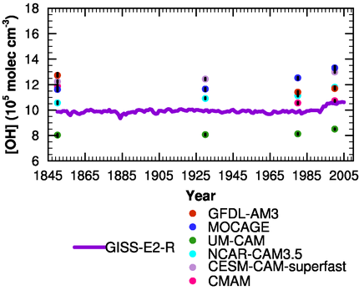
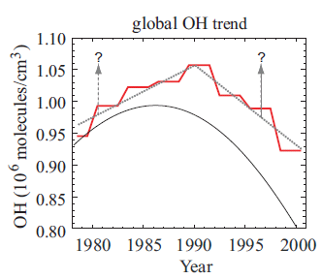
Historical Evolution of Global Mean CH₄ Lifetime and Tropospheric OH
OBS-based
Models simulate increases in OH from 1980 to 2000, disagreeing with observational estimates (Prinn et al., 2001; Krol and Lelieveld 2003; Lelieveld et al., 2004; Bousquet et al., 2005)
Models simulate different trends over the historical period, but agree in late 20th century
Lelieveld et al. [2004]

Slide 10
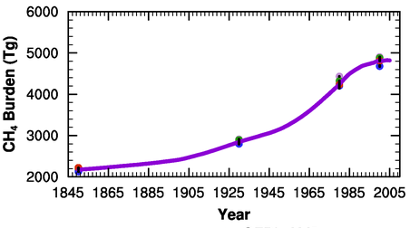
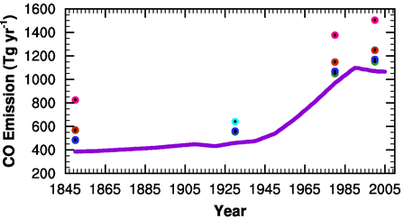
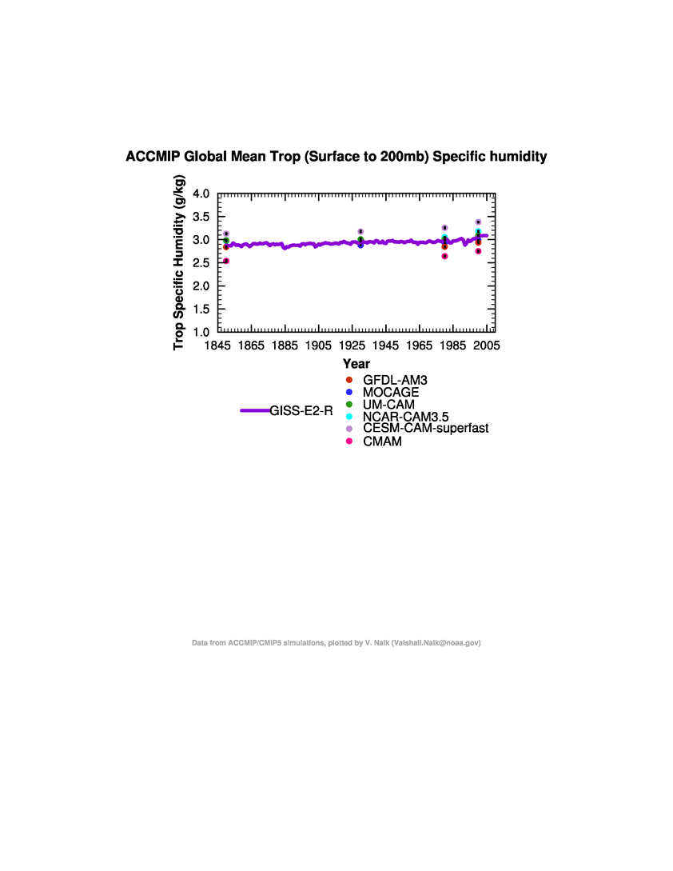
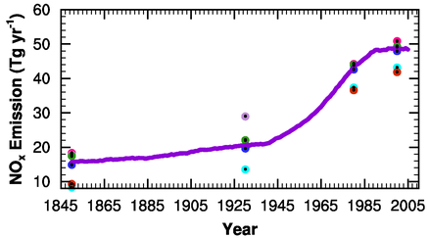
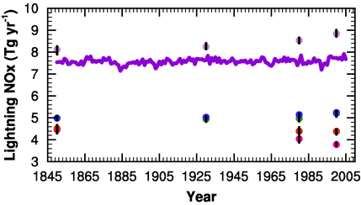
Historical Evolution of CH₄ Burden and CO/NO_{x}/LNO_{x} Emissions
Growth from PI to PD, rapid from mid-20th century, slower in the last 2 decades
Models simulate different trends

Slide 11
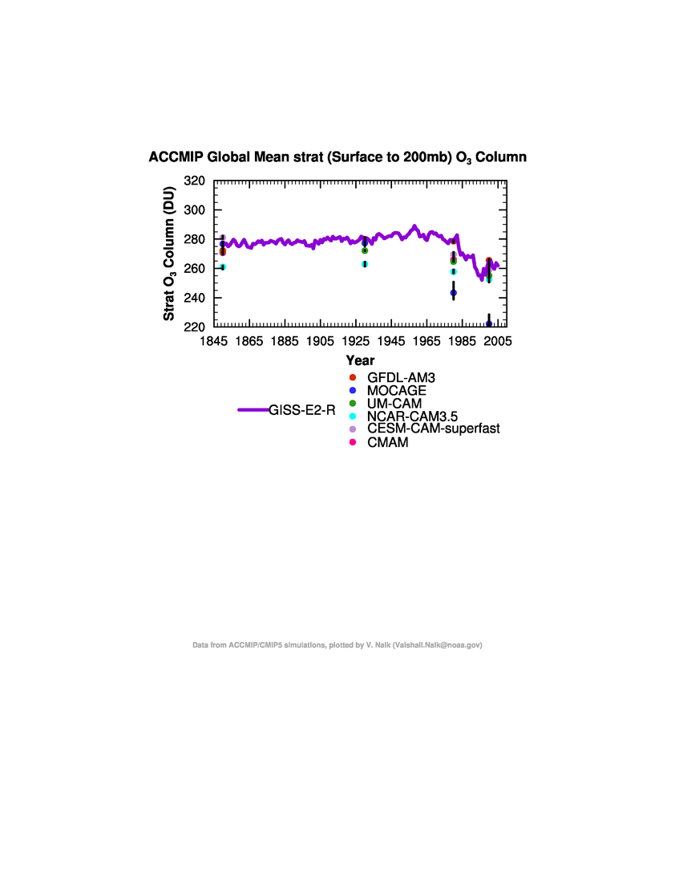
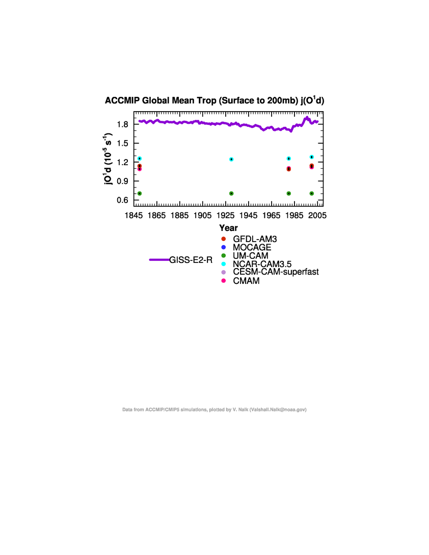
Historical Evolution of Stratospheric O₃ and Tropospheric O₃ Photolysis Rate
Models simulate 1980s/1990s Stratospheric O₃ loss
Increased O₃ photolysis rate
possible driver of 1980 to 2000 changes in OH/CH₄ lifetime

Slide 12
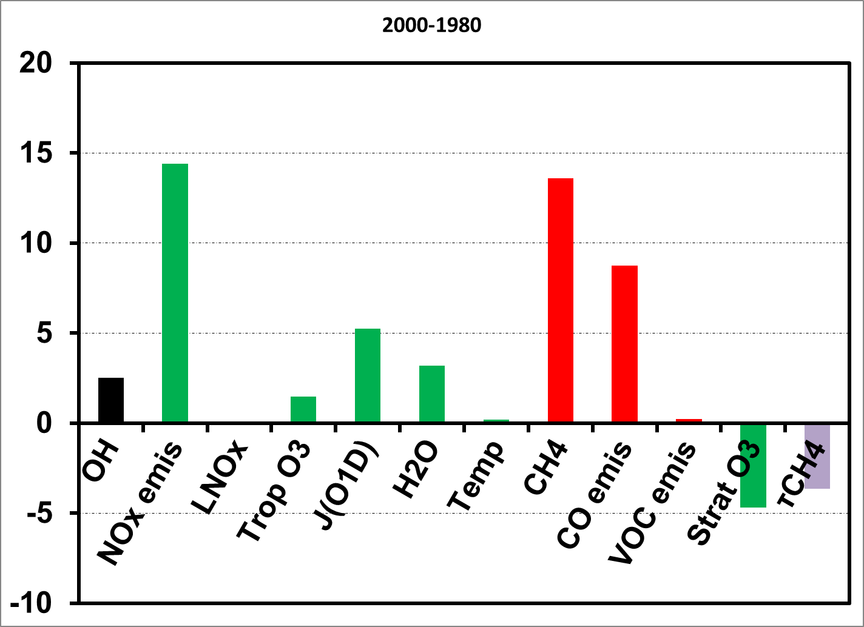
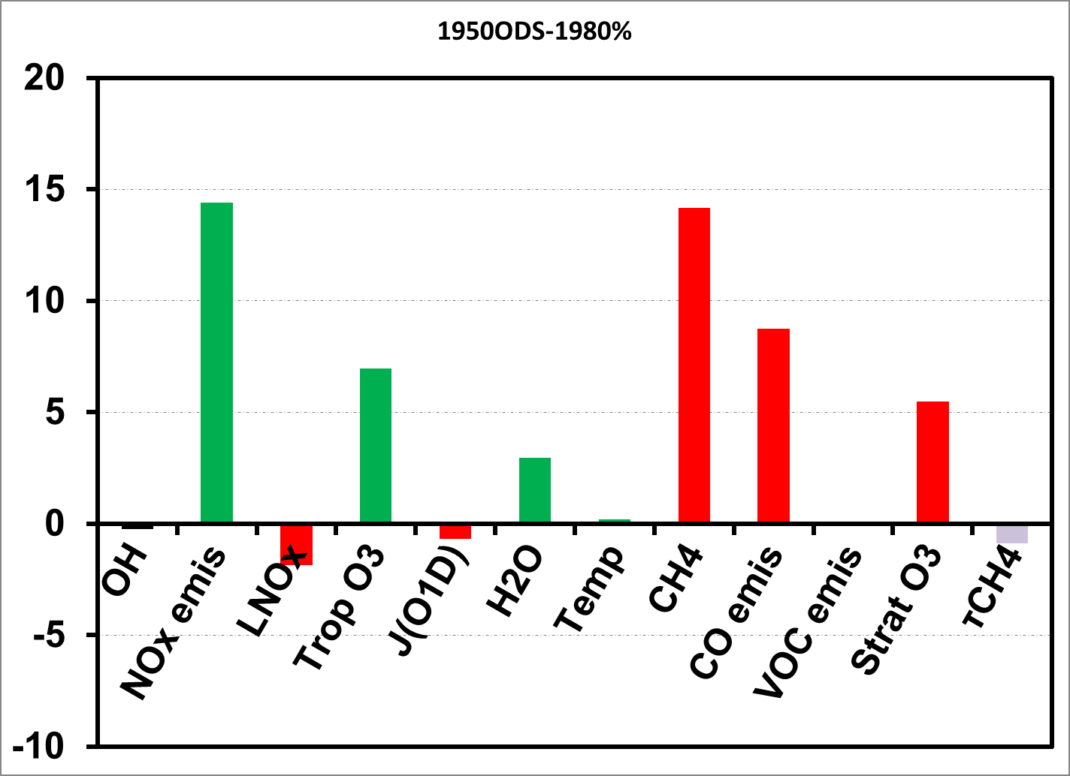
What is the contribution of Ozone Depleting Substances (ODS) to 1980 to 2000 changes in OH and CH₄ lifetime in the GFDL-AM3?
2000 – 1980 %
1950ODS – 1980 %
ΔNO_{x}=+14%, ΔCO=+9%, ΔCH₄=+13.5%, ΔTropO₃=+1.5%, ΔH₂O=+3.2%, ΔLNO_{x}=-0.1% ΔStratO₃ = -5% ΔJ(O¹D) = +5%, ΔOH = +2.5%
ΔNO_{x}=+14%, ΔCO=+9%, ΔCH₄=+14%, ΔTropO₃=+7%, ΔH₂O=+3%, ΔLNO_{x} = -2%,
ΔStratO₃ = +5%, ΔJ(O¹D) = -1% ΔOH = <-1%

Slide 13
Preliminary Conclusions
How do the models compare with present-day observational estimates of OH and CH₄ lifetime ?
  Simulate diverse present-day OH concentrations/CH₄ lifetimes, with a tendency to overestimate/underestimate observational estimates
  Simulate higher OH in NH vs. SH in contrast to observations
Have we reached a consensus on the sign of PD-PI change in OH?
  No, however the picture is more complicated now, as most ACCMIP models (except 2) simulate positive changes disagreeing with the negative change in the published literature in the last 2 decades.
Which factor(s) can explain the model to model differences in PD-PI OH?
  Differences in the balance between NO_{x} and CO/VOC/CH₄ plus sensitivity to LNO_{x}
Do models capture the observed decreasing trend in OH from 1980 to 2000 ?
  No, but agree with past modeling studies (Dentener et al., 2003; Dalsoren and Lelieveld 2006)

Slide 14
Next Steps…
Further examine the PI to PD changes in the drivers of OH/CH₄ lifetime, focusing on the:
  the balance between NO_{x} and CO/NMVOCs/CH₄ over different regions, for e.g., oceans vs. continents, tropics vs. mid-latitudes.
  sensitivity to LNO_{x} emissions.
  role of photolysis (stratospheric O₃, clouds, albedo).
Additional sensitivity experiments with a subset of models to isolate the impact of individual drivers (e.g stratospheric ozone hole, LNO_{x} ).
Include data from more models.
Write manuscript.

