Slide 1


Preindustrial to Present-day Changes in Tropospheric Hydroxyl Radical (OH) and Methane Lifetime from the ACCMIP
Vaishali Naik
Apostolos Voulgarakis, Arlene Fiore, Larry Horowitz, and Coauthors, including the ACCMIP Modeling Team
Acknowledgments: Jasmin John, Jingqiu Mao, Chip Levy,
Modeling Services (Kyle Olivo, Aparna Radhakrishnan), GFDL Computing Resources and British Atmospheric Data Center
GFDL Wednesday Seminar, July 17, 2013

Slide 2
Outline
Introduction to Hydroxyl Radical (OH)
  Why important? What determines it abundance? What do we know about historical changes?
The Atmospheric Chemistry Climate Model Intercomparison Project (ACCMIP)
  Evaluate present day lifetimes and OH
  Changes in present day OH relative to preindustrial and 1980
  Impact of climate change on Methane Lifetime
  Role of Methane and anthropogenic emissions in driving OH changes
  Future projections of Methane Lifetime
Concluding Remarks

Slide 3

OH is the primary oxidant in the atmosphere
Accurate measurements and modeling of OH are key to
  understanding photochemical oxidation in the troposphere
  better quantify the lifetimes of most atmospheric pollutants, including methane, HCFCs and HFCs

Slide 4
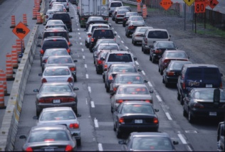
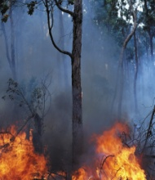


Processes that Determine Tropospheric OH
Stratospheric O₃
Stratosphere
Troposphere
OH
CH₄, CO,
NMVOCs
HO₂
NO
NO₂
+ hν
O₃ + hν
O¹D + H₂O
RO₂
T
T
O₂
O+NO
NO_{x}, CH₄, CO, NMVOCs,
Anthropogenic
Natural

Slide 5
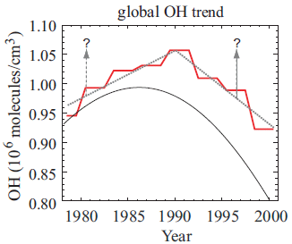
Global Mean Tropospheric OH:
Metric for atmospheric oxidation capacity
Inferred from measurements of trace gases whose emissions are well known and whose primary sink is OH
  methyl chloroform (CH₃CCl₃) [first measured by Singh et al., 1977; Lovelock et al., 1977], HCFC-22, C₂H₆, C₂Cl₄, CH₂Cl₂, ¹⁴CO
  d[CH₃CCl₃]/dt = Emission – k(T)[CH₃CCl₃][OH]
  Long term OH trends difficult to estimate as very accurate CH₃CCl₃ data are needed.
Krol and Lelieveld [2003]
Prinn et al. [2001]
Figure from Lelieveld et al. [2004]

Slide 6
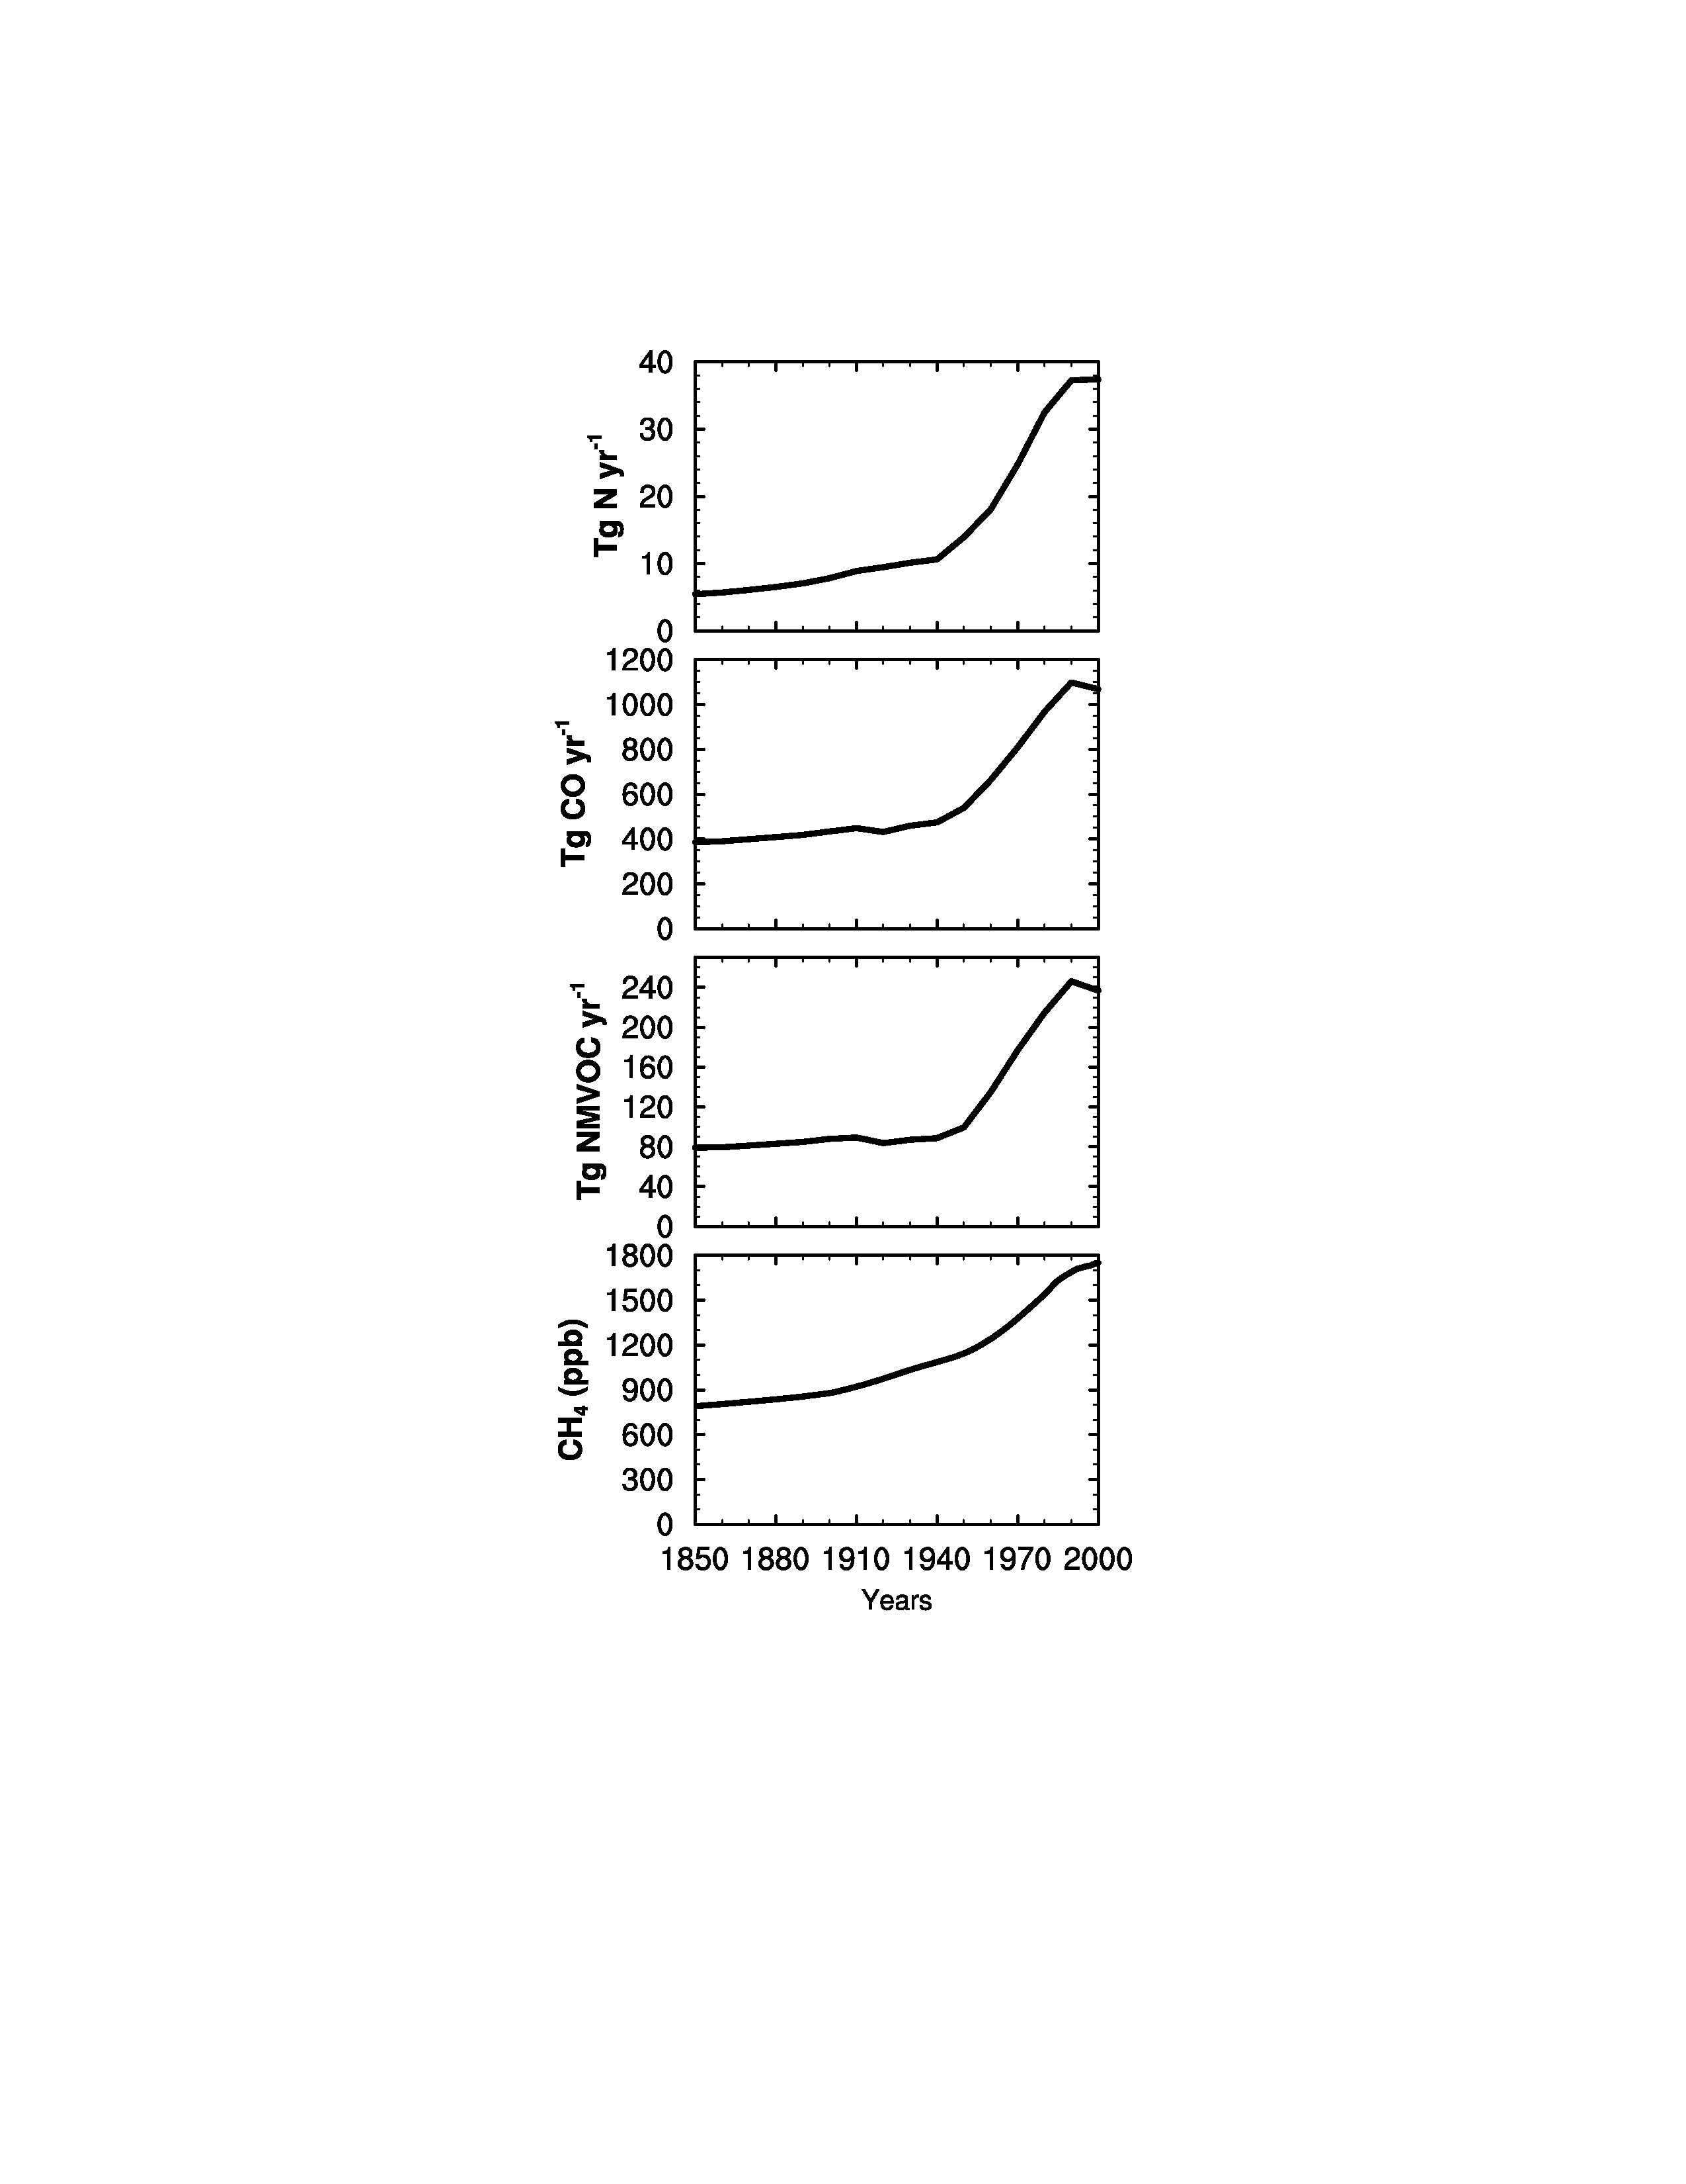
How has Global OH changed with Industrialization?
Global Anthropogenic +
Biomass Burning Emissions
OH
OH
Meinshausen et al. [2011]
OH
H₂O
Clouds/Aerosols
?
OH
OH
CFCs/UV
NET CHANGE??
Lamarque et al. [2010]

Slide 7
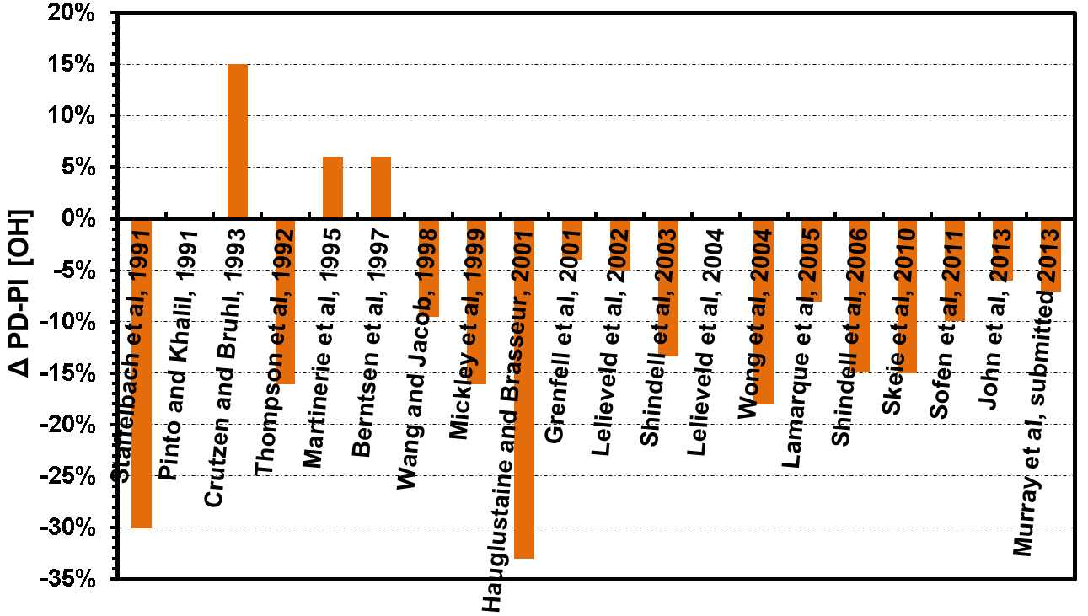
Preindustrial (1850) to Present (2000) Global OH changes:
No consensus in Published Literature
Increasing NO_{x}, H₂O, O₃ photolysis dominate
OBS-based
Increasing CO, CH₄, NMVOCs dominate

Slide 8
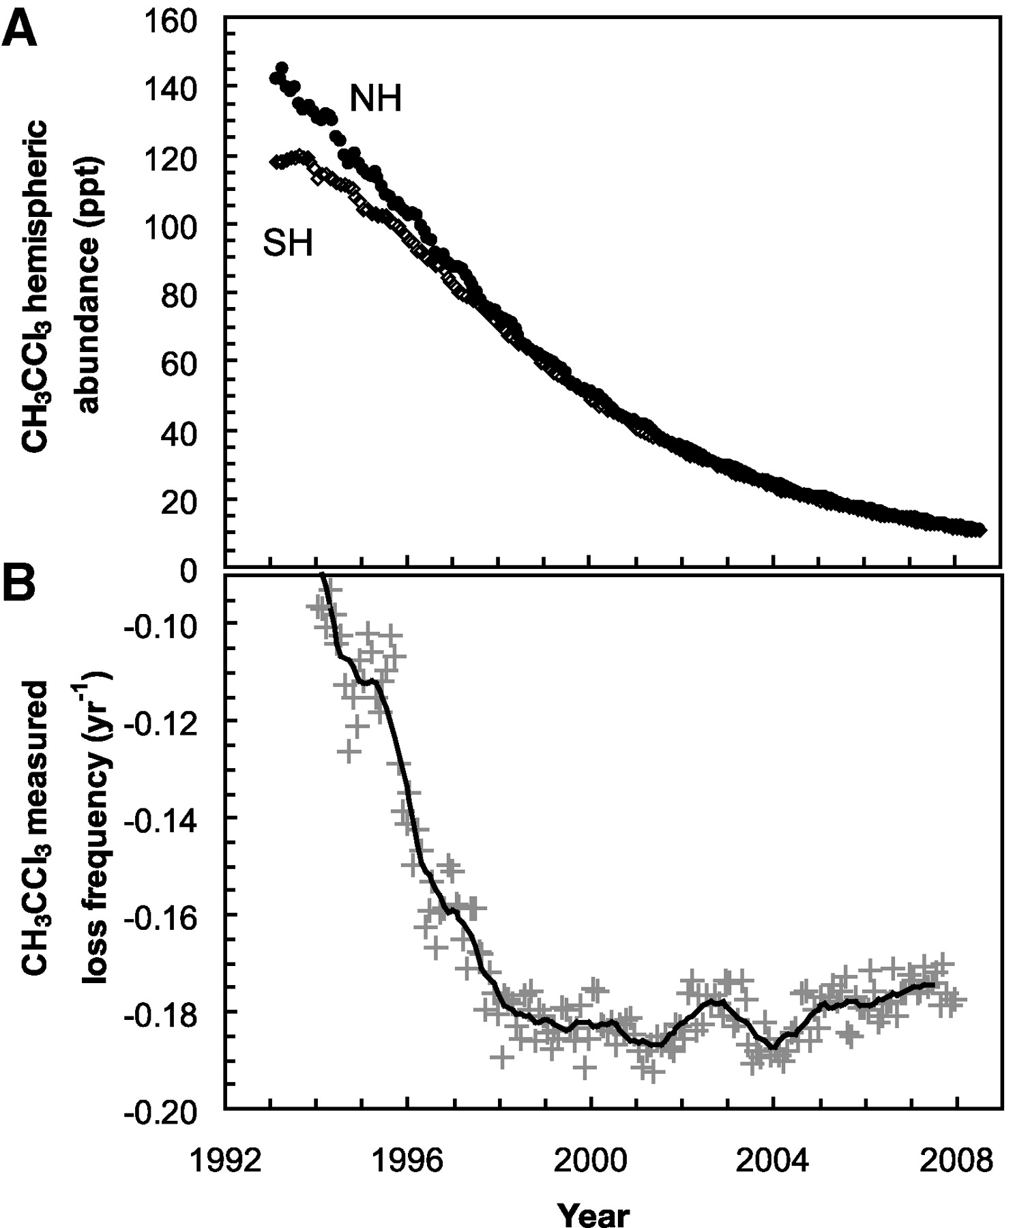
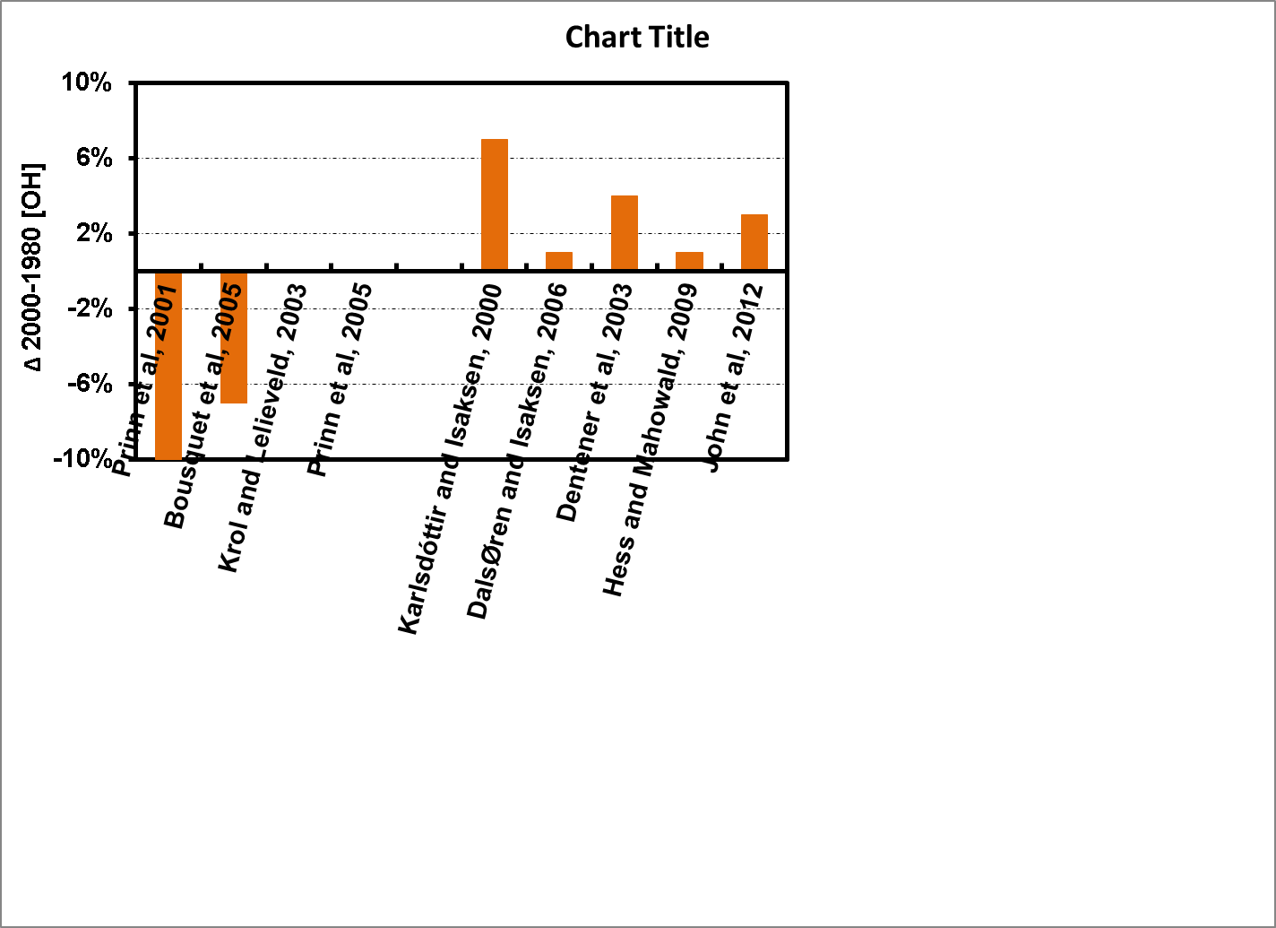
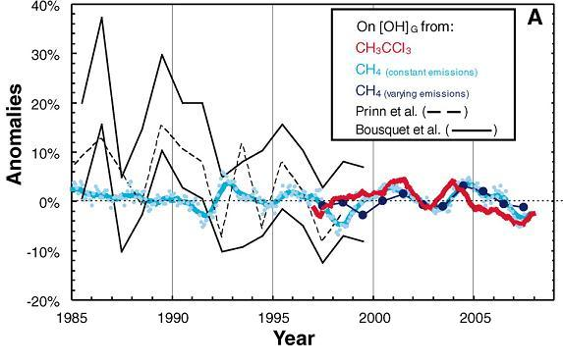
1980 to 2000 Global OH changes:
Model and Obs-based do not agree on the sign of change
OBS
Model
Diminished uncertainties in CH₃CCl₃ data after 1997 provide better constraints on OH trends and variability
Montzka et al. [2011]

Slide 9
Overarching Goals
Evaluate present day global OH in current generation of chemistry-climate models (CCMs)
Explore changes in OH and CH₄ lifetime
  2000 relative to 1850
  2000 relative to 1980
Investigate the impact of individual factors (climate and emissions) in driving present day to preindustrial changes in OH
Naik et al. ACP [2013]

Slide 10


Atmospheric Chemistry & Climate Model Intercomparison Project (ACCMIP)
“ACCMIP consists of numerical experiments designed to provide insight into atmospheric chemistry driven changes in CMIP5 simulations…”
Lamarque et al. [2013]
ACCMIP Models
  16 global models, of which 3 are chemistry-transport models
  CCMs mostly driven by SST/SIC from parent coupled models
  Anthropogenic emissions from Lamarque et al. [2010], diverse natural emissions
  WMGGs mostly from Meinshausen et al. [2011], CH₄ concentrations specified at the surface in most models
  Diverse representation of stratospheric O₃ and its influence on photolysis, and tropospheric chemistry mechanisms
Time slice simulations (run for ~4 to 10 years):
  1850, 1980, 2000
  Fixed 2000 emission and 1850 climate
  Fixed 2000 climate with CH₄ conc. and NOx, CO, NMVOCs emissions set to 1850 individually

Slide 11
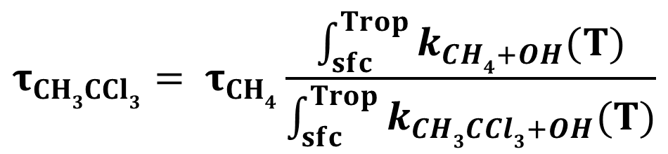
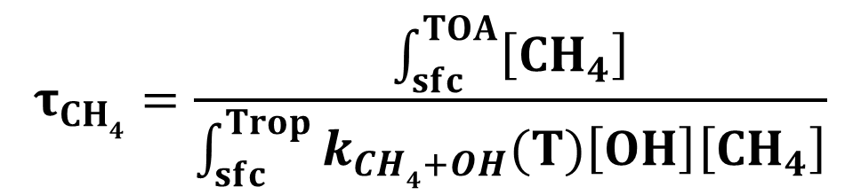
Analysis Approach
Data averaged over the numbers of simulation years for each model for each time slice
Global mean OH weighted by mass of air in each grid cell from surface to 200 mb (troposphere)
CH₄ Lifetime
CH₃CCl₃ Lifetime
$$τ_{CH4}=\frac{\int_{sfc}^{TOA}{\left[{CH}_{4}\right]}}{\int_{sfc}^{Trop}{k_{CH4+OH}(T)\left[OH\right]\left[{CH}_{4}\right]}}$$
Impact of variation in simulated T across models is minimal
$$τ_{CH3CCl3}= τ_{CH4}\frac{\int_{sfc}^{Trop}{k_{CH4+OH}(T)}}{\int_{sfc}^{Trop}{k_{CH3CCl3+OH}(T)}}$$
based on Prather and Spivakovsky [1990]

Slide 12
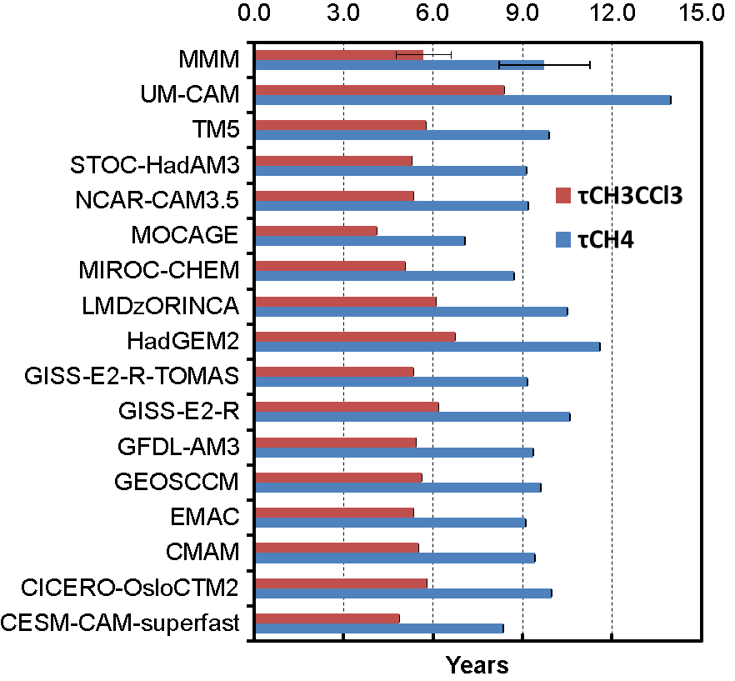






2000 Multi-model Mean (MMM) τ_{CH4} and τ_{CH3CCl3}:
5-10% lower than Obs-based estimates but within the uncertainty range
MMM${ τ}_{CH4}$= 9.7±1.5 years
Prinn et al. [2005] $τ_{CH4}$= ${10.2}_{−0.7}^{+0.9}$
Prather et al. [2012] $τ_{CH4}$= 11.2 ± 1.3
MMM${ τ}_{CH3CCl3}$= 5.7±0.9 years
Prinn et al. [2005] $τ_{CH3CCl3}$= ${6.0}_{−0.4}^{+0.5}$
Prather et al. [2012] $τ_{CH3CCl3}$= 6.3±0.4
MMM [OH] = 11.1±1.6 x 10⁵ molec cm⁻³ is overestimated by 5-10% but is within the range of uncertainties

Slide 13
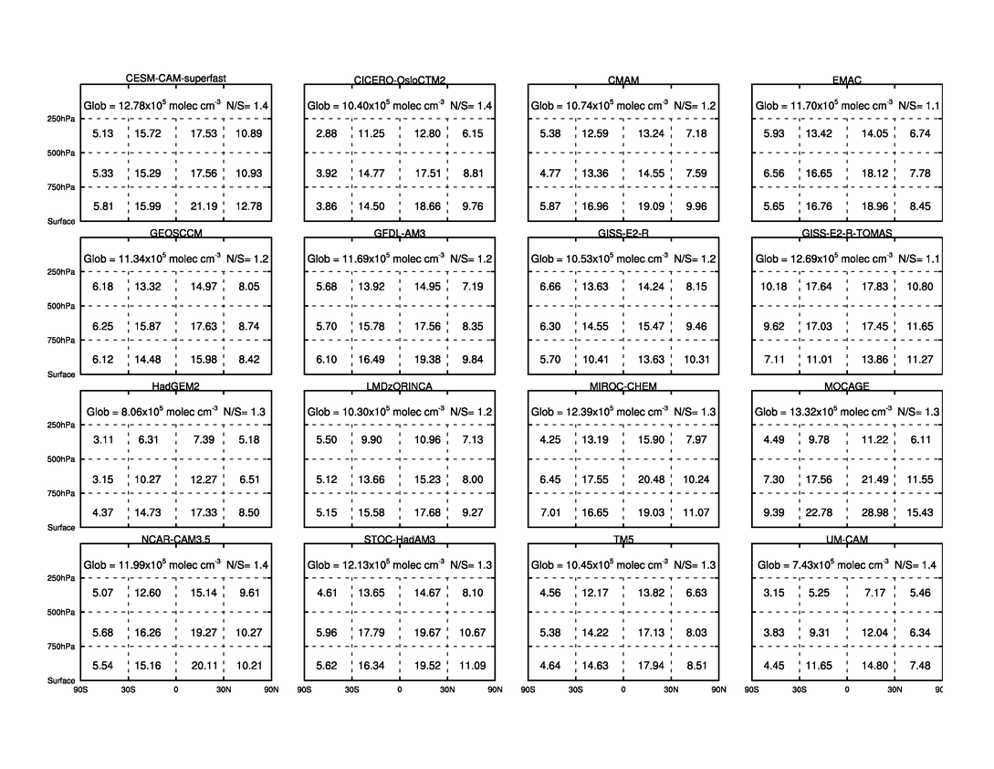
Regional Distribution of Tropospheric OH:
Models capture general characteristics

Slide 14
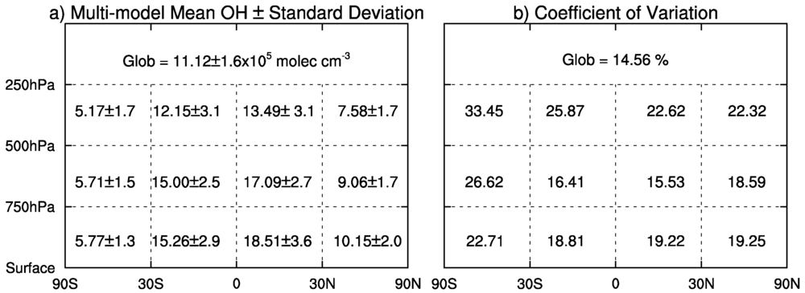
Regional Distribution of Tropospheric OH:
Large Inter-model Variability
Inter-model Diversity
Upper Troposphere > Lower and mid Troposphere
water vapour, clouds
Southern Hemisphere (SH) > Northern Hemisphere (NH)
Stratospheric O₃ and its influence on photolysis

Slide 15
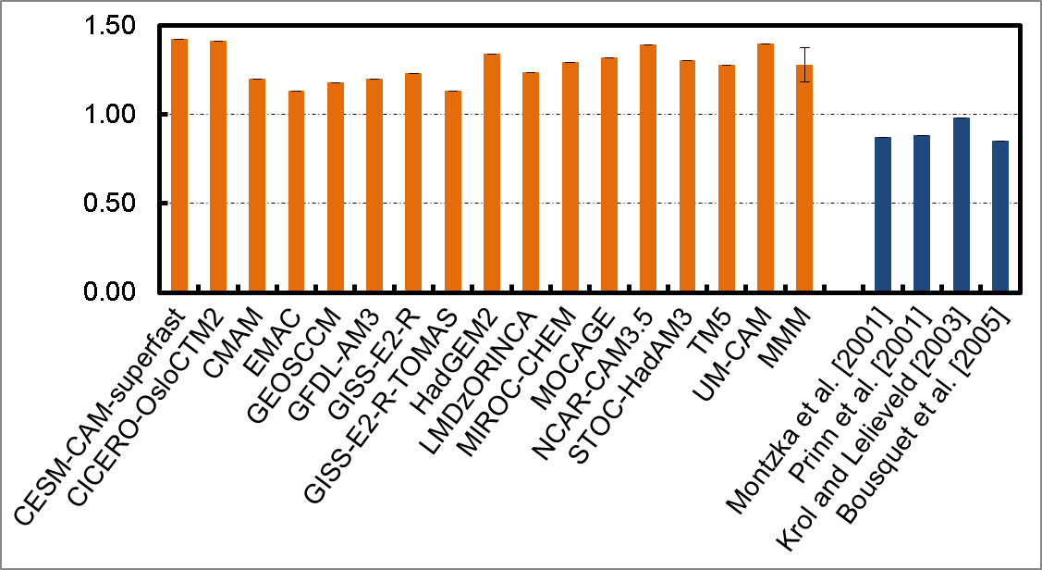
Present Day OH Inter-hemispheric (N/S) ratio:
All models have more OH in NH than SH (N/S > 1)
Obs-based estimates indicate N/S < 1 with 15-30% uncertainties

Slide 16
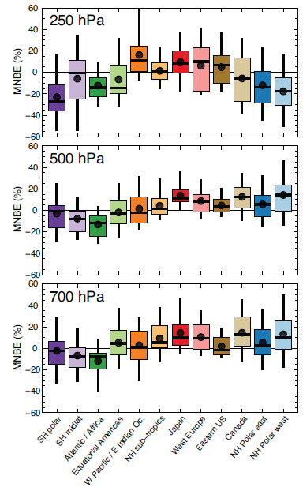
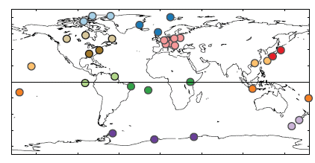
Present day Tropospheric Ozone (OH source):
Models are generally biased high in the NH
Comparison with Ozonesonde measurements (1995-2009)
Young et al. [2013]

Slide 17
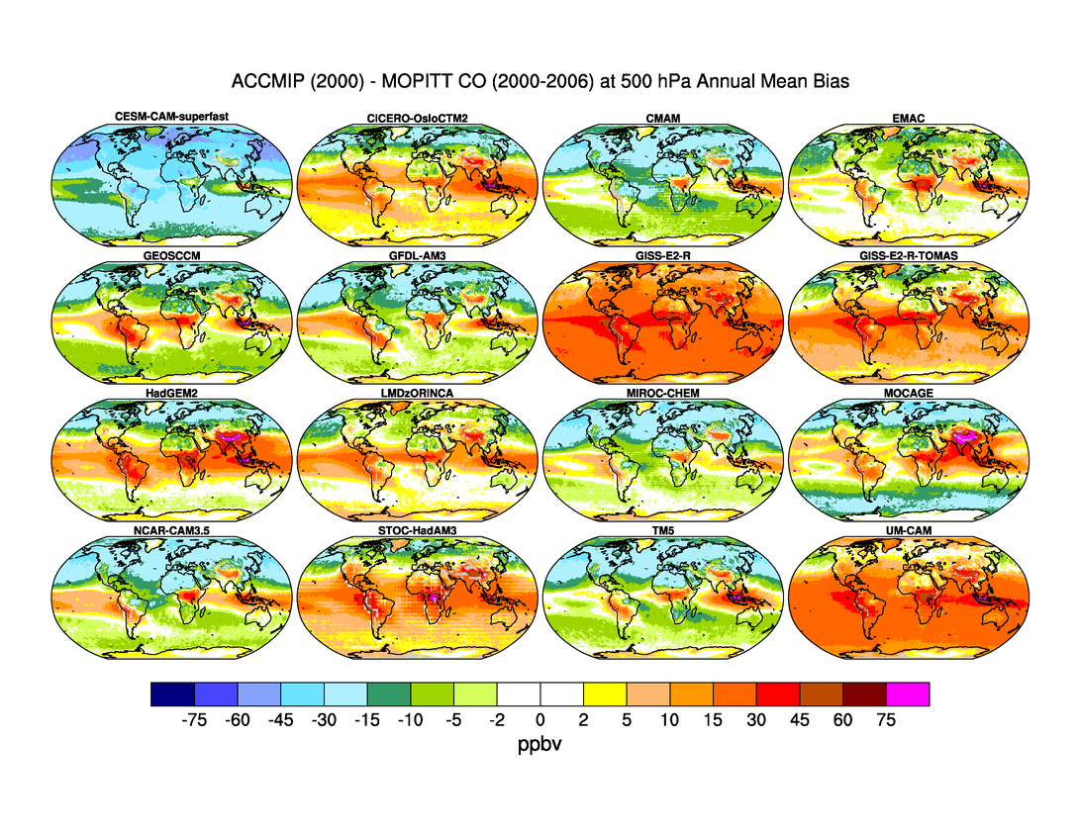
Present day Annual Mean Carbon Monoxide (OH sink):
Models generally biased low in the NH
Model – MOPITT at 500 mb (2000-2006)
ppbv

Slide 18
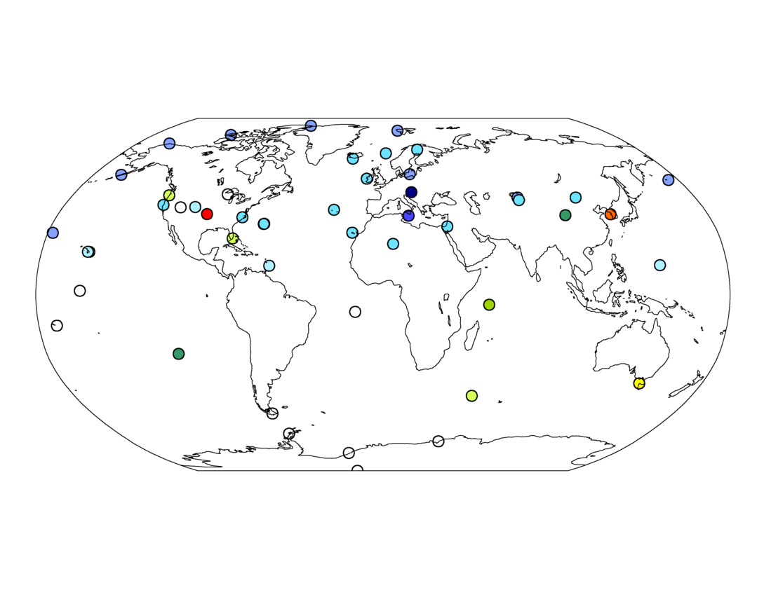
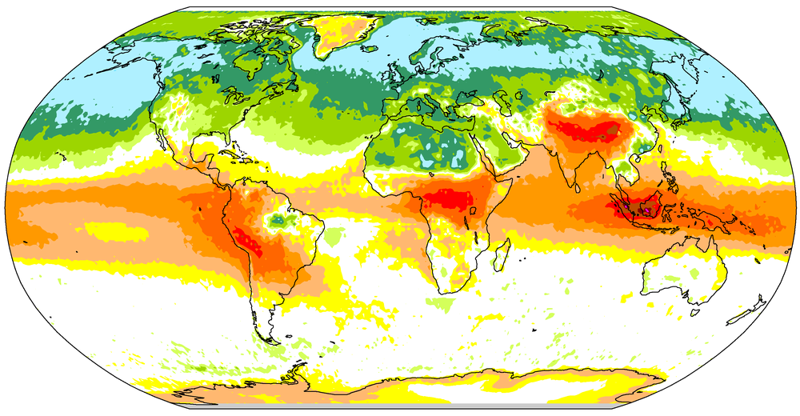
Present day Annual Mean Carbon Monoxide (OH sink):
Models generally biased low in the NH
Σ(Model – NOAA GMD)
Σ(Model – MOPITT) (500 mb)

Slide 19
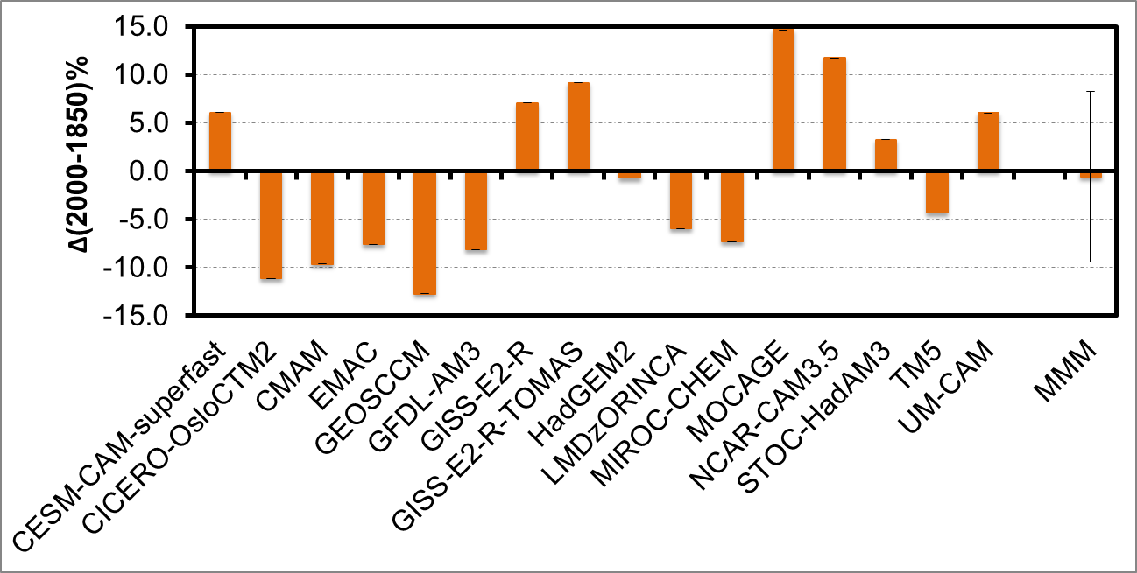
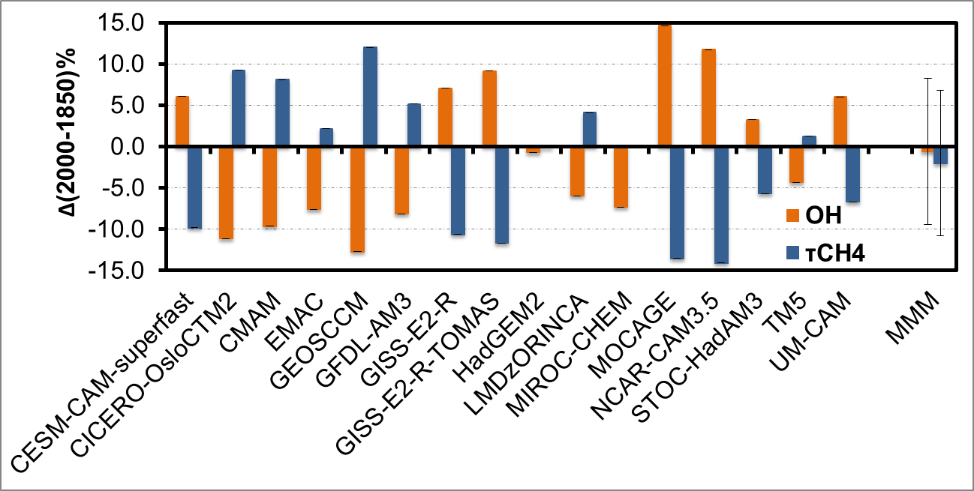
Preindustrial to Present-day OH change:
Large Inter-model diversity (-12.7% to + 14.6%)
Little change in global mean OH over the past 150 years, indicates that it is well-buffered against perturbations [Lelieveld et al. 2004, Montzka et al. 2011]

Slide 20
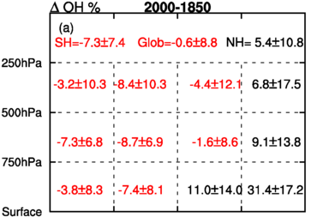
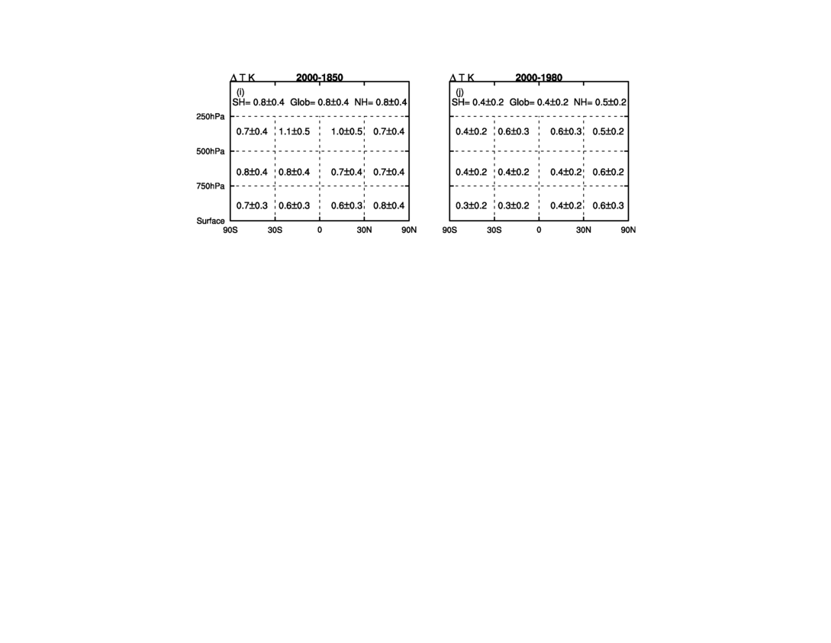
Preindustrial to Present-day Regional OH changes:
Large inter-model diversity in magnitude and sign of change
NO_{x}, O₃, H₂O
>
CO, NMVOCs, CH₄

Slide 21
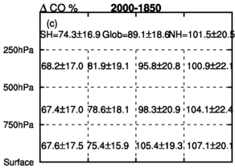
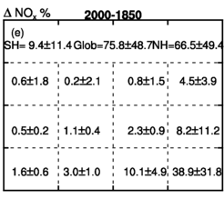
Preindustrial to Present-day Regional CO and NO_{x} changes:
Greater degree of variation in NO_{x} burdens → differences in lightning emissions?

Slide 22
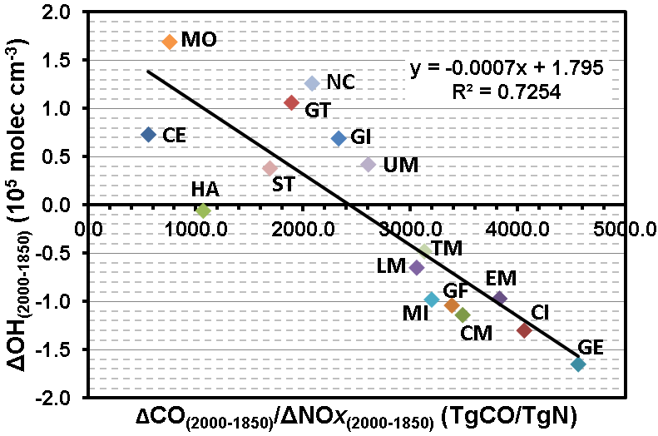
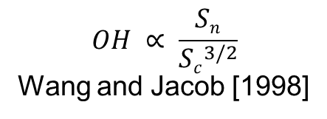
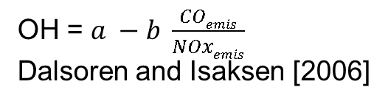
Inter-model diversity in PI to PD Global OH Changes: related to changes in OH sources versus sinks
$$OH ∝ \frac{Sn}{{Sc}^{3/2}}$$
Wang and Jacob [1998]
OH = $a −b \frac{COemis}{NOxemis}$
Dalsoren and Isaksen [2006]
ACCMIP
Δ Sources > Δ Sinks
Δ Sources < Δ Sinks
~ΔSinks
~ΔSources

Slide 23
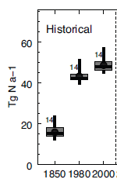
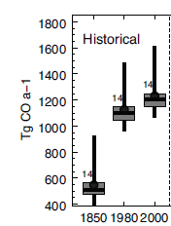
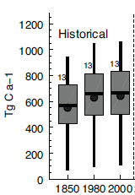
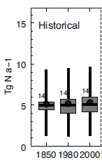
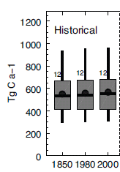
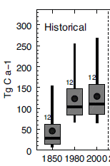
Spread in emissions across models: driven by natural emissions and chemical mechanisms
Total NO_{x}
Total CO
Total NMVOCs
Lightning NO_{x}
Biogenic, oceanic and surrogate for missing VOCs
BVOCs
Other VOCs
and soil emissions
[Young et al. 2013]

Slide 24
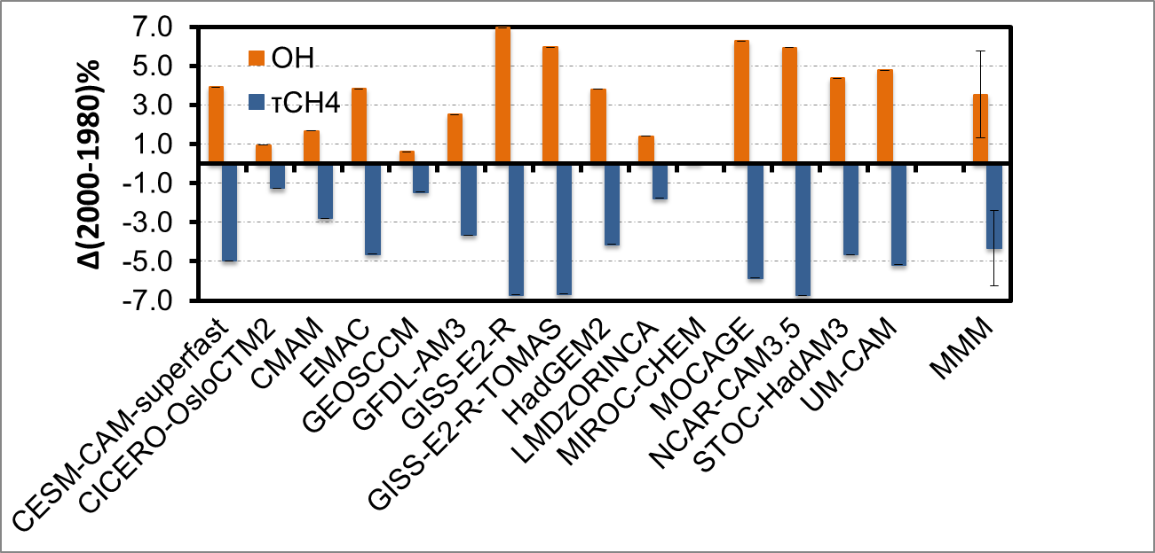
1980 to 2000 Global OH Changes:
Models agree on the sign of change
Small increase consistent with recent estimates from CH₃CCl₃ observations [Montzka et al. 2011] and methane isotopes [Monteil et al. 2011]

Slide 25
Impact of PI to PD climate change on CH₄ lifetime:
Decreases by about 4 months → negative climate feedback
OH + CH₄
k (T)
O₃ + hν
O¹D + H₂O
CH₃O₂
T
T
Models | Δτ_{CH4} (years) | ΔT (K) | Δτ_{CH4}/ΔT (years K⁻¹)
CESM-CAM-superfast | -0.27 | 1.4 | -0.20
GFDL-AM3 | 0.12 | 0.6 | 0.21
GISS-E2-R | -0.76 | 1.1 | -0.69
GISS-E2-R-TOMAS | -0.70 | 1.1 | -0.64
HadGEM2 | -0.20 | 0.5 | -0.40
MIROC-CHEM | -0.25 | 0.8 | -0.30
MOCAGE | -0.20 | 0.9 | -0.23
NCAR-CAM3.5 | -0.37 | 1.1 | -0.34
STOC-HadAM3 | -0.46 | 0.6 | -0.71
UM-CAM | -0.34 | 0.6 | -0.55
MMM±STD | -0.30±0.24 | 0.9±0.3 | -0.39±0.28

Slide 26
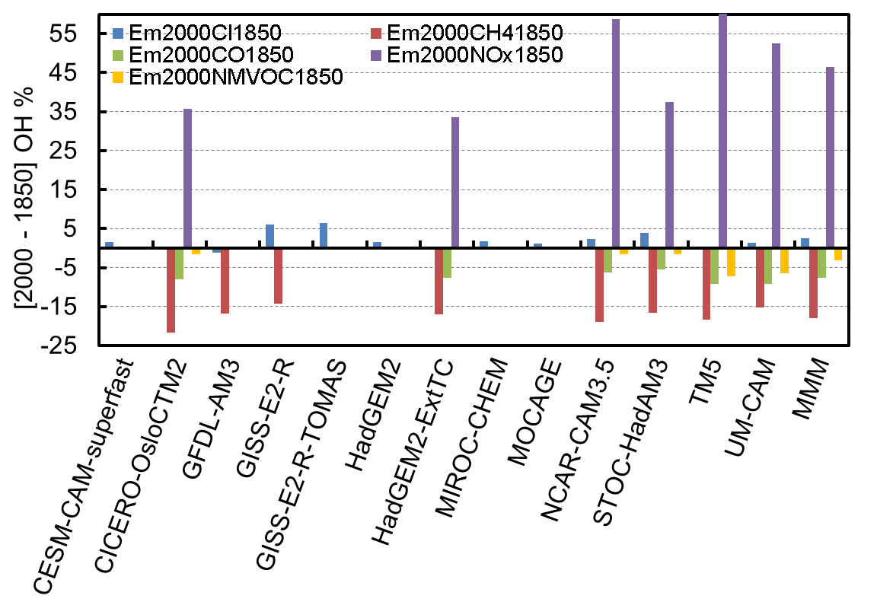
Influence of changes in CH₄ and anthropogenic emissions on PI to PD OH changes: NO_{x} > CH₄ > CO > NMVOCs

Slide 27
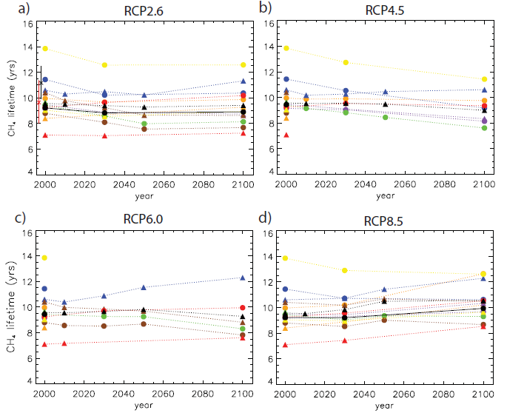
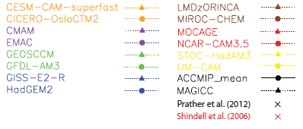
Future projections of Methane Lifetime:
Large Inter-model diversity for the RCP projections
Methane concentration along with stratospheric O₃ recovery drive increases in its lifetime in RCP 8.5
[Voulgarakis et al. 2013; John et al. 2013]
Voulgarakis et al. [2013]

Slide 28
Concluding Remarks
Present-day Global OH in ACCMIP models
  Diverse present-day CH₄ lifetimes, with a tendency to underestimate observational estimates but within the range of uncertainties
  Higher OH in northern vs. southern hemisphere in contrast to observations, consistent with high O₃ biases and low CO biases in the northern hemisphere
  Accurate observational constraints on OH either through direct measurements or using proxies are needed
Preindustrial to present-day Global OH change
  Global OH has changed little over the 150 years → increases in factors increasing OH compensated by increasing sinks
  Large inter-model diversity driven by differences in changes in OH sources versus sinks
  Better constraints on chemical mechanisms and natural emissions needed

Slide 29
Concluding Remarks
1980 to 2000 Global OH change
  Models show a small increase (~3%) consistent with current knowledge of the recent trends in OH
Impact of preindustrial to present day climate change
  Warming-induced small OH increase and enhanced reaction rates cause methane lifetime to decrease by about four months
  Climate induced changes in methane emissions not considered
Impact of preindustrial to present day methane and anthropogenic emissions
  NO_{x} > CH₄ > CO > NMVOCs
Questions remain about the role of aerosols (via chemistry), clouds, NMVOCs (OH recycling in low NOx, biogenic emission changes), and lightning in driving OH changes
What Next: CH₄ concentrations versus emissions in AM3

Slide 30
Extra Slides

Slide 31
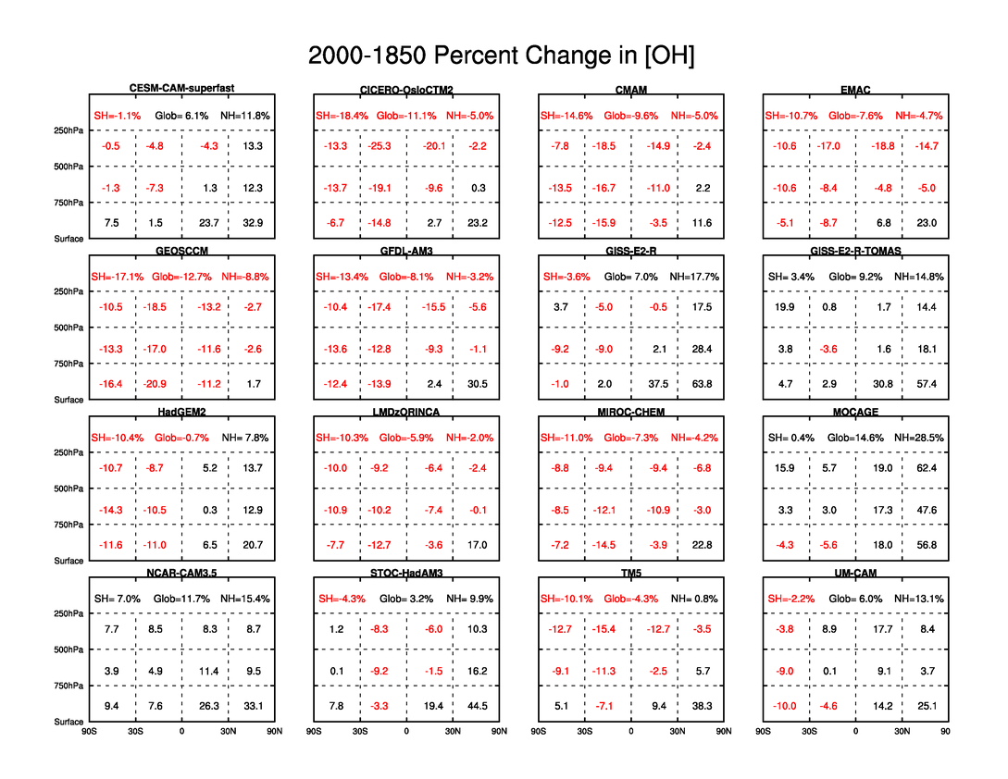
PI to PD change in Regional OH

Slide 32
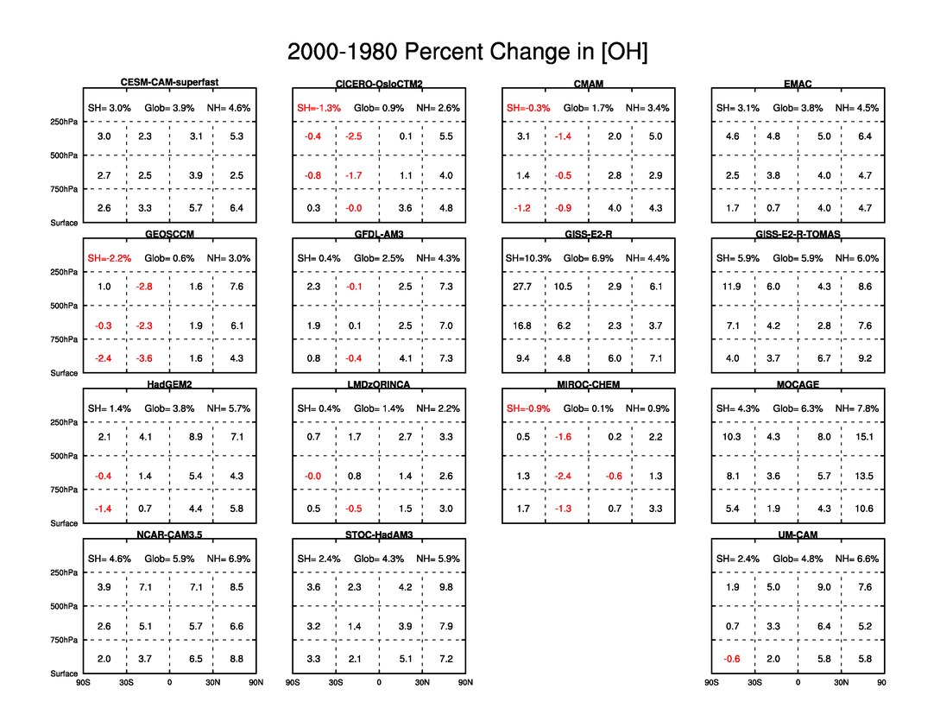
1980 to 2000 change in Regional OH

Slide 33
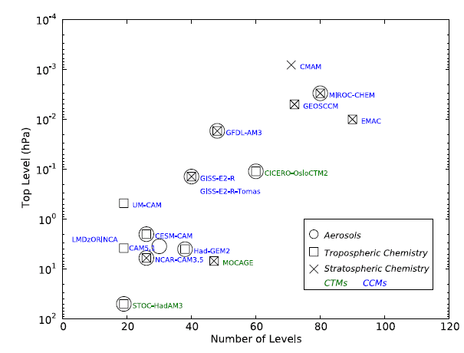
Model vertical extent and characteristics

