Slide 1
ENSO Predictability and Dynamics
Andrew Wittenberg

Slide 2
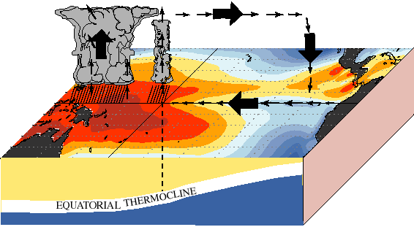
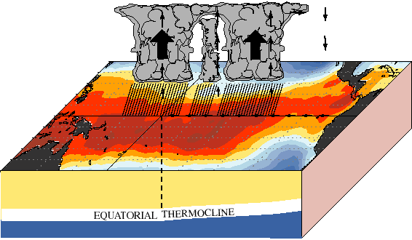
ENSO: Earth’s dominant interannual climate signal
Normal
El Niño
Global Impacts:
weather & climate, natural disasters, transportation
ecosystems, fisheries, agriculture
economies: commerce, energy, water, food, health
How vulnerable are we to future ENSO events?
natural vs. anthropogenic risks
changes in dynamics vs. impacts
short, gappy, nonstationary observing system -> models crucial
coupling & scale interactions -> key test for models

Slide 3
GFDL: Strongly positioned in the ENSO community
ENSO simulations among the best in the world
realistic ENSO patterns, mechanisms, teleconnections
rich spectrum of ENSO behavior
stable 4000-year control run
complementary assimilation & forecast systems
Wittenberg (2009); Vecchi & Wittenberg (2010)‏; Kug et al. (2010); Delworth et al. (2012); Choi et al. (2013);
Capotondi & Wittenberg (2013); Wittenberg et al. (2014); Bellenger et al. (2014); Jia et al. (subm); Wittenberg et al. (in prep)
Groundbreaking ENSO research & collaborations
diversity, sensitivities, mechanisms
historical & proxy reconstructions
predictability, forecasts, observing system evaluation
extratropical impacts, drought, decadal signals
conceptual models, statistical emulators, community metrics
Sample of external collaborations: Collins et al. (2010); DiNezio et al. (2010, 2011, 2012, 2013); Chen et al. (2011);
Guilyardi et al. (2012ab); Watanabe & Wittenberg (2012); Watanabe et al. (2012); Emile-Geay et al. (2013ab);
U.S. CLIVAR (2013); Ogata et al. (2013); McGregor et al. (2013); Karamperidou et al. (2014); Graham et al. (2014);
Cai et al. (2014); Capotondi et al. (subm); Graham et al. (in prep); Erb et al. (in prep); Chen et al. (in prep); Atwood et al. (in prep)

Slide 4
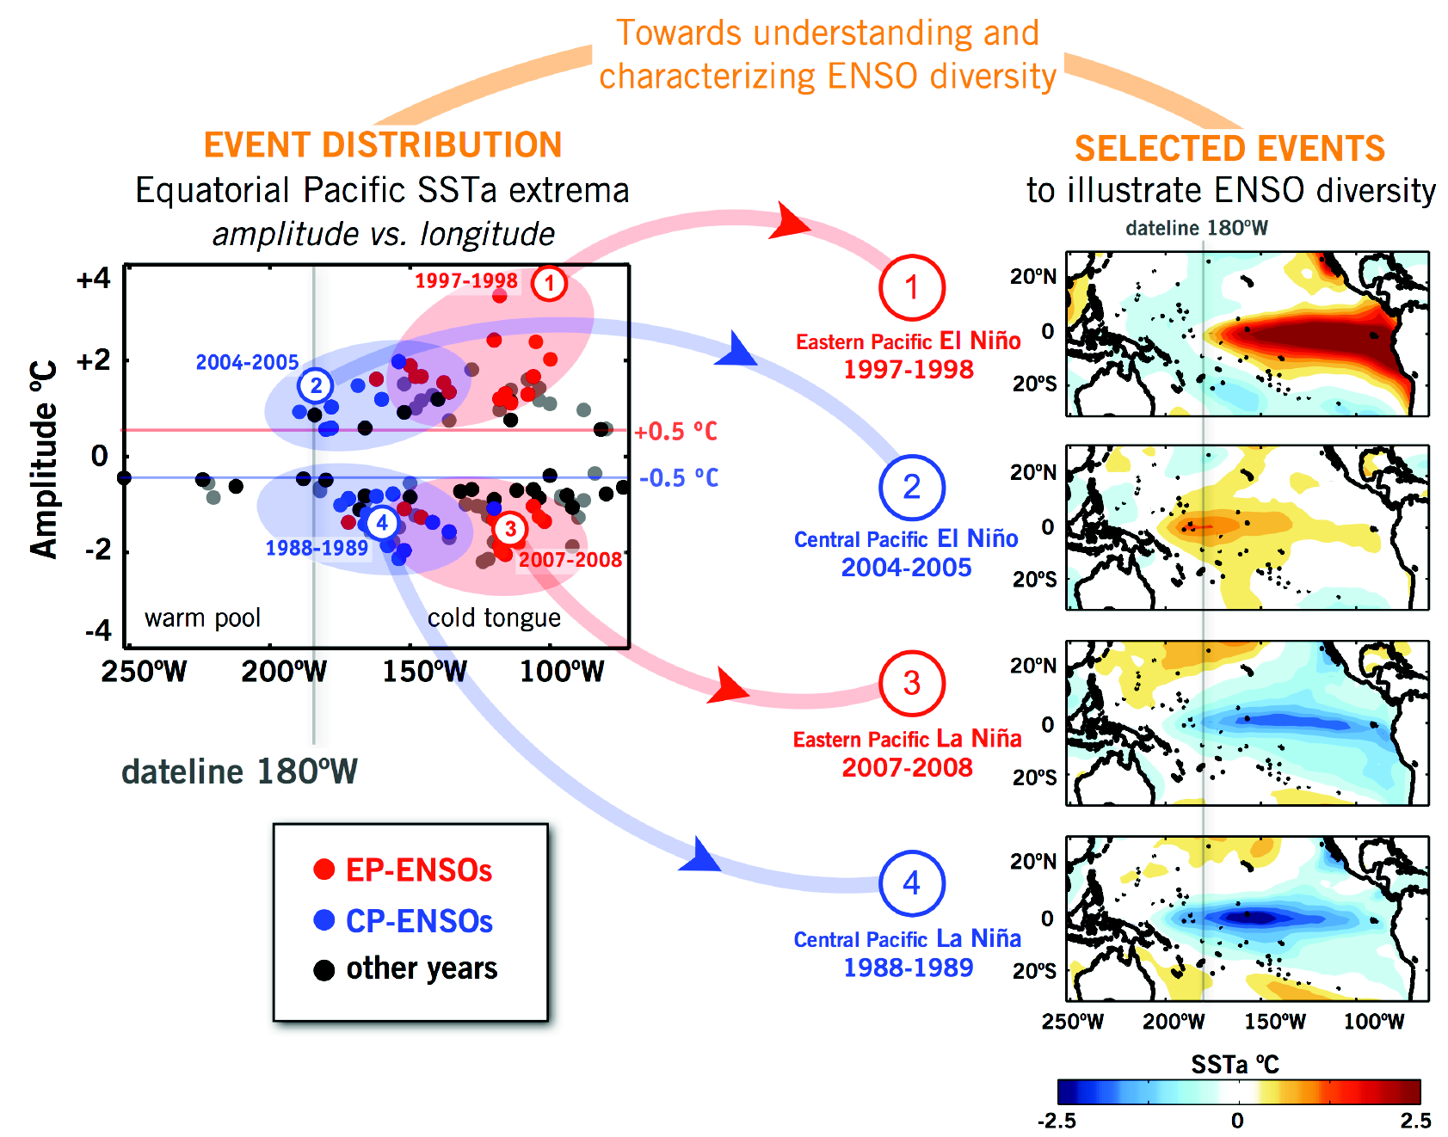
ENSO diversity in observations
NOAA ERSST.v3b
U.S. CLIVAR Working Group on ENSO Diversity: Capotondi, Wittenberg, et al. (BAMS, subm. 2014)
Kug et al. (2010); Chen et al. (in prep); Atwood et al. (in prep)

Slide 5
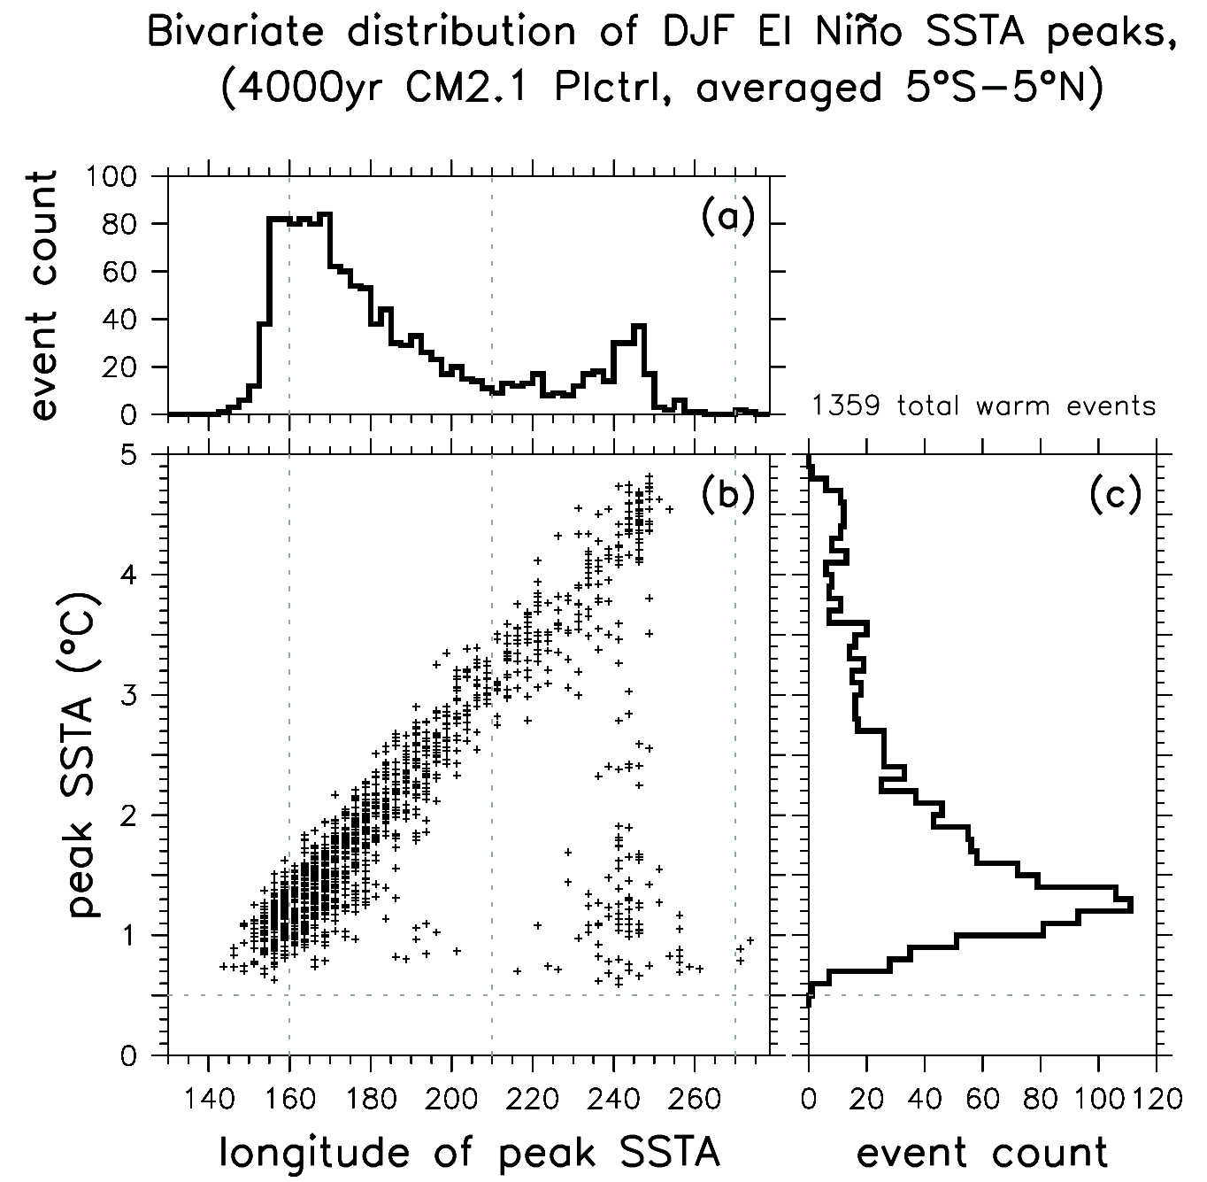
ENSO diversity in observations & models
CM2.1 simulation
NDJ
1900-1945 1945-2013
NOAA ERSST.v3b
U.S. CLIVAR Working Group on ENSO Diversity: Capotondi, Wittenberg, et al. (BAMS, subm. 2014)
Kug et al. (2010); Chen et al. (in prep); Atwood et al. (in prep)

Slide 6
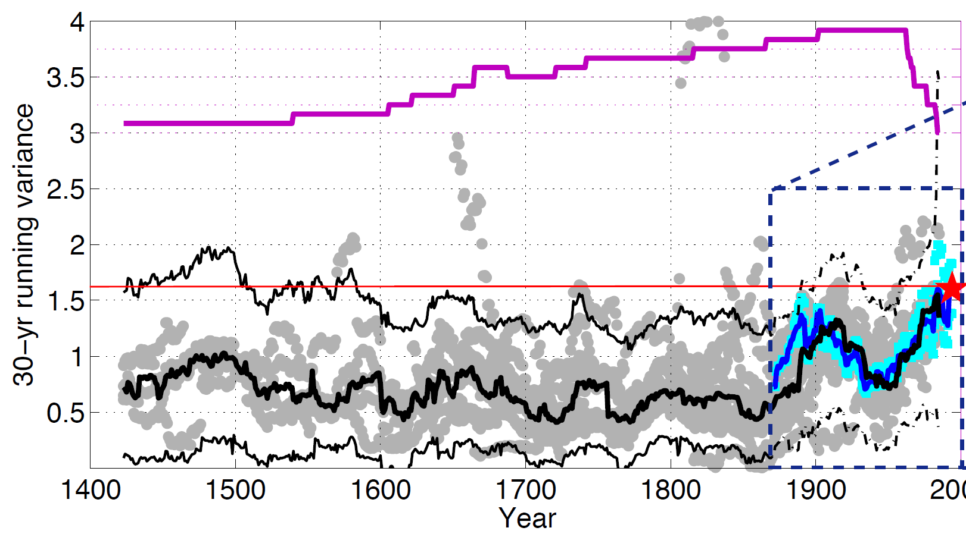
Reconstructing past variations in ENSO
Proxy evidence suggests that ENSO has waxed & waned,
with a significant amplification in recent decades.
Number of available
proxy reconstructions
12
9
6
3
2000
Multiproxy meta-reconstruction (from corals, tree rings, lake sediments & ice cores) of
30-year running variance of 10-yr lowpass July-June annual-mean NINO3.4 SSTs.
McGregor et al. (Clim. Past, 2013); Emile-Geay et al. (2013ab)

Slide 7
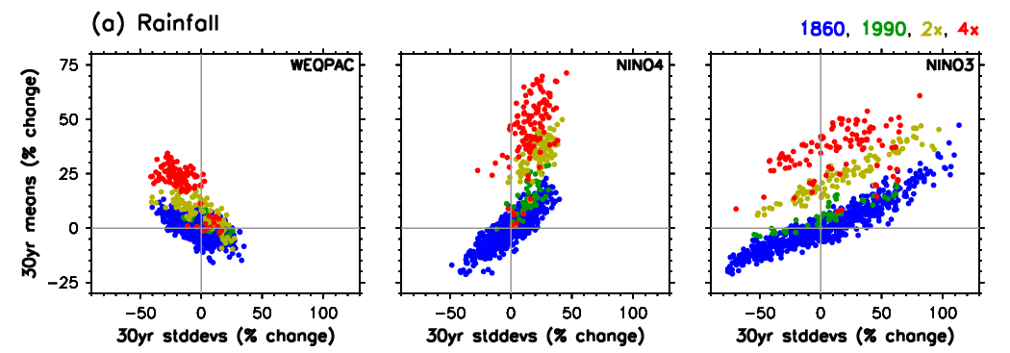
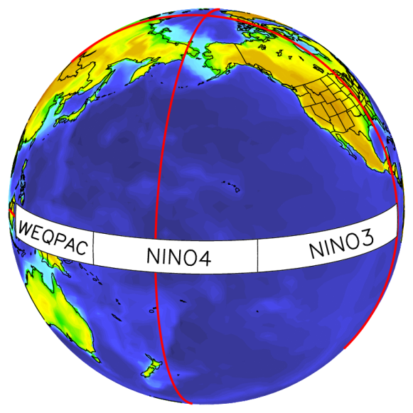
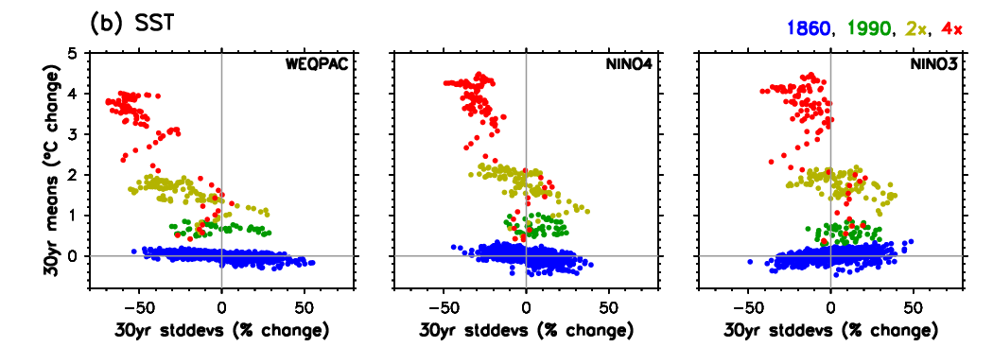
ENSO response to increasing CO₂
CM2.1 simulations show interplay of intrinsic ENSO modulation, decadal variation, and regional responses to increasing CO₂
wetter
climate
CO2-induced shift of rainfall variability
stronger-ENSO decades
➔ wetter local climate
Vecchi & Wittenberg (2010)
Collins et al. (2010)
Xie et al. (2010)
DiNezio et al. (2012)
Watanabe & Wittenberg (2012)
Watanabe et al. (2012)
Ogata et al. (2013)
Cai et al. (2014)
then
weaker.
warmer
climate
Stronger
ENSO...
stronger
ENSO

Slide 8
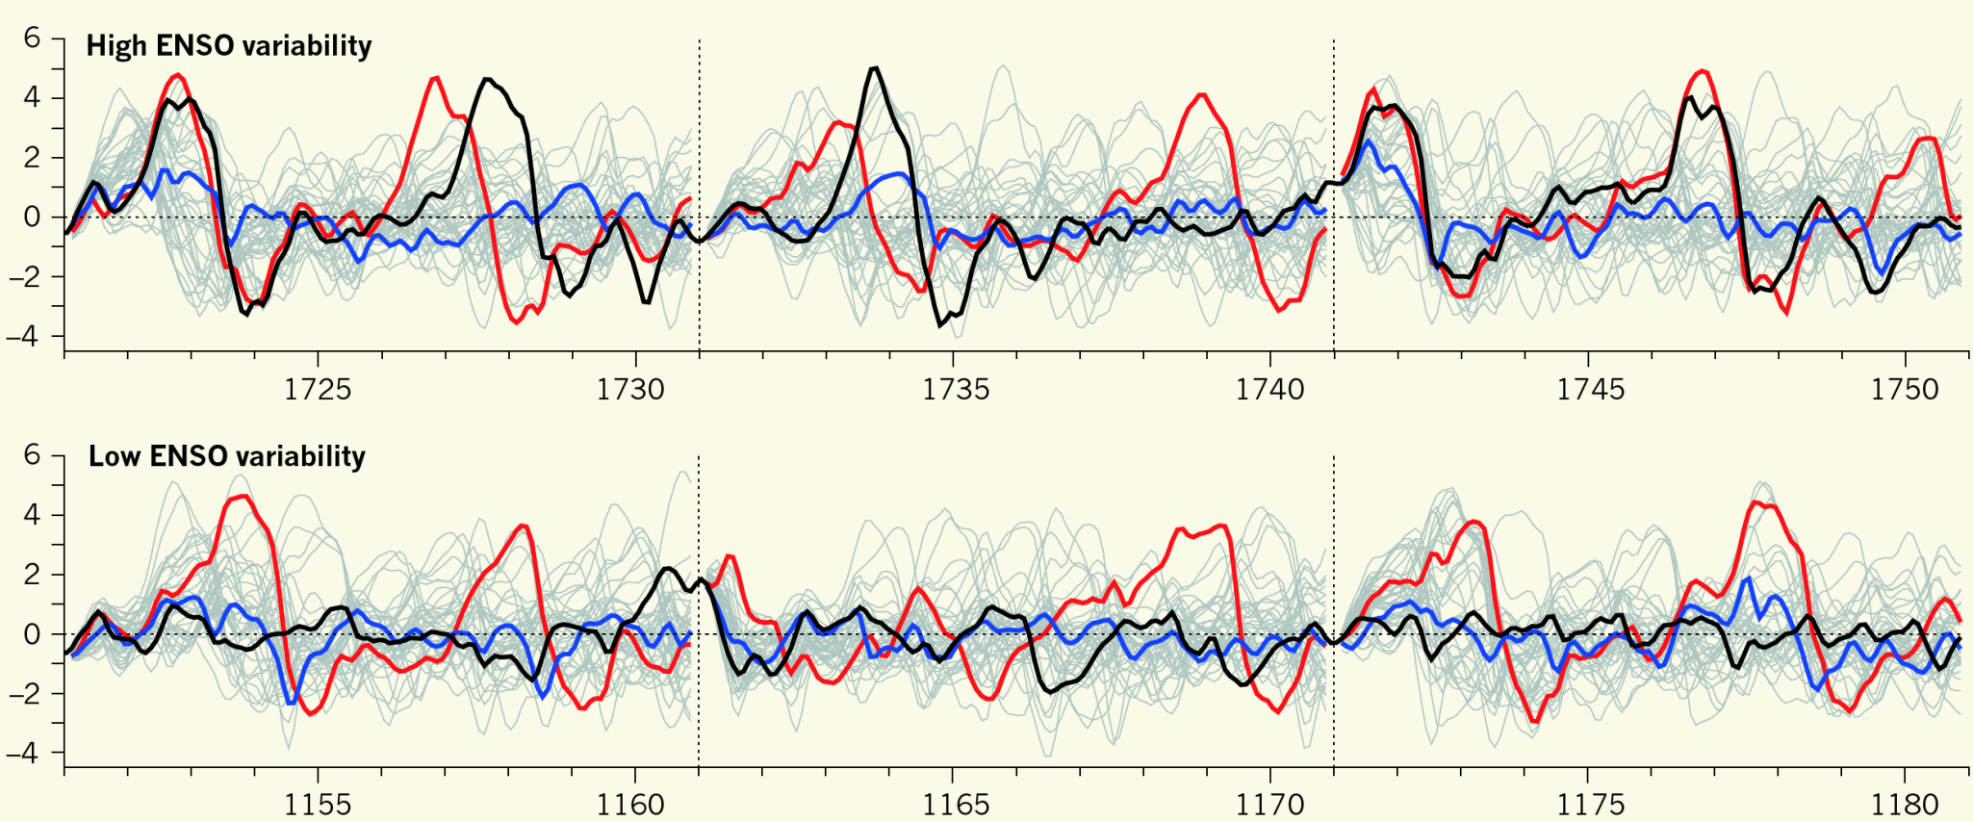
ENSO modulation: Is it decadally predictable?
“Perfect-model” forecasts of NINO3 SSTA, for extreme-ENSO epochs simulated by CM2.1
˚C
original
trajectory
quiet
forecasts
active
forecasts
˚C
model year
(External forcings held fixed at 1860 values.)
Wittenberg et al. (J. Climate, 2014)

Slide 9
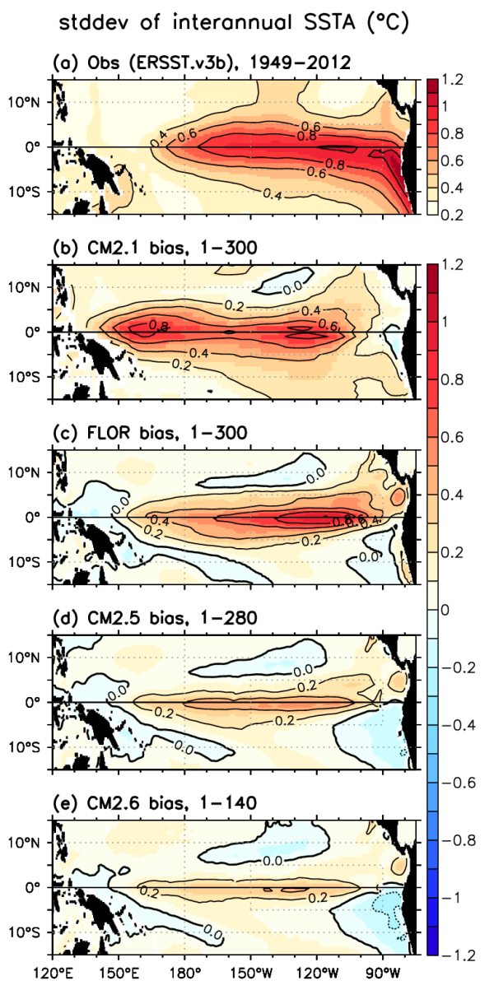
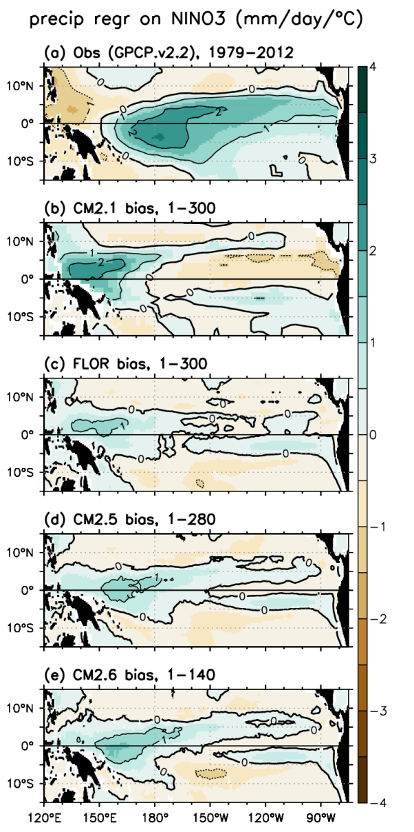
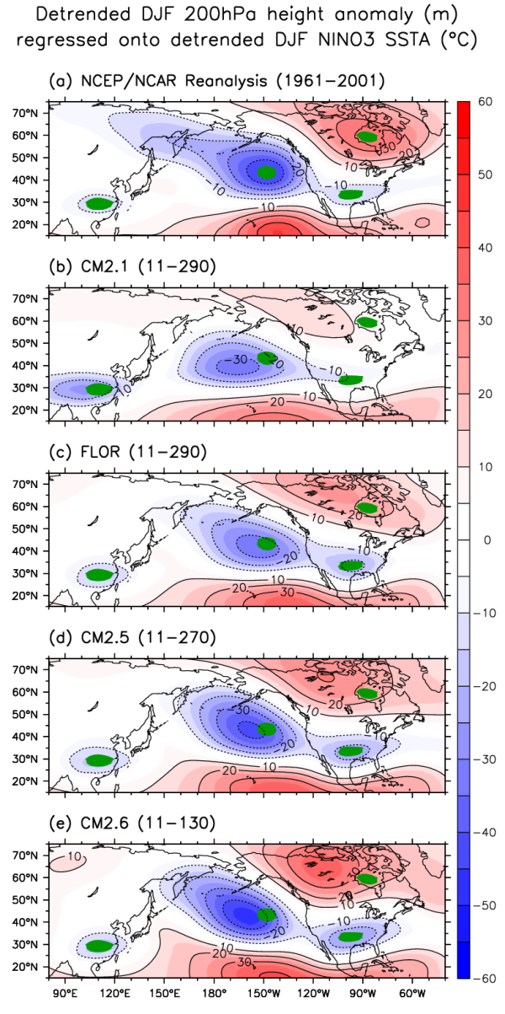
ENSO improvements with increasing resolution
OBS
new
forecast
model
5x atm
4x ocn
2.5x ocn
Delworth et al. (2012); Jia et al. (subm); Wittenberg et al. (in prep)

Slide 10
ENSO Summary
1. ENSO’s future depends on both intrinsic modulation and external forcings.
2. GFDL’s simulations are among the best in the world, and improving.
3. GFDL is rapidly advancing community understanding of ENSO’s diversity, dynamics, sensitivities, and predictability.

Slide 11
GFDL’s recent publications on ENSO
Wittenberg, A. T., et al., 2014: ENSO modulation: Is it decadally predictable? J. Climate, 27, 2667-2681. doi: 10.1175/JCLI-D-13-00577.1.
Cai, W., et al., 2014: Greenhouse warming leads to increasing frequency of extreme El Niño events. Nature Climate Change, 4, 111-116. doi: 10.1038/NCLIMATE2100.
Karamperidou, C., et al., 2014: Intrinsic modulation of ENSO predictability viewed through a local Lyapunov lens. Climate Dyn., 42, 253-270. doi: 10.1007/s00382-013-1759-z.
Chiodi, A.M., D.E. Harrison and G.A. Vecchi, 2014: Subseasonal atmospheric variability and El Niño waveguide warming; observed effects of the Madden-Julian Oscillation and westerly wind events. J. Climate, published online. doi: 10.1175/JCLI-D-13-00547.1.
Graham, F. S., et al., 2014: Effectiveness of the Bjerknes stability index in representing ocean dynamics. Climate Dyn., published online. doi: 10.1007/s00382-014-2062-3.
Choi, K.-Y., G. A. Vecchi, and A. T. Wittenberg, 2013: ENSO transition, duration and amplitude asymmetries: Role of the nonlinear wind stress coupling in a conceptual model. J. Climate, 26, 9462-9476. doi: 10.1175/JCLI-D-13-00045.1
McGregor, S., et al., 2013: Inferred changes in El Niño-Southern Oscillation variance over the past six centuries. Clim. Past, 9, 2269-2284. doi: 10.5194/cp-9-2269-2013.
Ogata, T., et al., 2013: Interdecadal amplitude modulation of El Niño/Southern Oscillation and its impacts on tropical Pacific decadal variability. J. Climate, 26, 7280-7297. doi: 10.1175/JCLI-D-12-00415.1.
Capotondi, A., and A. Wittenberg, 2013: ENSO diversity in climate models. U.S. CLIVAR Variations, 11, 10-14.
U.S. CLIVAR Project Office, 2013: U.S. CLIVAR ENSO Diversity Workshop Report. Report 2013-1, U.S. CLIVAR Project Office, Washington, DC, 20006, 20pp.
Emile-Geay, J., et al., 2013a: Estimating central equatorial Pacific SST variability over the past millennium. Part I: Methodology and validation. J. Climate, 26, 2302-2328. doi: 10.1175/JCLI-D-11-00510.1.
Emile-Geay, J., et al., 2013b: Estimating central equatorial Pacific SST variability over the past millennium. Part II: Reconstructions and implications. J. Climate, 26, 2329-2352. doi: 10.1175/JCLI-D-11-00511.1.
DiNezio, P.N., G.A. Vecchi, and A.C. Clement, 2013: Detectability of changes in the walker circulation in response to global warming. J. Climate, doi:10.1175/JCLI-D-12-00531.1.
Watanabe, M., et al., 2012: Uncertainty in the ENSO amplitude change from the past to the future. Geophys. Res. Lett., 39, L20703. doi: 10.1029/2012GL053305.
Watanabe, M., and A. T. Wittenberg, 2012: A method for disentangling El Niño-mean state interaction. Geophys. Res. Lett., 39, L14702. doi: 10.1029/2012GL052013.
DiNezio, P. N., et al., 2012: Mean climate controls on the simulated response of ENSO to increasing greenhouse gases. J. Climate, 25, 7399-7420. doi: 10.1175/JCLI-D-11-00494.1.
Guilyardi, E., et al., 2012: A first look at ENSO in CMIP5. CLIVAR Exchanges, 17, 29-32.
Guilyardi, E., et al., 2012: New strategies for evaluating ENSO processes in climate models. Bull. Amer. Met. Soc., 93, 235-238. doi: 10.1175/BAM S-D-11-00106.1.
Delworth, T. L., et al., 2012: Simulated climate and climate change in the GFDL CM2.5 high-resolution coupled climate model. J. Climate, 25, 2755-2781. doi: 10.1175/JCLI-D-11-00316.1.
DiNezio, P.N., et al., 2011: The response of the walker circulation to LGM forcing: Implications for detection in proxies. Paleoceanography, 26, PA3217, doi:10.1029/2010PA002083.
Chen, C.-K., et al., 2011: Static correlation visualization for large time-varying volume data. Proc. of IEEE Pacific Visualization Symposium, Hong Kong, China, March 2011, 27-34. doi: 10.1109/PACIFICVIS.2011.5742369.
Collins, M., et al., 2010: The impact of global warming on the tropical Pacific and El Niño. Nature Geoscience, 3, 391-397. doi: 10.1038/ngeo868.
Vecchi, G. A., and A. T. Wittenberg, 2010: El Niño and our future climate: Where do we stand? Wiley Interdisciplinary Reviews: Climate Change, 1, 260-270. doi: 10.1002/wcc.33.
Kug, J.-S., et al., 2010: Warm pool and cold tongue El Niño events as simulated by the GFDL CM2.1 coupled GCM. J. Climate, 23, 1226-1239. doi: 10.1175/2009JCLI3293.1.
Xie, S.-P., et al., 2010: Global warming pattern formation: Sea surface temperature and rainfall. J. Climate, 23, 966-986. doi: 10.1175/2009JCLI3329.1.
DiNezio, P, A. Clement, and G.A. Vecchi, 2010: Reconciling differing views of tropical Pacific climate change. EOS, Trans. Amer. Geophys. Union, 91(16), 141-152.
Wittenberg, A. T., 2009: Are historical records sufficient to constrain ENSO simulations? Geophys. Res. Lett., 36, L12702. doi: 10.1029/2009GL038710.
Anderson, W., A. Gnanadesikan, and A. Wittenberg, 2009: Regional impacts of ocean color on tropical Pacific variability. Ocean Sci., 5, 313-327. doi: 10.5194/os-5-313-2009.
Guilyardi, E., et al., 2009: Understanding El Niño in ocean-atmosphere general circulation models: Progress and challenges. Bull. Amer. Meteor. Soc., 90, 325-340. doi: 10.1175/2008BAMS2387.1.
Sukharev, J., et al., 2009: Correlation study of time-varying multivariate climate data sets. Proc. of IEEE VGTC Pacific Visualization Symposium 2009, Beijing, China, April 2009, pages 161-168. doi: 10.1109/PACIFICVIS.2009.4906852.
Harrison, D.E., A.M. Chiodi and G.A. Vecchi, 2009: Effects of surface forcing on the seasonal cycle of the eastern equatorial Pacific. J. Marine Research, 67(6), 701-729.
DiNezio, P.N., et al., 2009: Climate response of the equatorial Pacific to global warming. J. Climate, 22, 4873-4892. doi: 10.1175/2009JCLI2982.1
Lengaigne, M. and G.A. Vecchi, 2009. Contrasting the termination of moderate and extreme El Niño events in coupled general circulation models. Climate Dyn., doi: 10.1007/s00382-009-0562-3

