Slide 1
Seasonal-to-Decadal (S2D)
Variability and Predictability Division
Division Lead: Tom Delworth
Presenters: Andrew Wittenberg, Nat Johnson,
Hiroyuki Murakami, Xiaosong Yang
NOAA GFDL, 2 July 2019

Slide 2
Key NOAA Goals:
Weather-Ready Nation
“A society that is prepared for and responds to weather-related events.”
Climate Adaptation and Mitigation
“An informed society anticipating and responding to climate and its impacts.”
GFDL’s role in NOAA:
- Application-inspired basic research
- Long-lead science, targeting fundamental breakthroughs
- Proving ground for next-gen technologies and methods
- Work with NOAA partners to adapt advanced models to operations
GFDL’s Mission:
Develop comprehensive, integrated, unified models of the Earth system
and apply them to seamless understanding, predictions, and projections
from hours to decades and from global to regional scales.

Slide 3
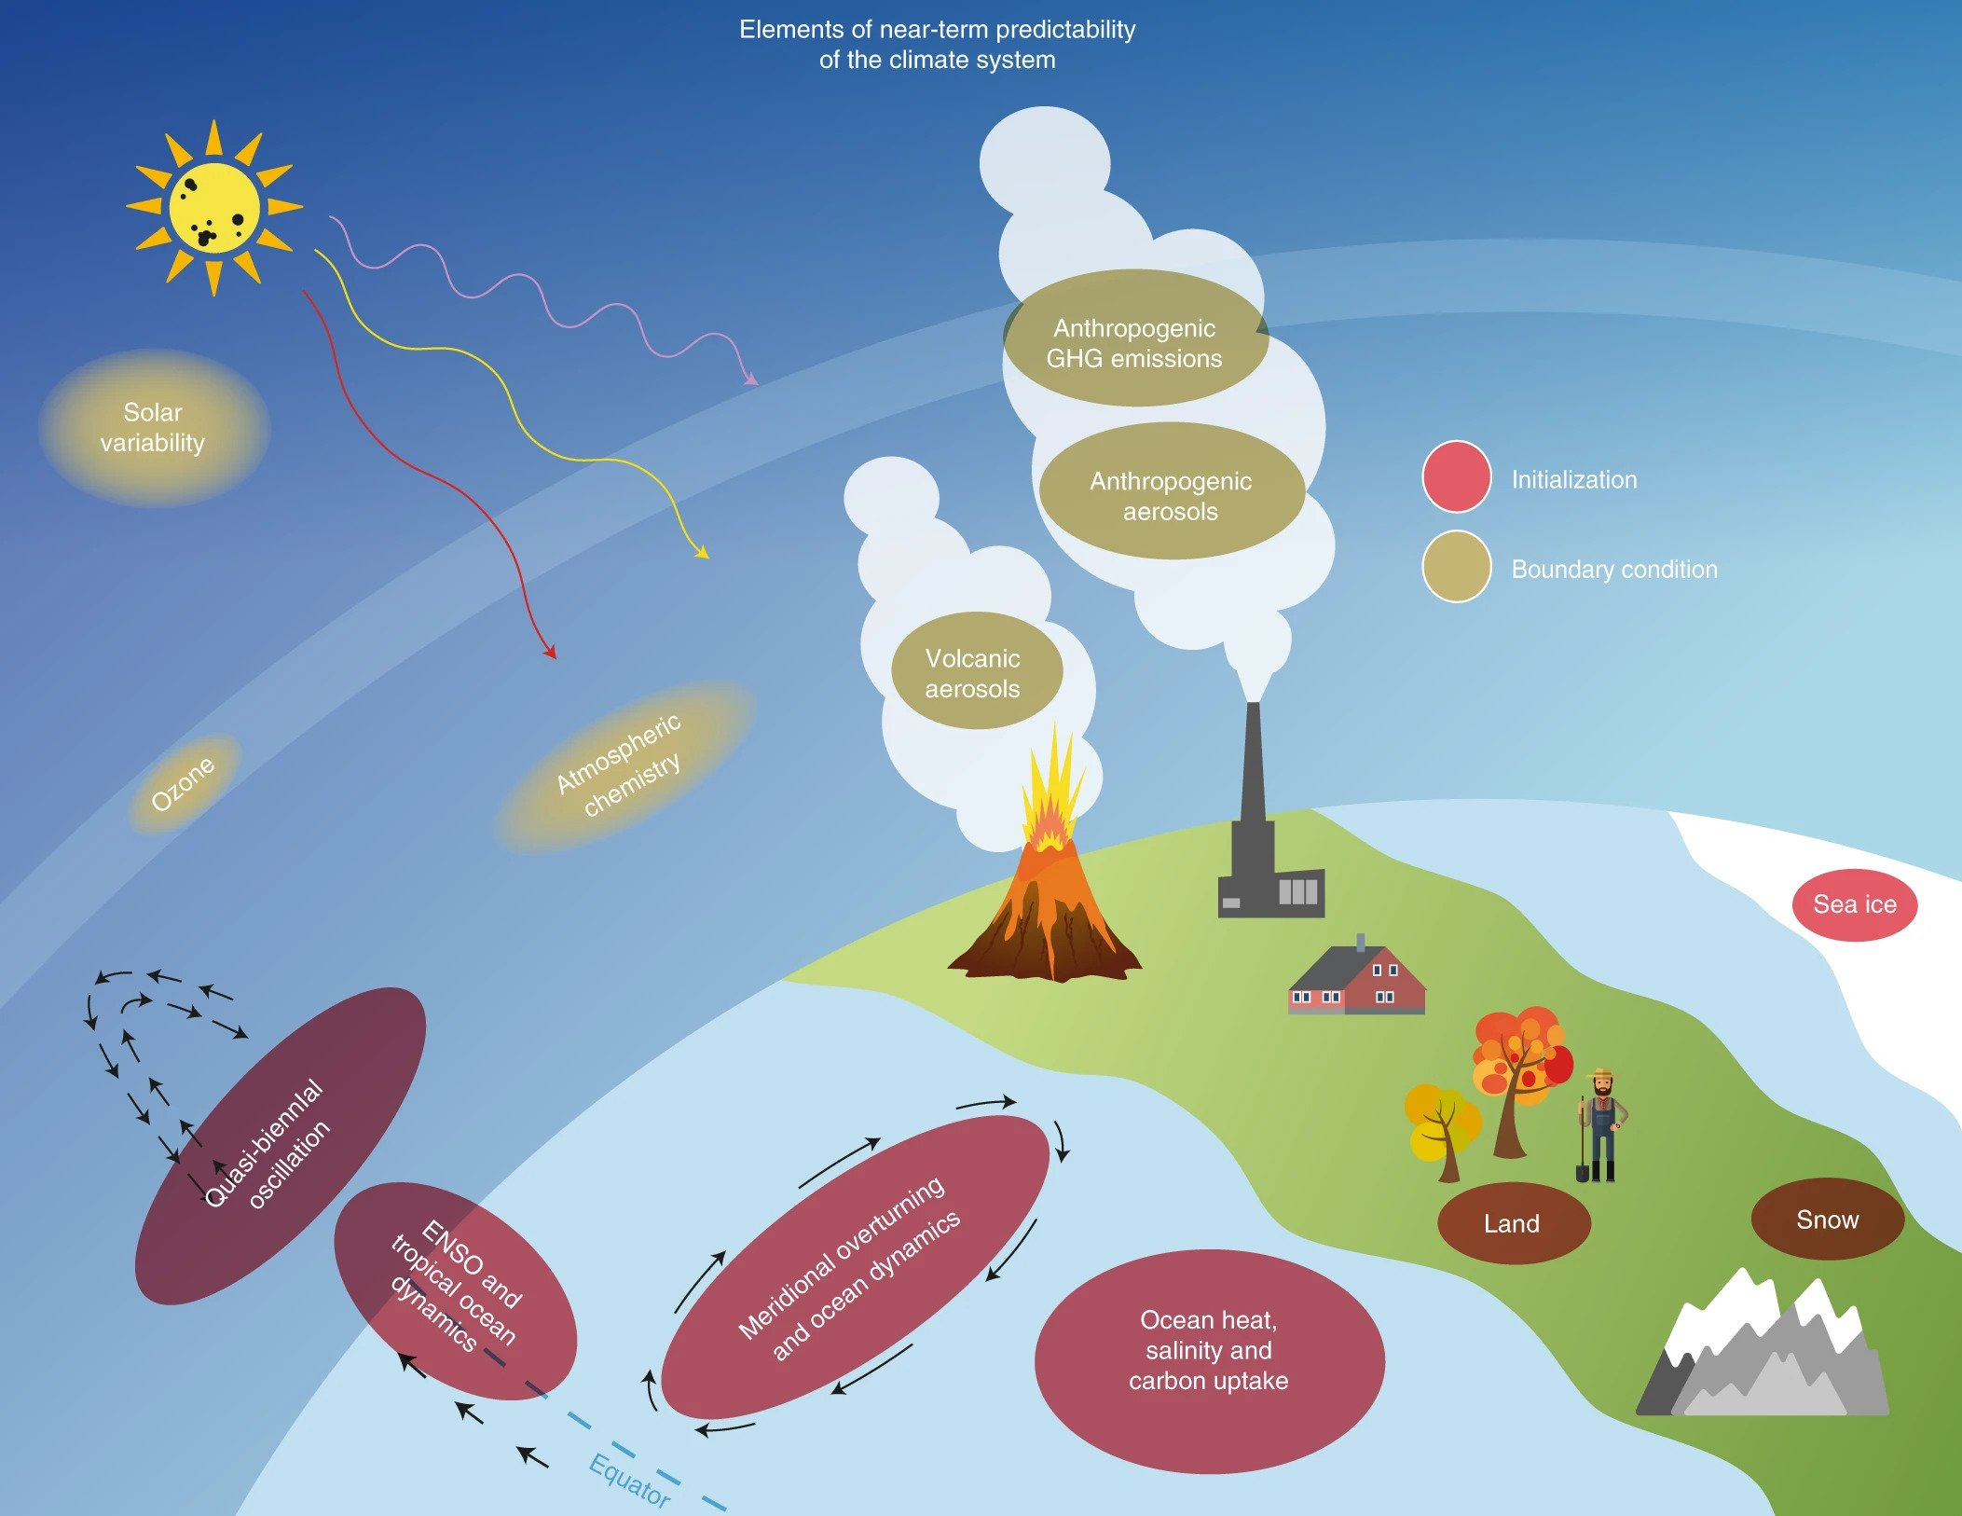
Sources of climate predictability
Kushnir et al. (NCC 2019)

Slide 4
Research Foci of the S2D Division
1. Improve scientific understanding of seasonal-to-multidecadal variability, arising from variations internal to the coupled climate system, and from interactions with changing radiative forcings.
2. Develop experimental prediction systems and explore predictability at lead times of seasons to decades, for high-impact events including hurricanes, severe storms, floods, droughts, heat waves, and El Niño.
3. Provide probabilistic predictions and projections of how climate and extremes will evolve over the next several decades, at global to regional scales.
GFDL’s newest prediction systems harvest the fruits of decades-long
research efforts toward model development and initialization systems.

Slide 5
Seamless seasonal-to-centennial prediction and projection
Representative phenomena that give rise to variability & predictability in the climate system
Physical Phenomena | Variability & predictability timescale
Mid-latitude storms, general circulation | Daily to two-week weather forecast
Madden-Julian Oscillation, etc | Subseasonal
El Niño/Southern Oscillation (ENSO) | Seasonal to interannual
Volcanic aerosol forcing | Seasonal to interannual
Decadal-scale ocean-atmosphere variability (AMO, PDO, etc) | Interannual to decadal
Anthropogenic greenhouse gases, aerosols, ozone changes | Decadal to centennial
Weather Act defines “Seasonal forecast” as three months to two years

Slide 6
Desired capability:
Modeling system that can produce large ensembles of initialized predictions and projections for time scales ranging from one season to multiple decades in advance.
Desired product:
Probabilistic predictions and projections of climate variations and change that have utility for planning across a range of time and space scales – including seasons to decades.
Examples:
How will predictable changes in ocean temperature influence tropical storm activity?
How likely is it that:
  ENSO or the AMO will change phase and alter Atlantic hurricanes and other climate features?
  the PDO will change phase and impact North American hydroclimate?
How will anthropogenic climate change alter the probability of extreme events over the US for the next decade, including rainfall/flooding and heat waves?

Slide 7
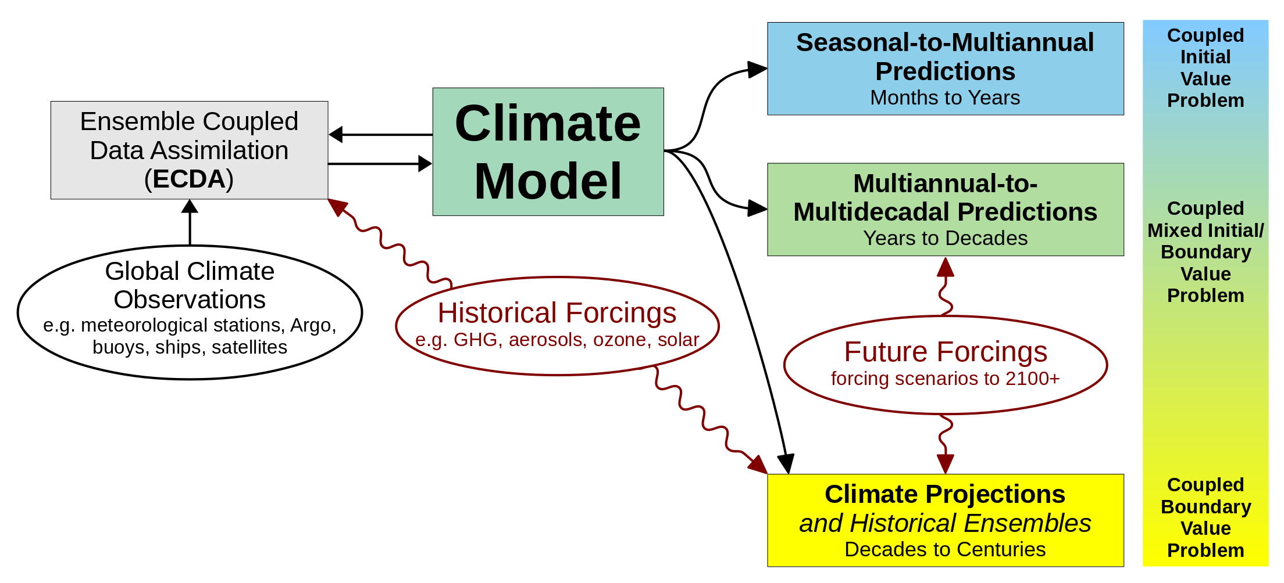
Seamless Prediction and Projection System
Requires good initialization & transient response & long-term climate.
Global + High resolution + Coupled + Ensembles + Retrospectives
→ Requires large computing resources. HPC is a key bottleneck.

Slide 8
Seasonal-to-Decadal Predictions
Since 2015, GFDL has delivered real-time seasonal forecasts on time each month to NMME, CPC, NHC, SIPN. It has provided seasonal forecasts to the IRI and APCC for over a decade.
GFDL contributes decadal predictions to the WMO Annual-to-Decadal Climate Prediction (ADCP) project, coordinated by UKMO.
Plans:
- Atmosphere: 50km → 25km → 10km refined mesh over N. America
better-resolved stratosphere → stratosphere/troposphere interactions
- Ocean: 100km → 25km (coastal applications)
- ESM capabilities (biogeochemistry, carbon, ecosystems, fisheries)

Slide 9
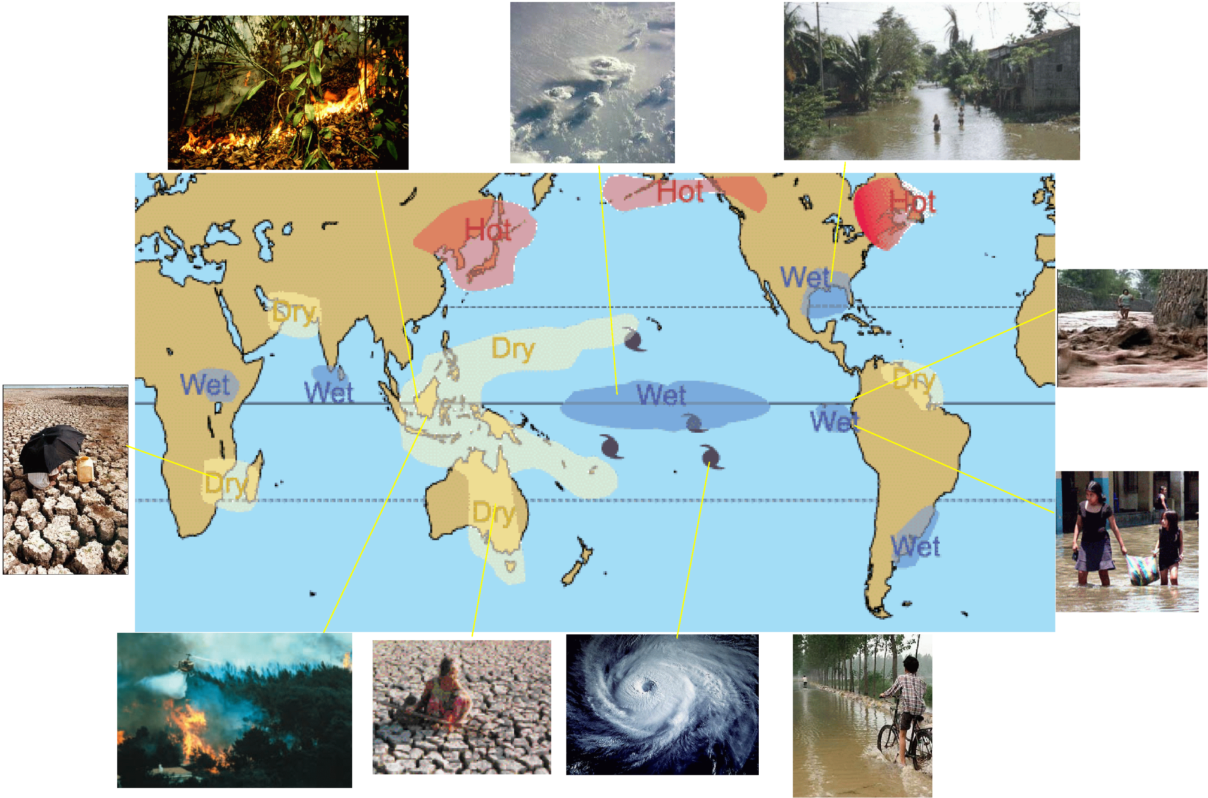
Seasonal-to-Interannual Variations & Predictability
Driven mainly from the tropics, e.g. ENSO.
Key foci: Temperature, hydroclimate, storms, snowpack, ocean currents, sea ice
→ impact agriculture, water resources, natural disasters, forests, wildfires, fisheries, shipping

Slide 10
Seasonal-to-Interannual Products and Research
Products:
- Models (CM2.1, CM2.5, CM2.6, CM3, CM4, FLOR, HiFLOR, SPEAR)
- Simulation data & publications
- CM2.1/FLOR/HiFLOR forecast systems and ensemble predictions
- Modern-era coupled reanalysis: ECDA using SST, TAO, Argo, XBT, etc.
Research Highlights:
- Processes responsible for ENSO diversity & sensitivities to forcings
- Roles of ocean/atmosphere data assimilation in seasonal predictions
- Role of stratosphere in seasonal predictions
- Impacts of explosive volcanic eruptions on ENSO
- ENSO impacts on tornado outbreaks over the U.S.

Slide 11
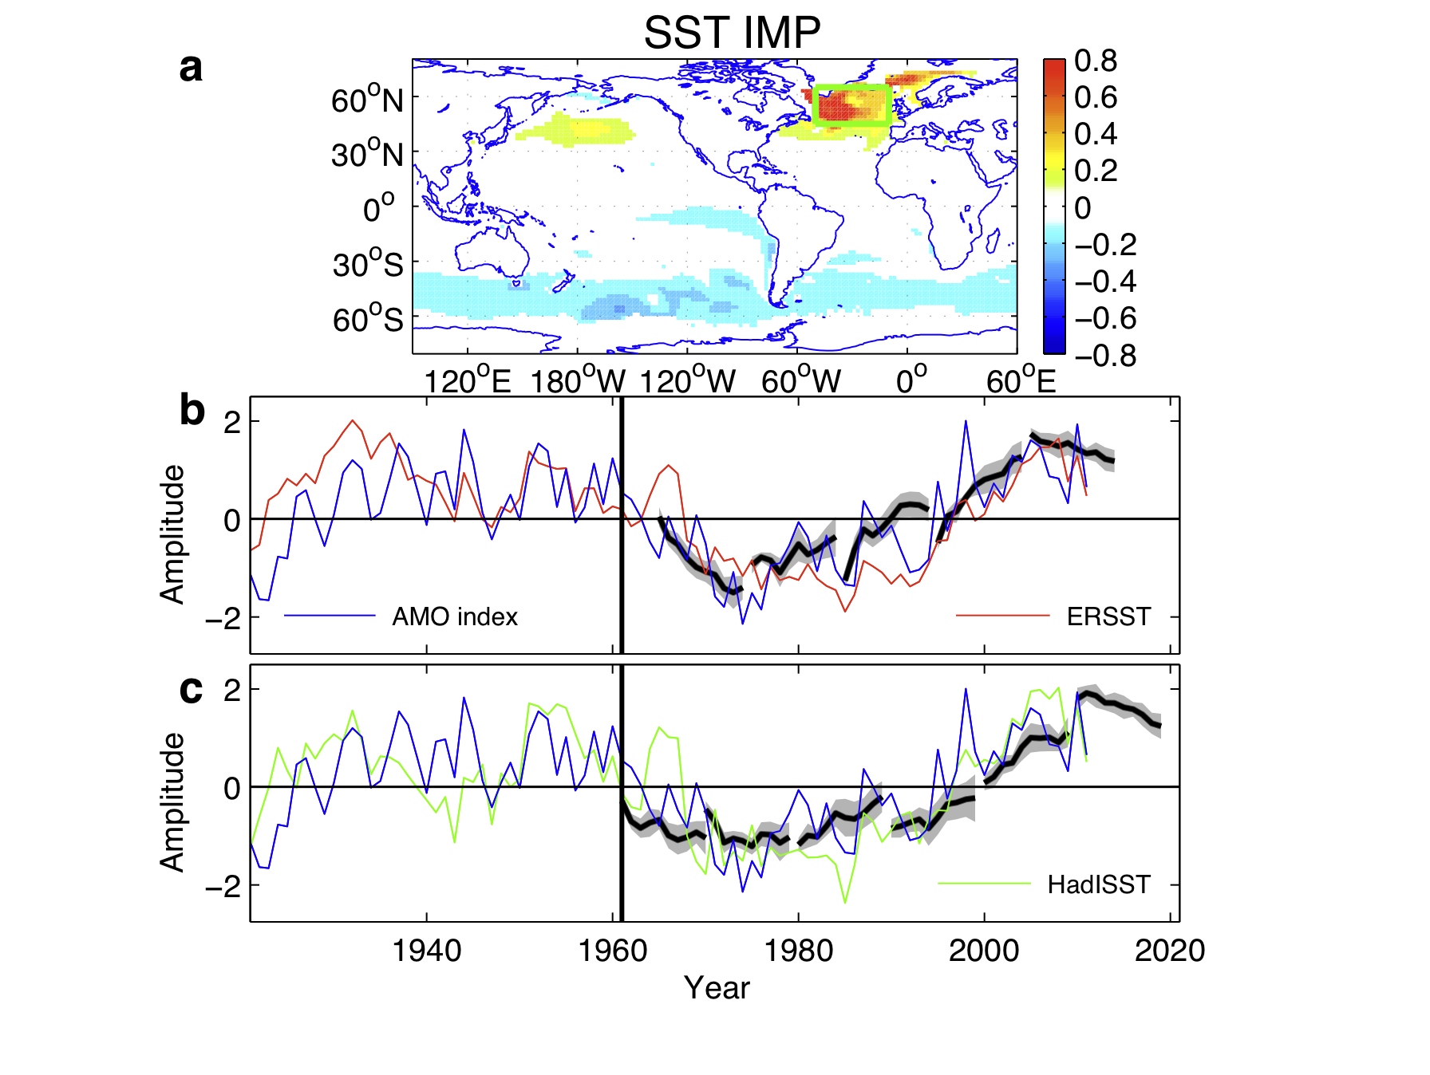
Decadal-to-Multidecadal Variations & Predictability
Driven by AMOC, S. Ocean, Arctic/Antarctic sea ice, PDO, ENSO modulation.
Most predictable pattern of SST anomalies
Substantial predictive skill in the North Atlantic from decadal swings of the Atlantic Meridional Overturning Circulation (AMOC).
predicted
observed SST
Yang et al. (JC 2013)
Key Foci: surface temperature, hydroclimate, storms, cryosphere & snowpack, ocean circulation, changes in modes of variability (ENSO, NAO).

Slide 12
Decadal-to-Multidecadal Products and Research
Products:
- Models (CM2.1, CM2.5, FLOR, SPEAR)
- Simulation data & publications
- CM2.1/FLOR forecast systems and ensemble predictions/projections
- Historical reconstruction: ECDA using SST & surface pressure
Research Highlights:
- Role of ocean heat transport variations in AMV
→ impacts on Arctic sea ice, heat waves, monsoon rainfall
- Predictable multidecadal variability of S. Ocean sea ice & temperature
- PDO mechanisms and sensitivities to anthropogenic forcings
- Role of tropical SST in decadal drought over N. America

Slide 13
Seasonal Prediction System

Slide 14
Real-time seasonal prediction at GFDL
 | Atmosphere resolution | Ocean resolution | Ensemble members
CM2.1 | 200 km | 1º | 10
FLOR | 50 km | 1º | 24*
CM2.1 and FLOR: run each month as part of the North American Multi-Model Ensemble (NMME) since 2015
Output provided to NCEP (National Hurricane Center and Climate Prediction Center) to inform their seasonal outlooks
  FLOR for hurricanes
  CM2.1 and FLOR for other climate outlooks, including ENSO, precipitation and temperature
Ocean reanalysis also provided to NCEP for Multiple Ocean Reanalysis Project
*2 slightly different versions with 12 members each
Notes:
The North American Multi-Model Ensemble (NMME) is a multi-model, seasonal forecasting system consisting of coupled models from North American modeling centers. The NMME contributors are NOAA's National Centers for Environmental Prediction (NCEP), NOAA's Geophysical Fluid Dynamics Laboratory (GFDL), the National Center for Atmospheric Research (NCAR), NASA's Goddard Space Flight Center (GSFC), and Canada’s Centre for Climate Modeling and Analysis (CCCma).
14

Slide 15
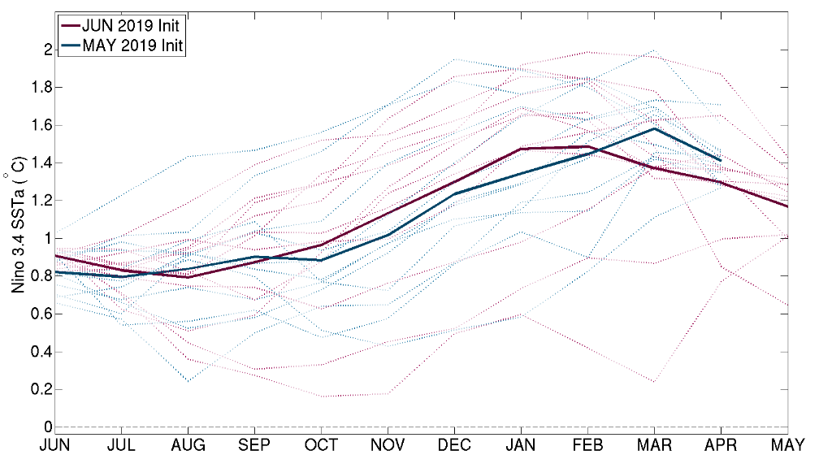
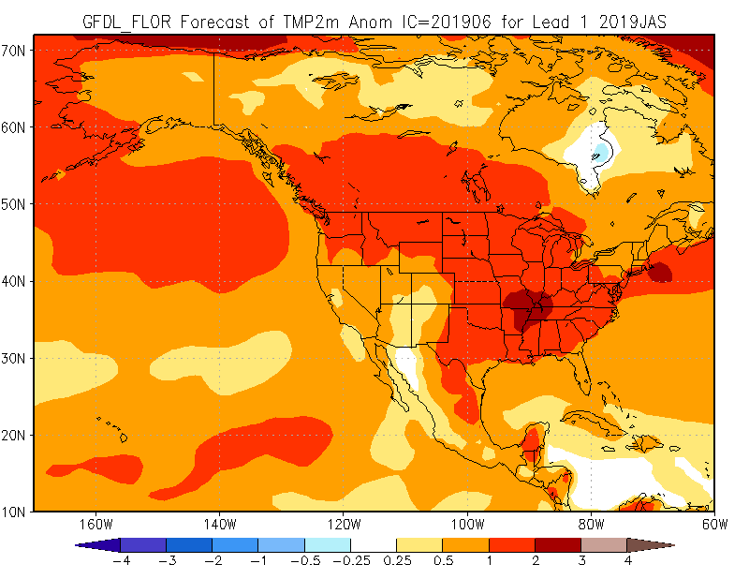
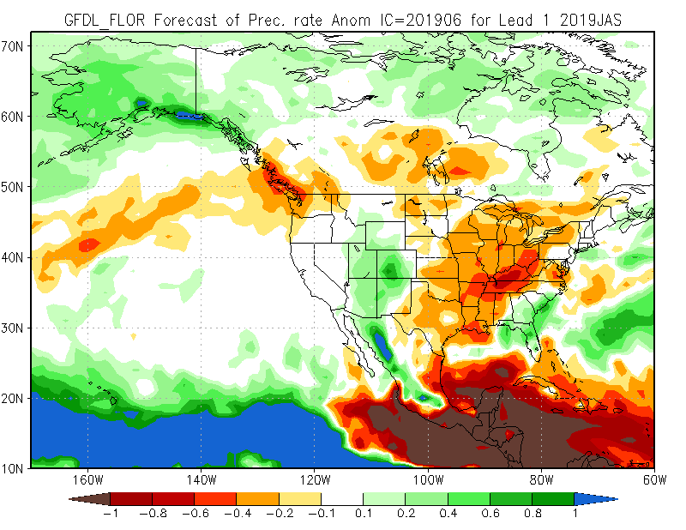
GFDL’s contribution to the NMME and
NOAA’s operational seasonal forecasts
FLOR ENSO forecast plume
FLOR July – September temperature and precipitation forecasts
Temperature
ENSO Correlation skill
Precipitation
Source: Barnston et al. (2017)
Notes:
15

Slide 16
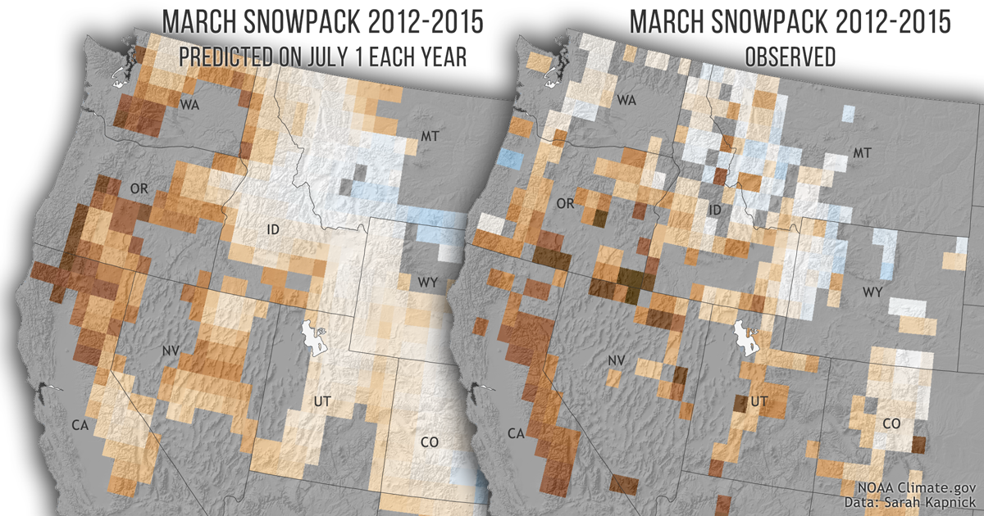
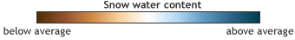

Demonstrated skill in seasonal snowpack prediction
Source: Climate.gov image adapted from Kapnick et al. (PNAS 2018)
Notes:
Average of predictions for the 2012-2015 snowpack drought (peak of snowpack drought in the West) made every July 1 for the following March using a 50 km model. To put in perspective: “The forecasts were made around the 4th of July holiday and fireworks before the first snowflake of winter hits the ground”
Brown = lower than average snow (drought); Blue = Higher than average snow
Note: in California, there was a drought state of emergency during this time period that did not lift until 2017. Regional stakeholders called for improvements in seasonal prediction of drought/snowpack during this time of water shortages
Interestingly, this (50km) model both reproduces a pattern of low snowpack in the southwest and heavy snow in the northeastern portion of the West
Note: observed values (on the right) are only shown where we take measurements. The model (left) can provide snowpack predictions everywhere. This is important for extrapolating total water values stored in the entire snowpack in the West.
Predictions were assessed from 1981-2016. Collective skill for all years in major western U.S. mountain ranges was found in the modeling system (using multiple models at 200, 50, 25 km) except the southern Sierra. These global climate model based predictions are better than any measures using climate mode statistical predictions like those from El Niño Southern Oscillation or the Pacific Decadal Oscillation. To put in perspective: a July 1st El Niño state does not outperform the predictions created from the global climate models.
This research required generating ~1,200 model years of predictions (3 models x 36 years x 12 ensemble members**----10 ensemble members in 200 km model)
A new seasonal prediction system, SPEAR, is under development that will address shortcomings in the previous prediction system and models
16

Slide 17
Towards a Seamless System for Prediction and EArth System Research
“SPEAR”
Using latest generation component models to build next generation
seamless prediction system. The building blocks are
AM4/FV3 (atmosphere), MOM6 (ocean), SIS2 (sea ice), LM4 (land)
 | Atmosphere res | Ocean res | Status of Development | Reforecasts
SPEAR_LO | 100 km | 1º | Completed | In progress
SPEAR_MED | 50 km | 1º | Completed | Planned in coming months
SPEAR_HI | 25 km | 1º | In development | Very limited set planned due to computational costs
Current R&D efforts:
Development of new initialization systems for seasonal and decadal prediction
Improving stratospheric resolution
Anticipate that SPEAR-based prediction system will join the NMME in late 2019 or early 2020
Notes:
17

Slide 18
Seasonal Hurricane Outlooks

Slide 19
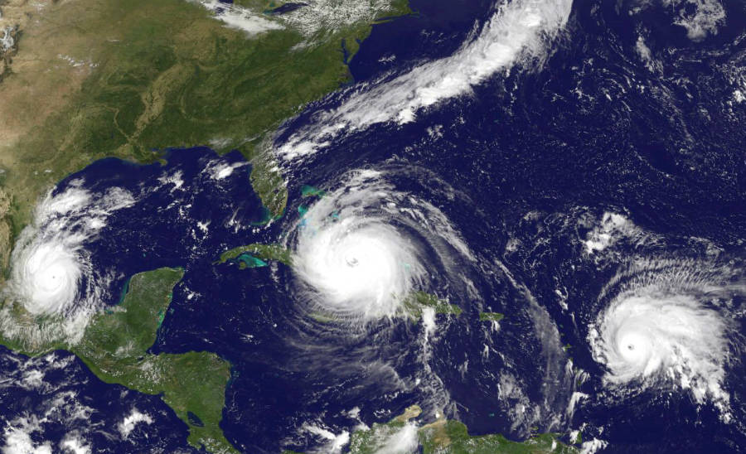
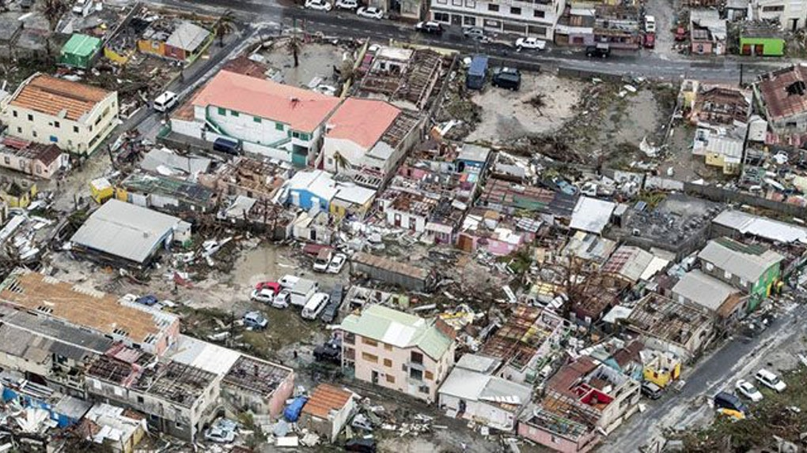
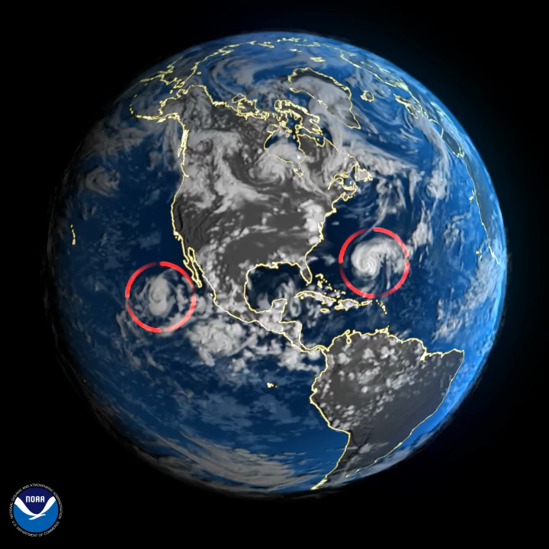
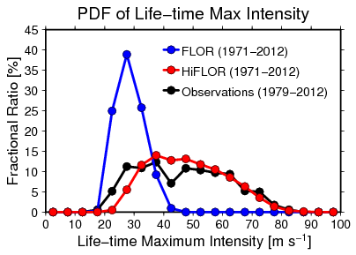
Motivation for Hurricane Prediction
2017 Major Hurricanes
Damage by Hurricane Irma in 2017
Developing a dynamical model that has skill in predicting intense hurricanes is central to NOAA’s mission and highly relevant to society.
 | FLOR | HiFLOR
Resolution | Atmosphere：50 km, L32 Ocean: 100 km, L50 | Atmosphere：25 km, L32 Ocean: 100 km, L50
Major Hurricanes
A simulation with HiFLOR
Notes:
06/09/11
19
S/I forecasts - initial value
IPCC projections - boundary value
Decadal - combination

Slide 20
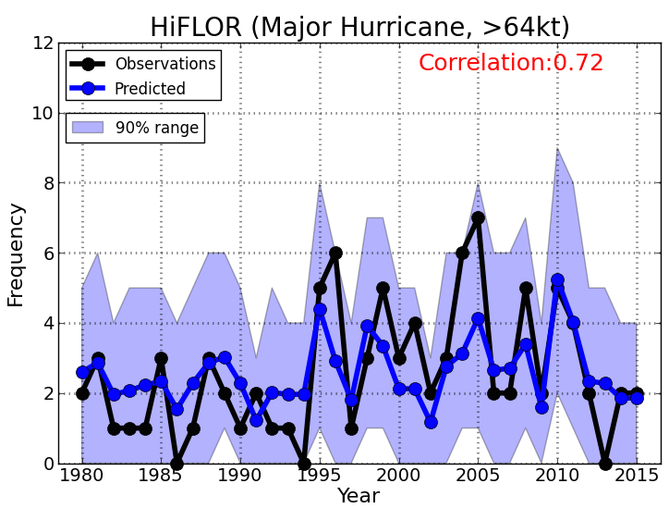
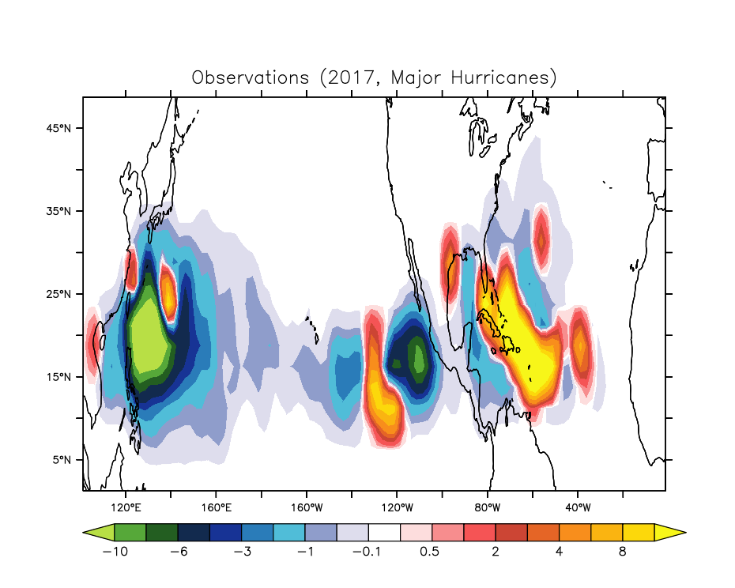
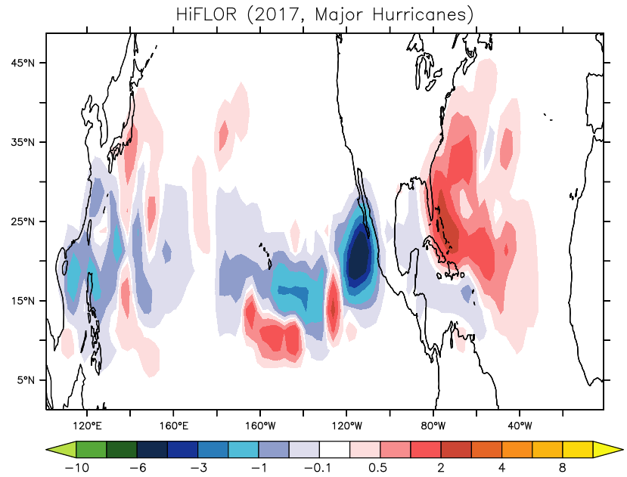
Seasonal Predictions of Major Hurricane Activity
OBSERVED
PREDICTED
Predicted major hurricane frequency in the North Atlantic from July 1st initial forecast for each year.
2017 anomalous major hurricane activity
HiFLOR shows skillful prediction for frequency of major hurricanes a few months in advance.
The real-time predictions are shared with the experts in National Hurricane Center and Climate Prediction Center to support their seasonal hurricane outlook.
Notes:
06/09/11
20
S/I forecasts - initial value
IPCC projections - boundary value
Decadal - combination

Slide 21
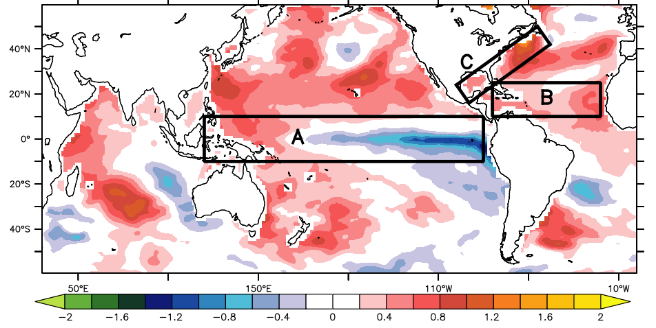
Seamless prediction facilitates attribution of observed events
What caused the active 2017 major hurricane season?
Observed SST Anomaly in 2017
Moderate La Niña?
Warmer Tropical Atlantic?
Warmer off the coast of North America?

Slide 22
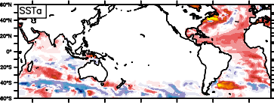
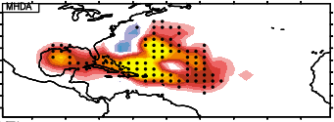
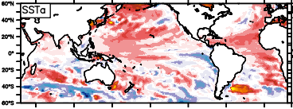
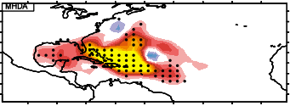
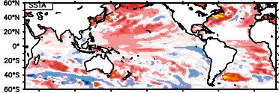
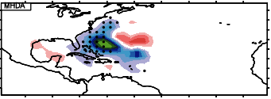
Seamless prediction facilitates attribution of observed events
Prescribed SST Anomaly
Predicted MH Density Anomaly
A. Moderate La Niña?
Pacific SST anomaly was removed.
Major hurricanes are still active.
C. Warmer off the coast of North America?
SSTa off the coast of US was removed.
Major hurricanes are still active.
B. Warmer Tropical Atlantic?
SSTa in the tropical Atlantic was removed.
Major hurricanes reduced.
We find:
Moderate La Nina was not responsible
Warming off US East Coast was not responsible
Tropical Atlantic warming played dominant role
More details in Murakami et al, 2018, Science

Slide 23
Global Data Assimilation

Slide 24
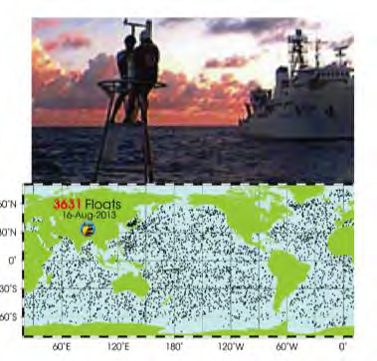
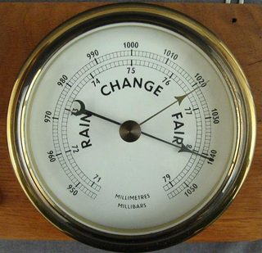
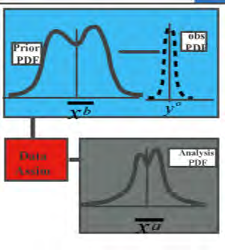
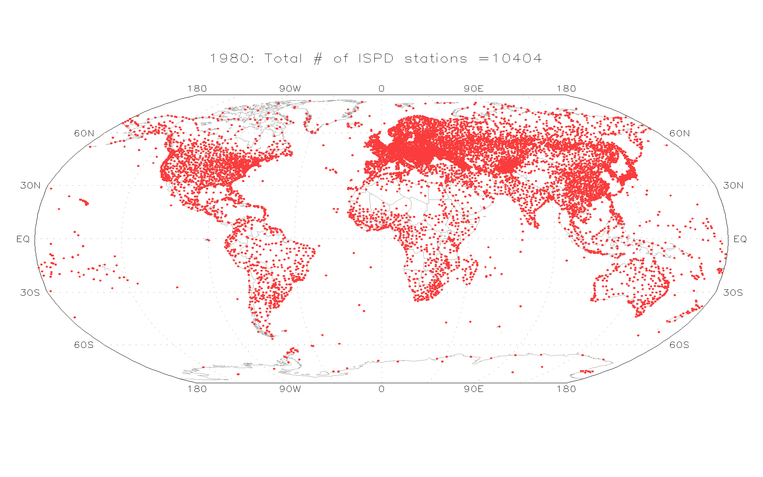
GFDL’s data assimilation system: Toward a coupled climate reanalysis
(ocean T/S profiles & atmospheric surface pressure)
Data assimilation system:
Combines observations with coupled climate model to estimate climate state
International
Surface Pressure
Databank (ISPD)
Compo et al. 2011
Current data assimilation system:
An Ensemble Coupled Data Assimilation (ECDA) system using GFDL/CM2.1
SST, Ocean T/S profiles
Atmosphere T and winds
Stations:1980
Current development and transition towards the new coupled prediction system:
Coupled model: SPEAR
MOM6 Ocean Data Assimilation (Feiyu Lu)
FV3 Atmosphere Data Assimilation (Xiaosong Yang)

Slide 25
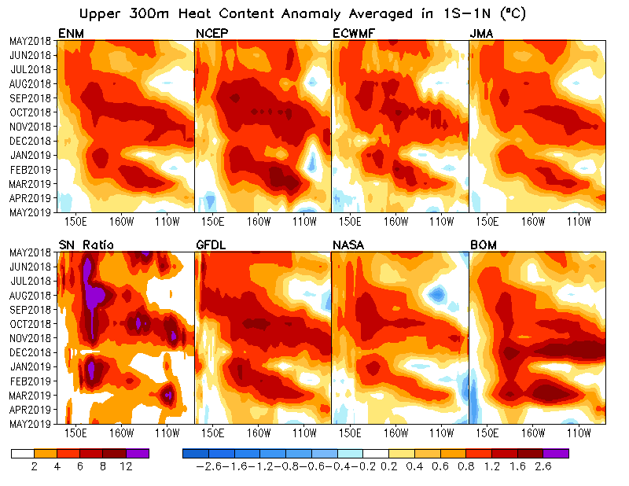
Assimilation and observing system assessment
Real-time ocean assessment
Real time prediction and state estimation
http://www.gfdl.noaa.gov/ocean-data-assimilation
Real time multiple ocean reanalysis intercomparison
Observing system assessment (e.g., TAO & Argo evaluation OSE; TPOS-2020)
SLP Assimilation: Towards a coupled climate reanalysis and initialization system
Depth
https://www.cpc.ncep.noaa.gov/products/GODAS/multiora_body.html
25

Slide 26
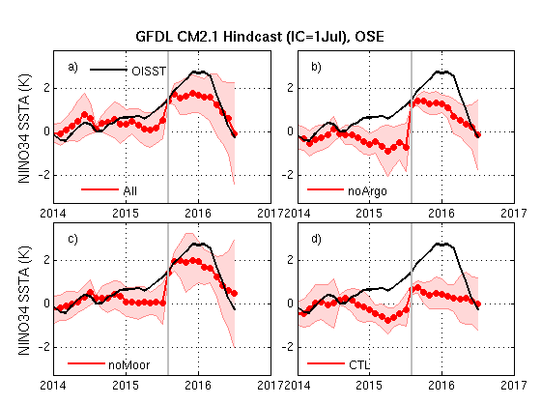
Impact of ocean subsurface observations on predicting
the strong 2015/16 El Niño (Initial condition: 1July, from OSE)
No Argo data
No subsurface data
No Mooring data
26
Notes:
Black: Observation
Red: ensemble mean (dots) and spread (shading).
All: initialization using all available oceanic subsurface observations
noArgo: initialization uses all available oceanic subsurface observations except Argo data
noMoor: initialization uses all available oceanic subsurface observations except TAO Mooring data
CTL: initialization without any oceanic subsurface observations.

Slide 27
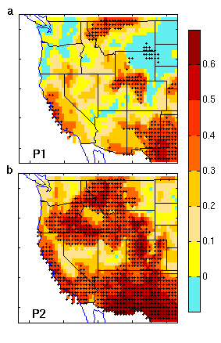
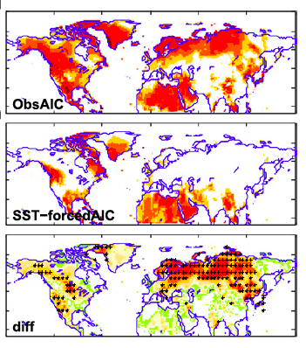
Understanding sources of predictability for first-season prediction:
Roles of atmosphere/land initialization
Winter precip skill
Winter T2m skill
Fcst
Ocean/Atm/Land Obs. Ini.
Fcst
Ocean
Obs. Ini.
17%
Fcst
Ocean
Obs. Ini.
Fcst
Ocean/Atm/Land
Obs. Ini.
Diff.
55%
The atmosphere initial condition plays an important role in predicting the unusual 2015/16 winter precipitation pattern over the western U.S.
Jia et al. (2017, J. Clim.)
Yang et al. (2018, Clim. Dyn.)
27

Slide 28
Reserve Slides

Slide 29
Selected accomplishments with CM2.1, FLOR, and HIFLOR
Simulation, prediction, attribution of hurricanes, including Cat 4/5 (Murakami et al, 2015, J. Climate; 2016, 2017)
Attribution of causes of 2017 Major Hurricanes in Atlantic (Murakami et al, 2018, Science)
Seasonal sea ice prediction (Bushuk et al, 2017, Geophys. Res. Letters; 2017, J Climate)
Improved seasonal prediction of temperature and precipitation with improved initialization (Jia et al, 2016, J Climate; 2017, J. Climate )
Seasonal prediction of winter storminess (Yang et al, 2015, J. Climate)
Western US snow pack (Kapnick et al, 2018, PNAS)
  Skill in predicting western US snowpack 8 months in advance
Western US precip, 2015/2016 ENSO (Yang et al, 2018, Climate Dynamics)
  Impact of initialization system on seasonal prediction of precipitation
Interannual to decadal prediction of Atlantic ocean temperature (Yang et al., 2013, J. Climate)
Decadal predictability and prediction of Southern Ocean (Zhang et al, 2017a, J. Climate; 2017b, J. Climate)
Causes of Southern Ocean trends in sea ice (Zhang et al, 2018, Nature Climate Change)
Projection & attribution of Arabian Sea tropical storms in response to anthropogenic forcing (Murakami et al., 2017)
Attribution of anomalous 2015 Pacific hurricane season (Murakami et al., 2017)
Multi-decadal projection of US & Global Hydroclimate (Zhang and Delworth, 2018a, 2018b)
Seasonal to decadal biogeochemical prediction (Park et al., 2018, Climate Dynamics)
See https://www.gfdl.noaa.gov/bibliography/
for searchable database of GFDL papers

Slide 30
GFDL coupled GCM development
CM2.1
A: 2.5° × 2° × L24
O: 1° × 0.33° × L50
CMIP5:
ESM2M
ESM2G
CM3
CMIP3 workhorse &
SI forecast model.
CMIP6:
ESM4
atm×4
“Forecast-oriented
Low Ocean Resolution”
(SI forecast model)
FLOR
A: 0.5° × 0.5° × L32
O: 1° × 0.33° × L50
Decadal-to-centennial
LOAR1
SPEAR
atm×2
ocn×10
flux-adjust SST,
SSS, wind stress
Corrected surface
climate
hiFLOR
A: 0.25° x 0.25° x L32
O: 1° x 0.33° x L50
CM2.6
A: 0.5° x 0.5° x L32
O: 0.1° x 0.1° x L50
FLOR-FA
A: 0.5° x 0.5° x L32
O: 1° x 0.33° x L50
FLOR connects many of GFDL’s newest climate models,
and is used extensively for seasonal-to-interannual research and forecasts.
Notes:
30

Slide 31
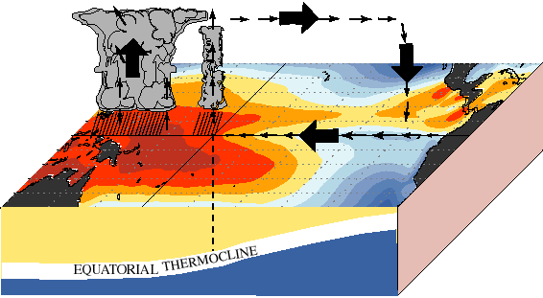
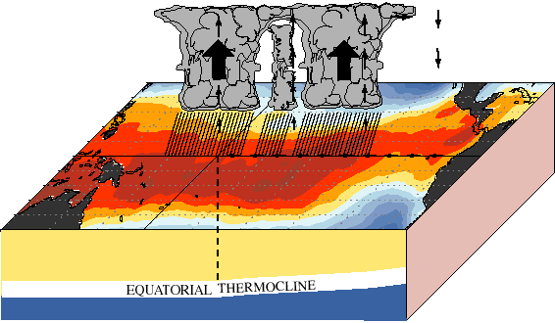
Earth's dominant interannual climate fluctuation:
Asymmetric:
cold tongue, warm pool;
ITCZ north of equator;
easterly trade winds;
sea level slopes up to west,
thermocline down to west
Normal
Ekman
upwelling
rain follows warmest SST;
surface winds converge
onto rainy/warm zones
Events occur at
irregular intervals (2-8yr);
peak around Nov-Dec;
last about a year;
often followed by La Niña
El Niño
NOAA/CPC
Fundamentally coupled phenomenon,
involving troposphere + top 300m of the tropical Pacific ocean.

Slide 32
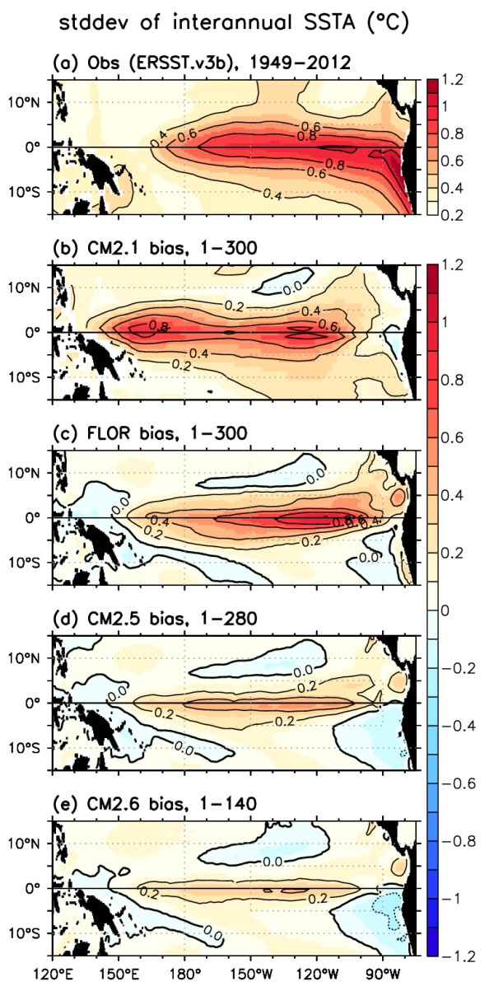
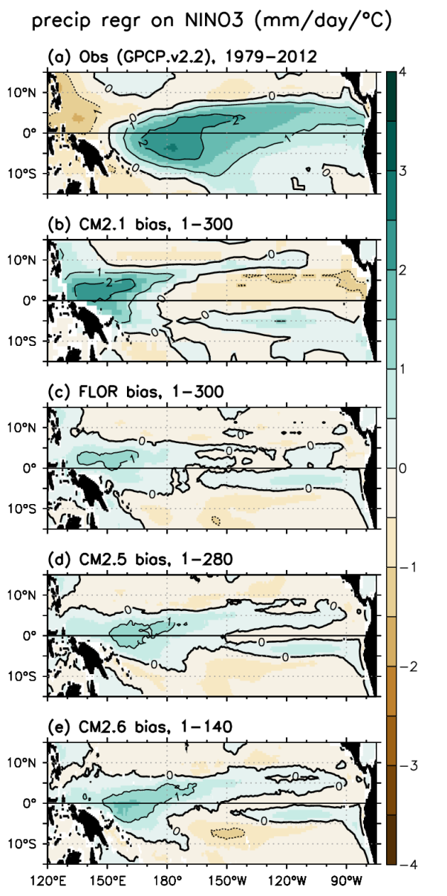
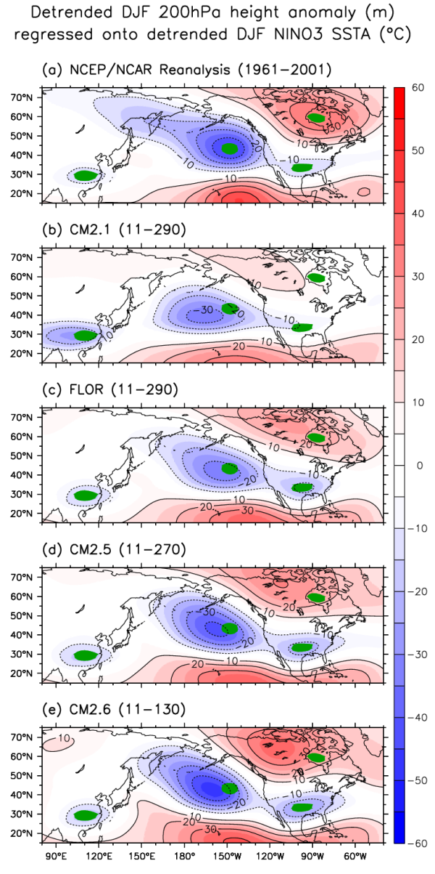
ENSO improvements with increasing resolution
OBS
forecast
model
4x atm
4x ocn
2.5x ocn
Delworth et al. (2012); Vecchi et al. (JC 2014); Jia et al. (JC 2015); Wittenberg et al. (JAMES 2018)
Notes:
32

Slide 33
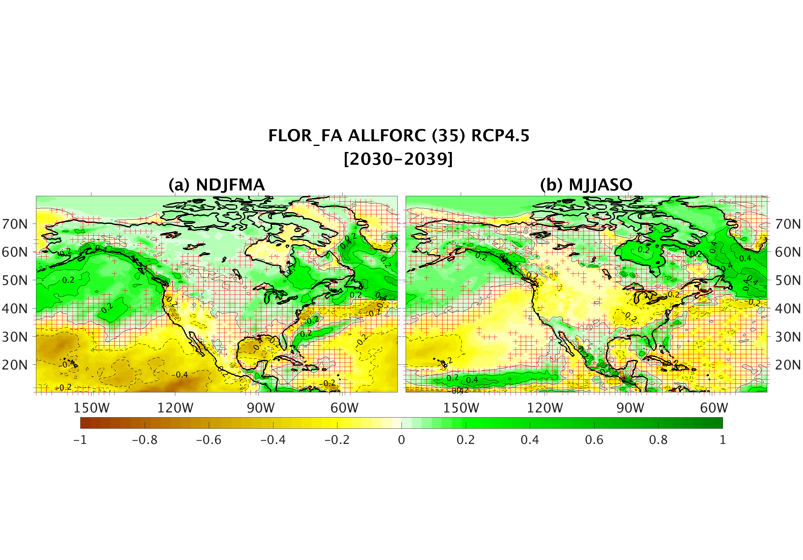
Projecting decadal scale changes in North American Hydroclimate
Key goal: Probabilistic assessment of decadal changes in weather extremes over North America
Precipitation extremes and water resources, especially over North America
Characteristics and impacts of changing tropical and extratropical storms
Snowpack and western water resources
Projected change in P-E (winter, for decade of 2030s) using large ensembles with FLOR
H. Zhang and
Delworth,
2018,
J Climate
Drier
Wetter
Change in Precipitation minus Evaporation (mm day⁻¹)

Slide 34
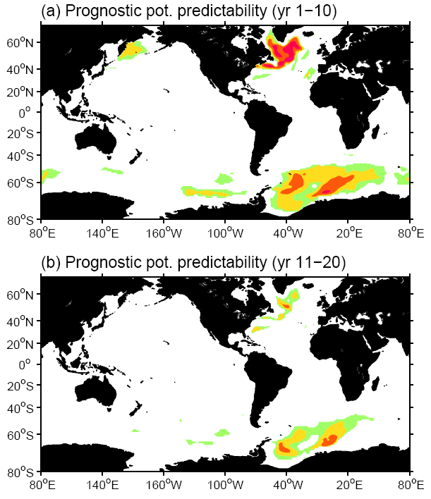
There are a number of phenomena with decadal predictive skill from internal variability:
Atlantic Ocean surface and subsurface temperature (AMOC, ocean circulation)
Pacific Decadal Oscillation (less predictable than North Atlantic)
Southern Ocean – potentially predictable on long time scales

Slide 35
TRADEOFFS: Building the best prediction system given available computing resources
The table above shows how long it would take (in months) to complete a reforecast suite for three resolutions of an atmospheric model (100 km, 50 km, and 25 km) coupled to a 1º ocean model. The different columns make different assumptions about either the characteristics of the reforecast suite (duration of the reforecast, start months, or ensemble members) or the available computational resources to understand the viability of reforecast selections. Based on experience, a set of reforecasts that would take 5 or more months is not viable (these boxes are shaded in red). Such a long process would not allow for the normal iterative process that is necessary in the development of models and prediction systems. A box shaded in yellow is at the margins of viability.
The “Base Case” assumes 10% of the NOAA GAEA supercomputer system is used for a full suite of reforecasts producing 10,800 model simulation years.
An “alternative reforecast suite” (20 ensemble members and 20 years of reforecasts) makes a 50 km viable in addition to the 100 km model.
Altering computer resources (rightmost columns) and limiting the number of start months to quarterly improves the viability of higher resolution models.
NOAA currently allocates 74 million CPU hours per month on the GAEA supercomputer. In this document we refer to 100% of GAEA as 74 million CPU hours per month.
¹NOAA currently allocates 74 million CPU hours per month on the GAEA supercomputer. In this document we refer to 100% of GAEA as 74 million CPU hours per month.

