Slide 1
Essential ENSO Properties & Metrics
Prepared for the CLIVAR Pacific Region Panel
Working Group on Conceptual Models of ENSO
Presented by Andrew Wittenberg
with contributions from: Y. Planton & the ENSO Metrics Team, S. Stevenson, …
10 September 2020

Slide 2
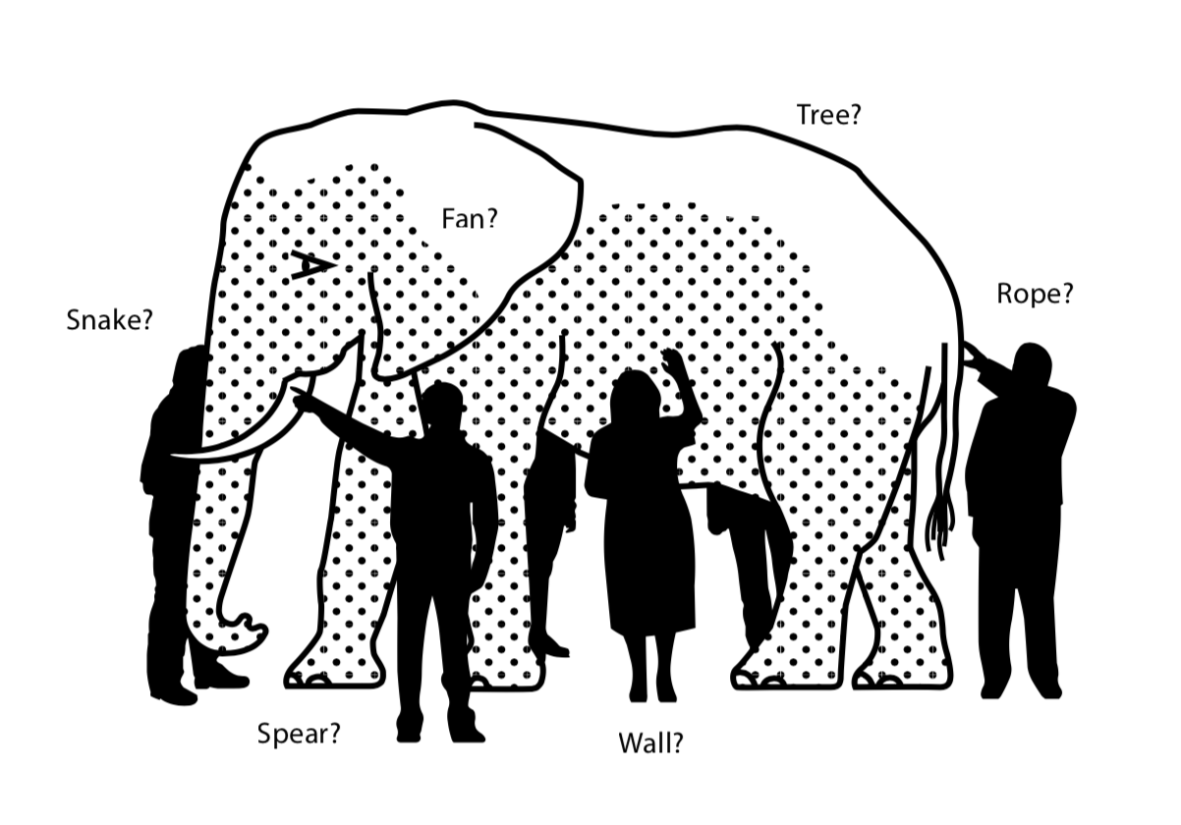
From our Terms of Reference: “Agree on fundamental properties of ENSO that a conceptual model should account for, and quantitative measures of those properties.”
Today: - Role, scope, and desired features for conceptual model(s) - Desired ENSO properties to account for - Relation to ENSO metrics (e.g. new CLIVAR ENSO package)

Slide 3
Role of a conceptual model
A model is a mathematical construct that describes observations.
The main role of a conceptual model is to enhance understanding.
Accuracy & fine details can be left to more comprehensive models, whose development can be informed by conceptual models.
An ENSO conceptual model should: - Capture essential behaviors, dynamics, & sensitivities of ENSO - Map clearly onto observed ENSO properties in nature & GCMs - Strive for simplicity, to aid understanding

Slide 4
Desired features of conceptual models (1)
Elegant, quantitative, observable, physical, and extensible.
1. Elegant a. Simple yet effective (parsimonious) - Realistic behavior, with minimal structure & few free parameters - Easy to explain, code, explore; valuable as a teaching tool - Analytical tractability is a plus
b. Fast to simulate: e.g. run millennia on a laptop
2. Quantitative a. Dynamical “budgets” for ENSO behavior - Equations for how parameter changes/biases affect ENSO
b. Predicts something new - Skillful out-of-sample predictions (events, phenomena, sensitivity) - Identifies key parameters
c. Suggests quantitative metrics for CGCMs - To compare/evaluate CGCMs & obs - Why models differ, and what to do about it - To rank GCMs for certain tasks. Depends on: - Application - Simulations: Does ENSO mimic observed behavior & mechanisms? - Reanalyses: Are ENSO features in the right place? - Forecasts: Does ENSO retain useful long-term memory for forecasts? - Projections: Are future ENSO changes plausible? - Region/variable of interest (e.g. NINO3 SST vs. Peru SST vs. Australian drought)

Slide 5
Desired features of conceptual models (2)
3. Observable a. Well constrained by existing obs or GCM simulations
b. Clear recipes to estimate free parameters from obs/GCMs
4. Physical a. Derived from fundamental physics, with reasonable assumptions - The less empirical the better (though statistics/LIMs could help guide formulation)
b. Conceptual elements independent of fixed lat/lon/depth regions - Regimes can shift due to climate change or CGCM biases
c. Relevant to GCM development - Clear mapping onto GCM-simulated variables - Relates clearly to GCM parameterizations, e.g.: - CMT → wider 𝝉_{x}’ response → weaker discharge → stronger/slower ENSO - Weaker viscosity → stronger TIWs → more LN damping → more SSTA skewness
5. Extensible a. Part of a model hierarchy that builds toward more realism & complexity - Start simple; add layers as needed - Helps to resolve tension between elegance & realism/comprehensiveness
b. Flexible “resolution”, variables, ENSO features - Application-dependent; a single conceptual model cannot serve all purposes - May need a diverse toolbox of conceptual models
These characterize the conceptual model. What’s the scope of ENSO that we hope to explain?

Slide 6
Scope of ENSO conceptual models (1)
Region, composition, structure, behavior.
1. Region(s): Where does ENSO “live”? a. Tropical Pacific (20°S–20°N, 120°E–80°W)
b. Coupling to tropical Indian & Atlantic (e.g. MJO, IOD, AMV)
c. Coupling to higher latitudes (e.g. PMM, PDV)
d. Coupling to continental climates (e.g. volcanic cooling, anthro warming)
2. ENSO composition: Key physical variables & fields a. Ocean - SST - thermal structure - heat content (e.g. temp of top 300 m; WWV) - thermocline depth (depth of max dT/dz) - SSH - MLD (~30-100m) - “entrainment temperature” (T_{e}) - currents & upwelling (surface, ML, EUC, recharge/discharge) - SST/MLT budget: advection, mixing, solar penetration - salt/freshwater budget (barrier layers) - TIW activity (noise & nonlinearity)
b. Atmosphere - surface wind stress (𝝉) - air-sea heat fluxes (especially shortwave & latent) - precip (latent heating → winds & teleconnections) - convection & clouds; moisture budget - WWEs (noise & nonlinearity)

Slide 7
Scope of ENSO conceptual models (2)
3. ENSO structure: Key indices & averages x, y - box indices: WEqPac, NINO4, NINO3.4, NINO3, NINO12 - Can these be (re)defined in terms of climate features & boundaries, rather than lat/lon? - EOFs (linear, complex, nonlinear, ...) - equator (wave guides, peak upwelling) - meridional structure (wind stress curl, ocean recharge/discharge, asymmetry) - east/west boundary layers (boundary reflectivity)
z - surface - boundary layers: ABL, ML (not constant!), barrier layers - baroclinic modes (troposphere & upper ocean)
t - 30–90 day means (core ENSO dynamics) - 5–30 day means (WWE & TIW noise) - seasonality - may need 30–500yr record for robust fits (depending on ENSO statistic)
4. ENSO behavior (details below) a. PDFs b. Patterns & evolution c. Mechanisms, including nonlinearity & noise d. Predictability e. Sensitivities to climate & parameters
Given this scope, what ENSO properties would we like to capture?

Slide 8
Key ENSO properties (1)
1. PDFs a. Amplitude - e.g. stddev of NINO3 SSTA, or composite LN/CPEN/EPEN intensity
b. Quantiles (including extremes) - e.g. 95th-percentile EN & LN
c. Joint distributions might better resolve impacts of climate shifts/biases - e.g. SST & rainfall; SST & h; SST & cloud & net surface heat flux
2. Spatial patterns a. Standard deviation maps (e.g. SSTA stddev)
b. Regressions/correlations onto key ENSO indices (e.g. 𝝉_{x}’ regr on NINO3 SSTA)
c. Composites (e.g. DJF SSTA pattern for all DJF NINO3 SSTA exceeding a threshold)
d. EOFs
e. Inter-event diversity
3. Temporal evolution a. Spectrum: peak, breadth, spatial dependence (QB, QQ)
b. Event duration & inter-event spacing
c. Seasonal synchronization
d. Transition probabilities
e. Time-scale interactions - irregularity & interdecadal modulation - multiplicative noise - e.g. coupling to WWEs, TIWs, decadal modes
f. Inter-event diversity

Slide 9
Key ENSO properties (2)
4. Mechanisms: Cross-variable relations & feedbacks a. Regressions or composites - e.g. SST → wind; wind → h; h → SST - e.g. NINO3 SST → NINO3 net surface heat flux - e.g. NINO3 SST → NINO4 zonal wind stress
b. Lead-lag relations - Phase relations can reveal causality & predictability - Correlations, regressions, composites - e.g. zonal-mean eqPac h’, lag-regressed onto NINO3 SSTA
c. Heat budget of ocean mixed layer - Convective & stratus cloud feedbacks - Evaporative cooling - Thermocline feedback & ocean-dynamical thermostat (-wbar * dT’/dz) - Ekman feedback (-w’ * dTbar/dz) - Zonal advective feedback (-u’ * dTbar/dx)
d. Conceptually-integrated feedbacks - Bjerknes feedbacks: SST → 𝝉_{x} → u, w, h → SST - Delayed negative feedback (recharge/discharge) - Wind-evaporation-SST (WES) feedback
e. Variations in feedbacks & impacts - Seasonal modulation - Inter-event diversity - Sensitivity to background climate (biases, change)
f. Interactions & teleconnections with remote regions and other modes

Slide 10
Key ENSO properties (3)
5. Nonlinearity & noise a. EN/LN asymmetries: intensity, duration, transition
b. Convection & SST-wind coupling; nonlinear dynamical heating (NDH)
c. Maximum potential intensity (MPI)
d. Multiplicative noise & rectification (e.g. WWEs & TIWs)
6. Predictability a. ENSO precursors
b. Sources of memory; and limits due to noise & chaos
c. Predictable patterns (LLEs, optimal perturbations, model-analogs, …)
d. Decadal variations of predictability; “predicting the predictability”
7. Sensitivities to climate & parameters a. Consistency with historical & paleo obs and change (for right physical reasons)
b. Explain dependence of projections on model biases - Stratify CMIP models by plausibility - “Budgets” for model behavior, to target processes for development
c. Emergent constraints: Leverage intermodel diversity to better assess future risks
d. Emulate CGCM → cheaply extend simulations - More robust statistics & detection, and better characterize extremes
So many properties! How to prioritize? Case study: the CLIVAR PRP ENSO Metrics project.

Slide 11
ENSO Metrics
CLIVAR Research Focus: ENSO in a Changing Climate http://www.clivar.org/research-foci/enso 2014-2018; then merged back into CLIVAR PRP Co-chairs: E. Guilyardi (IPSL) & A. Wittenberg (NOAA GFDL) Implementation & application: Yann Planton (IPSL/PMEL) 12 members (France, US, Australia, Japan, Korea, UK)
Goals: - Understand ENSO processes & past/future changes - Develop evaluation protocol for ENSO in GCMs - Identify obs to improve models & projections
Performance metrics: Andrew, Antonietta, Mike, Matt, Scott, … Teleconnections: Scott, Shayne, Cai, … Processes: Eric, Yann, Soon-Il, Fei-Fei, Tobias, ...
Community package liaisons: PMP: Jiwoo Lee & Peter Gleckler (PCMDI) ESMValTool: Veronika Eyring (DLR); Barcelona Computing Center (BSC) CliMAF: Jérôme Servonnat (IPSL)

Slide 12
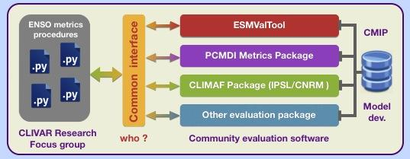
ENSO metrics strategy
Start with a small subset of essential, simple metrics. Avoid getting bogged down with complexity Aim more at model users than model developers. Expand as code, interfaces, use-cases take shape.
Metrics (scalars) are first step in a diagnostic hierarchy Useful for intercomparing models & metrics Dive-down diagnostics: Scalar → 1d → 2d → 3d Want to see both “forest” and “trees”.
Account for: - internal variability (multiple historical ensemble members) - obs uncertainties (use multiple obs products)
Written in Python Powerful, flexible Plugs into community efforts

Slide 13
Requirements for defining a metric
1. Documentation: Whys & hows of metric and collection
2. Math definition of metric (positive scalar “distance”)
3. Input data frequency (monthly, daily, ...) and grid (1x1 lat/lon, region, etc.)
4. Obs (as many as possible) and epoch to use
5. Literature reference to show robustness/utility of metric
6. Minimum duration (or ensemble size) needed for metric to make sense
7. Dive-down diagnostics (e.g. the spatial maps used to compute RMSE)
8. Normalization to use in a multi-model intercomparison (single color bar)

Slide 14
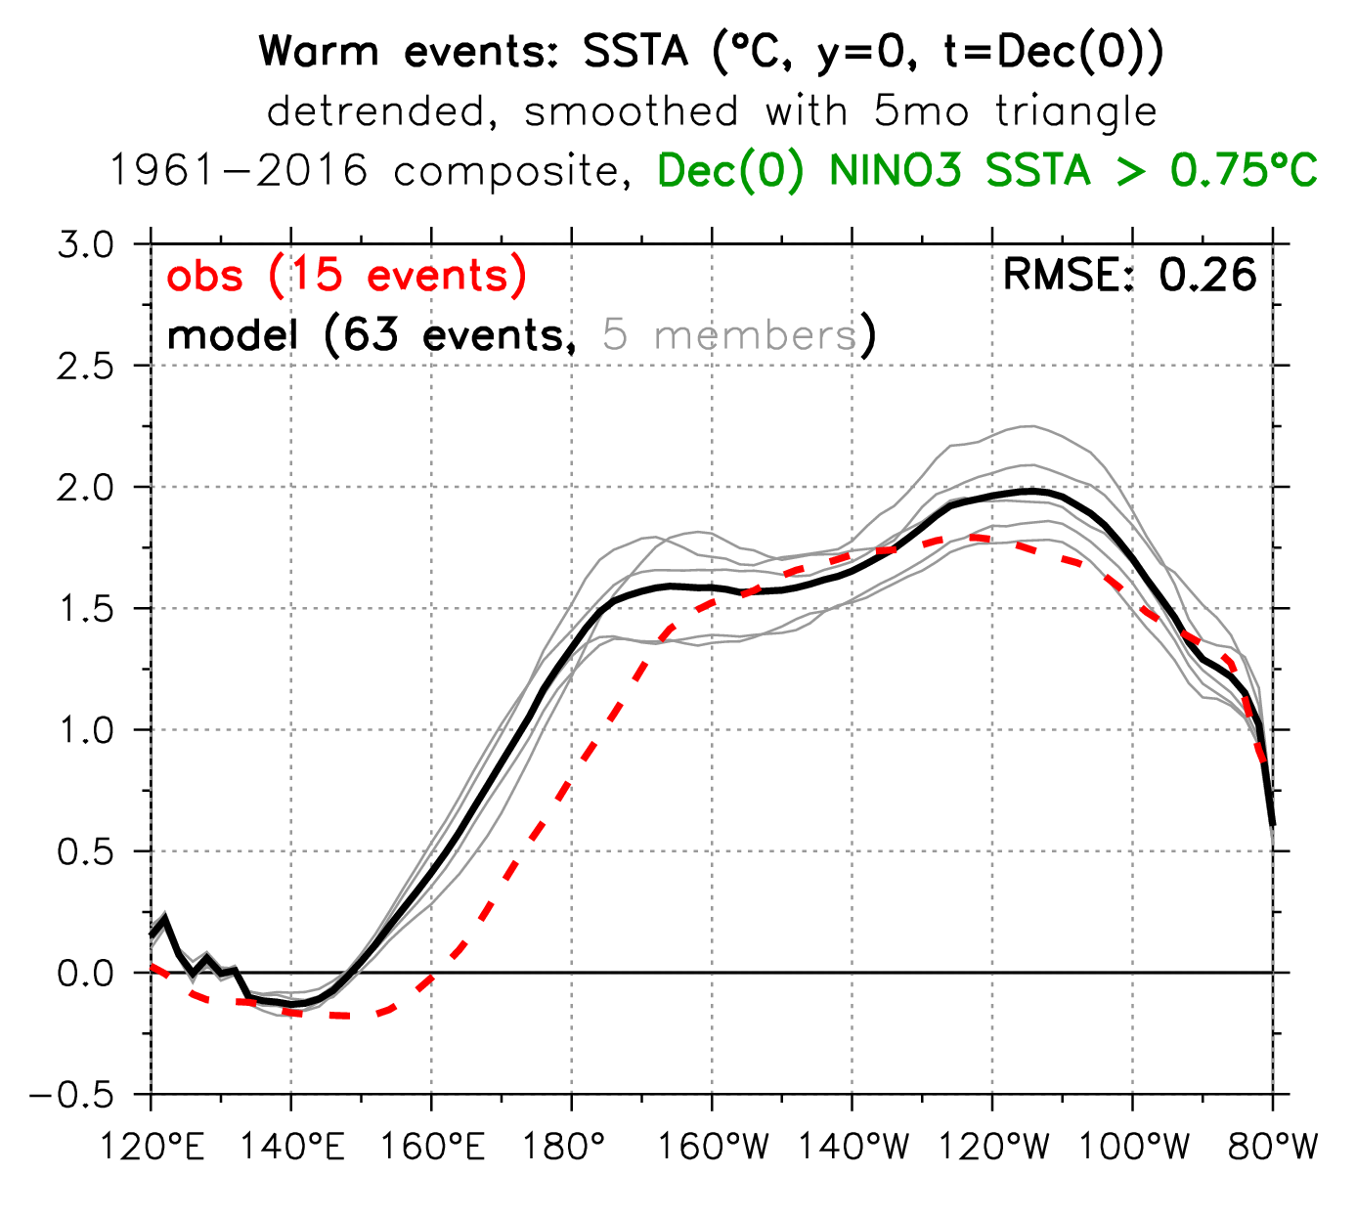
metric
double peak
diagnostic
SSTAs extend too far west

Slide 15
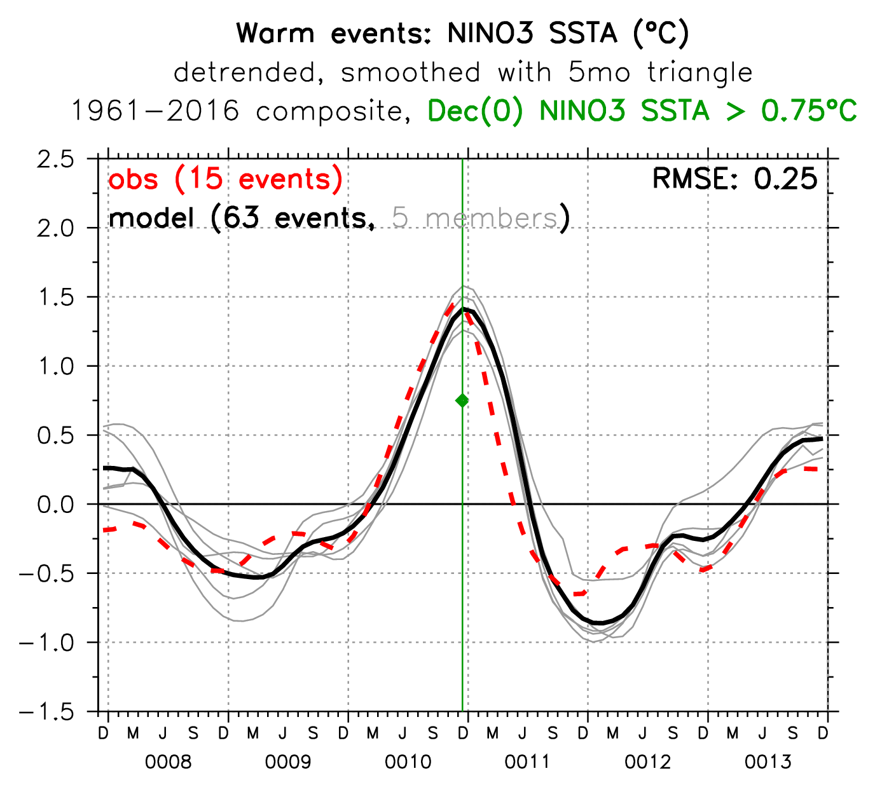
delayed termination
Inter-EN spacing
EN duration
ENSO lifecyle
Inter-LN spacing
excessive overshoot

Slide 16
Historical ENSO (63 metrics)
Properties (3)
EnsoAmpl (K)
EnsoSeasonality (K)
EnsoSstSkew (K)
Composite patterns & evolution (for warm & cold events; 16 in total)
NinoSstDur (months)
NinoSstDiv (%), IQR of diversity relative to obs
NinoSstLonRmse (K), along equator
NinoSstTsRmse (K), for NINO3 life cycle
Teleconnections (38)
EnsoAmpl
EnsoSstLonRmse (K): zonal SSTA pattern (5S-5N)
NinoMap_Rmse (outside eqPac, for warm & cold events)
variables: SSTA, SLPA, precip anom
statistics vs. NINO3.4: regression, correlation, ratio of stddevs → Taylor diagram
Processes / feedbacks (6)
EnsoAmpl
EnsoFbSstTaux: SST → tau_x
EnsoFbSstThf: SST → heat flux
EnsoSstOce: role of ODC in SST change
EnsoFbSshSst: SSH → SST
EnsoFbTauxSsh: tau_x → SSH feedback
monthly data, MKS units,
CMIP variable names,
auto-regridded to 1°x1°

Slide 17
Historical Climatology (9 metrics)
Annual mean (6)
Equatorial Pacific (5S-5N)
BiasSstLonRmse (K)
BiasPrLonRmse (mm/day)
BiasTauxLonRmse (mPa)
EPac meridional structure (15S-15N)
BiasSstLatRmse (K) (140W-110W)
BiasPrLatRmse (mm/day) (140W-110W)
BiasTauxLatRmse (mPa) (150E-90W)
Seasonal cycle (3)
SeasonalSstLonRmse (K)
SeasonalSstLatRmse (K)
SeasonalPrLatRmse (mm/day)

Slide 18
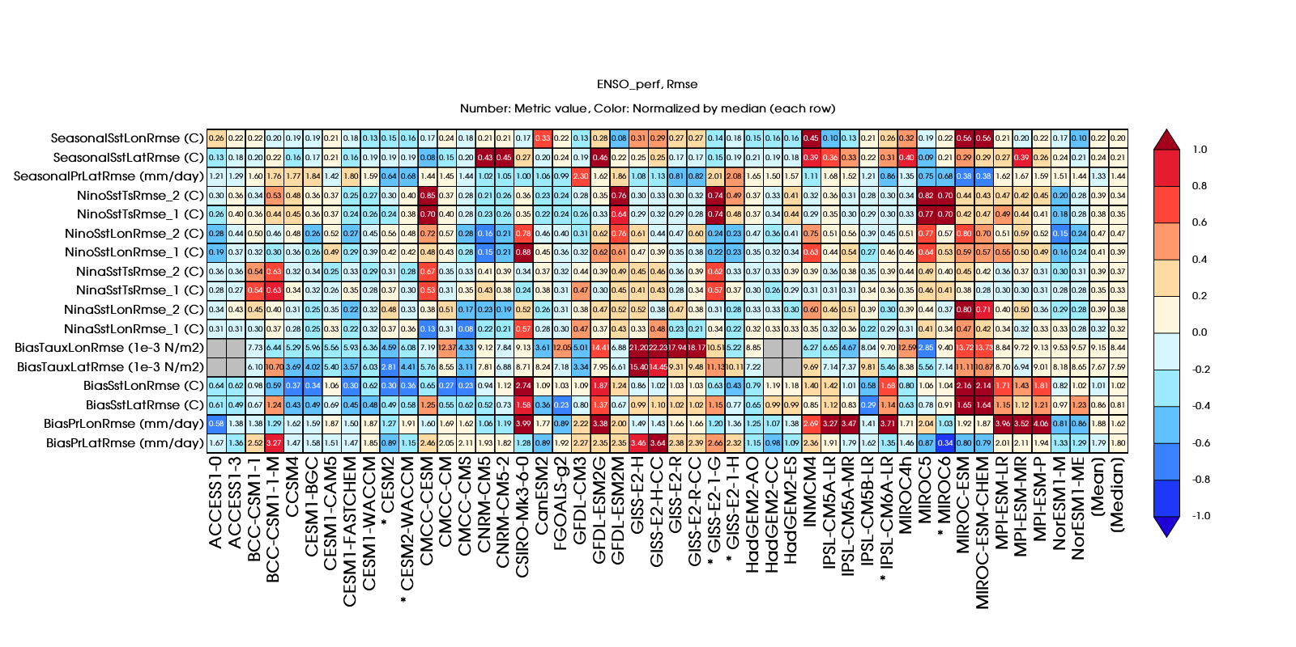
ENSO performance
RMSE-based metrics
Colors: relative to the median value of the metric (last column)
Numbers: metric value
colors:
medians
from
inter-model
median
metrics
numbers: RMSE relative to obs
(perfect score is 0)
worse
median model
better
different
composite
thresholds
models
* = CMIP6

Slide 19
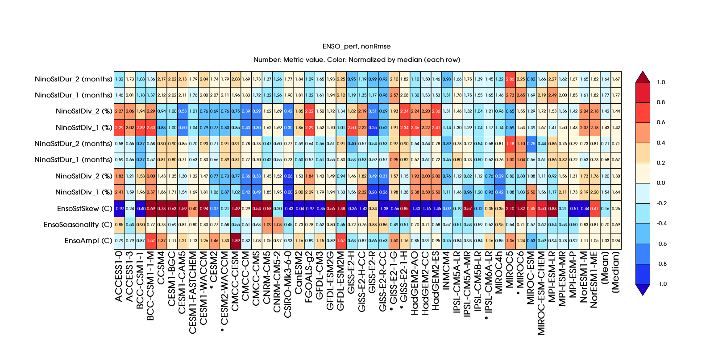
ENSO performance
Non-RMSE-based metrics
Colors: relative to the median value of the metric (last column)
Numbers: ratio of model to obs value
colors:
medians
from
inter-model
median
metrics
numbers: model/obs
(perfect score is 1)
more
median model
less
models
* = CMIP6

Slide 20
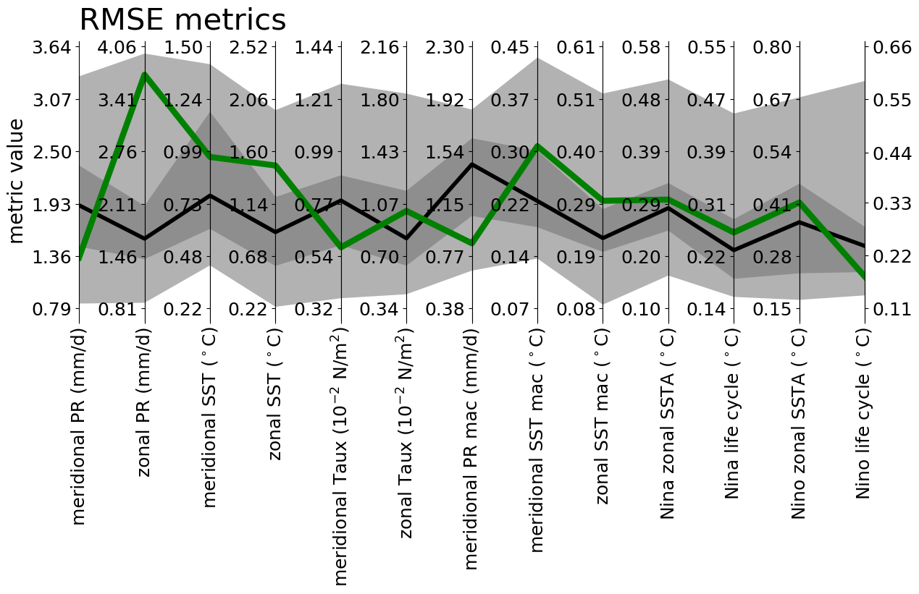
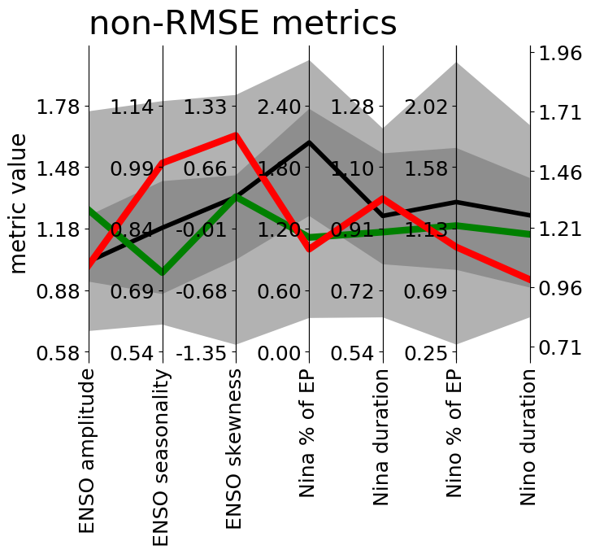
ENSO performance
Parallel coordinate plot: Multi-metric performance relative to CMIP distribution
Example of use for IPSL-CM5A-LR, vs. CMIP5 (shading) and Obs

Slide 21
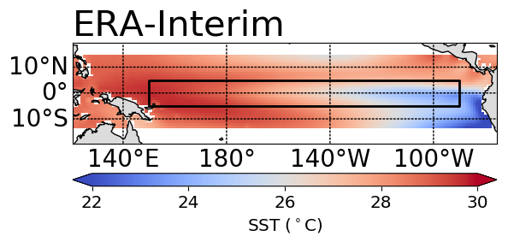
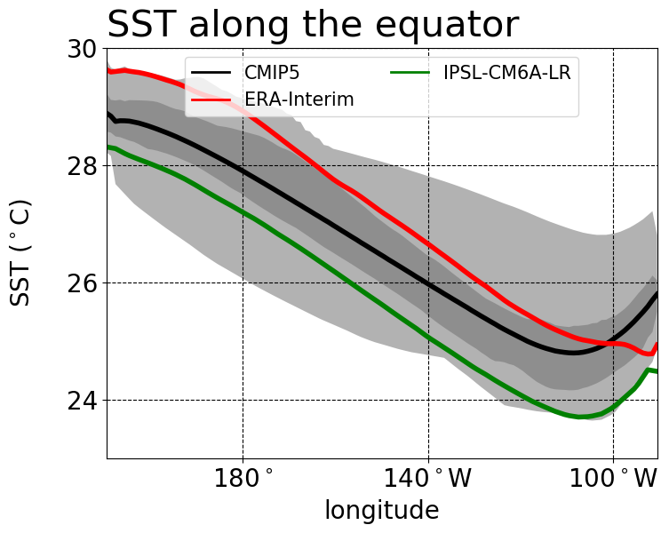
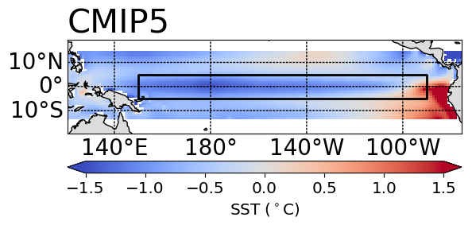
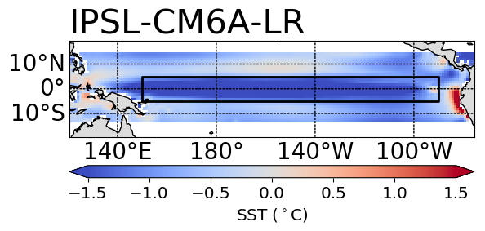
Annual-mean climate
Dive down level 2:
Metric:
RMSE(obs, model)
IPSL-CM6A-LR = 1.6°C
Dive down level 1:
(5°S-5°N)
IPSL-CM6A-LR
too cold everywhere

Slide 22
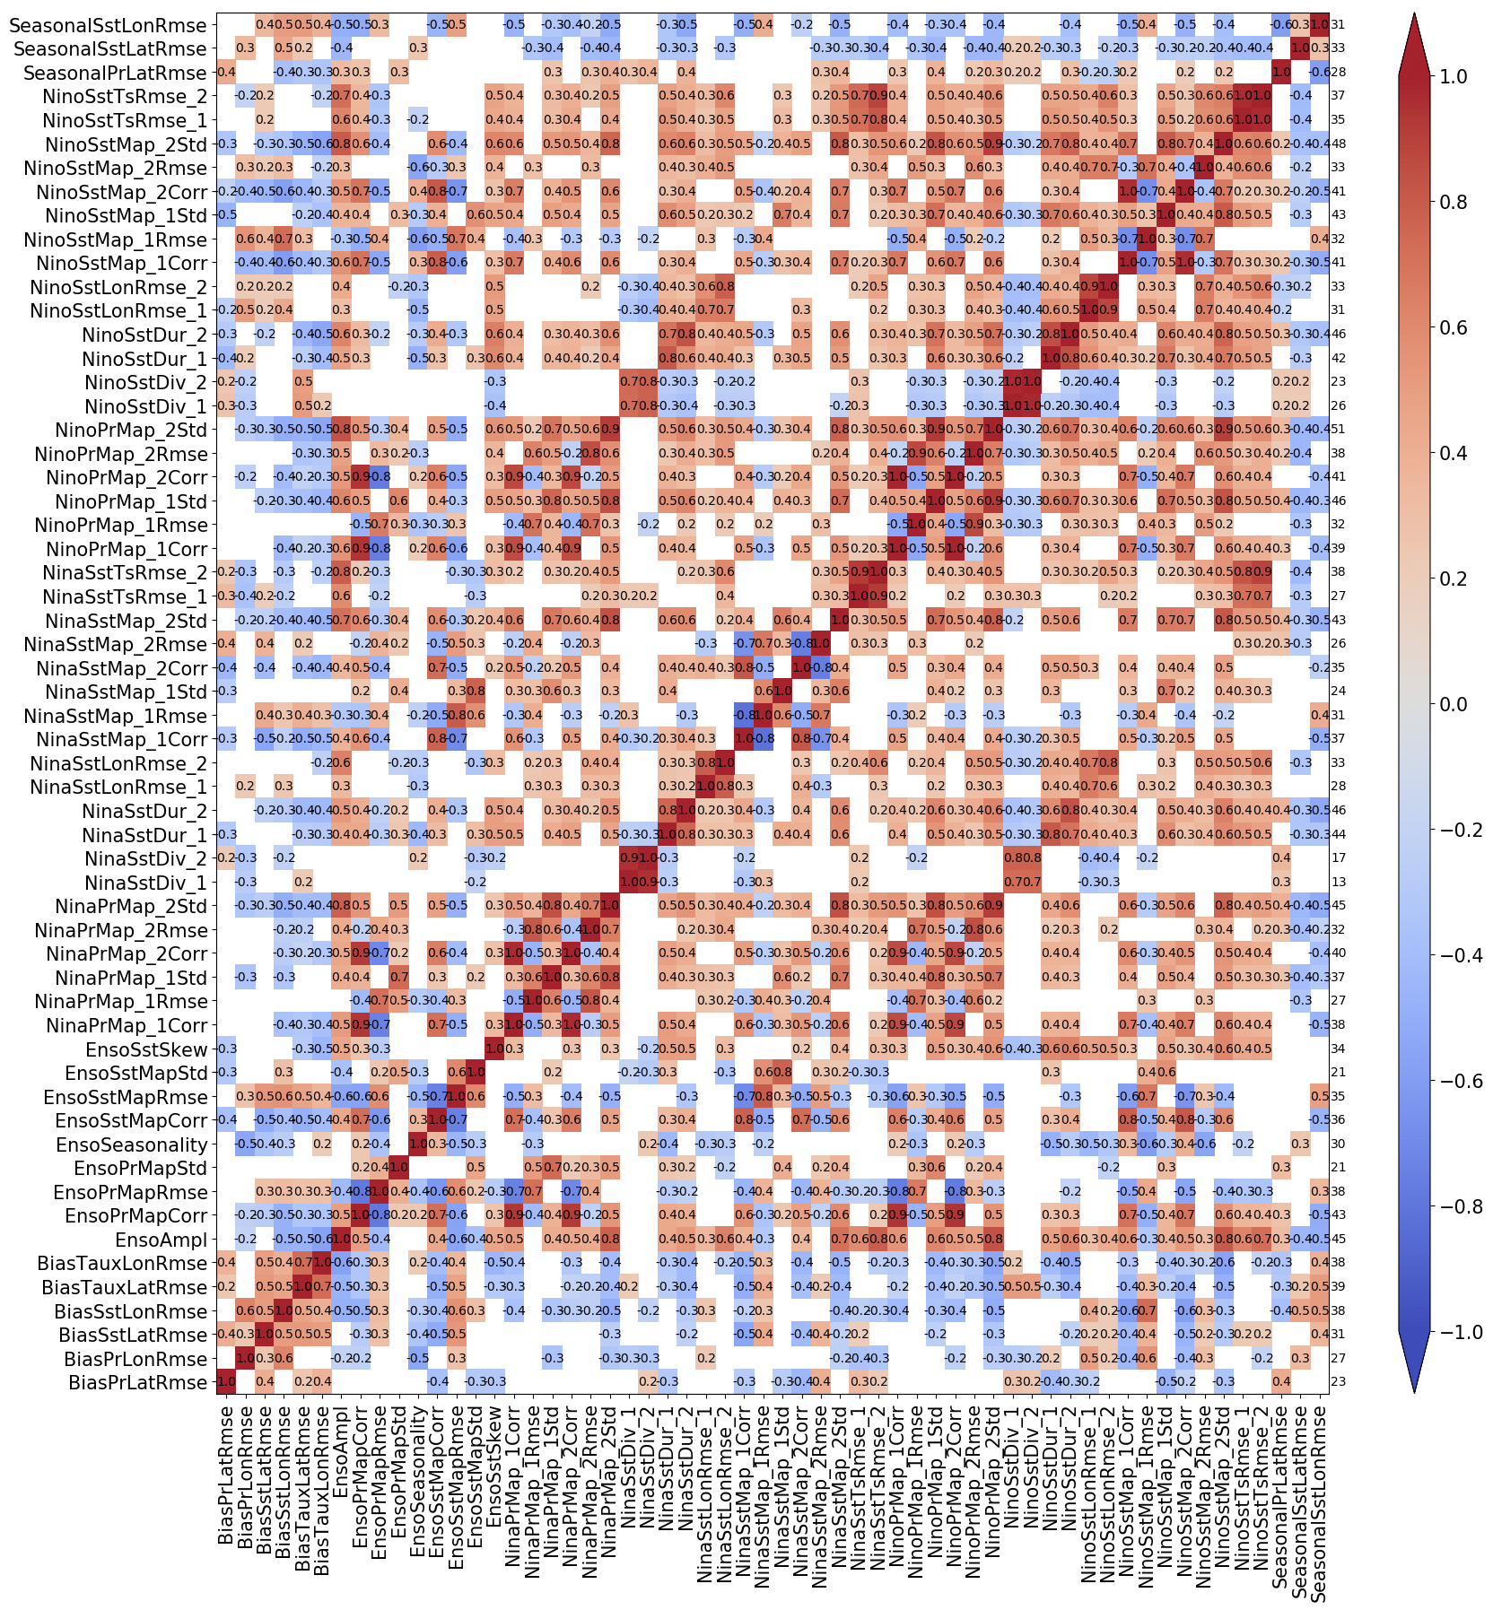
Discovering links among metrics
correl(metric₁, metric₂)
Compute correlations & EOFs across CGCMs, to identify redundancies & cull the metrics.
Findings:
- ECT cold/dry biases affect ENSO patterns & feedbacks
- h → SST feedback anticorrel with other feedbacks
Can inform conceptual modeling.
← correlate metrics across the models →

Slide 23
Metrics Collections (after culling)
ENSO performance (16)
Mean state biases (6): BiasPrLatRmse, BiasPrLonRmse, BiasSstLatRmse, BiasSstLonRmse
Annual cycle biases (3): SeasonalPrLatRmse, SeasonalSstLatRmse, SeasonalSstLonRmse
ENSO stats (4): EnsoAmpl, EnsoSeasonality, EnsoSstSkew, NinoSstDiversity
ENSO regression (3): EnsoDuration, EnsoSstLonRmse, EnsoSstTsRmse
ENSO teleconnections (11):
ENSO stats (1): EnsoAmpl
ENSO regression at Eq.(1): EnsoSstLonRmse
ENSO precip reg. (3): EnsoPrMap x3 (RMSE, corr. and spatial variability ratio)
ENSO SPL reg. (3): EnsoSlpMap x3 (RMSE, corr. and spatial variability ratio)
ENSO SST reg. (3): EnsoSstMap x3 (RMSE, corr. and spatial variability ratio)
ENSO processes (6):
ENSO stats (1): EnsoAmpl
Taux-SST feedback (1) EnsoFbSstTaux
HF-SST feedback (1) EnsoFbSstThf
SST change origin (1) EnsodSstOce
SSH-SST feedback (1) EnsoFbSshSst
Taux-SSH feedback (1) EnsoFbTauxSsh
Reduced from 72 metrics down to 33.

Slide 24
Results from the ENSO Metrics Project
Paper (documentation & application to CMIP5/6): Planton et al., 2020: Evaluating climate models with the CLIVAR 2020 ENSO metrics package. BAMS, in press. - CMIP6 models mostly outperform CMIP5 - Exception: process metrics (h → SST coupling actually worsens)
Wiki: https://github.com/CLIVAR-PRP/ENSO_metrics/wiki
Software: https://github.com/CLIVAR-PRP/ENSO_metrics
Interactive portrait plots (with dive-down diagnostics): https://pcmdi.llnl.gov/research/metrics/enso
Questions for ENSO conceptual models: - What other metrics are important? (Especially process metrics) - How should we weight or prioritize metrics (depends on application)? - How else can we use conceptual models to understand GCMs?

