Slide 1
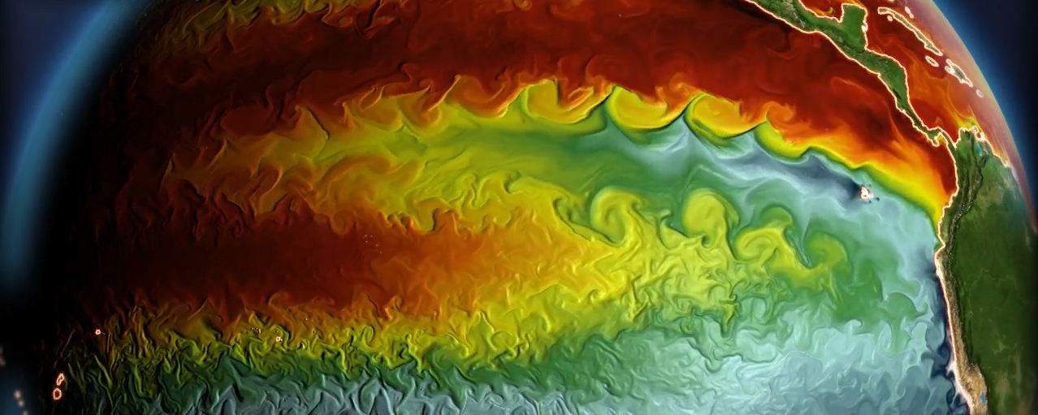
Relating model biases to regional uncertainties:
Tropical Pacific climate and ENSO
GFDL CM2.6 simulation
Andrew T. Wittenberg
NOAA GFDL, Princeton, NJ, USA

Slide 2
What do we want to achieve with this paper?
1. Awareness that projections are uncertain, but progress is being made
2. Promising opportunities lie ahead, to improve our projections.
3. Encourage engagement & support - From labs, funders, and scientists (especially early-career) - Should convey optimism & excitement

Slide 3
Key Questions for Sec. 2.1
1. What do we know about tropical climate change patterns from observations?
2. How do model biases currently limit our tropical climate projections?

Slide 4
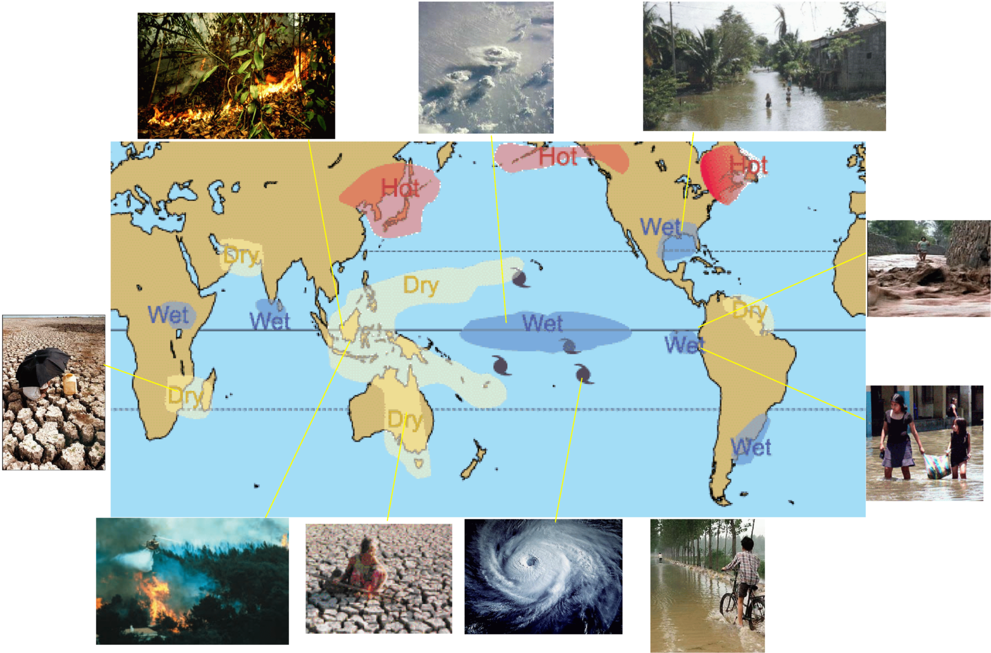
Focus: Tropical Pacific & ENSO
These drive much of the future regional uncertainty worldwide
Weaker upwelling, altered currents -> affects marine ecosystems & fisheries.
Eastward/equatorward shifts in rainfall -> impacts terrestrial ecosystems & agriculture.

Slide 5
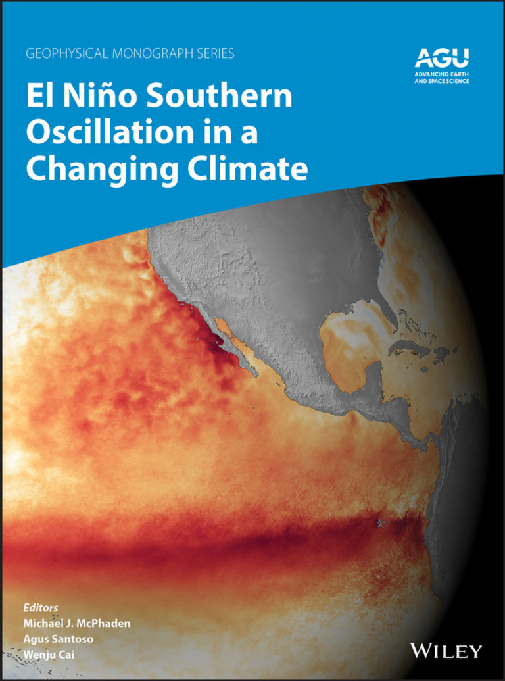
https://agupubs.onlinelibrary.wiley.com/doi/book/10.1002/9781119548164
Section I. Introduction
1. Introduction McPhaden, et al.
2. ENSO in the Global Climate System Trenberth
Section II. Observations
3. ENSO Observations McPhaden, et al.
4. ENSO Diversity Capotondi et al.
5. Past ENSO Variability: Reconstructions, Models, & Implications Emile-Geay et al.
Section III. Theories and Dynamics
6. Simple ENSO Models Jin, et al.
7. ENSO Irregularity and Asymmetry An et al.
8. ENSO Low-frequency Modulation and Mean State Interactions Fedorov et al.
Section IV. Modeling and Prediction
9. ENSO Modelling: History, Progress and Challenges Guilyardi et al.
10. ENSO Prediction L’Heureux, et al.
Section V. Remote and External Forcing
11. ENSO Remote Forcing: Influence of Climate Variability outside the Tropical Pacific Kug et al.
12. The Effect of Strong Volcanic Eruptions on ENSO McGregor et al.
13. ENSO Response to Greenhouse Forcing Cai et al.
Section VI. Teleconnection and Impact
14. ENSO Atmospheric Teleconnections Taschetto et al.
15. ENSO Oceanic Teleconnections Sprintall et al.
16. Impact of El Niño on Weather and Climate Extremes Goddard & Gershunov
17. ENSO and Tropical Cyclones Lin et al.
18. ENSO-Driven Ocean Extremes and Their Ecosystem Impacts Holbrook et al.
19. ENSO Impact on Marine Fisheries and Ecosystems Lehodey et al.
20. ENSO and the Carbon Cycle Betts et al.
Section VII. Closing
21. Challenges, Paleo-Perspectives, and Outlook Karamperidou et al.
*red: chapters relevant
to our paper on regional
projection uncertainties
Published Oct. 2020
98 authors

Slide 6
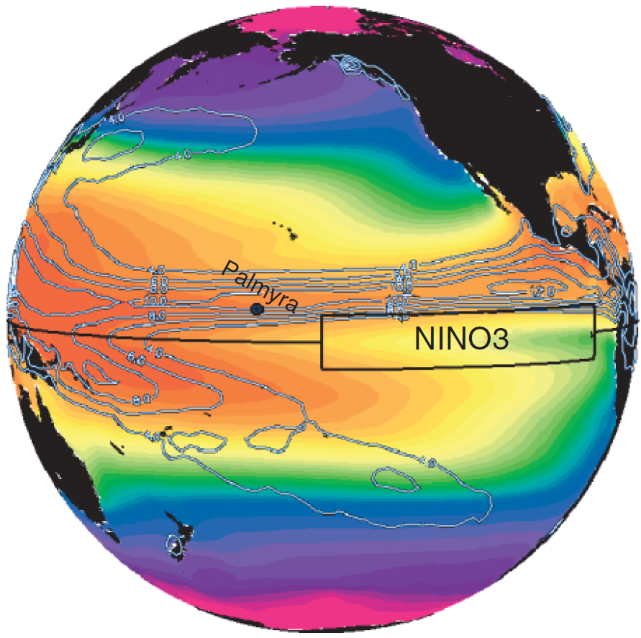
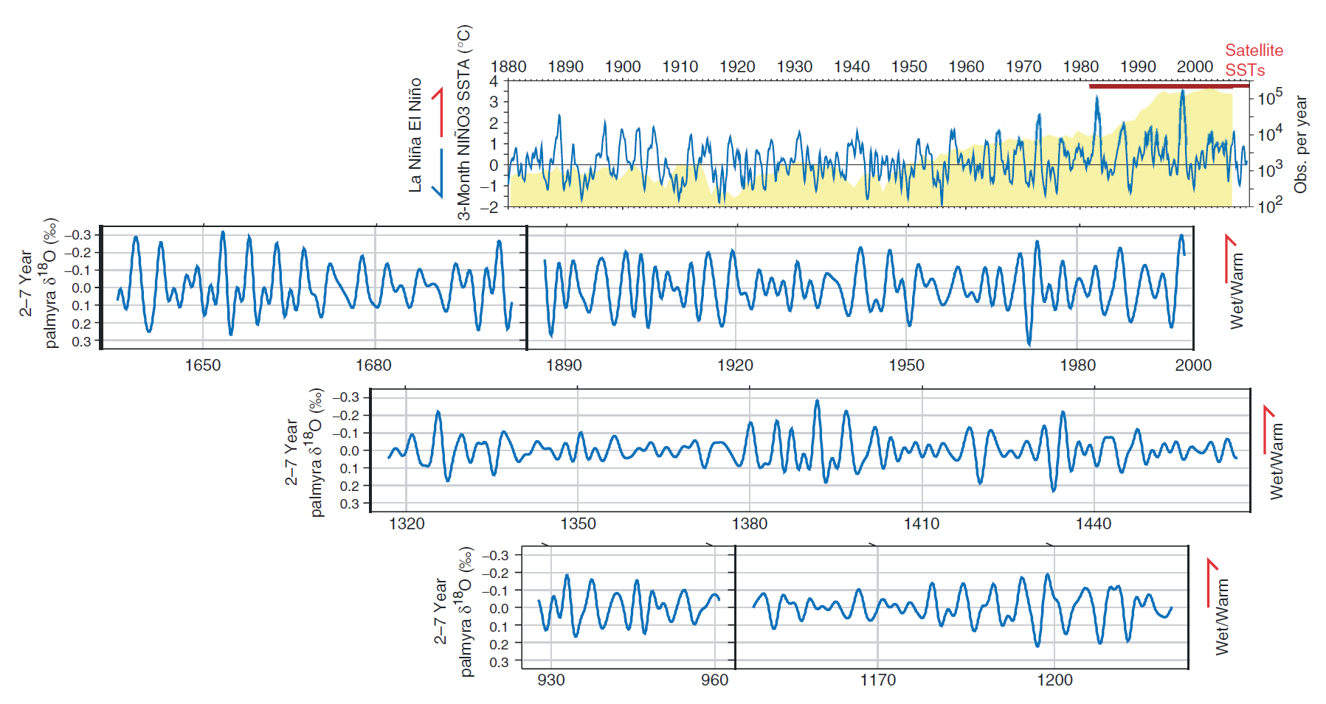
Tropical Pacific Climate
& ENSO Modulation
warm
pool
ITCZ
Vecchi & Wittenberg (WIREsCC 2010)
cold
tongue
1982
1997
SPCZ
Historical SSTA (ERSST.v3)
Palmyra corals
(Cobb et al.,
Nature 2003)
Multiproxy reconstructions:
e.g. Li et al. (NCC 2011);
Emile-Geay et al.
(J. Climate, 2013ab);
McGregor et al. (CP 2013)
ENSO waxes & wanes. It has strengthened recently — why?
ENSO also obscures detection of slower climate changes (decadal, global warming).

Slide 7
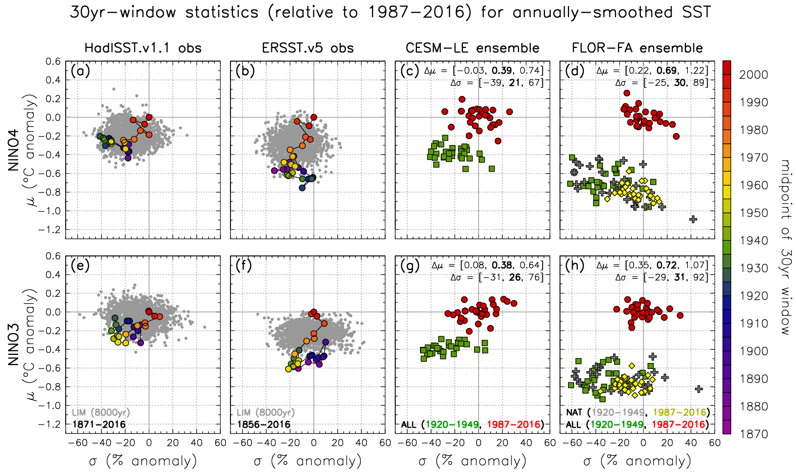
Observed & simulated mean/ENSO SST changes
warmer
climate
stronger
ENSO
Newman, Wittenberg, et al. (BAMS 2018)

Slide 8
Observed & simulated mean/ENSO SST changes
Mean change is marginally detectable. ENSO change, less so.
Newman, Wittenberg, et al. (BAMS 2018)‏

Slide 9
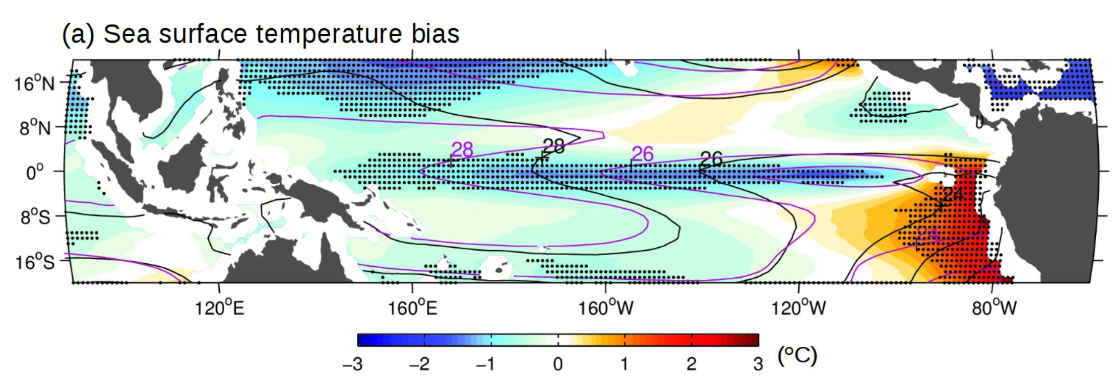
CMIP5 multi-model time-mean SST bias
20-model mean for CMIP5 historical runs, relative to ERSST.v5.
SST contours are for obs (black) and models (purple).
Stippling: at least 90% of models have bias of same sign.
Santoso et al. (BAMS 2019)
Notes:
<number>

Slide 10
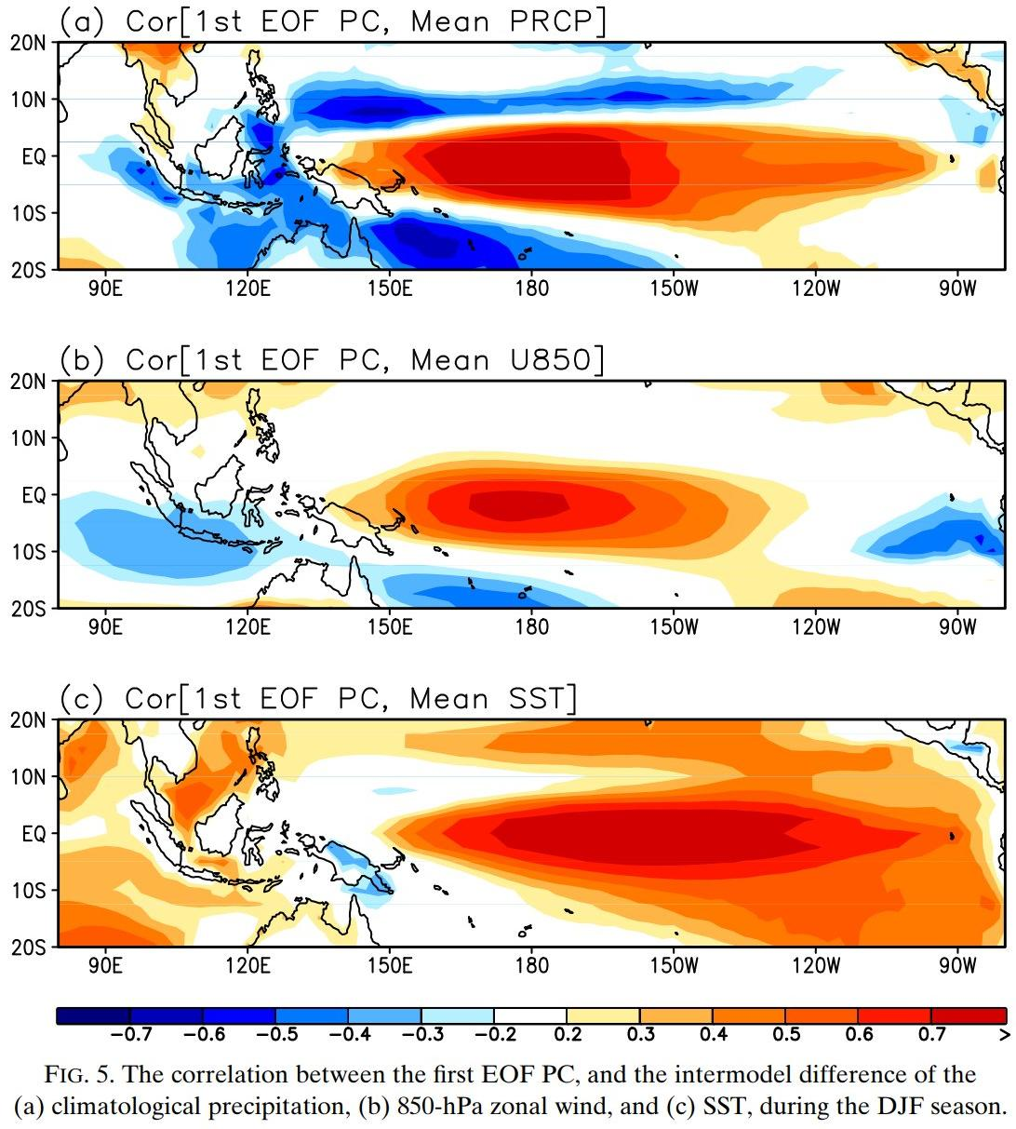
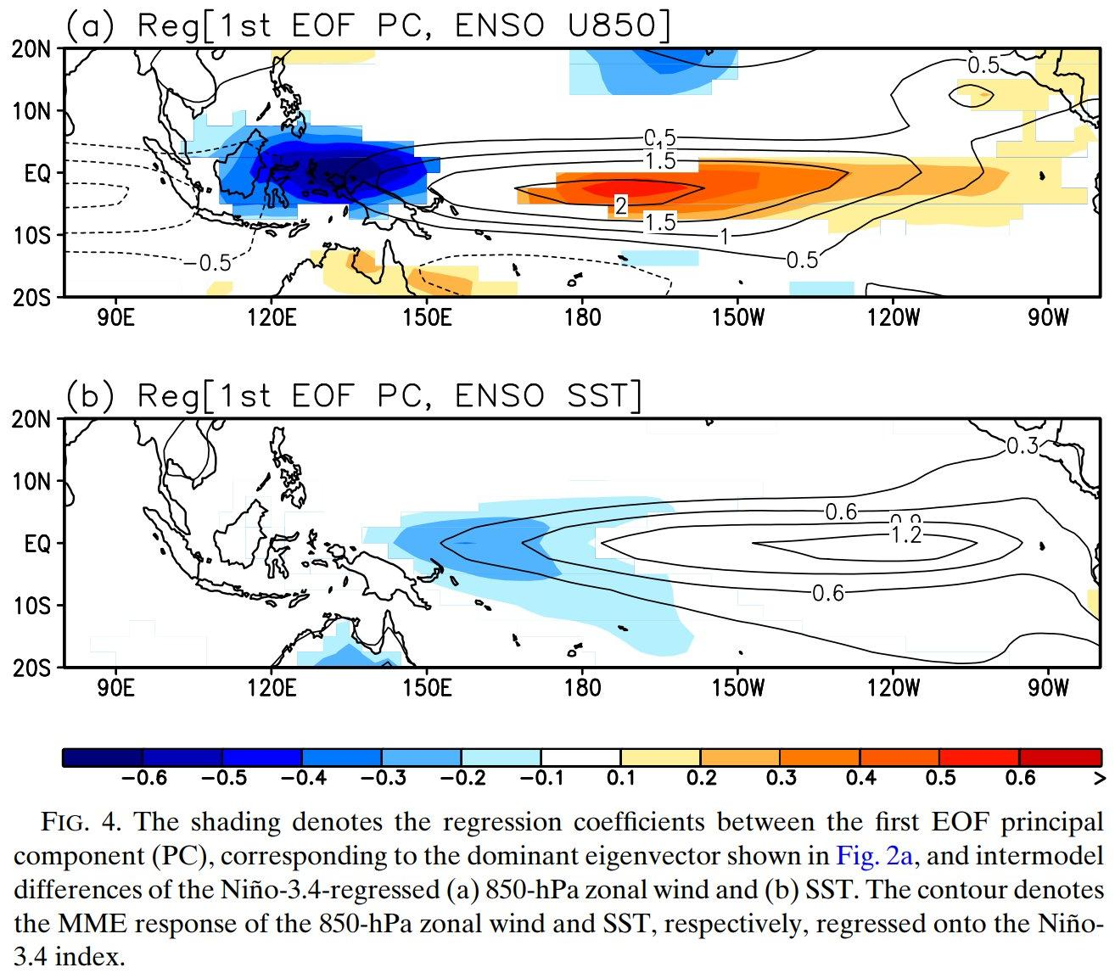
CMIP5: ENSO response patterns linked to mean state
Improved El Niño
anomaly response...
…goes with improved background ECT.
Leading mode
of inter-model variation in
rain response.
rainfall
wetter equator
Eastward
& equatorward shift of El Niño rain/wind/SST anomalies...
u₈₅₀
weaker trades
...linked to
warmer equatorial cold tongue (ECT).
SST
warmer ECT
Ham & Kug
(JC 2015)
Notes:
<number>

Slide 11
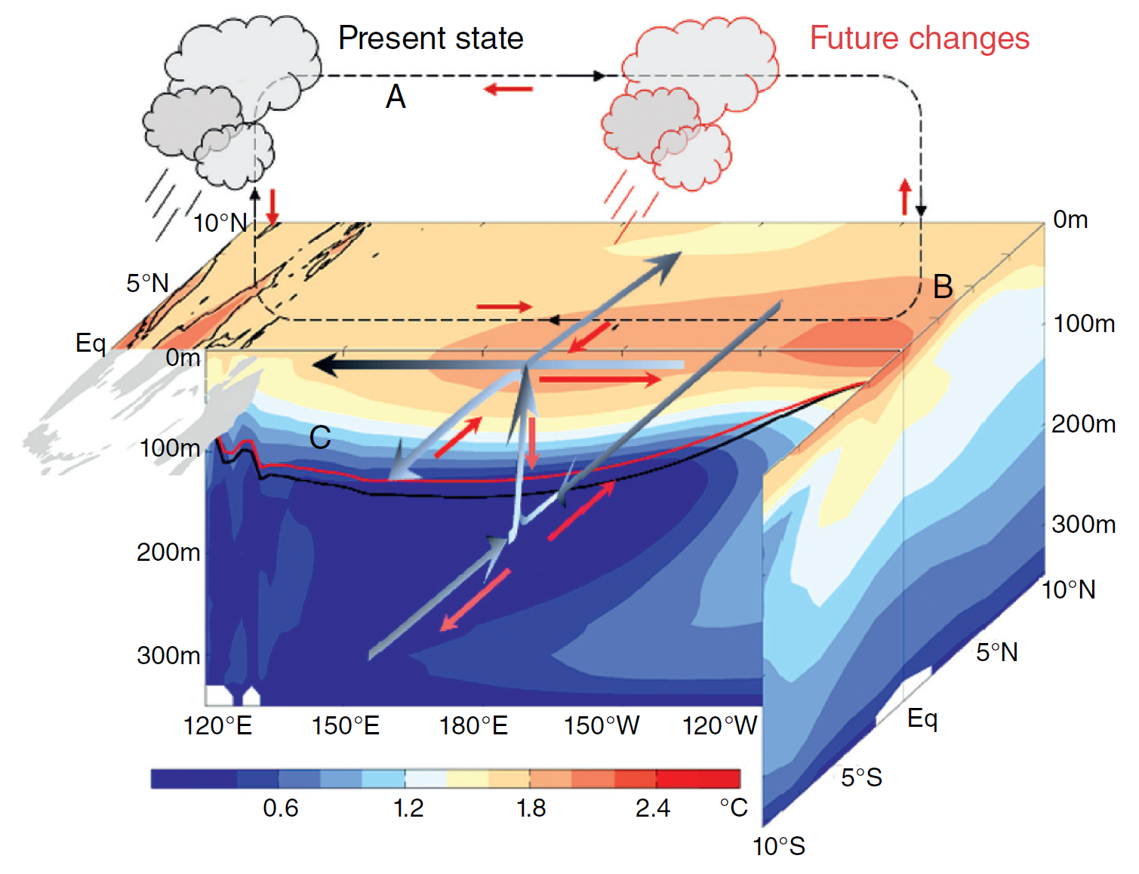
“Average” CMIP5-projected changes in tropical Pacific climate
Cai et al. (NCC 2015b, AGU 2020)
Sen Gupta et al. (GRL 2012)
Reduced cold tongue SST contrast, shallower & more intense thermocline.
Weaker equatorial Walker circulation, more cyclonic curl(τ) near equator (mainly S. Hem.).
Weaker subsurface meridional overturning, stronger EUC.
Notes:
<number>

Slide 12
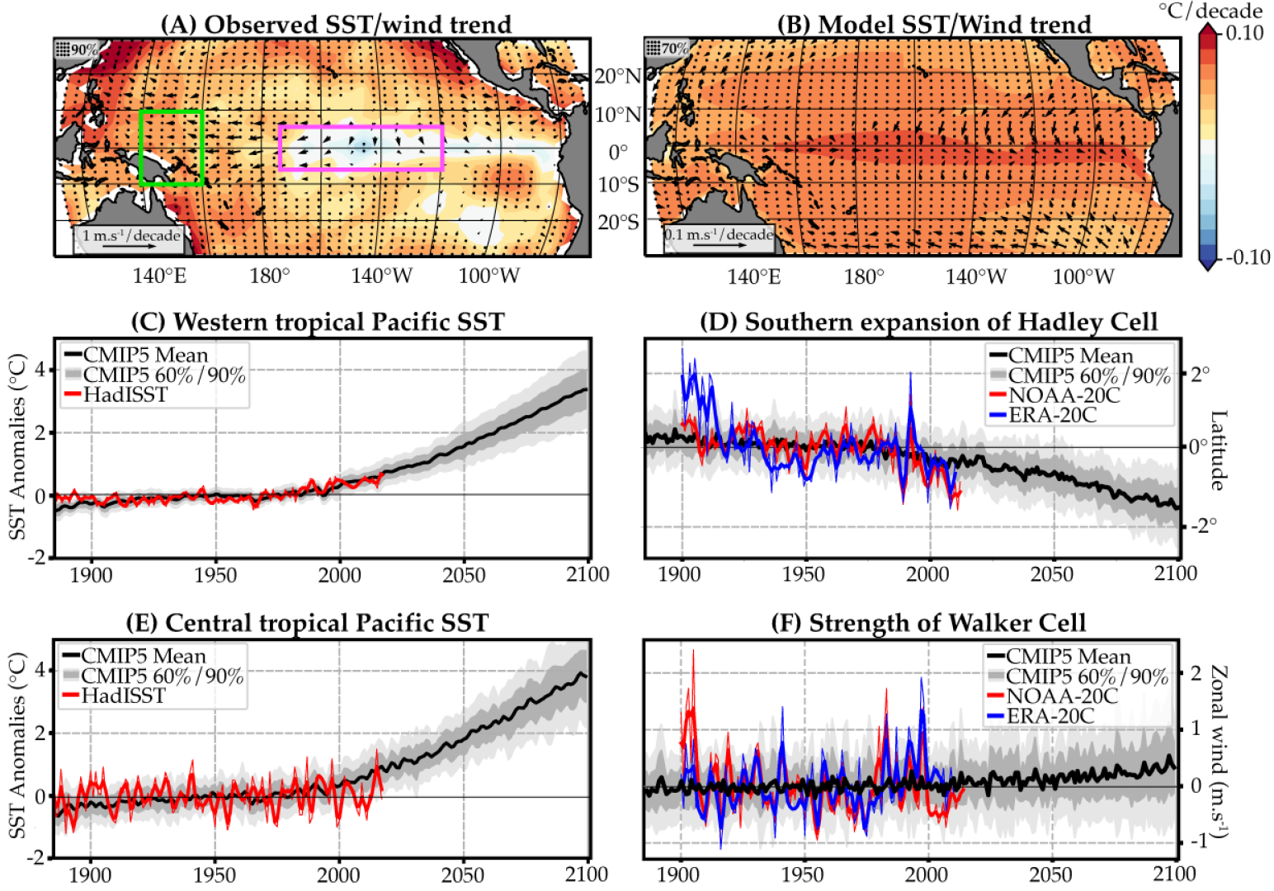
Detection & attribution of tropical Pacific trends
Power et al. (in review)
HadISST
CMIP5 mean
1900-2009
NINO3.4
West Pacific warming, poleward expansion of Hadley Cell (detected & attributed).
Cold tongue SST / trade wind changes: depend on obs product (edge of CMIP5 PDF).
Notes:
<number>

Slide 13
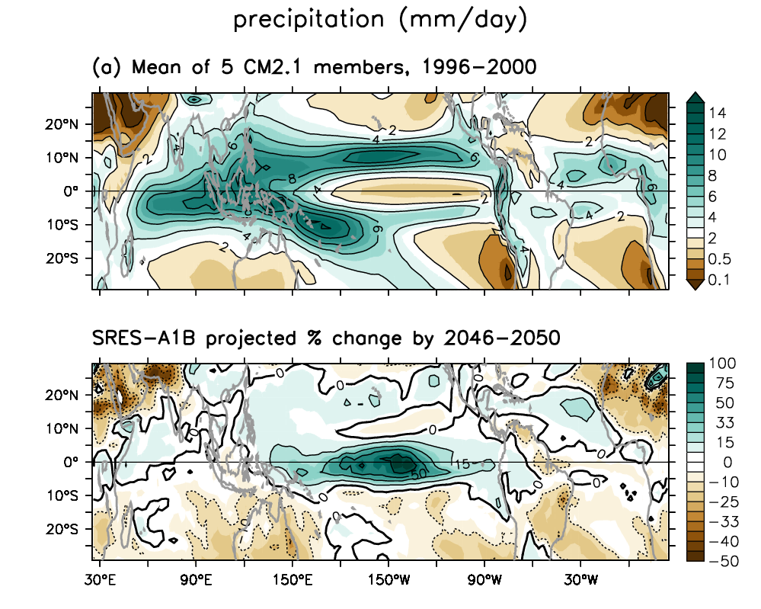
Projected changes in time-mean rainfall
Held & Soden (2006)
Vecchi & Wittenberg (2010)
DiNezio et al. (2010)
Xie et al. (2010)
Chadwick et al. (2013)
Grose et al. (2014)
Example from GFDL-CM2.1 CGCM ensemble
Zonal mean:
“wet get wetter,
dry get drier”.
Over tropical
oceans:
“warmer
get wetter”.

Slide 14
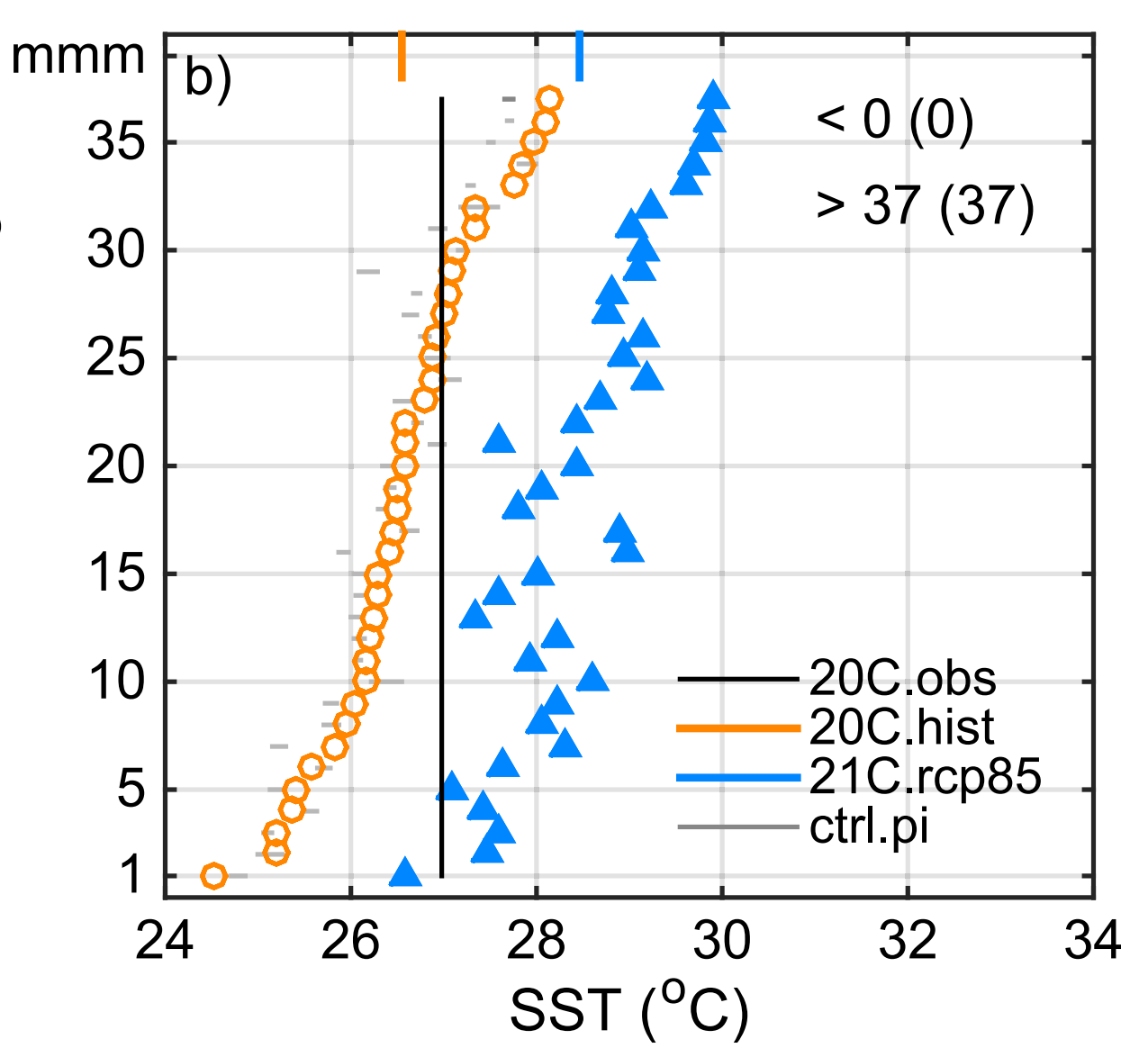
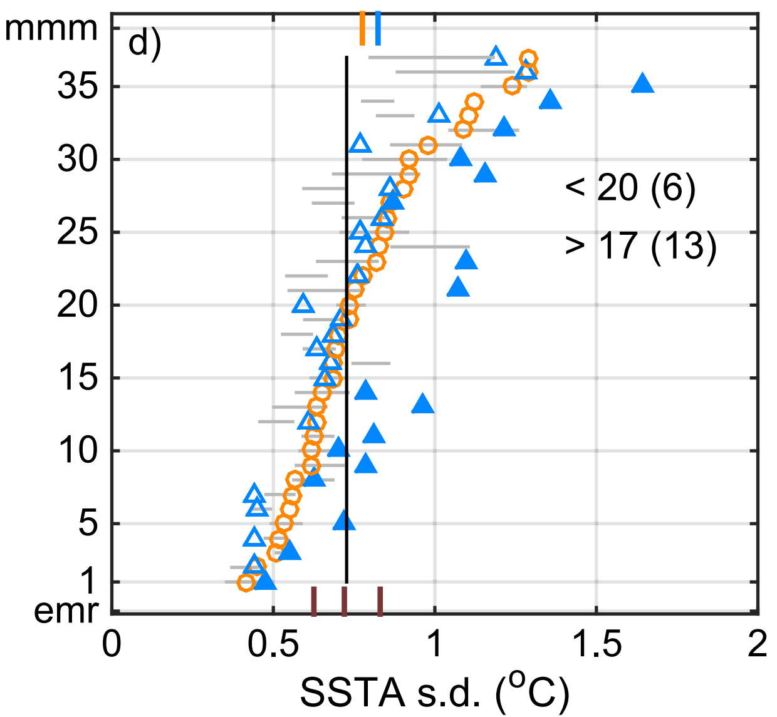
CMIP5 projections (PI, 1900-99, 2000-99)
Mean NINO3.4 SST
NINO3.4 SSTA amplitude
More models
weaken than
strengthen...
Most
models
are too
cold.
Significant warming
in the 21st century.
models sorted by 20th century values
...but the models that
strengthen, tend to do
so more significantly.
obs
obs
All the models show significant mean warming in the 21st century.
But ENSO SSTAs weaken in some models, strengthen in others.
Chen et al. (JC 2017)‏

Slide 15
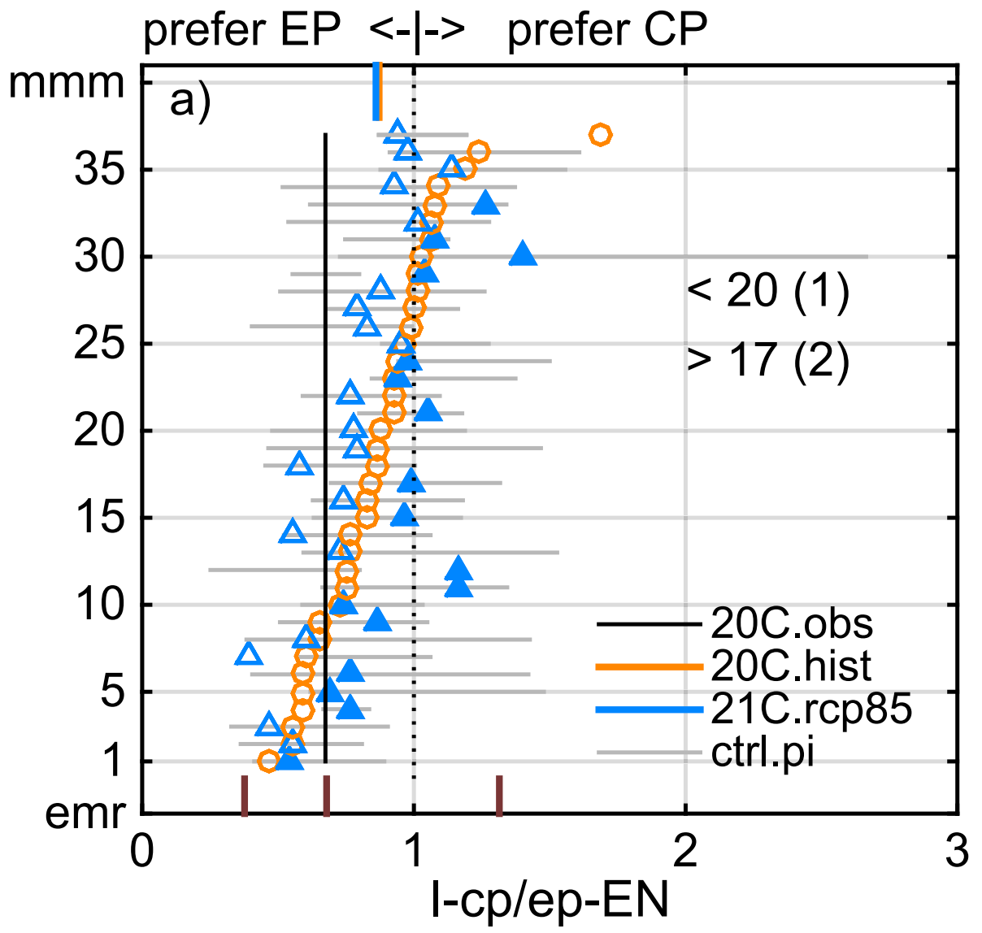
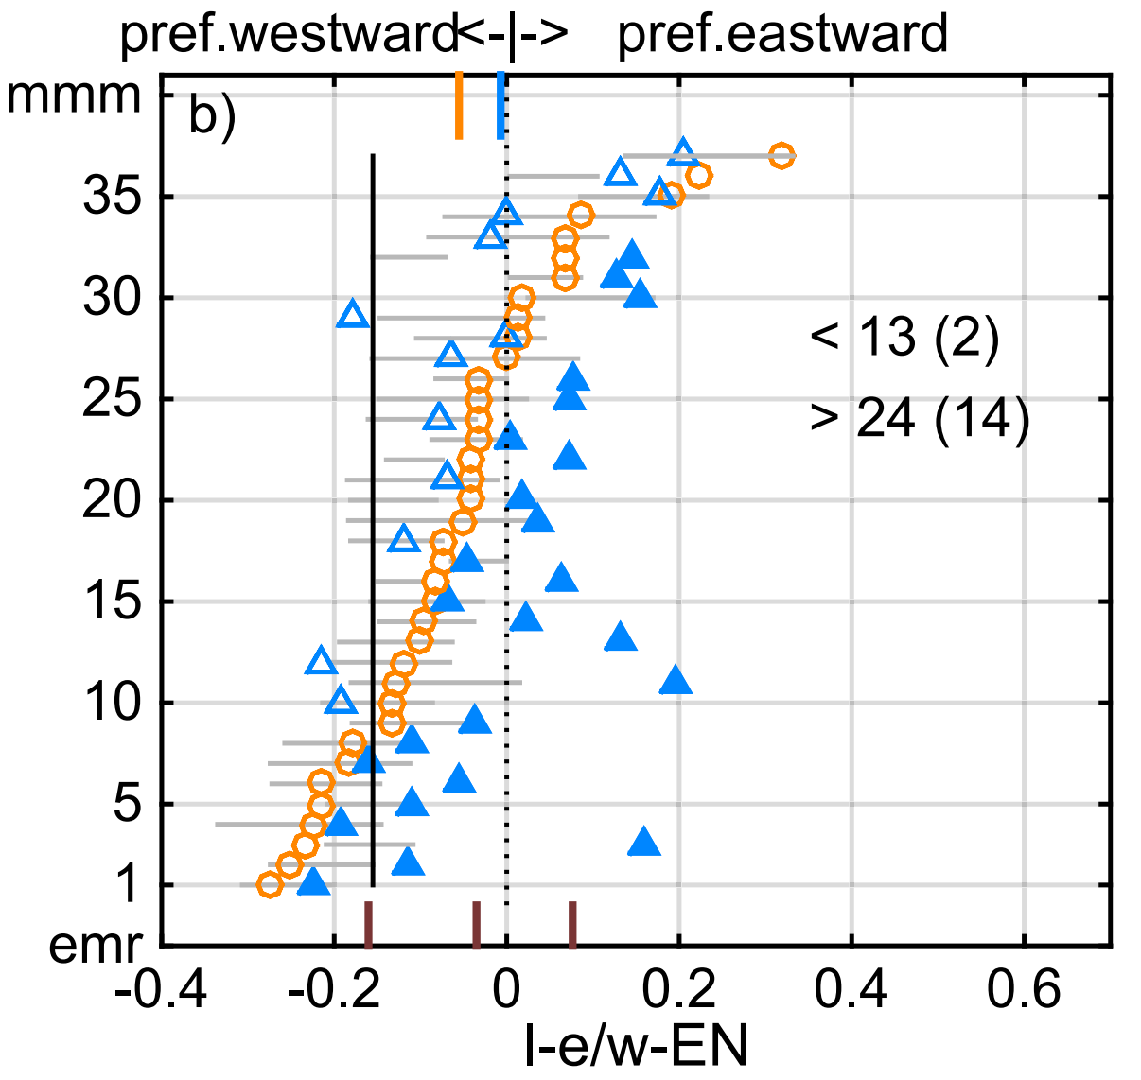
CMIP5 projections (PI, 1900-99, 2000-99)
SSTA peak longitude
SSTA propagation direction
Most models
show too much
eastward
propagation.
Most models
have too many
CP events.
models sorted by 20th century values
Strong intrinsic
variation, so most
changes are
not significant.
Most show
more eastward
propagation
in the future,
especially those
with less of it
in the present.
No consensus on whether EP or CP El Niños will be more likely in the future.
But projected ENSO SSTAs do show more eastward propagation.
Chen et al. (JC 2017)‏

Slide 16
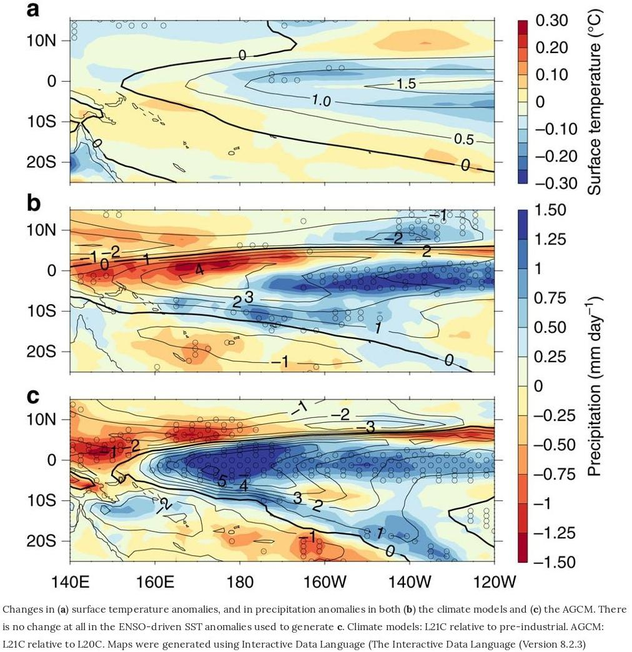
CMIP5: Future changes in El Niño SST & rainfall anomalies
CGCM SSTA change (CMIP5, RCP8.5 minus PIctrl)
Most models project weaker
time-mean SST contrasts near the equatorial cold tongue (ECT).
El Niño rain anomalies strengthen
& shift eastward/equatorward.
Happens even when an AGCM sees only the mean SST changes,
without changing the SSTA pattern.
In most CGCMs, weaker
ENSO SSTAs offset some of
the eastward shift, but the equatorward shift remains.
weaker
SSTAs
AGCM rain anom change (ACCESS 1.0, no SSTA change)
CGCM rain anom change (CMIP5, RCP8.5 minus PIctrl)
see also:
Cai et al. (NCC 2014, 2015)
Power et al. (Nat. Commun. 2017)
Notes:
<number>

Slide 17
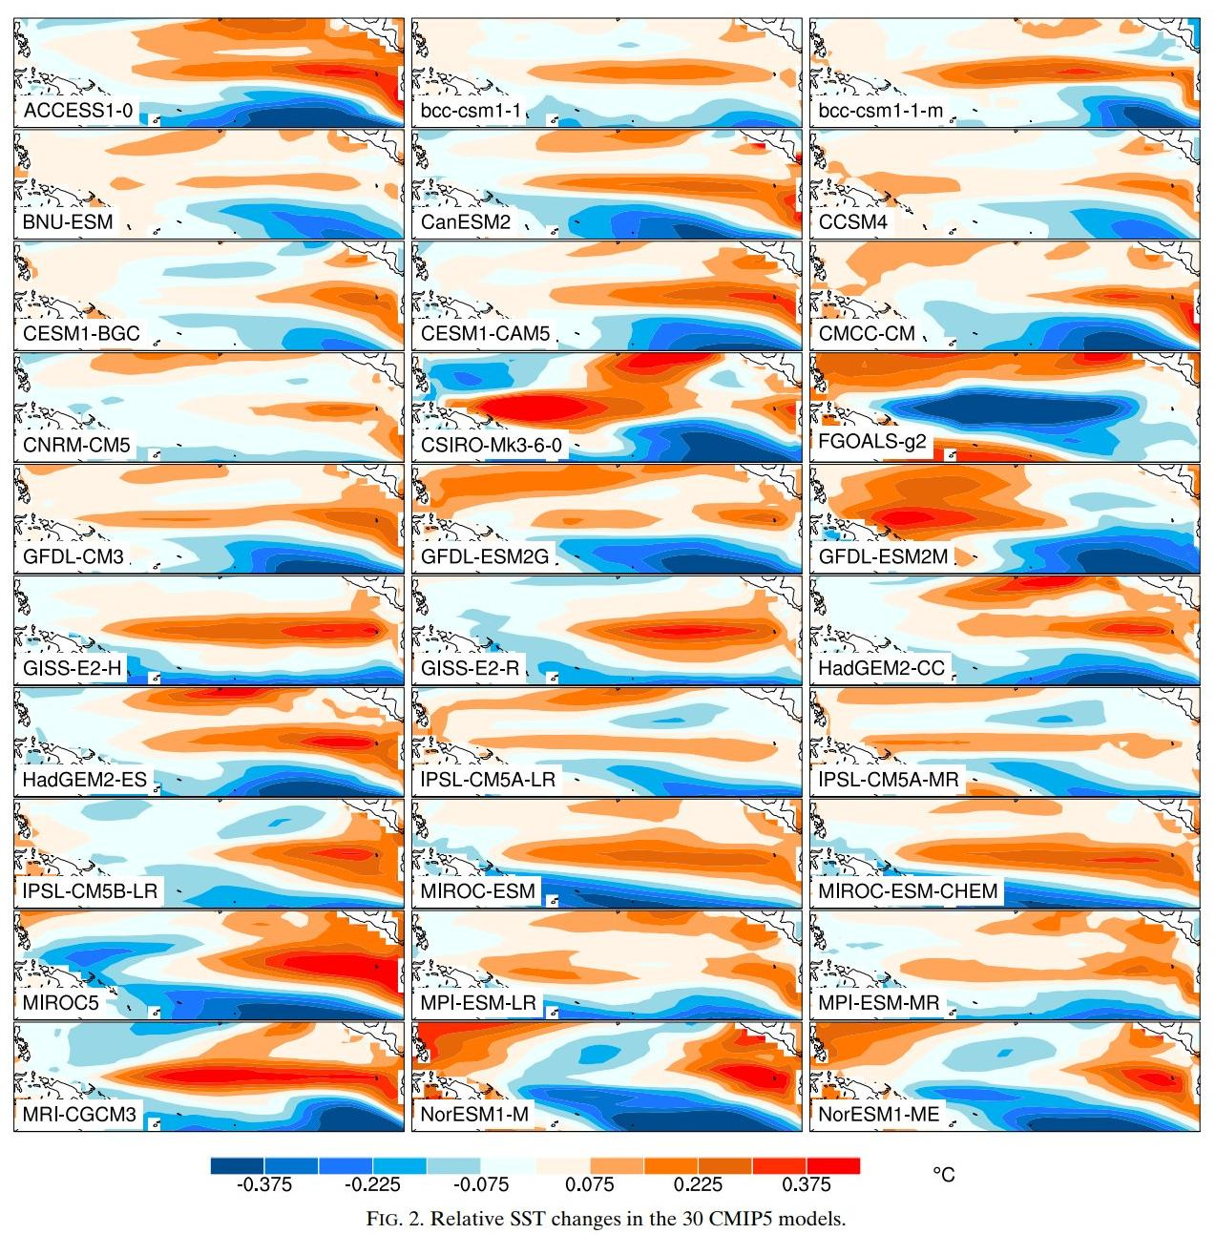
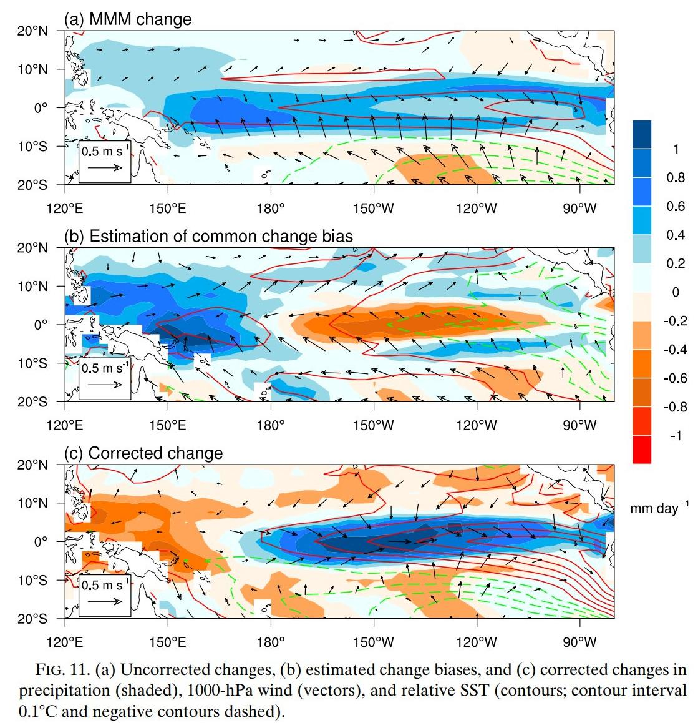
CMIP5-projected future changes in time-mean relative SST
RCP8.5 (2081-2100) minus historical (1981-2000)
Huang & Ying (JC 2015)
Large inter-model diversity of responses.
Inter-model regression → adjust for historical SST biases → more El Niño-like change.
Notes:
<number>

Slide 18
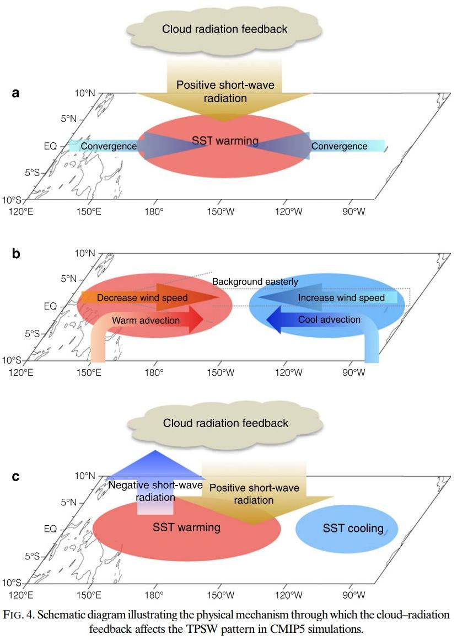
CMIP5 cloud feedback biases affect time-mean SST change
Equatorial cold SST biases in CGCMs
→ central EqPac convection too weak
→ SST warming less damped
by convective cloud shading
→ zonal wind convergence
→ trades weaken in west (warming),
strengthen in east (cooling)
→ warming drifts west, and
ΔSST is too La Niña-like.
Explains 24% of inter-model
variance of ΔSST
(largest single factor).
Need obs constraints for
shortwave feedbacks!
Ying & Huang (JC 2016a)
Notes:
<number>

Slide 19
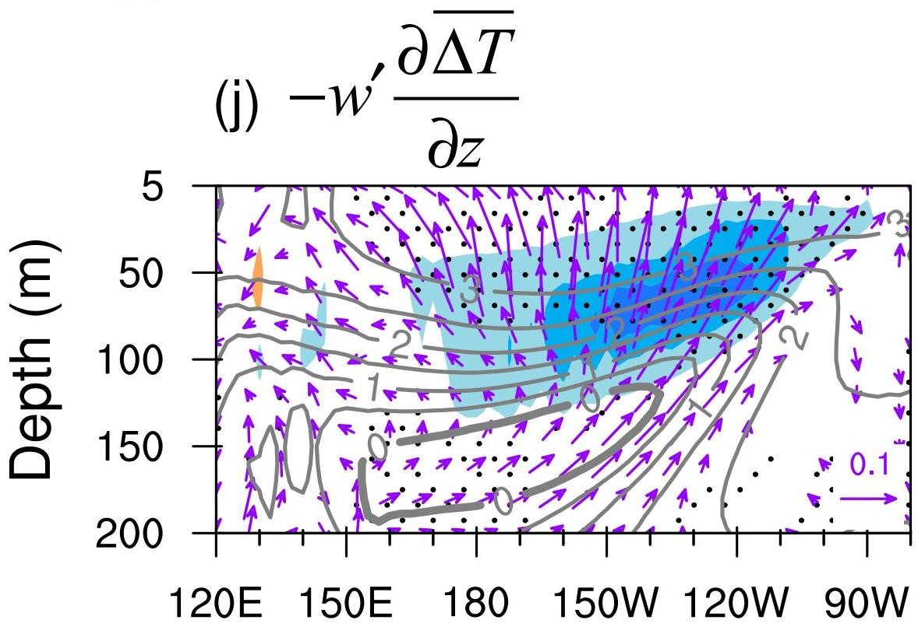
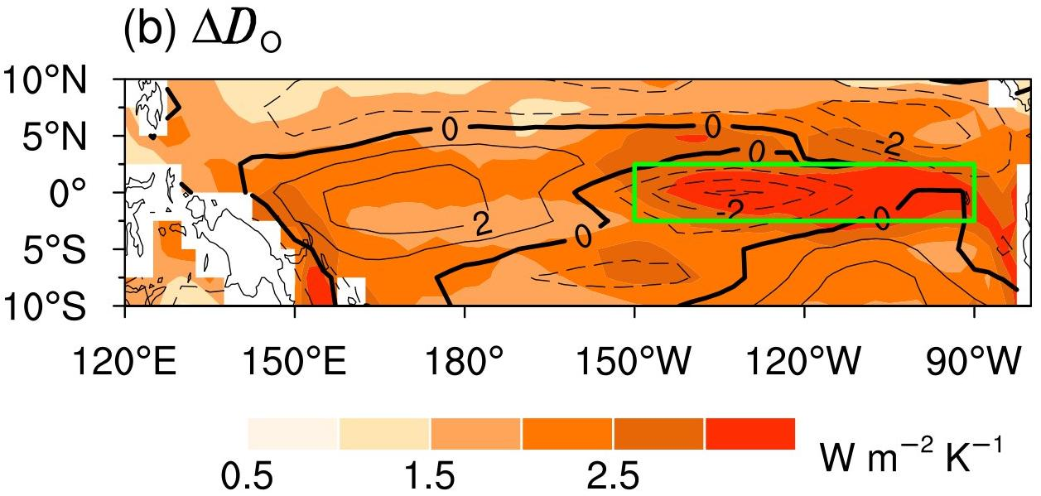
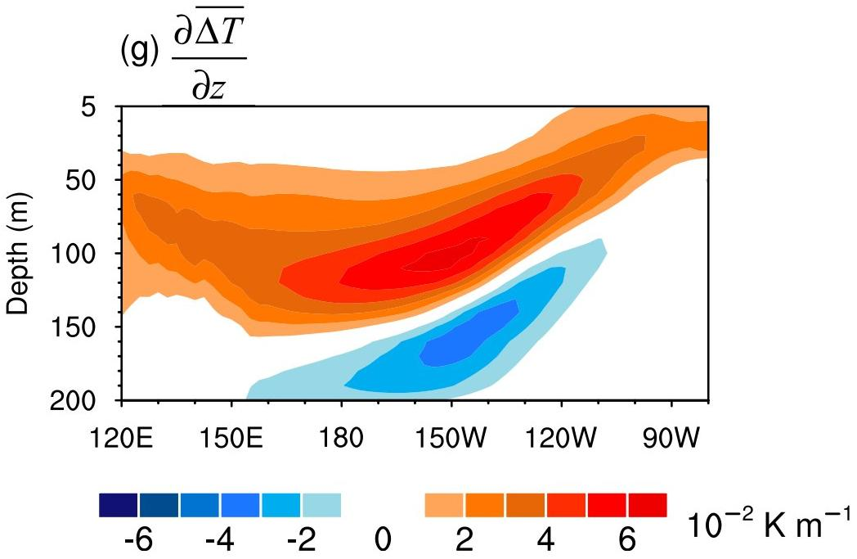
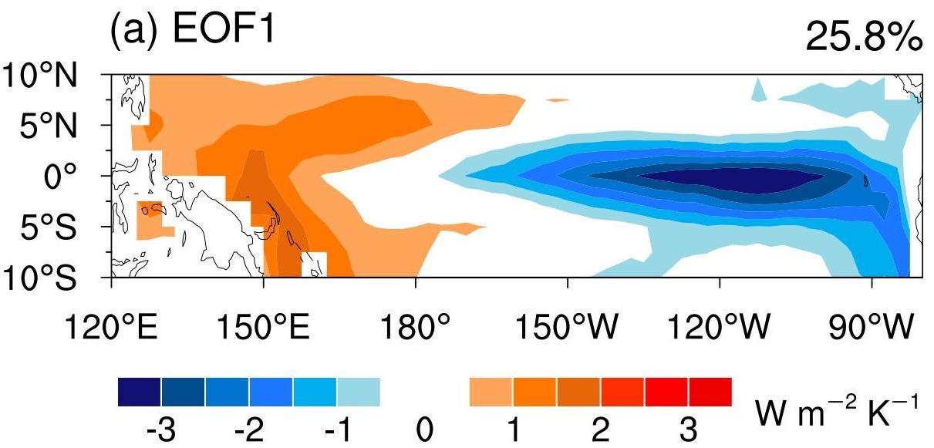
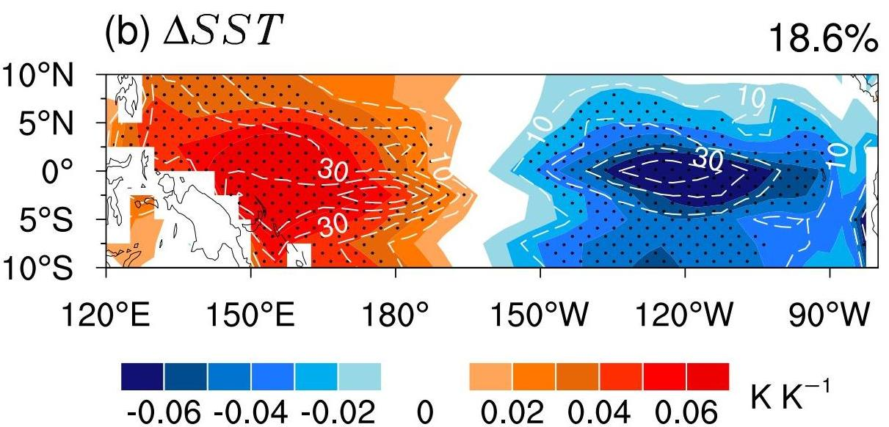
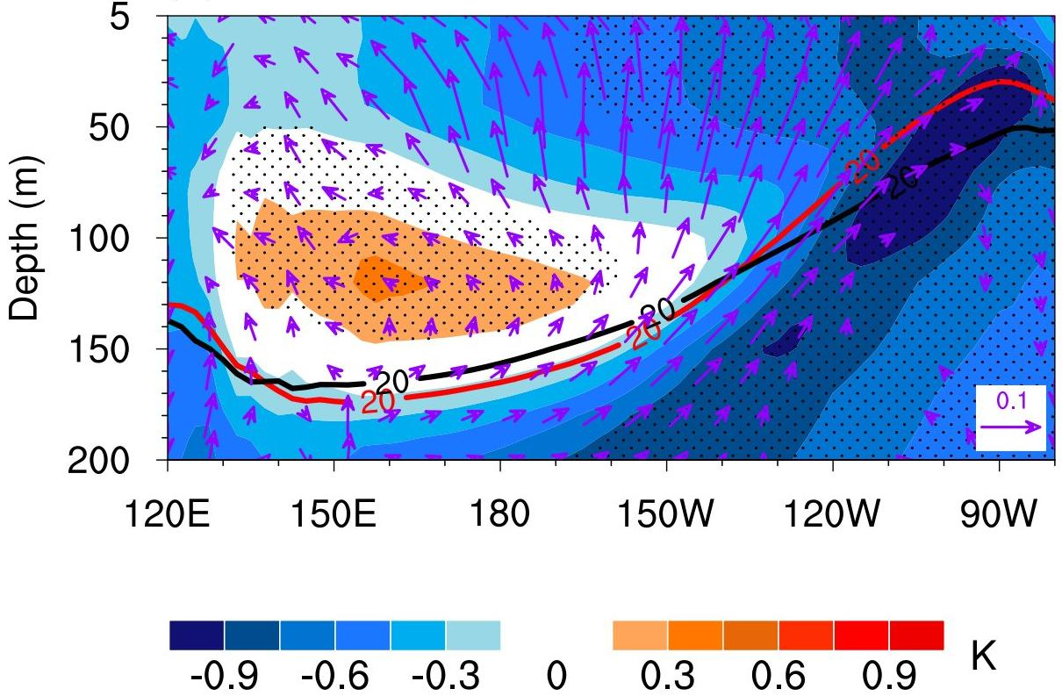
CMIP5 ocean upwelling biases affect time-mean SST change
Weaker trades weaken the
ocean-dynamical cooling (ODC),
by diverse amounts in models.
Culprit: diverse upwelling strengths!
Equatorial cold SST bias
→ EqPac upwelling too strong
→ excessive ocean-dynamical thermostat in east
(where thermocline is shallow)
→ weakens SST warming in east,
as dT/dz intensifies in future
→ ΔSST is too La Niña-like
Explains 14% of inter-model
variance of ΔSST
(2nd-largest single factor).
Need obs constraints for
mean upwelling!
Multiply by the future
stratification increase...
Models with less ODC weakening...
... show less EN-like change.
LN-like bias (strong upwelling)
means less ODC weakening,
and less EN-like change.
Ying & Huang (JC 2016b)
Notes:
<number>

Slide 20
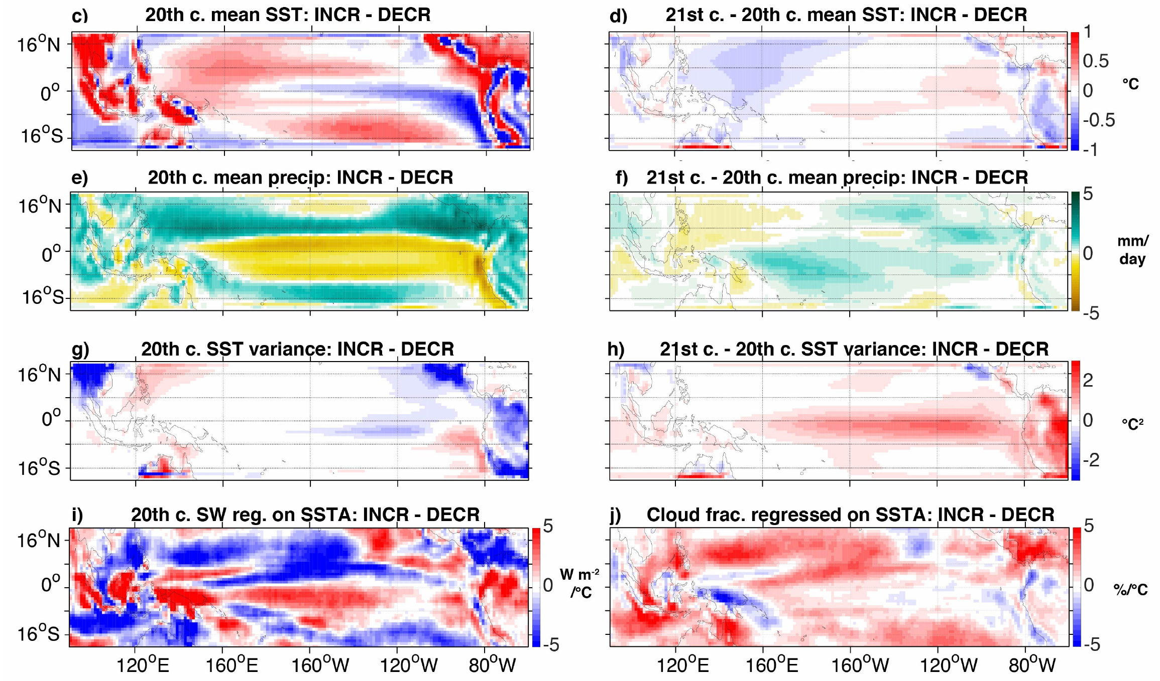
Emergent constraints for future ENSO extremes
Stevenson et al. (J. Climate, 2021)
Change in likelihood of extreme wet El Niño in NINO3 (CMIP5, 2006-2100 minus 1950-2005)
Models project a wide range of changes in El Niño rainfall extremes: some strongly increase, others decrease.
“Increasers” start with common biases: cooler & drier cold tongue, weaker ENSO, and weaker heat flux damping of SST changes.
→ More room to amplify
ENSO extremes.
Different model biases…
…yield different future changes.
cooler
more warming
drier
Increasers also project more future warming, wetting, and ENSO SSTA amplification in the cold tongue.
more wetting
weaker
SSTAs
more SSTA
amplification
Can use these emergent constraints to leverage
model diversity and inform future projections.
less SSTA damping
from cloud shading
Notes:
So that's SST -- what about changes in ENSO rainfall? In the NINO3 region, the CMIP5 models project a *wide range* of changes: some say El Nino rainfall will strongly increase, others decrease.
Why such diversity? Well, we found that *increasers* tend to have stronger present-day *biases* toward cool & dry conditions over the cold tongue, and also weaker ENSOs -- giving them more room to *boost* their ENSO extremes in the future. The increasers also had less convective *cloud* over the cold tongue -- leading to less radiative damping of SST changes, stronger future warming & wetting, and amplified ENSO SSTAs.
So many models may be *overestimating* future El Nino rainfall, with implications for teleconnections. So we need to reduce model biases.
<number>

Slide 21
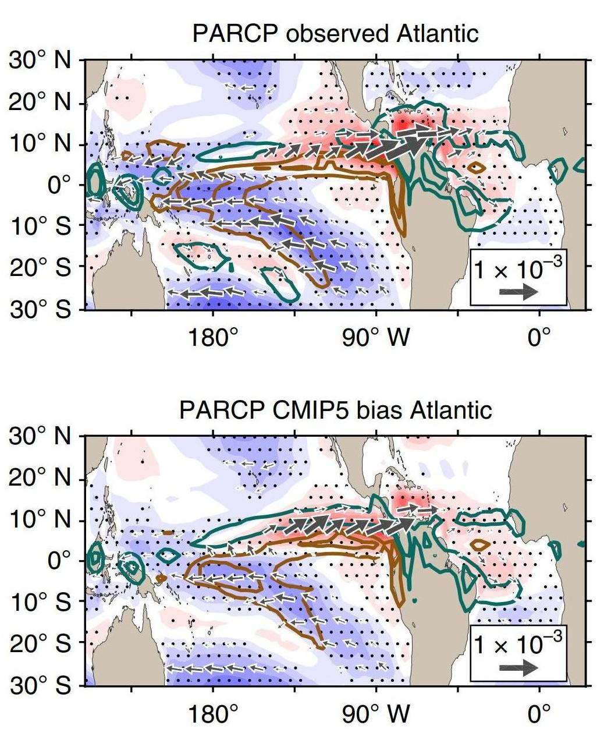
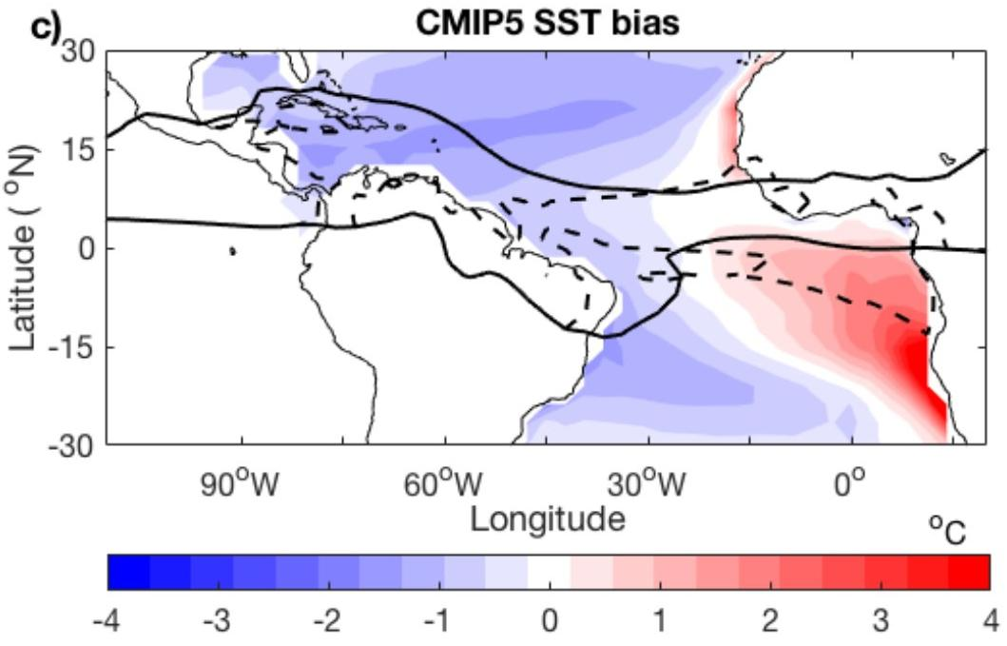
Atlantic SST biases affect Atlantic→Pacific connections
obs 27°C
CMIP5 27°C
Obs Atlantic warming → poleward & westward shift of WPac convection
→ easterly τ_{x} response in Pacific.
But add CMIP5 Atlantic SST bias
→ convection responds farther east
→ weakens Pacific τ_{x} response.
AGCM + Pacific slab OML + prescribed
Atlantic SST warming (1992-2011)
McGregor et al. (NCC 2018)
Notes:
<number>

Slide 22
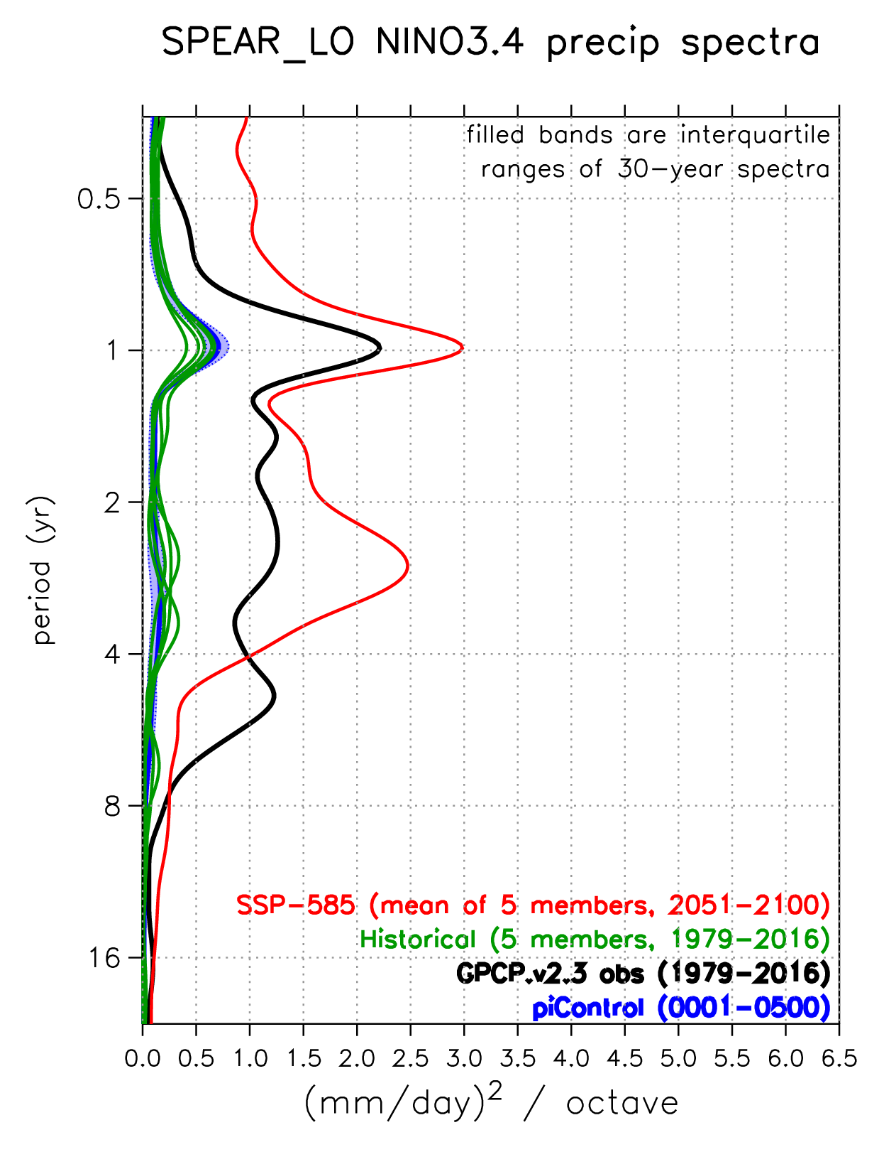
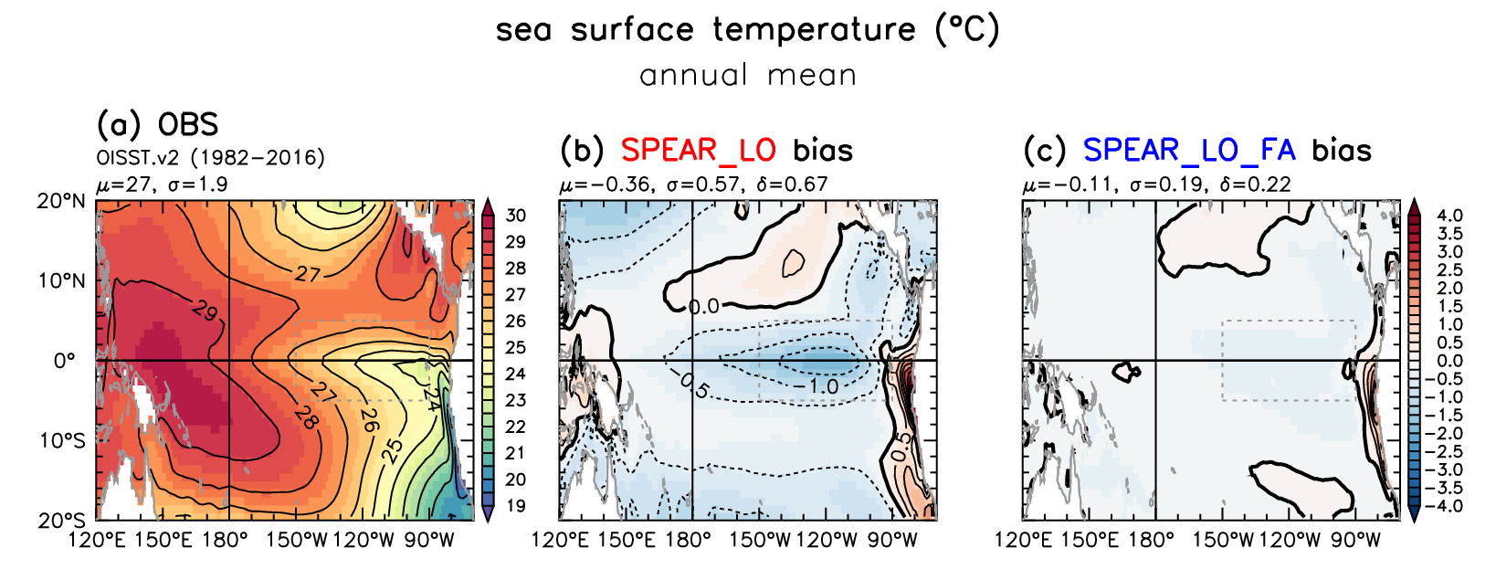
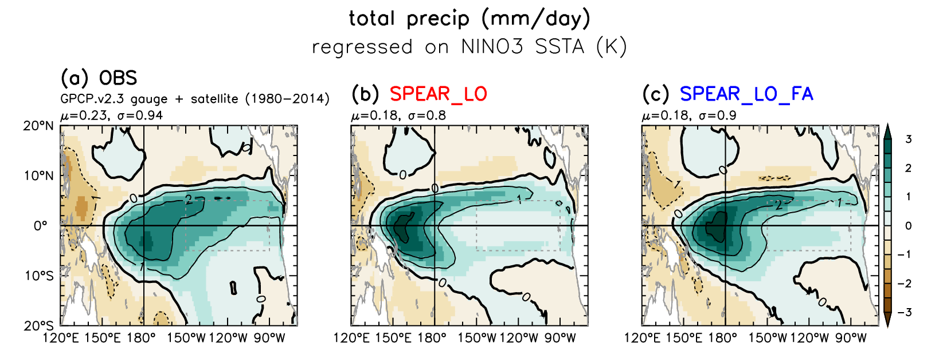
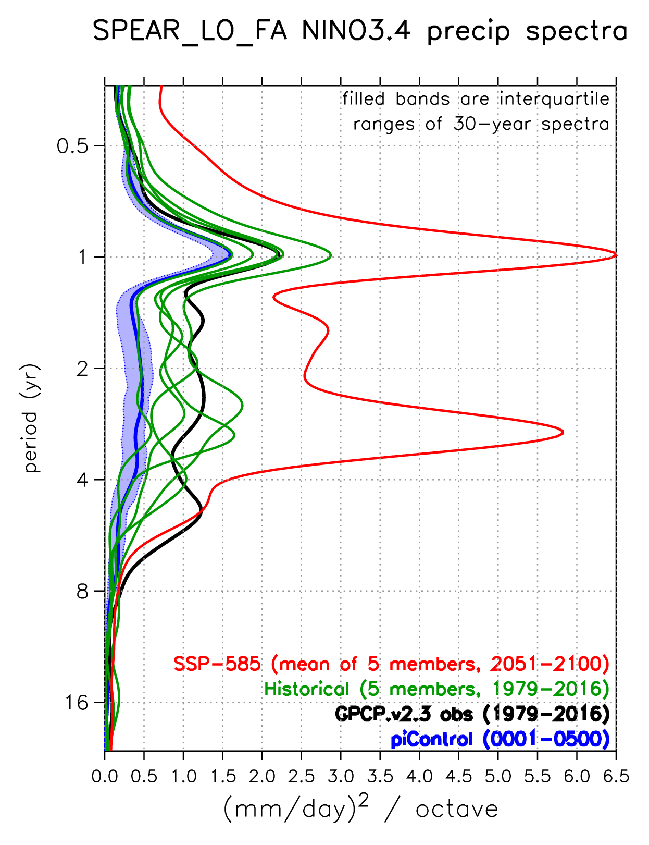
How do tropical SST biases affect future projections?
Wittenberg et al. (in prep.)
SPEAR: NINO3.4 rainfall spectra
Experiment: Correct GFDL-SPEAR CGCM’s
tropical climatological SST & wind stress,
using surface flux adjustments.
Now
Observed
SPEAR
SPEAR_FA
Future
Mean
SST
Original
Model
El Niño
precip
anomaly
FA improves ENSO’s anomaly patterns,
amplitude, and spectra.
Also amplifies projected future rainfall extremes
in the central equatorial Pacific.
Bias
Corrected
Notes:
<number>

Slide 23
What to include in Sec. 2.1?
“Relating model biases to tropical projections”
Target: ~350 words (1 page)
Lean on the AGU monograph.
1. Key uncertainties in historical & future tropical changes in obs & models. - Highlight extreme events (e.g. ENSO & hydroclimate impacts) - SST gradients, surface fluxes, mixed layer heat budget
2. Progress in understanding causes & consequences of tropical biases & sensitivities. - Metrics, emergent constraints, conceptual models - Resolution, feedbacks, interbasin interactions, bias corrections (FA)
3. Avenues to reduce uncertainties - Short term: LEs, scenarios, emergent constraints, FA, novel experiments - Long term: obs, model development (resolution, convection, clouds, mixing) - What resources are needed? - What is the potential return on investment?

