Slide 1
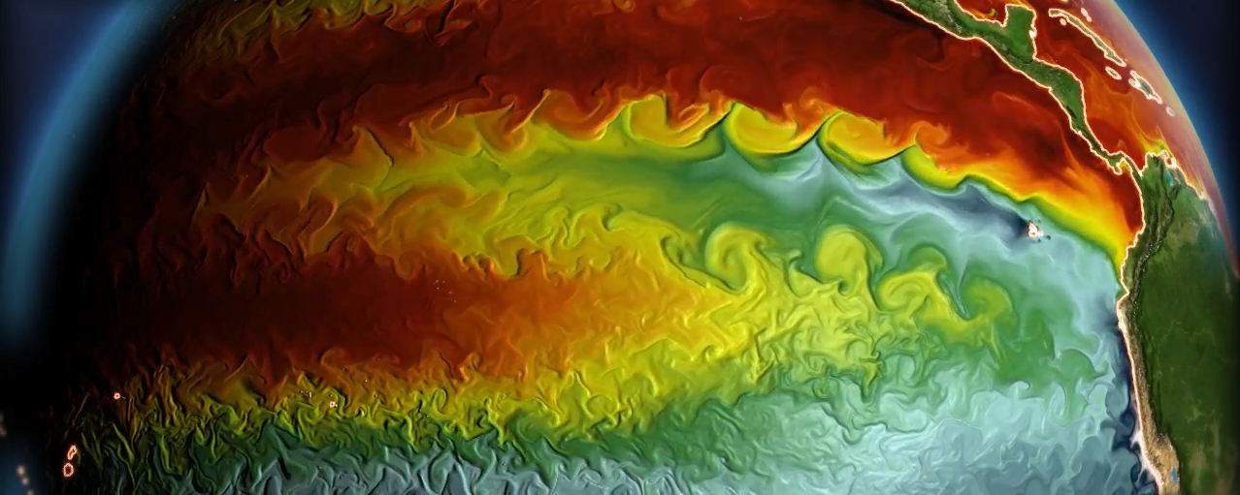
Tropical Pacific Variability &
Air-Sea Interactions Across Time Scales
GFDL CM2.6 simulation
Andrew T. Wittenberg
NOAA GFDL, Princeton, NJ, USA

Slide 2
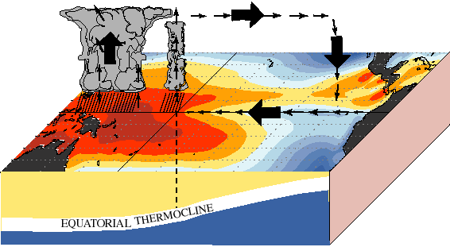
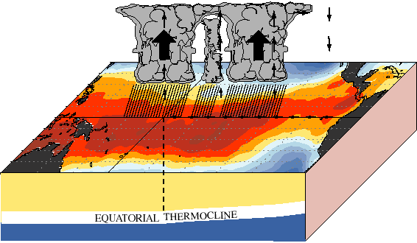
ENSO: Earth’s dominant year-to-year climate signal
2-7 years
warm
pool
cold
tongue
Normal
El Niño
Global impacts:
Weather & climate, extremes, natural disasters
Ecosystems, fisheries, agriculture, forests
Economies: commerce, transportation, energy, water, food, health
Reliable predictions & future projections are crucial
Sources & limits of seasonal-to-decadal predictability?
Future ENSO risks: natural vs. anthropogenic influences?
Changes in ENSO dynamics vs. impacts?
Short, gappy, nonstationary observing system → models essential
Coupled, multiscale, intermittent, diverse → key test for models
Notes:
ENSO is Earth's dominant year-to-year climate signal. Every 2-7yr, the west Pacific warm pool expands eastward, carrying with it the deep convection and rainfall, and altering global climate. These changes affect weather, ecosystems, and economies worldwide, and link to all of NOAA's strategic goals.
So how vulnerable *are* we to ENSO? Models are crucial to answer this, since obs records are short. ENSO's also a key *test* for models, since it depends on the full range of scales they simulate & parameterize. So a good ENSO simulation can build confidence in our ability to simulate other things, like climate change.

Slide 3
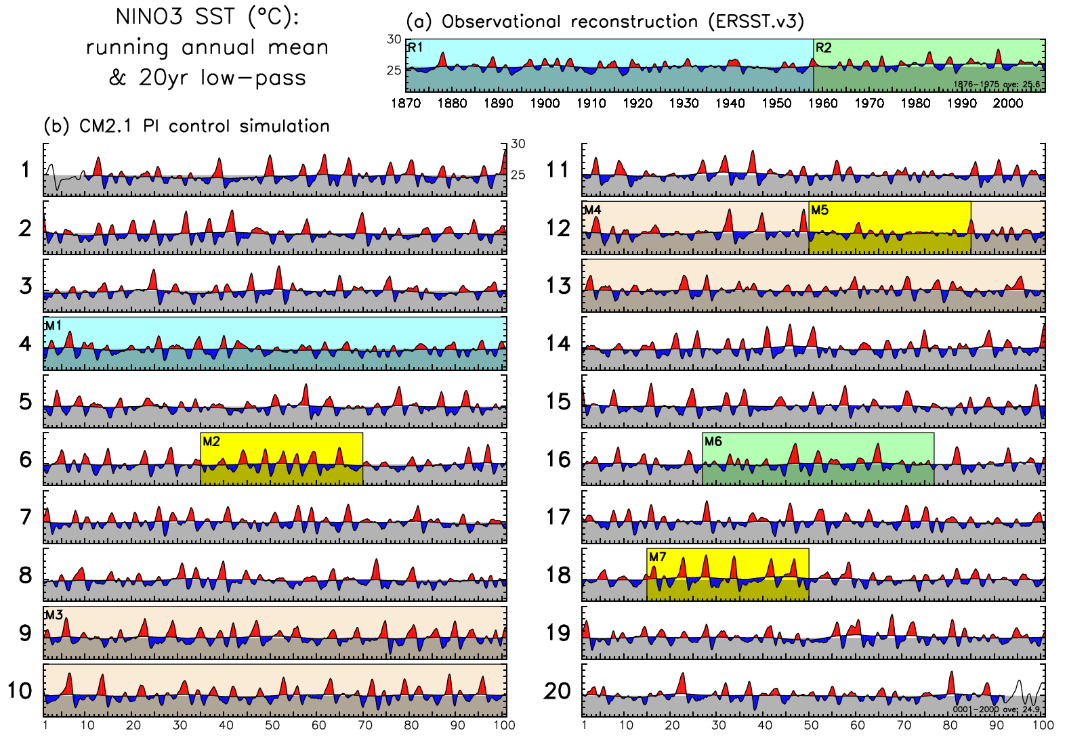
ENSO modulation
Wittenberg (GRL 2009)
https://doi.org/10.1029/2009GL038710

Slide 4
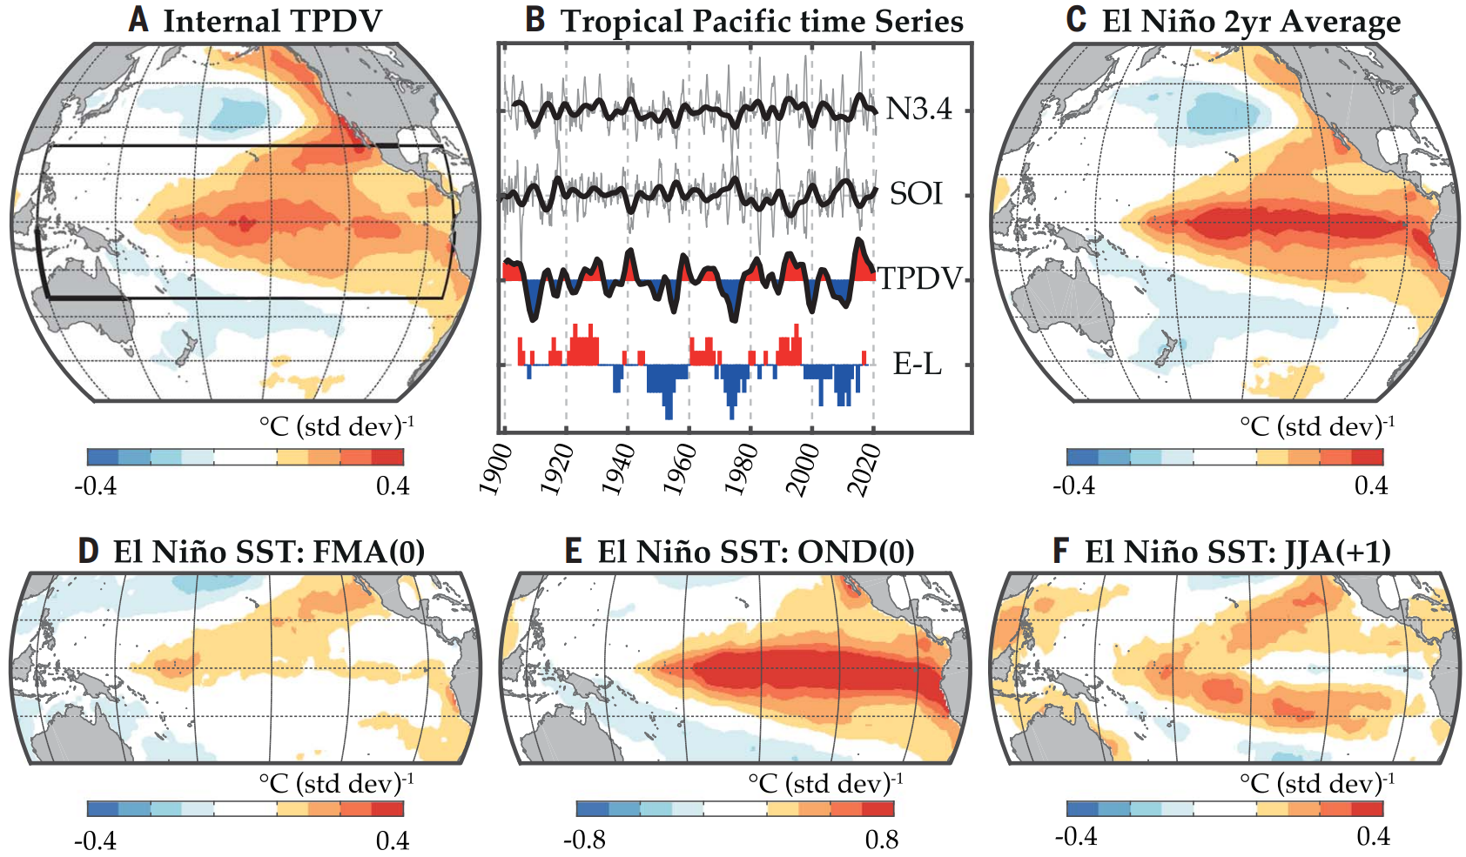
Observed Tropical Pacific Decadal Variability (TPDV)
Null hypothesis: TPDV is a residual of random ENSO events.
When more ENs than LNs → warm decadal pattern.
EN/LN asymmetry & diversity also contribute to decadal residual.
Similar patterns
Similar evolution
ENSO precursor & aftermath
add meridional broadening
Power et al. (Science 2021): https://doi.org/10.1126/science.aay9165
Notes:
‹#›

Slide 5
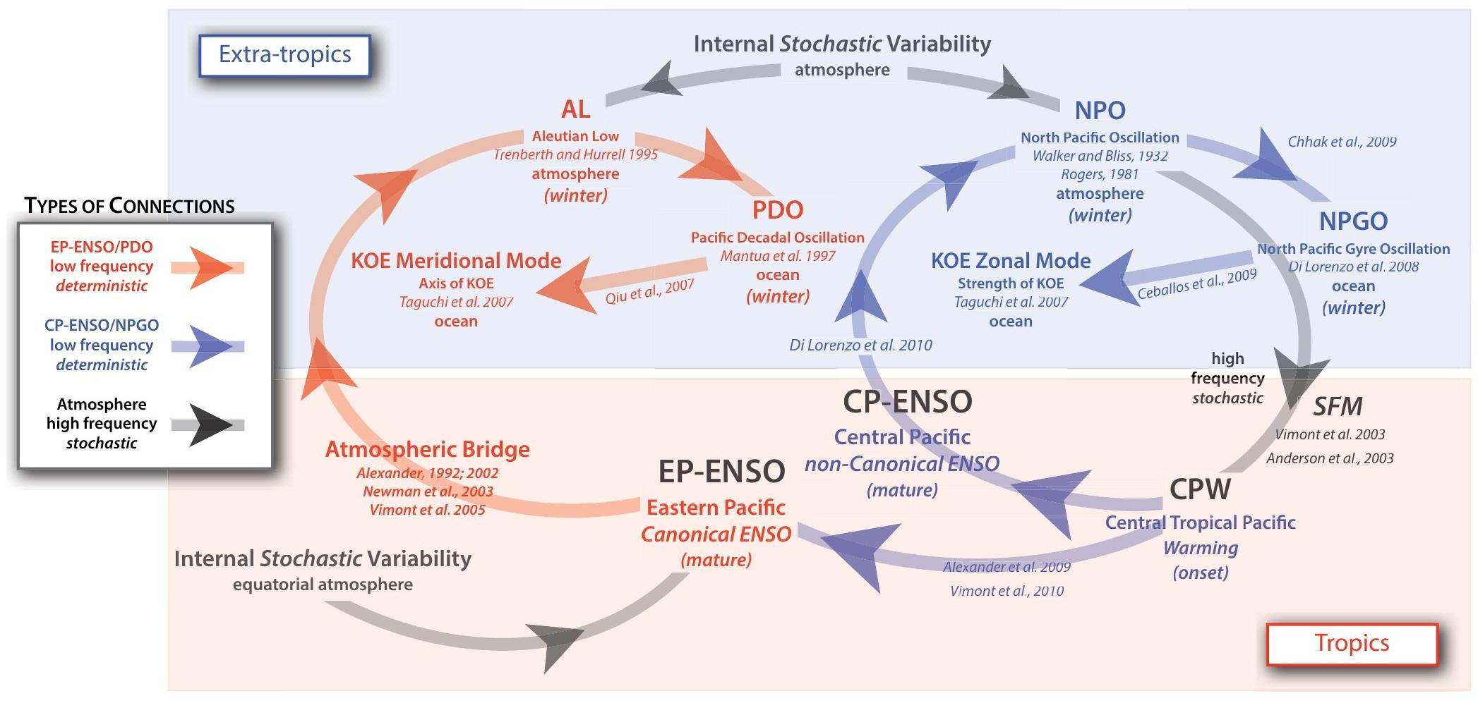
Pacific decadal interactions with ENSO
Di Lorenzo et al. (Oceanogr. 2013); also Meehl et al. (CD 2021)
KOE =
Kuroshio-
Oyashio
Extension
Random ENSO modulation + ML/RW reddening at higher latitudes.
PDO & NPGO might interact with ENSO flavors.
Are these open or closed loops? Do these links imply predictability?
Notes:
‹#›

Slide 6
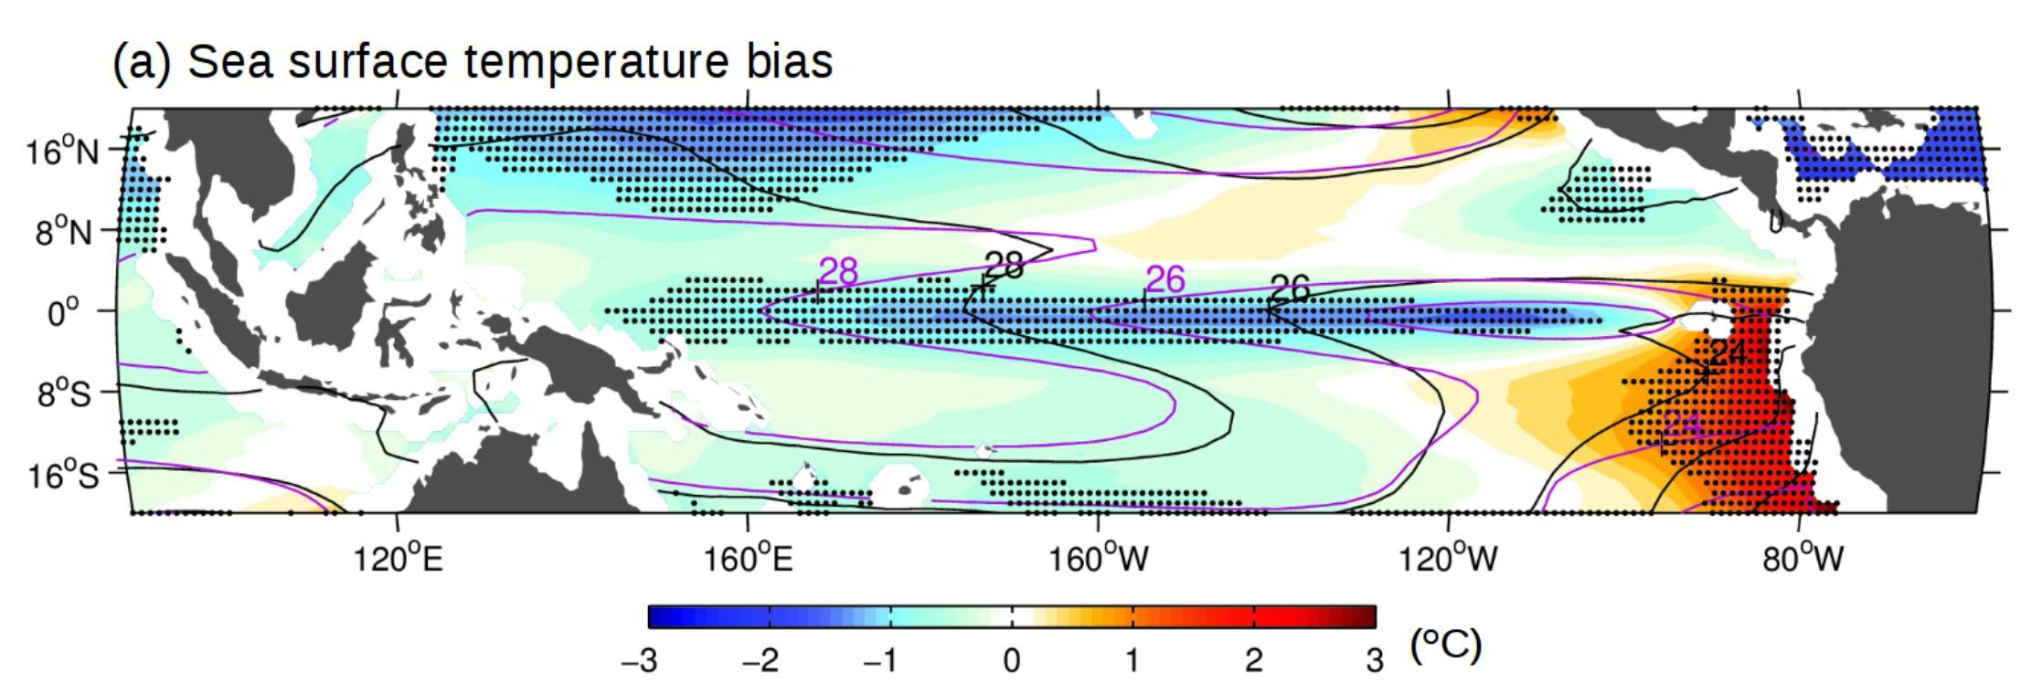
Common tropical Pacific biases in CGCMs
Santoso et al.
(BAMS 2019)
20-model mean for CMIP5 historical runs, relative to ERSST.v5. SST contours are for obs (black) and models (purple). Stippling: at least 90% of models have bias of same sign.
Equatorial cold SST bias, eastern warm bias, strong trades, double ITCZ, weak TIWs.
→ Weak ENSO coupling, damping, diversity, asymmetry; shifted teleconnections.
Notes:
‹#›

Slide 7
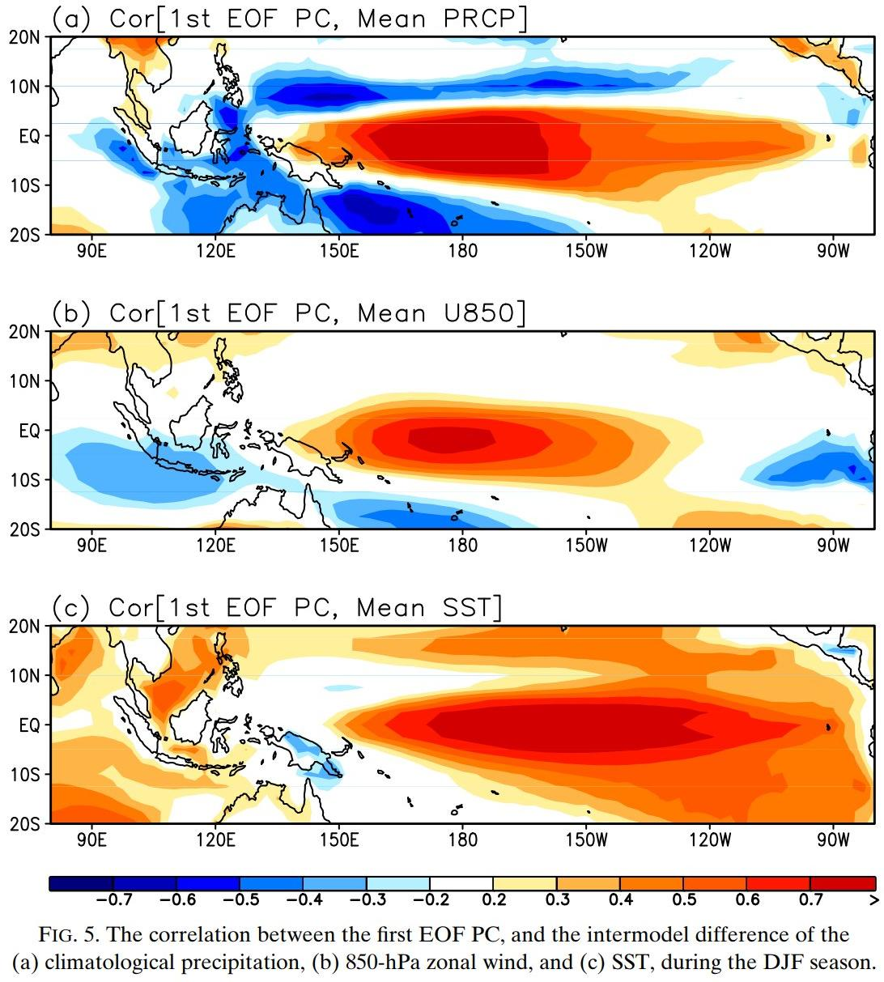
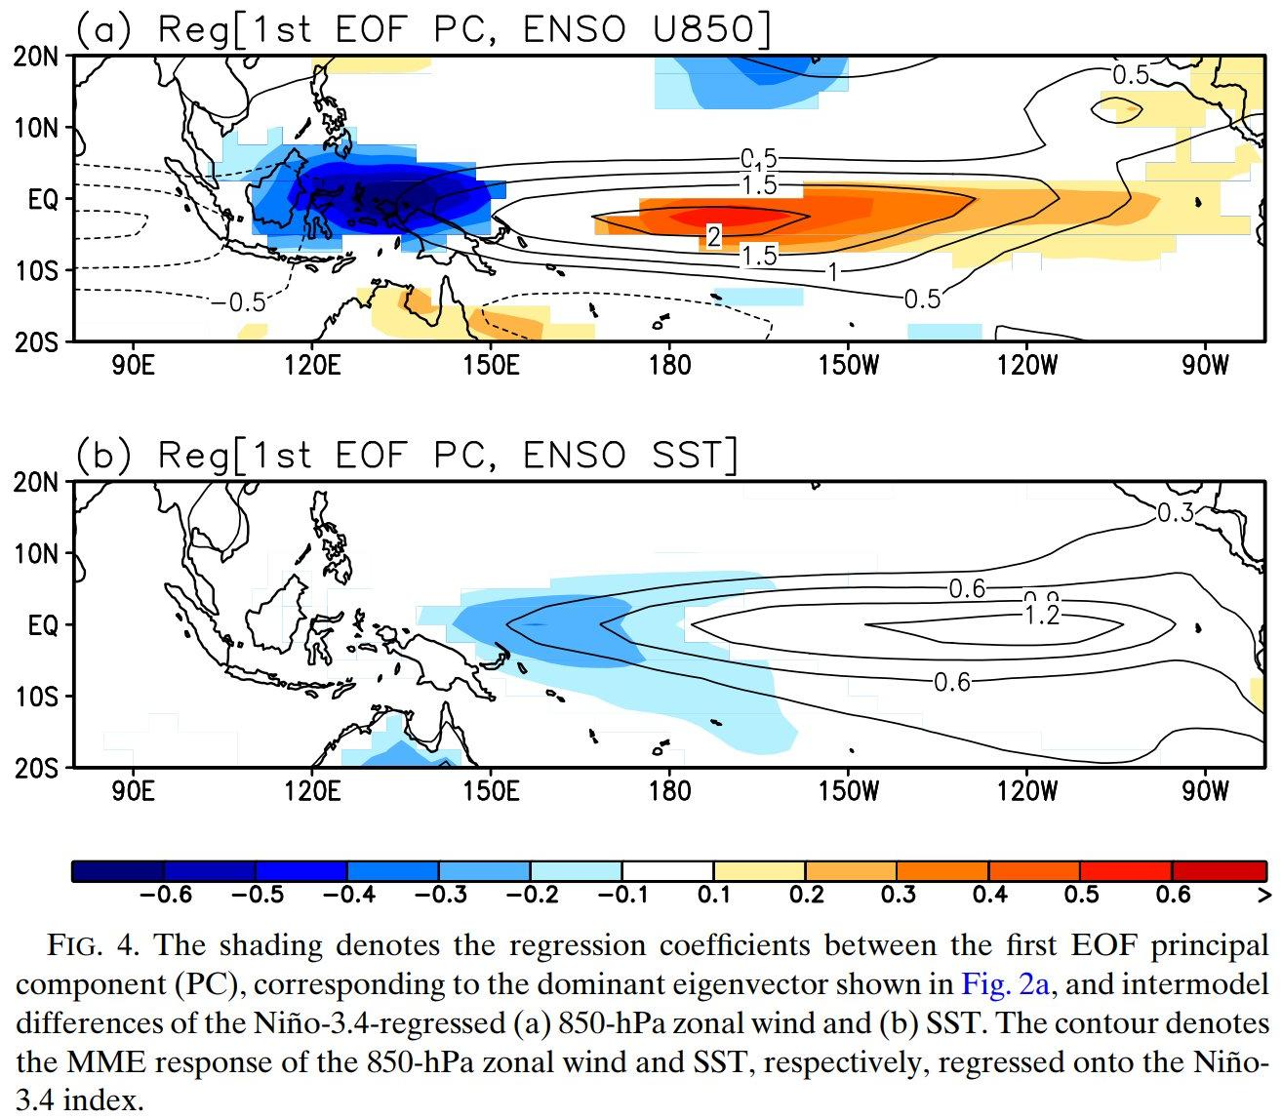
Background climate biases affect ENSO
Improved El Niño
anomaly response...
…goes with weaker/better background cold tongue.
Leading mode of CMIP5 inter-model variation in rain response.
rainfall
wetter equator
Eastward
& equatorward shift of El Niño rain/wind/SST anomalies...
u₈₅₀
weaker trades
...linked to
warmer equatorial cold tongue (ECT).
SST
warmer ECT
Ham & Kug
(JC 2015)
Notes:
‹#›

Slide 8
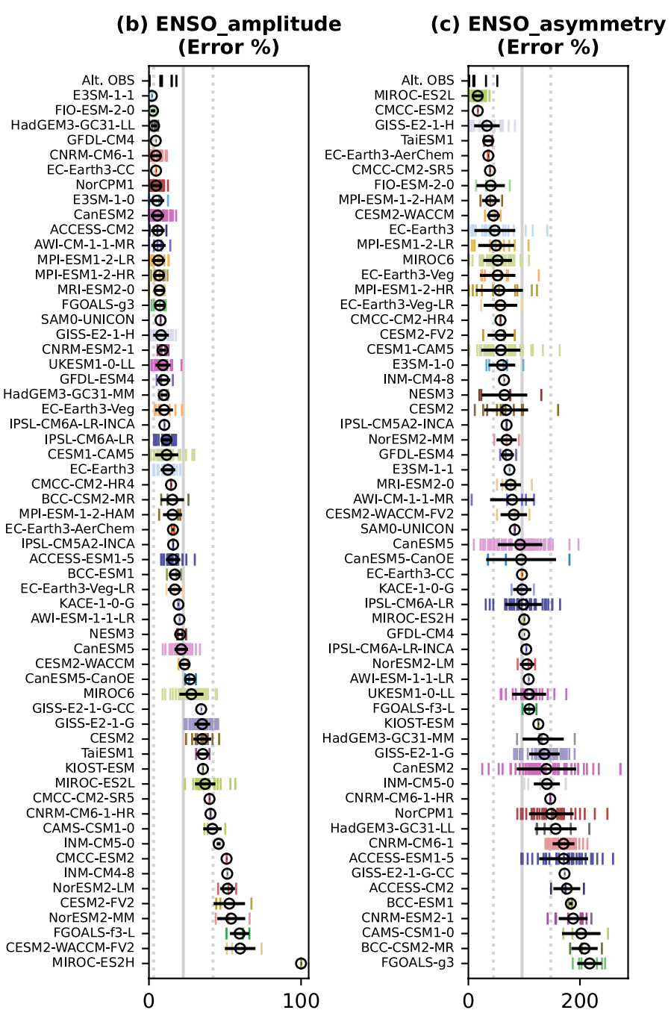
CMIP6 (1850-2014)
biases in ENSO
amplitude & asymmetry
Many CGCMs now get a
reasonable ENSO amplitude
(stddev of NINO3.4 SSTA).
But they seem to struggle with
ENSO nonlinearity & asymmetry
(skewness of NINO3.4 SSTA).
Note that amplitude, and
especially asymmetry, are strongly
modulated — with large ensemble
spread even on centennial scales.
Lee et al. (GRL 2021)
https://doi.org/10.1029/2021GL095041
Notes:
‹#›

Slide 9
Key ENSO feedbacks
noise
heat
fluxes
warm pool extent
(evaporation,
cloud shading)
wind stress
“coupling”
“damping”
TIW stirring
u, w,
mixing
SST
warm
pool
cold
tongue
“zonal-advective
& Ekman
feedbacks”
Indonesia
South America
(fast / slow)
h
“thermocline feedback”
“Bjerknes feedback loops”

Slide 10
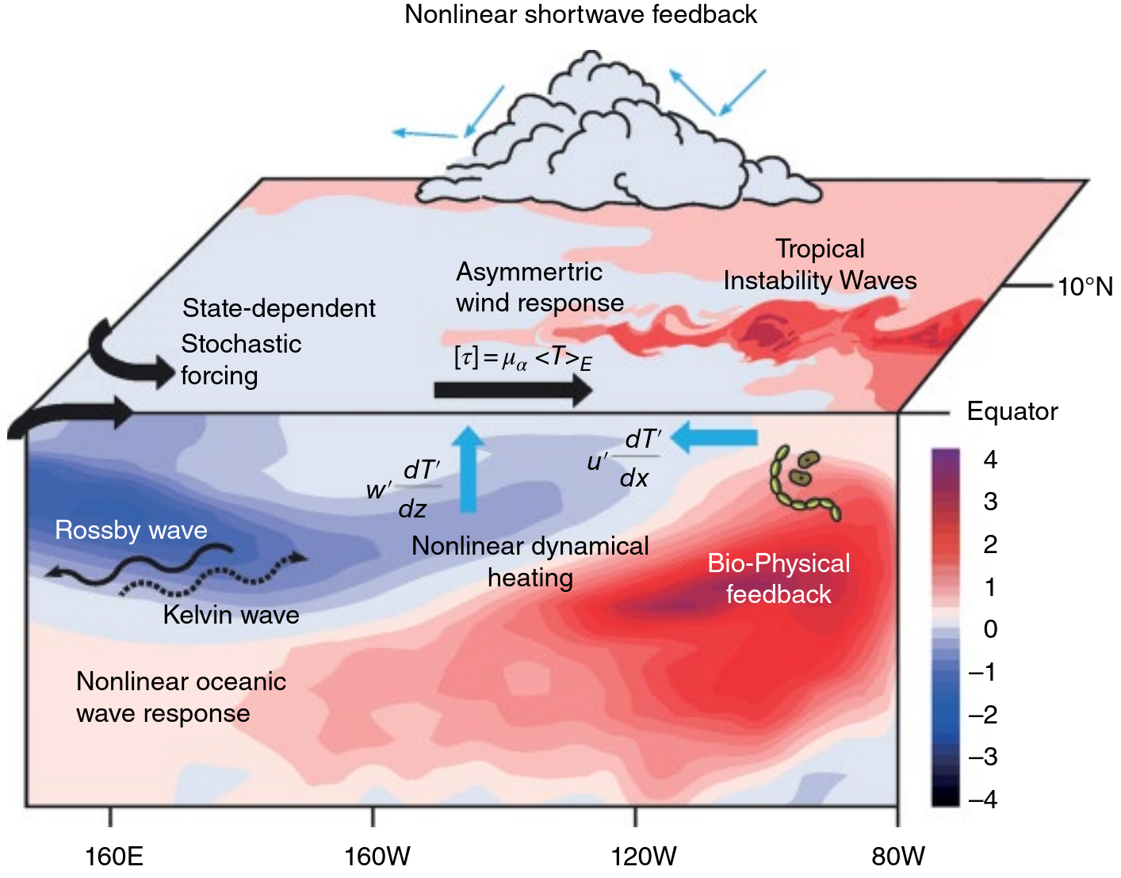
Key ENSO nonlinearities
… lead to ENSO asymmetry & irregularity, interactions across
time scales, and feedbacks from & onto the background climate.
An et al. (AGU 2020): https://doi.org/10.1002/9781119548164.ch7

Slide 11
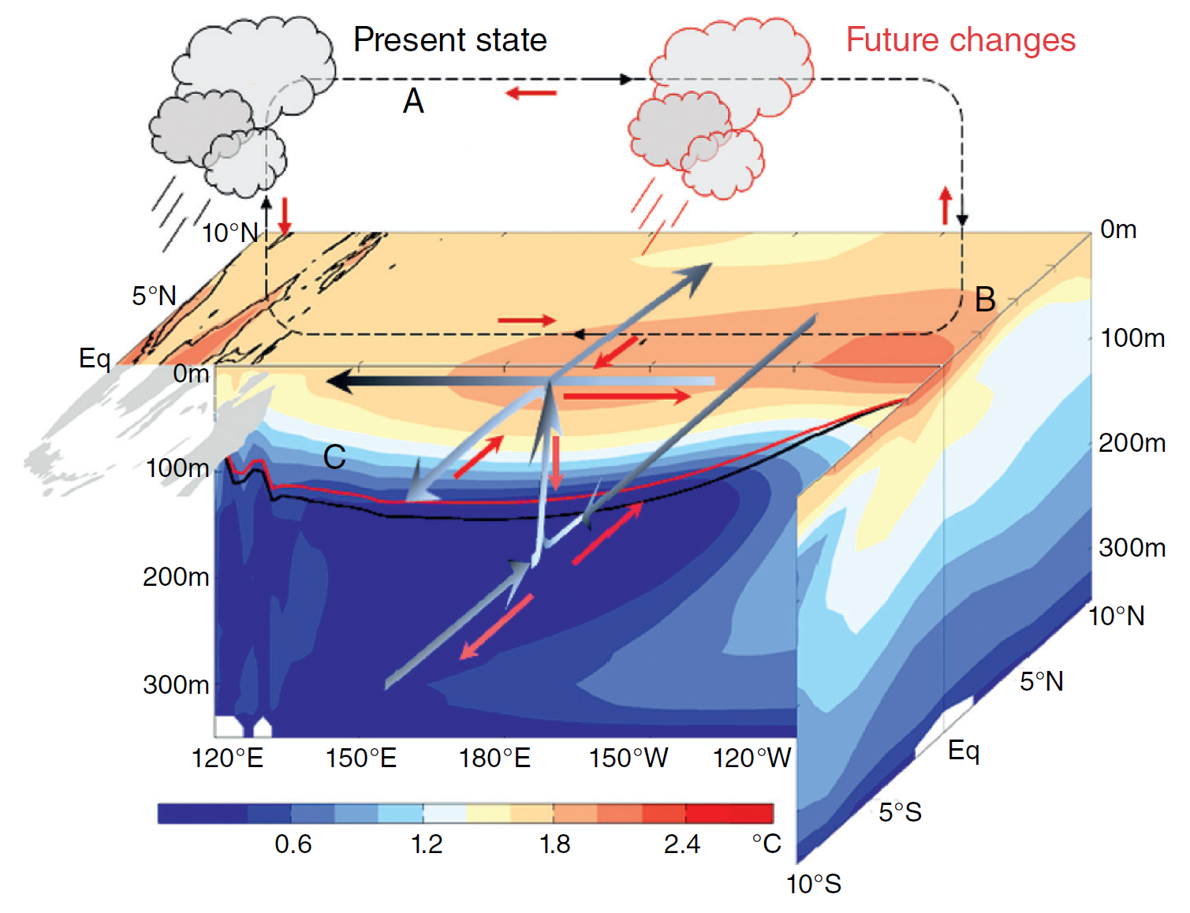
“Average” CMIP5-projected changes in tropical Pacific climate
Cai et al. (NCC 2015b, AGU 2020)
Sen Gupta et al. (GRL 2012)
Reduced cold tongue SST contrast, shallower & more intense thermocline.
Weaker equatorial Walker circulation, stronger ENSO rain extremes in central Pacific.
Weaker subsurface meridional overturning, stronger EUC.
Notes:
‹#›

Slide 12
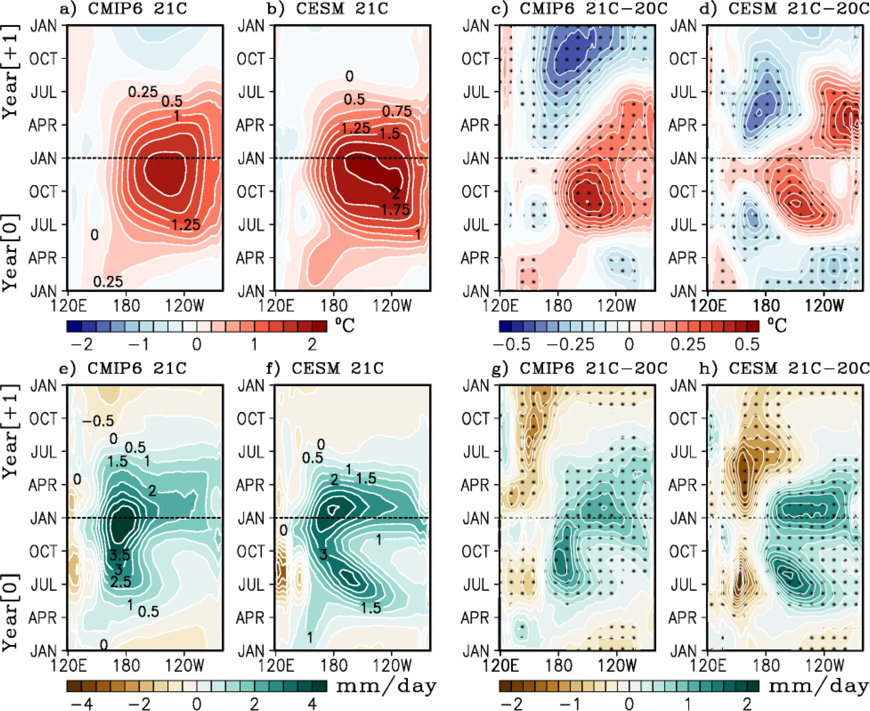
Projected changes in El Niño evolution (CMIP6 & CESM-LENS)
slower
decay
Faster onset
→ reduced forecast
lead time?
faster
onset
Delayed decay
of east Pacific SSTA,
stronger rain response
→ Stronger remote impacts over continents.
more
rain
Lopez et al. (Nature Communications 2022)
https://doi.org/10.1038/s41467-022-29519-7
Notes:
‹#›

Slide 13
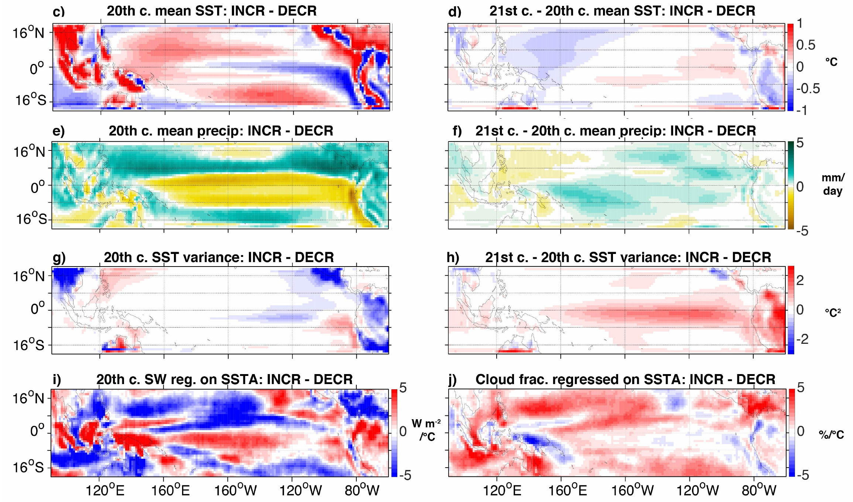
Emergent constraints for future ENSO extremes
Stevenson et al. (J. Climate, 2021): https://doi.org/10.1175/JCLI-D-19-0969.1
Change in likelihood of extreme wet El Niño in NINO3 (CMIP5, 2006-2100 minus 1950-2005)
Models project a wide range of changes in El Niño rainfall extremes: some strongly increase, others decrease.
“Increasers” start with common biases: cooler & drier cold tongue, weaker ENSO, and weaker heat flux damping of SST changes.
→ More room to amplify
ENSO extremes.
Different model biases…
…yield different future changes.
cooler
more warming
drier
more wetting
Increasers also project more future warming, wetting, and ENSO SSTA amplification in the cold tongue.
weaker
SSTAs
more SSTA
amplification
Can use these emergent constraints to leverage
model diversity and inform future projections.
less SSTA damping
from cloud shading
Notes:
So that's SST -- what about changes in ENSO rainfall? In the NINO3 region, the CMIP5 models project a *wide range* of changes: some say El Nino rainfall will strongly increase, others decrease.
Why such diversity? Well, we found that *increasers* tend to have stronger present-day *biases* toward cool & dry conditions over the cold tongue, and also weaker ENSOs -- giving them more room to *boost* their ENSO extremes in the future. The increasers also had less convective *cloud* over the cold tongue -- leading to less radiative damping of SST changes, stronger future warming & wetting, and amplified ENSO SSTAs.
So many models may be *overestimating* future El Nino rainfall, with implications for teleconnections. So we need to reduce model biases.
‹#›

Slide 14
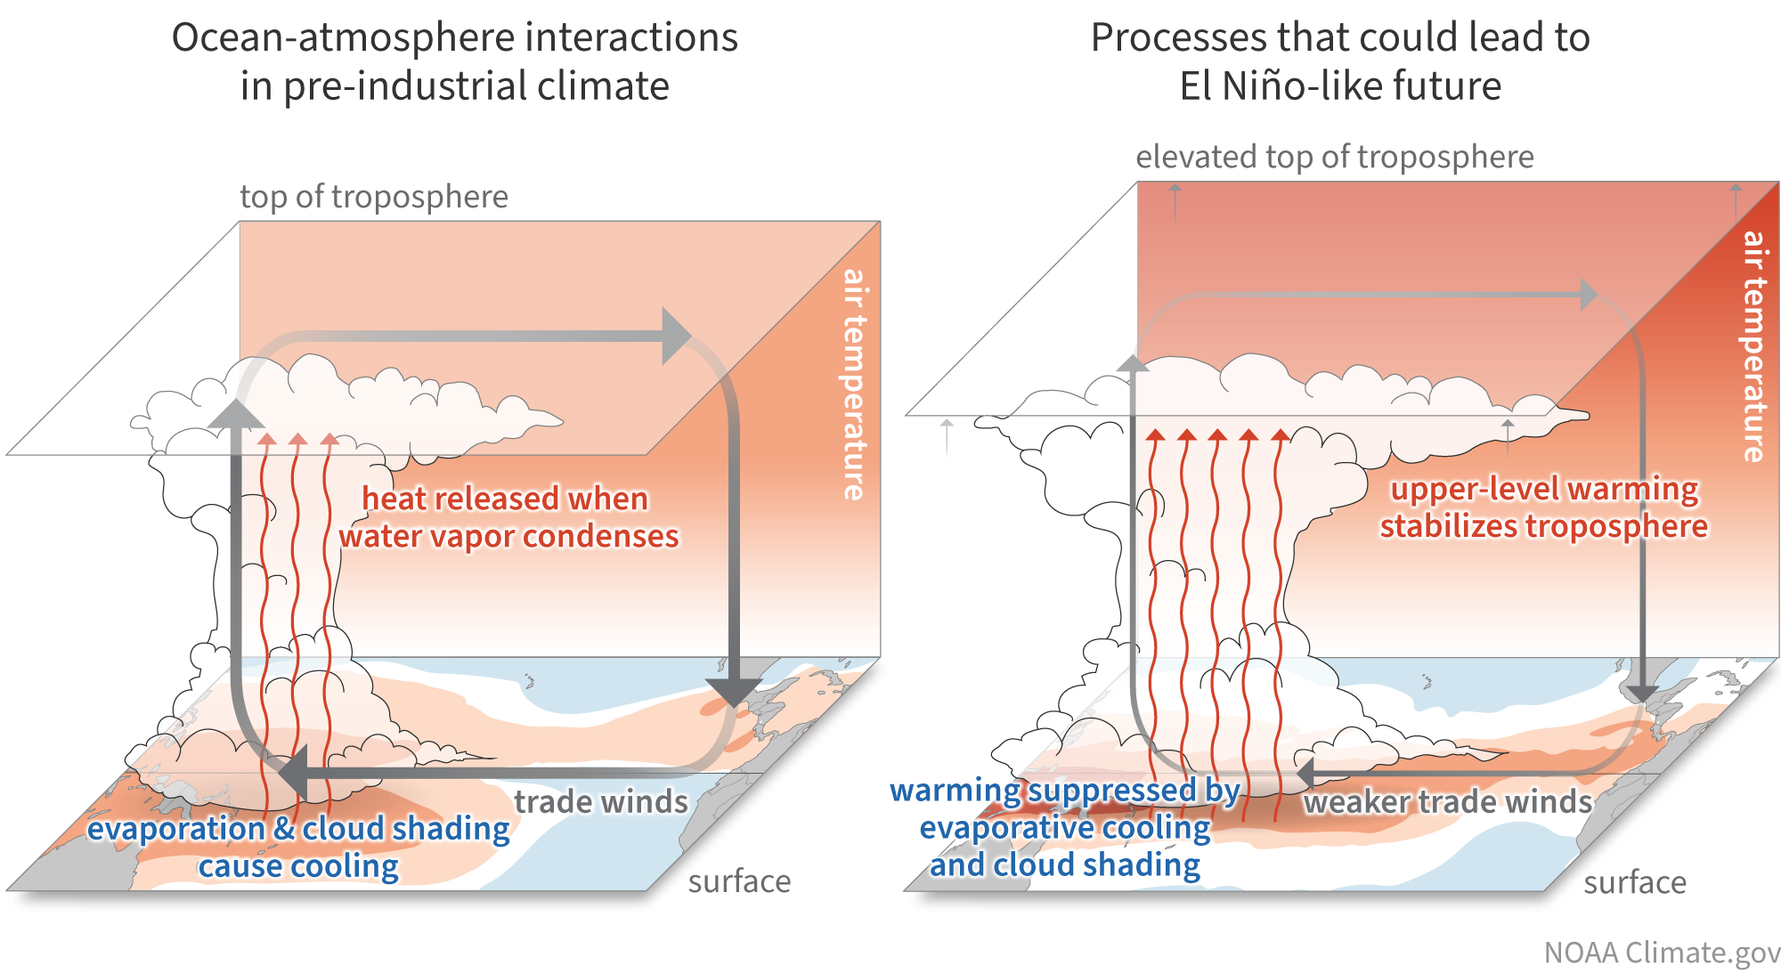
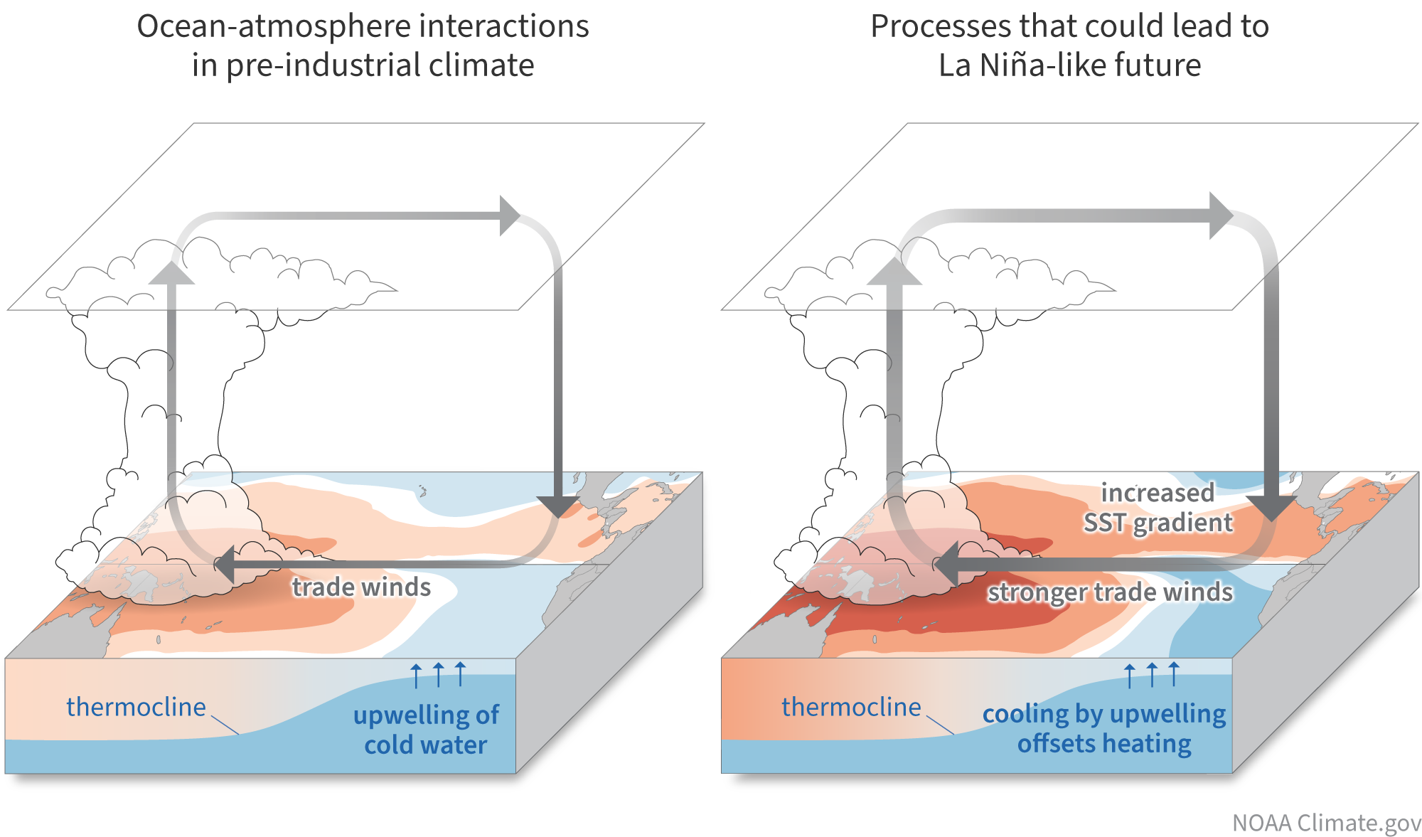
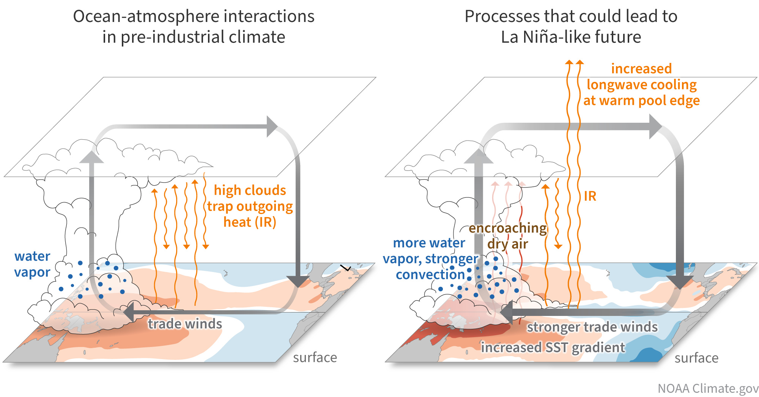
Understanding sources & impacts of EqPac biases
Mechanisms of EqPac climate change
Lee et al. (npjCAS 2022) &
NOAA Climate.gov
Future tropical Pacific climate, ENSO, & global impacts depend on balance of coupled, multi-scale, intermittent, and often nonlocal processes. Changes in background oceanic thermal gradients are key to the ENSO response.
Unresolved physics in CMIP-class models: Clouds & convection, air-sea fluxes, shears & mixing, barrier layers, diurnal cycle, TIWs, … → Atm/ocean errors + coupled feedbacks → Emergent biases in CGCMs → Degrade ENSO forecasts, projections
Need a hierarchical coupled model framework to:
- Attribute emergent coupled biases
- Guide TPOS obs to improve CGCMs
- Test new physics in coupled/global context
- Identify where bias corrections could help
→ NOAA CVP-funded TPOS project at GFDL
A. Wittenberg, X. Wu, B. Reichl, F. Zeng, F. Lu, A. Adcroft

Slide 15
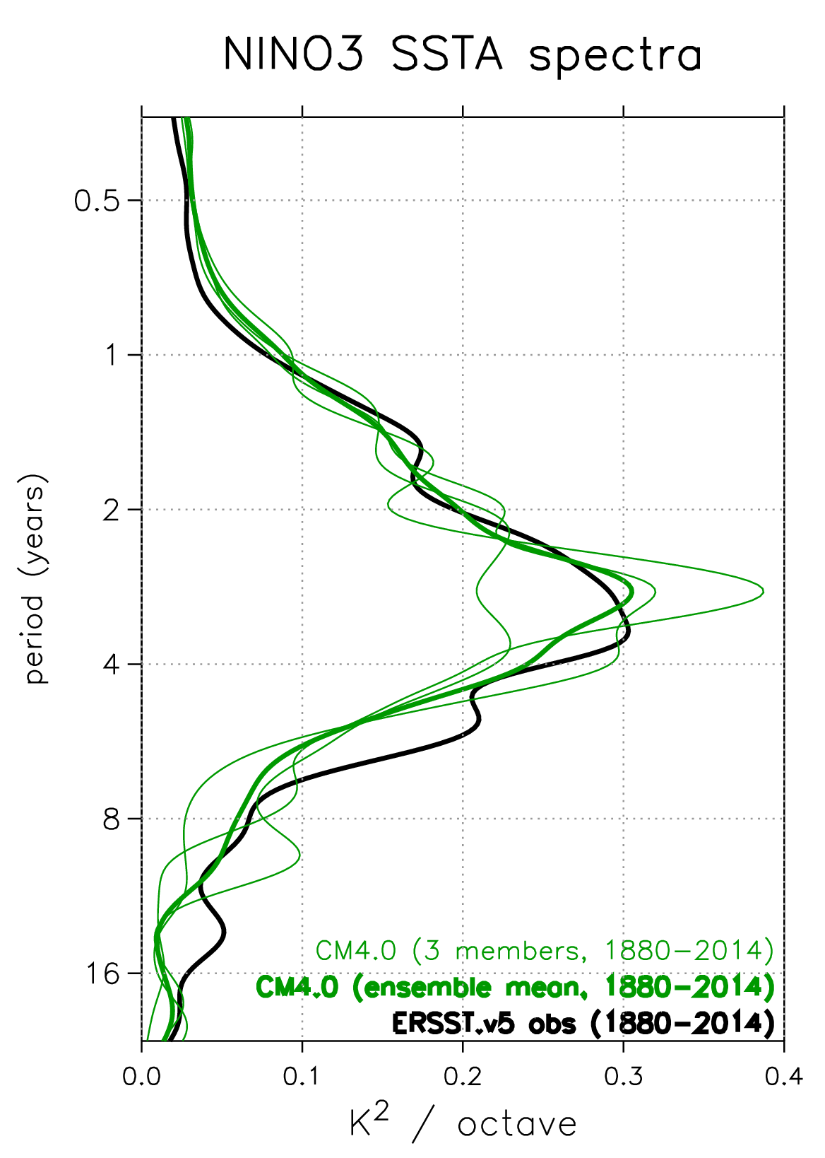
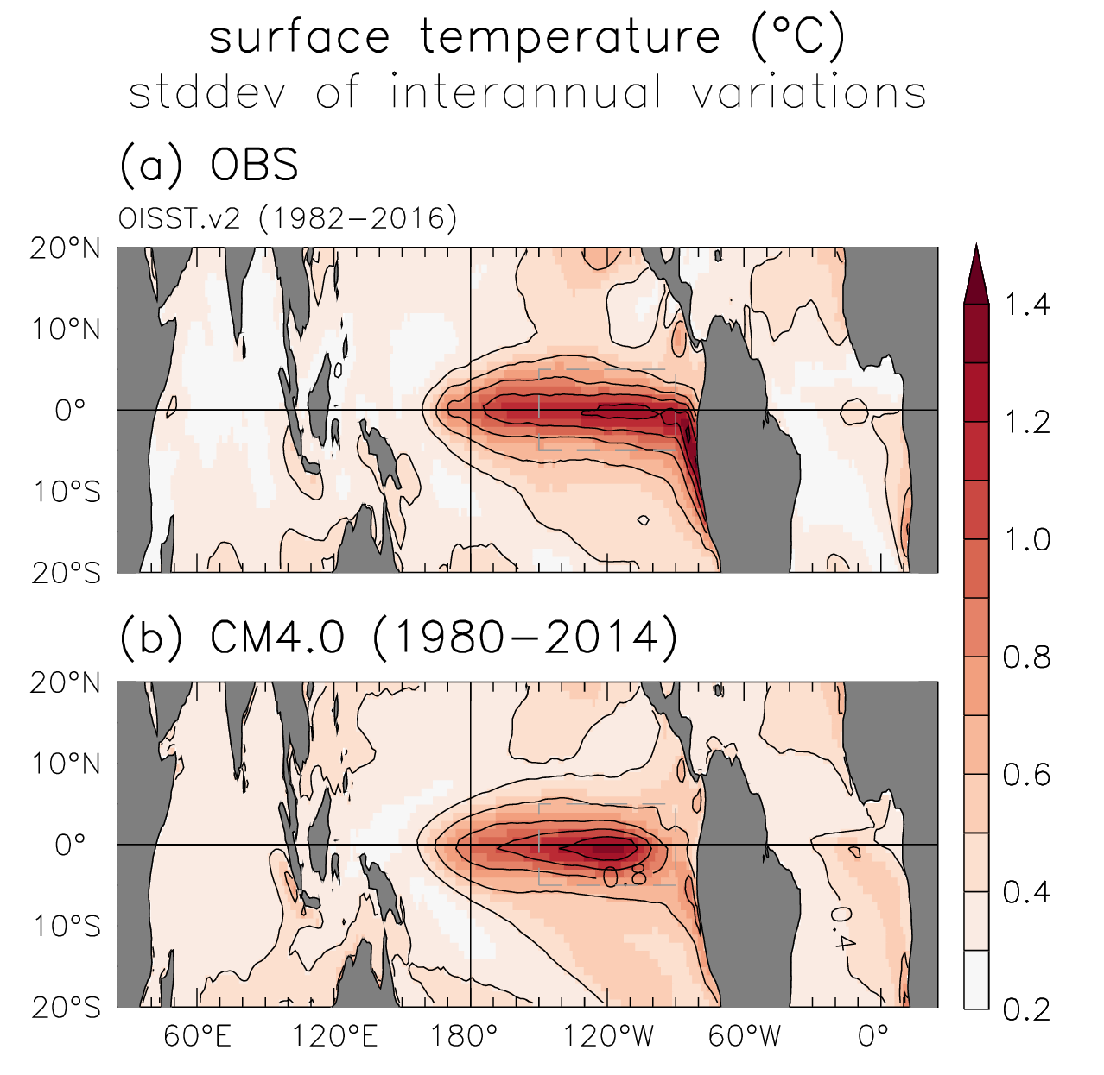
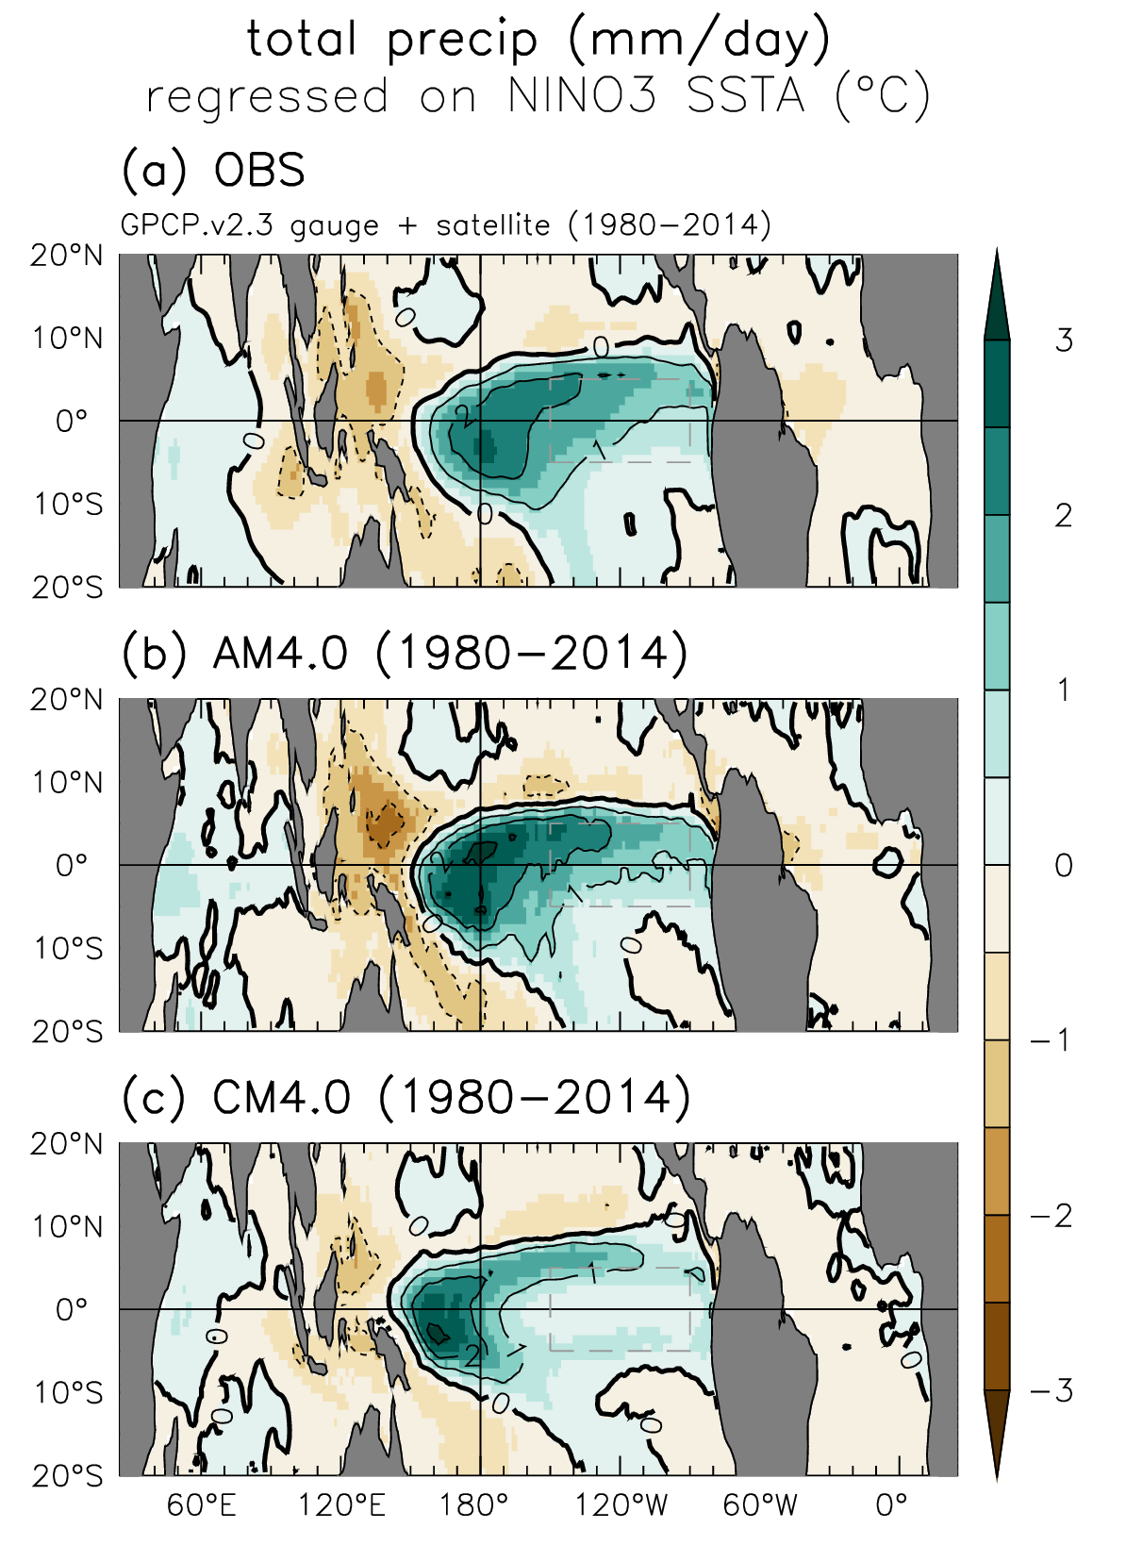
Improved ENSO in CM4 & SPEAR
Realistic patterns
& spectra
→ New avenues for
research & applications
Zhao et al. (JAMES 2018a)
Held et al. (JAMES 2019)
Notes:
Our latest models show further improvements. In particular, CM4's ENSO SST & rainfall patterns, and ENSO spectra, are some of the best I've seen from any coupled GCM. And their better resolution & comprehensiveness open new avenues for research & applications.

Slide 16
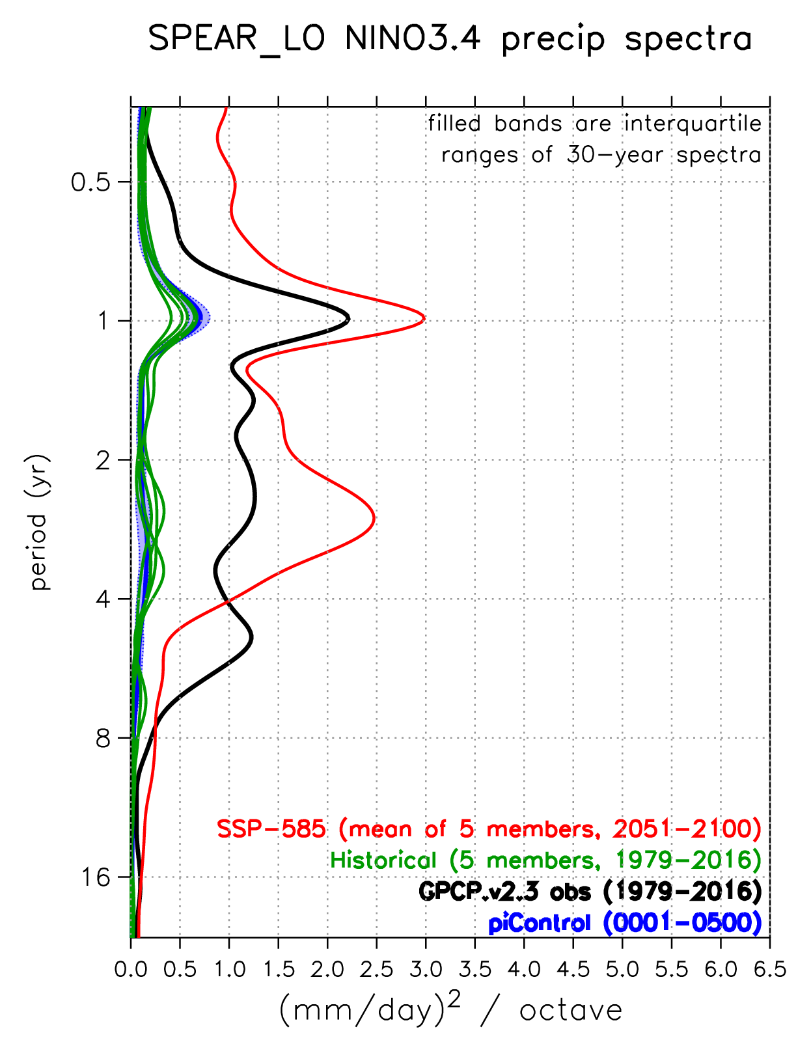
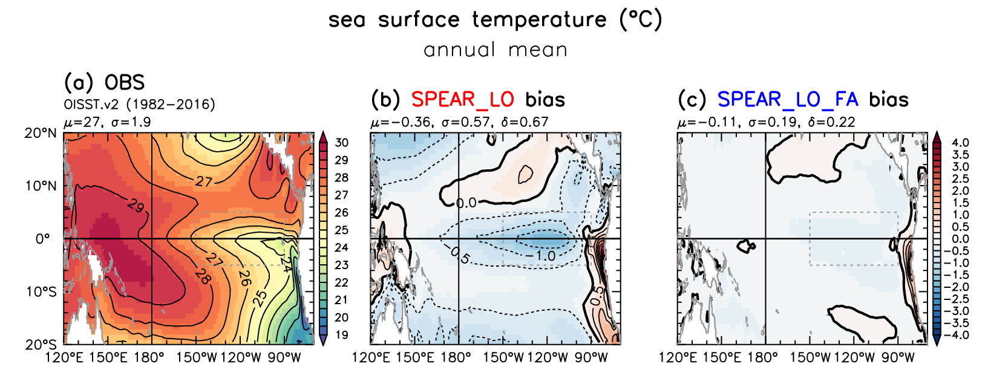
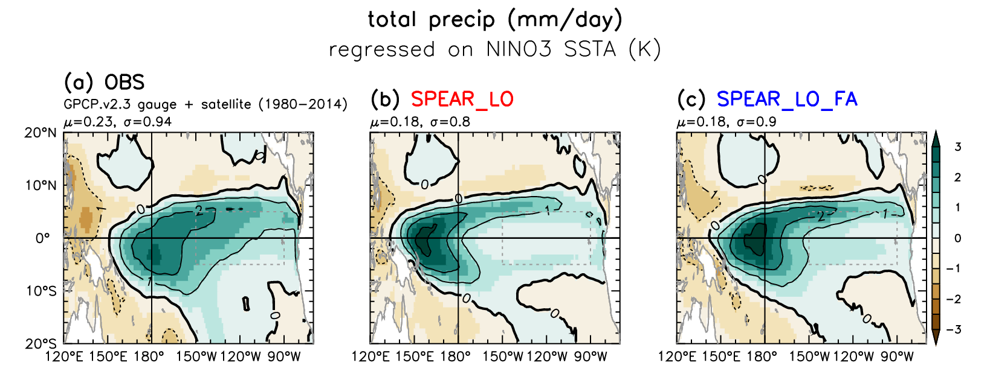
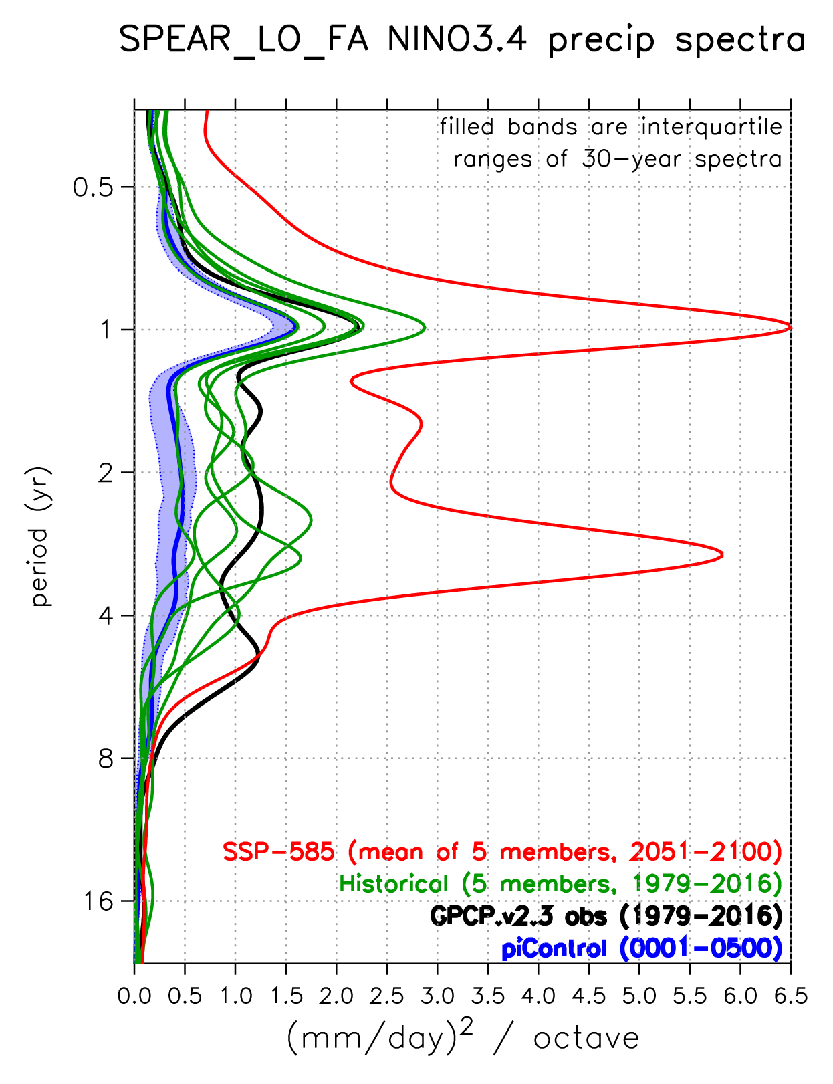
How do tropical SST biases affect future projections?
Wittenberg et al. (in prep.)
SPEAR: NINO3.4 rainfall spectra
Experiment: Correct GFDL-SPEAR CGCM’s
tropical climatological SST & wind stress,
using surface flux adjustments (FA).
Now
Observed
SPEAR
SPEAR_FA
Future
Mean
SST
Original
Model
El Niño
precip
anomaly
FA improves ENSO’s anomaly patterns,
amplitude, and spectra.
Also amplifies projected future rainfall extremes
in the central equatorial Pacific.
Bias
Corrected
Notes:
‹#›

Slide 17
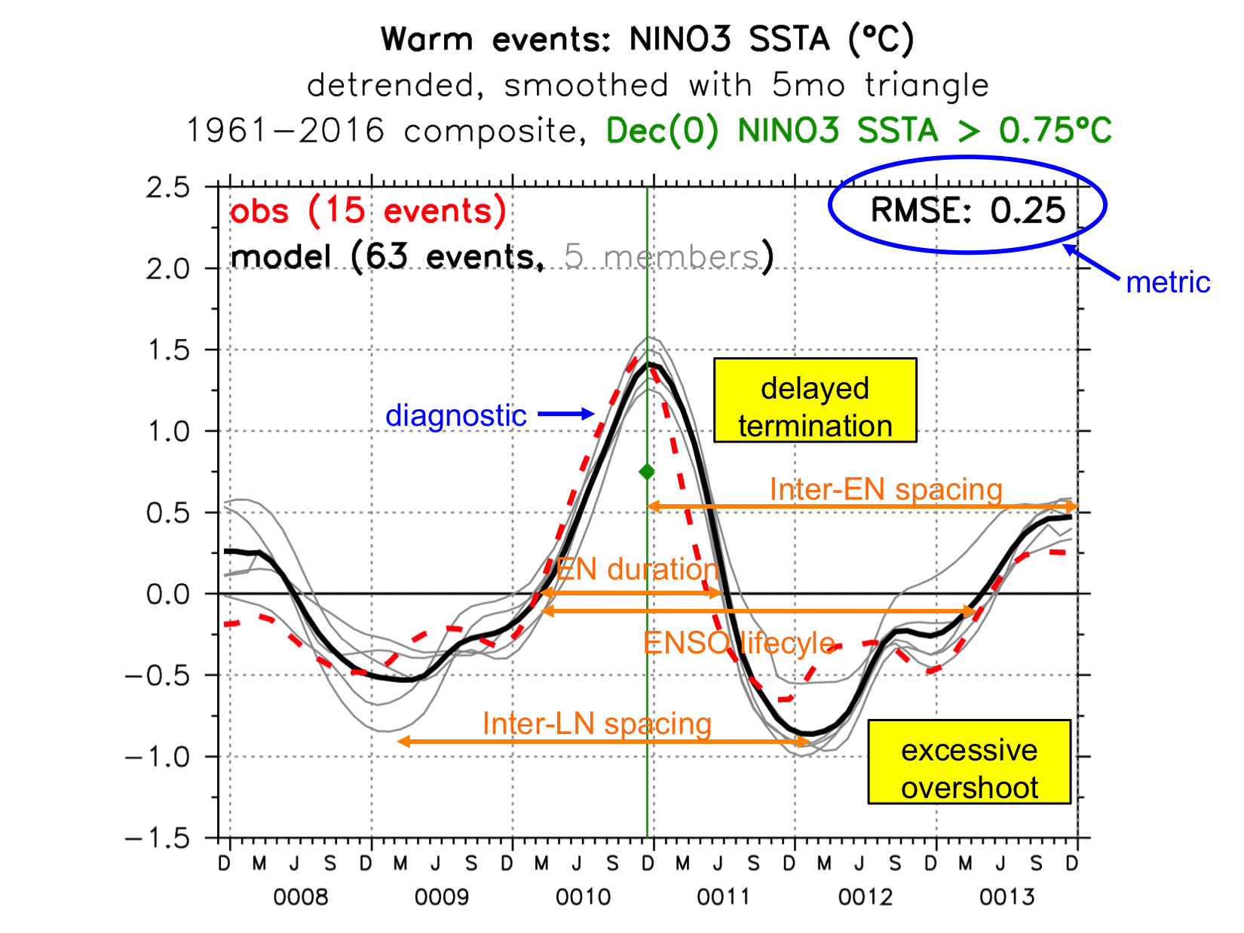
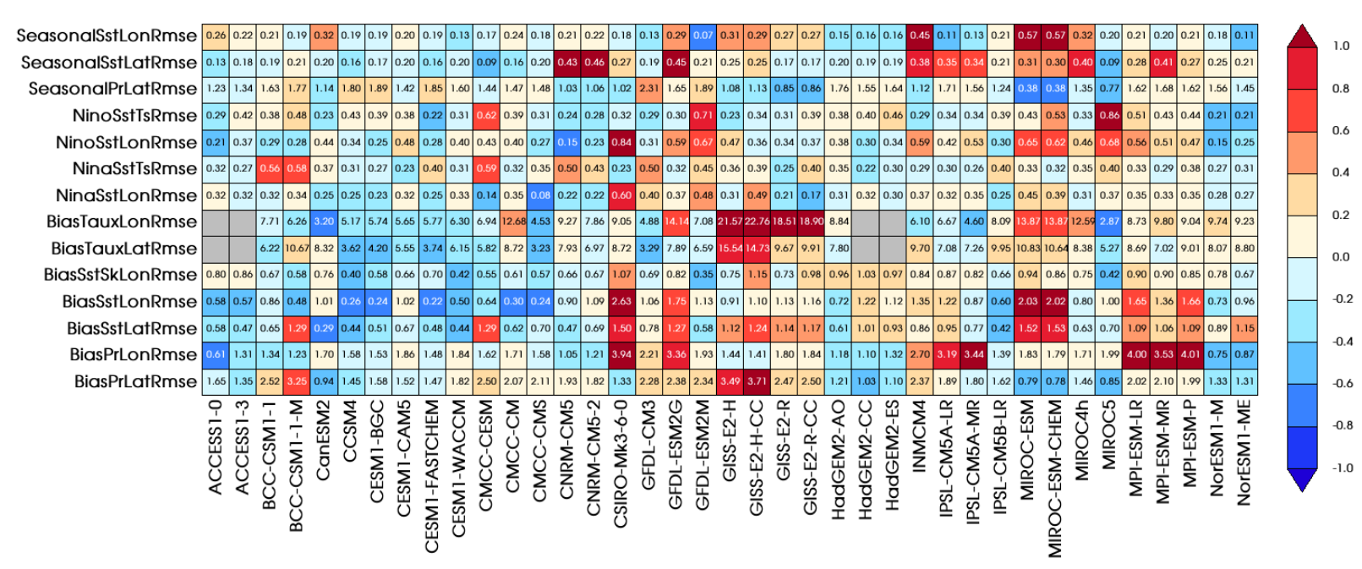
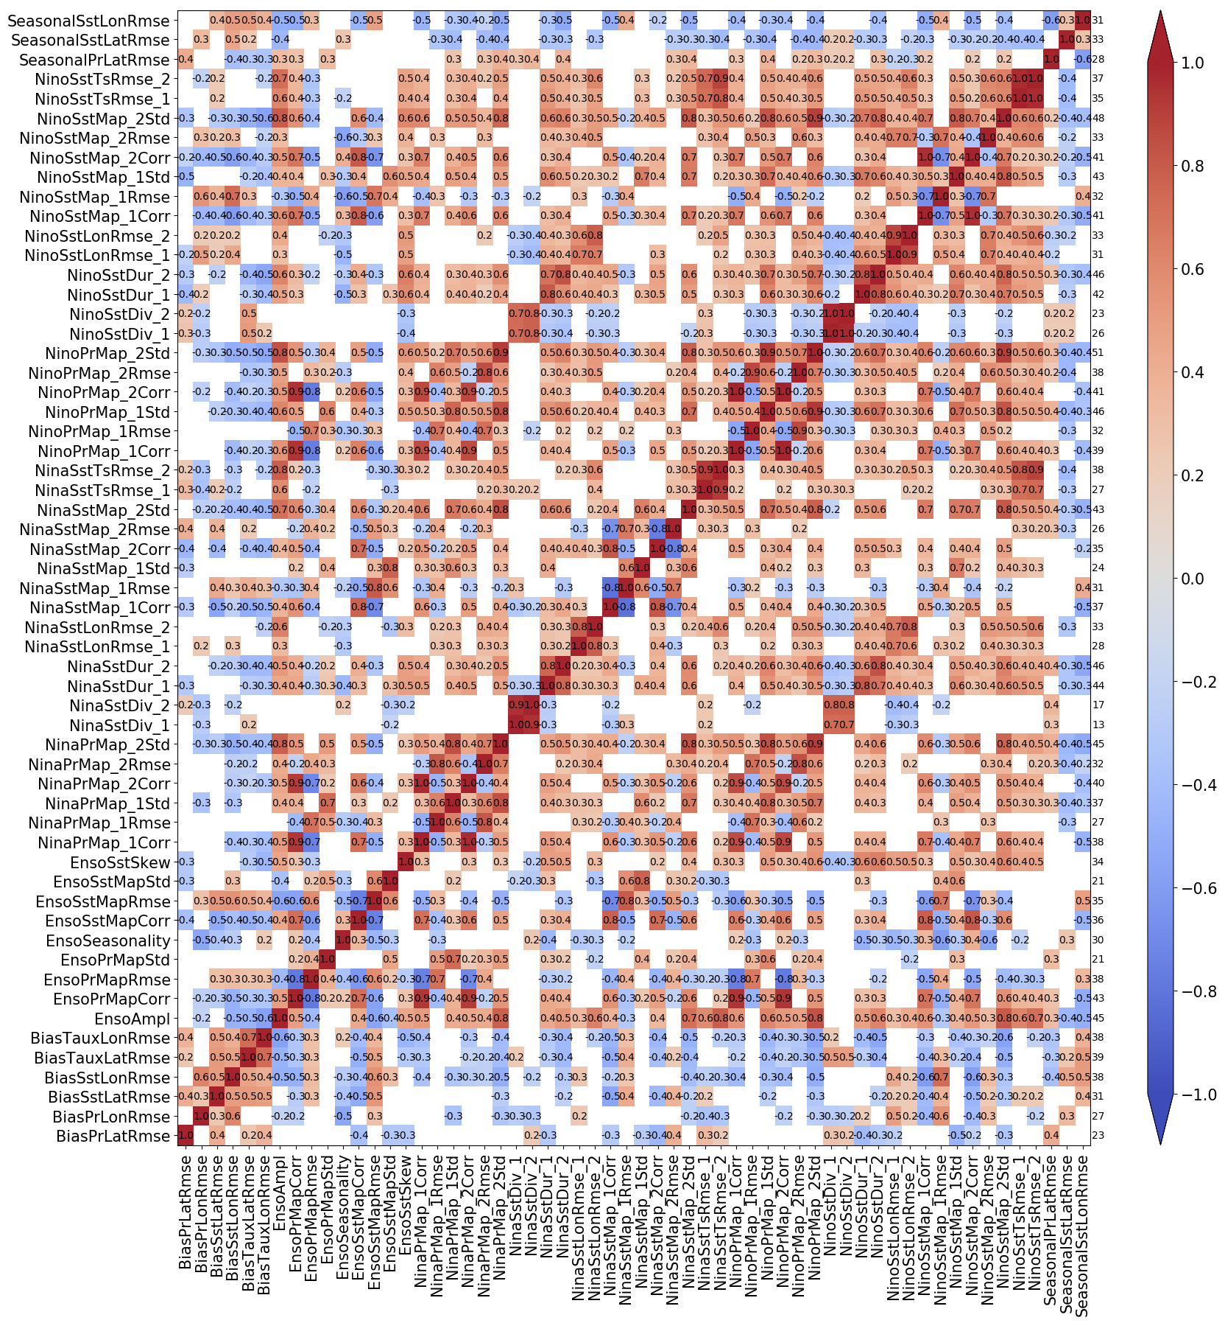
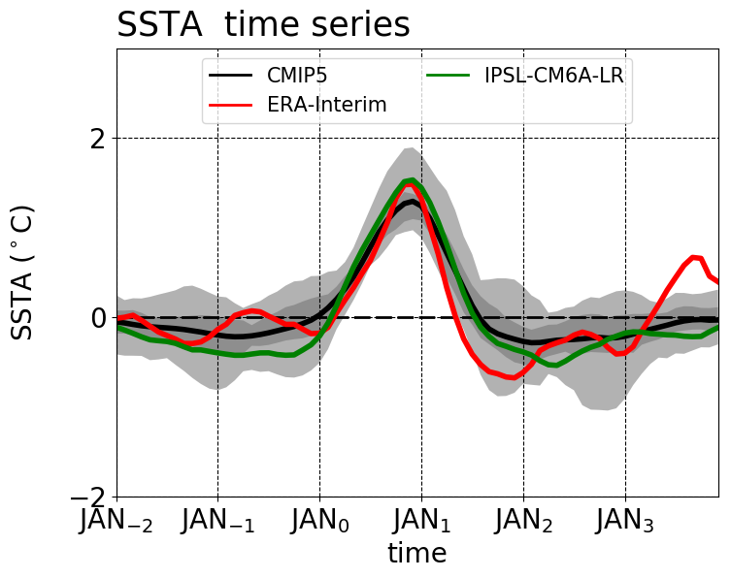
Community metrics for ENSO simulations
CLIVAR Research Focus on ENSO – Planton et al. (BAMS 2021)‏
Example:
El Niño
life cycle
Compare to
other models
& metrics
Discover connections
among metrics, find
emergent constraints
Provide
multi-model
context
Inter-model
correlations
among metrics
Notes:
To that end, we've led CLIVAR's Research Focus on ENSO -- and produced a new Python package to diagnose ENSO in models. Here's an example, the composite *evolution* of an El Nino event. Obs in red, model in black. And some key *metrics* for that evolution -- RMS error, event duration and spacing, and so on.
We can then *compare* such metrics to other models and other metrics, as in this plot for CMIP5. CMIP provides *context* for our model diagnostics. And we can discover *connections* among metrics, and *constraints* for future changes, by computing inter-model *correlations* among metrics. We're using this to analyze the CMIP6 models, and plan to contribute it to community efforts, like ESMValTool and the PCMDI metrics package.

Slide 18
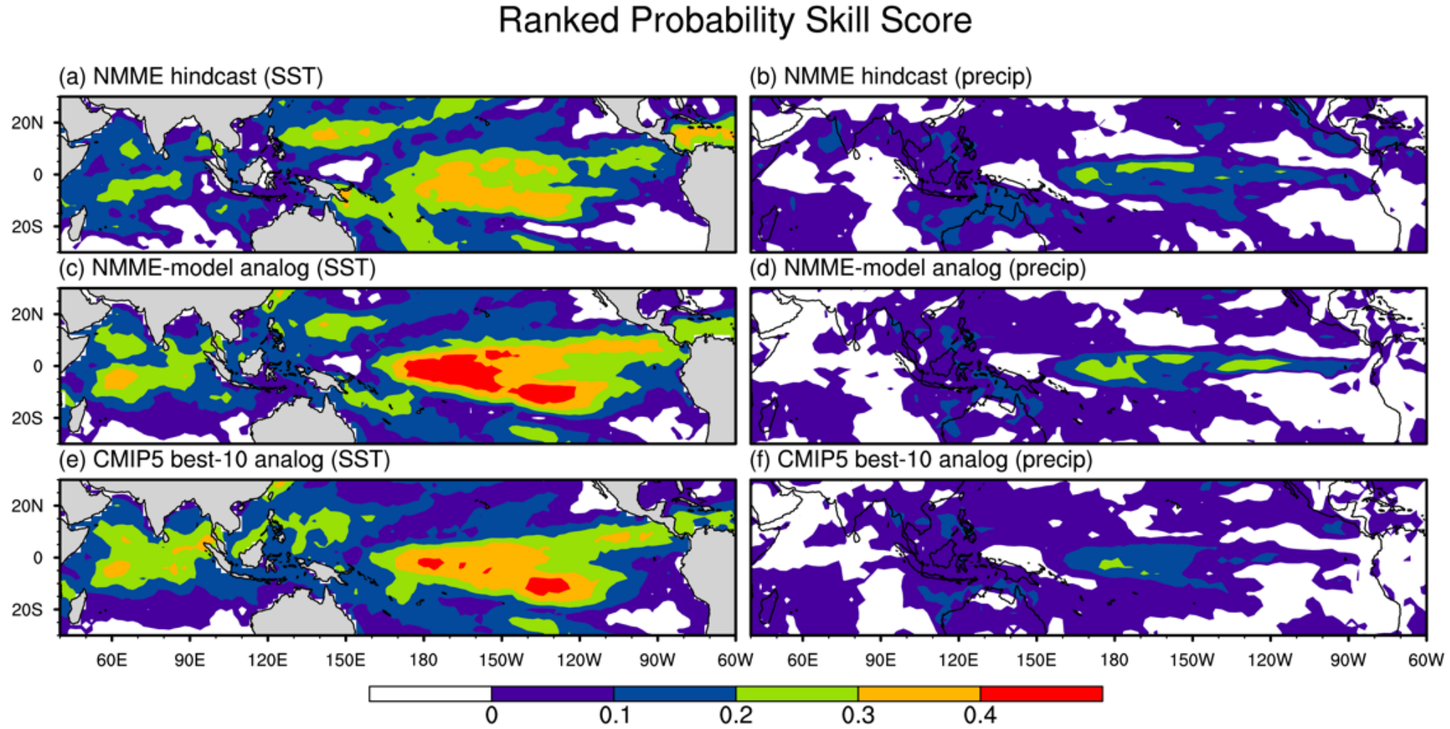
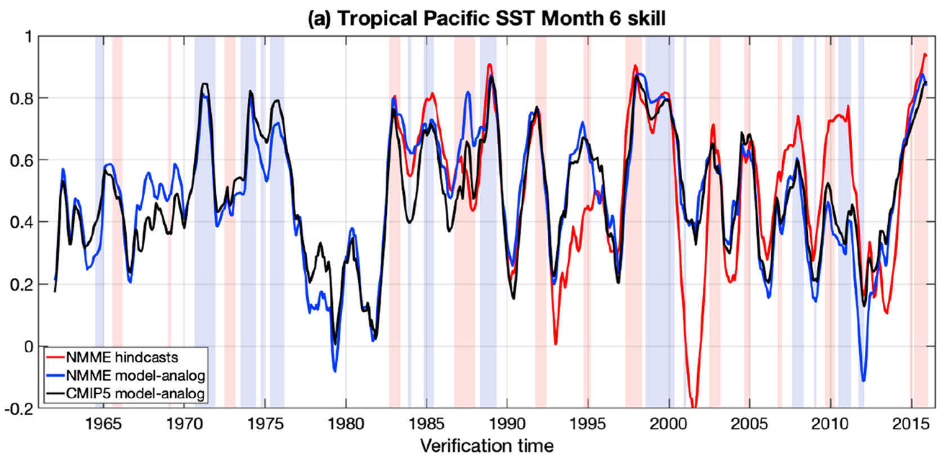
ENSO forecasts using model-analogs
Existing long model control runs are like “libraries” of ENSO behavior.
Find analogs of obs SST & SSH → trace how those states evolved in control runs.
→ Like a forecast with
no initialization shock.
(bias-corrected,1982-2009)
At 6-month leads in the tropics, analogs from
the NMME control runs beat the same models’ initialized forecasts!
Suggests that even models without assimilation (e.g. CMIP5) could offer useful forecast guidance.
Also permits rapid assessment of secular variations in predictability.
Roughly tracks NMME skill
(highest when ENSO is strong)
Ding et al. (JC 2018;
GRL 2019, 2020)
Notes:
Finally, we're working to assess ENSO predictability and improve forecasts. With colleagues at ESRL, we searched *existing* long model control runs for analogs of *observed* states over the past 50 years, then simply traced how those states evolved in the control runs. So, model forecasts without initialization shock.
This simple method is amazingly skillful -- it actually beats the state-of-the-art NMME forecasts, for both SST & rainfall. This is a powerful result, suggesting that even the CMIP5 models, *without* assimilation systems, could offer forecast guidance.
We also used this method to assess secular variations in ENSO *predictability* over the past 50 years -- and found that it tracked the NMME skill, which is highest when ENSO is strong. We're hoping to work with NCEP to further develop this for use in operations.

Slide 19
Summary for Tropical Pacific (1)
1. ENSO is a major driver of global impacts & extremes - Key source of year-to-year climate predictability; reliable predictions are crucial - Interacts with dec-cen climate; key for projections of future risks - Need improved models for better seasonal-to-centennial outlooks Tough test for CGCMs (global, coupled, multiscale, nonlinear, intermittent, diverse)
2. Background climate affects ENSO - E.g. model biases and climate change - Especially thermal gradients: dT/dx, dT/dy, dT/dz, interbasin → ENSO amplitude, frequency, seasonal timing, patterns, diversity, extremes, impacts
3. Unresolved processes + coupling → CGCM biases - Atmospheric convection & clouds: precip, winds, surface fluxes, teleconnections - Ocean mixing (diurnal cycle, TIWs, barrier layers) → thermocline, MLD, upwelling - Coupled interactions (often nonlocal) modify these biases

Slide 20
Summary for Tropical Pacific (2)
4. Observing needs - Surface boundary layers, air-sea fluxes (heat, wind stress), diurnal cycle - Sustained in-situ monitoring at key sites (west Pacific gap in TMA since 2016!) - Reliable long-term gridded reanalyses & reconstructions from obs (including paleo!) Realistic error estimates; regular refresh & intercomparisons; proxy constraints
5. Modeling needs - Higher resolution to capture multi-scale interactions (shears, gusts, fronts) - Better parameterizations of subgrid processes (convection, clouds, mixing) (see Session 3, e.g. Brandon Reichl’s talk on tropical upper-ocean mixing) - Computing power: resolution × complexity × ensemble × duration × inits × experiments
6. Ways forward - TPOS enhancements & process studies (PUMP, EEWP) - Community diagnostics for models e.g. CLIVAR ENSO Metrics; budgets for equatorial heat/momentum/mixing - Model hierarchies (resolution, coupling, obs constraints) - LES’s as intermediaries between obs & coarse GCMs
- Bias corrections (FA, OTA) to mitigate emergent coupled errors - Leverage large ensembles & inter-model diversity - PDFs & extremes; multi-model ensembles (CMIP, NMME); emergent constraints - Model-analogs & AI → faster & easier forecasts, and diagnoses of prediction skill

